Slide 1
LHCOPN & LHCONE
Network View
Joe Metzger
Network Engineering, ESnet
LHC Workshop
CERN February 10th, 2014

Slide 2
LHCOPN & LHCONE Review
Lets take a step back and agree on what we have before trying to figure out what needs are not met, and how things might be changed.
Evaluation Criteria
  Key Attributes
  Network Resources
  Relationships
  Roles and Responsibilities
  Attributes of Overlay Networks
Understanding the LHC Networks & Networking Services
  LHCOPN
  LHCONE

Slide 3
Key Attributes
Mission & Purpose
  Why does it exist?
  Who does it serve?
  What does it do?
Governance & AUP
  How are the rules established?
  How are violations of the rules handled?
Security Assertions
  Is it an open or closed network?
  What risks does this pose?
  How are they handled?

Slide 4
Network Resources 1
  Raw materials
    Fiber, transponders (optical-electrical coders that plug into optical wave division multiplexers), lit circuits (fiber connected to optical multiplexers and the intervening optical amplifiers), switches (e.g. G.709, Ethernet), routers
  Managed Systems
    Optical Networks (lit fiber connected to Ciena, Alcatel, Infinera, etc. optical-electrical systems)
    MPLS Networks (virtual circuit mechanism for IP networks)
  Note: I will be referring to Network Service Providers as NSPs in this talk. This would include ESnet, I2, GEANT, NRENS, etc

Slide 5
Network Resources 2
Managed Services
    Point to Point Circuits (now most commonly an Ethernet circuit)
    Multipoint Layer2 Ethernet Circuits
    Routed services (Layer 3 / IP)
    Timescale of service lifetime
      A continuum between
        sub-second (unachievable in almost all situations)
        very long term (commitment to provide service exceeds expected life of the underlying resources)
    Security Services
    Diagnostic & Debugging Services
    Measurement Services

Slide 6
Roles
User
  Entity that consumes network services from a provider.
Provider
  Provider delivers a network service to the user.
Customer
  The entity that pays for network services.
  Some users are customers. Other users have 3rd party customers who pay for them.
  Keep in mind that somebody is paying for every network resource being used.
  It is critical that the services we develop and deploy align with the LHC centers, NSPs and funding agencies business models, otherwise they become unwieldy or unstable.
Notes:
For example, the DOE Office of Science is
- ESnet’s biggest customer who pays for providing services to most of the DOE labs & big instruments
- A very Small ESnet user, (An office,building with no scientific instruments or data, and 1 Gbps service)

Slide 7
NSP Relationships
Peering
  A symmetric relationship where 2 entities are providing network services to each other, and using the network services provided by the other for mutual benefit.
  E,g, when networks exchange traffic
  Often informal and frequently done without contracts.
Transit:
  An asymmetric relationship where one entity provides services between 2 (or more) other entities. Usually managed via formal business contracts.
    E,g, when one network carries traffic for another through it’s infrastructure
  Usually managed via formal business contracts
Notes:
For example, the DOE Office of Science is
- ESnet’s biggest customer who pays for providing services to most of the DOE labs & big instruments
- A very Small ESnet user, (An office,building with no scientific instruments or data, and 1 Gbps service)

Slide 8
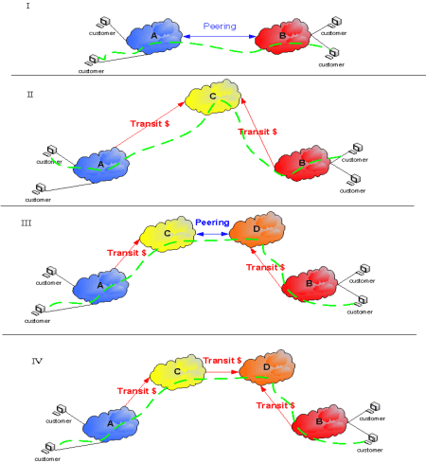
Peering vs Transit
Peering & Transit Image taken from arstechnica article: “How the ‘Net works: in an introduction to peering and transit”
http://arstechnica.com/features/2008/09/peering-and-transit/
This is a useful article to read if you are not familiar with NSP business & economic models.
Notes:
Image from Wikipedia

Slide 9
Responsibilities
  Network Operations Responsibilities
  NOC operations including fault isolation and repair
  Ticketing system operations
  Network monitoring
  Capacity planning
  AUP definition & enforcement
  Troubleshooting soft network failures
  Security
    Security of the network infrastructure
    Security of the data transiting the network
  etc

Slide 10
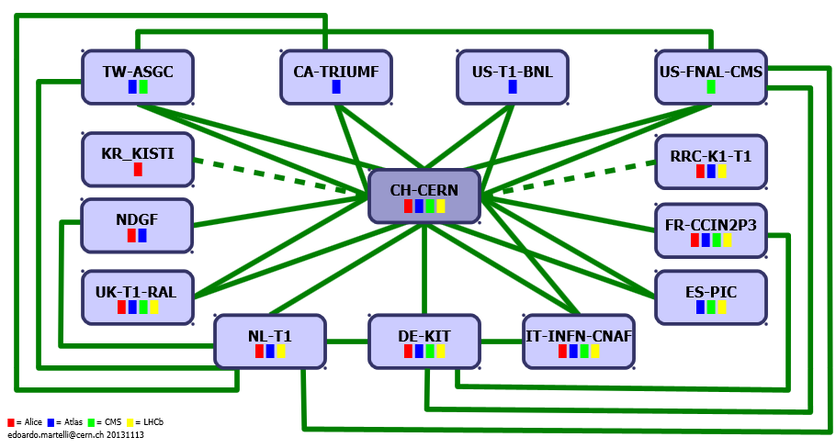
LHCOPN

Slide 11
LHCOPN
Mission:
  Support Tier 0 to Tier 1 data transfers
  Other Tier 1 to Tier 1 transfers.
Governance & AUP
  Tier 1 participation in “OPN” required by TDR.
  https://espace.cern.ch/WLCG-document-repository/Technical_Documents/TDR/LCG_TDR_v1_04.pdf
Security Assertions
  Formally defined in: https://edms.cern.ch/file/708248/LAST_RELEASED
  Actually quite weak.
Link services provided by the NSPs
Routing & management services provided by the Tier 0 & Tier 1.

Slide 12
LHCOPN – Resources
Resources
    NSPs are providing point-to-point Layer2 circuits
      Circuits are provided following the typical business relationships in the NSPs region
      Some circuits are ‘virtual circuits’ provided on to of NREN networks.
      Other circuits are ‘physical circuits’ purchased from Telcos.
    LHC Centers built a virtual routed network out of the circuits.
    In most cases the LHCOPN is dedicated capacity which the LHC community is directly funding.

Slide 13
LHCOPN - Relationships
Relationships
    LHC centers are providing Network Services to each other
      CERN is providing un-restricted transit
      Some centers are providing limited transit
      Some LHC centers are peering
    NSPs
      Providing services to their usual users & customers
Responsibilities
    NSPs support individual link operations & management
    LHC Sites are responsible for network management including operations, monitoring, troubleshooting, capacity planning, security management, AUP enforcement, etc.

Slide 14
LHCOPN Protocol Stack
Notes:
The light green boxes are my understanding of the major components in the LHC software stack, and are missing multiple other layers.
They could be refined by subject matter experts.

Slide 15
LHCOPN Protocol Stack
LHC center demark is at the link layer. Details below this are hidden.
LHC center are building a network out of a set of links, and are responsible for managing Network Layer and above.
NSPs build the links on top of their underlying MPLS, SONET/SDH, OTN, optical, fiber, or other type of network.
Notes:
The Green boxes are approximate. They

Slide 16




















LHCONE VRF
SimFraU
NDGF-T1a
NDGF-T1a
NDGF-T1c
UVic
UAlb
UTor
NIKHEF-T1
NORDUnet
Nordic
TRIUMF-T1
CANARIE
Canada
McGilU
SARA
Netherlands
Korea
CERN-T1
KISTI
Korea
UMich
CERN
Geneva
UltraLight
Amsterdam
TIFR
India
Geneva
Chicago
KNU
DESY
KERONET2
Korea
GSI
DE-KIT-T1
SLAC
DFN
Germany
ESnet
USA
New York
India
Seattle
FNAL-T1
BNL-T1
ASGC-T1
GÉANT
Europe
ASGC
Taiwan
UCSD
Caltech
NE
Washington
UWisc
UFlorida
SoW
CC-IN2P3-T1
NCU
NTU
PurU
UNeb
MidW
Sub-IN2P3
TWAREN
Taiwan
MIT
GLakes
GRIF-IN2P3
RENATER
France
CEA
Internet2
USA
Harvard
PIC-T1
INFN-Nap
CNAF-T1
RedIRIS
Spain
GARR
Italy
UNAM
LHCONE VRF domain
End sites – LHC Tier 2 or Tier 3 unless indicated as Tier 1
Regional R&E communication nexus
Data communication links, 10, 20, and 30 Gb/s
See http://lhcone.net for details.
CUDI
Mexico
NTU
Chicago
April 2012

Slide 17
LHCONE VRF
  Disclaimer: There are several docs that describe what we thought we wanted to build over the last couple years, but nothing that accurately describes what we currently have. This is my understanding. Other view points are perfectly reasonable.
  Mission
    A private overlay internet (or set of networks) dedicated to moving data between LHC Tier 1, Tier 2 and Tier 3 centers.
    It segregates LHC traffic from general R&E traffic so that it can be managed independently in ways that benefit both the LHC and NSP communities.
  Governance & AUP
    A community project driven by rough consensus.
    Most community members agree that traffic carried by LHCONE should be restricted to LHC related traffic, or traffic between LHC related subnets.
      But some sites make no effort to restrict the traffic across LHCONE to LHC related subnets or traffic.
  Security Assertions
    No final or authoritative AUP document for LHCONE-VRF could be found.
    Some useful info in the following:
      https://twiki.cern.ch/twiki/pub/LHCONE/LhcOneHowToConnect/LHCONEconnectionguide-1.0.pdf
      http://lhcone.web.cern.ch/sites/lhcone.web.cern.ch/files/LHCONE%20end-site%20Technical%20Requirements%20v1.2.doc

Slide 18
LHCONE VRF Resources
  NSPs provide the network including core links and routers as a virtual overlay on their regular infrastructure.
  Resource provisioning is done across different parts of LHCONE using different models:
    Critical:
      Some organizations are doing careful planning and acquiring necessary resources and making them available via the LHCONE to meet their users needs.
    Incidental:
      Some organizations are treating LHCONE as a way to make ‘found’ resources available to the LHC community.
    Unreliable or Unnecessary:
      Some organizations plan to meet their LHC Tier 2 & 3 needs using standard R&E networking services.
  Most LHCONE-VRF infrastructure is shared and is covered by regular networking fees.

Slide 19
LHCONE VRF – Relationships
Relationships
    NSPs are providing network services to their typical users following standard business relationships in their regions
    NSPs have peering or transit relationships with each other, usually following the well established peering and transit relationships in use for their general R&E traffic.
    LHC Centers are strictly users of the services, and are mostly consuming services from their normal upstream provider.
Responsibilities
    NSPs have their standard suite of responsibilities including network operations: monitoring, troubleshooting, capacity planning, security management, etc.
    Customers are responsible for adhering to the AUP (if defined).

Slide 20
LHCONE VRF Protocol Stack

Slide 21
LHCONE VRF Protocol Stack
NSP are providing a full network service to LHC centers, not a set of links.

Slide 22
Joe’s Opinions
LHCOPN vs LHCONE
LHCOPN and LHCONE are both are overlay networks built on top of the same pool of underlying NSP resources.
  LHCOPN is a virtual private network built and managed by LHC sites.
  LHCONE is a virtual private network built and managed by the NSP community.
Future Directions
Maintain the LHC investment in networking capacity (LHCOPN) at the current scale.
    Or to rephrase: Don’t shrink the pool of resources available to LHC right now.
Maintain the LHCOPN network, if the mechanism it provides for priority or guaranteed traffic are able to be used effectively by the experiments.
Develop methods to shift network resources between LHCOPN and LHCONE as needed to best meet user demands.
Tighten up the LHCONE VRF definition & AUP.
Point to points circuits outside the LHCOPN should be considered part of LHCONE. Probably best used to pull ‘found’ resources into production paths. (ie ANA-100 LHCONE experiment)
Notes:
Are we conflating a technical discussion with a financial one?
IE, does eliminate LHCOPN = eliminate HEP contribution to R&E network capacity?

Slide 23
The End

Slide 24
Challenge using dynamic point-to-point circuits in LHC
The obvious thing is to take info from the workflow manager, and use it to request changes at the link layer between NSPs.
This combines all of the challenges of crossing multiple domains with all the challenges of violating every layer in the protocol stack.

Slide 25
Idea for a possible way forward
The ANA-100G LHCONE integration experiment is doing some interesting work:
  Turning up and down bandwidth between LHCONE instances
  Adjusting routing between LHCONE instances
  Developing measurement philosophy and plans for measuring impact on LHC end users
Could we build on this work, and try to figure out how to use dynamic circuits to provision ‘found’ or temporarily available resources into the LHCONE VRF?

Slide 26
Advantages
Breaks the requirement for coordinated lock-step planning and development between the NSP and LHC software development groups.
The NSP circuit development teams already contain, or have easy access to the right ‘application level’ experts (BGP routing).
Constrains the scope of the work to the NSP’s who are involved in developing and deploying dynamic circuits.
Could establish a framework for NSPs, and other entities to easily contribute network resources to the LHC community.

