Slide 1
Brief overview on Cabling and Optical Fibre activities
With particular accent on Optical Fibre working method
D. Ricci, on behalf of EN-EL-CF section
EDMS 1327029

Slide 2
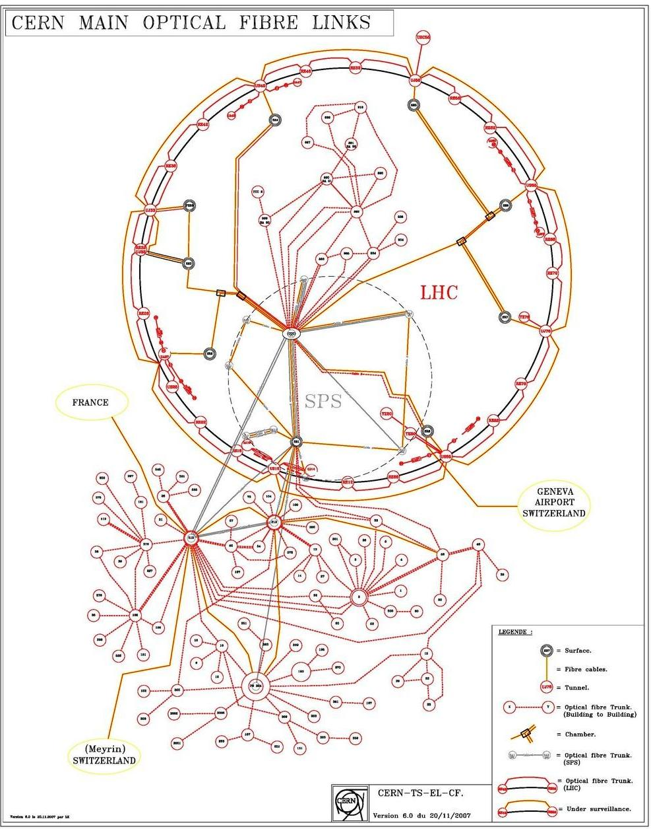
What’s Cabling ?
Cabling = copper cables (CTRL+DC) + optical fibres:
  ~ 90.000 km copper cables
  ~ 35.000 km of optical fibres
The activity includes:
  Installation of cabling for CERN accelerators, general infrastructure and experiments
    Collaborate in the definition of the cable cross-sections, connectors and optical fibre types
  Operation and maintenance of the optical fibre infrastructure
    Design, reconfiguration, maintenance (all CERN users)
    Qualify and procure radiation resistant optical fibres (2400 km for LS1)
  Procure and standardise cables, optical fibres and connectors for CERN users
    233 orders in 2012 – Average investment per year: 3.5MCHF
    managing cable parc: ~4200 drums for LS1
  Operation and maintenance of the cable tray infrastructure (350 km)
  Monitor aging and steer the cable/fibre replacement campaigns
    ~1MCHF/machine point

Slide 3
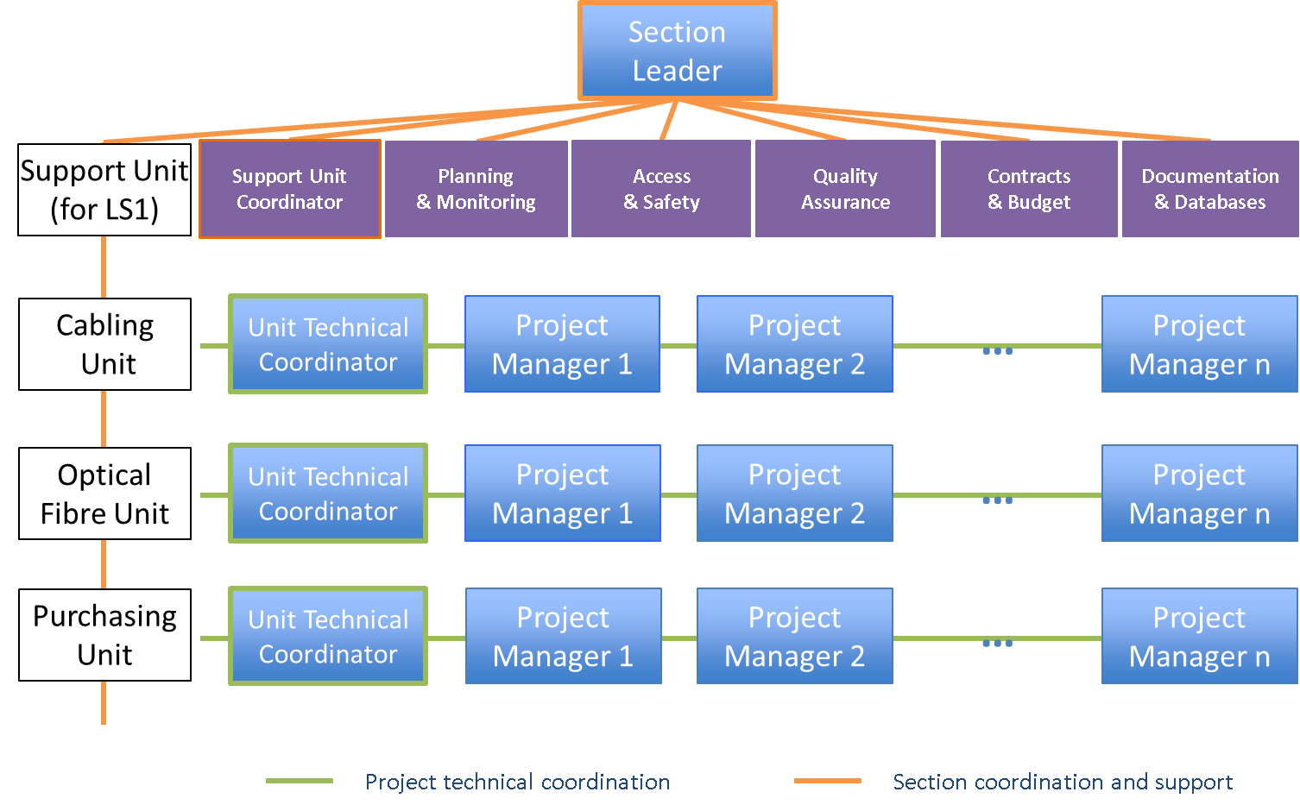
Cabling and Optical Fibre section (EN-EL-CF)
Projects
→
same working method
35 staff + 100 contractors during LS1 peak

Slide 4
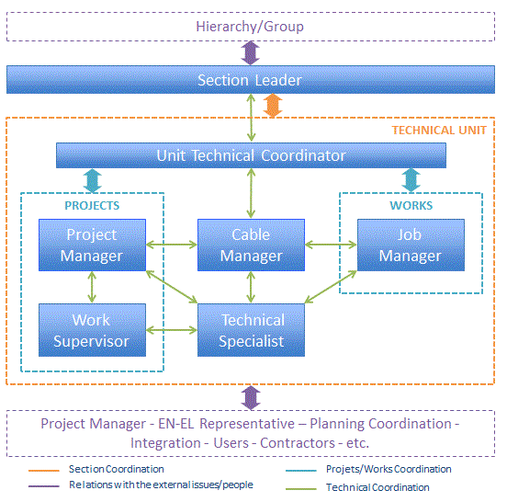
EN-EL-CF functional model
Work: punctual activity. Taken at charge by a Section member following from a User’s request.
Project: activity with the following characteristics:
  A “Project Leader” is assigned among the CERN’s Users
  A project “Technical Coordination” is put in place
  A project “planning coordination” is put in place
  Strong interactions with central/periferals study offices (Integration)
Interaction with ~600 users for all CERN departments/groups

Slide 5
The LS1 challenge: the important numbers
37 main projects to carry on + day-by-day installation works
  (Some examples: R2E, LHC cabling campaigns, WCC hose consolidation, SPS campaigns & irradiated cables TS1+, new SPS fibre infrastructure (BI & others), PSS, LINAC4 & Meyrin campaigns, Computer Centre extension B513, LHC-Experiments fibre upgrade)
Overall estimated budget ~15 MCHF
~1000 km of copper and optical cables being installed during LS1

Slide 6
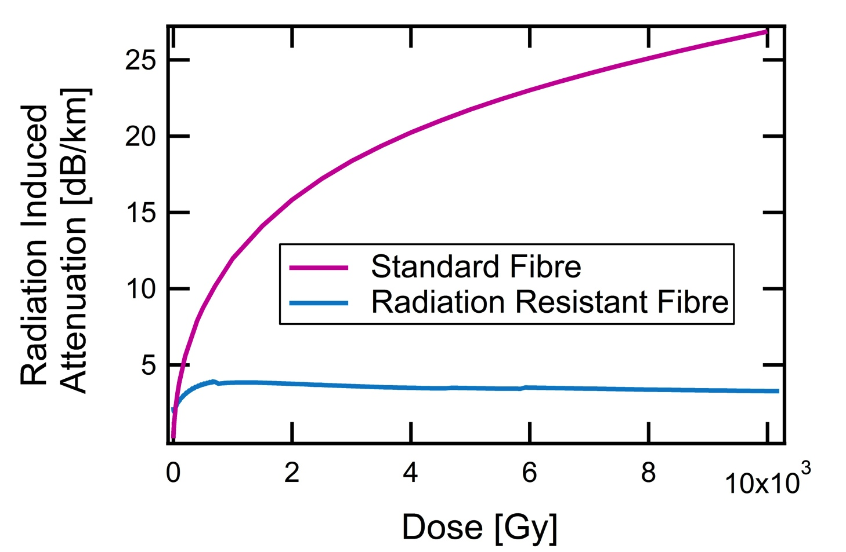
The strategy
Example1: anticipate qualification and procurement of material
  Some special cables/fibres require 6 months to be procured
  Early processing of the user’s needs (deadline June 2012)→ orders placed
  All cables/connectors defined by Oct 2012 → last orders finalised
Qualification of RRF
Procurement copper cables & connectors
More than 20 irradiation tests
2400 km procured in 2012/13
LHC consolidation + upgrade
SPS new Beam Instrumentation
+ fibres…
For more details see LSC presentation June 2013
Notes:
In the case of Fibres, the procurement of material is included in the contract

Slide 7
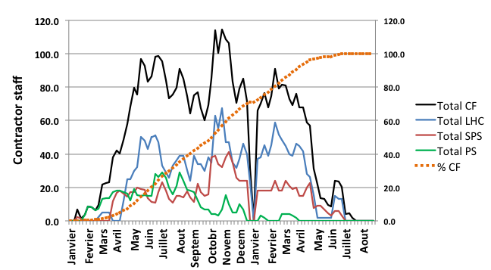
The strategy
Example2: anticipate contractors’ workload and optimize planning time-slots
  Negotiation of working time slot with machine & project coordinators since Sep 2012
  Optimal shaping of workload curves for contractors w.r.t. co-activity constraints
  Work organized by geographical campaigns
For more details see LSC presentation June 2013
Notes:
Note: LHC dominates the planning →
critical not to change accessibility for CF,
PS and SPS load curves compensate each other

Slide 8
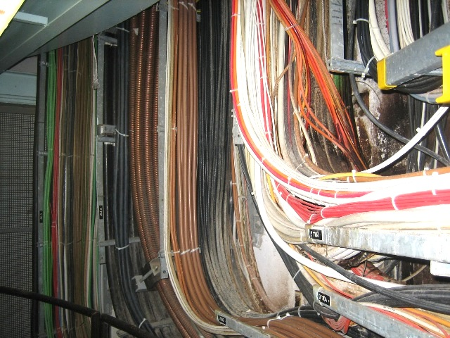
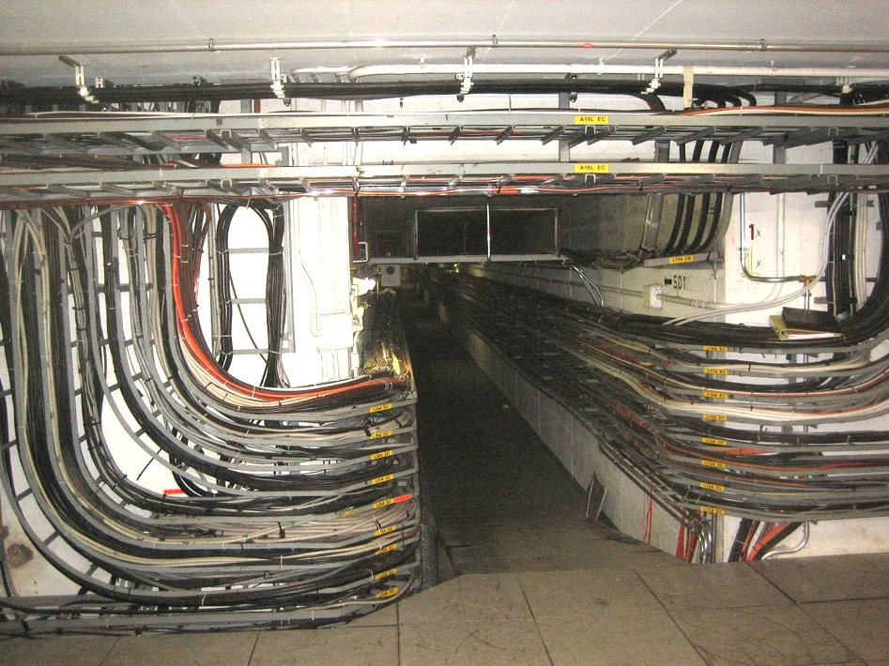
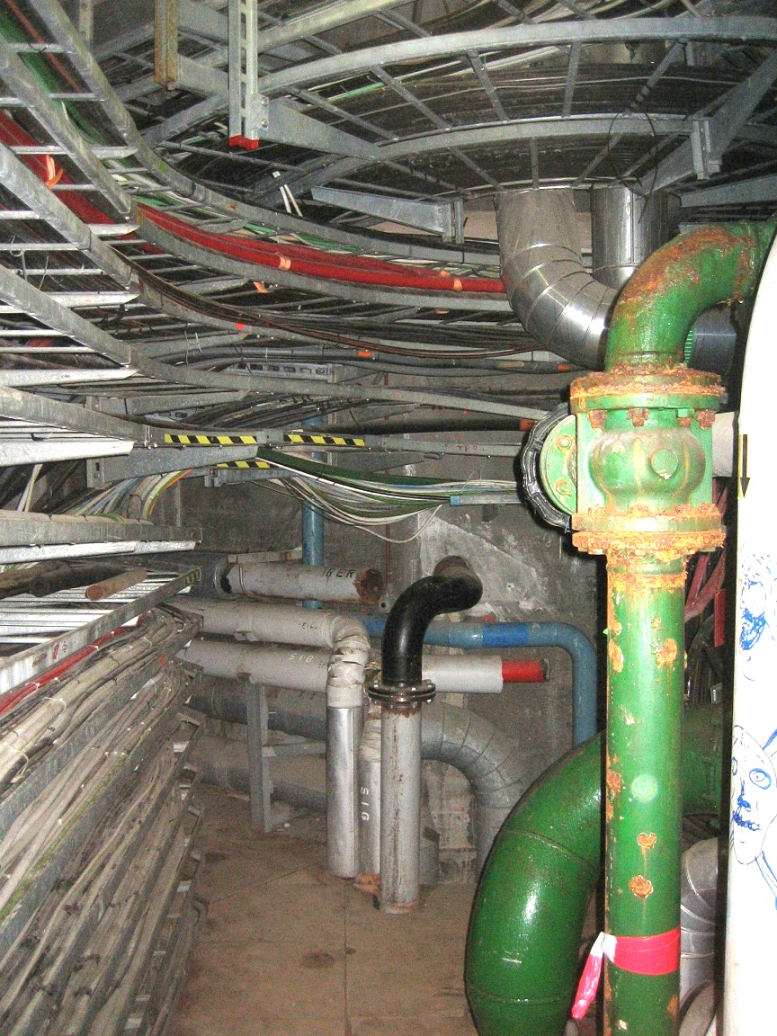
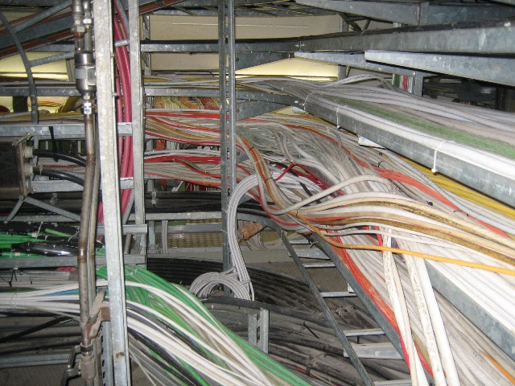
Infrastructure: current situation
Overloaded areas
Rest of PS-complex and Meyrin technical galleries
SPS: class1976 (36 years old)
PS: class 1959 (53 years old)
Shafts
Galleries
PS ring centre
Gallery TP9
Intersection Linac2-Linac4-PSB
Cables installed before ’80s are with halogens (risk in case of fire accidents)

Slide 9
Unité Fibres Optiques – Méthode de travail contrat C202/EN
UTILISATEUR
EN-EL-CF
CONTRACTANT
DIF
Demande Installation Fibres
PREPARAT I ON
Accusé de réception
Réunion de planification/présentation des travaux
Etude de la demande
Vérification des données
Préparation du dossier technique
Etude des passages, cheminements, etc. - VIC
Commande de matériel
Production du matériel
Préparation procédures de sécurité (AOC, VIC, IMPACT, etc.)
Préparation du dossier administratif
Devis
Estimation financière
Signature
Envoi du OSVC (Ordre Service Valant Commande)
Préparation chantier, transport du matériel
Envoi de l’OE (Ordre Exécution)
Fibres supplémentaires
Installation (pose tubes/câbles, terminaison, test)
EXECUT
ION
Préparation dossier complémentaire
Fiche de modification
Modifications éventuelles
Contrôle de l’installation
Fiche de réception
Réception/reprises
RECEPTION
Remise de l’installation
Fiche de retour
Remise de l’installation
TRANSMI SS ION
Contrôle des métrés
Métrés
Remise des métrés
Updated: 5 Nov 2013
D. Ricci – EDMS 1184327

Slide 10
Backup slides

Slide 11
The strategy
Facing technical challenges: optimize work organisation and resource distribution by working by geographical campaigns
PROJ 1 Various works for TE/ABT
Campaign Booster
Case 1
PROJ 2 LIU
Campaign SPS-BA1
PROJ n Various works for BE/BI
Campaign LHC-Point1
Case 2
PROJ x Repl. Irradiated cables TS1+
Campaign SPS-TS1+
Campaign LHC-Point 5
Case 3
PROJ y R2E
Campaign LHC-Point 8
~700 cables/fibres work orders for LS1
Campaign LHC-Point 1
Notes:
All project requests are constituted for us of several work orders for installing cables in different machine ares. The concept of campaign consists of decomposing and re-organizing these works by geographical areas allowing to optimize the intervention time in that area, the necessary resources and the overall plannning to fit all campaigns.

