Slide 1
Linac4 – Project Meeting
Access to the linac tunnel during commissioning

Slide 2
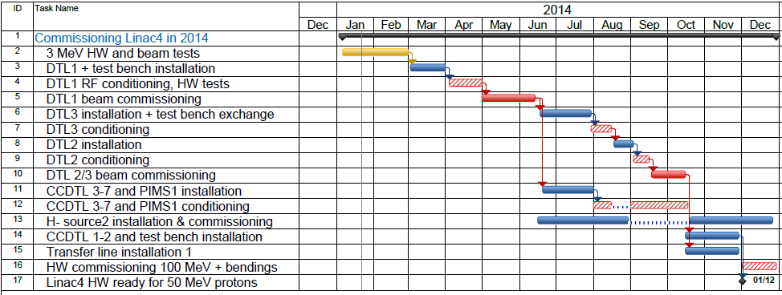
Master Plan
No Access during the beam commissioning
Access System ready (DSO Tests done)
Restricted Access during the RF conditionning

Slide 3
Linac4 access control system (access point - PAD)
What to do for accessing in Linac4
People Identification: own a dosimeter with an “INSIDE” chip (also required for LHC)
Access authorisation:
  EDH request granted for Linac4 access
  impact (if needed)
Criteria for access : to be updated with one’s access rights
  safety courses
  Dosimeter (to be read monthly) and not exceeding the allowed limit
Access authentication: have carried out one’s biometric enrolment (Bld 55)

Slide 4
The access modes
Access mode
Access procedure
Closed
No access but the egress is possible
The access procedure is local to authorized persons (no key request)
(in case of problem intercom call → CSA)
General
Restricted
User has to take a key to get through access point, which is released remotely by CCC operator ; (intercom call → CCC)
Patrol
the access key request must be validated by superintendent by turning a key at the access point ; then it’s the same procedure as the “Restricted” mode
Special Permit
Radiation veto
No access but the egress is possible
Safety veto
No access and no egress (access equipment locked)

Slide 5
Local information panel
Access mode
Screen for PAD badge reader
LN4-TNL or LN4-SP (special permit)
Access rights required
Screen for key distributor badge reader
used in “access with key” to take a key

Slide 6
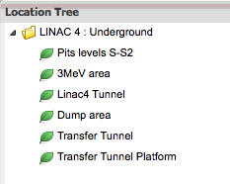
IMPACT
url : https://pptevm.cern.ch/impact
This intervention request will be mandatory for underground as soon as the access system will be in service → April 2014
  Short description of the work
  Dates
  Location
  Safety procedures
  Hazards

