Slide 1

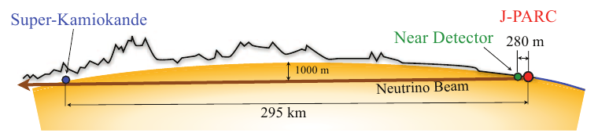

T2HyperK from hints at CP violation with T2K to discovery in T2HyperK?
(via ‘evidence’ from T2K+NOvA…)
Hyper-Kamiokande
2km detector?
Mark Alastair Rayner
Université de Genève
SINERGIA meeting, 7 January 2014, CERN
N.B. For details on the plots in this talk see the 3rd open meeting, and the
1st European meeting, especially the talks by Nakaya-san and Dave Wark

Slide 2
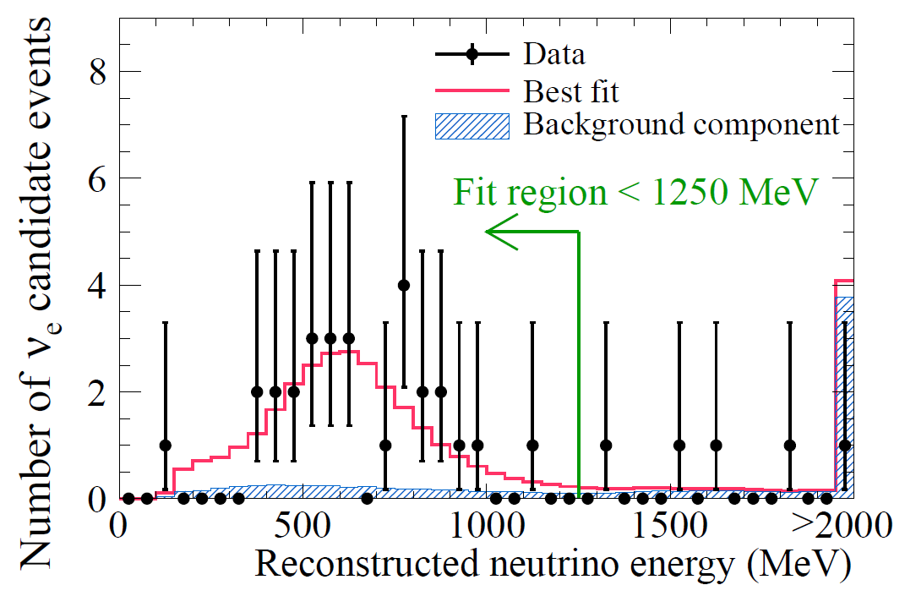
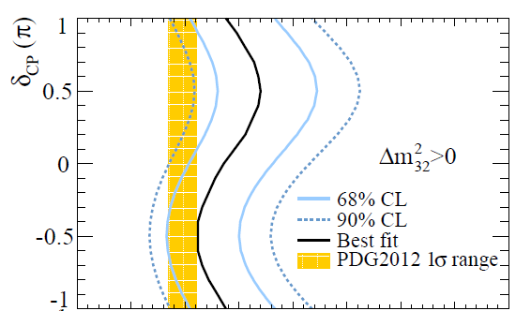

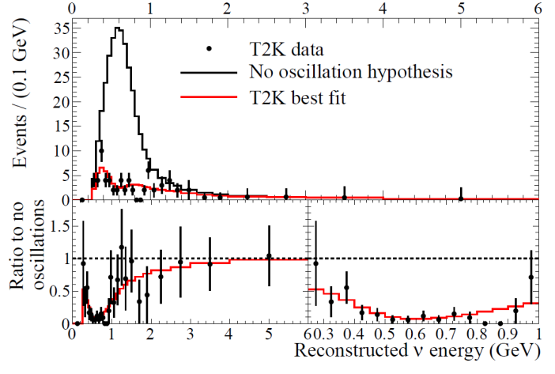
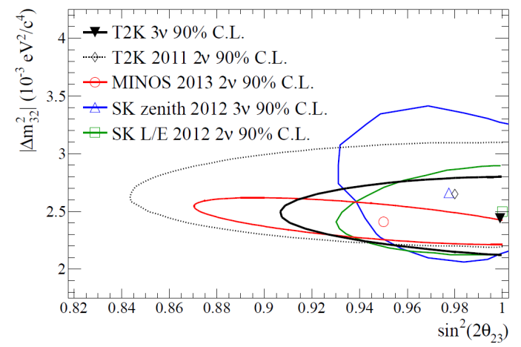
T2K 2013 appearance
Reactor
Tiny
BG
Recent T2K results have opened up
an unexpected window on CPV
T2K 2013 disappearance
T2K 90% CL
Powerful
disappearance
Maximal θ₂₃

Slide 3
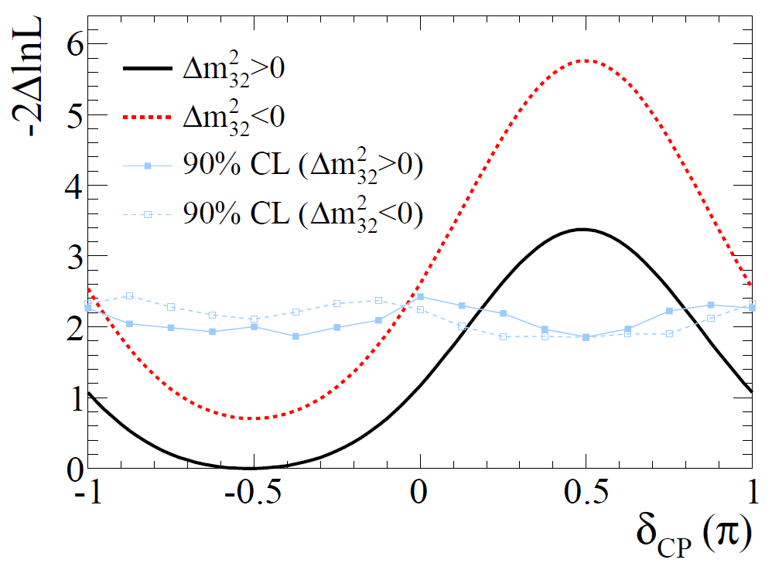
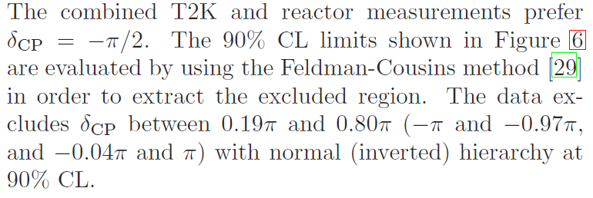
With the reactor constraint,
and marginalising…
Observation of nue app. in a numu beam
T2K, Nov 2013, arXiv:1311.4750v1

Slide 4
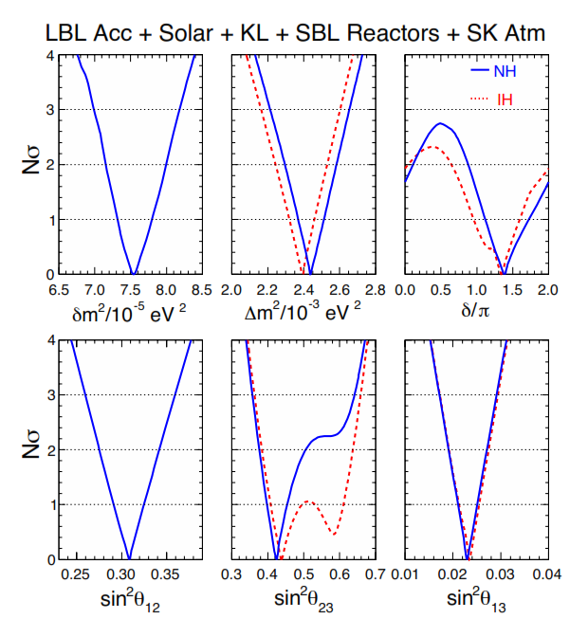
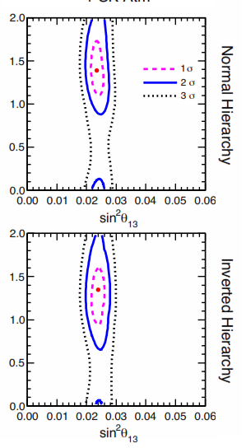
We are left with 4 questions for 3ν…
Dave Wark, 1st EU meeting
w/ Global fit, Lisi et al, Dec 2013
What is δ?
What is the MH?
What is θ₂₃?
4th Question – Is this all there is?
Halzen’s Rule – 1σ
is an error bar, not a discovery

Slide 5
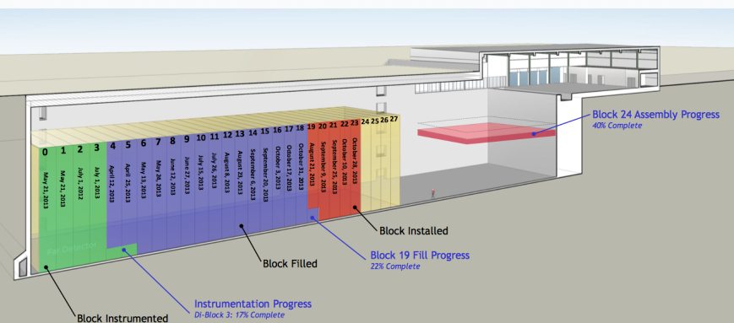
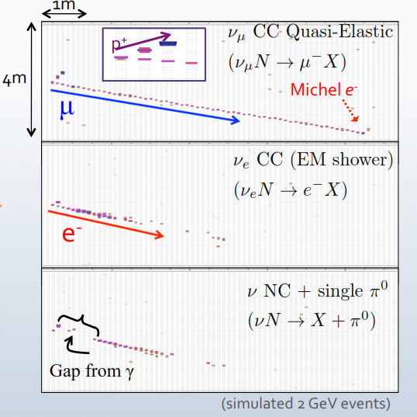
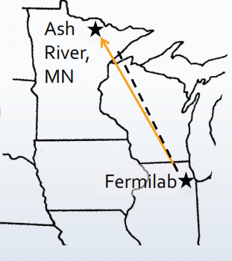
Where will be by 2020?
If we combine the T2K and NOvA data sets with the reactor fit…
Aside: The NOvA experiment

Slide 6
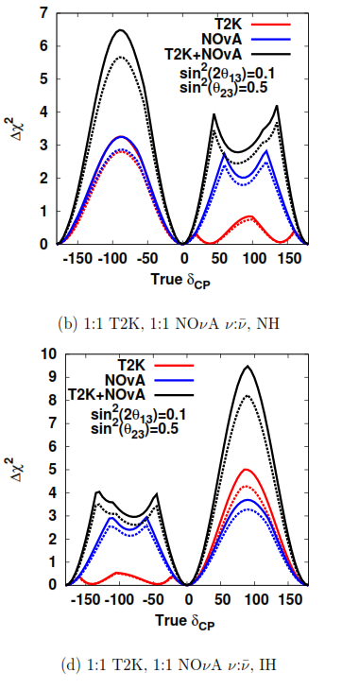
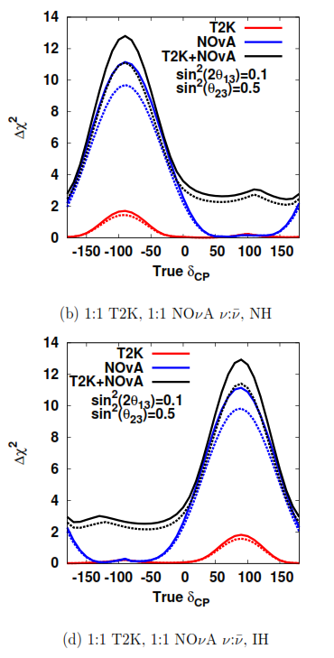
δ_{CP} Sensitivity
MH Sensitivity
Normal
hierarchy
90%
Inverted
hierarchy
MH also from
DB + 60km JUNO detector,
INO and PINGU
90%
Wark, EU meeting
(Assuming T2K and NOvA use 1:1 nu:nubar)

Slide 7
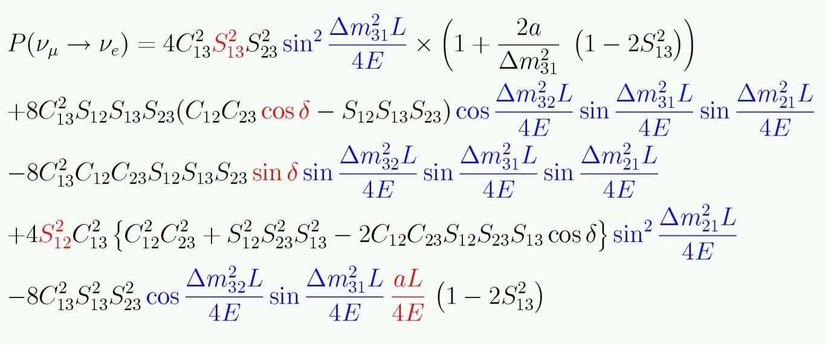
To measure CPV…
Matter effects
➔ Hierarchy ?
Flip sign for antinu
➔ CP sensitivity
Challenge: reduce statistical error on signal extraction to 2% and reduce systematics from ~10% to ~2%

Slide 8
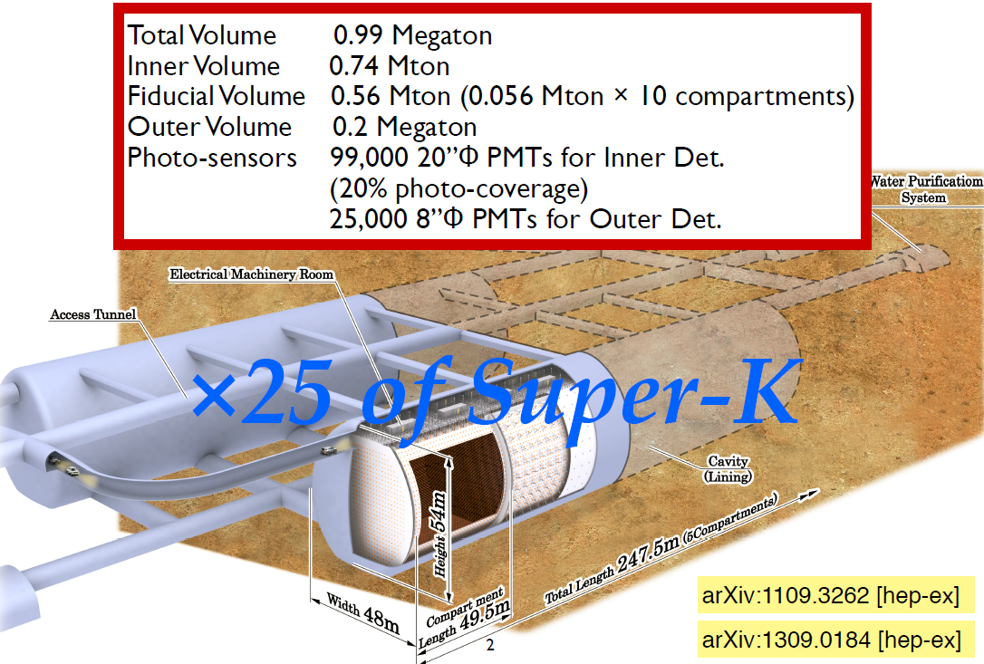
Hyper-Kamiokande Overview
Slide by Nakaya-san

Slide 9
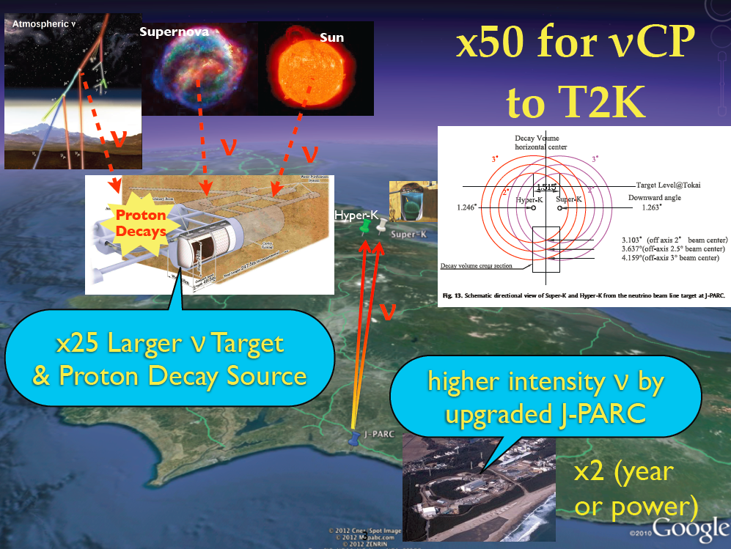
Slide by Nakaya-san

Slide 10
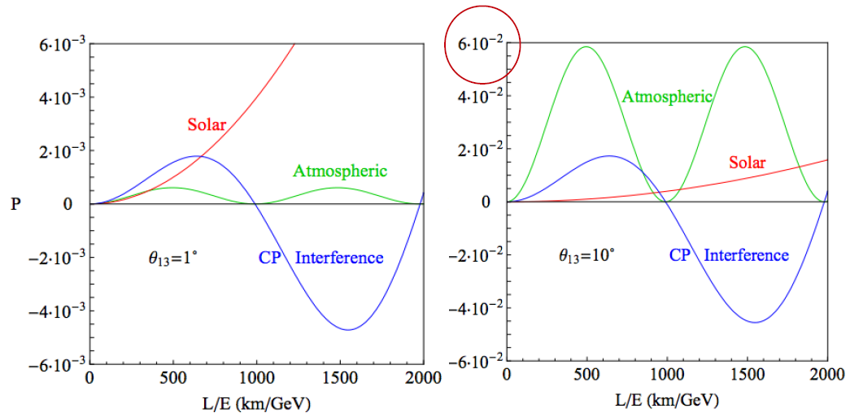
A wrinkle: CP interference is actually subleading
Appearance probability terms
theta-23 systematics are more important than we previously realized

Slide 11
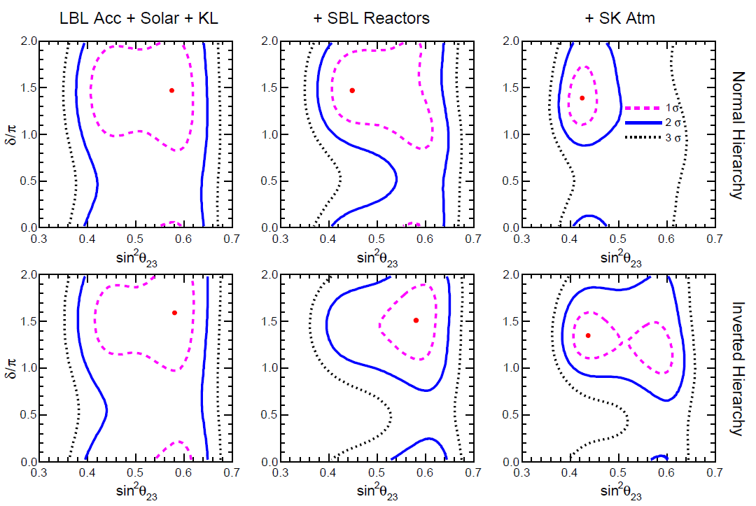
Latest global fit in the theta23, deltaCP plane
Status of three-neutrino oscillation parameters, circa 2013, arXiv:1312.2878
F. Capozzi, G.L. Fogli, E. Lisi, A. Marrone, D. Montanino, A. Palazzo, Dec 2013

Slide 12
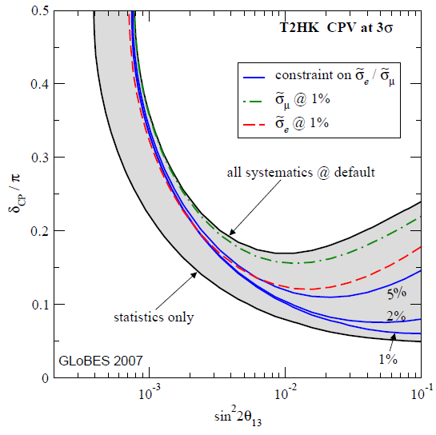
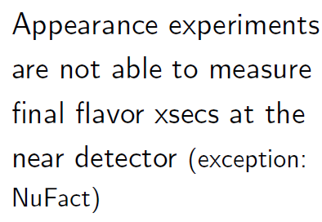
3 sigma sensitivity for T2HyperK (for 0<delta<pi/2)
i.e. the smallest delta you can measure at 3 sigma
Huber et al., 2008
arxiv:0711.2950
Reactor constraint
(➔ nuSTORM?)

Slide 13
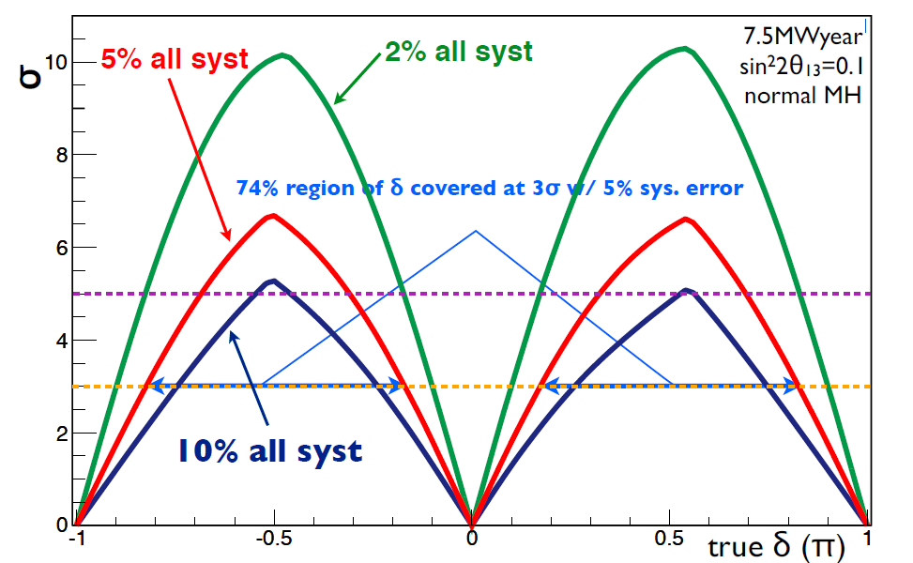
T2HyperK CP violation discovery sensitivity (known MH)
Yokoyama-san, 2nd open meeting

Slide 14
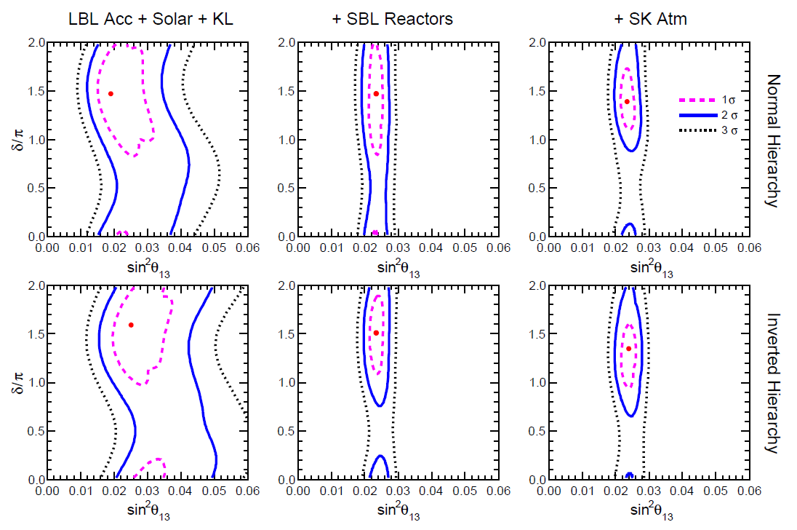
We now see closed 2 sigma (theta13, deltaCP) contours in the latest global fits
Status of three-neutrino oscillation parameters, circa 2013, arXiv:1312.2878
F. Capozzi, G.L. Fogli, E. Lisi, A. Marrone, D. Montanino, A. Palazzo, Dec 2013
Statistical fluctuations?
Precarious?

Slide 15
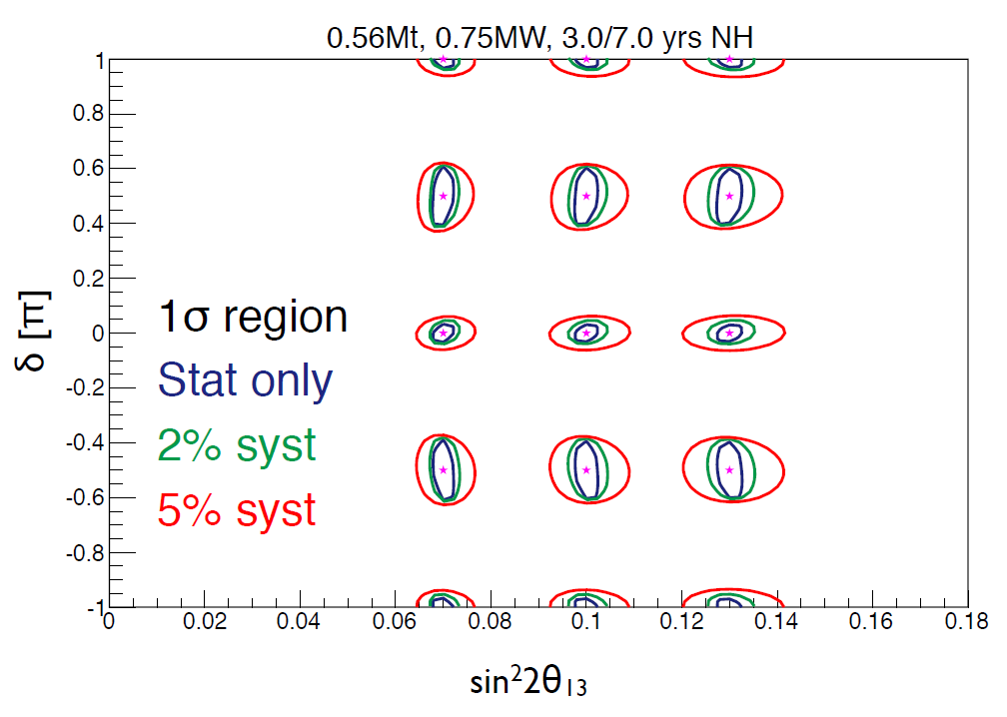
T2HyperK sensitivity
Yokoyama-san, 2nd open meeting

Slide 16
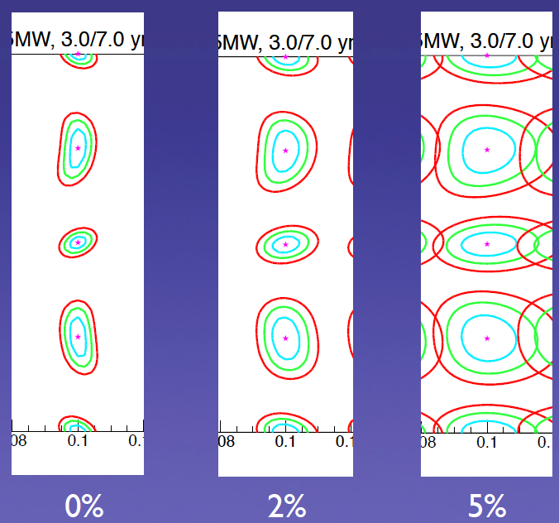
Effect of systematic errors
Nakaya-san,
EU meeting

Slide 17
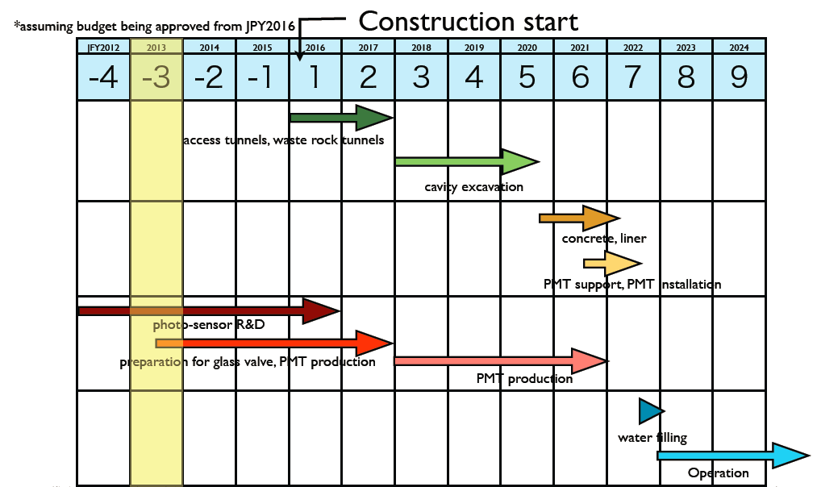
TDR in <1 year, construction in 2016

Slide 18
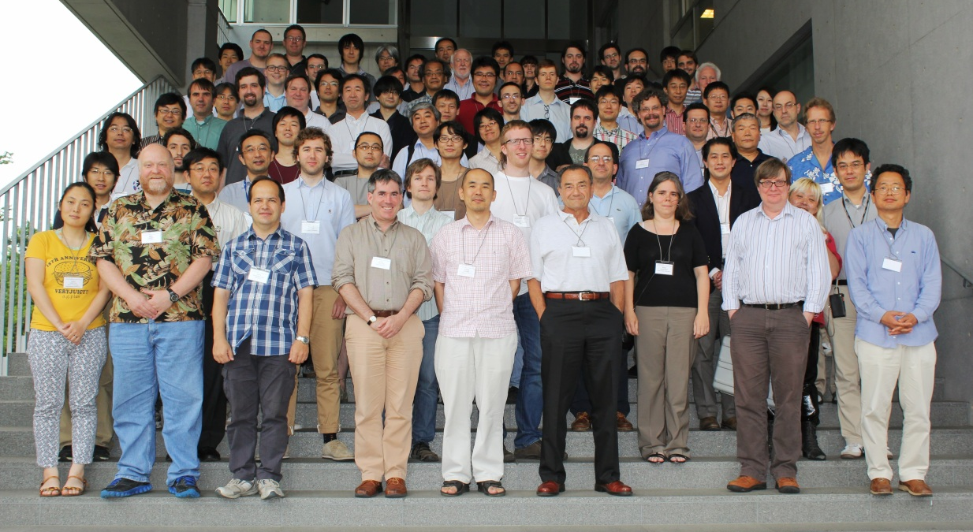
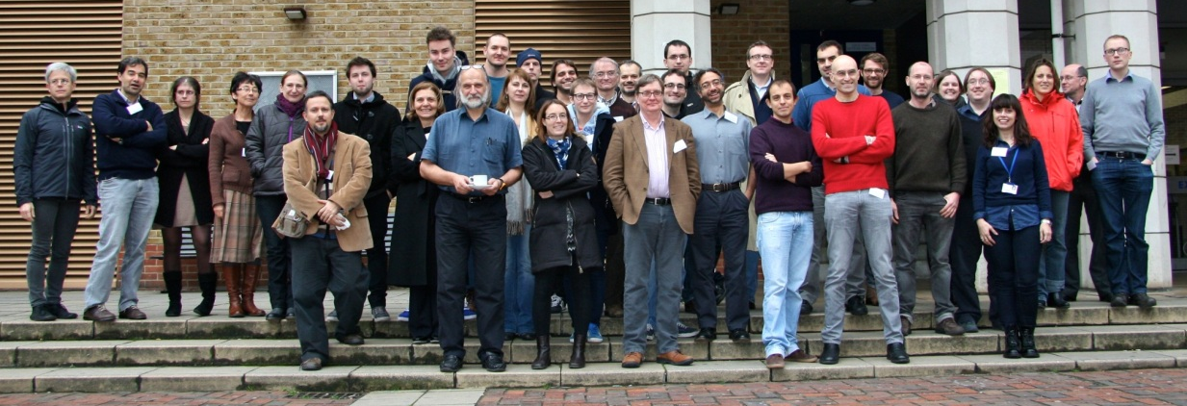
The Hyper Kamiokande collaboration is growing
49 institutions in 9 countries: Brazil, Canada, Japan, Korea, Russia, Spain, Switzerland, UK, and US
European leadership of software working group
3rd Open Meeting
  21-22 June 2013, Tokyo
1st European Open Meeting
  18 December 2013, London
4th Open Meeting
  January 27-28 2014, Tokyo
To give an idea of numbers…
The 3rd open meeting in Tokyo
The 1st European meeting last month

Slide 19
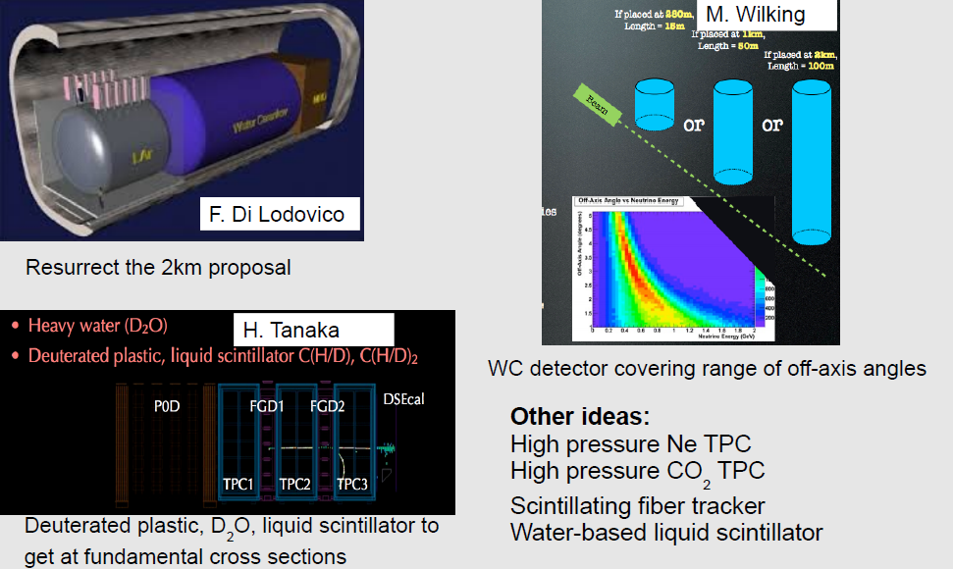
T2HyperK near detector ideas from the last CM
Tall, segmented
water ckov:
off-axis angle
➔ energy
100m
if at
2km
and… Upgrades to ND280
Plus interesting
TPC concepts!

Slide 20
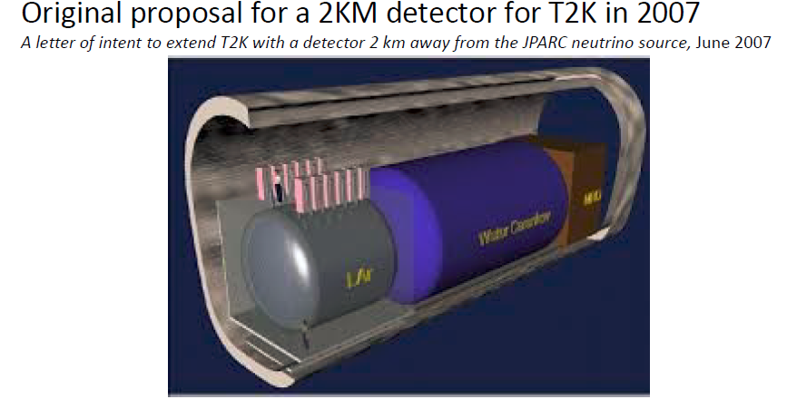
A 2km detector was originally proposed for T2K
Fe muon range
➔ U. Geneva?
1 kton water Cherenkov
Same nucleus, same energy bias
Also 4pi coverage
20% of SK events are backwards
100 ton LAr detector

Slide 21
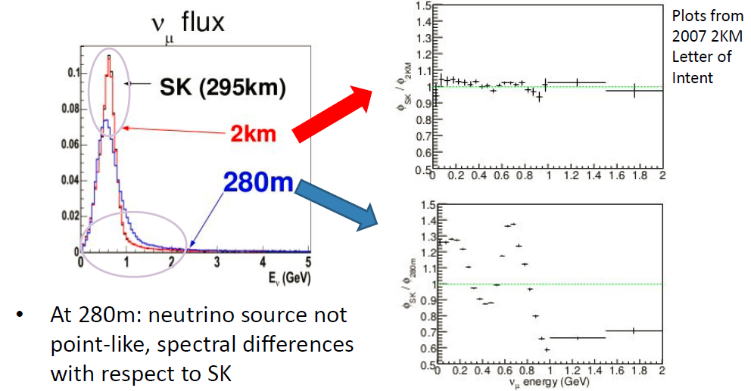
2km detector: advantages in flux shape
phi(SK) / phi(2km)
phi(SK) / phi(280m)

Slide 22
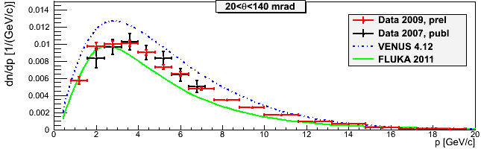
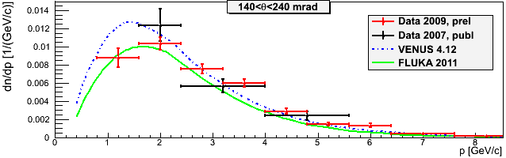
In addition, NA61 will continue to be crucial
2007 results on p±, K⁺ ➔ beam MC of T2K
With data 2009 improvement in precision by a factor 2-3
Example: K⁺ multiplicities for 2007 & 2009
Korsenev, University of Geneva

Slide 23
More hot topics
Cavern design approved in principle, geological survey at Mozumi ongoing
Funding approved for a 1kton prototype
Gadolinium doping is being studied
  80% transmission to 60% neutron absorption, 70% at 90% of neutron absorption
Focusing by parabolic lens arrays rather than Fresnel
B-field shielding can be passive (mu-metal)
It’s difficult to design a >20yr experiment (ultrapure water = ideal acid/base)
Increase PMT coverage from 20% to 40%?
  Needed for solar neutrino, geo neutrinos and SNR studies
Are geophysics studies really feasible? Is earth’s core Fe or rock?
  Assume rho(matter) known precisely from seismic tomography
  Measure rho(e) using the matter effect in Hyper Kamiokande
World best constraint possible on low mass WIMPs
And of course, proton decay

Slide 24
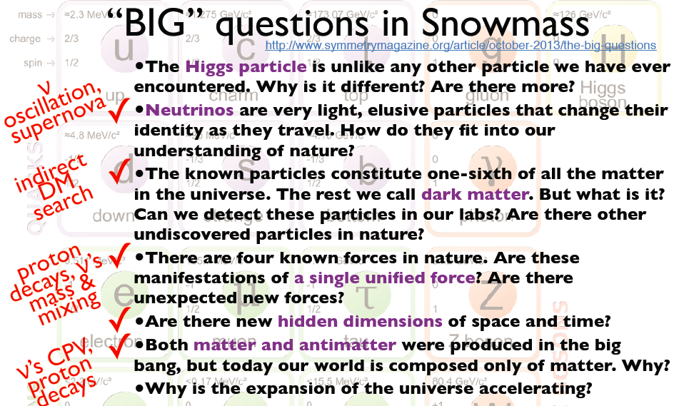
In fact T2HyperK lines up nicely with 6/7 ‘big questions’
Shiozawa-san

Slide 25
Summary – a road to CPV discovery
Hyper Kamiokande
× 25 fiducial volume compared to Super-K
  Proton Decay, Atmospheric neutrinos, Solar neutrinos, Supernova neutrinos, Cosmic neutrinos (and search for dark matter decaying to neutrinos)
240 kW (T2K now) → ~1 MW for T2HyperK (lab is more ambitious)
  ➔ ×100 compared to T2K’s data set today
2km detector
Given large theta-13, statistical errors on signal extraction = 2%
To achieve full CPV potential, require 2% systematics
  Difficult to get this without a 2km detector
Upgrades to ND280
Could alternatively/also upgrade the tracker
  High pressure TPC doubles as the target to study meson exchange currents and constrain nuclear models
  Or simply a water target surrounded by 4pi TPC tracking
➔ Lots of potential for significant European contributions

Slide 26
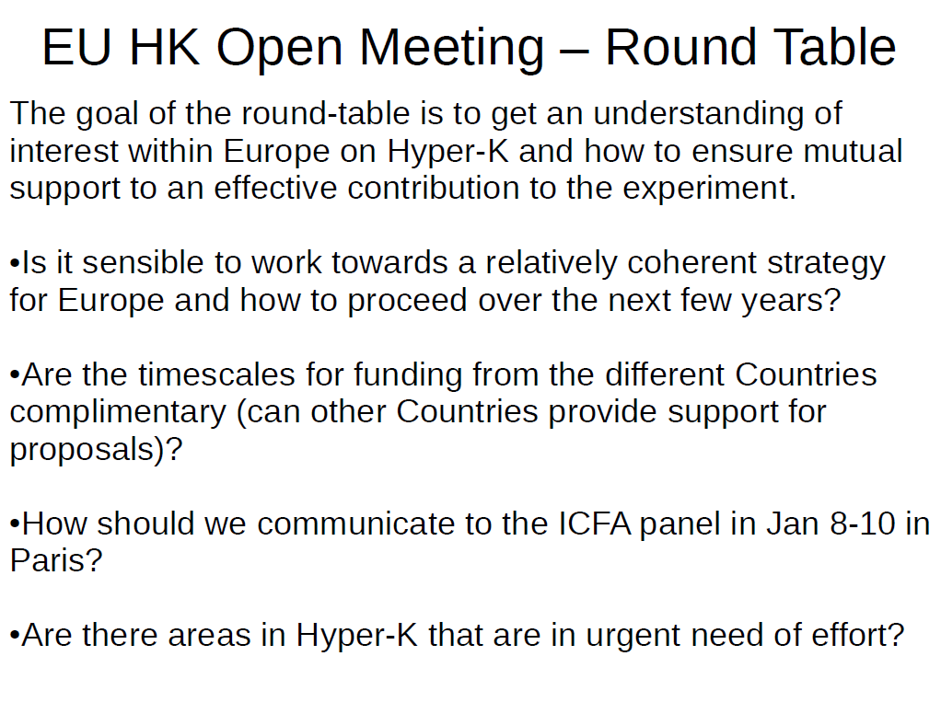
Post script: The questions posed at the 1st European T2HyperK meeting last month…
F. di Ludovico

Slide 27
Backup slides

Slide 28
Which experiment should we do?
Aside: Dave Wark at the EU meeting
I think that is the wrong question.
The right question is: How many, and which experiments do we need to do to have complementary confirmations for the answers to all the big questions.
Another thing to emphasize is multiple observables or techniques within each of the experiments (if possible).
The SNO experiment was never going to be repeated, so we measured the critical NC signal three different ways within the same experiment.
So what new experiments will help us answer these questions?

Slide 29
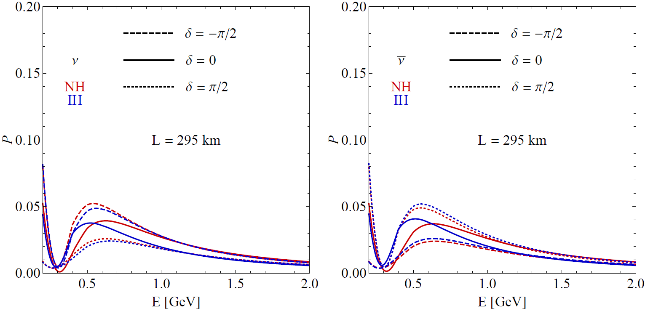
T2K, T2HyperK baseline

Slide 30
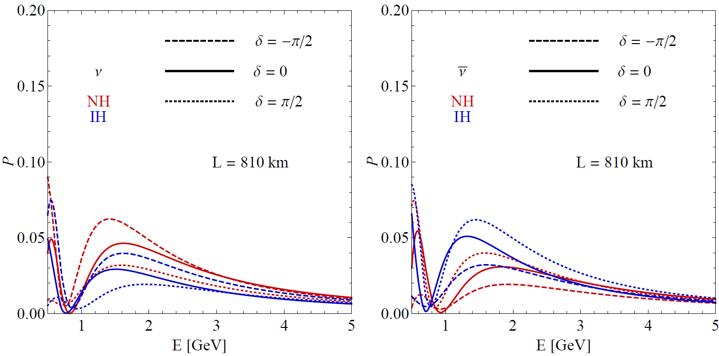
NOvA baseline

Slide 31
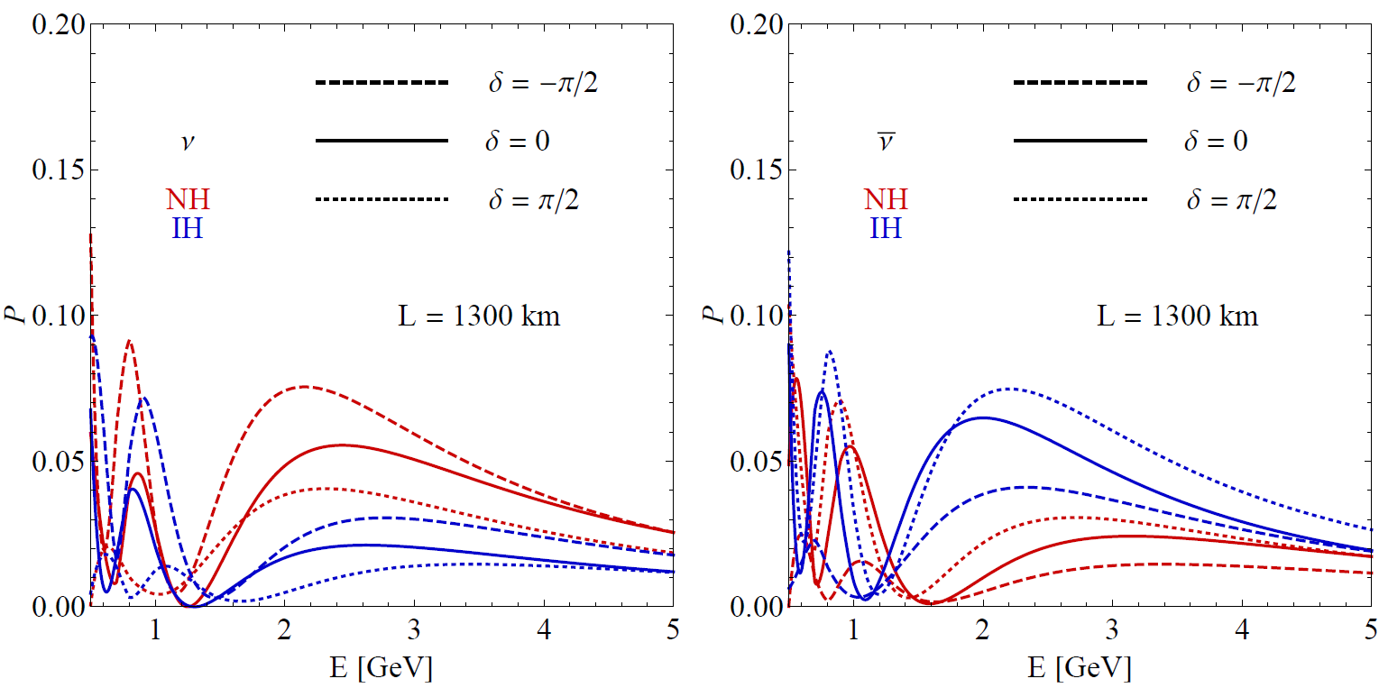
LBNE baseline

Slide 32
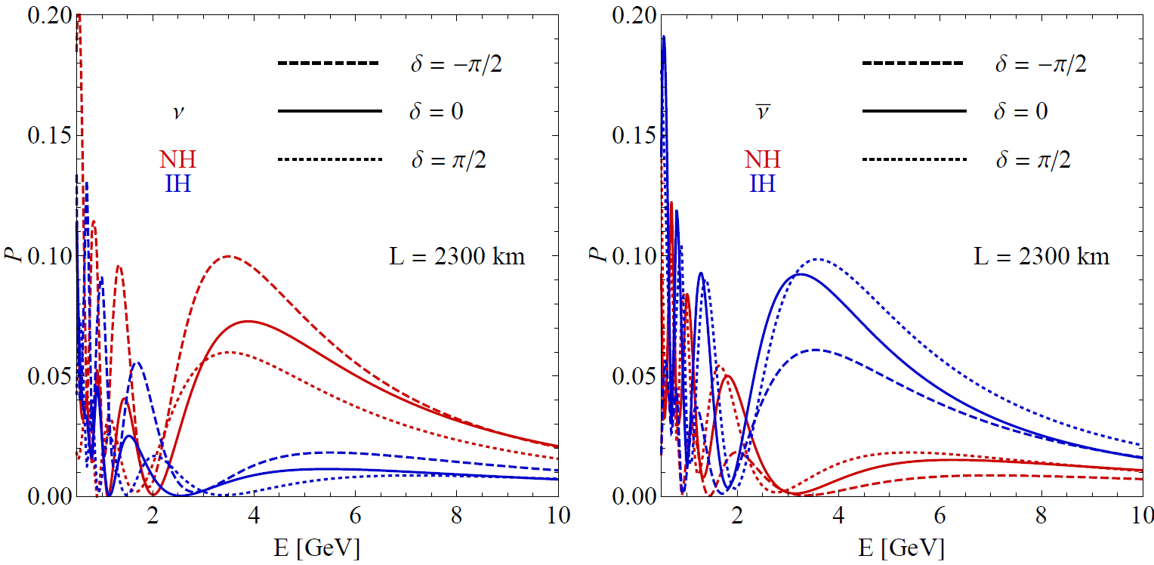
MH effect increases with baseline,
CP effect is ~roughly constant.
Note size of CP effect in second maximum…

Slide 33
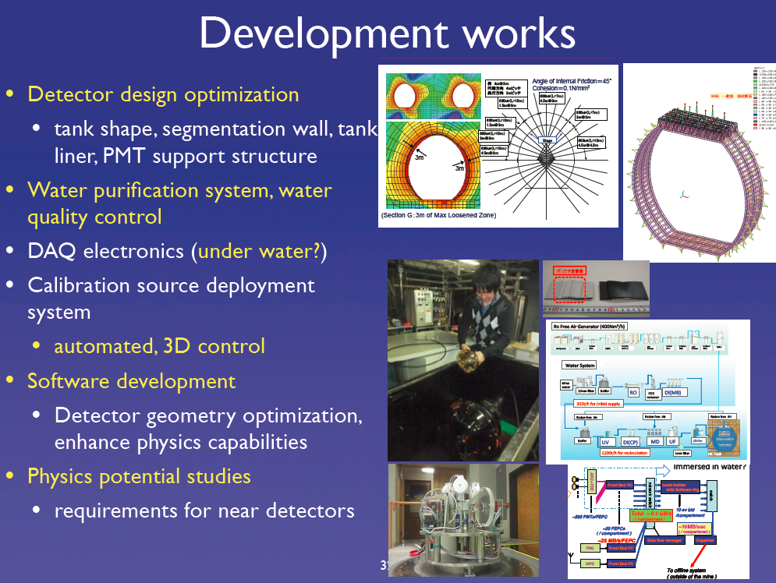
Nakaya-san, EU meeting

Slide 34
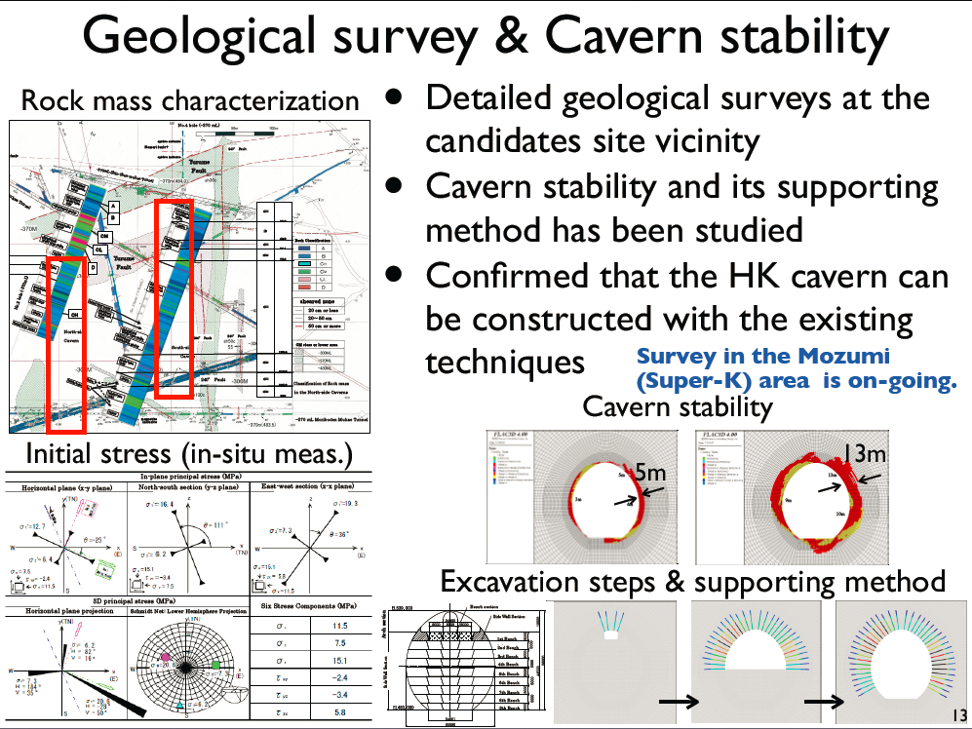
Nakaya-san, EU meeting

Slide 35
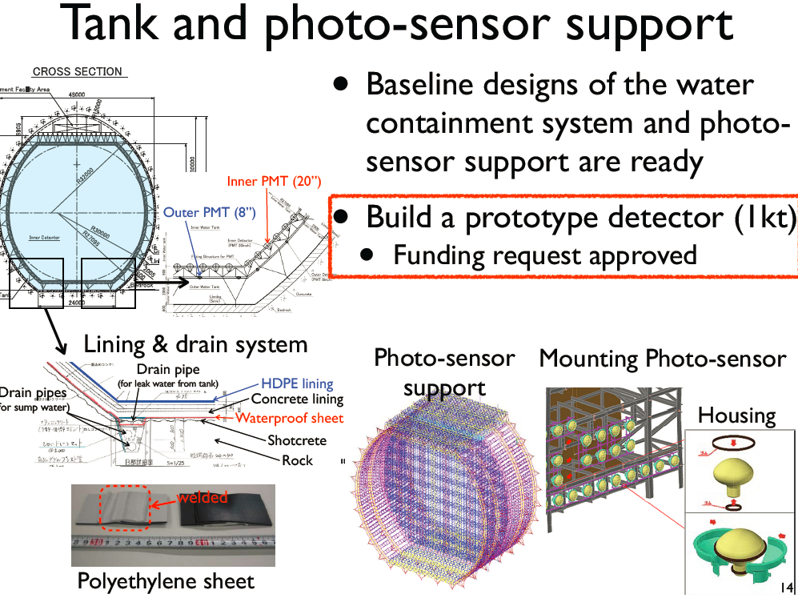
Nakaya-san, EU meeting

Slide 36
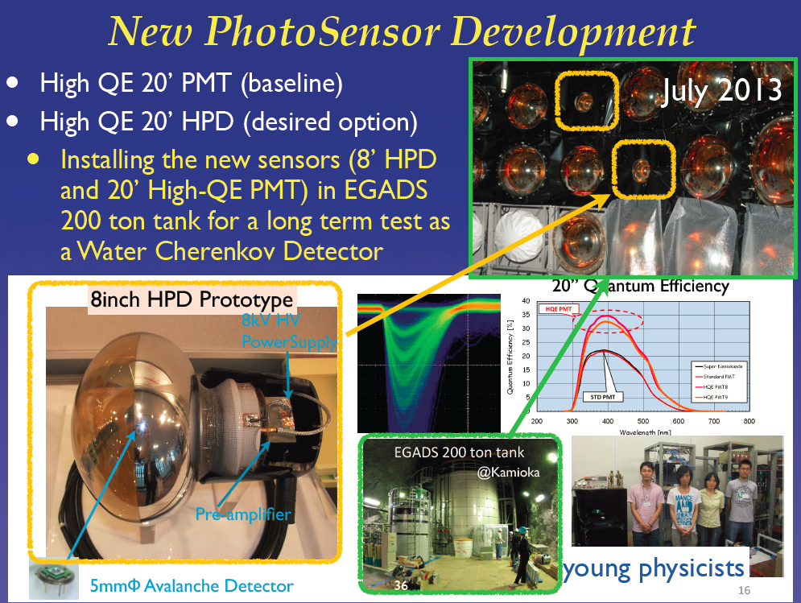
Nakaya-san, EU meeting

Slide 37
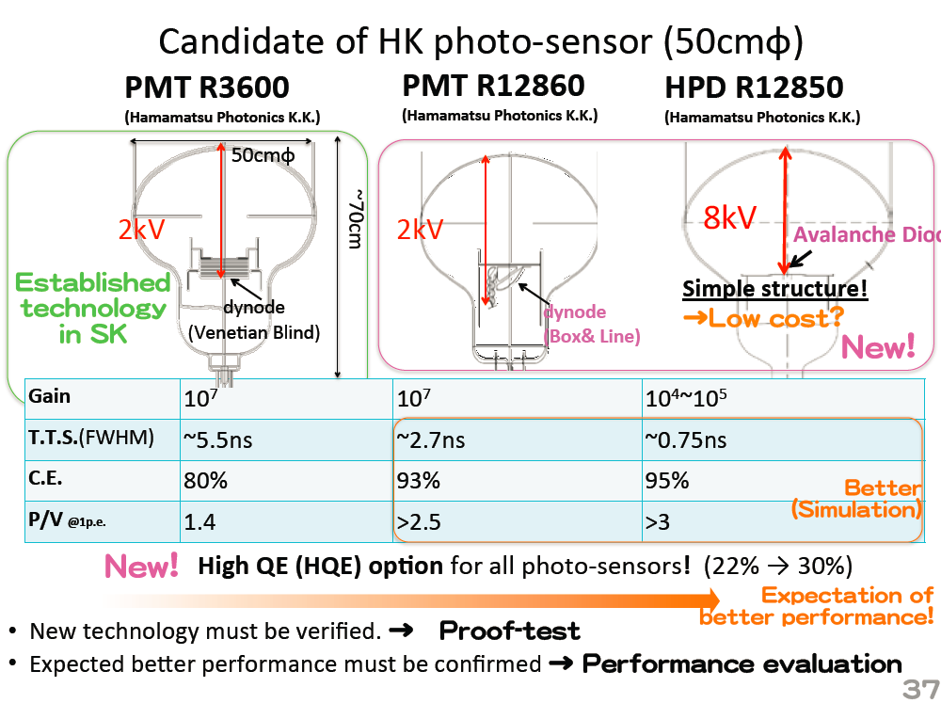
Nakaya-san, EU meeting

Slide 38
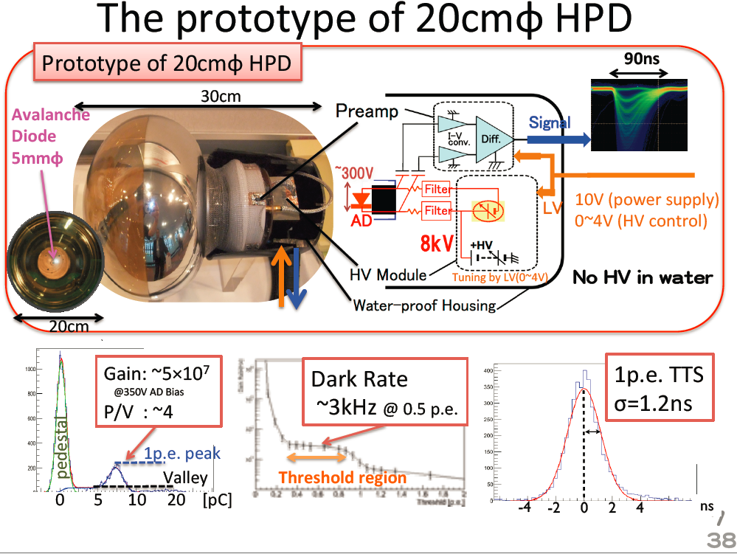
Nakaya-san, EU meeting

