Slide 1
T2K: Contribution of Bern and general prospect
Ariga
on behalf of T2K-Bern and -Swiss group

Slide 2
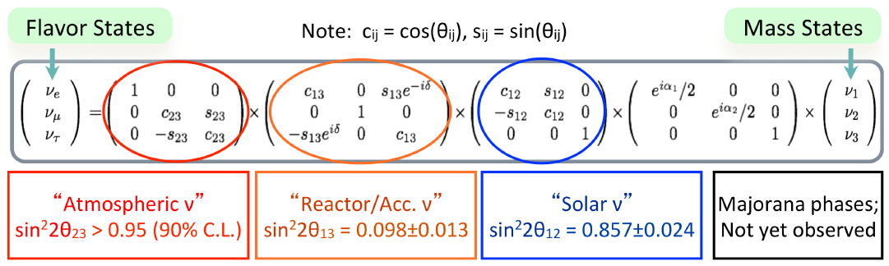
T2K goals
T2K
T2K
Observation of ν_{μ}→ν_{e} oscillation in appearance mode
Precision measurement of ν_{μ} disappearance

Slide 3
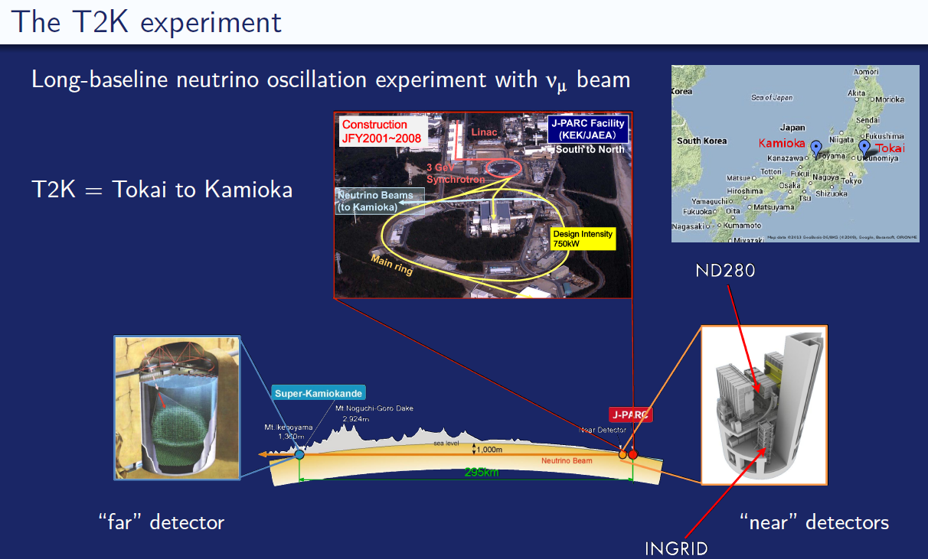
The T2K experiment

Slide 4
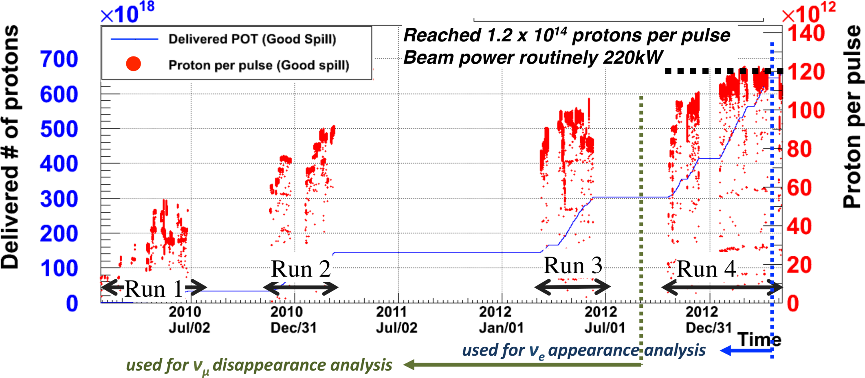
Data taking
Stable operation at 220kW
6.63 x 10²⁰ POT has been delivered
  8.3% of the final total POT

Slide 5
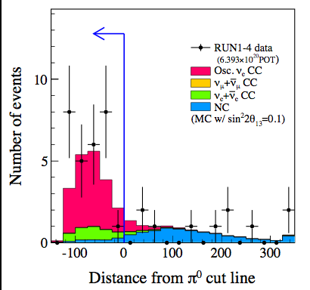
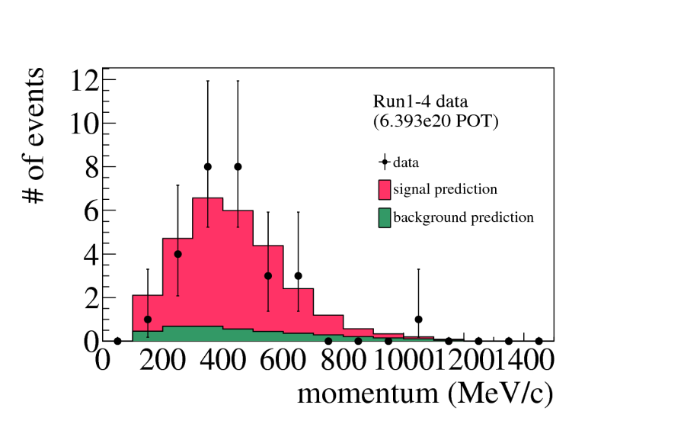
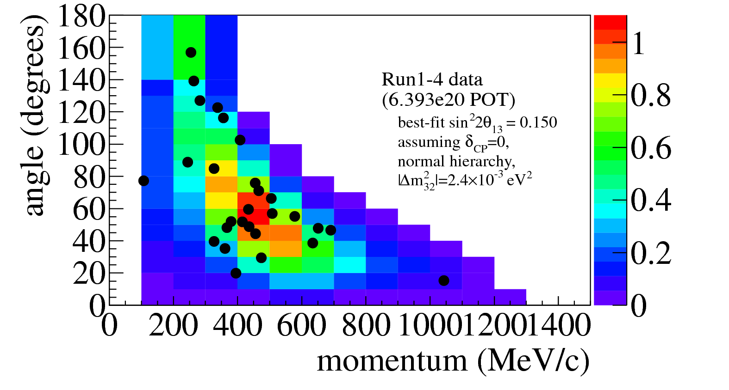
Observation of ν_{e} appearance
28 events selected (6.4x10²⁰ pot)
while 4.92+-0.55 events expected without oscillation.
Best fit (errors =1σ C.L.)
  NH :sin2(2q13)= 0.150 _{-0.034} ^{+0.039}
  IH : sin2(2q13) = 0.182 _{-0.040} ^{+0.046}
Excludes sin²(2θ₁₃) = 0 at 7.3σ

Slide 6
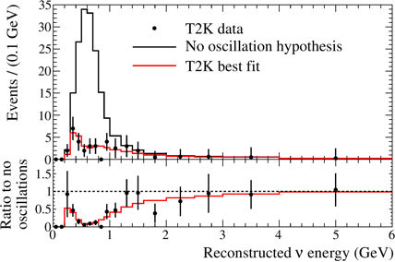
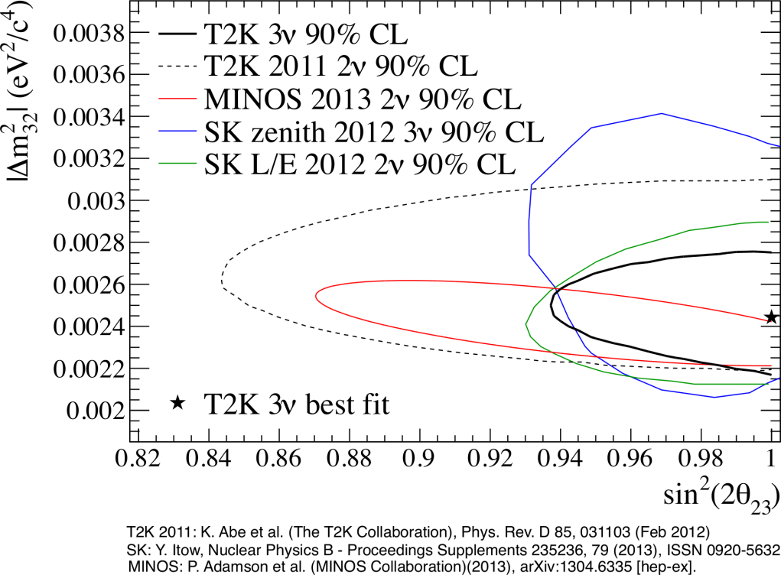
Disappearance
Select ν_{μ} CCQE candidates in far detector
58 events in data (3.01x1020 POT)

Slide 7
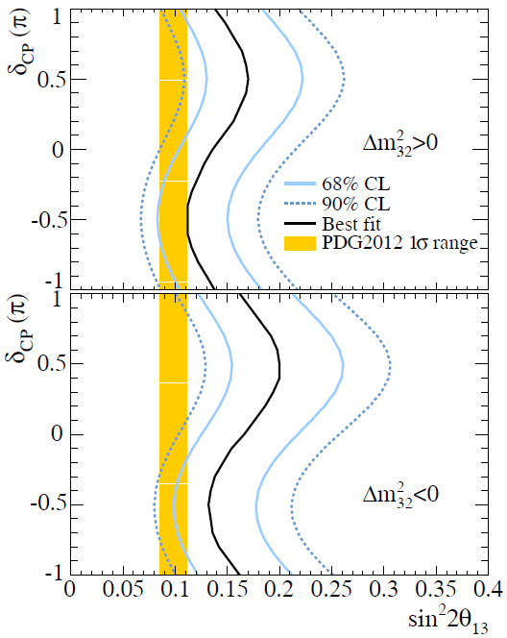
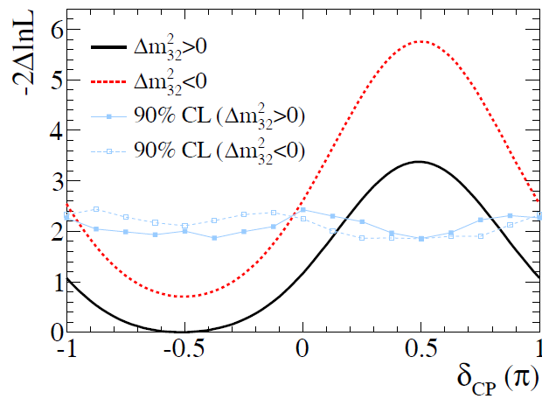
dependence of δ_{CP}
Allowed region of sin²2θ₁₃ for each value of δ_{CP}
Combination with reactor result disfavored a part of δCP space
disfavored
90% CL

Slide 8
Swiss contribution to T2K
(sorry, I couldn’t cover all due to lack of time)

Slide 9
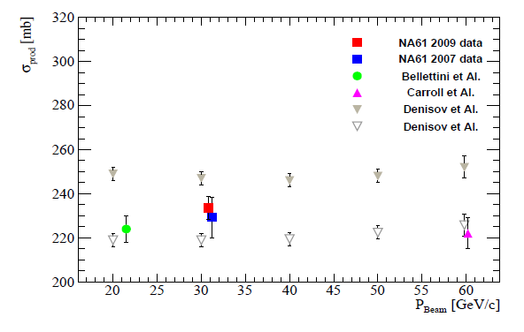
NA61/SHINE
T2K requires a precise knowledge of neutrino beam flux
Data taking in 2007,2009 and 2010 with proton momentum of 31 GeV/c on Carbon target
Determination of total p+C cross-section and also π⁺⁻, K⁺⁻, K⁰ differential production cross-section
The result has been taken into
account in the T2K flux prediction

Slide 10
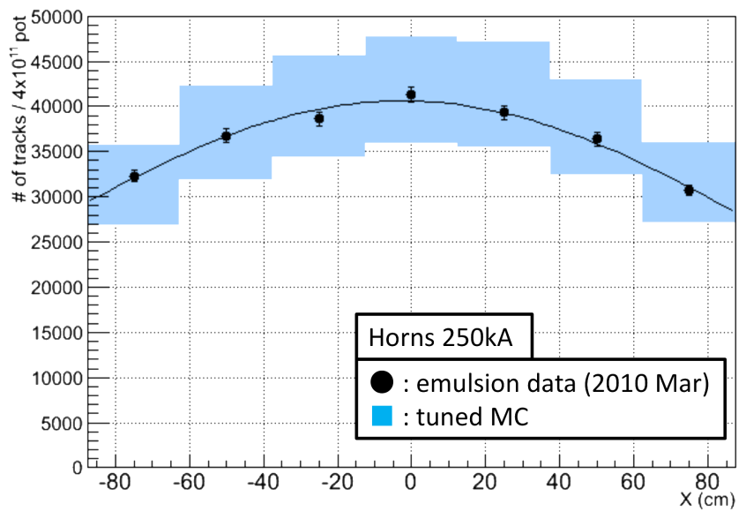
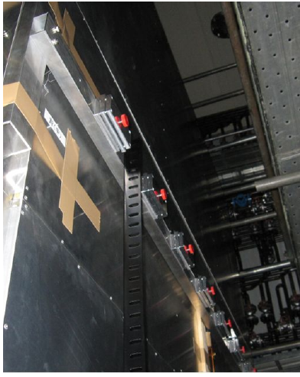
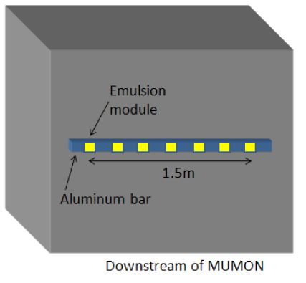
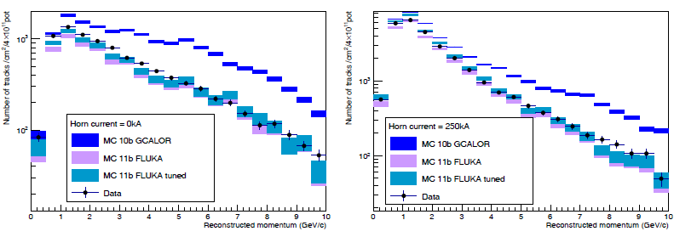
Muon measurement by emulsion
Akitaka Ariga, Tomoko Ariga (Bern)
Absolute muon flux measurement
Momentum measurement
Observed flux and MC prediction (with NA61 tuning)
Data/MC = 0.97+- 0.14
Preliminary
Preliminary
Momentum distributions

Slide 11
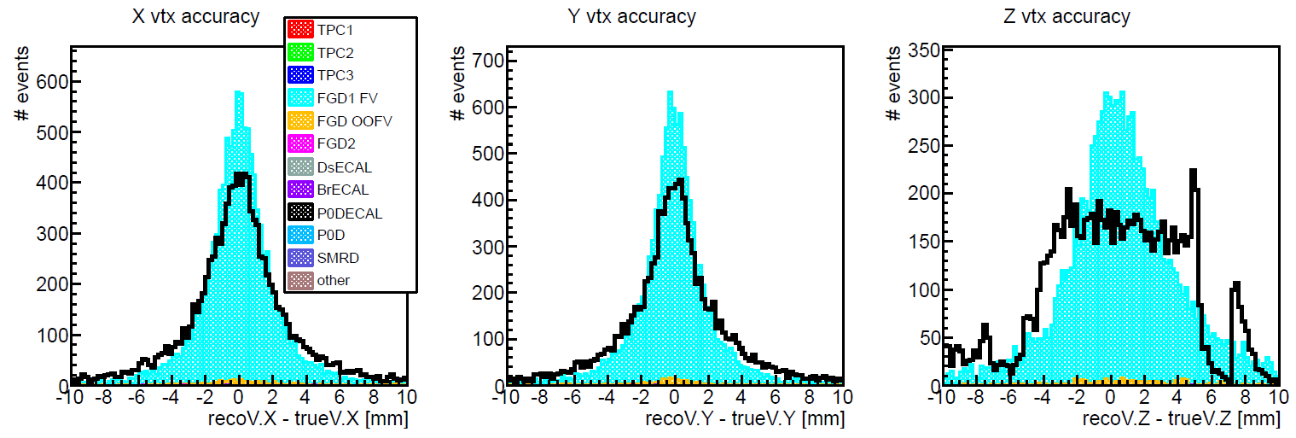
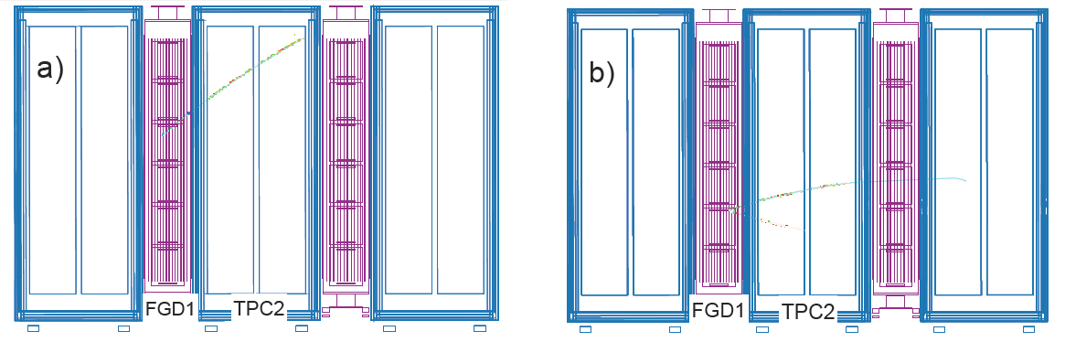

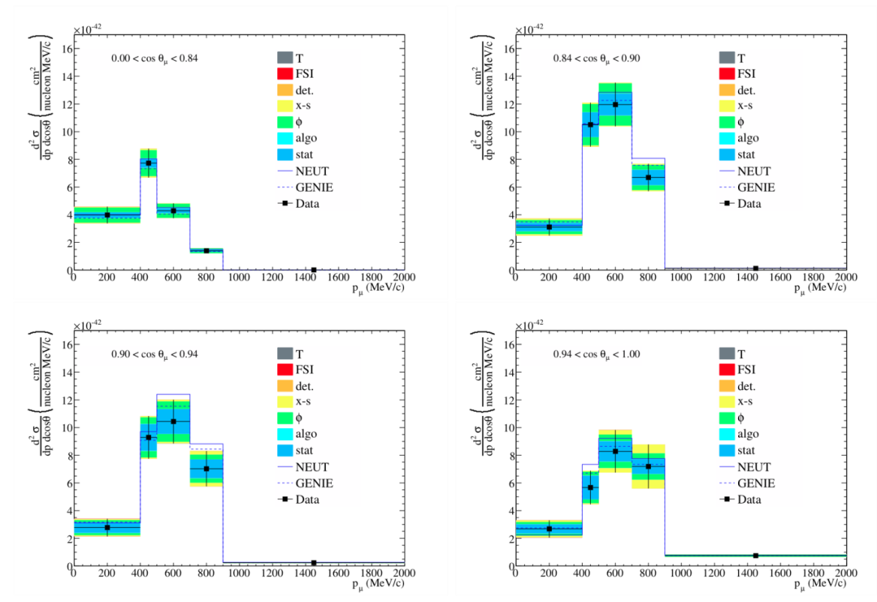
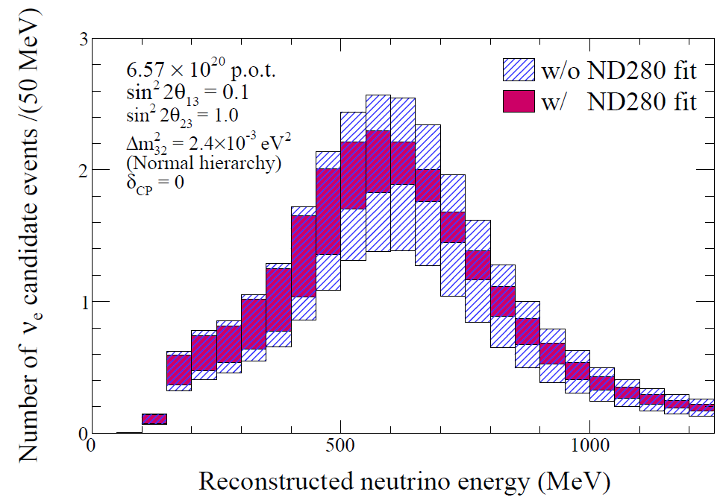
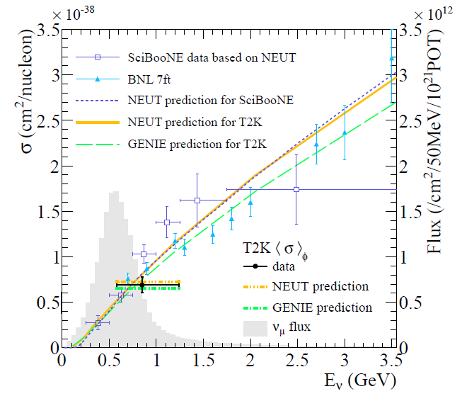
TPC Micromegas
Development, testing…
Global vertexing via Kalman Filter track fitting
UniGe
A selection of Université de Genève contributions to
First cross-section measurement by T2K
Inclusive numu CCinc differential xsec vs. (p, θ)
Systematics for ND280
OOFV, propagation within the software…

Slide 12
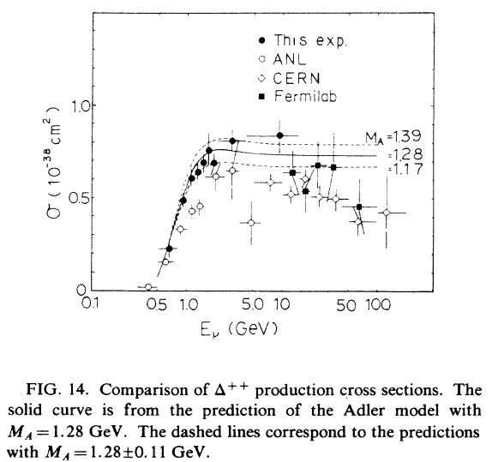
Work on neutrino cross-section measurements in Bern
Martin Hierholzer, Damian Goeldi (Bern)
Model-independent measurement of the CC
resonant π⁺ production cross-section (mostly Δ⁺⁺)
  Observe final states consisting of each one μ⁻, p, π⁺
  Extract differential cross-sections depending on
  kinematic variables like T_{μ}, T_{π}, Θ_{μ} etc.
  No measurement since ANL/BNL (~1980), large
  uncertainties in those measurements.
  Good test for FSI models as well!
Development of a multi-purpose cross-section measurement tool
  Attempt to unify efforts for cross-section analyses within T2K
  Designed to be flexible and expandable for use in different scenarios
    different detectors like ND280 and INGRID
    different event selections as input
    allow use of multiple algorithms to extract the cross-section, e.g. unfolding and fitting
    handle systematic errors from detector, background cross-sections, FSI and beam (based on existing systematic studies and tools)

Slide 13
Global vertexing validation
Martti Nirkko (Bern)
ND280 reconstruction software contains an algorithm to fit a global vertex to reconstructed subdetector tracks. (see fig.)
This code is currently being validated.
Control samples have been developed to
evaluate systematic effects for potential analyses
using global vertices.
Outlook: Use events with multiple global vertices (due to e.g. particle decays) to look for “rare” physics such as strangeness production from neutrino interactions.
FGD1
TPC2
isoFGD
HMN
SHMN
isoFGD

Slide 14
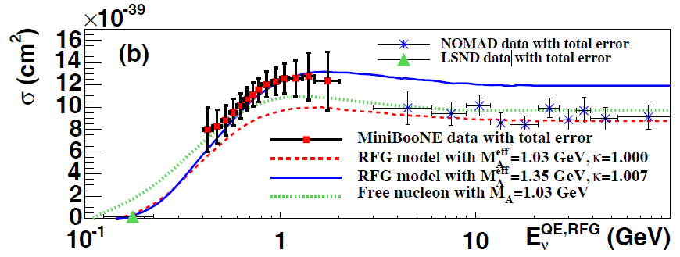
CCQE cross-section
Asmita Redij (Bern)
Recent experiments report higher value of axial mass M_{A}=1.35 from the fit CCQE data.
These effects could be attributed to the nuclear effects from the use of heavy nucleus target. Theory models available.
With increase of statistics in T2K, the systematic coming from these effects will limit the precision measurement of oscillation parameters.
NEUT, generator used for T2K analysis, is being updated for new interaction models like
  Multi-nucleon ejection model. *
  Random Phase Approximation.*
  Spectral function
Bern group contributed in these *.
Further will do model dependent
cross-section measurement to test
these new models against T2K data

Slide 15
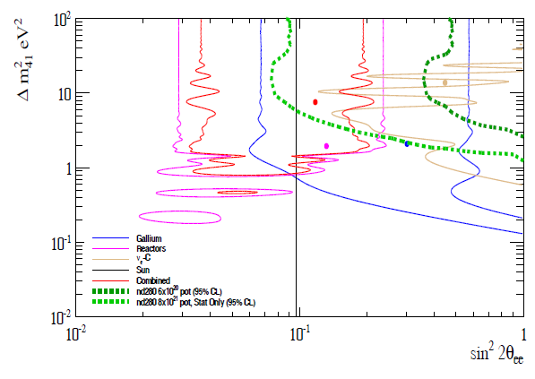
Sterile neutrino search
ETHZ
Search of ν_{e} disappearance
  ν_{e}→ν_{s} in “3+1 model”
Use of electron selection algorithm developed by ETHZ
Sensitivity study has been done
The fit result from data will be obtained soon
T2K Sensitivity

Slide 16
Oscillation analysis
Fatih Bay (ETHZ)
Combining data from the ND280, SK, Neutrino flux using NA61.
Precision measurement of Δm²₂₃ (10⁻⁴ eV²) and sin²2θ₂₃ (0.01)
Strengthen the interpretation of non-zero θ₁₃ results.
ETHZ takes part of physics data analysis group (VALOR, in collaboration with Liverpool, Oxford and Barcelona)
  3-flavour disappearance oscillation analysis.
Notes:
Observation of disappearance oscillations by the atmospheric and long-baseline experiments depends strongly on the angle (23) and mass splitting (m223) oscillation parameters, and hence proving that neutrinos are massive. Also, improving the results of the oscillation parameters provide a crucial impact on neutrino mass models and the interpretation of recently discovered non-zero 13 oscillation parameter measured in terms of appearance.

Slide 17
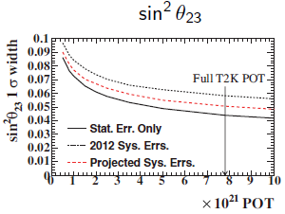
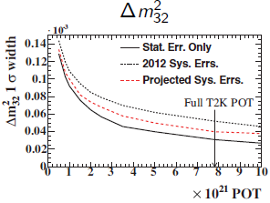
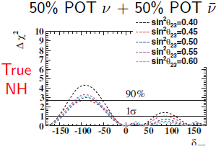
Future plan
Total POT approved is 750kW x 5x10⁷s = 7.8x10²¹POT
  so far 0.66 x 10²¹POT
Accelerator/beamline upgrades as early as possible
  220 kW operation in 2013, integrated 6.7 · 1020 POT to date
  Linac upgrade to be completed this year. Expect up to 400 kW
  Planned MR upgrade by 2018 (depends on funding). Up to 750 kW
Updated T2K main goals are
  Precision measurements of ν_{μ} disappearance
    δ(sin²θ₂₃)~±0.05 ~ δ(sin²2θ₂₃)~0.01
    δ(Δm₂₃²)~<10⁻⁴eV²
  Precision measurements of ν_{e} appearance
    Syst err ~ 5% (~10%) for nu(anti-nu) to be less than stat error
  Initial measurement of CP violation
In addition,
  Various precious data of interaction cross sections
  Other topics
We request anti-ν test run of 1x10²⁰POT (25.3day at
220kW) data in 2014
Near detector improvements are under discussion
7.8e21pot

Slide 18
Summary
Measured non-zero θ₁₃ with 7 σ significance by observation of ν_{μ} → ν_{e} oscillations
Disfavouring region of δ_{CP} in combination with reactor results
Also measurement of ν_{μ} disappearance which favours maximal mixing
Accelerator-based oscillation experiments at “atmospheric” baselines are now precision measurements
Measurements of neutrino cross sections (CC incl., CCQE)
More statistics in near future

Slide 19
Backup

Slide 20
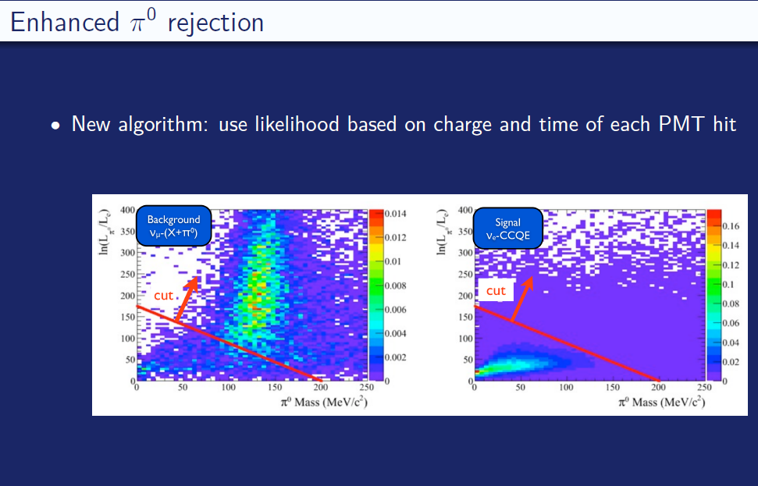

Slide 21
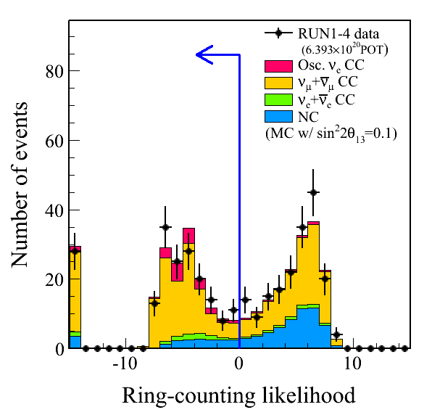
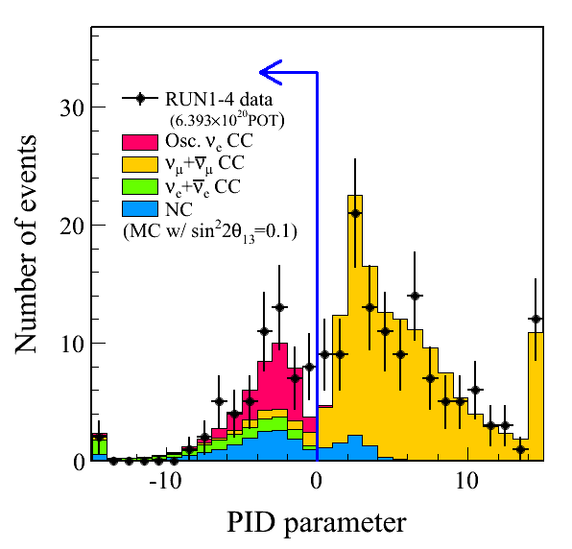
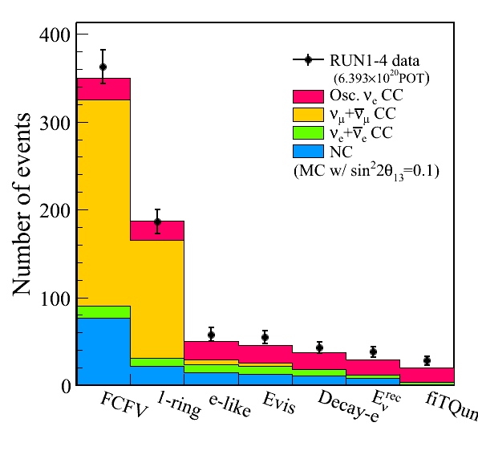
ne-appearance selection
E_{vis} > 100 MeV
Veto hits < 16
Fully contained
(Fid. Vol. = 200 cm)
Single ring
Muon-like
p_{μ} > 200 MeV
0 or 1 Michel e
28 events selected
while 4.92+-0.55 events expected without oscillation.

