Slide 1


MICE RF Cavity Simulations and Multipactor
Tianhuan Luo, LBNL

Slide 2
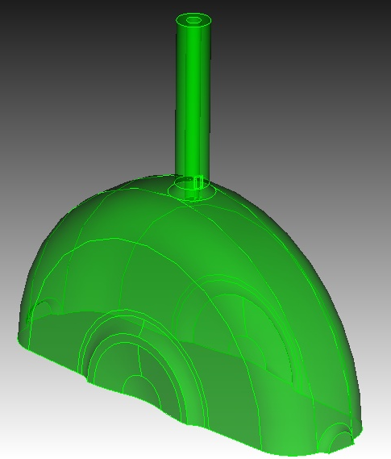
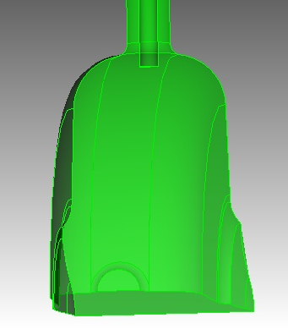
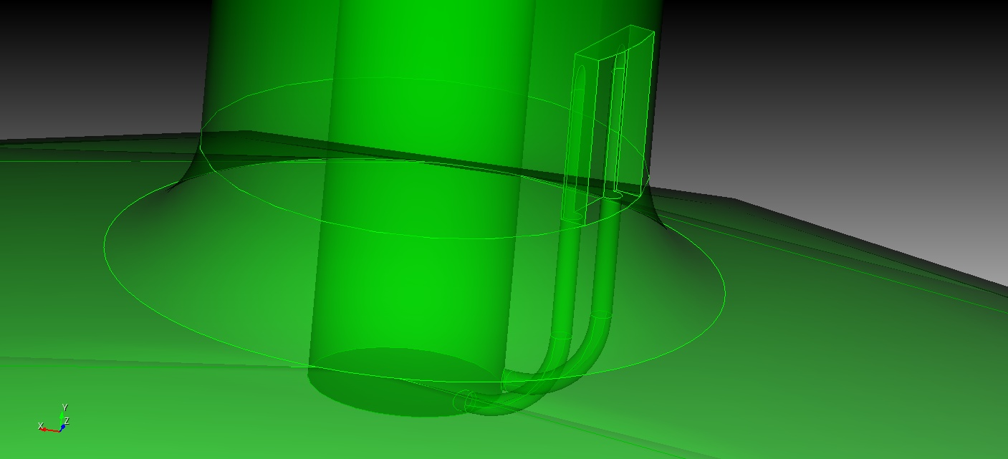
RF Modeling of Cavity
The cavity model is built on the CAD drawing, including the detailed geometries of curved Beryllium windows, port extrusion, loop coupler and coaxial waveguide.
The RF simulation is carried out with SLAC ACE3P code.
  Omega3P solves the cavity eigenmode and the coupling between the cavity and the waveguide.
  S3P solves the scattering parameters and the power feeding of the cavity.

Slide 3
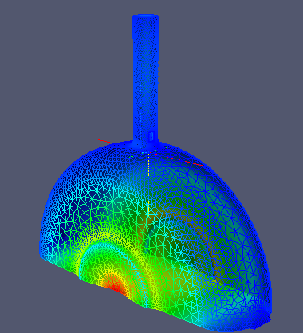
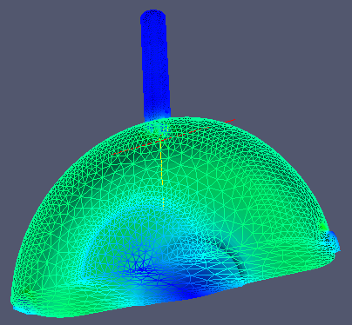
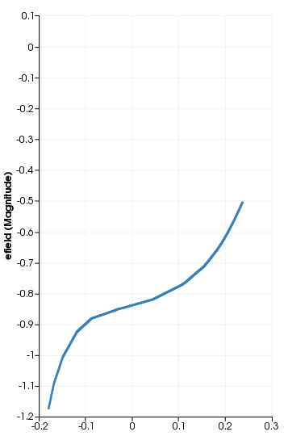
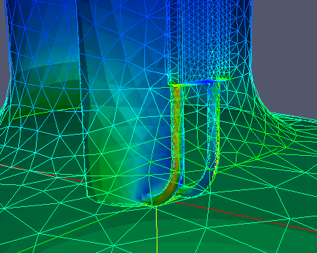
RF Simulation Results (1)
E Field Magnitude
B Field Magnitude
Resonant frequency by Omega3P:
201.900 MHz
Copper cavity with beryllium windows:
Q0=51572
For a coupling angle at 15 degree:
Qe=49340
coupling beta=1.05
Reflection=0.038
For relativity beta=0.85:
R/Q= 354 Ohm
Ez along beam axis
Maximum heating at loop coupler

Slide 4
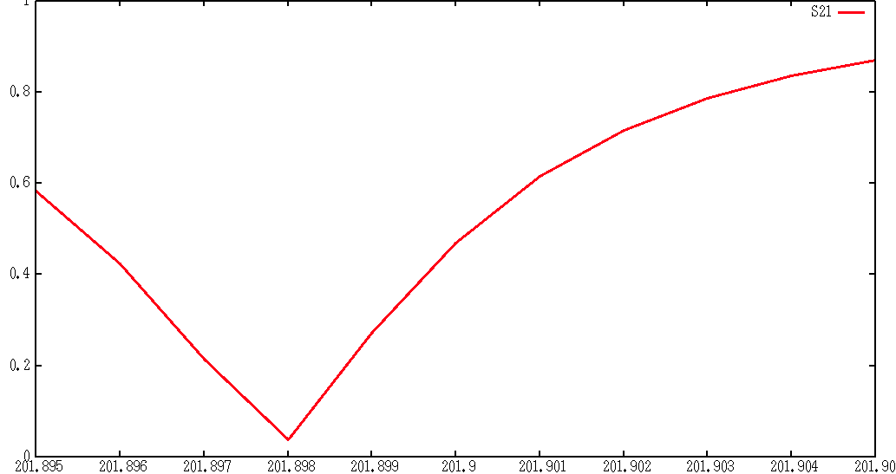
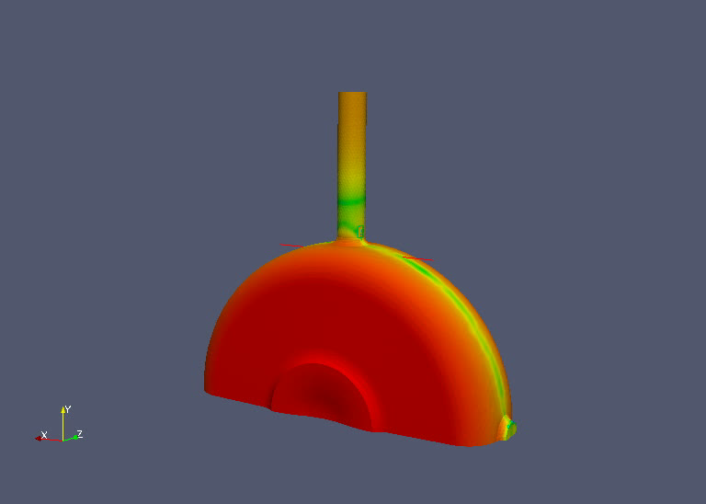
RF Simulation Results (2)
The coupling angle is set at 15 degree, which is about critical coupling.
The frequency scan of S21 by S3P shows the resonant frequency seen by power supply is 201.898 MHz.
For the later multipacting simulation, it is important to solve the EM field in the cavity correctly. By setting the proper “impedance” and “waveguide” boundary condition, the power is fed into cavity and dissipated on the cavity wall. This “propagation” part of the EM field is especially important for the multipacting simulation in the waveguide and at coupler region.
S21
201.898 MHz
Frequency (MHz)

Slide 5
Multipacting issue for MICE Cavity
Multipacting is a phenomenon in RF device when secondary electron emission in resonance with an alternating electric field leads to exponential electron multiplication.
Multipacting can lead to surface heating, out gassing, RF power reflection, RF power absorption, RF breakdown and even unrecoverable cavity damage. In the cavity conditioning, MP is identified by vacuum loss and X-ray radiation increase.
MICE operates with a long RF pulse of 1 ms, corresponding to 2e5 RF cycle at 200 MHz frequency, thus MP is an important issue.
MICE cavity will be operated in strong magnetic fields, which will significantly change the trajectory of emitted electrons and the MP behavior of the cavity.

Slide 6
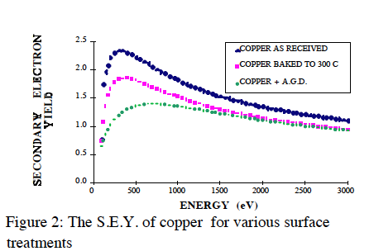
Multipacting simulation by Track3P
Track3P is the particle tracking code of SLAC ACE3P suite, a parallel computing code ran NERSC. It has been bench-marked in several RF cavities.
  Import the RF field results fro Omega3P or S3P.
  Add the external DC electric or magnetic field.
  Track the emitted electron motion over several RF period and record the trajectory of resonant electrons
The potential dangerous MP is identified from the resonant electrons record.
  Surface material secondary electron property: Second Emission Yield (SEY) data.
  Resonant trajectory with impact energy whose SEY > 1
  Calculate Enhancement Counter (EC):

Slide 7
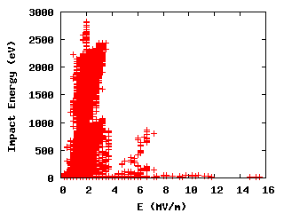
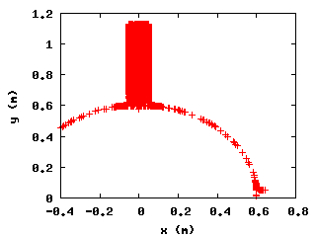
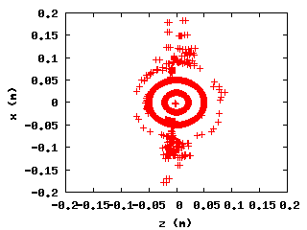
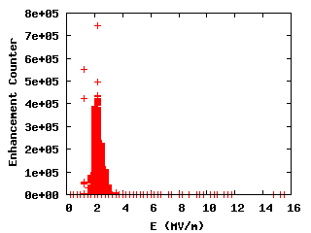
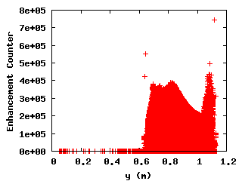
MP without external field
Impact Energy Spectrum
Impact Location
EC Spectrum

Slide 8
MP without external field
Without external B field, most dangerous MP happens in the coaxial waveguide, at E ~ 1.75 MV/m to 3.75 MV/m, or P ~ 35 KW to 159 KW.
The simulation result is consistent with previous MUCOOL prototype cavity experiment results.

Slide 9
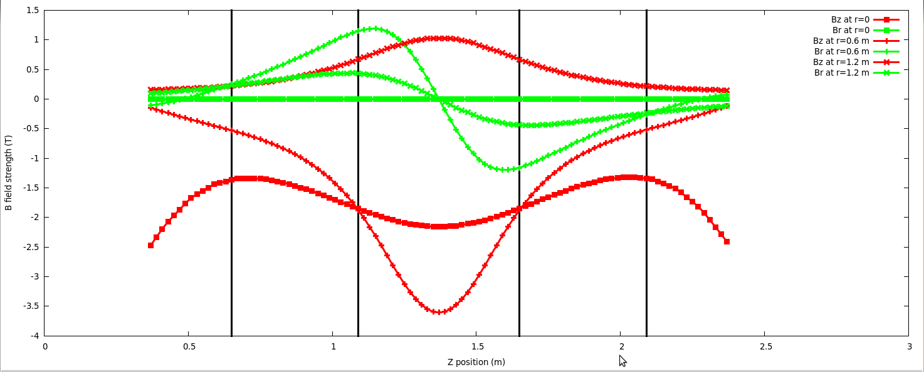
Magnetic Field in MICE RFCC
The MICE Cavities are operated in a series of superconducting magnet. Strong external magnetic field change the MP significantly. Four different B field configurations for MICE operation.
The external B field mapping is provided by Dr. Heng Pan, including all the CC, AFC and SS magnets. The effect from the magnetic shielding is not considered here.
Inner cavity
Outer cavity
B field plot at r=0 (center), r=0.6 m (RF coupler) and r=1.2 m (RF window).

Slide 10
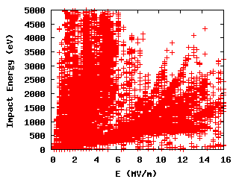
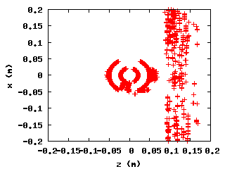
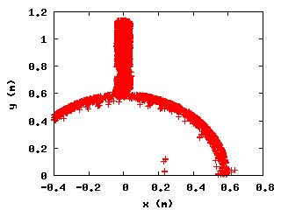
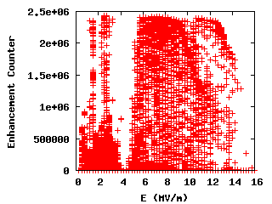
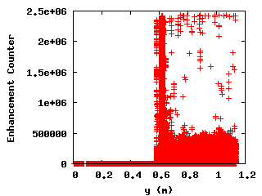
MP For Inner Cavity
Impact Energy Spectrum
Impact Location
EC Spectrum

Slide 11
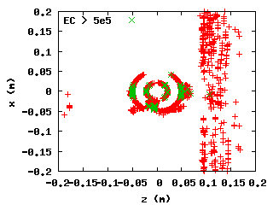
MP for Inner Cavity (con’t)
Compared with no B field situation, MP in the inner cavity become more serious:
MP band has extended to the energy level from 0 to 14 MV/m, except a narrow region around 4 MV/m. Besides in the coaxial waveguide, strong MP also appears in the RF coupler region.
The maximum enhancement counter has increased significantly. 1.35^49~2.43e6, which means the emitted electrons with the largest SEY reach the resonant condition within a few RF cycles with a MP order of 1.

Slide 12
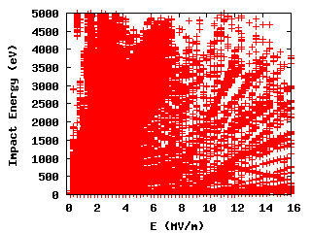
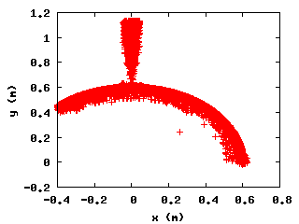
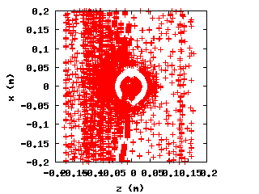
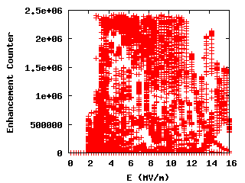
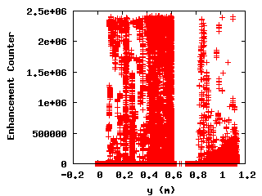
MP for Outer Cavity
Impact Energy Spectrum
Impact Location
EC Spectrum

Slide 13
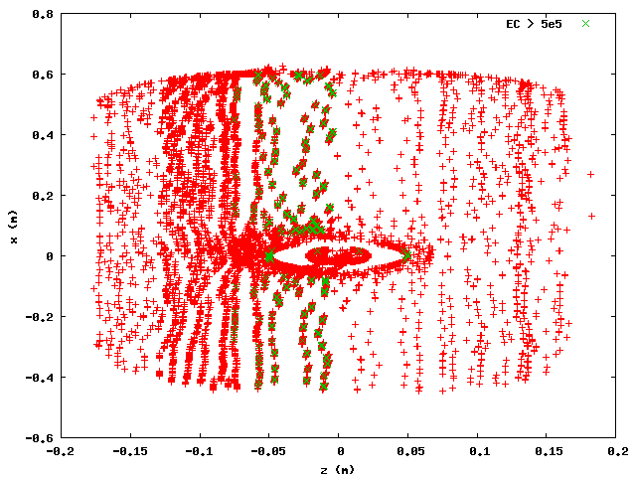
MP for Outer Cavity (con’t)
The same as the inner cavity, MP in the outer cavity is much stronger than the no B field situation:
MP band has extended to all the energy level from 2 to 16 MV/m.
The maximum enhancement counter has increased significantly. 1.35^49~2.43e6, which means the emitted electrons with the largest SEY reach the resonant condition within a few RF cycles with a MP order of 1.
MP still shows up in the coaxial waveguide but not the coupler region. Strong MP also appears along the equator in the cavity.

Slide 14
Summary
A RF model of MICE 201 MHz cavity has been built from CAD. RF properties of the cavity has been simulated by Omega3P and S3P.
Multipacting of the cavity has been studied by Track3P, without magnetic field and with the B field of MICE cooling channel. Cavities at different locations show different MP patterns due to different local B fields. In general, we expect to see more MP effect when cavities operated in MICE cooling channel: the MP band grows wider and the maximum EC increases significantly.
Based on the previous experience and the MP simulation, the RF coupler has been redesigned. To suppress the MP, TiN coating has been applied on the outer conductor of coaxial line and the coupler loop of the MICE prototype cavity, which will be tested soon at Fermilab MTA.

