Slide 1
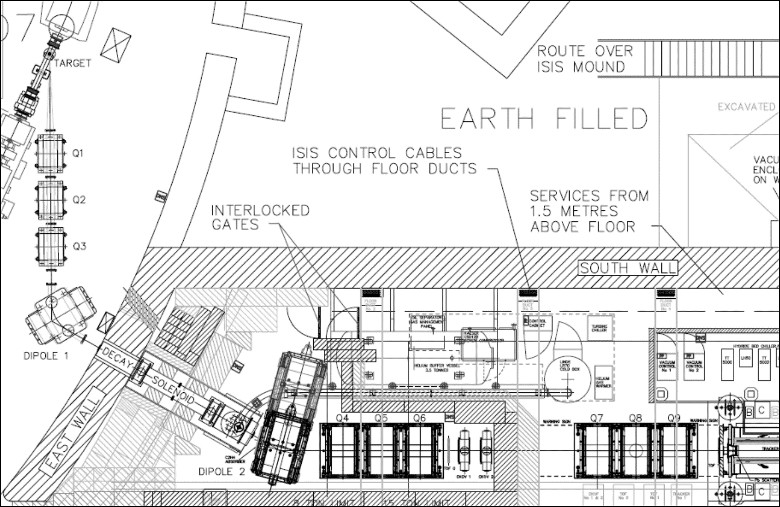
Beamline Update
Adam Dobbs, MICE CM38
Feb 2014

Slide 2
Contents
Recent and Upcoming Activities
Target
Conventional magnets
Decay Solenoid
Proton Absorber
Summary

Slide 3
Recent Activity
2013 was relatively quiet for the beamline...
4V activation run – Feb 13
Shifter training runs – July 13
TOF calibration runs – Aug 13
EMR commissioning runs and TOF calibration - Oct 13
Target higher rate commissioning run - Jan 14
BPS tripped ISIS for 20mins in summer, and for 1 hr during autumn due to blown fuse

Slide 4
Upcoming Activity
BLOC training - Easter shutdown 14
  BLOC volunteers are always appreciated – please consider if you can serve the experiment in this way and contact Henry Nebrensky
Activation run at higher target rate – June 14
Pneumatic proton absorber installation - Easter 14
Since last summer, have the requirement that target be exercised monthly to give us warning of issues

Slide 5
Target: Status and Increased Rate
Target mechanism in ISIS continues to work fine, 2.5 years after installation – quite a triumph!
Need to consider future however, new ‘S’ series stator
Plan to double the actuation rate with current stator, to 0.8Hz in response to ISIS' request
Jan commissioning run without beam was a success, no problems encountered. Need to test with beam and check activation in sync
Need to test full beamline chain with increased dip rate before end of Summer 14
See Paul Smith talk for details

Slide 6
Target: Laser Fibres
Optical readout levels found to be decaying
Believed due to radiation damage to plastic patch fibres local to target in ISIS
Could not diagnose immediately in the summer because of higher activation in ISIS SP7 (no radiation surveys done between 2010 and 2013... point of concern, too long a gap)
Changed fibres in Nov 13, which resolved problem
All fibres now replaced, with armour cladding
Remains an issue for the longer term

Slide 7
Target: New Stator
Development of S-series target stator continues; has passed 10M actuations milestone!
Intent is that ISIS will qualify the S-series target design to 10M
actuations, but each assembly will be run-in in R78 to some level; rather than existing agreement of parallel running
Again, see Paul Smith talk

Slide 8
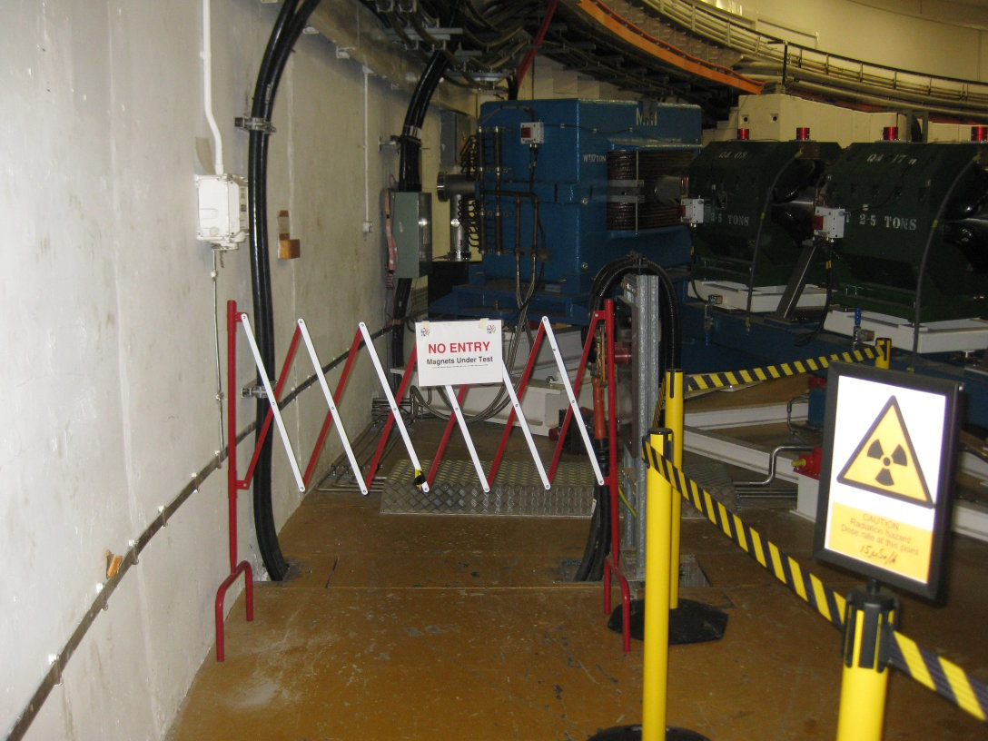
Conventional Magnets
Behaving themselves pretty well
"Magnet-On" warning lamp system completed
Mystery of Q4 Earth Leakage trips partly solved (see eLog entry 2552)
All trips seen occurred while magnet overheating because of interruption to the chiller
Chiller behaviour understood, not relevant to increased Step IV heat load
Magnet performance a function of British weather...

Slide 9
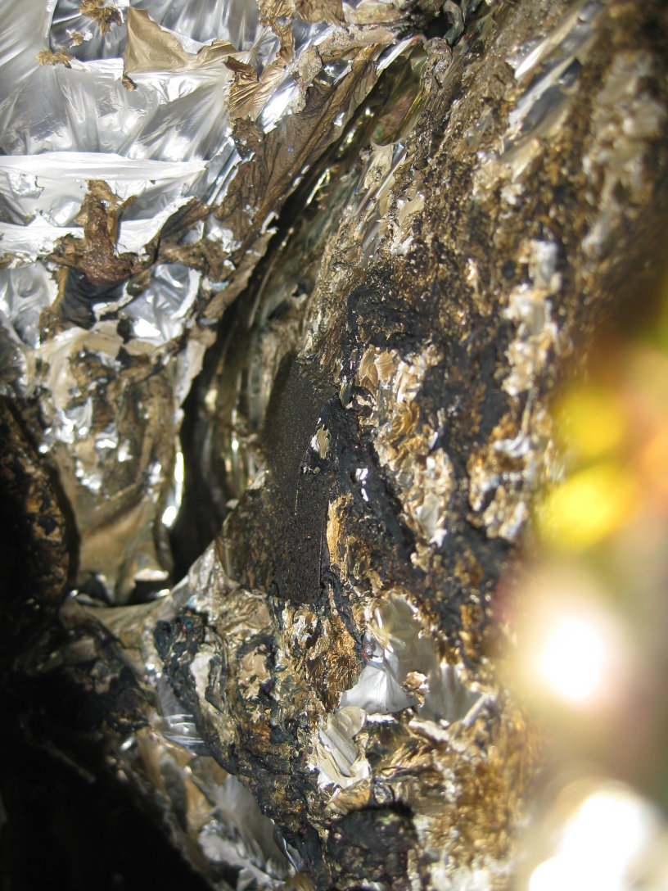
Decay Solenoid: Damage report
Damage suffered last summer to current lead
Superconducting ‘tail’ between the helium vapour cooled copper current lead, and SC wire going to the magnet melted
Control crate powered off before system expert had finished using it
Has lead to a long off time for DS ~ 1 year

Slide 10
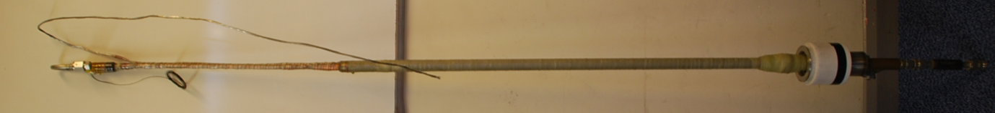
Decay Solenoid: Repairs undertaken
SC wire replaced, involved removal of current led turret, solder new SC tail on, and replacement of copper lead
Vapour cooled pipe had to be cut and new VCR joint welded in position to reattach. Joint has now been pressure tested
Repair work also included removal and replacement of some voltage taps and MLI in the area.
Crate replaced (aside: need to watched cleanliness of hall!)
Vapour cooled current lead removed from turret

Slide 11
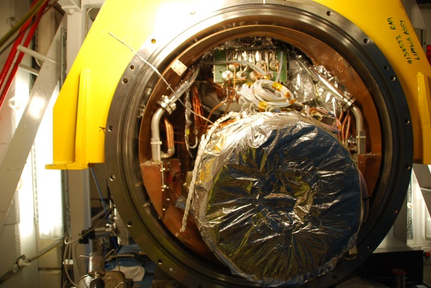
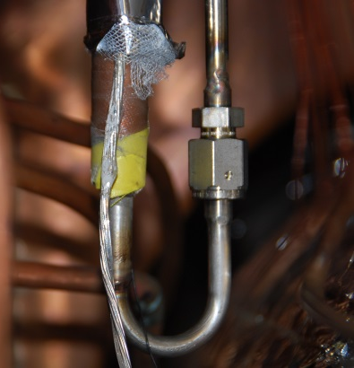
Decay Solenoid: Status and Plans
DS vacuumed out and cold
Power up magnet in March to check repair job
Install new quench detector
Install the new power supply
Some fridge maintenance and fridge control PC needed
New VCR Joint

Slide 12
Decay Solenoid: Update from last week
Helium flow-meter on the DS radiation-shield circuit found to be faulty, requires repair or replacement
Following cleaning of the helium within the Linde fridge via its cold-trap, a nitrogen leak into compressor circuit was also discovered.
Leak is quite large, nitrogen content increasing from 4.5ppm to ~70ppm in the first 24 hour period following cold-trapping
Bottom line is that the DS cool-down is further delayed from last Monday (17th Feb) by at least 3 weeks, with an earliest start date of 10th march

Slide 13
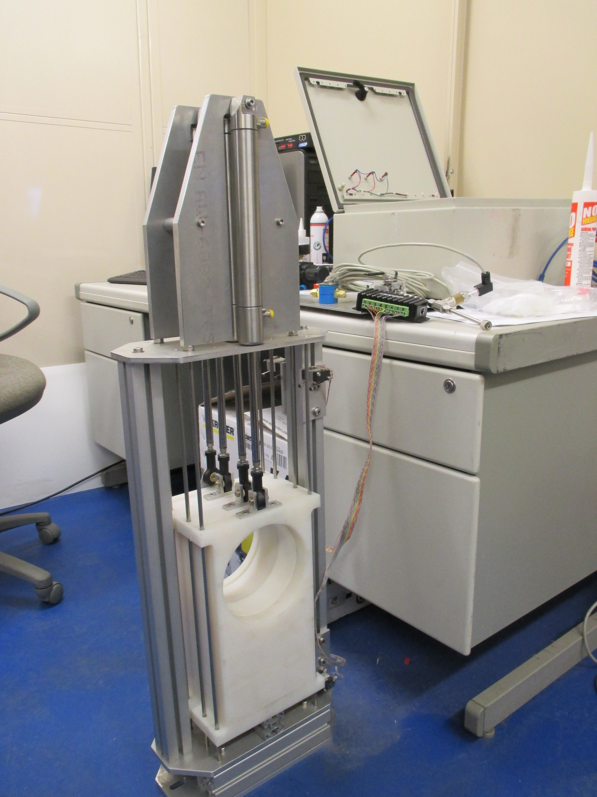
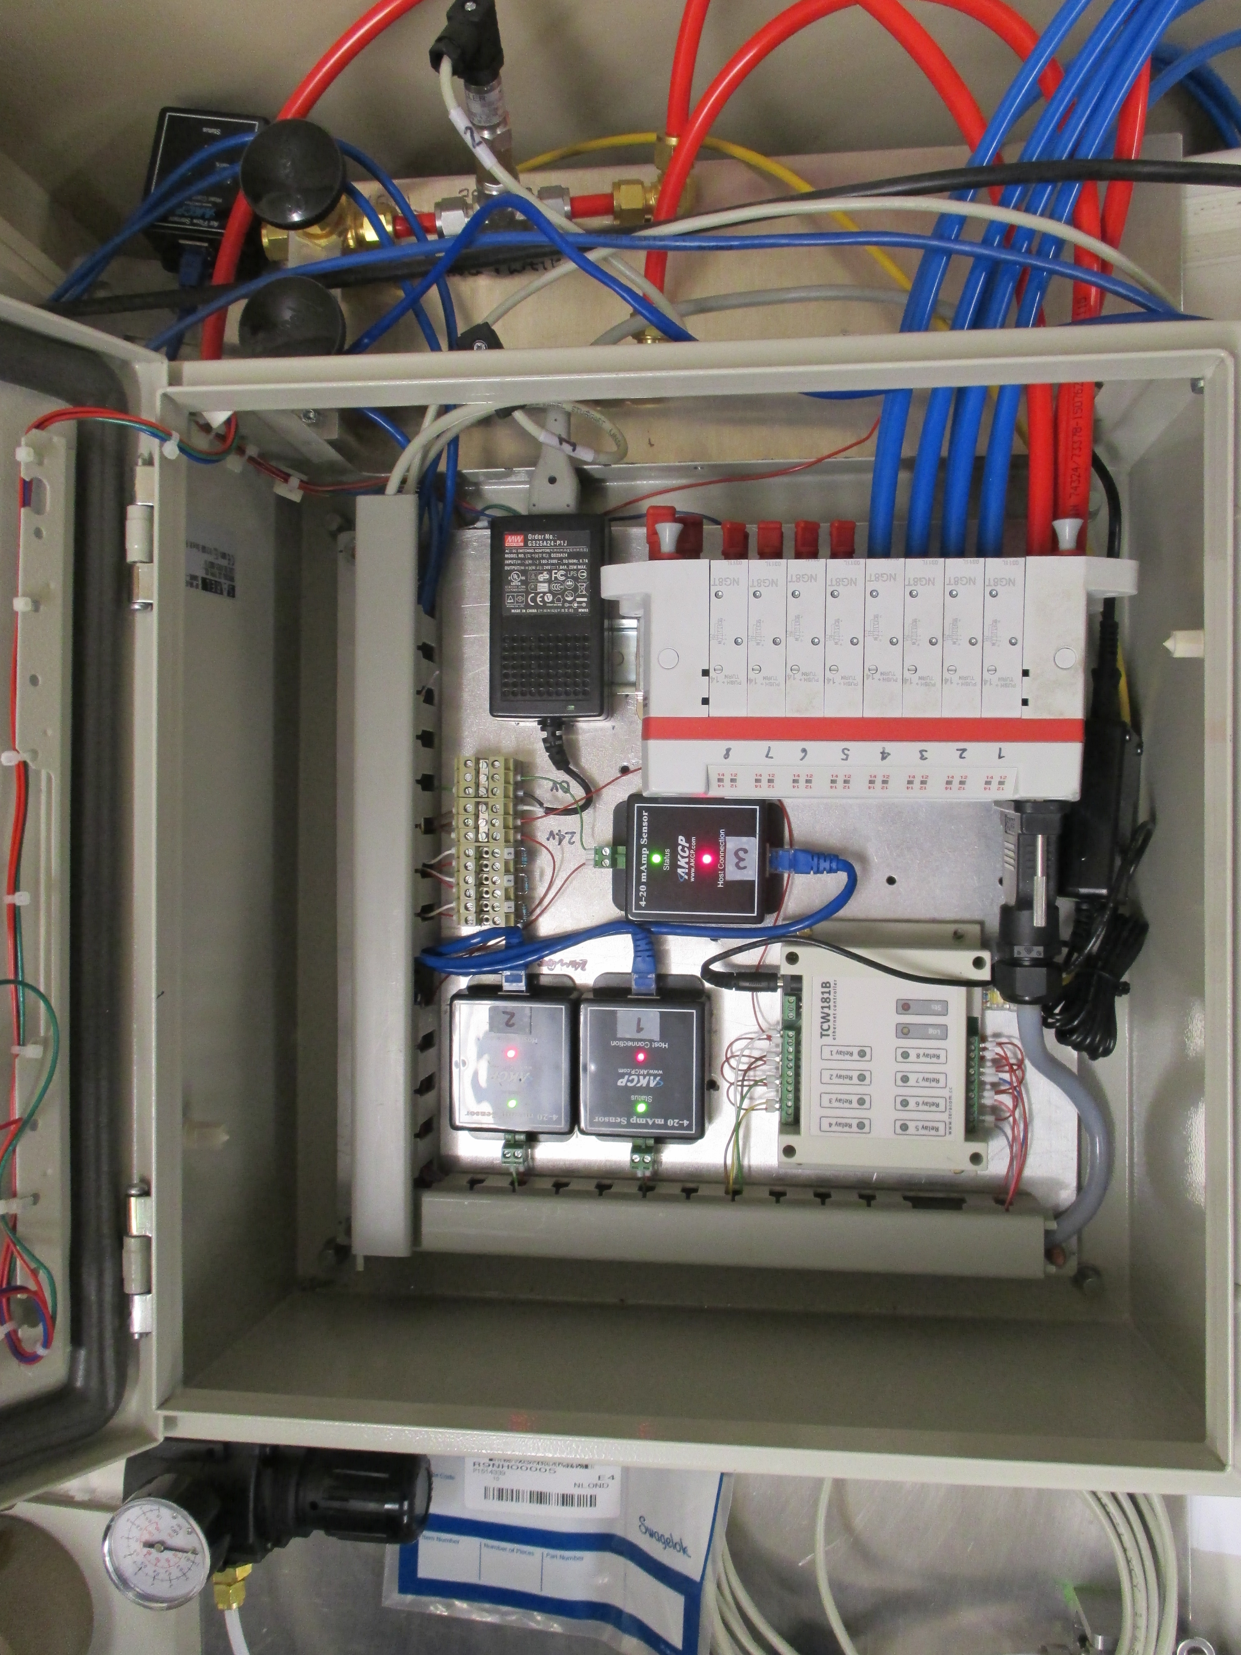
Proton Absorbers
Pneumatic absorbers nearly complete
EPICS-based control GUI
Some modification to control box for connectors needed
Testing
Install during ISIS Easter shutdown

Slide 14
Summary
Target looking in good shape, higher rate seems good but needs full testing, fibre decay issue needs a long term solution
Conventional magnets are all well
DS suffered damage, lessons to learn, but repairs well underway
New proton absorber system almost ready
Age-related fragility of the equipment is becoming a bigger issue
Response includes increased organisation:
  More detailed shifter training (two full days) introduced last year
  Regular "practice runs" (not necessarily of the whole beamline together)
  More organised BLOC training, with more coverage of non-target systems
  Higher priority needed for maintenance activity e.g. cleaning the Hall
See also Beamline Step IV readiness talk

Slide 15

Experiment

Slide 16
Questions

