Slide 1



Analysis overview & “The Missing Physics”
1/14
V. Blackmore
CM38
23rd February 2014

Slide 2
Purpose of this talk...
2/14
You will hear about
  Our (physics) readiness for carrying out Step IV
  Our (physics) preparations for Step V or Step VI
This talk is what you will not hear about.
  If there’s something that is mentioned in none of these talks, then it truly is “missing physics”
  Everyone is encouraged to think about their favourite physics topic and what we are (or are not) doing to satisfy that.

Slide 3
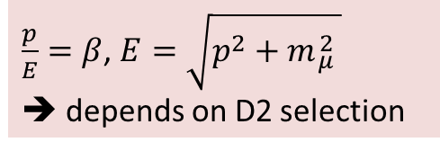
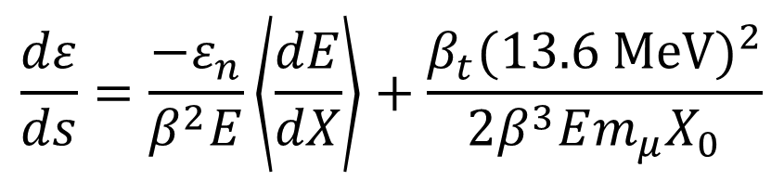
Analysis at Step IV
3/14
A full and definitive exploration of the ionisation cooling equation
+ Proof that we can predict it
+ Proof that we can measure it
Depends on upstream beam line (mostly diffuser)
Depends on magnetic lattice
Ionisation Cooling
Multiple scattering
$$\frac{dε}{ds}=\frac{−ε_{n}}{β^{2}E}\left\langle \frac{dE}{dX}\right\rangle +\frac{β_{t}{(13.6 \text{MeV})}^{2}}{2β^{3}Em_{μ}X_{0}}$$
Measure a change in emittance
$\frac{p}{E}=β$, $E=\sqrt{p^{2}+m{}_{μ}^{2} }$
➔ depends on D2 selection
Depends on material
Depends on particle species → backgrounds!

Slide 4
Analysis at Step IV
4/14
famous last words!
“Sounds simple enough...”
Depends on upstream beam line (mostly diffuser)
Depends on magnetic lattice
Ionisation Cooling
Multiple scattering
$$\frac{dε}{ds}=\frac{−ε_{n}}{β^{2}E}\left\langle \frac{dE}{dX}\right\rangle +\frac{β_{t}{(13.6 \text{MeV})}^{2}}{2β^{3}Em_{μ}X_{0}}$$
Measure a change in emittance
$\frac{p}{E}=β$, $E=\sqrt{p^{2}+m{}_{μ}^{2} }$
➔ depends on D2 selection
Depends on material
Depends on particle species → backgrounds!

Slide 5
Step IV Operating States
Presented as part of the “analysis wishlist” discussion on Sunday
5/14
Diffuser
SS1
FC
SS2
EMR
CKOVs
7.5—8m
TOF0
TOF1
Tracker planes
Absorber
TOF2
KL
No fields
No/empty absorber
With absorber
No fields, no absorber
No fields, LH2
No fields, solid absorber
Fields, no absorber
Fields, LH2
Fields, solid absorber
LiH
Fields (Flip/Solenoid mode)
Plastic, Al,...
LiH wedge
Noble Goal: Always have a Monte Carlo before taking data!

Slide 6
Presented as part of the “analysis wishlist” discussion on Sunday
6/14
PID and straight track reconstruction
indicates “influences”
Detector alignment
NB: Each consists of many sub-analyses.
Multiple scattering: high-Z
Background study
Multiple scattering: low-Z
No fields, no absorber
No fields, LH2
No fields, solid absorber

Slide 7

Presented as part of the “analysis wishlist” discussion on Sunday
7/14
PID and straight track reconstruction
indicates “influences”
Detector alignment
NB: Each consists of many sub-analyses.
Multiple scattering: high-Z
Background study
Multiple scattering: low-Z
No fields, no absorber
No fields, LH2
No fields, solid absorber
Fields, no absorber
Full track reconstruction & PID
Measure $ε_{n},p,E$ of input beams
Characterise lattice

Slide 8
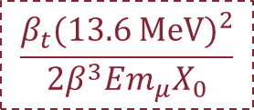
Presented as part of the “analysis wishlist” discussion on Sunday
8/14
PID and straight track reconstruction
Detector alignment
Repeat for each type of absorber: liquid, disc or wedge
Multiple scattering: high-Z
Background study
Multiple scattering: low-Z
No fields, no absorber
No fields, LH2
No fields, solid absorber
Fields, no absorber
Fields, LH2
Fields, solid absorber
Full track reconstruction & PID
$$\frac{β_{t}{(13.6 \text{MeV})}^{2}}{2β^{3}Em_{μ}X_{0}}$$
Measure $ε_{n},p,E$ of input beams
Characterise lattice
Heating term
Background study
Multiple scattering: low-Z

Slide 9
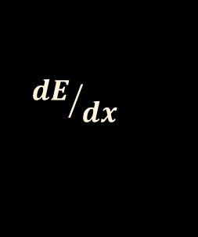
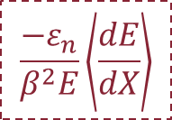
Presented as part of the “analysis wishlist” discussion on Sunday
9/14
PID and straight track reconstruction
Detector alignment
Repeat for each type of absorber: liquid, disc or wedge
Multiple scattering: high-Z
Background study
Multiple scattering: low-Z
No fields, no absorber
No fields, LH2
No fields, solid absorber
Fields, no absorber
Fields, LH2
Fields, solid absorber
Full track reconstruction & PID
Cooling term
$$\frac{−ε_{n}}{β^{2}E}\left\langle \frac{dE}{dX}\right\rangle$$
Measure $ε_{n},p,E$ of input beams
Characterise lattice
Heating term
Background study
Multiple scattering: low-Z
Background study
$${dE}/{dx}$$

Slide 10
Presented as part of the “analysis wishlist” discussion on Sunday
10/14
PID and straight track reconstruction
Detector alignment
Repeat for each type of absorber: liquid, disc or wedge
Multiple scattering: high-Z
Background study
Multiple scattering: low-Z
No fields, no absorber
No fields, LH2
No fields, solid absorber
Fields, no absorber
Fields, LH2
Fields, solid absorber
Full track reconstruction & PID
Cooling term
Measure $ε_{n},p,E$ of input beams
Characterise lattice
Heating term
Background study
Multiple scattering: low-Z
Background study
$${dE}/{dx}$$
Equilibrium emittance & ionisation cooling

Slide 11
11/14
PID and straight track reconstruction
What you won’t hear about today...
Detector alignment
+ All of the calibrations/configuration/systematic analyses that make these possible!
Multiple scattering: high-Z
Background study
Multiple scattering: low-Z
No fields, no absorber
No fields, LH2
No fields, solid absorber
Fields, no absorber
Fields, LH2
Fields, solid absorber
Full track reconstruction & PID
Cooling term
Measure $ε_{n},p,E$ of input beams
Characterise lattice
Heating term
Background study
Multiple scattering: low-Z
Background study
$${dE}/{dx}$$
Equilibrium emittance & ionisation cooling

Slide 12
Presented as part of the “analysis wishlist” discussion on Sunday
12/14
PID and straight track reconstruction
Progress (MC only):
“Circle of Glory”
“Circle of Hope”
The proportion of green is a “guesstimate”
Detector alignment
“Circle of Gloom”
Multiple scattering: high-Z
Background study
Multiple scattering: low-Z
No fields, no absorber
No fields, LH2
No fields, solid absorber
Fields, no absorber
Fields, LH2
Fields, solid absorber
Full track reconstruction & PID
Heating term
Cooling term
Measure $ε_{n},p,E$ of input beams
Characterise lattice
+ all of this influences Step V, Step VI...
Background study
Multiple scattering: low-Z
Background study
$${dE}/{dx}$$
Equilibrium emittance & ionisation cooling

Slide 13
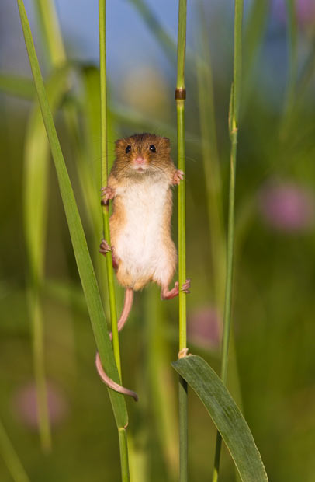
Summary
13/14
Photograph’s from “The Secret Life of Harvest Mice”, taken by Jean-Louis Klein and Marie-Luce Hubert
Thank you to
Asfandiyarov, Blondel, Carlisle, Cobb, Dobbs, Drielsma, Hanlet, Kaplan, Lagrange, Leonova, Long, Middleton, Nugent, Orestano, Overton, Pasternak, Pidcott, Popovic, Rajaram, Rogers, Santos, Soler, Snopok, Speirs, Taylor, Uchida
who have balanced physics analyses with their other responsibilities and provided us with support.

Slide 14
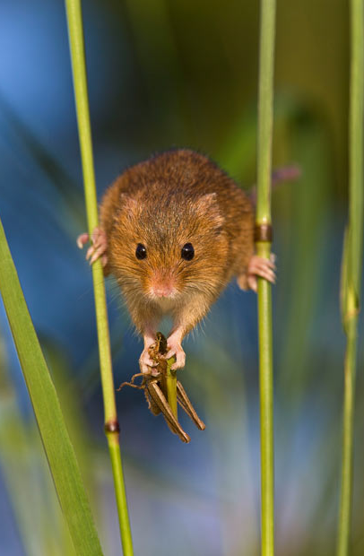
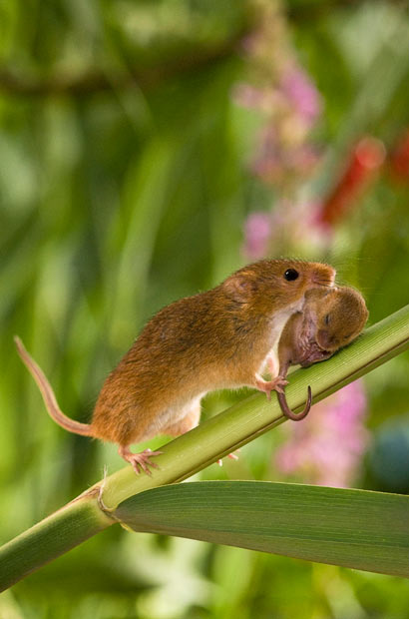
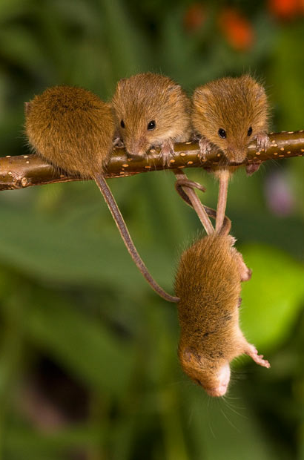
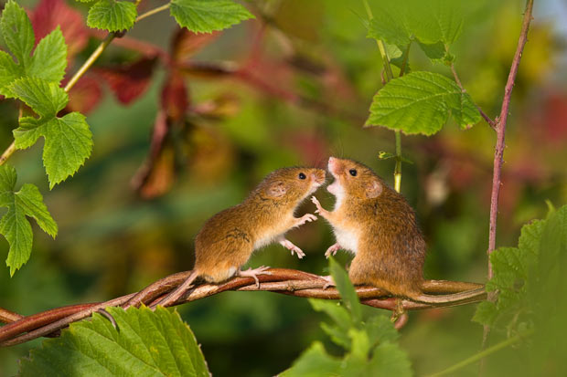
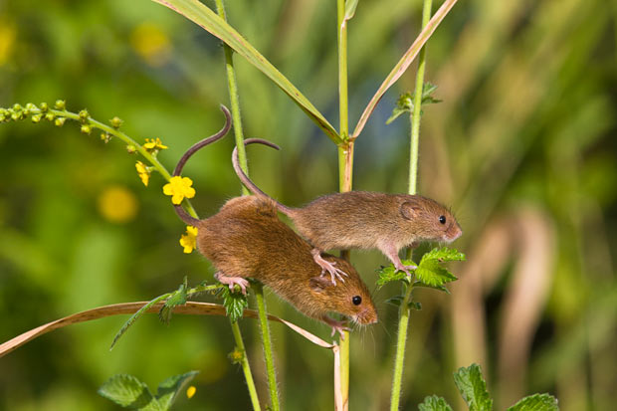
Summary
14/14
Photograph’s from “The Secret Life of Harvest Mice”, taken by Jean-Louis Klein and Marie-Luce Hubert
Everyone is welcome to do physics, no which mouse you are
As seen by a common harvest mouse
There’s a bit of physics for everybody
With everyone’s support, we’ll get to our goals
Analysis meetings are full of discussion

