Slide 1
The AWAKE Project at CERN
BI Technical Board for the AWAKE Project
29 January 2014

Slide 2
AWAKE
AWAKE – A Proton Driven Plasma Wakefield Acceleration Experiment at CERN
Proof-of-principle R&D experiment proposed at CERN.
→ First beam driven wakefield acceleration experiment in Europe
→ First proton driven PWA experiment world-wide.
Use high-energy protons to generate wakefields in the plasma cell at the GV/m level.
Inject low energy electrons (~ 15 MeV/c) to be accelerated in the wakefield to multi-GeV energy range.
Advantages of using protons as driver: single stage acceleration
  Higher stored energy available in the driver (~kJ)
  Electron/laser driven requires many stages to reach the TeV scale.

Slide 3
Introduction
Proton beam: drive beam
SMI: Modulated in micro-bunches (1mm) after ~several meters drives the axial electric field.
Laser pulse:
1) Ionization of plasma and 2) Seeding of bunch modulation.
Using the same laser for electron photo-injector allows for precise phasing of the e⁻ and p bunches.
Electron beam: accelerated beam
Injected off-axis (on-axis??!!) some meters downstream (upstream??!!) along the plasma-cell.
→ Off-axis: merges with the proton bunch once the modulation is developed.

Slide 4
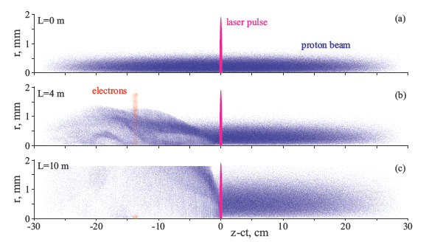
Proton Self Modulation
SPS beam: bunch length of ~12 cm.
For strong gradients: need short proton bunches (order of ~mm)
Modulate a long proton bunch.
  Micro-bunches are generated by a transverse modulation of the bunch density (transverse two-stream instability). Naturally spaced at the plasma wavelength. → Self-modulation instability (SMI).
Distribution of the beams in the plasma cell
Plasma cell position z=0 m
Plasma cell position z=4m
Plasma cell position z=10 m

Slide 5
Time-Scale for AWAKE
 | 2013 | 2014 | 2015 | 2016 | 2017 | 2018 | 2019 | 2020
Proton beam-line
Experimental area
Electron source and beam-line
Installation
Study, Design,
Procurement, Component preparation
Modification, Civil Engineering and installation
Commissioning
Data taking
Data taking
Study, Design,
Procurement, Component preparation
Phase 1
Studies, design
Fabrication
Installation
Commissioning
Phase 2
LS2
18 months
Run-scenario | Nominal
Number of run-periods/year | 4
Length of run-period | 2 weeks
Total number of beam shots/year (100% efficiency) | 162000
Total number of protons/year | 4.86×10¹⁶ p
Initial experimental program | 3 – 4 years

Slide 6
AWAKE Measurement Program
Perform benchmark experiments using proton bunches to drive wakefields for the first time ever.
Understand the physics of self-modulation process in plasma. Compare experimental data with detailed simulations.
Probe the accelerating wakefields with externally injected electrons, including energy spectrum measurements for different injection and plasma parameters.
Study the injection dynamics and production of multi-GeV electron bunches. This will include using a plasma density step to maintain the wakefields at the GV/m level over meter distances.
Develop long, scalable and uniform plasma cells.
Develop schemes for the production and acceleration of short proton bunches for future experiments and accelerators.
Phase 1
Phase 2
||

Slide 7
AWAKE Collaboration – Organization
AWAKE: international Collaboration with 13 institutes
Spokesperson: Allen Caldwell (MPI)
Deputy: Matthew Wing (UCL/DESY)
CERN Project Leader:
Edda Gschwendtner
Experimental Aspects Coordinator:
Patric Muggli (MPI)
Theory&Simulation Coordinator:
Konstantin Lotov (Budker Institute)
Beam Lines (p/e/γ)
Experimental Areas
Infrastructure
Interface p/e/γ/cell
RF gun powering
Plasma cell
Laser
Electron spectrometer
Sec. beam diagnostics
Plasma/beam simulation

Slide 8
Baseline Beam Parameters
Proton Beam | Momentum | 400 GeV/c
 | Protons/bunch | 3 E11
 | Bunch extraction frequency | 0.5 Hz (ultimate: 0.14 Hz)
 | Bunch length | σ_{z} = 12 cm (0.4 ns)
 | Bunch size | σ∗_{x,y} = 200 μm
 | Normalized emittance | 3.5 mm mrad
 | Relative energy spread | Δp/p = 0.35% (0.1?)
 | Beta function | β∗_{x} = β∗_{y} = 4.9m
 | Dispersion | D∗_{x} = D∗_{y} = 0
Electron Beam | Momentum | 15 MeV/c
 | Electrons/bunch | 1.25 E9
 | Bunch length | 2.5 mm (10 ps)
 | Ultimate bunch length | 90 μm (0.3 ps)
 | Bunch size at merging point | σ_{x,y} = 250 μm
 | Normalized emittance | 2 mm mrad
 | Relative energy spread | Δp/p = 0.5 %
Laser Beam | Laser Type | Fiber Ti:Sapphire
 | Pulse wavelength | λ₀ = 780 nm
 | Pulse length | 100 – 120 fs
 | Pulse energy (after compression) | 450mJ
 | Focused laser size | σ₀ = 1 mm

Slide 9
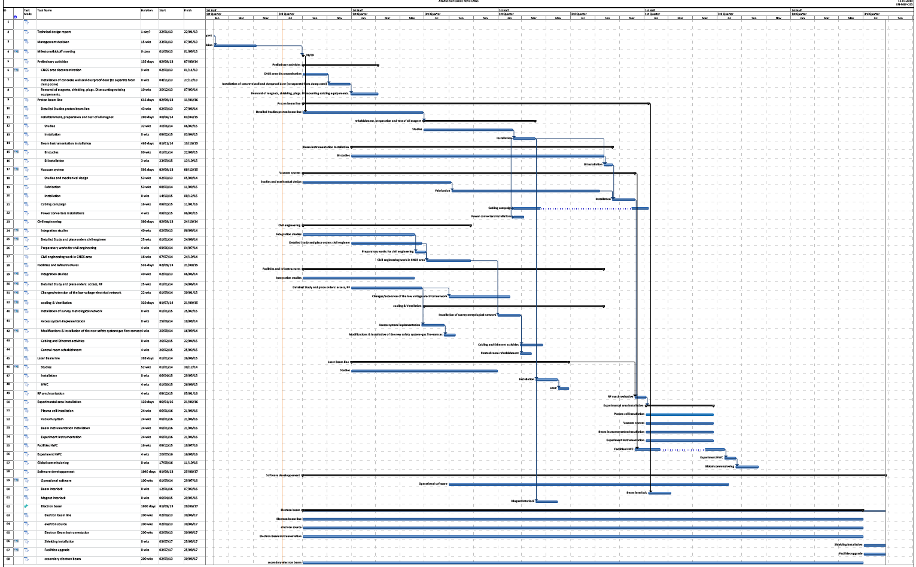
First Preliminary Planning for Proton Beam to Plasma
2013
2014
2015
2016
2017
Cleaning; Removal of shielding, plugs, existing equipment
M. Bernardini, S. Girod
Installation: p-beam magnets
Install.: BI
Integration and mechanical design
Install.: Vacuum
Cabling
Civil engineering: Electron beam and laser tunnel
CV
Install.: Laser
Experimental area installation:
Plasma cell, BI, vacuum, exp. instrumentation, …
1st Critical Milestone:
April/June 2014: start with digging!
Commissioning
End Sept. 2016:
p-beam for physics
Electron
beam

Slide 10
Planning for AWAKE
Until end 2013:
Cleaning of the CNGS area
Until June 2014:
Cut/remove shielding plugs
Maintenance
Work Dose Planning!!
Remove proton beam line
Remove doors
Target separation wall
Laser tunnel drilling
Move crane racks
…
July 2014 – Dec 2014:
Civil engineering for electron tunnel

Slide 11
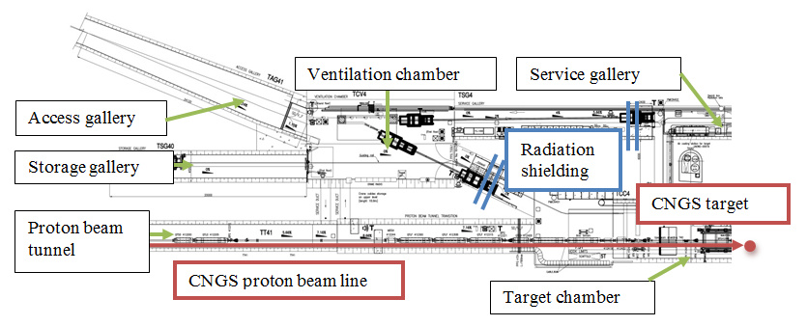
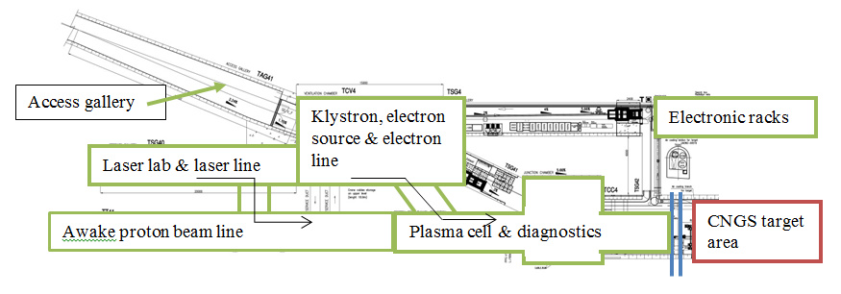
CNGS ➔ AWAKE
CNGS
AWAKE
last ~80 m of proton line will be modified

Slide 12
Layout of the AWAKE Experiment

Slide 13
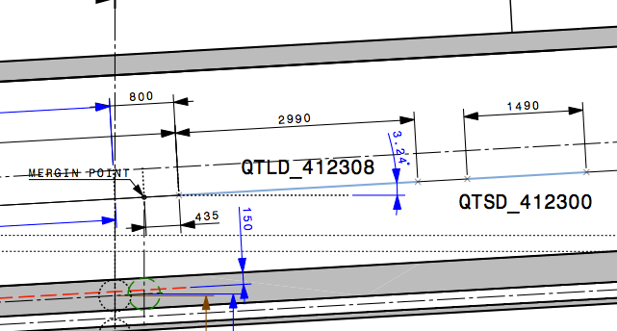
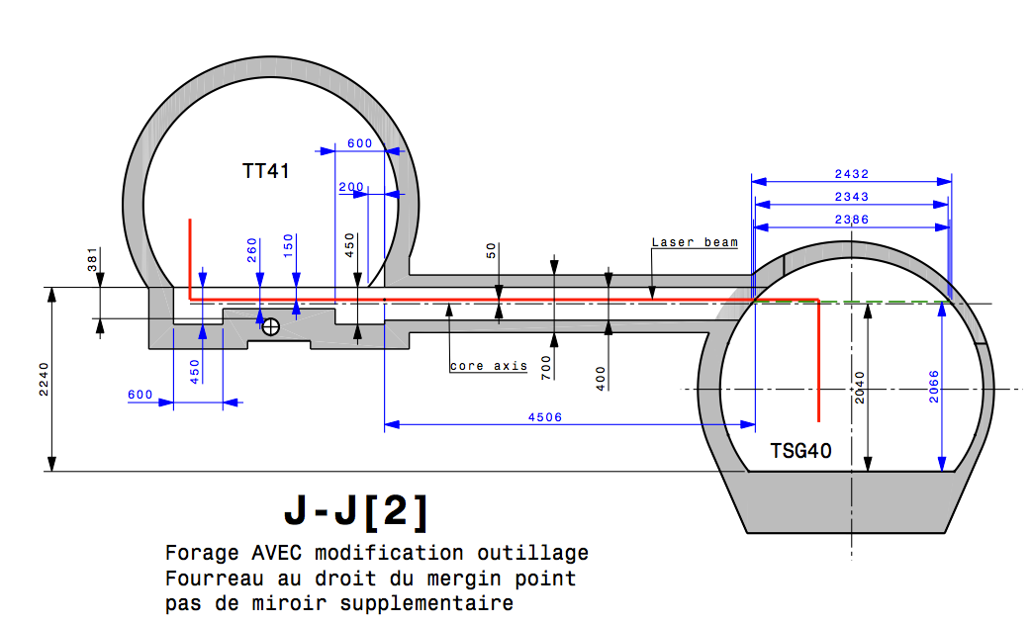
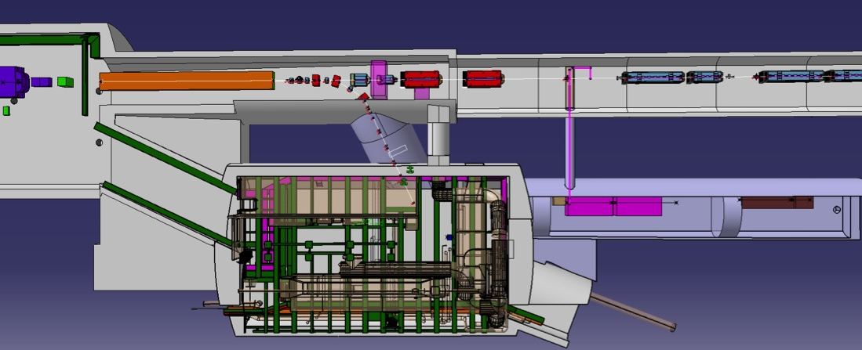
Laser Tunnel
Laser tunnel vers. 1.0:
••
Laser
source

Slide 14
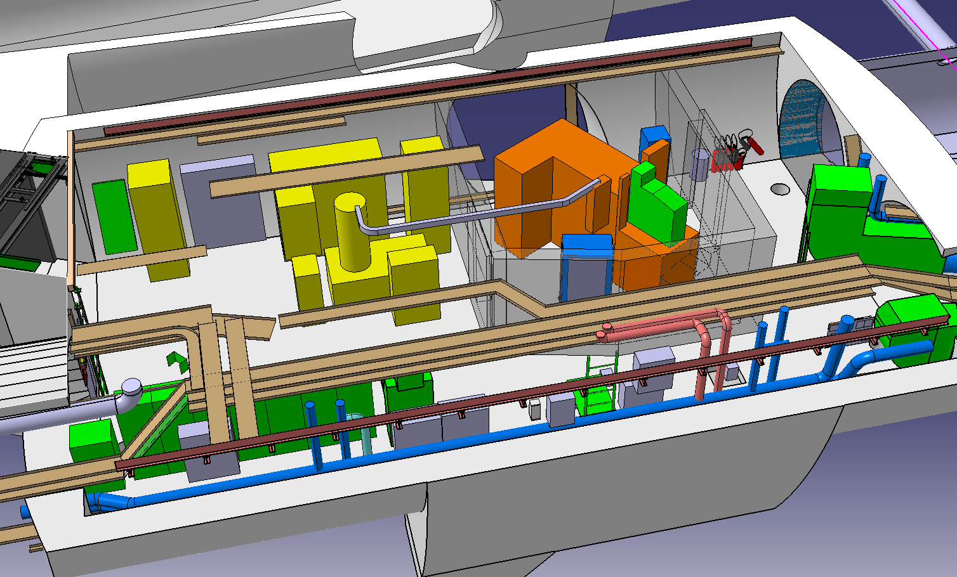
Electron Source Area
S. Girod, V. Clerc
Status today:
CERN will provide RF powering system (modulator, klystron) from CTF3 and interface to gun
Electron source: waiting proposals from Cockcroft, Frascati
  Or electron source: PHIN
➔ More news in next collaboration in April 9-11, 2014 @ CERN
→ likely: re-use some BI from PHIN

Slide 15
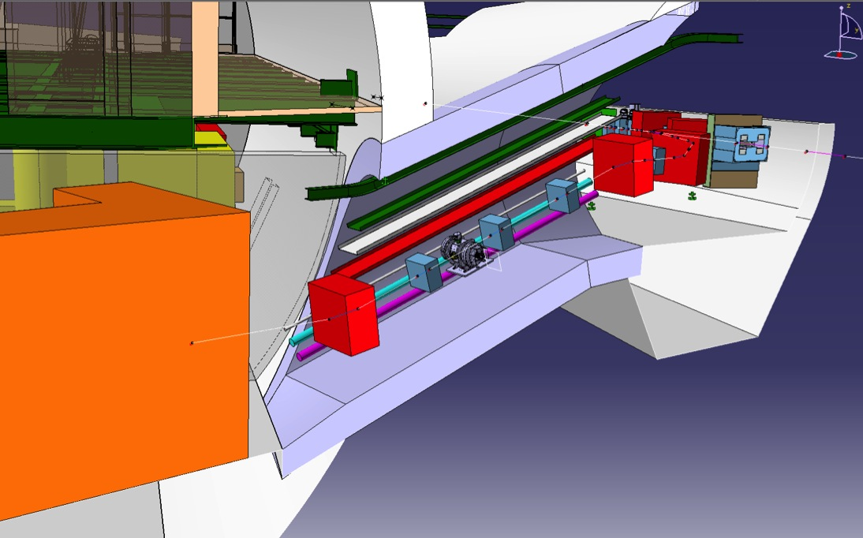
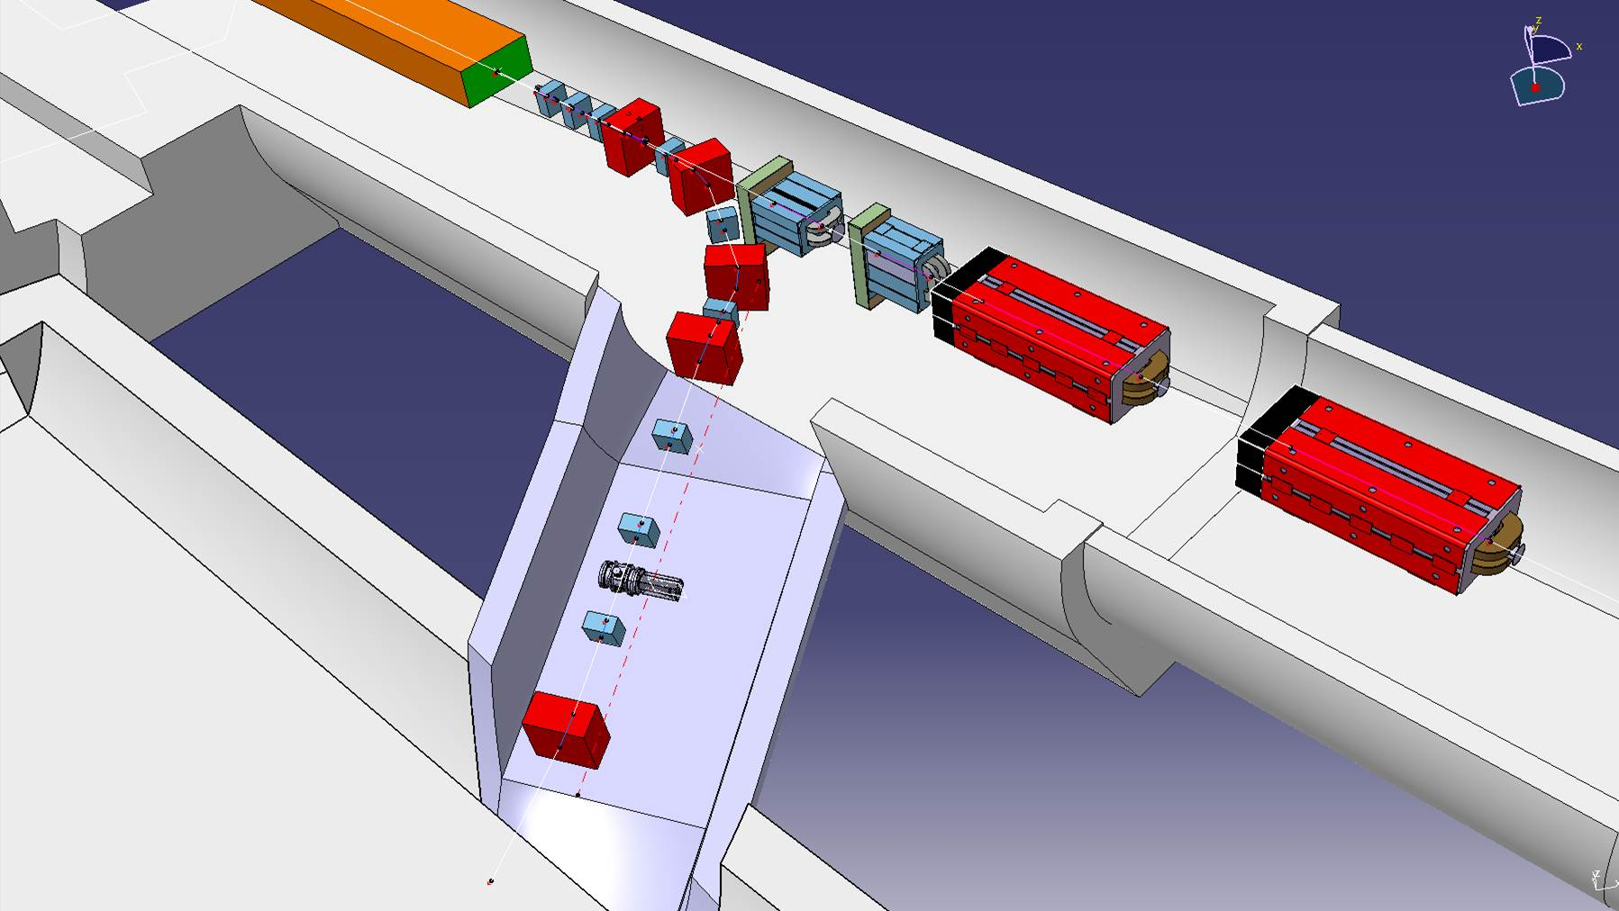
Electron Beam Tunnel
C. Magnier, F. Galleazzi
1 BPM for each quadrupole
2 BPMs additional at the end of the line
Spectrometer
Profile measurements

Slide 16
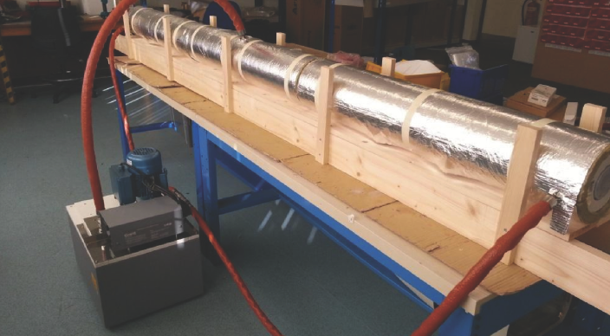
Plasma Cell
Rubidium vapour source: 3m prototype. Need 0.2% density uniformity. n_{e} = 7 E14 cm⁻³.
→ oil heating! → Temperature stability test achieved uniformity of +/-0.5K at 230C.

Slide 17
RF Synchronization of p, e, Laser Beam
Thomas Bohl, Andy Butterworth
  Electrons from RF gun driven by a laser pulse derived from same laser system as used for ionization.
  → Synchronization between laser pulse and electron beam at < 1ps can be achieved.
  Synchronization of proton beam w.r.t. laser beam at ~100ps (15° in 400MHz) level is desired:
  → SPS RF must re-phase and lock to a stable mode-locker frequency reference from laser system.
  → Synchronization just before p extraction.
Electron bunch (1σ~10 ps)
e- RF gun:
2998.5 +/- 1 MHz
SPS RF frequency reference:
f_{rev SPS} = 200.394 +/- 0.001 MHz
Plasma
gas
proton bunch (1σ ~400 ps)
laser pulse (100 fs)
Method:
→ Coarse rephasing of SPS to the common frequency f_{c} (= : f_{rev SPS}/n)
→ Fine rephasing to the RF frequency reference
→ also needed to synchronize with the laser pulse: laser pulse repetition frequency f_{rep} (~10Hz)
→ Beam instrumentation: timing/synchronization of the beams

Slide 18
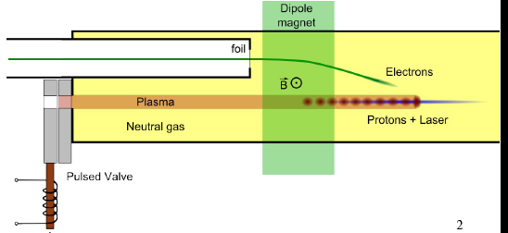
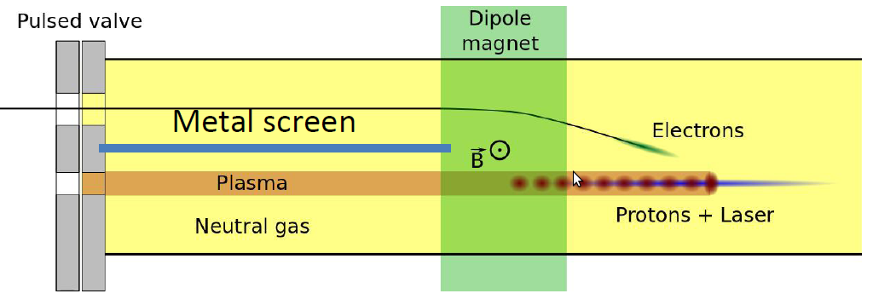
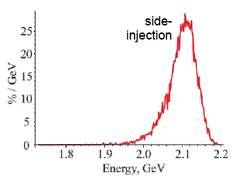
Electron Injection Off-Axis
Original idea: off-axis injection of electrons into plasma wakefield.
Injection after SMI has built up (4-6m) → electrons are caught under optimal angle (~15mrad)
Typical side-injection efficiency:
~ 2% with 15 MeV/c
Challenges:
Two vacuum tubes upstream the plasma to shield e⁻ and p beam
Dipole magnet
Fast valves/windows
Space around vacuum
Plasma cell design
Beam instrumentation

Slide 19
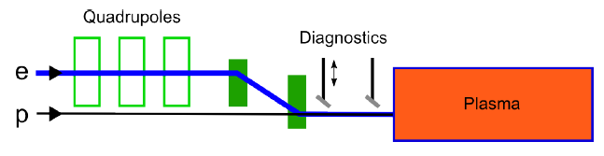
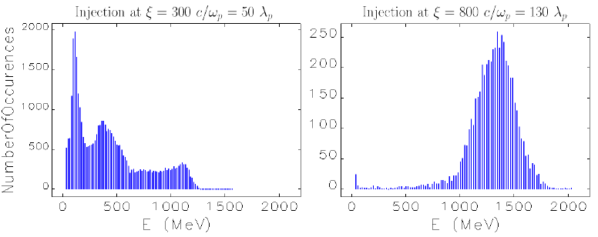
Electron Injection On-Axis
Inject electrons to proton beam line upstream the plasma cell.
Typical side-injection efficiency: ~ 2-5% with 15 MeV/c
Challenges:
Junction electron/proton injection →Electron spectrometer

Slide 20
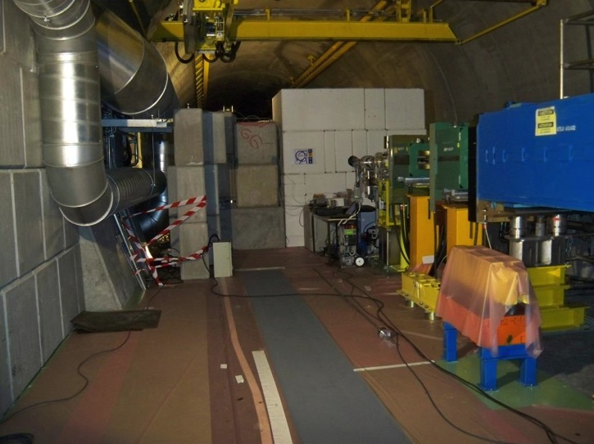
Experimental Area
Area where electron spectrometer will be installed.
Magnets, shielding, etc… will be removed.

Slide 21
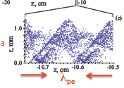
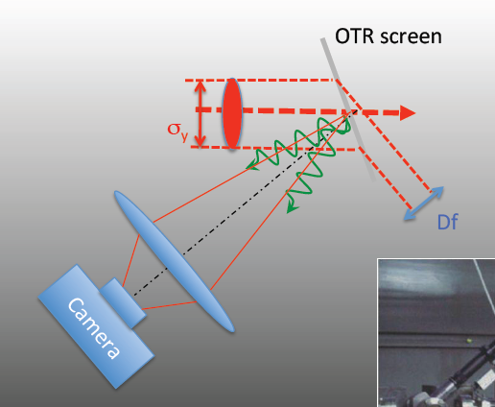
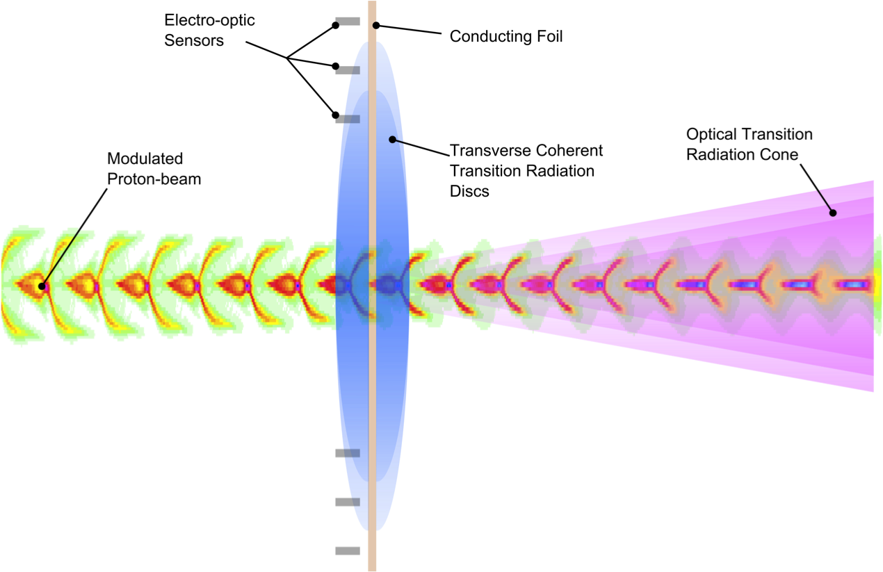
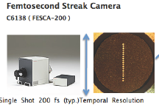
Phase I – Proton Bunch Self-Modulation
OTR + Streak Camera (MPI Munich)
→ Direct evidence of the occurrence of the SMI.
Plasma density: n_{e} = 7 E14 cm⁻³.
Plasma wavelength = 1.2 mm → 4 ps
→ Streak camera with ~ps resolution

Slide 22
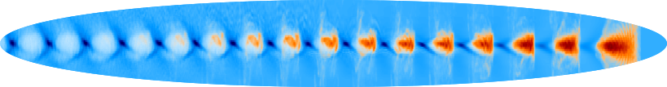


Phase I – Proton Bunch Self-Modulation
Coherent Transition Radiation - CTR (MPI Munich)
→ Direct evidence of the occurrence of the SMI.
A)
B)
p⁺
p⁺
Coherent radiation around plasma wavelength emitted (microwave frequency range 100-400GHz)
→ Intense signal: for 2mm² antenna several Watts of radiation power.
237.5 GHz
237.5 GHz
Filter
~
Mixer
Broadband
Detector
Oscillator
e.x: 228.5 GHz
Real-time
Oscilloscope
Spectrum
analyzer
A) Look at cut-off frequency
→ Use cut-off waveguides
B) Mix with local oscillator signal, detect intermediate frequency signal with fast oscilloscope

Slide 23
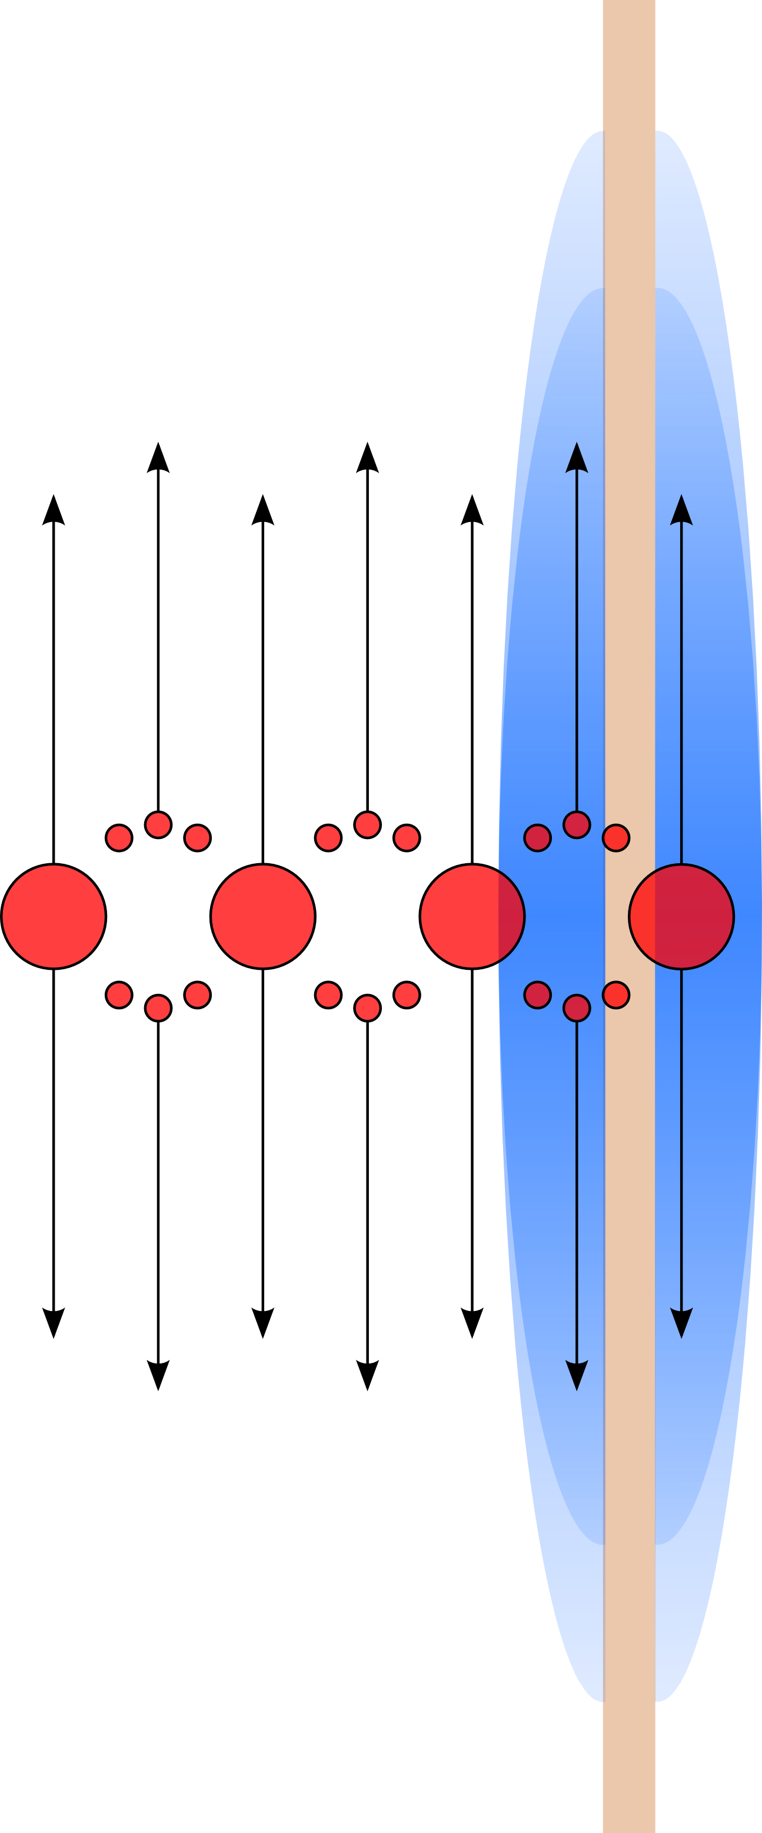
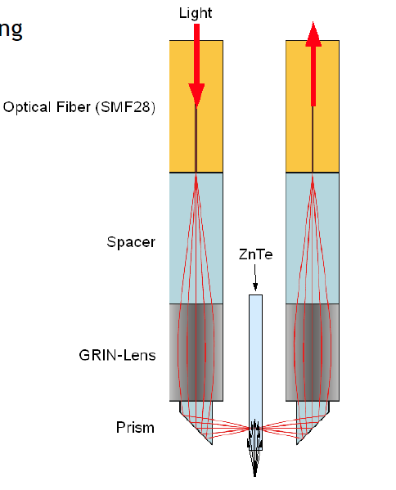
Phase I – Proton Bunch Self-Modulation
Transverse Coherent Transition Radiation - TCTR (MPI Munich)
→ Measurement of p⁺-bunch modulation frequency and amplitude
metal foil
Probe
configuration
Transverse coherent transition radiation disc
Micro-bunches
Transverse CTR
  Normal E-field component to the screen
  Signal is modulated by beam density to first order
  237.5 GHz @ n_{e} ~ 7*10 ¹⁴ cm⁻³
  Hundredths of kV/m at about 10 mm distance
Use transverse coherent radiation to frequency modulate a probe laser:
Radiation modifies birefringency of crystal → modifies laser pulse sidebands.
→ MPI plans to have first tests end 2014 at DESY/Zeuthen
Notes:
Time-varying beam radius at the foil
Creates a time-varying vector potential.
Dipole radiation at the plasma frequency is emitted transverse to the beam axis.

Slide 24
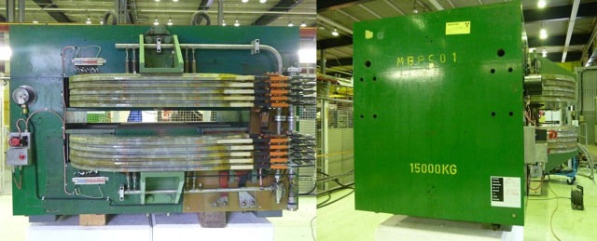
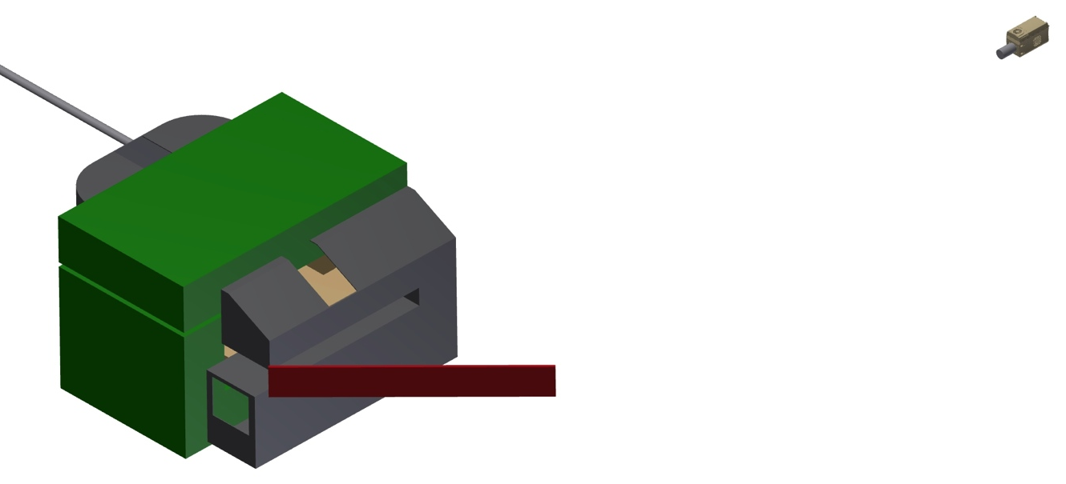
Phase II: Electron Acceleration in Wakefield
Electron spectrometer (UCL)
MBPS magnet (CERN)
1.84 T
3.80 Tm
Vert. aperture: 110-200 mm
Horiz. Aperture: 300 mm
L=1670 mm
W=1740 mm
15 t
Camera
p
e⁻
Camera already purchased.
Andor iStar 340T iCCD camera:
2048 x 512 total pixels
13.5 um pixels.
Gen-2 W-AGT P43 intensifier, gated at 7 ns. Nikon F-mount lens mount.
16-bit readout, 150 ke⁻ pixel full well.
Scintillator screen

Slide 25
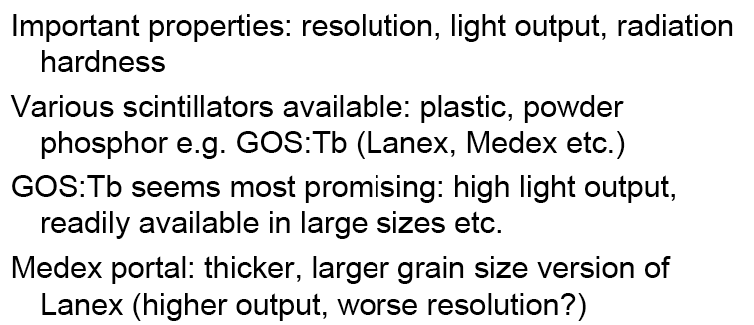
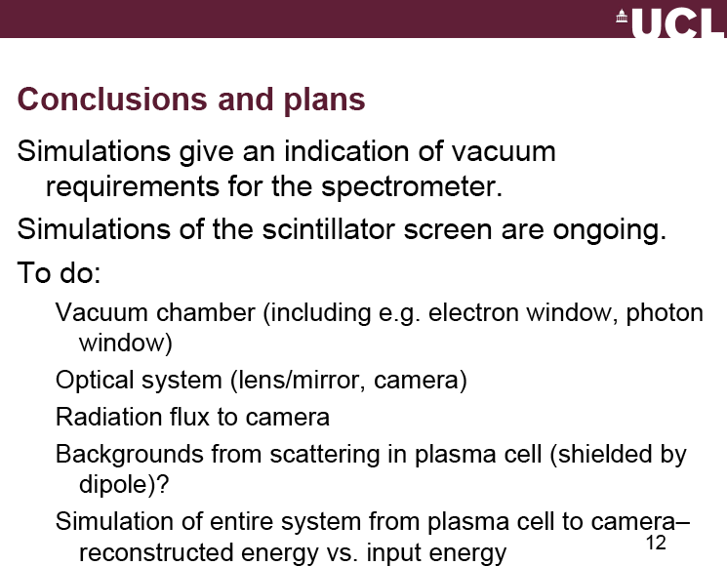
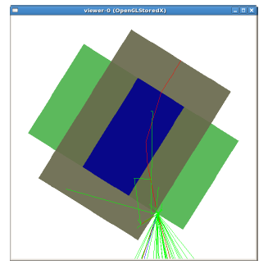
Electron Spectrometer
With side-injection efficiency of ~1%:
1 E7 electrons/pulse
AWAKE Collaboration Mtg, Dec 2013
UCL (S. Jolly, L. Deacon)

Slide 26
Other Issues and Summary
How best to implement institute’s instrumentation into CERN DAQ/logging system?
  Are there standard input crates to which experiment can connect to?
  Advise to purchase equipment which is also CERN standard.
  FESA
Need close collaboration with institutes
→ needed for interface and integration
  Marie Curie fellowship?
  PhD student?
  Fellow?
  Triumf contribution?

Slide 27
Additional slides

Slide 28
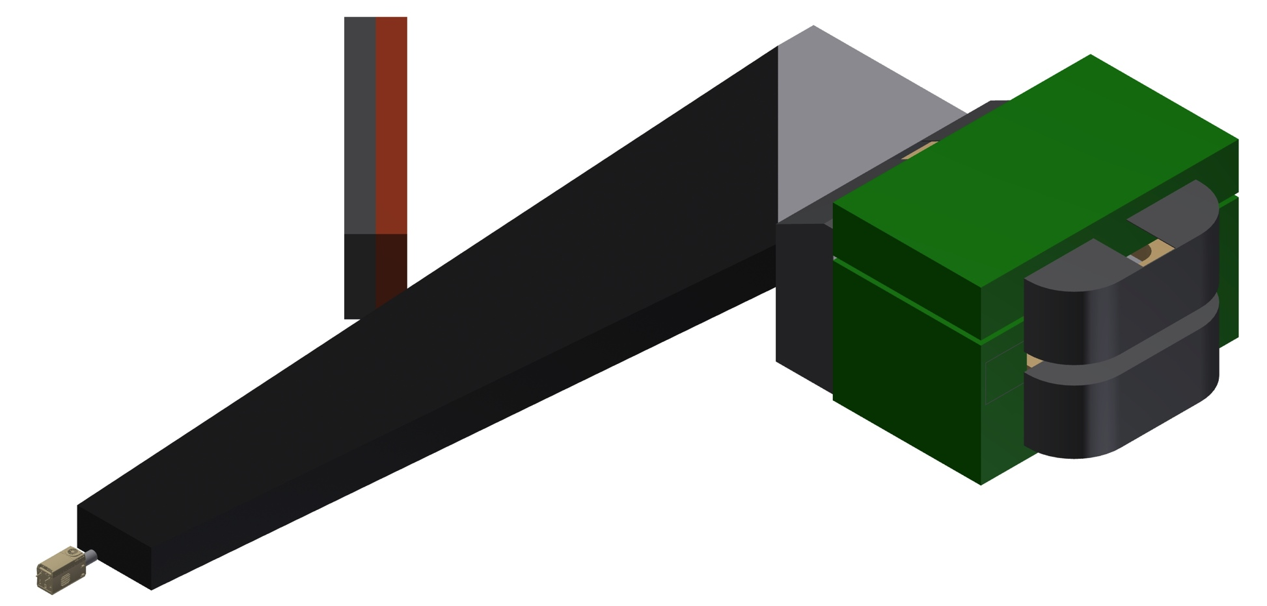
Light Tight Vessel

