Slide 1
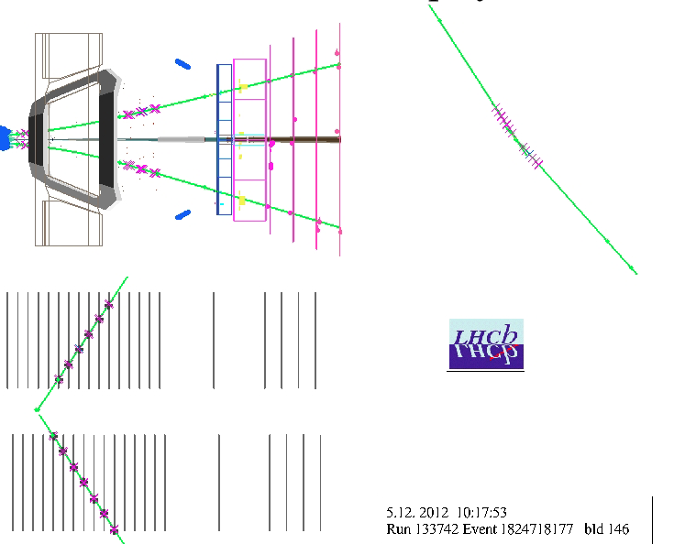
Yellow Report medium lumi (focus LHCb)
Paula Collins, CERN

Slide 2
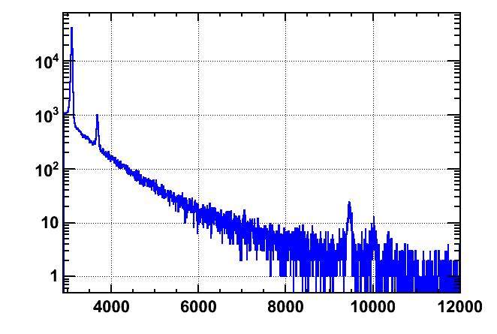
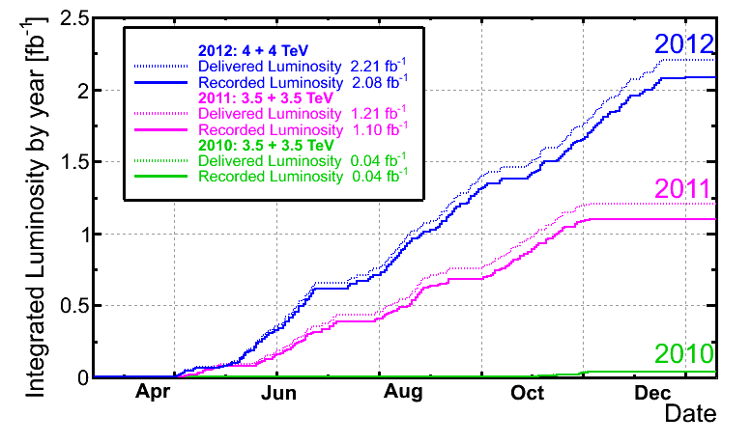
Exclusive Dimuon
2011-2012 p-p dataset is ~ 80 times larger than previously published results
updated 2011 results use ~20% of 1 fb⁻¹, with more for 2012
For 2015 running statistics will go up by a factor 4-6 at an Upgraded Energy
(useable ~40% of lumi)
“CEP triggered”
2012 μ⁺μ⁻ data sample
LHCb
unofficial
20% useful

Slide 3
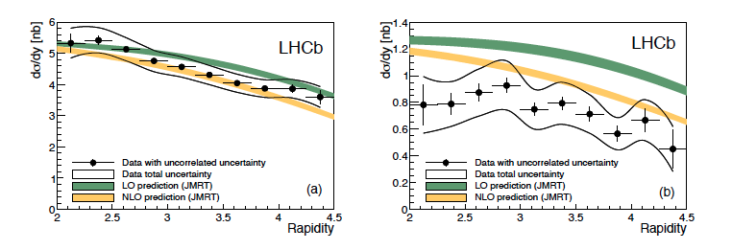
Differential cross sections
J/ψ
ψ(2S)
Comparison with LO and NLO predictions
(Jones Martin Ryskin and Teubner)
Similar comparisons with models including saturation effects
Notes:
NLO = power law photoproduction combined with photon flux function and gap survival factor

Slide 4
Analyses in progress
Dimuon final states
  χ_{c,} χ_{b}
  X(3872)
  other
Hadronic final states
  χ_{c0}→ K⁺K^{-,} π⁺π⁻
Herschel project – forward shower scintillators for LHCb
  Status
For yellow report should also discuss
  open charm, double j/psi

Slide 5
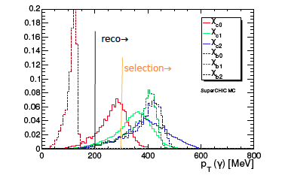
More Exclusive Dimuon Signals
Soft photons generally not ideal for hadronic machines –
but low multiplicity CEP environment gives great opportunities
χ_{c(0,1,2)} → γJ/ψ, J/ψ → μ⁺μ⁻
χ_{b(1,2)} → γΥ(1S), Υ(1S) → μ⁺μ⁻
Similar analysis to the dimuon but with one extra photon
γJ/ψ and γΥ mass resolution challenging
142 MeV mass difference χ_{c(0,2)}
33 MeV mass difference Υ_{c(0,2)}
Purity can be different for each state, giving additional uncertainties
Simulated photon energies

Slide 6
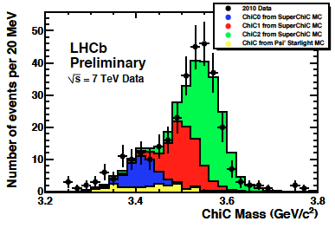
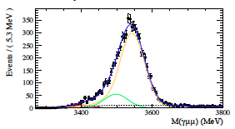
Exclusive χ_{c(0,1,2)}
LHCb Preliminary Result
    LHCb-CONF-2011-022
    2010 data
Thesis: Marius Bjornstad
    CERN-THESIS-2013-217
    2011 data
LHCb
unofficial
J/ψ + γ mass
 |  | χ_{c(0)} | χ_{c(1)} | χ_{c(2)}
cross sec x branching ratio (pb) | 2010 (conf) | 9.3 ± 4.5 | 16.4 ± 7.1 | 28.0 ± 12.3
 | 2011 (thesis) | 2.2 ± 3.0 | 4.3 ± 7.6 | 25.0 ± 9.2
 | Superchic | 14 | 9.8 | 3.3

Slide 7
Exclusive χ_{c(0,1,2)}
LHCb Preliminary Result
    LHCb-CONF-2011-022
    2010 data
Thesis: Marius Bjornstad
    CERN-THESIS-2013-217
    2011 data
LHCb
unofficial
J/ψ + γ mass
 |  | χ_{c(0)} | χ_{c(1)} | χ_{c(2)}
cross sec x branching ratio | 2010 (conf) | 9.3 ± 4.5 | 16.4 ± 7.1 | 28.0 ± 12.3
 | 2011 (thesis) | 2.2 ± 3.0 | 4.3 ± 7.6 | 25.0 ± 9.2
 | Superchic | 14 | 9.8 | 3.3
χ_{c2} seems dominant
verification needs firm handle
on disassociation background

Slide 8
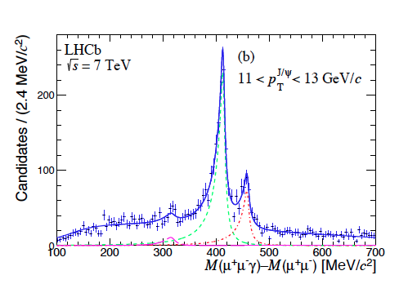
χ_{c(0,1,2)} – converted photons
Possible to improve resolution by use of converted photons in detector
Efficiency significantly reduced
LHCb paper: Prompt χ_{c(0,1,2)}
J. High Energy Phys.10 (2013) 115
inelastic
collisions
Similar approach is being tried
for CEP like events

Slide 9
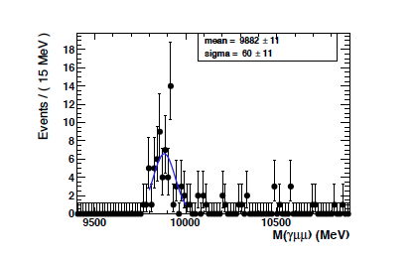
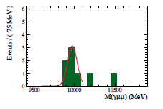


Exclusive χ_{b(0,1,2)} (dimuon + photon)
Thesis: Marius Bjornstad
    CERN-THESIS-2013-217
    2011 data
Fit to MC (arbitary signal)
Similar analysis to χ_{c}
Expected Cross section down by a factor ~ 10⁴
SUPERCHIC predictions: 0.13, 0.004, 0.010 fb
Signals already emerging with 2011 data!
Other backgrounds (non negligible)
Feed down from Υ(2,3S) decays
additional photon not detected
Efficiency for χ_{b0} a factor ~ 70 lower than χ_{b(1,2)}
Large x-sec expected, so potential signal source
LHCb
unofficial
2011 data ~ 1.5 σ signal

Slide 10
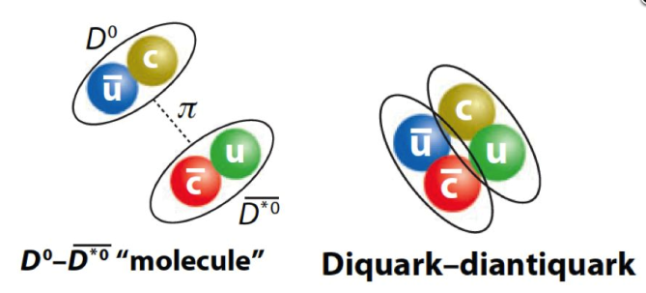
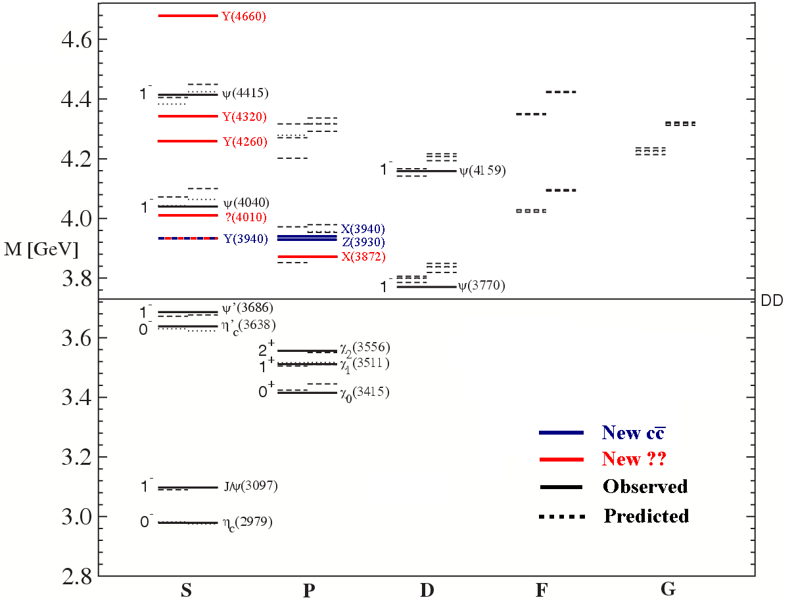
X(3872) analysis: motivation
X(3872) is “a riddle, wrapped in a mystery,
inside an enigma; but perhaps there is a key” ¹
What is it? LHCb J^{PC}=1⁺⁺ determination leaves χ_{C1}(2³P₁) available as well as DºD*º molecule, tetraquarks, ccg hybrids + combinations…
Observation of CEP X(3872) could lend
weight to charmonium interpretation:
Prediction possible for ratio of CEP cross sections σ(χ_{c1}(2P))/σ(χ_{c1}(1P))
Tetraquark/molecule interpretation
requires additional quarks or D mesons - available to inclusive processes only
If the X(3872) is a combination of these
the proportion can be probed by the
CEP cross-section measurement
¹ Winston Churchill, 1939

Slide 11
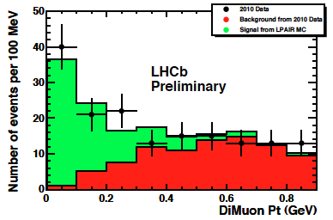
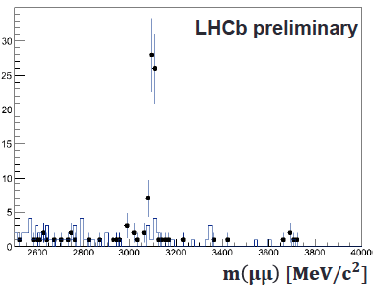
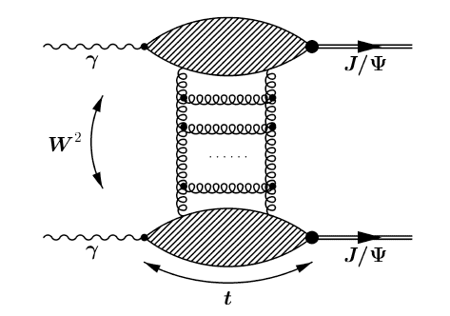
Other dimuon analyses in pipeline
φ/ω production – see previous talk
Exclusive diphoton-dimuon continuum
Di-jpsi production
Exclusive signals in pA data
expect x10 more data in 2015
AA collisions with lighter ions for Run III
LHCb unofficial
arxiv: hep-ph/9806260

Slide 12
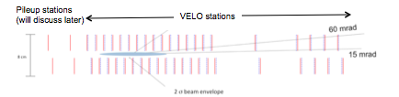
Triggering on CEP→hadrons
Low multiplicity hadronic final states require special treatment to survive LHCb trigger
June 2012: New Trigger implemented → significant improvement!
Threefold strategy:
Use of “Pile-up” stations
(“upstream” silicon sensors)
at L0 stage to veto backwards activity
Greater pass through
trigger rate exploiting
small events and short processing times
Soft p_{T} cuts essential for hadronic final states from low p_{T} objects
+
+
Silicon sensors
at 8.2<R<42mm and z>-315mm
40 MHz readout
Very effective VETO

Slide 13
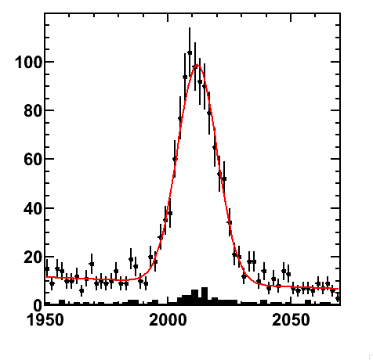
CEP→hadrons at LHCb
Main physics goals:
Study charmonium states decaying into two and four-body
final states (e.g. χ_{c0}→K⁺K^{-,} π⁺π⁻) to complement di-muon studies
Study production of open charm in such events
Spectroscopy: e.g. search for higher mass charmonia states
decaying to open charm, e.g. χ_{c2}(2P)
New trigger has collected ~ 1.4 fb⁻¹ of integrated luminosity (~ 19% useful for CEP)
Dedicated trigger lines include:
standard D decays
charmonia decays to 2 and 4
body final states
Inclusive di kaon line
Low mass resonance line to search for e.g. K_{S}, Φ
D* yield in low
multiplicity events
after June 2012
before June2012

Slide 14
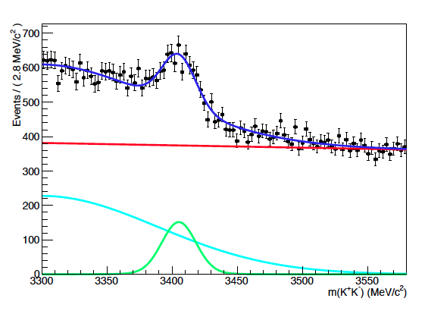
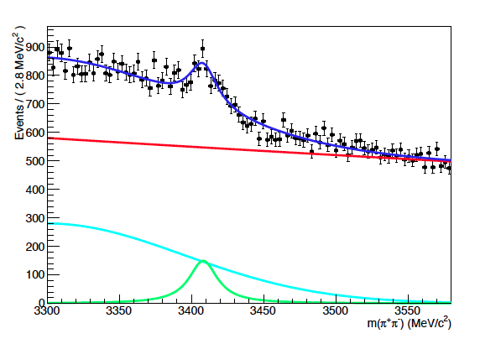
Clear signals emerging
χ_{c0}→ K⁺K^{-,} π⁺π⁻
K⁺K⁻
π⁺π⁻
LHCb
unofficial
LHCb
unofficial
Fix of problem in stripping lines – clean χ_{c0} signal
First clear signal seen in π⁺π−
Can provide clear benchmark cross section
Signal also visible in other hadronic modes e.g. J/ψ → pp
Open charm analyses also beginning…

Slide 15
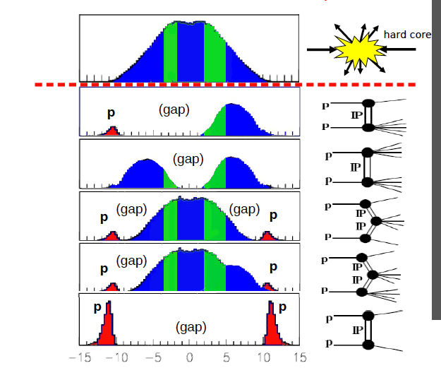
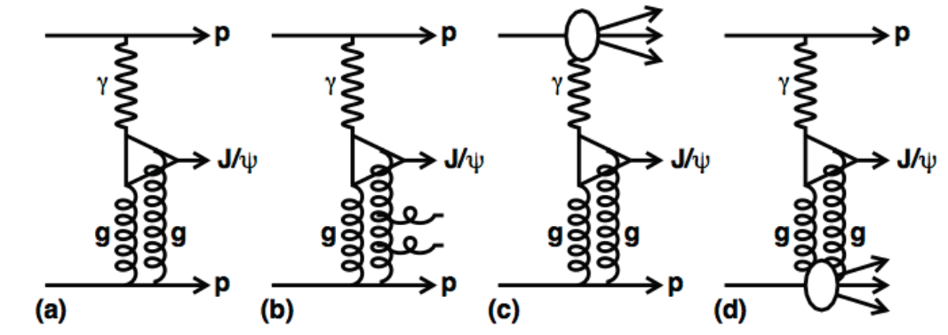
Future – essential to constrain backgrounds
The Bad Guys!
One or more rapidity gap
contains particles which
may escape our acceptance
For 2010 analysis estimated with p_{T} fit:
However, contamination of signal is significant
Fit can be model dependent, and does not scale well to small samples.
Amount of disassociation background can be different for different CEP final states

Slide 16
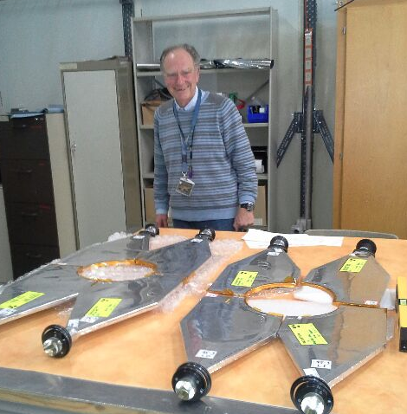
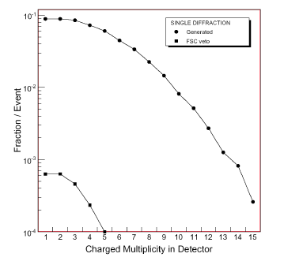

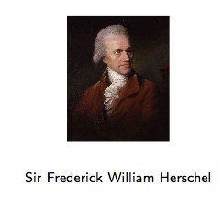
Forward Shower Counters for LHCb
Expect greater CEP yield with move to 25 ns running (20%→40% useable luminosity)
LHCb plans to expand the programme with the installation of scintillator counters
A series of stations upstream and downstream of the experiment will be used to veto CEP background
Information will be used at analysis stage and also in L0 trigger, helping to suppress background and increase signal rate
Many thanks to our colleagues from CMS for help and advice
arXiv:0907.38847v2
(2009)
(as previously proposed for LHCb)
Herschel project:
High Rapidity Shower Counters for LHCb
V. Coco, P. Collins, R. Dumps. R. Dzhelyadin, P. Dziurdzia, R. Jacobsson, B. Langhans, R. McNulty, L. Roy, H. Schindler, S. Stevenson, G. Wilkinson

Slide 17
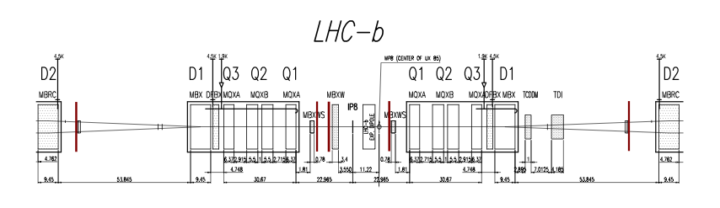
Proposed Station Positions
Proposal accepted by LTEX – 21 November 2013
Left
z ~ -7.5 m (after MBXW)
z ~ -19m (before MBXWS)
z ~ -114m (after BRANS)
Right
z ~ 19 m (close to MBXWS)
z ~ 114m (after BRANS)

Slide 18
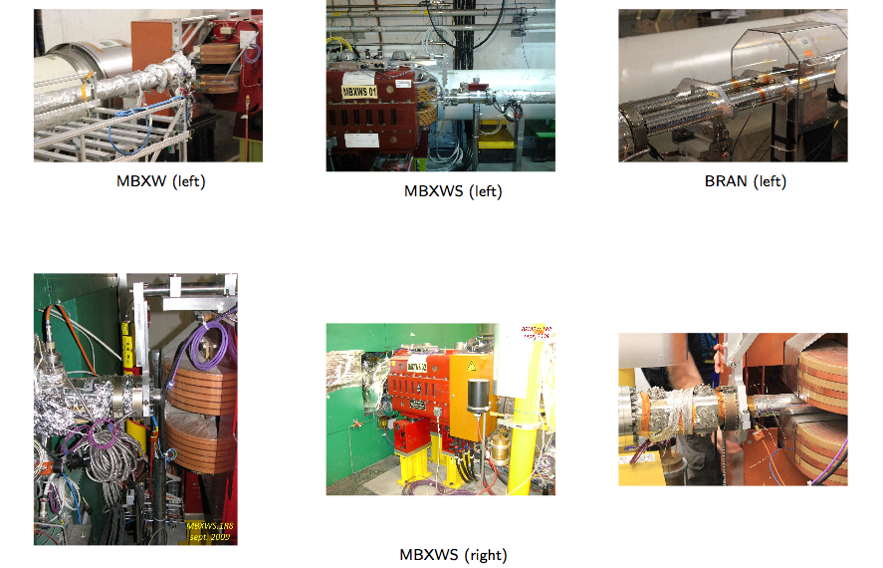

Slide 19
Topic list for yellow report
J/ψ, ψ(2S) update, Υ production, double J/ψ
light vector mesons, meson pairs
ηη,η’η’, ηη’ studies starting
Further improvement of exclusivity in χ_{c(0,1,2)}
  study of relative rates as a function of p_{T}
  Comparison of γJ/ψ and ππ, KK results
ππ, KK in resonance and non-resonance regions
DD, DD* production – resonances and continuum
γγ CEP
pA

