Slide 1
Readout System Review
Niko Neufeld
Electronics Upgrade Meeting, April 10th 2014

Slide 2
FTDR - Architecture
UX85B
Detector
GBT: 4.8 Gbit/s (9000 x) DAQ
3.2 Gbit/s (2400 x) TFC/ECS
Input into DAQ network (10/40 Gigabit Ethernet (1000 to 4000)
Output from DAQ network into compute unit clusters (100 Gbit Ethernet / EDR IB) (400 links)
Bi-directional links for TFC/ECS to/from TELL40 for timing, back-pressure and LLT
TRG40
shielding wall
TELL40
SOL40
SODIN
UX85A
DAQ network
100 m rock
Point 8
surface
Compute Units

Slide 3
Cost-optimised readout system
Bring readout-boards, network and farm together in one location (containerized data-centre on SX)
  run Versatile Links from detector to surface (~ 300 m)
Move from AMC40 to PCIe40
  Removes optical link from TELL40 to network
  Free (and late) choice of network technologies
  PC separates off event-builder network technology
  Number of core-network ports can be halved

Slide 4
Readout System Review
Held on Feb 25th, 9:00 – 16:00
4 reviewers
  Christoph Schwick (PH/CMD – CMS DAQ)
  Stefan Haas (PH/ESE)
  Guido Haefeli (EPFL)
  Jan Troska (PH/ESE)
https://indico.cern.ch/event/297003/
All documents can be found in EDMS
https://edms.cern.ch/document/1357418/1

Slide 5
Review
Organised by Renaud, Ken and myself
Many thanks to the reviewers for stimulating, interesting discussions, their patience to read through a mountain of material and the timely preparation of the report
Many thanks to the presenters – the feedback I got on the quality of the presentations was overwhelmingly positive

Slide 6
Questions to the reviewers
Long-distance optical fibres:
  Have we fully demonstrated the feasibility?
  Are further tests recommended?
  Are there further risks to be assessed?
For both ATCA/AMC and PCIe:
  Does the proposal comply with the global architecture?
  Have we fully demonstrated the feasibility?
  Are further tests recommended?
  Are there further risks to be assessed?
  Are the technology choices appropriate? (e.g. cost-effective, performance, obsolescence, long-term availability)
  Can the system handle the target luminosity of 2x10^33?
  Are the proposals scalable? (e.g. for future increases in luminosity)
We propose a change of baseline from ATCA/AMC to PCIe. Do the reviewers support the choice of baseline (PCIe) and back-up (ATCA)?
Comment on manpower/schedule
Is documentation in good shape?

Slide 7
Optical links 1
OM3 vs OM4: “[…] the review committee thinks that the choice of OM4 fibers would be preferable since it would allow future upgrades to higher bit rates in case this will become necessary. The final decision might depend on the cost of these fibers once they need to be purchased.”
→ note that no intrinsic advantage of OM4 for current application is identified. Price difference for material currently 50% (1 → 1.5 MCHF)
In situ tests: “[…] recommend that the testing be repeated on a test span of both OM3 and OM4 fibre that are installed in the LHCb experimental area via the proposed fibre route. This would allow unforeseen effects to be observed.”
→ see next page
“The radiation environment leaves a lot of margin for the majority of the optical links since the worst radiation level (80 Gy/10^12 neq/cm^2 for the tracker) is well below the Versatile Link Calorimeter grade qualification level.”

Slide 8
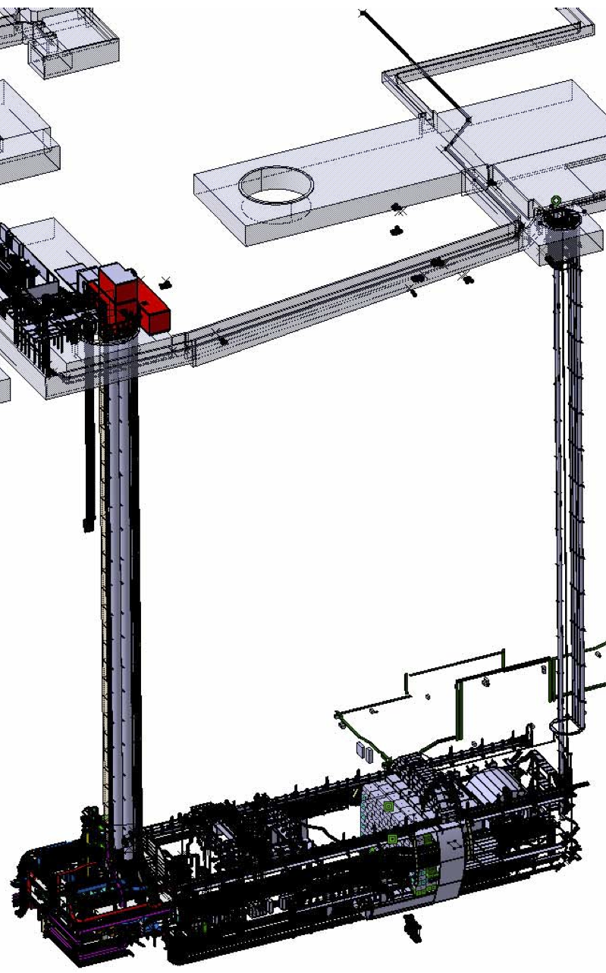
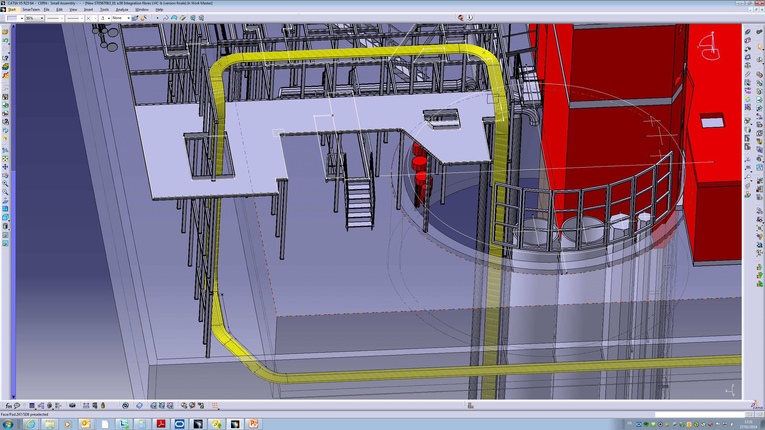
Optical fibres 2 - test at P8
SD8 – try to get rid of 30 m loop
Thanks a lot to Laurent for info and pictures!

Slide 9
Test installation - planning
Choose “worst” (== longest distance, most bends) point in cavern (in the bunker)
  We will need some space!
Planning:
  Before June 2014 (cool-down start): install support structures in PM85 et US85
  Before December 2014 (closure of cavern): install supports in surface gallery and UX85
  Install prototypes of both solutions (blown fibres (from bottom to top and pre-connectorized cables (OM3 and OM4)
Long-term tests starting from 2015 (with beam)

Slide 10
Optical fibres - 3
We want to do more sampling of the Minipod transmitters and receivers
Test-stand setup at CERN (by Rainer and Paolo)→ plan to test all AMC40 of the new batch before being handed out to SD (tests should not take more than 2 weeks total)
Goal: get more information about inter-channel and inter-component variability

Slide 11
TELL40 implementation
Basic question to reviewers: “We propose a change of baseline from ATCA/AMC to PCIe. Do the reviewers support the choice of baseline (PCIe) and back-up (ATCA)?”
Basic answer:
“Given the listed advantages the review committee endorses the choice of the PCIe based design as a baseline.”

Slide 12
However…
“a prototype should be produced and evaluated as soon as possible”
  → see Jean-Pierre’s presentation
paraphrasing a bit: care has to be taken in the PC environment: thermal stability, quality of power-supply and noise, especially when used for TFC
“The PCIe demonstrator must show that the implementation of the optical components […] is mechanically feasible without restricting the options on [the] PC […]”
→ we are in contact with PC vendors for all these issues. There is a choice of compatible 1U and 2U chassis
  GPU-cards have worse requirements than we do (size, power)

Slide 13
However 2)
“It is recommended that, even if it is considered unlikely by the experts, the collaboration addresses the problem which might occur if the PCI express bus (v3.0) in PCs becomes unavailable during the lifetime of the experiment”
→assume life-time == end of run 4. The “experts” are sure there will be no problem until end of run 3. Then if PCIe is replaced by something not backward compatible
  will use PCs with a “legacy” slot (require only 1 per PC)
  stock PCs and/or components (mainboards, memory modules, fans, power-supplies)
If life-time > run 4, and no more PCIe, then redesign the card (FPGA cost will have come down enormously, optical components are pluggable and can be re-used or new ones will be qualified)

Slide 14
LLT
“In the reviewers' opinion, only the software option should be pursued if any. For this case it should be clarified in how far the resources in the FPGA of the PCIe board could be used to support the Software LLT with some pre-processing”
→ will establish the feasibility of the software LLT in time so that hardware LLT could be still developed in case needed.

Slide 15
Evolution 2 - Architecture
UX85B
Detector
GBT: 4.8 Gbit/s (9000 x) DAQ
3.2 Gbit/s (2400 x) TFC/ECS running over 300 m
DAQ network >= 100 Gbit/s Ethernet / EDR InfiniBand / …/400 links)
AMC40 → PCIe40 + PC
Output from event-builder into edge switches (100 Gbit Ethernet / EDR IB) (<= 400 links)
Bi-directional links for TFC/ECS to/from TELL40 for timing, back-pressure and LLT
10G BaseT to farm-nodes
100 m rock
UX85A
TELL40
SOL40
TRG40
DAQ network
edge switches
Point 8
surface
Compute Units

Slide 16
Features of upgraded LHCb DAQ 2)
Push-protocol with centralized flow-control (throttle)
  back-pressure from PC/DMA will activate throttle in PCIe40
Event-building protocol
  Lots of buffering in event PCs: use zero-copy (remote DMA)
  100 Gbit/s link matches input bandwidth → full-event-building for every bunch-crossing
  Event-builder PCs act as gateways, network technology to farm-nodes can be different from event-building network
LLT merged into event-building (“LLT as a co-processor”)
Collateral benefits: more than 3x less FPGA resource usage for PCIe compared to 10 Gigabit Ethernet
# links 100 Gbit/s (from event-builder PCs) | 400 - 500 | # links 100G Ethernet (from event-builder PCs to edge switches) | 400 - 500
Event-size (total – zero-suppressed) | ~ 100 kB | # edge switches | ~ 100
Event-building rate | 40 MHz | # core-switches | 2
# read-out boards | 400 - 500 | # farm-nodes | 1000 (up to 4000)
output bw / read-out board | up to 100 Gbit/s (useable) | max. input bw / farm-node | 10 – 40 Gbit/s

Slide 17
Conclusion
The review committee endorses the plan of the collaboration to continue with the PCIe based readout card as a baseline solution for the new Readout System. The committee notes that there are still risks involved and that a prototype should be produced as soon as possible in order to assess the critical technical issues mentioned above. It is further recommended to work out a resource loaded overall schedule of the project […]
The tests performed on the long distance optical link are encouraging but need to be completed with further tests under realistic conditions.

Slide 18
Conclusion
The preparation of the review and the review itself have been very useful and productive
We will now go on to create the PCIe40 prototype to address all issues raised
We will do a extensive tests of the fibres in the final conditions
We are ready to start working on the Trigger and Online TDR

