Slide 1
Intro to ECS to FE
of the Upgraded LHCb Readout System
LHCb Upgrade Electronics Meeting
09 October 2014
Federico Alessio, CERN

Slide 2
The new TFC system at a glance
S-ODIN responsible for controlling upgraded readout system
Distributing timing and synchronous commands
Manages the dispatching of events to the EFF
Rate regulates the system
STORAGE
SOL40 responsible for interfacing FE+PCIe40 to S-ODIN
Fan-out TFC information to TELL40
Fan-in THROTTLE information from TELL40
Distributes TFC information to FE
Distributes ECS configuration data to FE
Receives ECS monitoring data from FE
DATA
2

Slide 3
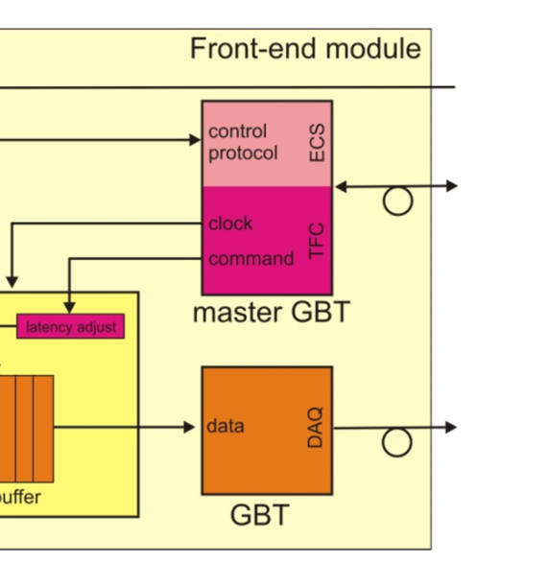
Fast & Slow Control to FE
TFC
TFC
On detector
4.8 Gb/s
Off detector
4.8 Gb/s
ECS
ECS
Data
Off detector
Data
4.8 Gb/s
Separate links between controls and data
  A lot of data to collect
  Controls can be fanned-out (especially fast control)
Compact links merging Timing, Fast and Clock (TFC) and Slow Control (ECS).
  Extensive use of GBT as Master GBT to drive Data GBT (especially for clock)
  Extensive use of GBT-SCA for FE configuration and monitoring
3

Slide 4
SOL40 firmware (only FE part)
E-link drivers build GBT-SCA packets with addressing scheme and bus type for associated GBT-SCA user busses to selected FE chip
- basically each block will build one of the GBT-SCA supported protocols and send the bits to the right GBT-SCA via the right pair of bits
GBT-SCA Memory Map with internal addressing scheme for GBT-SCA chips + FE chips addressing, channels addressing and bus types:
- content of memory loaded from ECS
4

Slide 5
Few preliminary comments (I)
The SOL40 firmware is a common development for the entire LHCb upgrade
  It will be a single firmware with all necessary features and requirements
  Minimize unconformities, enforce test-benches
    Follow specs
TFC bits to FE are at maximum 24 (see specs for details)
  Sub-detectors can choose less if wished – no minimum limit
    Provided you ensure a scheme that minimizes loss of events and desynchronization – in any case think it through (and be ready to negociate)
  TFC bits can be arranged at sub-detectors’ preference, this is done in FPGA
    Repeat pattern if needed or arrange in different bit position
    Or generate specific sub-detectors commands (that do not affect global readout)
    Simple VHDL code to adapt to your needs (and be flexible towards possible mix-up)
5

Slide 6
Few preliminary comments (II)
3. We are going to support at maximum 16(+1) SCAs per GBT link
  But we can be flexible and support more if really needed...
  The SOL40 firmware will be able to drive *any* GBT-SCA channel in a generic and common way and it will be able to configure and drive *any* Master GBT at FE
  SOL40 firmware can then be stripped down when we are in the final system to reduce resources if needed by taking away blocks which are not used (modularity)
  Backbone ready end of 2014, optimization with sub-detectors and chips in 2015
  With the help of Clara, we will have common WinCC low-level software
    Datapoints, fwComponents, etc...
  Sub-detectors’ work will be on the high-level software side, where you will need to write your own GUIs, scripts to send the right commands in the right order with the right information etc...
  For the details on how the firmware to drive the SCA is done, see Cairo’s presentation.
6

