Slide 1
Experiment in PS
G. Franchetti, GSI
CERN, 20-21/5/2014

Slide 2
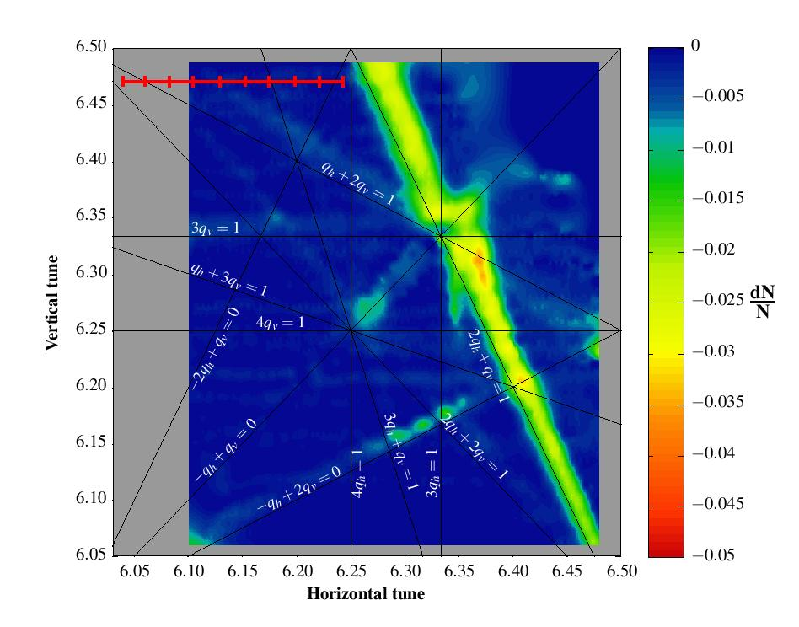
PS measurements 2012
Measurement
Resonance:
q_{x}+2 q_{y} = 19
1.1s
q_{y0} = 6.47
I = 2A
Dqx = -0.046
Dqy = -0.068
Q_{x0}
R. Wasef, A. Huschauer, F. Schmidt, S. Gilardoni, G.Franchetti
SPACE CHARGE 2013

Slide 3
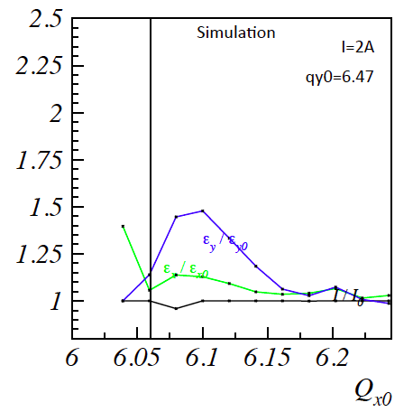
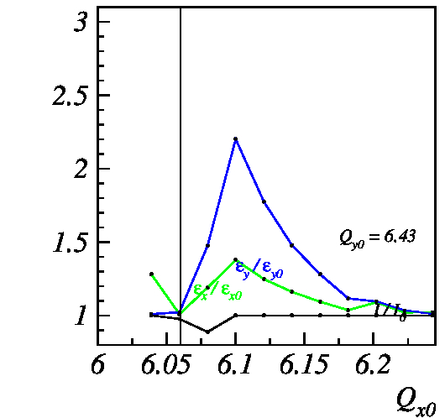
Presence of natural resonance was not included, then we tried by enhancing the resonance strength
Simulation
I=4A
q_{y0} = 6.47

Slide 4
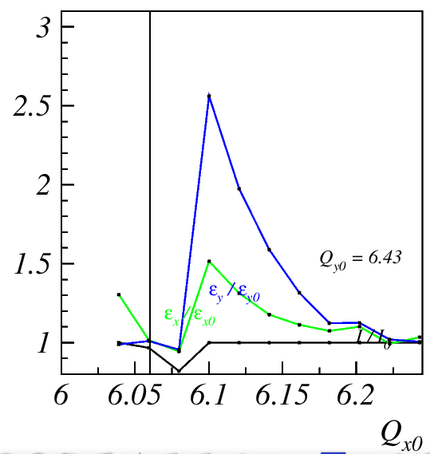
For a stronger resonance excitation but this is an artificial enhancement
Simulation
I=6A
q_{y0} = 6.47

Slide 5
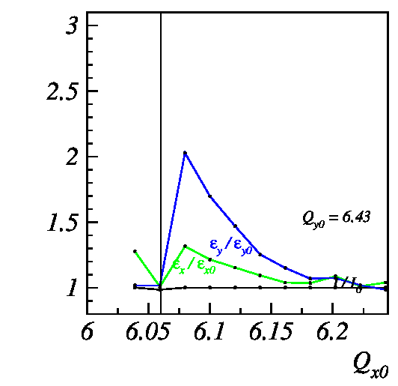
Modeling was still incomplete
Simulation
I=2A
new simulations
performed after
the visit of
Frank Schmidt at
GSI. Correcting
the PS model in
computer code.
q_{y0}=6.47

Slide 6
Adding random errors
sigma = 10% but distribution of errors
with inverted sign, same seed
(“inverted seed”)
sigma = 10%

Slide 7
For larger random errors of the same seed
sigma = 20% inverted seed
sigma = 40 % inverted seed

Slide 8
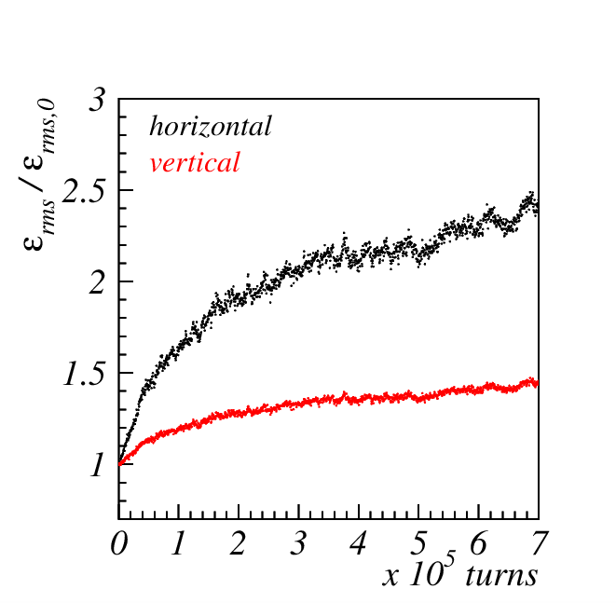
Emittance evolution
Measurement
Simulation “inverted seed” 10%
q_{x0} = 6.1
q_{y0} = 6.47
q_{x0} = 6.1
1.5 sec

Slide 9
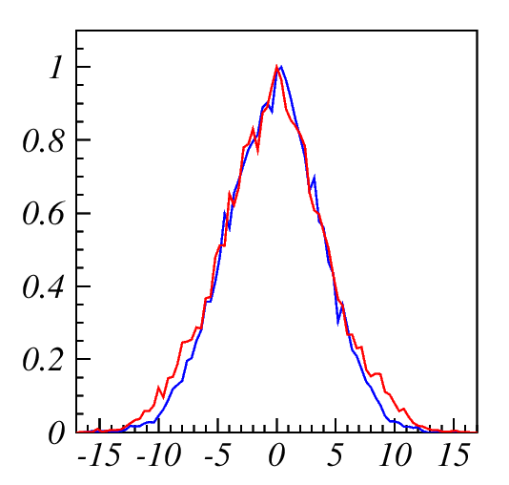
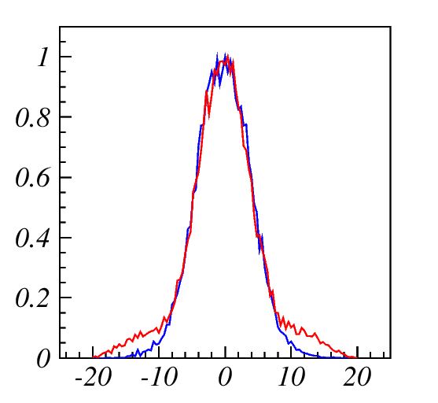
Final/Initial distribution for the “inverted seed” 10%, I=2A
q_{x0} = 6.11
initial
q_{x0} = 6.11
initial
q_{y0} = 6.47
final
q_{y0} = 6.47
final

Slide 10
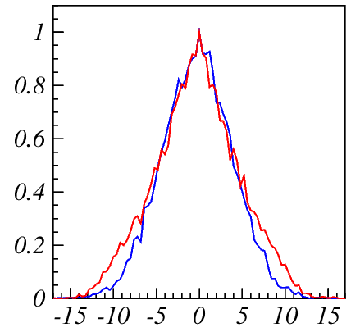
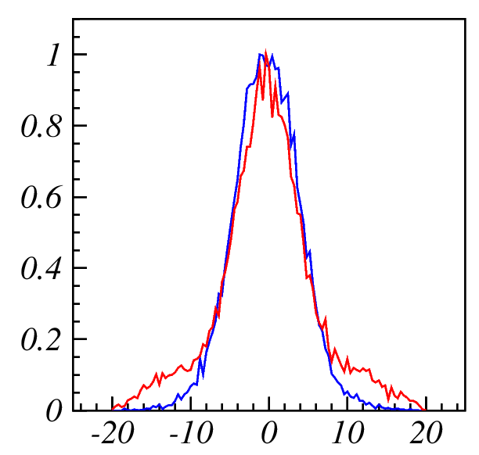
With a stronger current I=4A, to include artificially a pre-existing resonance
Simulation
Simulation
q_{x0} = 6.11
“inverted seed” 10%
initial
q_{x0} = 6.11
“inverted seed” 10%
initial
q_{y0} = 6.47
final
q_{y0} = 6.47
final
core
growth
thick
halo
X [mm]
Y [mm]

Slide 11
Halo formation: experiment
Measurement
Measurement
q_{x0} = 6.11
q_{y0} = 6.47
X
Y

Slide 12
Challenges
The main challenges are 2
1) Reliable modeling of the nonlinear lattice
2) Understanding the coupled dynamics
in the resonance crossing + space charge

Slide 13
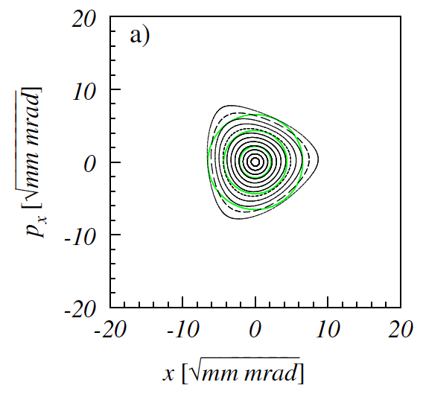
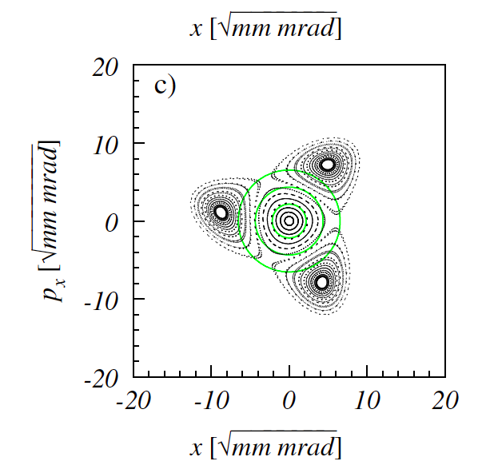
1D dynamics well understood
The asymmetric beam response is mainly attributed to the resonance
crossing of a coupled resonance.
Third order resonance 1D

Slide 14
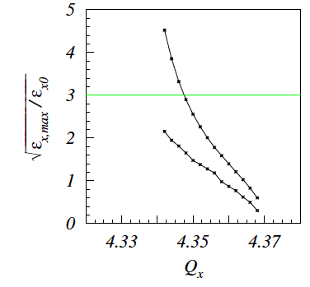
Halo formation/core formation
If the island of the frozen
system go far out, than an
halo is expected
If the islands of the frozen
system remain inside the
beam edge → core growth

Slide 15
Halo formation through non adiabatic resonance crossing
Third order resonance 1D
Halo

Slide 16
Coupled dynamics much more difficult
Resonance →
What is it an island ?
What is it a fix point ?

Slide 17
Fix-lines
3 Qx = N
Fix points are points in phase space that after 3 turns go back
to their initial position
Qx + 2Qy = N
In 4D this dos not happen, but in 4D after 3 turns a point does
not return back on the same point. However there are points that
after each turn remains on a special curved line. This line is closed
and it span in the 4D phase space.

Slide 18
Fix-line projections
Frank
Schmidt
PhD

Slide 19
Properties
What are the
parameters
that fix these sizes ?
Δ_{r}
K2 (driving term)
Stabilizing detuning
(space charge,
octupole, sextupole-themself)

Slide 20
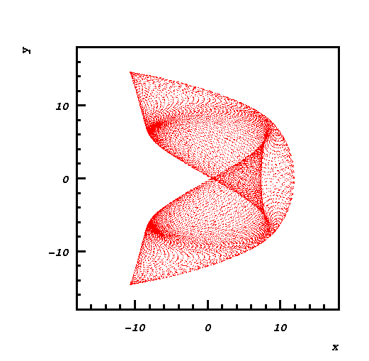
What happen to the islands ?

Slide 21
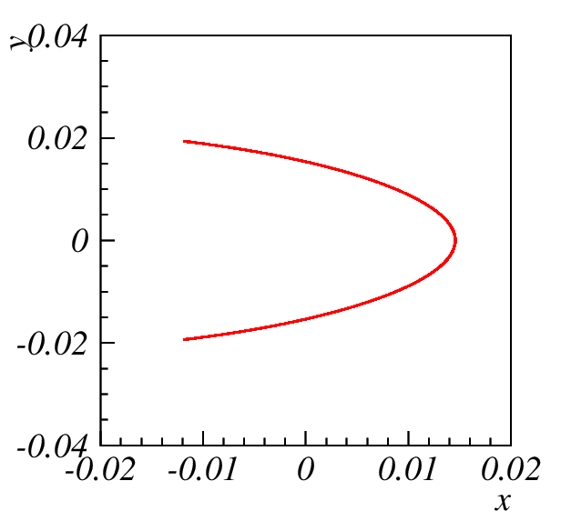
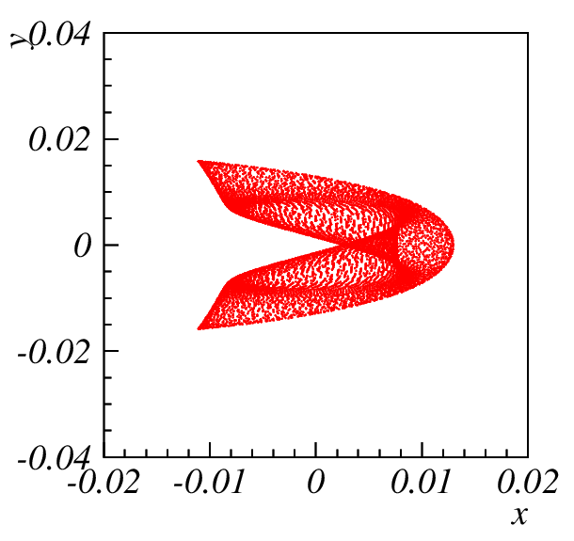
What happen to the islands ?
fix- line
“island”

Slide 22
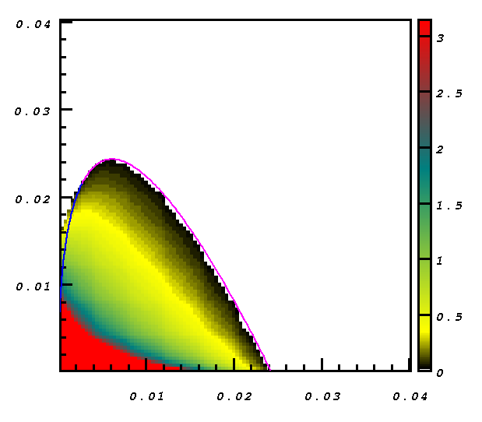
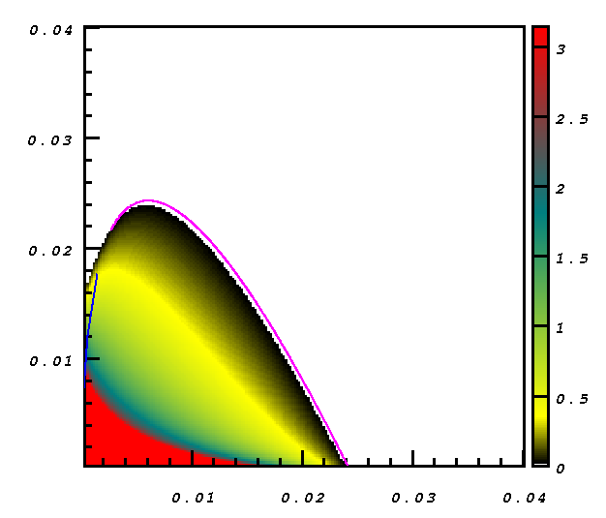
For sextupoles alone fix-lines set DA !
ay
ay
From tracking
From theory
ax
ax

Slide 23
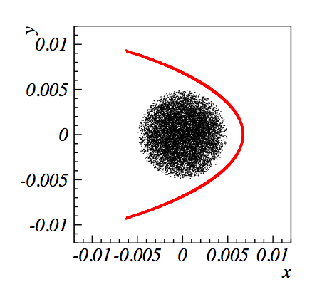
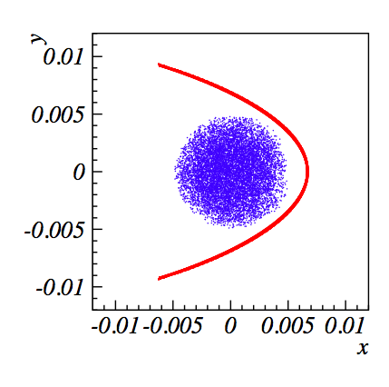
What do the stable fix-lines do to the beam ?
After 10000 turns
Here we change the distance of the resonance. Stabilization with an octupole

Slide 24



Slide 25



Slide 26
Core
growth
x
y
Halo

Slide 27



Slide 28

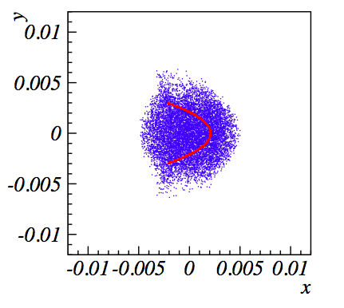

Slide 29



Slide 30
Effect of space charge:
Gaussian round beam
DQsc
DQy
Qx + 2 Qy = N

Slide 31
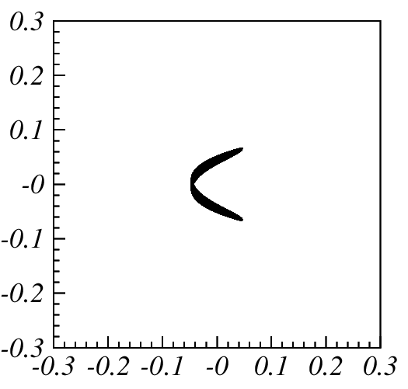
3rd order fix-line controlled by the space charge of a Gaussian CB
DQsc = -0.048
DQy = 0.08

Slide 32
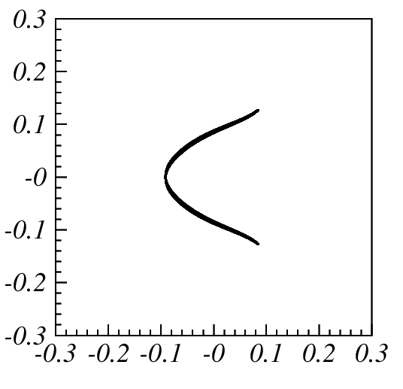
DQsc = -0.093
DQy = 0.08

Slide 33
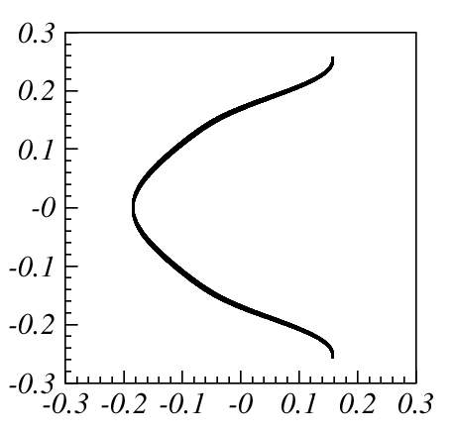
y [1]
DQsc = -0.3
DQy = 0.08
x [1]

Slide 34
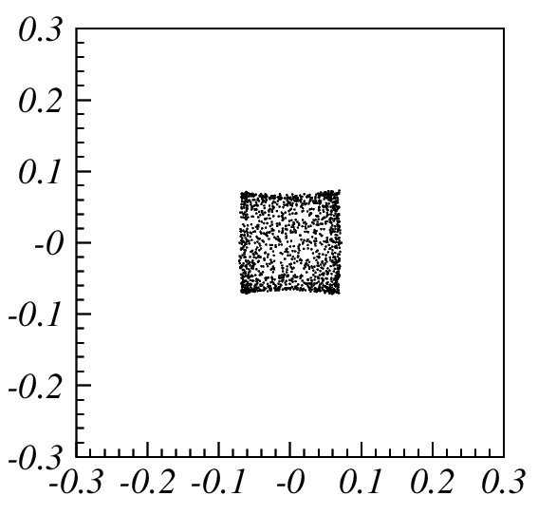
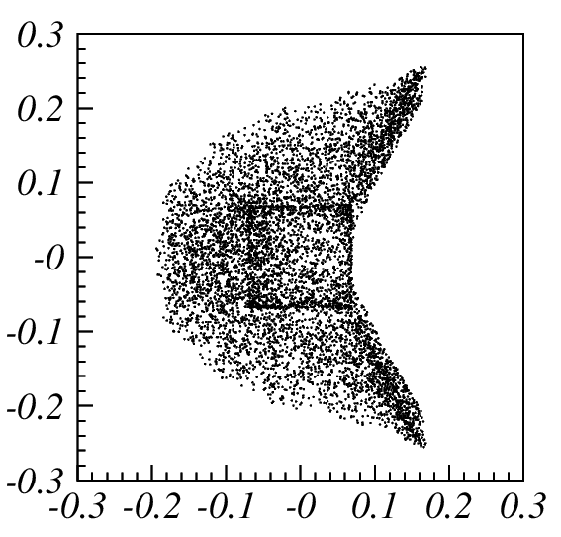
trapping/non trapping
Resonance crossing without trapping
Resonance crossing with trapping
FAST (10000 turns)
SLOW (10000 turns)

Slide 35
Resonance crossing with trapping + larger fix-line

Slide 36
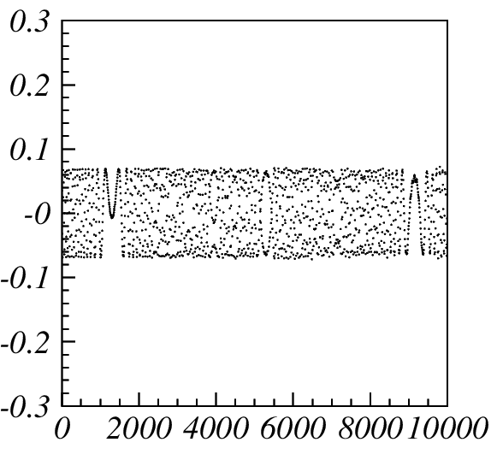
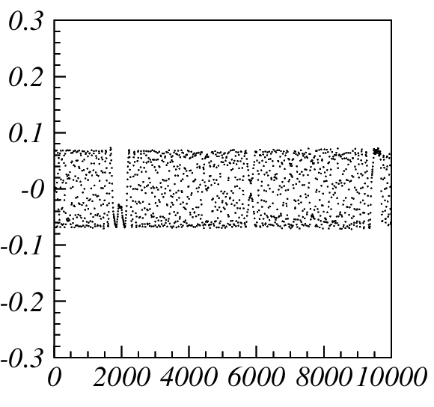
time evolution fast crossing

Slide 37
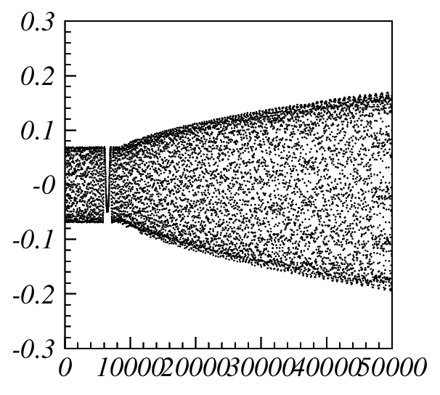
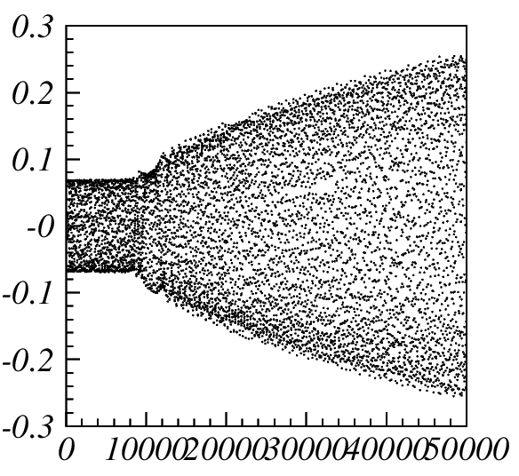
time evolution slow crossing

Slide 38
Summary
After the lattice model is improved the simulation shows an emittance
increase ratio of 2
Random errors have a significant effect and may bring the emittance growth
ratio to 2.5
A pre-existing resonance is not properly included
Beam distribution from simulations have the same pattern as for the measured
The asymmetric beam response is explained in terms of the periodic
crossing of fix-lines with the beam
Theory of the fix-lines with detuning (space charge or octupoles) is essential
to understand the extension and population of the halo/core growth →
hence to control the negative effects: impact on effective resonance compensation
in SIS100…. but it would be nice to measure it!

