Slide 2
PS-LIU Space-charge related issues
S. Gilardoni for the PS-LIU project
CERN –BE/ABP
Contributions from: H. Damerau, G. Franchetti,
A. Huschauer, S. Machida, A. Oeftiger, Y. Papaphilippou,
J. Qiang, G. Rumolo, F. Schmidt, R. Wasef

Slide 3
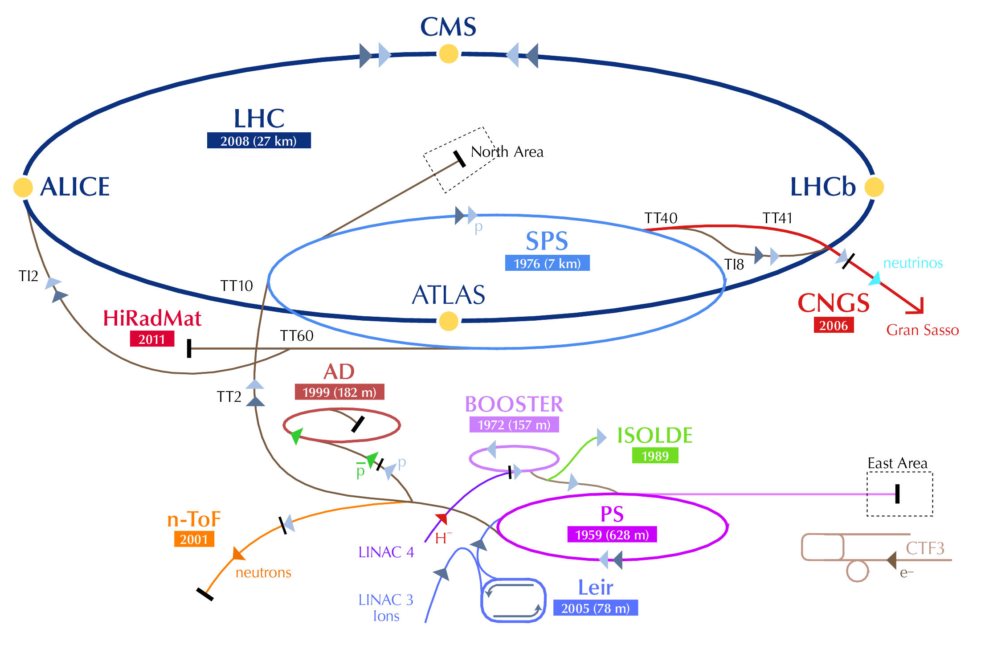
LHC injectors upgrade Goals
Present
LIU (2019)
Proton flux / Beam power
50 MeV
Linac2
Linac4
160 MeV
1.4 GeV
PSB
2.0 GeV
PSB
26 GeV
Output energy
PS
PS
450 GeV
SPS
LHC /
HL-LHC
7 TeV
“The LHC Injectors Upgrade should plan for delivering reliably to the LHC
the beams required for reaching the goals of the HL-LHC. This includes LINAC4, the PS booster, the PS, the SPS, as well as the heavy ion chain…” (This is the mandate … Upgrade of Brightness)
+ determine possible improvements for high intensity beams.

Slide 4
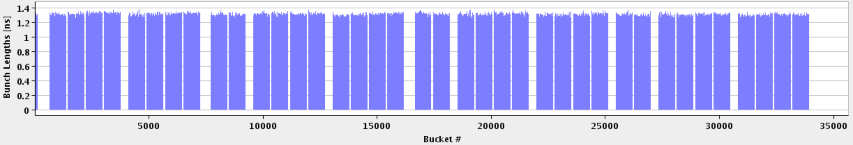
LHC and Injectors – 50 ns
1 SPS batch
(144 bunches)
1 PS batch
(36 bunches)
Abort gap
2012-2013 LHC - 26.7 km - 1380 bunches – 50 ns
To LHC
= Field in main magnets
450 GeV
= Proton beam intensity (current)
= Beam transfer
SPS
26 GeV
PS
1.4 GeV
PSB
1.2 seconds
Time

Slide 5
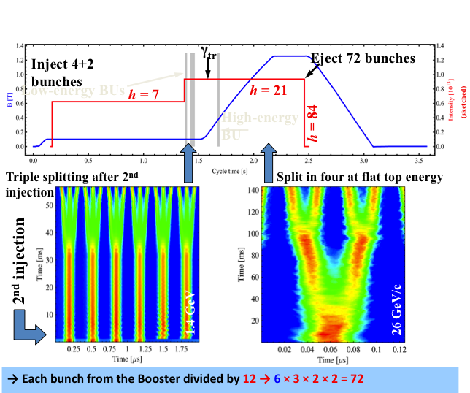
LHC25(50)ns Production Scheme as today
Production scheme:
a) Double batch injection from PSB (4 + 2 bunches, 6 bunches for PS at h=7)
b) Up to 4 batches of 72 bunches each transferred to the SPS (288 bunches)
Transverse emittance produced in the PSB, longitudinal in the PS
Multiturn proton injection in PSB
RF gymnastics in PS:
  Triple splitting
  Acceleration
  2 x Double splittings
    (1 Double splitting for 50 ns)
  Bunch rotation
3 RF systems in PSB
5 RF systems in PS
2 RF systems in SPS

Slide 6
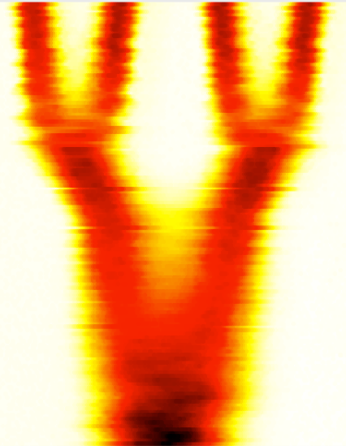
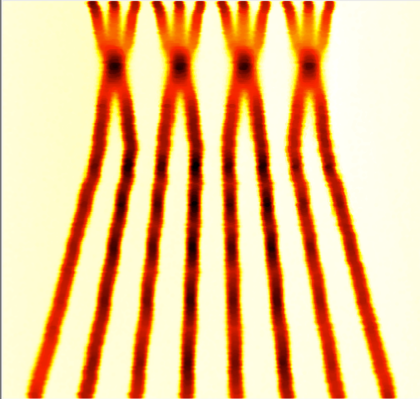
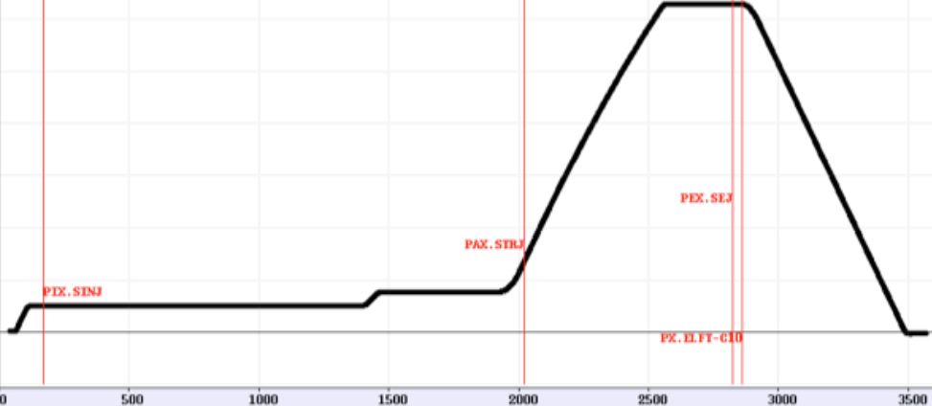
LHC 25(50)ns alternative Production (BCMS)
Production scheme:
a) Double batch injection from PSB (4 + 4 bunches, 8 bunches for PS at h=9)
b) Up to 5 batches of 48 bunches each transferred to the SPS (240 bunches)
Transverse emittance produced in the PSB, longitudinal in the PS
- Multiturn proton injection in PSB with shaving
RF gymnastics in PS:
  Batch compression
  Bunch merging
  Triple splitting
Acceleration
2 x Double splittings
  (1 Double splitting for 50 ns)
Bunch rotation
BCMS “Batch Compression, Merging and Splitting in PS”
h = 9 →10 → 11→12 → 13 → 14 → 7 → 21
h = 21 → 42 → 84
4 bunches
+4 bunches
h = 9
h = 21

Slide 7
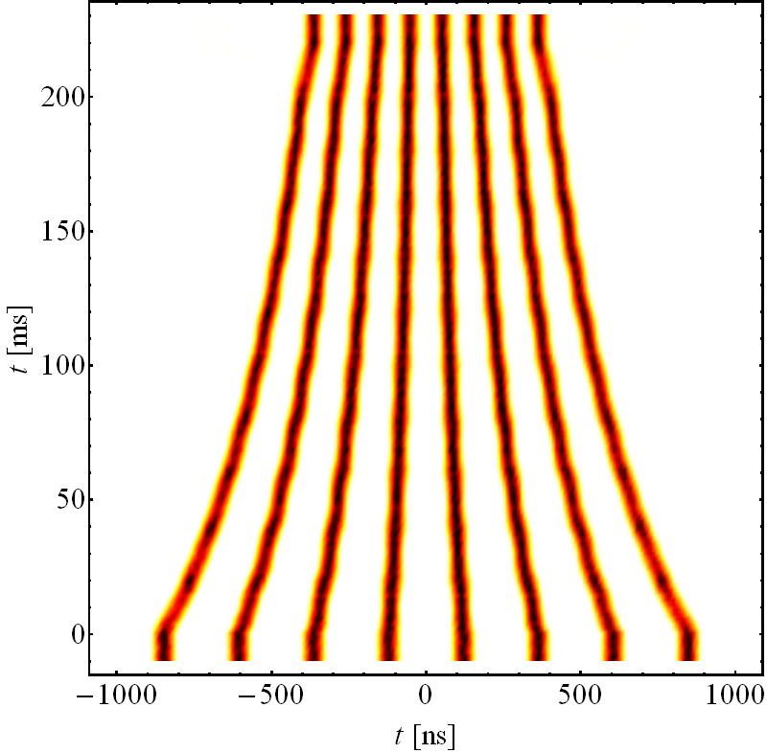
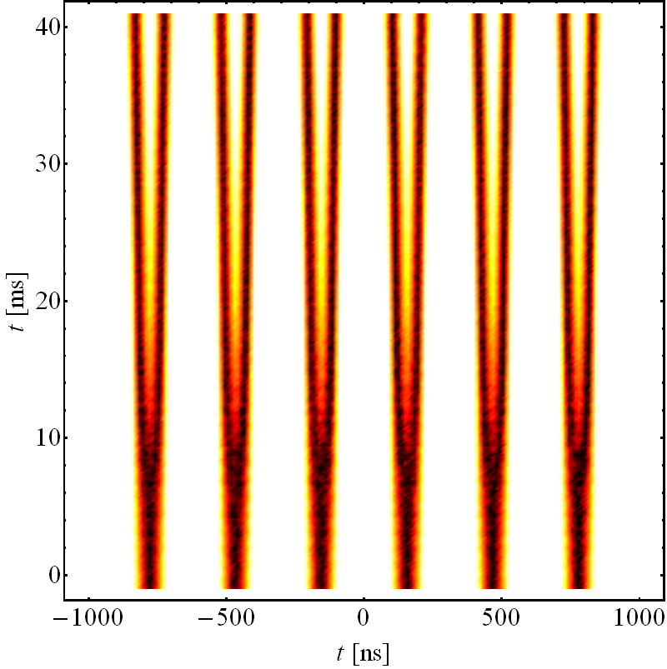
Catalogue of Possible production schemes - 25 ns
Schemes 25 ns | PSB – PS bunches | RF gym. in PS | RF gym. at injection | RF gym. at extraction | b/Train to SPS | SPS injections
3-spitting (standard scheme) | 4 + 2 | /3 ↗ /2 /2 |  |  | 72 | 4
BCMS | 4 + 4 | +2C/3↗/2 /2
 |  |  |  |  | 48 | 5
BCS | 4 + 4 | C ↗ /2 /2
 |  |  |  |  | 32 | 5
8b+4e | 4 + 2 | /2 ↗ /2 /2
 |  |  |  |  | 48 | 5
/ Splitting C Batch Compression + Merging ↗Acceleration to 26 GeV/c

Slide 8
Present and future performance @ SPS extraction
(in terms of beam power for Neutrino beams)
 | Operation |  | SPS record |  | After LIU (2020)
 |  |  |  |  | Aim | Study
 | LHC | CNGS | LHC | CNGS | LHC | post-CNGS
SPS beam energy [GeV] | 450 | 400 | 450 | 400 | 450 | 400
bunch spacing [ns] | 50 | 5 | 25 | 5 | 25 | 5
bunch intensity/10¹¹ | 1.6 | 0.105 | 1.3 | 0.13 | 2.2 | 0.17
number of bunches | 144 | 4200 | 288 | 4200 | 288 | 4200
SPS beam intensity/10¹³ | 2.3 | 4.4 | 3.75 | 5.3 | 6.35 | 7.0*
PS beam intensity/10¹³ | 0.6 | 2.3 | 1.0 | 3.0 | 1.75 | 4.0*
PS cycle length [s] | 3.6 | 1.2 | 3.6 | 1.2 | 3.6 | 1.2/2.4*
SPS cycle length [s] | 21.6 | 6.0 | 21.6 | 6.0 | 21.6 | 6.0/7.2
PS momentum [GeV/c] | 26 | 14 | 26 | 14 | 26 | 14
average current [μA] | 0.17 | 1.17 | 0.28 | 1.4 | 0.47 | 1.9/1.6
power [kW] | 77 | 470 | 125 | 565 | 211 | 747/622
*Feasibility including operational viability (especially in PS) remains to be demonstrated
Notes:
Numbers as required by LAGUNA. However, they are not granted. Further studies necessary to understand if this value is reachable.

Slide 9
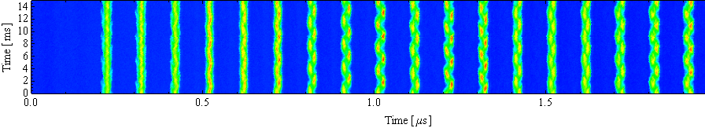
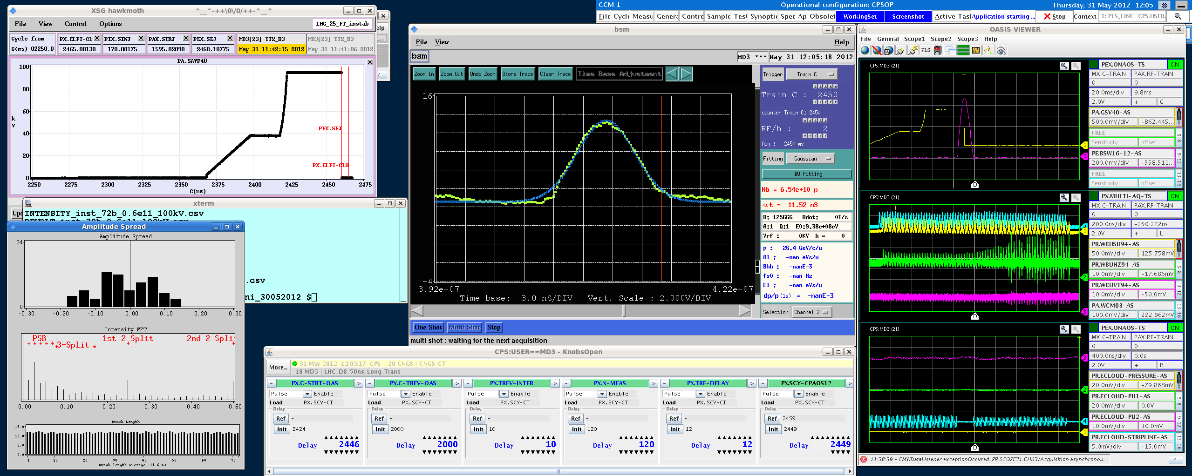
Challenges in the PS
Acceleration/Bunch splittings
Longitudinal CBI → new damper
Transient beam loading → 1 turn delay FB
Transition crossing → no limitation expected
Flat top:
Longitudinal CBI → new damper
Electron cloud → transverse FB
Transverse instabilities → transverse FB
Injection flat bottom:
Space charge → 2 GeV injection upgrade
Headtail instability → transverse FB
Injection flat bottom:
Space charge → higher brightness with 2 GeV
Headtail instability → transverse FB

Slide 10
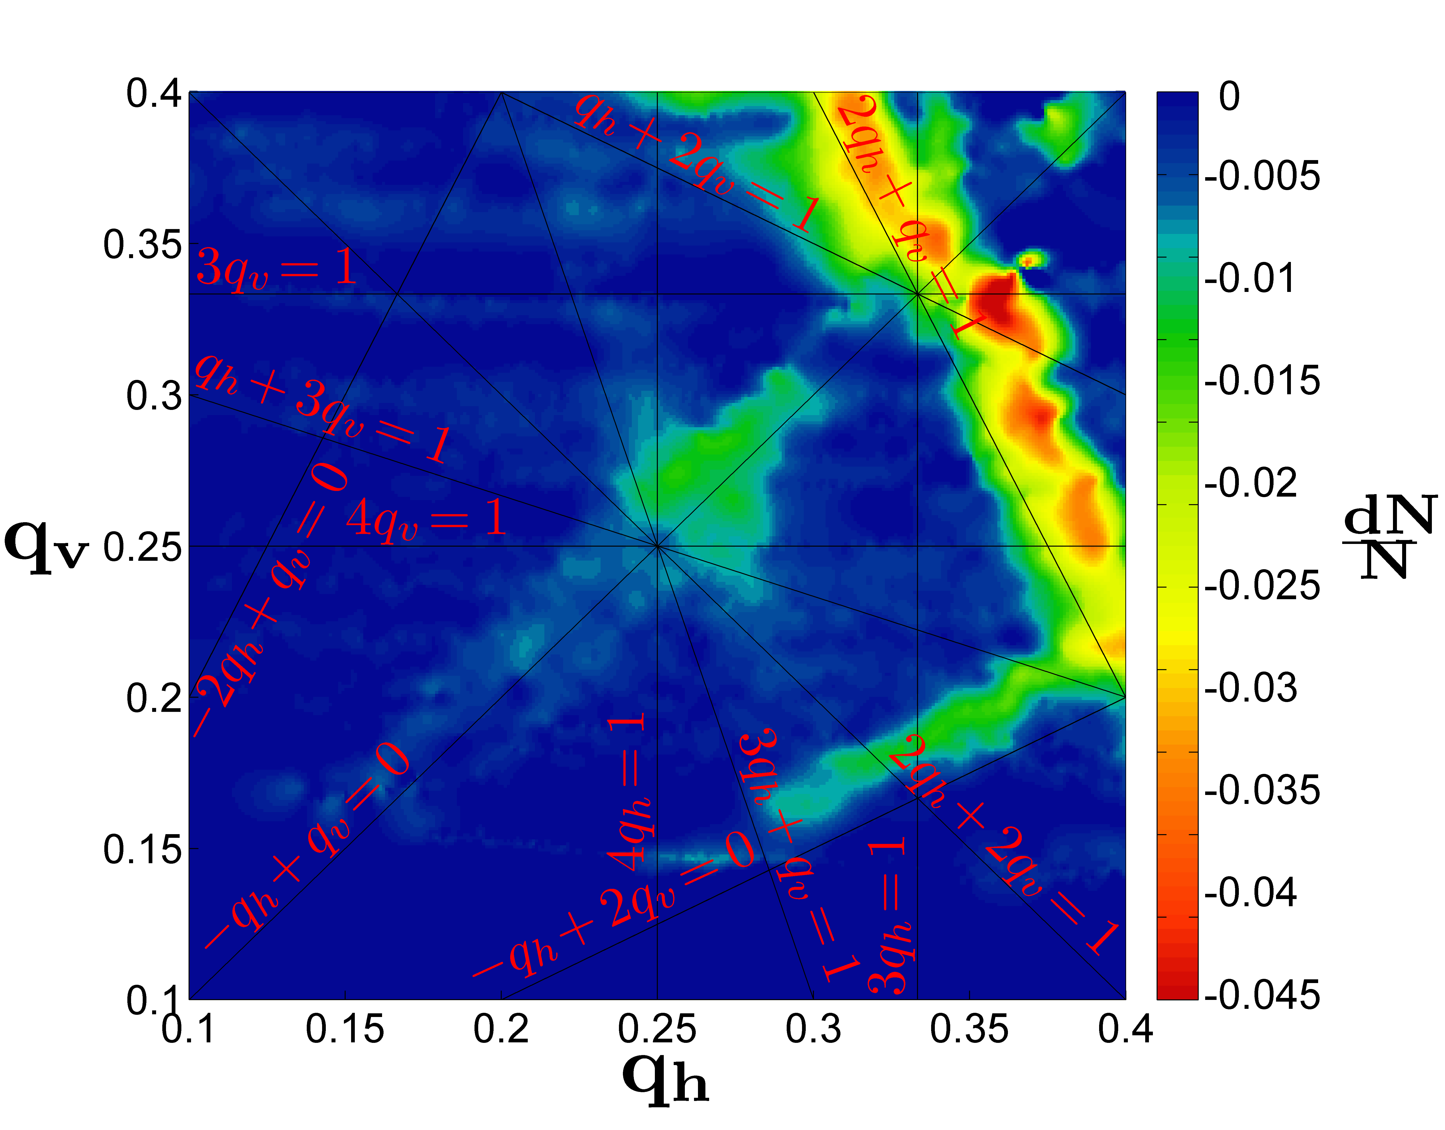
Space Charge at injection (1.4 GeV - 2 GeV)
Study to determine largest acceptable tune spread.
Today max acceptable: ΔQy ~|0.3| @ 1.4 GeV
HL-LHC max needed: ΔQy > |0.3| @ 2 GeV
Goal: demonstrate that possible to inject a beam
with ΔQ>|0.3| with limited emittance blowup (max 5%)
Experimental studies:
  Learn from operational beams experience.
  Current Laslett at about -0.28 with Qy<0.25
  Tune scan to identify via beam losses dangerous
  resonances
  Driving terms measurements
  Compensate resonances
  (as done already in 1975 with injection at 50 MeV)
Simulation studies:
  PTC–Orbit simulations
  IMPACT – MADX-FZM simulations
  Lack of good magnetic error model
    No error tables from magnetic measurements
    (à la LHC) available from 195
    Opera©-based magnetic error simulations
2013-2014 important results:
Better understanding of integer resonance
Better understanding of 4th (or 8th)
order resonance

Slide 11
Space charge issue: Vertical growth vs. Tune-spread vs. Losses
See Raymond’s presentation
Existing operational LHC-type beams
Sometimes 4th order res. used
to scrape tails

Slide 12
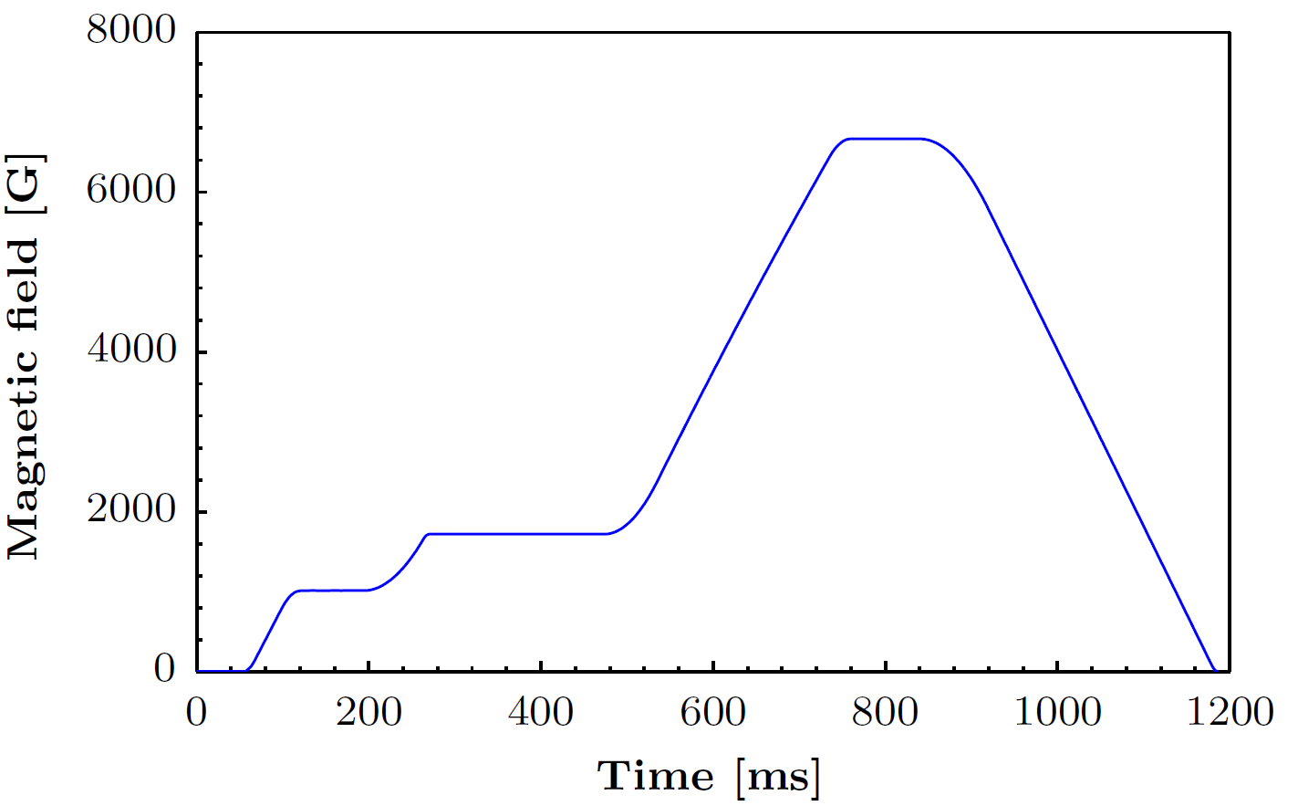
PS Limitations for high-intensity beams: what we learned from the CNGS run
See Alexander’s presentation
Extraction
losses due to extraction mechanism CT/MTE
14 GeV/c
Acceleration
RF voltage limited at transition
TMCI instabilities at transition
1.4 GeV
Injection
losses due to optics
losses due to oscillations
Notes:
More detailed information will follow concerning injection and extraction. Concerning acceleration one can say the following: for HL-LHC beams we need an upgrade of the 10 MHz cavities (the accelerating structures in the PS). In this regard, a study is ongoing and within this study the possible gain for HI beams is going to be investigated. Additionally a thesis concerning the HW upgrade has just started.

Slide 13
Current activities (mainly presented later by Raymond, Alex, Shinji, Ji and Adrian)
Improve understanding of existing space charge limits
  Integer resonance (in collaboration with LBL)
  4th order resonance (in collaboration with RAL, talks of Raymond and Shinji)
  Normal 3rd order resonance (in collaboration with GSI, talks of Raymond and Giuliano)
  Understand indirect space charge effects (talk of Alexander)
Improve machine modeling
  Random multipoles errors from geometry
  Machine alignment
  Longitudinal and transverse impedance model
  Still missing : chromo-geometric terms modeling
Investigate alternative solution to increase maximum acceptable direct
tune shift on top of the 2 GeV injection energy upgrade (baseline)
  Hollow bunches in the longitudinal plane (talk of Adrian)
  Horizontal dispersion increase
  Resonance compensation
  Fully coupled optics : generate vertical dispersion by linear coupling

Slide 14
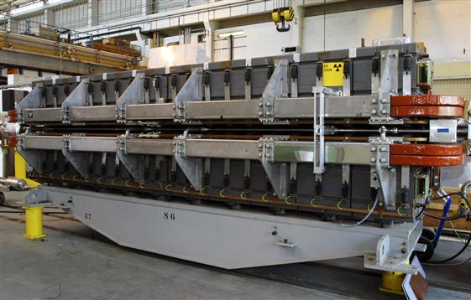
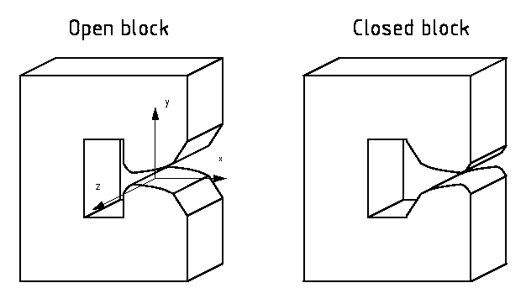
Proton Synchrotron main magnetic unit
Combined-function magnet with hyperbolic pole shape
  Dipole field – guiding
  Quadrupole field – focusing
  Higher component from axiliary circuits
  Higher component also present
  due to saturation at 26 GeV/c
Focusing and defocusing half (FDDF)
  5 C-shaped block in each half
  Wedge shaped air gaps between blocks
Complex geometry of coils system
In total 100+1 main units of four different types.

Slide 15
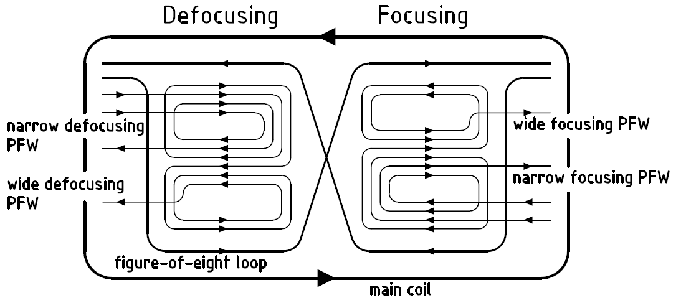
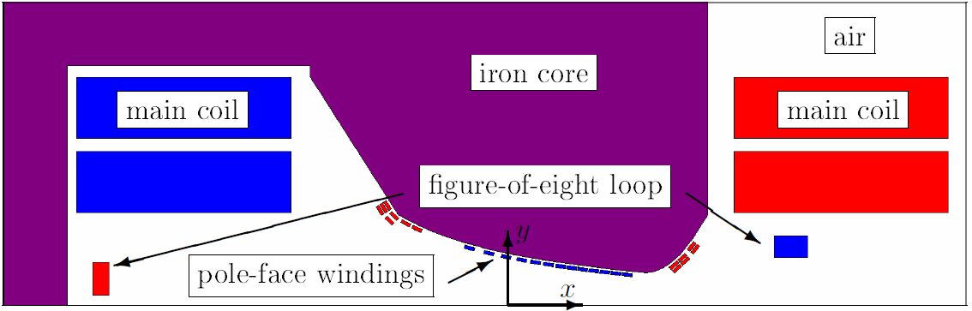
Coils of the PS magnet
Main coil
  Dipole and quadrupole field mostly
Figure-of-eight loop
  Adjusts quadrupole field but also contributes to dipole field
Pole-face windings (PFW)
  Separately for focusing and defocusing half
  Each winding has narrow and wide circuit
  Corrects higher components of the field
PFW Powering
  5 currents
  Control of the four beam parameters Q_{h}, Q_{v}, ξ_{h}, ξ_{v}
  One current remains free
  for controlling an additional physical parameter

Slide 16
Magnet representation in the optical model
Official optics
  Static elements length
  SBEND
    Bare machine
    quadrupolar component
    No pole-face angle
  MULTIPOLE
    Beam-based fit of NL-chroma
  JUNCTION=DRIFT
Model optics
  Dynamic elements length
  – effective length correction
  SBEND
    Up to K2 from the model
    Integrated pole-face angle effect
  MULTIPOLES
    K3 (and higher if needed)
  No JUNCTION element
  Beam-based matched
  effective lengths corrections
Defocusing
Half-unit
(SBEND)
Focusing
Half-unit
(SBEND)
Drift space
(DRIFT)
Drift space
(DRIFT)
Defocusing higher order components
(MULTIPOLE)
Defocusing higher order components
(MULTIPOLE)
Junction
(SBEND)
Defocusing
Half-unit
(SBEND)
Focusing
Half-unit
(SBEND)
Drift space
(DRIFT)
Drift space
(DRIFT)
Defocusing higher order components
(MULTIPOLE)
Defocusing higher order components
(MULTIPOLE)

Slide 17
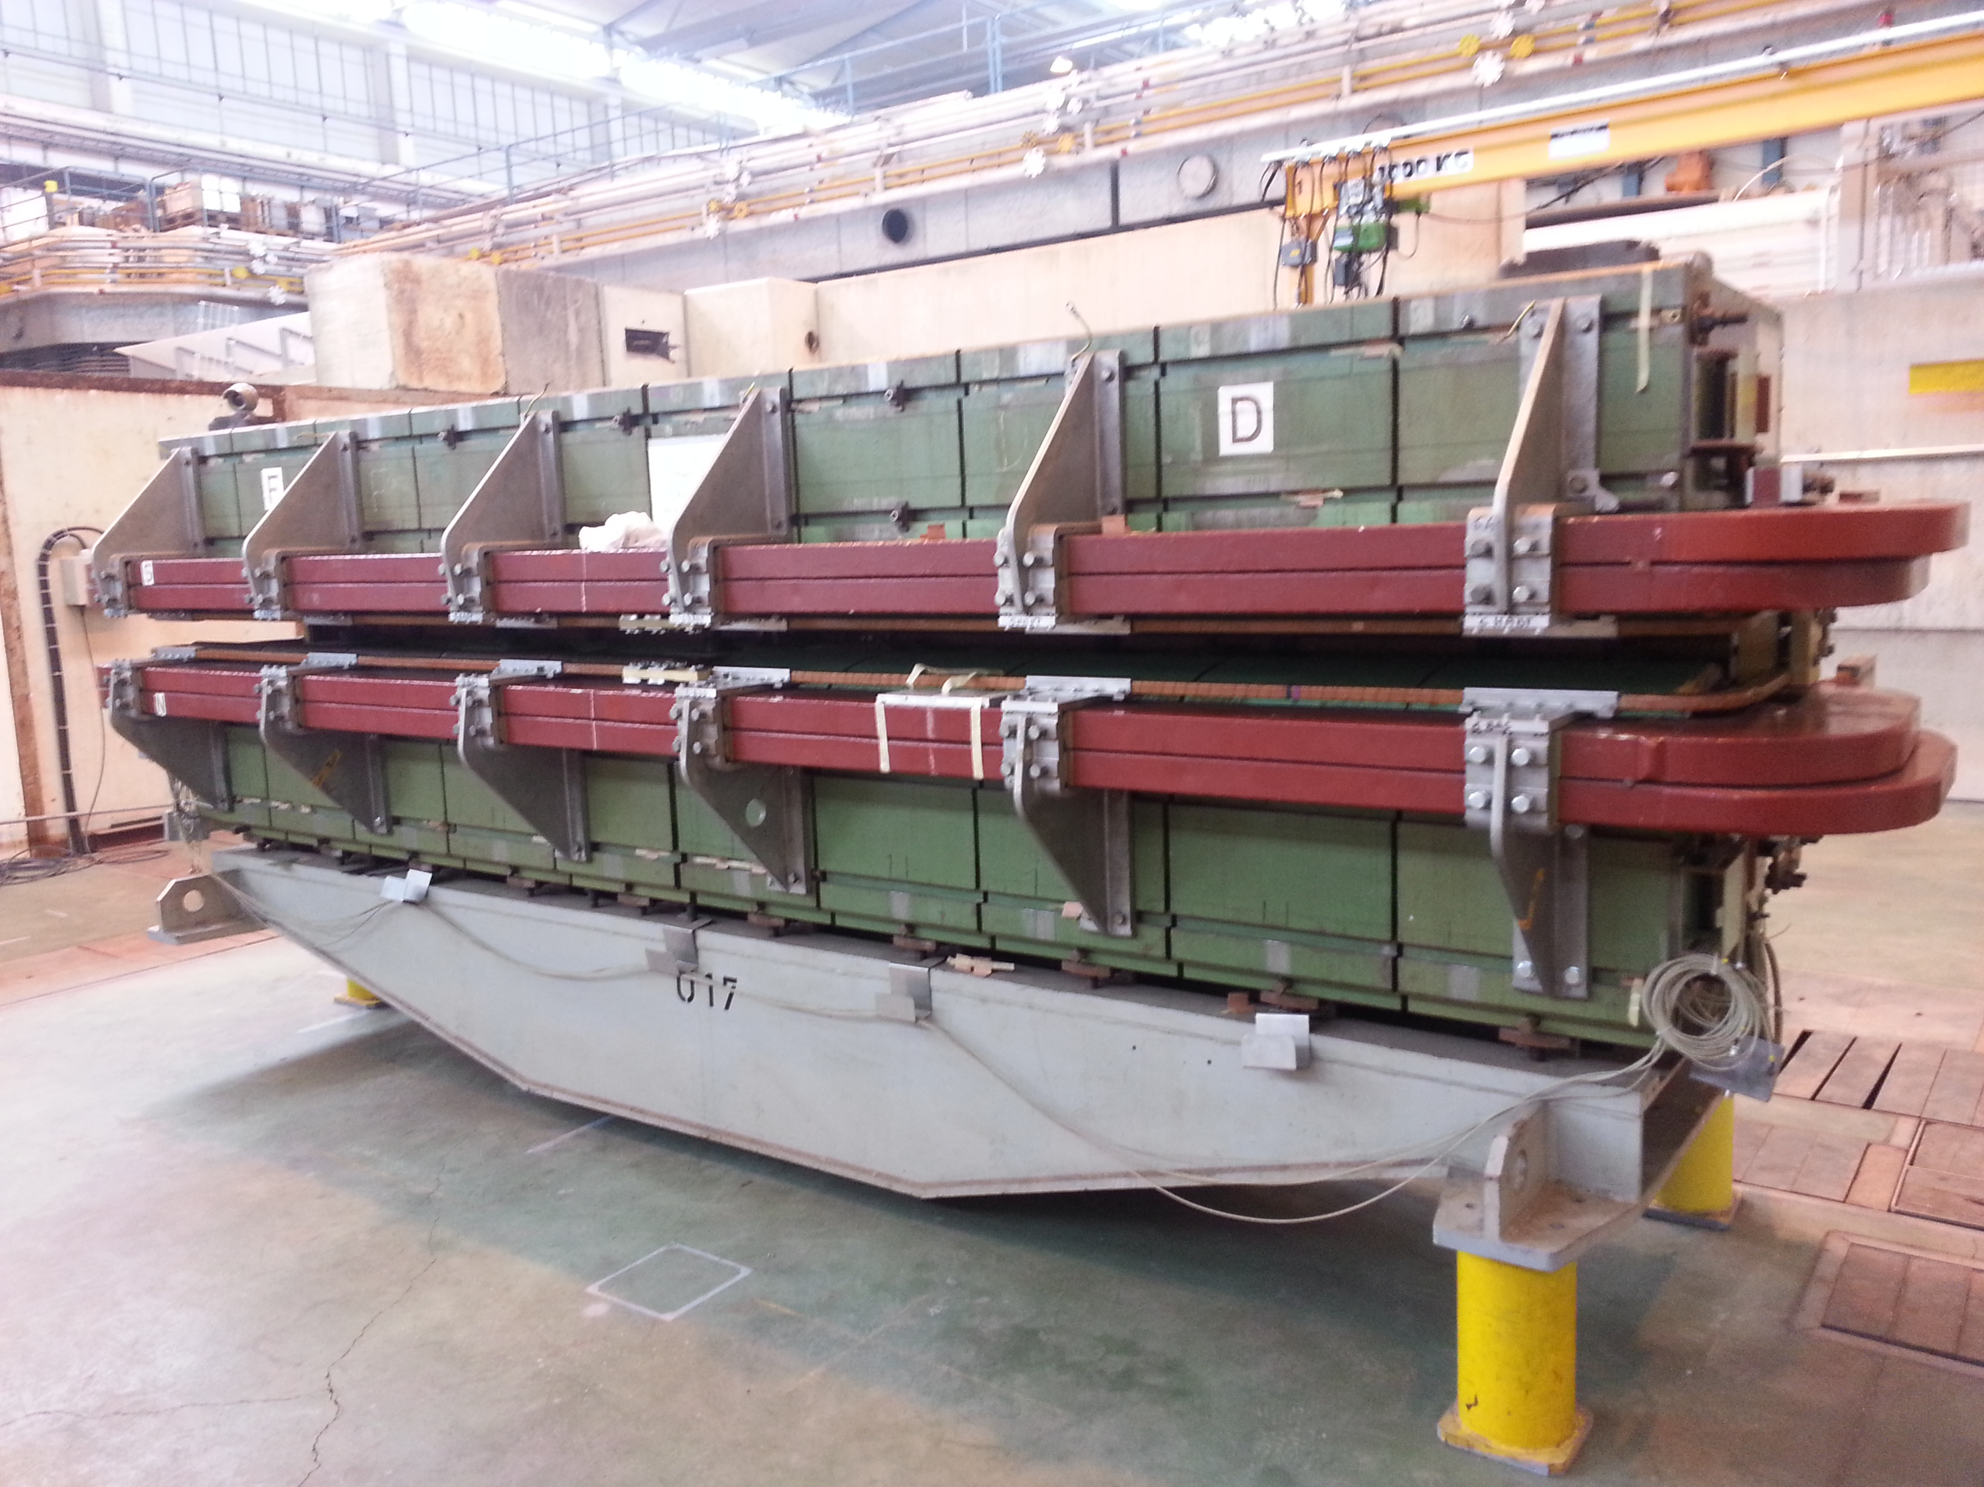
Magnets (Opera© 2/3D model, measurements)
Geometry and magnetic measurements
Opera© model (2-3D)
Simulated normal and skew components and errors
D. Schoerling, IPAC14

Slide 18
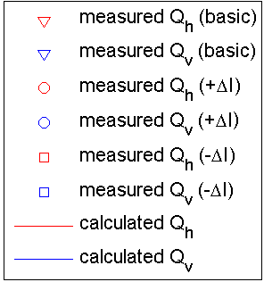
Nonlinear chromaticity (2 GeV)
Narrow focusing PFW variation
Narrow defocusing PFW variation
ΔI_{aux}=2A
ΔI_{aux}=2A
Figure-of-eight variation
Wide focusing PFW variation
Wide defocusing PFW variation
ΔI_{aux}=5A
ΔI_{aux}=2A
ΔI_{aux}=2A
I_{f8}=-0.018 A I_{fn}=-0.015A I_{fw}=-14.545A I_{dn}=-4.669A I_{dw}=-8.235A
M. Juchno Thesis
Measurement data: A. Huschauer Simulation: M. Juchno

Slide 19
Machine alignment 2014 (only main magnets)
Magnet tilted
for orbit correction
Magnet alignements known but not included in MADX model yet

Slide 20
Beta-beating @ 1.4 GeV
T. Bach et. al, IPAC2013

Slide 21
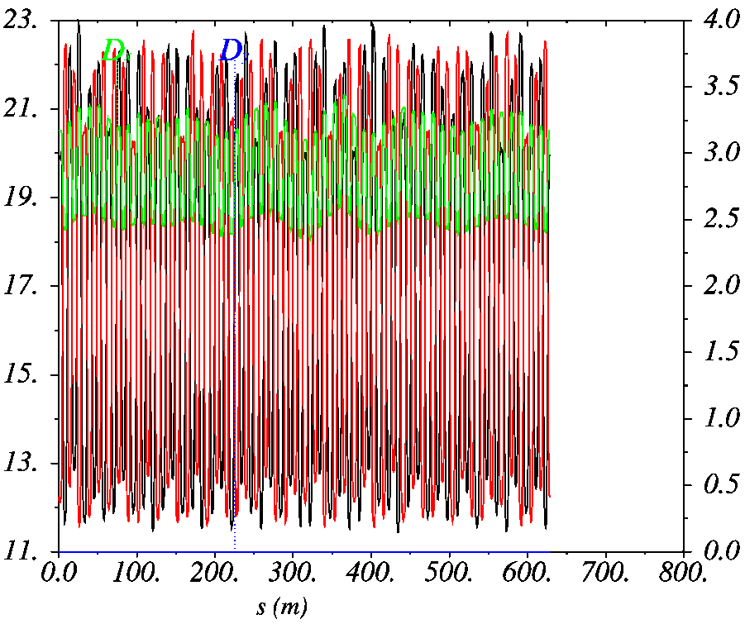
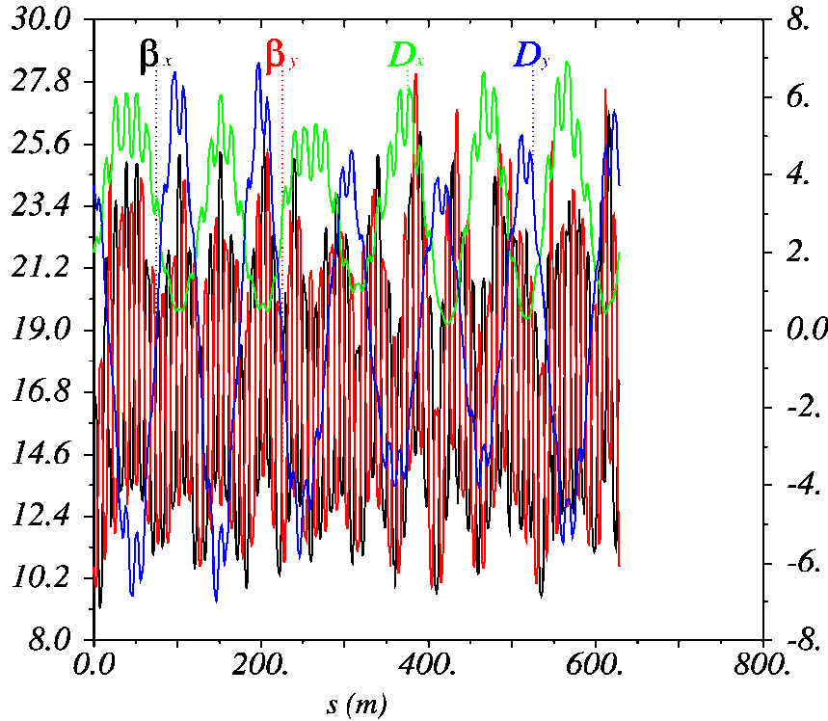
Space charge reduction, transverse
  Compensation of resonances (Q_{x/y}=0.21/0.24)
    Closest resonance 4Q_{y} = 1 difficult as excited by space charge
    Compensation of 2Q_{x} + Q_{y} = 1 and 3Q_{y} = 1 lines during studies in 2013
  Special optics with vertical dispersion
    Introduce vertical dispersion to maximize beam size and reduce DQ_{sc}
    Optics becomes very irregular, needs simulations and beam studies
    Evaluate potential benefit with first beam studies after LS1
Regular optics, zero D_{y}
Irregular optics, non-zero D_{y}
Present configuration
Requires hardware upgrades

Slide 22
Experimental study 2014
Compensation of 4Qv=1 with quadrupoles/breaking sym.
or with octupoles
Integer tune split of two units for 4th order resonance
Integer resonance scan
Special large horizontal dispersion optics
Fully coupled optics at injection
Space charge study with Quadrupolar PU
Transfer of longer bunches from PSB
Hollow bunches
Tune vs kick strenght at different dp/p for chromo-geom.
terms at 2 GeV
Kick response measurements
Beta-beating and loss maps before and after orbit correction
Space Charge and resonances
Longit. plane
Model

Slide 23
Simulation codes requirements
Combined function magnets, with proper treatment of stray fields
Inclusion of multipoles (eventually up to octupole)
Inclusion of skew component (normal and error)
Inclusion of alignment errors (x,y and tilts)
Inclusion of time-varying field (injection bump and RF fields for gymns)
Long term simulations (up to 1.2 s)

Slide 24
Conclusions
Outcome of 2013-14 analysis: the beam characteristics foreseen after implementation of all of LIU(25 ns, 2E11 p/b, 1.9 μm) are good enough for reaching the HL-LHC goal.
2 GeV injection energy upgrade is the baseline as solution to reduce direct-space charge effects
Better understanding of different phenomena limiting performances thanks to simulations and improved experiments analysis
We are in condition to choose between PIC and FZM codes depending on the time scale needed for the simulations thanks to the code development of this year
Intense MD program for 2014 (as btw in 2012-2013)
Thanks to all the collaborators inside and outside CERN for the progresses done so far.

