Slide 2
PS Experiments and Simulations
R. Wasef
in collaboration with:
G. Franchetti, S. Gilardoni, A. Huschauer, S. Machida, F. Schmidt
Acknowledgements: J. Qiang, N. Mounet, PS/PSB operations team.
R. Wasef, Space Charge Collaboration meeting, 20/05/2014

Slide 3
Outline
Space Charge at injection
Experimental studies of 2012/2013
Available simulation codes
Simulations of the Qx+2Qy resonance
Simulations of the 4th order resonance
Summary and Outlook

Slide 4
Space Charge at injection (1.4 GeV)
Current injection energy: 1.4 GeV
➔upgrad to 2GeV
Typical tune-spread of current
operational beam~(0.2 ; 0.28)
LHC double batch injection:
Long flat bottom: 1.2s
HL-LHC beams requirement:
tune-spread > .3 (at 2GeV)
LIU Budgets: 5% losses,
5% emittance growth
➔ Importance of the study
of excited resonances and
their influence on the beam.
Current operation area
1st Injection 170ms
4 bunches
2nd Injection 1370ms
2 bunches
1.2s

Slide 5
Tune scans
Current operation area
Excited resonances: 3Qy=19 and 2Qx+Qy=19 (skew sextupolar)
Operation area very close to the integer resonances ➔ Study the effect of this resonance
During a measurement campaign I noticed the excitation of the 4Qy=25.

Slide 6
4th order Resonance
Horizontal tune fixed at 6.23
Vertical tune: 6.24->6.3->6.24
Maximum detuning due to space charge:
Beam 1 : (-.22 ; -.4)
Beam 2 : (-.18 ; -.37)
Beam 3 : (-.08 ; -.07)
Beam 4 : (-.01 ; -.01)
6.3
6.24
➔ The 4th order resonance seems to be excited by space charge

Slide 7
Vertical growth vs. Tune-spread vs. Losses
Halo particles
Core of the beam
The beam tune-spread is trapped between the 4Qy=25 and the integer.
If one increases the vertical tune to avoid growth due to the integer, the losses increase because of the 4th order resonance
There are less losses with higher tune-spread because the proton population becomes smaller on the 4Qy=25 after compression.
The choice of the working point is a compromise between losses and emittance blow-up

Slide 8
Resonance compensation
Vertical tune scan
2Qx+Qy compensation
3Qy compensation
➔ Successful implementation of a
resonance compensation scheme

Slide 9
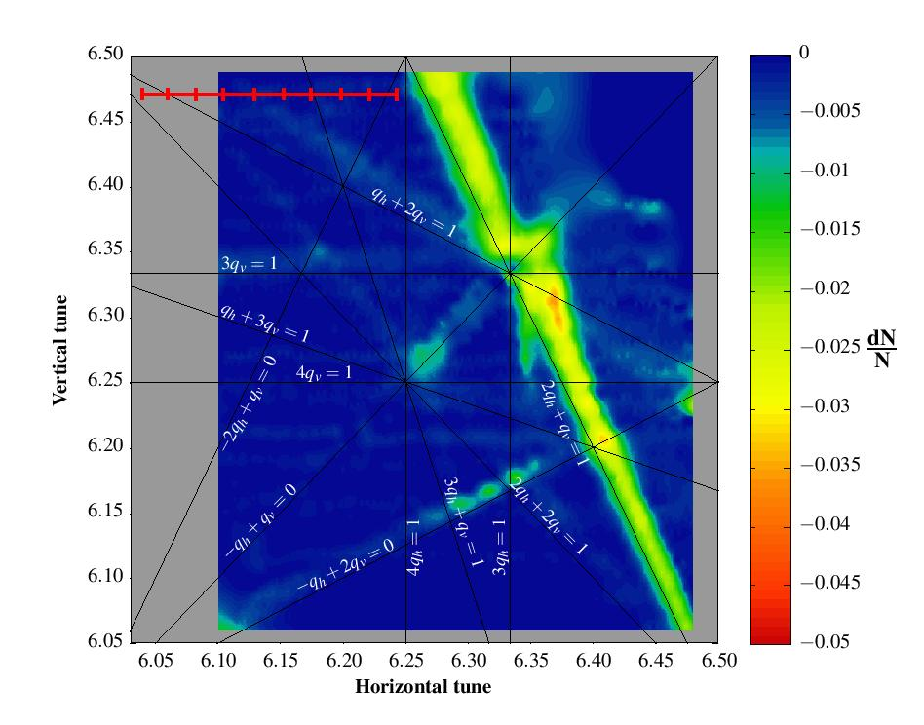
Measurements of the Qx+2Qy resonance
Controlled excitation of the resonance: normal sextupole powered (2A)
10 static measurements of the resonance: for each measurement, Qy fixed at 6.47 and Qx fixed at a value between 6.04 and 6.24.
Observables over 1.1s: beam loss, transverse and longitudinal profiles.
Useful for SIS100 design

Slide 10
Measurements of the Qx+2Qy resonance
Tunes (6.11, 6.47)
Tunes (6.13, 6.47)
The most interesting behaviors were observed for Qx=6.11 and Qx=6.13 (programmed tune). ➔ A simulation campaign was launched, especially to see if we can reproduce such a profile deformation

Slide 11
Available Simulation Codes
PTC-ORBIT
- Advantage: benchmarked, self-consistent.
- Limitations: slow (~1000 turns/day on “spacecharge” cluster at CERN)
➔ Short simulations (few 1000 turns)
MADX-Frozen-model
- Advantage: MADX developed and maintained at CERN, fast with
modest cluster (~50k turns/day on 4 proc.).
- Limitations: very small number of macro-particles for a convenient speed
➔Long-term simulations with Gaussian beams
IMPACT
- Advantage: fast (~ 90k turns/day, on NERSC cluster), self-consistent.
- Limitations: user interface sophisticated, runs on NERSC for ideal speed.
➔Long-term which needs a self-consistent code
Note: All figures are given for the PS case and the same lattice.

Slide 12
Simulation of Qx+2Qy resonance
Simulations are on-going with MADX-Frozen-model.
Preliminary results are very promising.
Limitation and hypothesis:
For the frozen model introduced in MADX, the number of M.P. is limited due to simulation time issues.
To be able to compare profiles, and specially tails, it is very difficult to use only 1000 M.P.
➔ It is supposed that the evolution of the profiles are negligible over 1000 turns.
➔ 1000 successive turns are averaged to generate the profile at a given turn.
➔ which induces high correlation in the distribution since it’s the profile of 1000 M.P. over 1000 turns and not 1M M.P. at the given turn.
This assumption is also comparable to the measurement technique (wire-scanner averaging over 2ms~1000turns).

Slide 13
Experiment & Simulation of Qx+2Qy resonance
TUNES (6.11 ; 6.47)
MEASUREMENT
SIMULATION
Good agreement between measurement and simulation (same binning).
The simulated distribution is going to be regenerated, because of a depopulation issue in the center.
The extent of the tails is not the same between simulation and measurement, but it could be due to the “natural” excitation of the resonance, or an error on the assumed tune.

Slide 14
Experiment & Simulation of Qx+2Qy resonance
TUNES (6.13 ; 6.47)
MEASUREMENT
SIMULATION
Good agreement between measurement and simulation
The difference between the final profiles could come from the “natural” excitation of the resonance, or an orbit oscillation/wire-scanner oscillation and/or an error of the tune settings.
Note: The simulated and measured profiles are not at the same position (~factor of 2 difference in β ➔ different sizes)

Slide 15
Simulation of the Qx+2Qy resonance
The difference between the simulated and measured profiles for Qx=6.11 is believed to come from the difference between measured and simulated tune.
➔ Tail development is very sensitive to tune-settings.
Measurement at tunes:
programmed (6.11 ; 6.47) measured (6.105 ; 6.476)
Simulation at
Tunes (6.105 ; 6.47)
Simulation at Tunes
(6.105 ; 6.48)
Preliminary results (only 425k turns)

Slide 16
4th order resonance
The preferred hypothesis is that the 4th order resonance is a structure resonance driven by space charge.
The resonance is driven by the space charge force modulation which has a harmonic (4*6.25=25 or 8*6.25=50) of the symmetry of the machine (25x “FD DF FD DF” or 50x ”FD DF”)
If one changes the vertical integer tune, then the space charge harmonic should be different from the lattice one, and shouldn’t be excited anymore. (ex: 4*7.25=29)
Another advantage, noticed during this study, is that the space charge tune spread would be reduced (because of the higher dispersion).

Slide 17
Change of vertical integer tune
To change the integer, I use only the F8L (introduces only quadrupolar component).
Going to 7 as vertical integer tune seems to be more advantageous (reduces the tune-spread due to space
One has to verify if the injection transfer line can match these optics.
A limitation (for large beams): the horizontal size is doubled. (For an LHC-type beam, the aperture~24σ in H and 17.5σ in V)

Slide 18
Change of vertical integer tune
The aim of the following study is to verify the hypothesis of structure resonance driven by space charge.
The simulated beam is different from the measured ones, to have a smaller tune-spread, to overlap only the 4Qy=25.

Slide 19
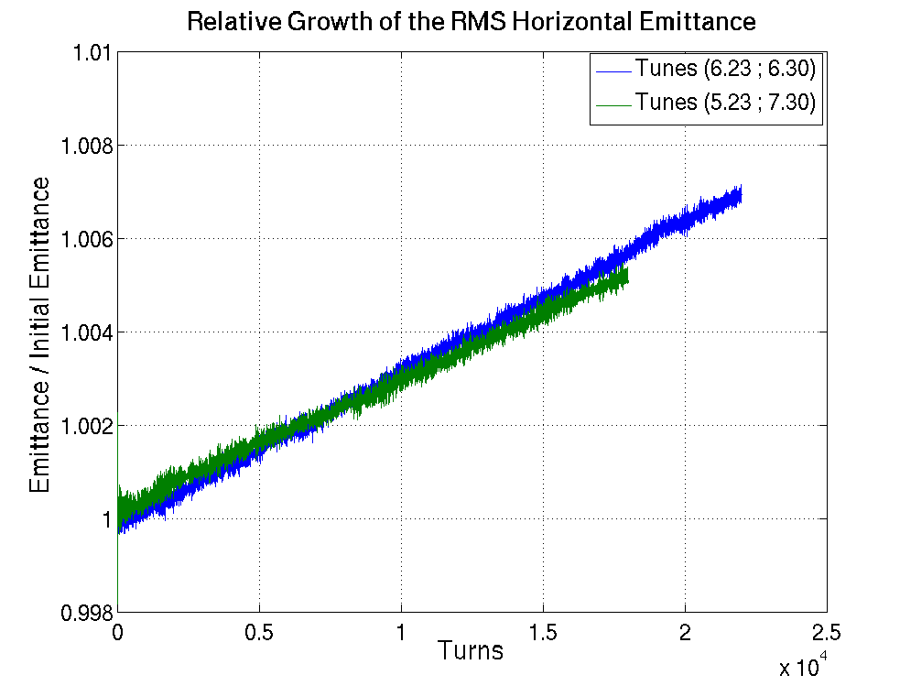
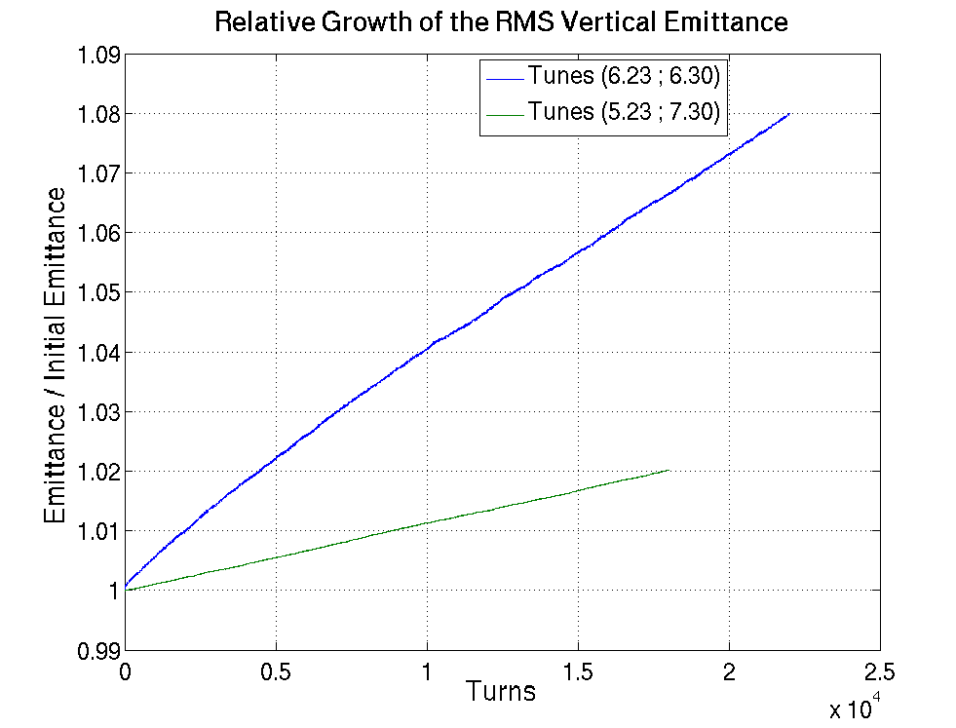
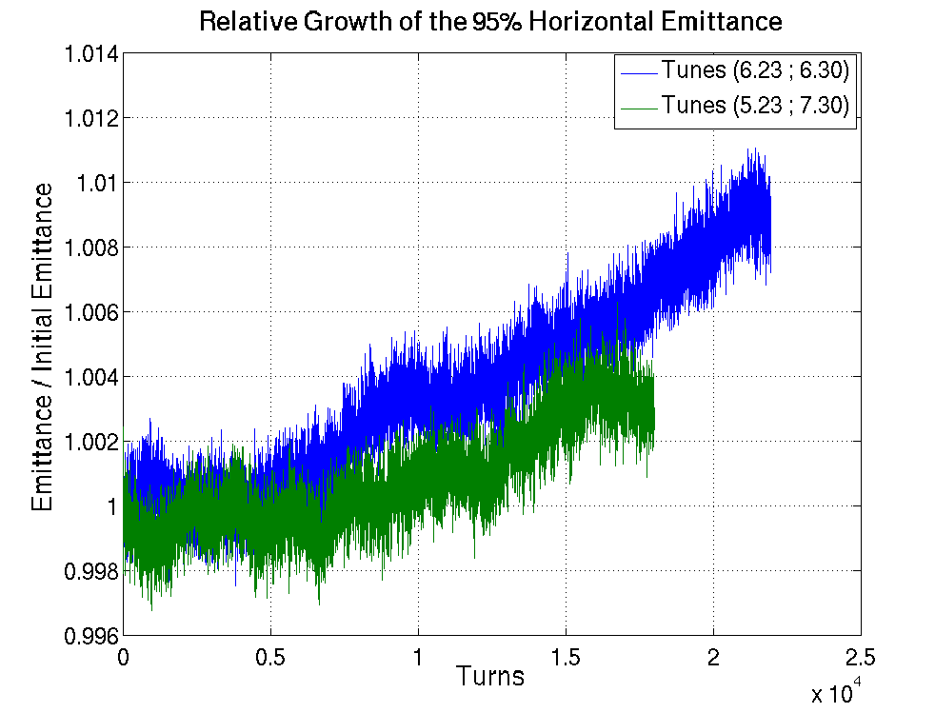
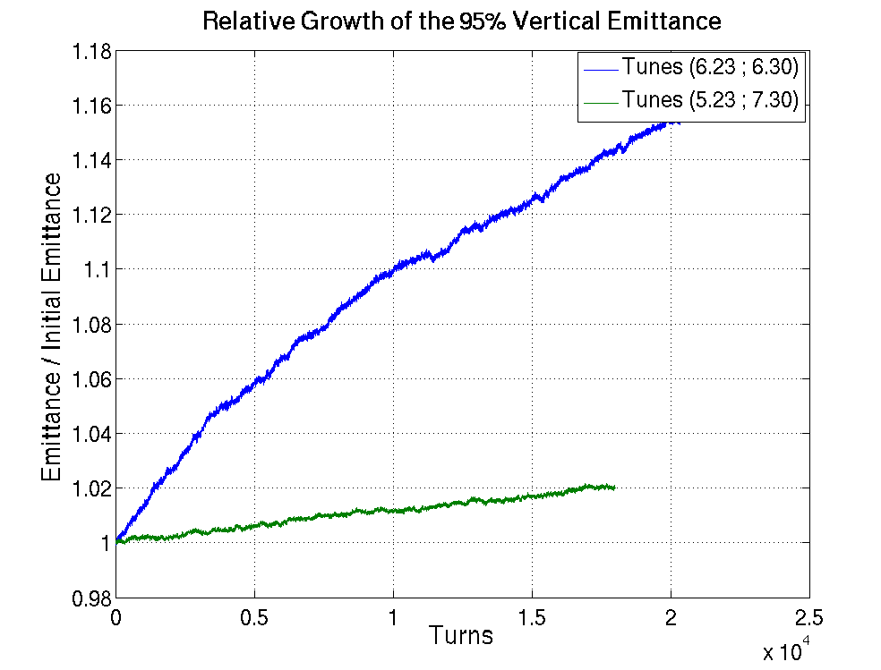
Change of vertical integer tune
Horizontal
Vertical
RMS Emittance
95% Emittance

Slide 20
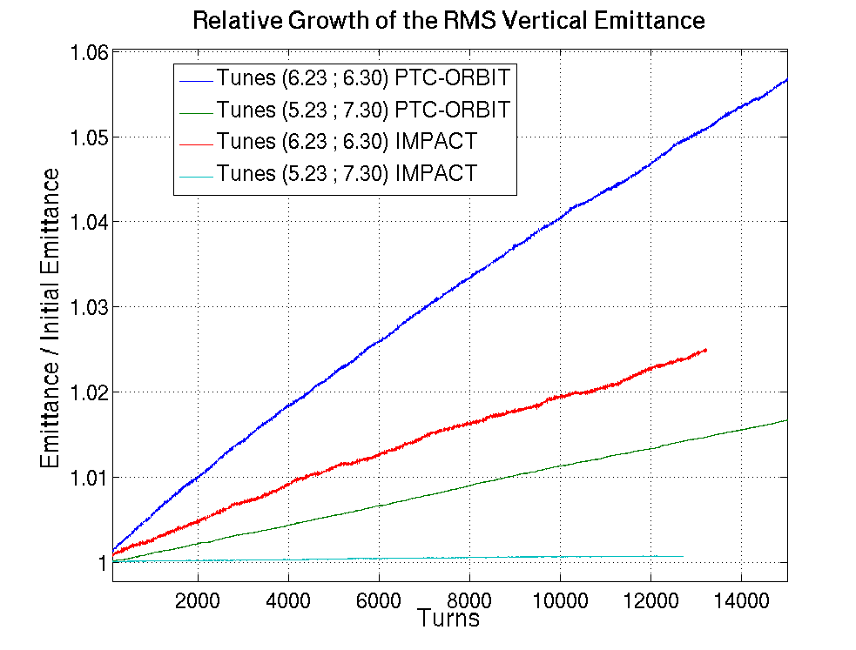
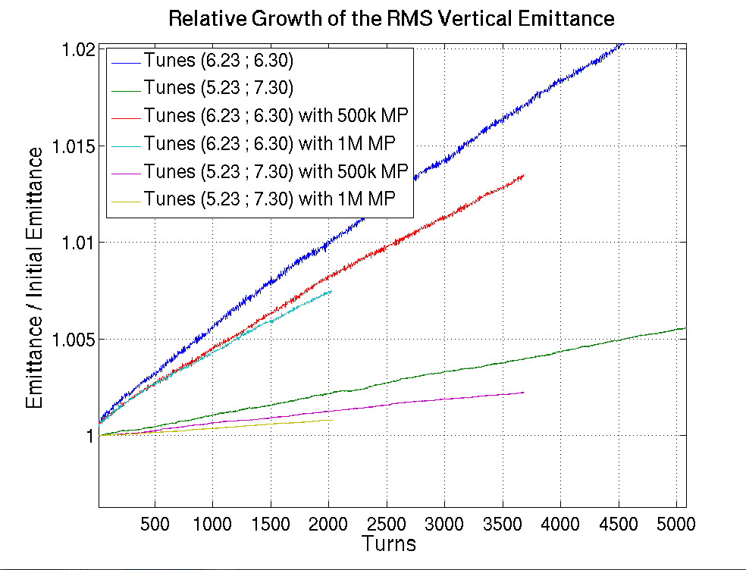
Change of vertical integer tune
PTC-ORBIT vs. IMPACT
PTC-ORBIT with different # of MP
The main goal of these simulations is not to have an absolute value of emittance growth but to verify the relative behavior with the different settings.
➔ Simulations tend to confirm the hypothesis of the 4th order being a structure resonance driven by space charge.

Slide 21
Summary and Outlook
Excited resonances: Skew sextupolar and 4Qy=25.
The skew sextupolar resonances have been compensated.
Simulations are on going using PTC-ORBIT, IMPACT and MADX-SC.
Good agreement between measurement and simulation (MADX-SC) for the case of the Qx+2Qy resonance.
Simulations tend to confirm the hypothesis of the 4th order being a structure resonance driven by Space Charge
Several experiments are planned at the restart of the machine (change of integer, hollow bunches, resonance compensation…etc)
➔ Potential large increase of the available tune area.

Slide 23
Backup Slides

Slide 24
Resonance compensation
Horizontal tune scan
2Qx+Qy compensation
3Qy compensation

Slide 25
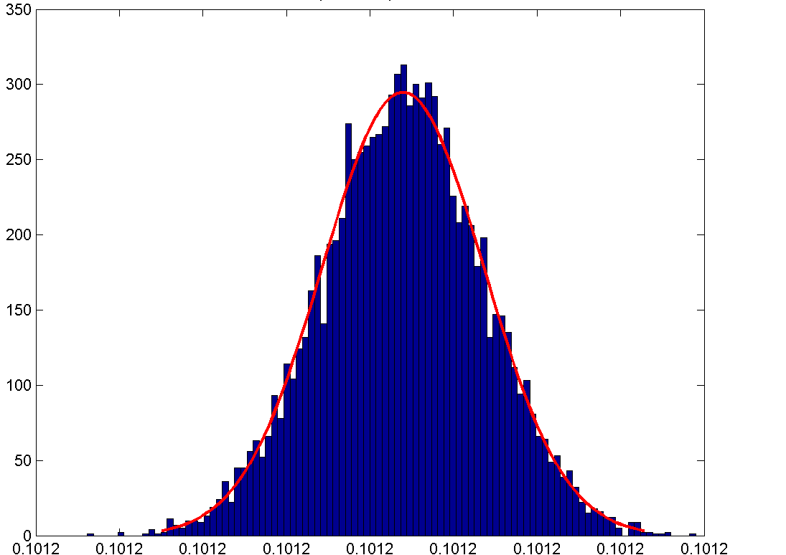
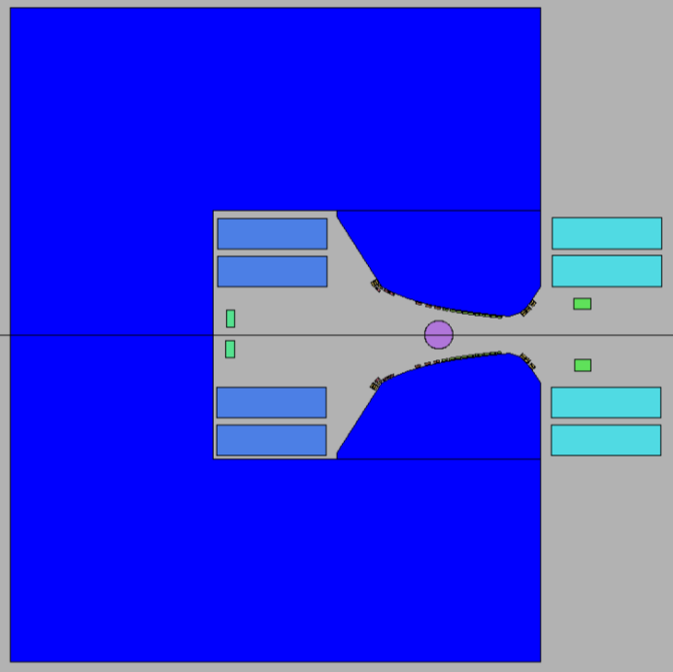
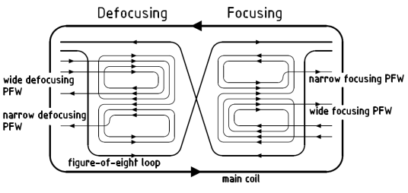
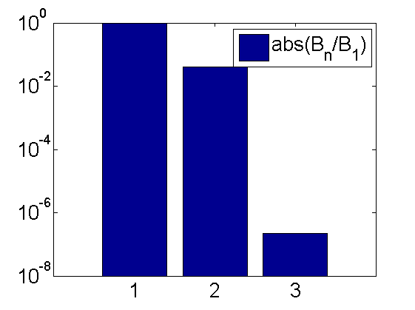
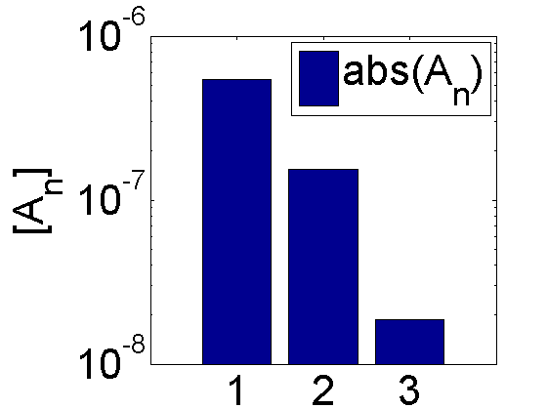
Resonance Compensation
  2D calculation including Gaussian distribution of the position of the coils and the shape of the iron with up to 22 DOFs per magnet (OPERA) were performed.
  1000 models per magnet type (4 types) and current level have to be calculated. Performed for momentum of 2.14 GeV/c, 2.78 GeV/c, 14 GeV/c, 26 GeV/c.
Dipolar Component
Number of test magnet designs (total:9655)
Field [T]
Coils can be displaced, no rotation:
Main coils (2 x 4 DOFs), σ = 3 mm
F8 (2 x 4 DOFs), σ = 1 mm
PFW (2 x 2 DOFs), σ = 0.7 mm
Iron is displaced in y-direction,
σ = 0.02/3 mm
Kinetic energy: 1.4GeV
Reference radius
r = 10 mm
Vacuum chamber: 140x70mm
➔ These errors were randomly distributed on the magnets in the PTC model to compute the driving terms of each of the resonances.

Slide 26
III. 4th order Resonance
Testing the effect of the 4qy by changing the population crossing it (Bunch compression @ C1000)
Tune spread before and after compression
If the working point is close to the resonance, before and after the compression it is mainly the halo crossing the resonance
If the working point is relatively far from the resonance the population crossing the resonance changes after compression
➔ Losses due to the resonance are expected to be different
5

Slide 27
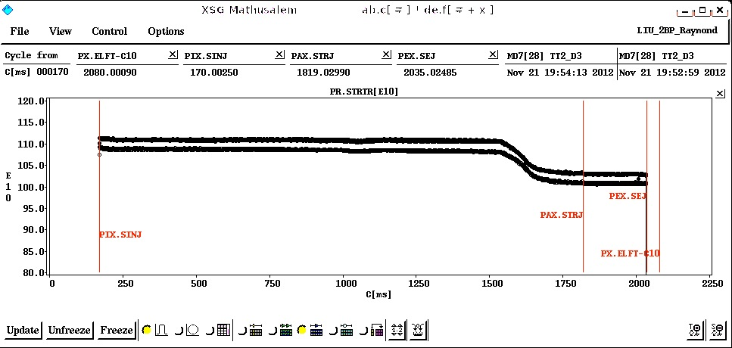
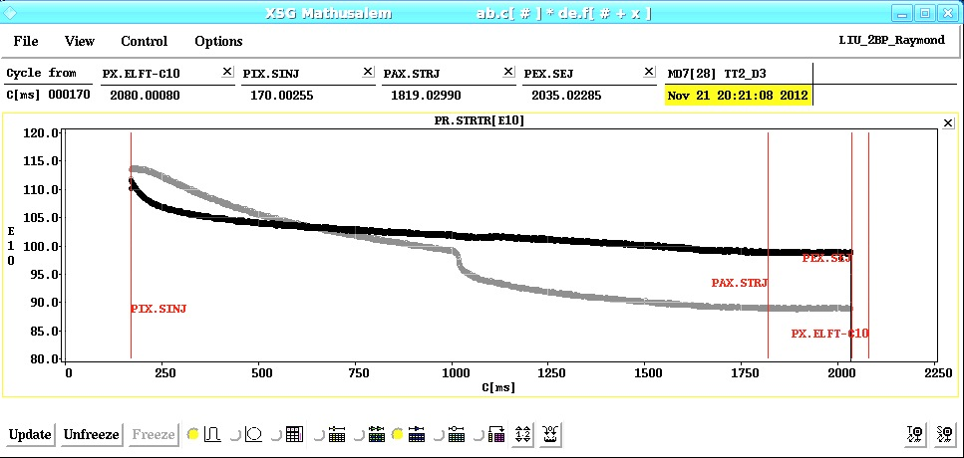
III. 4th order Resonance
Bunch compression @ C1000
Intensity [E10 ppb]
Qy=6.24
Time[ms]
➔No effect of the compression (losses due to change of W.P.)
Qy=6.3
Qy=6.27
Intensity [E10 ppb]
Before compression: losses are faster in the case of Qy=6.27
After compression: No effect for Qy=6.27 but faster losses for Qy=6.3
6

Slide 28
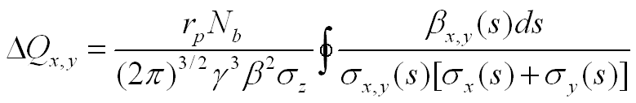
Integer resonance effect
The tune-spread was varied using an adiabatic bunch compression (20ms).
The effect of the integer is observed through the longitudinal and transverse profiles as well as losses.
The transverse profile is measured using a wire-scanner, which averages the profile over ~2ms and it can only be used once per cycle.
The emittances are computed using the a fit of the beam profile from the wire-scanne assuming the optics (β,dispersion) of the model.
The maximum tune-shift due to space charge is estimated using:
After a quick check of the losses and emittances after compression, (6.23 ; 6.255) has been chosen as starting working point. (Measured ~(6.228 ; 6.253) )

Slide 29
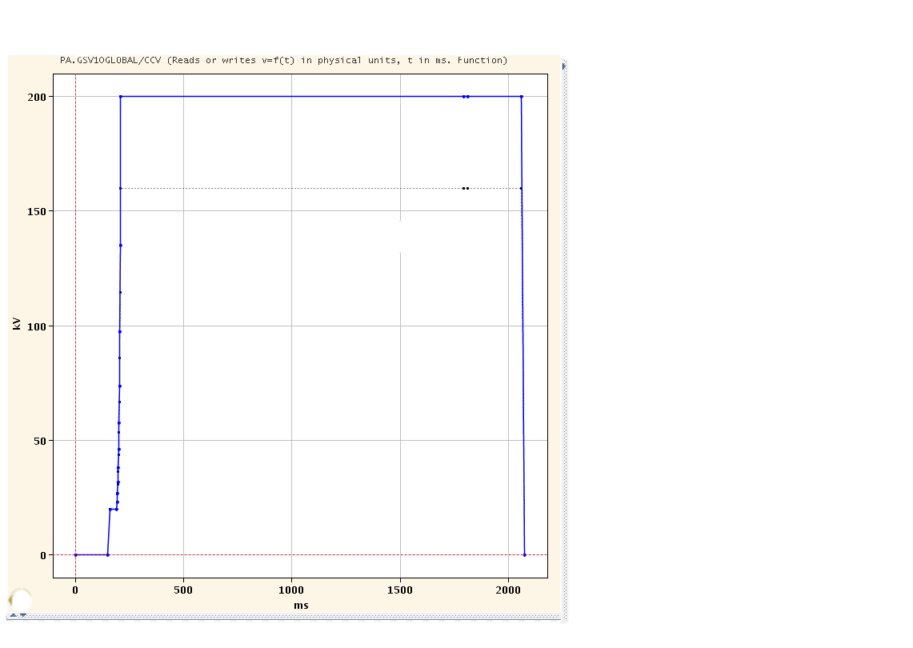
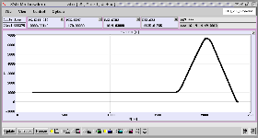
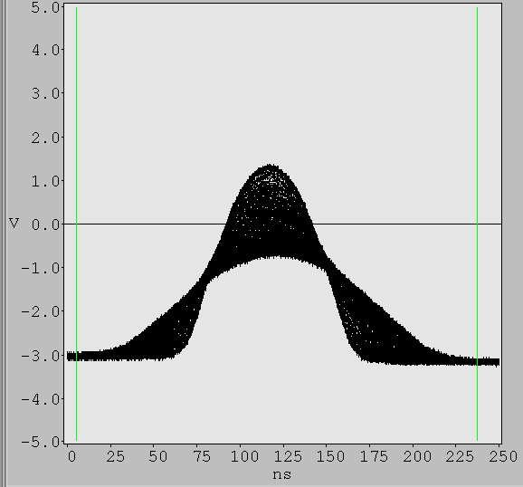
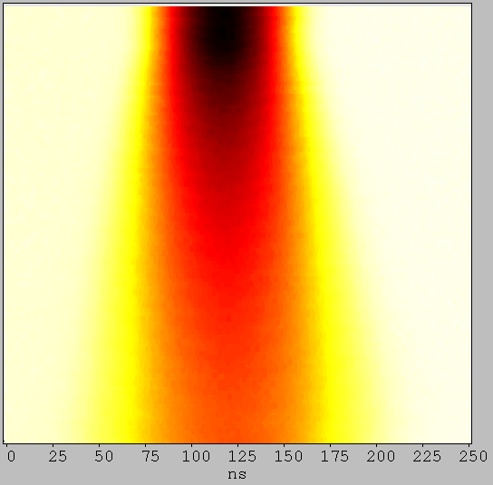
Adiabatic Bunch Compression
Measurements @ flat bottom of 1.2s
End of compression @C210
RF Voltage [kV]
Injection @ C170
Beginning of compression @ C190
Time [ms]

Slide 30
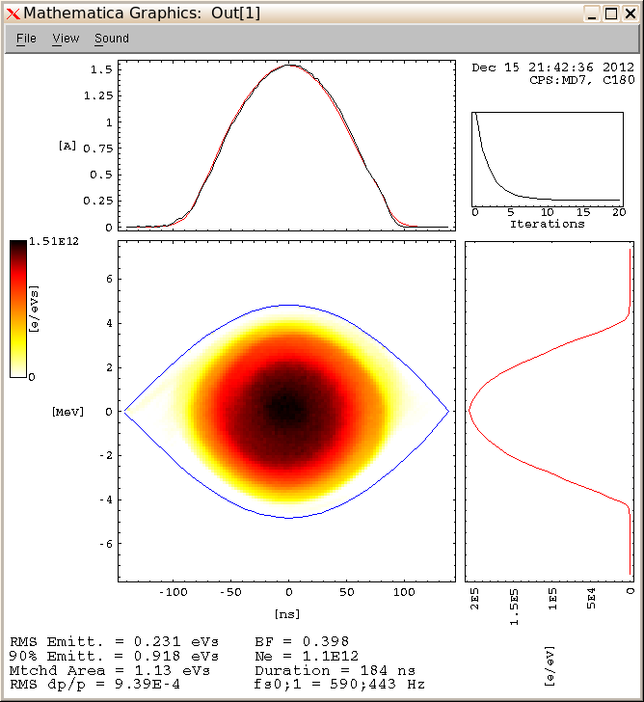

Longitudinal profile before/after compression
Before compression
After compression

Slide 31
Vertical growth vs. Tune-spread vs. Losses

Slide 32
IV. Horizontal emittance behavior
Beam used:
I=1.15e12 ppb; εh,normalized=1.6μm; εv,normalized=1.25μm; Δp/p(1σ)= 0.95E-3 ; full bunch length=185ns
Since the horizontal detuning is always less than .23 (Qx=6.23), no relevant change has been noticed in the horizontal plane. Therefore, only the vertical emittance is shown in the following results

Slide 33
IV. Vertical growth vs. Time vs. Tune-spread

Slide 34
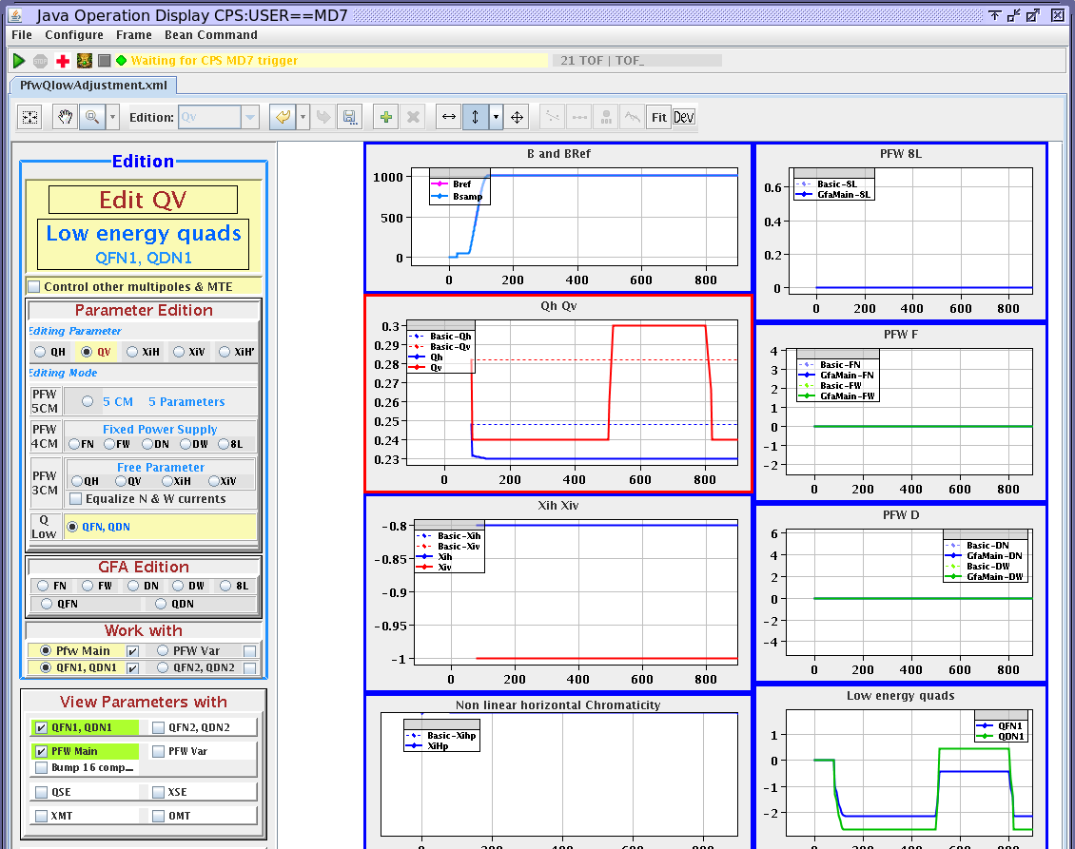
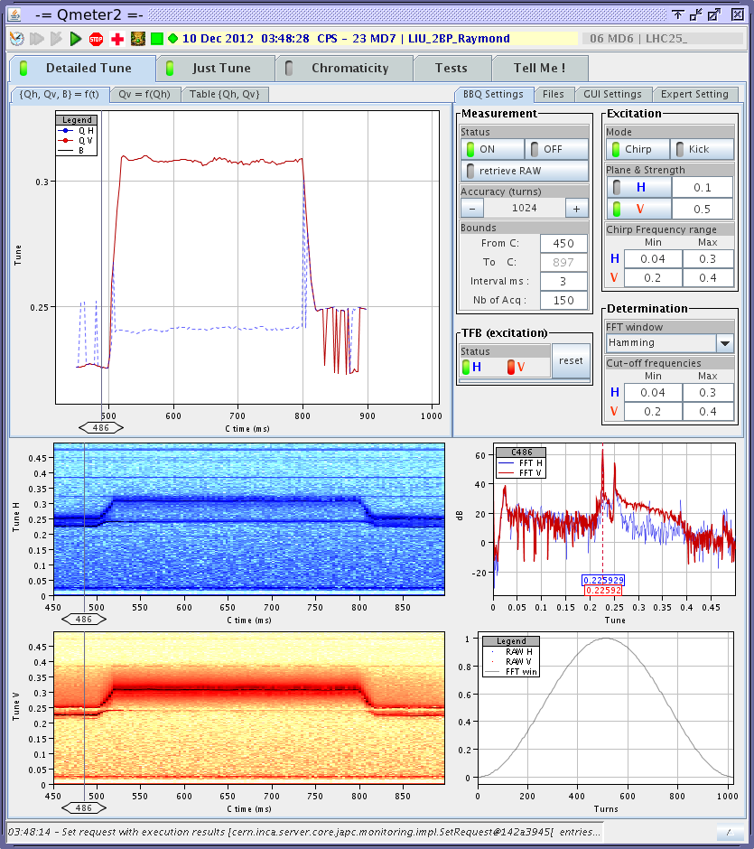
III. 4th order Resonance
Testing if the 4qy=1 is excited by Space Charge:
- Bunch compression @ C190
- Tune step between C500 and C800
Set tunes
Measured tunes
Time[ms]
4 different settings:
  I=115 e10 ppb Tune-spread =(.22 ; .4) (for Q21Q23 optics)
  I=80 e10 ppb Tune-spread =(.18 ; .37) (for Q21Q23 optics)
  I=35 e10 ppb Tune-spread =(.08 ; .24) (for Q21Q23 optics)
  I=115 e10 ppb Debunched
7

Slide 35
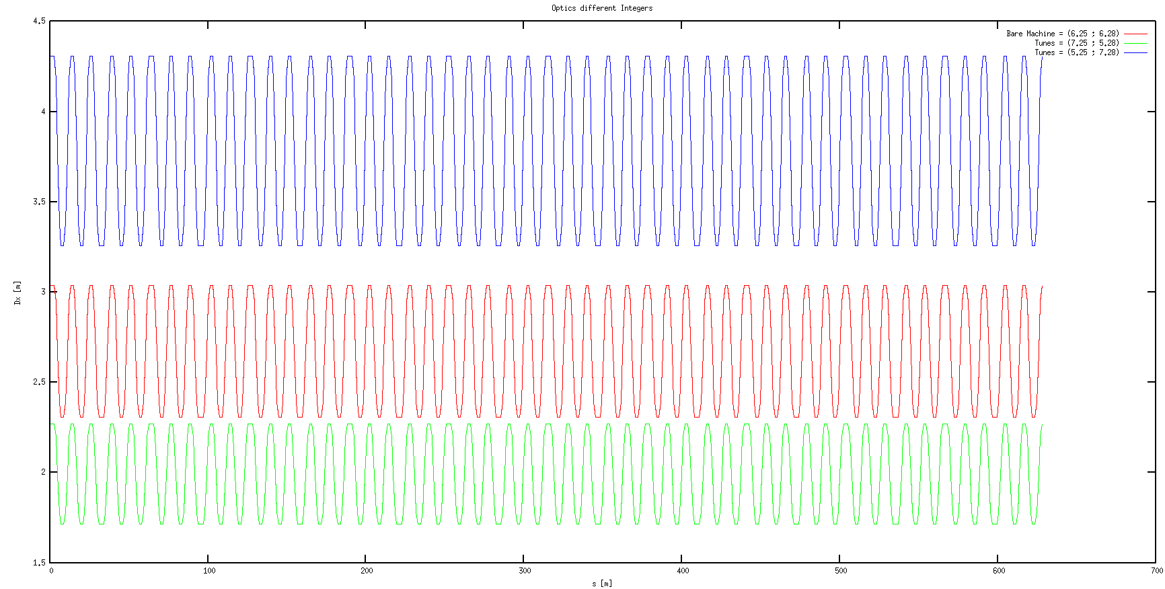

Slide 36
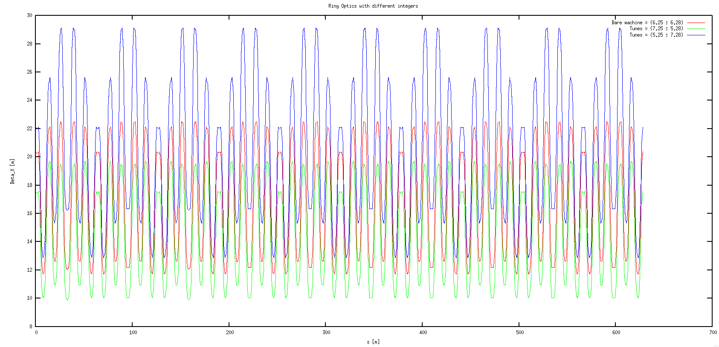

Slide 37
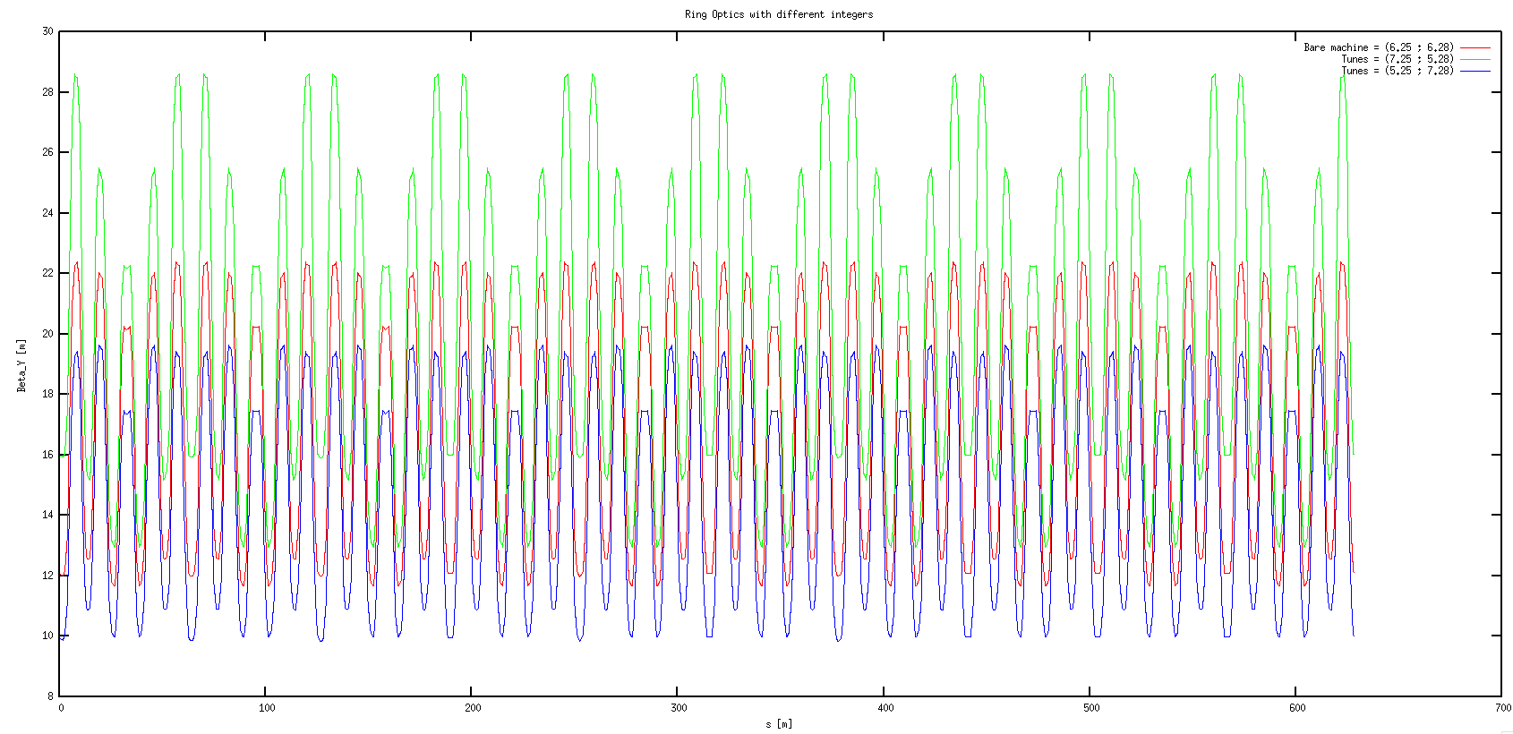

Slide 38
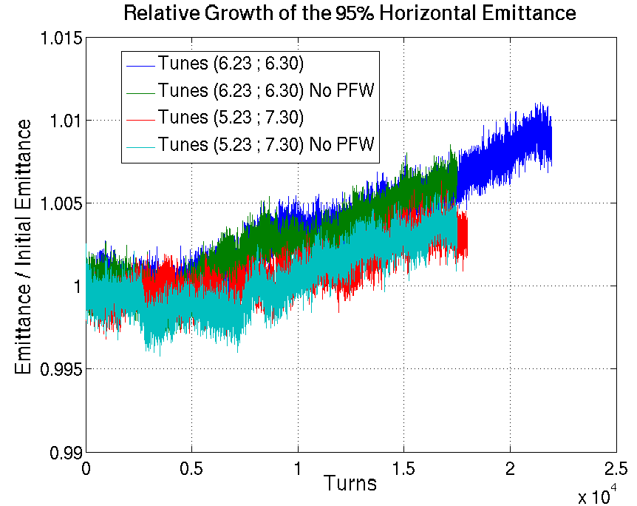
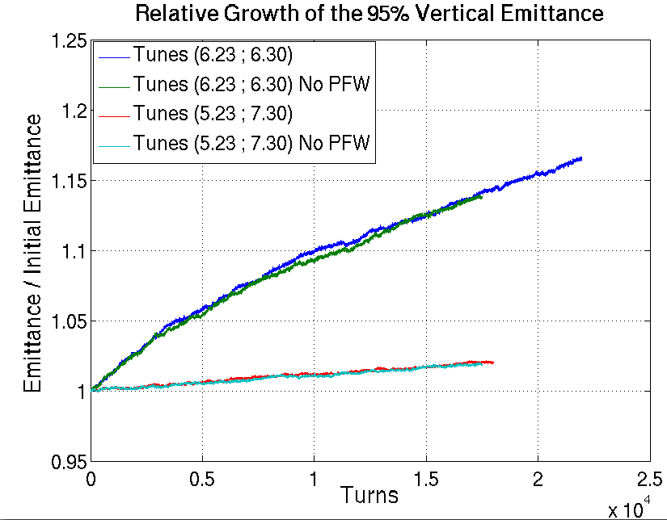

Slide 39
