Slide 2


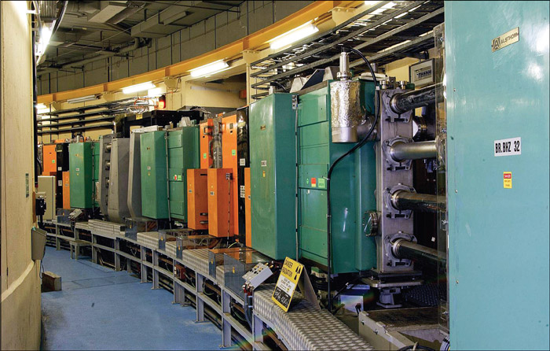
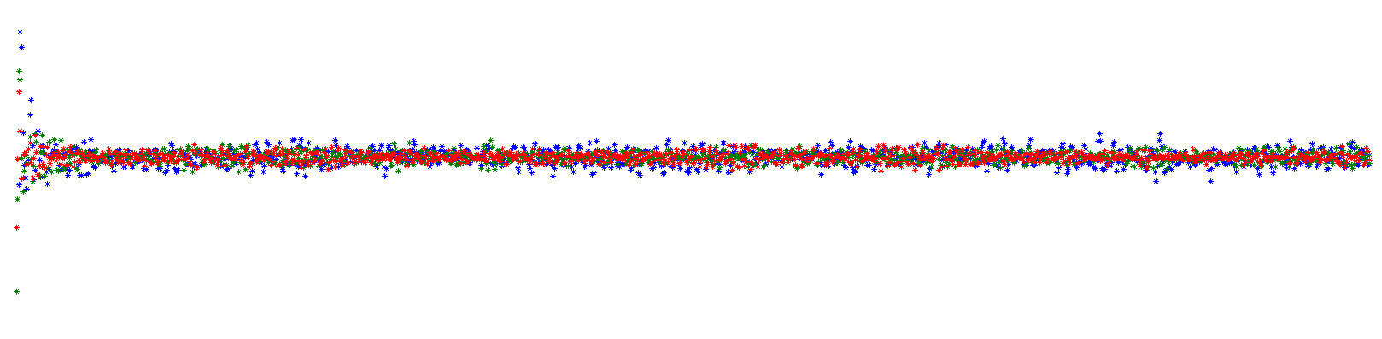
PSB Experiments, 6D Tune evolution with SC
Space charge collaboration meeting – CERN – 20/05/2014
Layout
Tunes evolution in a space charge dominated beam
Measurements-simulations benchmark: the half-integer resonance (2Qy=9)
Vincenzo Forte
CERN BE-ABP-HSC
Université Blaise Pascal – Clermont Ferrand - France
Thanks to:
E. Benedetto, M. McAteer, M. Migliorati, F. Schmidt

Slide 3



Tunes evolution in a space charge dominated beam
Relation between tunes and coord. phase space
Cuts
Single particle tunes modulation
Averaging
PSB space charge studies update
Vincenzo Forte – BE-ABP/LIS meeting – CERN - 04/11/2013
PSB Experiments, 6D Tune evolution with SC
Vincenzo Forte – Space charge meeting – CERN - 20/05/2014

Slide 4
Tunes evolution in a space charge dominated beam
Relation between tunes and coord. phase space
Cuts
Single particle tunes modulation
Averaging
PSB space charge studies update
Vincenzo Forte – BE-ABP/LIS meeting – CERN - 04/11/2013
PSB Experiments, 6D Tune evolution with SC
Vincenzo Forte – Space charge meeting – CERN - 20/05/2014

Slide 5
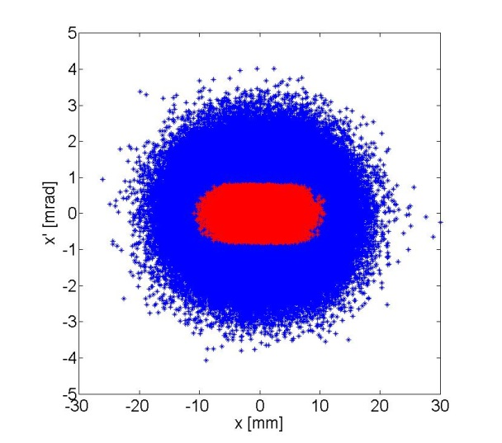
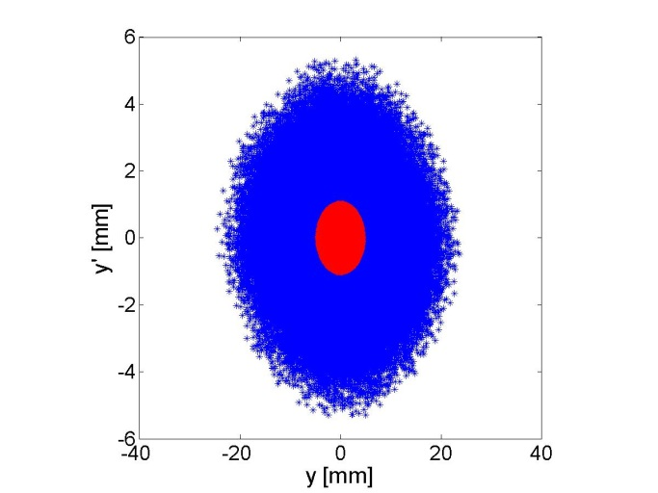
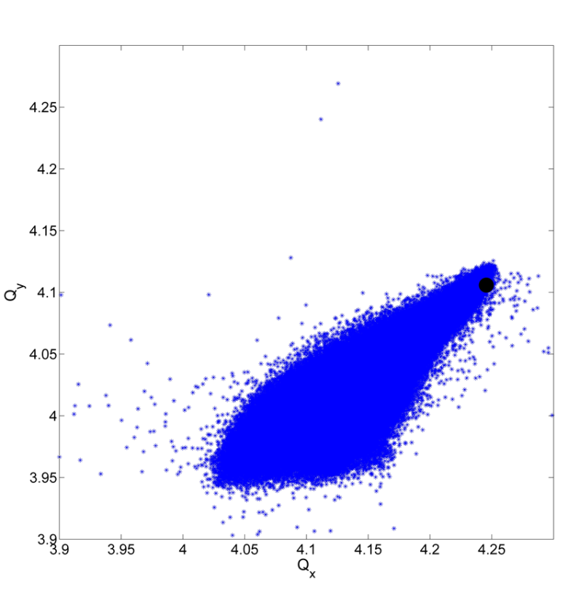
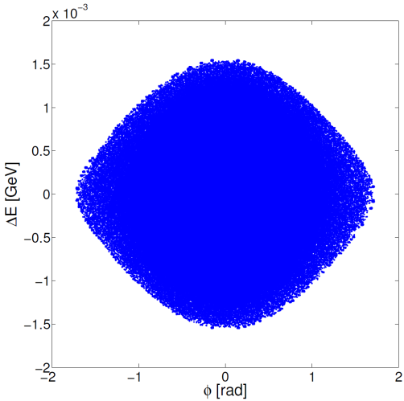
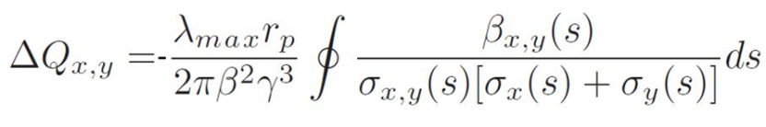
Relation between tunes and coord. phase space
Bare tune
?
PSB space charge studies update
Vincenzo Forte – BE-ABP/LIS meeting – CERN - 04/11/2013
PSB Experiments, 6D Tune evolution with SC
Vincenzo Forte – Space charge meeting – CERN - 20/05/2014

Slide 6
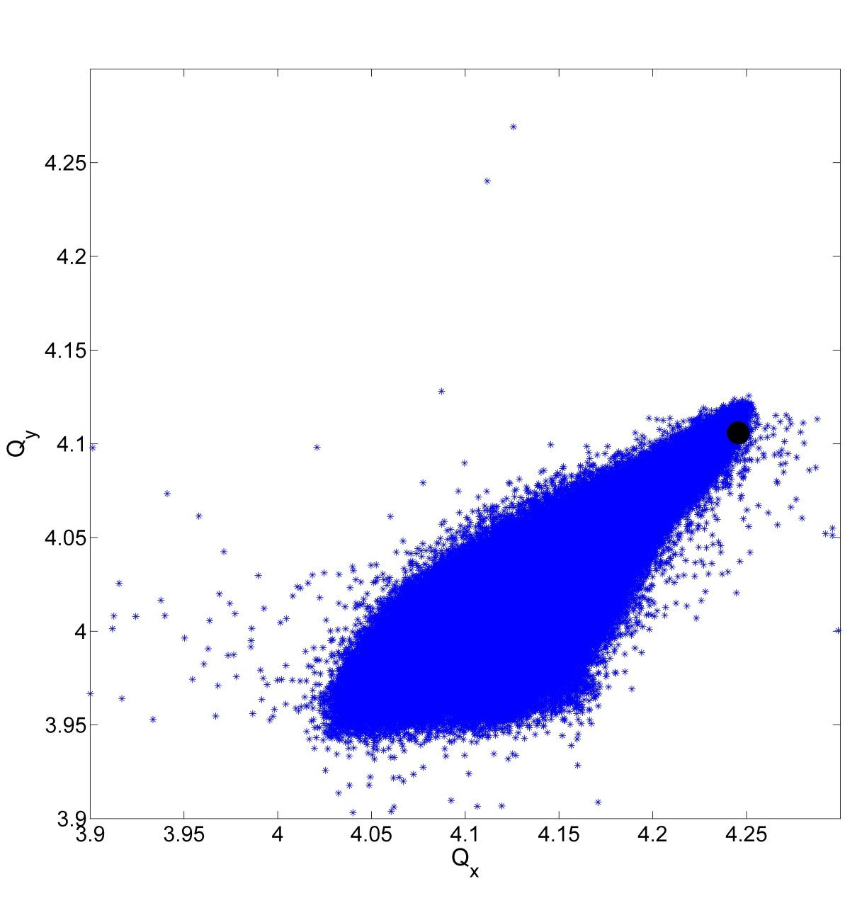
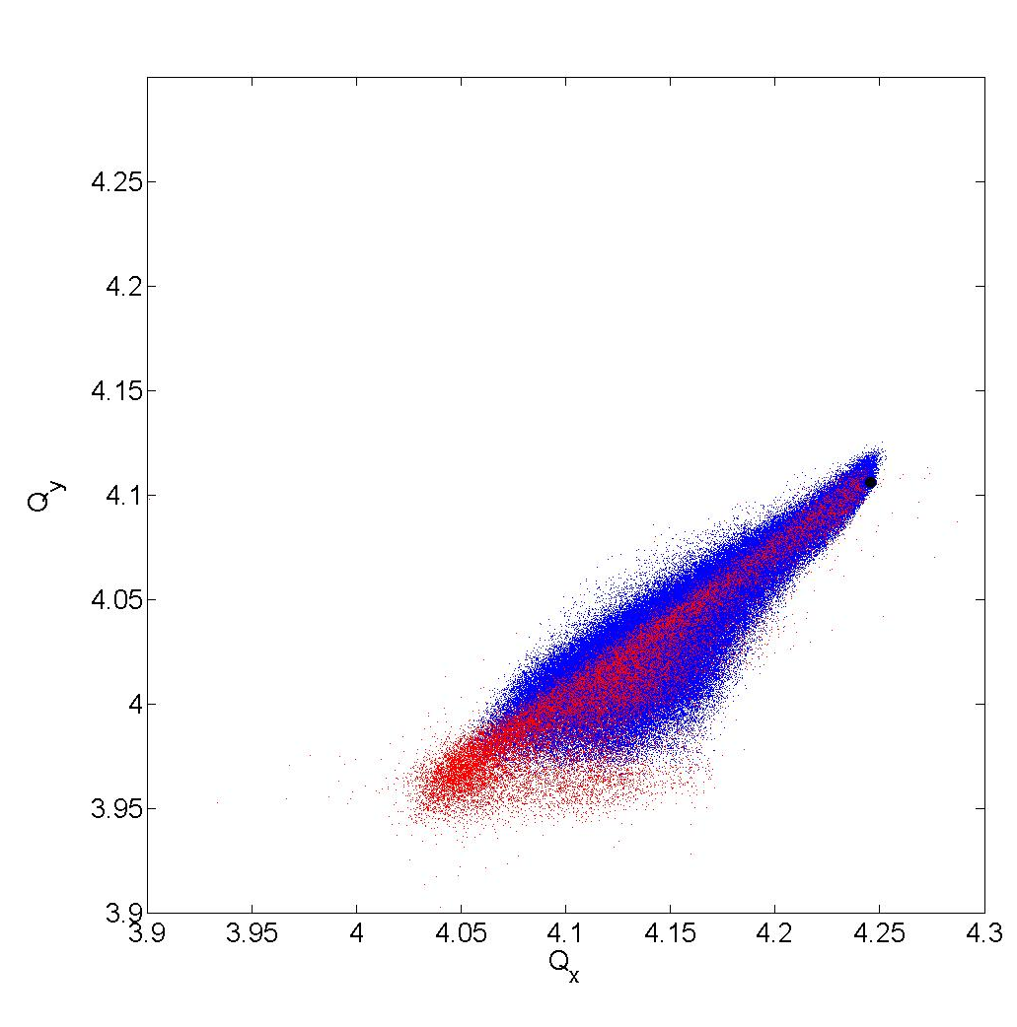
The cuts
What happens to the particles in the necktie if one starts cutting the distribution in different sublets?
Subsets of macroparticles – transverse cut
Bare tune
In the next slides the analysis will be performed on a subset of macroparticles with small* transverse amplitude (red)
Small transverse amplitude macroparticles reach larger tune shifts than halo particles
Transverse planes
*4D Cut boundaries = 1/32 x max (Jx) & 1/32 x max(Jy)
PSB space charge studies update
Vincenzo Forte – BE-ABP/LIS meeting – CERN - 04/11/2013
PSB Experiments, 6D Tune evolution with SC
Vincenzo Forte – Space charge meeting – CERN - 20/05/2014

Slide 7
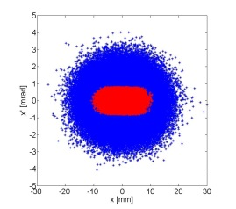

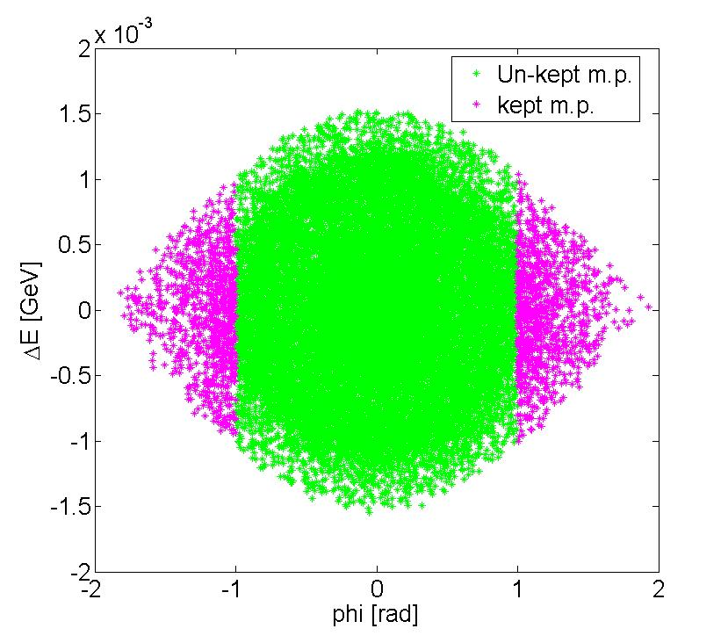
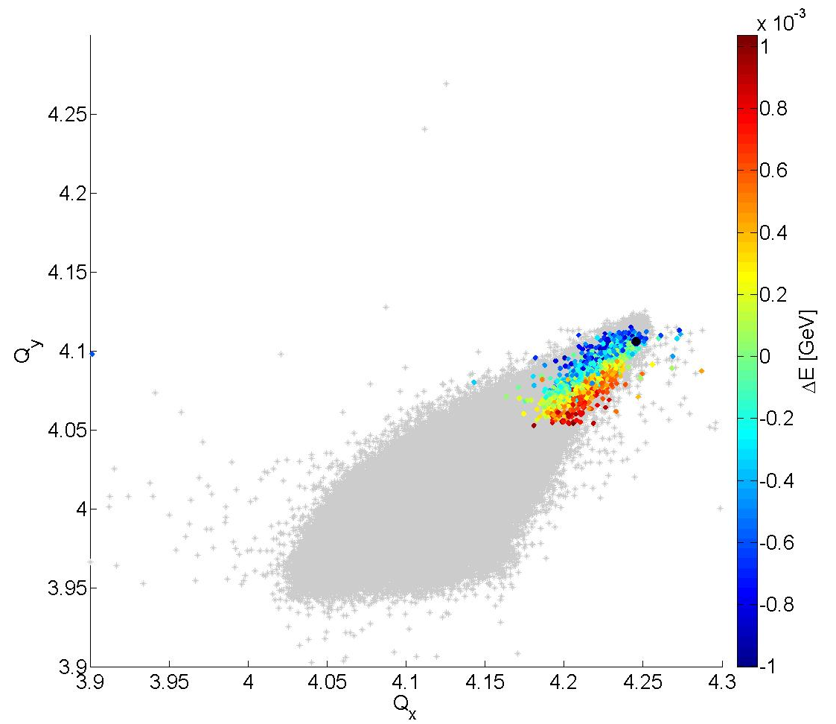
RED TRANSVERSE AREA + HEAD/TAIL CUT
Bare tune
PSB space charge studies update
Vincenzo Forte – BE-ABP/LIS meeting – CERN - 04/11/2013
PSB Experiments, 6D Tune evolution with SC
Vincenzo Forte – Space charge meeting – CERN - 20/05/2014

Slide 8
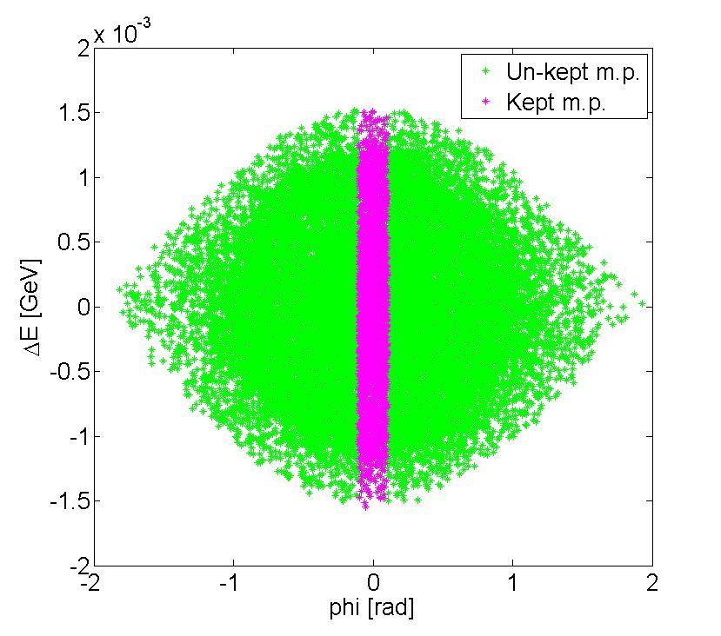
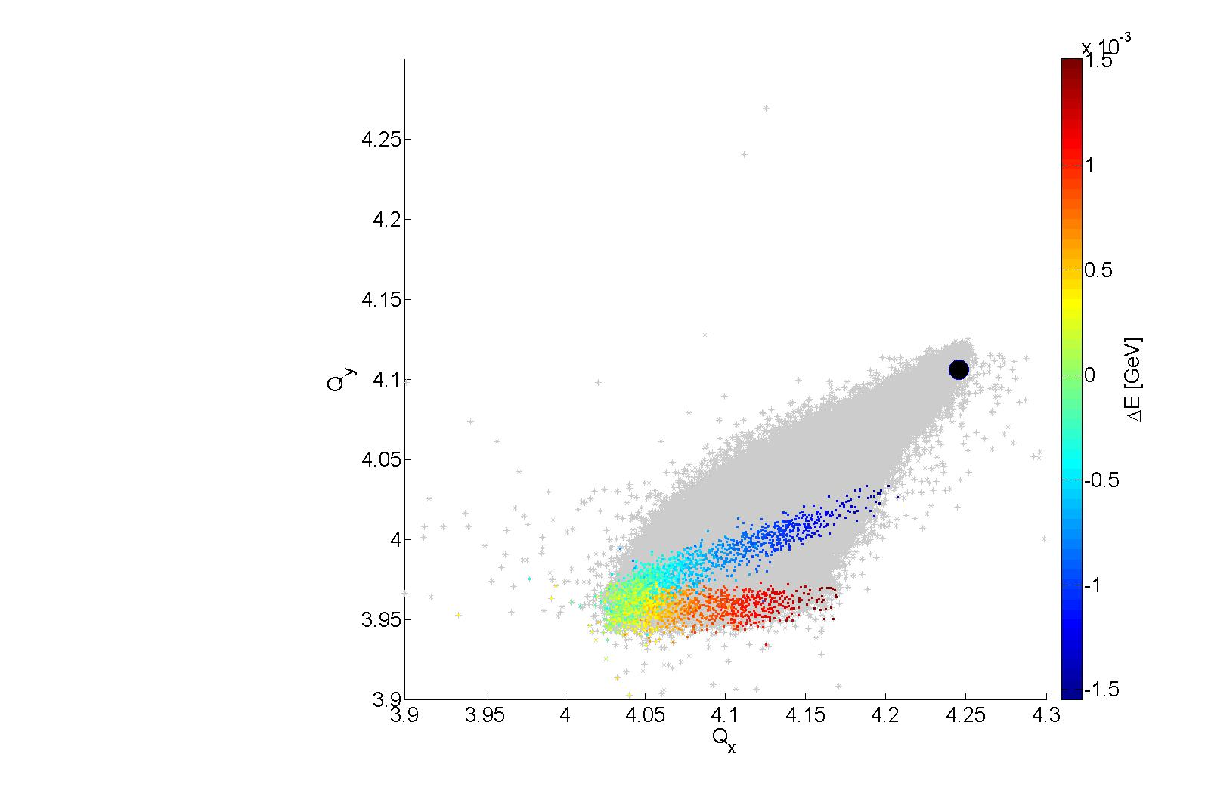
RED TRANSVERSE AREA + ZERO PHI CUT
Bare tune
In the PSB:
Dx=1.4m;
DQx=-3.34;
DQy=-6.50;
PSB space charge studies update
Vincenzo Forte – BE-ABP/LIS meeting – CERN - 04/11/2013
PSB Experiments, 6D Tune evolution with SC
Vincenzo Forte – Space charge meeting – CERN - 20/05/2014

Slide 9
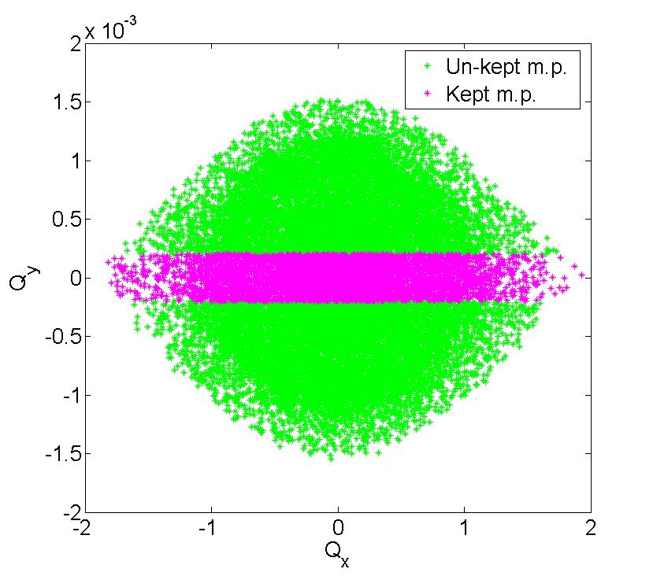
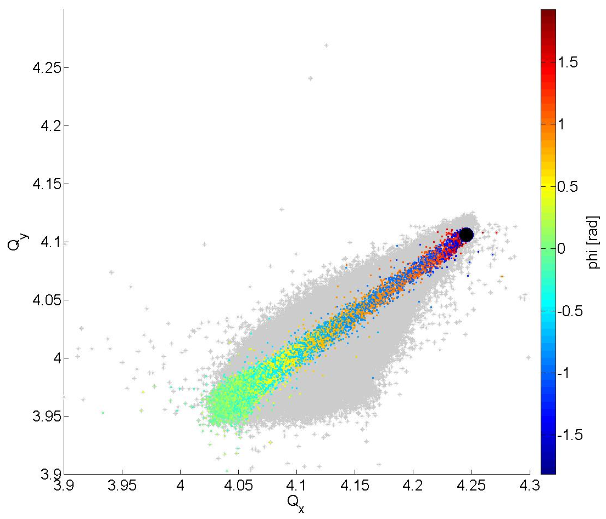
RED TRANSVERSE AREA + ZERO ΔENERGY CUT
Bare tune
PSB space charge studies update
Vincenzo Forte – BE-ABP/LIS meeting – CERN - 04/11/2013
PSB Experiments, 6D Tune evolution with SC
Vincenzo Forte – Space charge meeting – CERN - 20/05/2014

Slide 10
Tunes evolution in a space charge dominated beam
Relation between tunes and coord. phase space
Cuts
Single particle tunes modulation
Averaging
PSB space charge studies update
Vincenzo Forte – BE-ABP/LIS meeting – CERN - 04/11/2013
PSB Experiments, 6D Tune evolution with SC
Vincenzo Forte – Space charge meeting – CERN - 20/05/2014

Slide 11
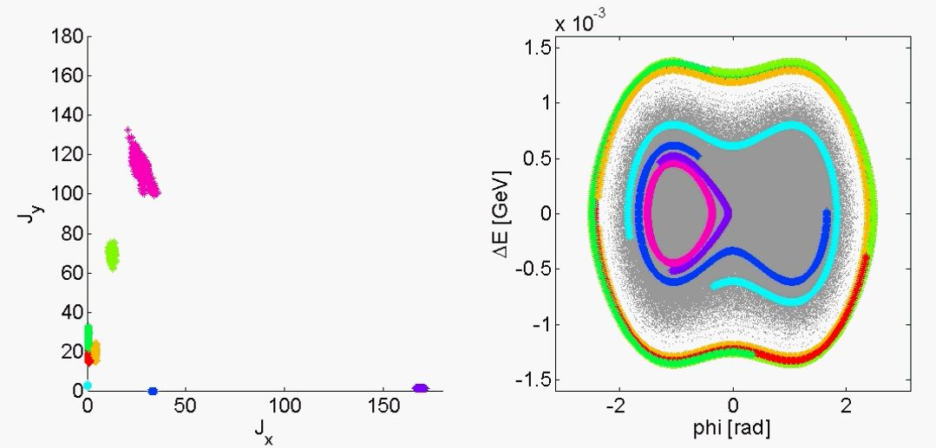
Single particle dynamic behavior (tunes modulation)
A double RF bucket simulation (with h=1 and h=2 in antiphase) close to the vertical integer Qy=4 in the PSB has been taken as example for the analysis.
The yellow particle (large synchrotron amplitude and relative small transverse actions) has been taken into account for an accurate turn-by-turn analysis.
PSB space charge studies update
Vincenzo Forte – BE-ABP/LIS meeting – CERN - 04/11/2013
PSB Experiments, 6D Tune evolution with SC
Vincenzo Forte – Space charge meeting – CERN - 20/05/2014

Slide 12
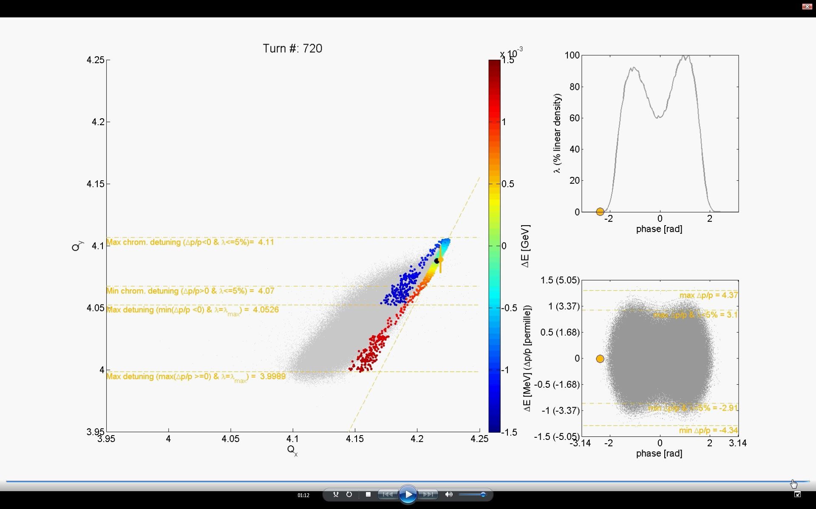
Single particle dynamic behavior (tunes modulation)
In the PSB:
DQx=-3.34;
DQy=-6.50;
Sliding hyperplane (line) where only the chromaticity
affects the tune shift because λ<5%
PSB space charge studies update
Vincenzo Forte – BE-ABP/LIS meeting – CERN - 04/11/2013
PSB Experiments, 6D Tune evolution with SC
Vincenzo Forte – Space charge meeting – CERN - 20/05/2014

Slide 13
Tunes evolution in a space charge dominated beam
Relation between tunes and coord. phase space
Cuts
Single particle tunes modulation
Averaging
PSB space charge studies update
Vincenzo Forte – BE-ABP/LIS meeting – CERN - 04/11/2013
PSB Experiments, 6D Tune evolution with SC
Vincenzo Forte – Space charge meeting – CERN - 20/05/2014

Slide 14
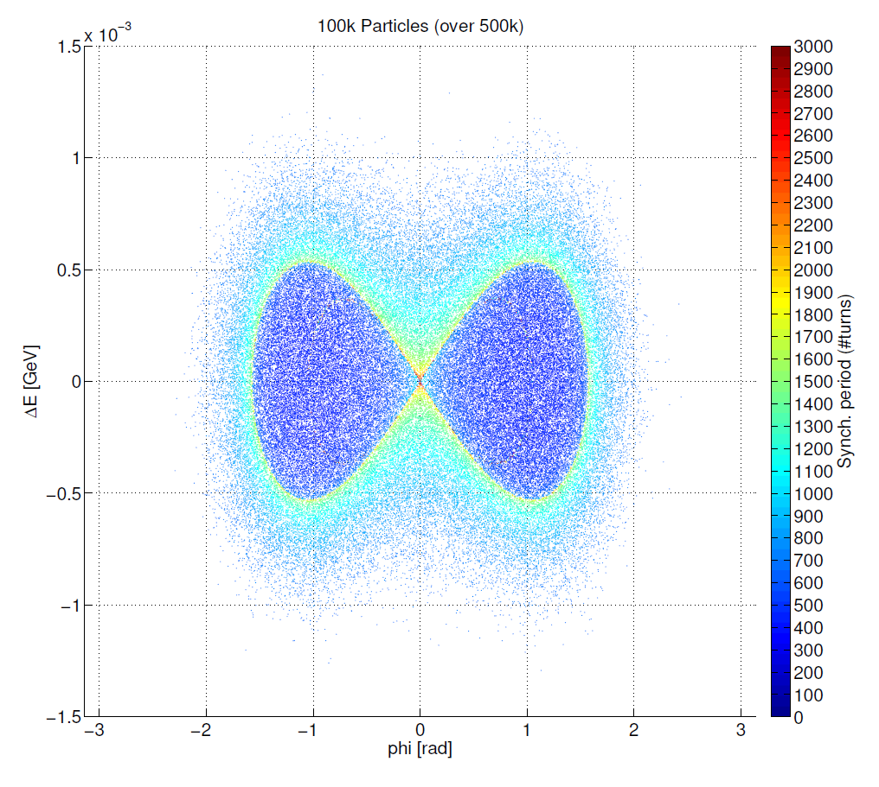
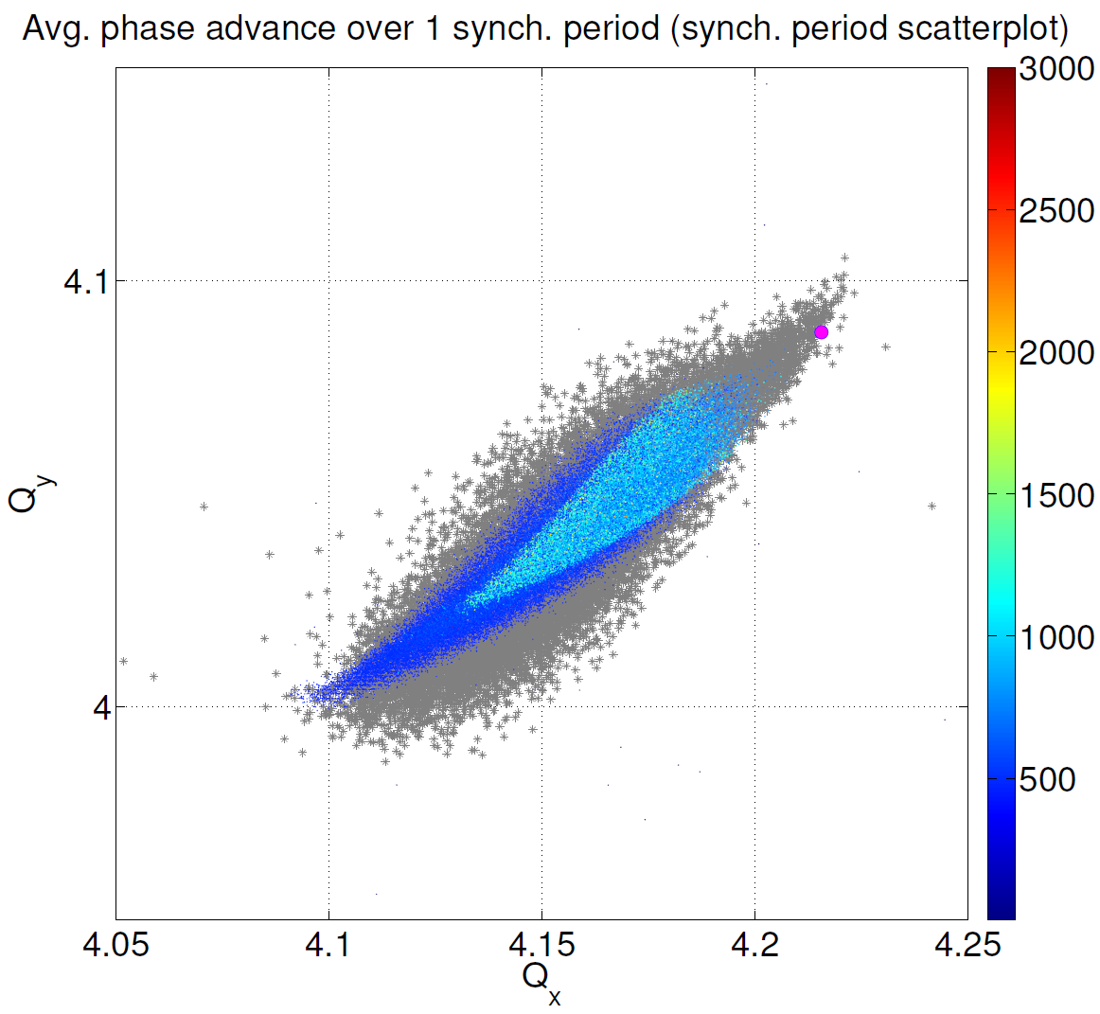
Averaging the phase advance over many turns…
The tunes of each particle, averaged over 1 synchrotron period, are shown on the right.
The averaging is extremely useful to underline some specific phenomena in the next part of the talk, in which the half-integer resonance has been studied to benchmark PTC-Orbit with the measurements.
PSB space charge studies update
Vincenzo Forte – BE-ABP/LIS meeting – CERN - 04/11/2013
PSB Experiments, 6D Tune evolution with SC
Vincenzo Forte – Space charge meeting – CERN - 20/05/2014

Slide 15
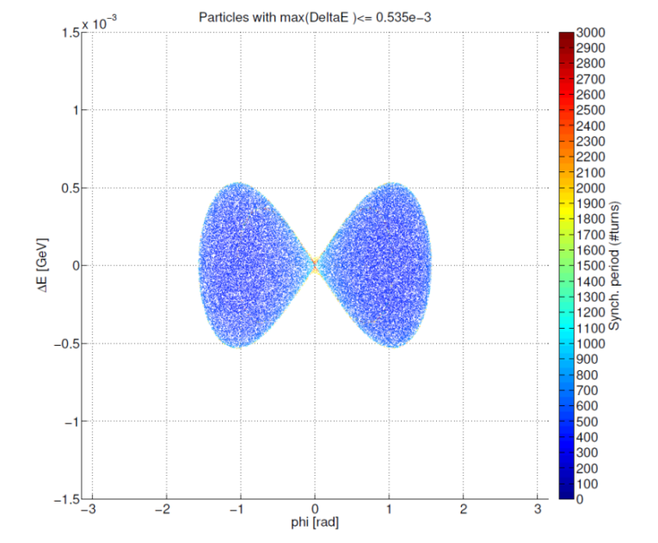
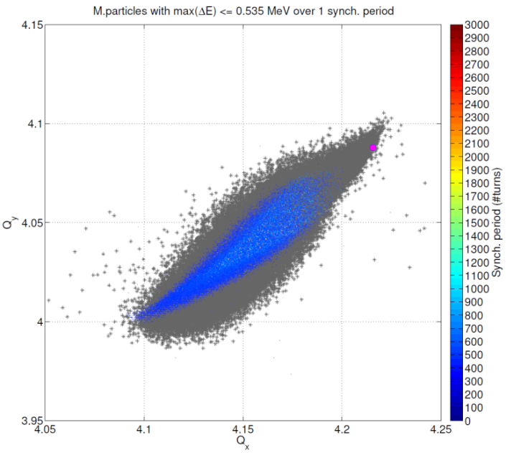
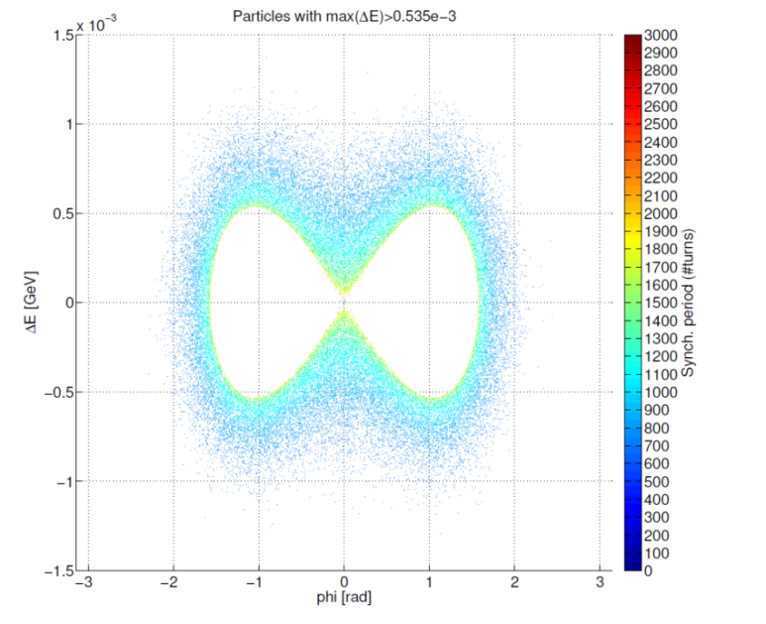
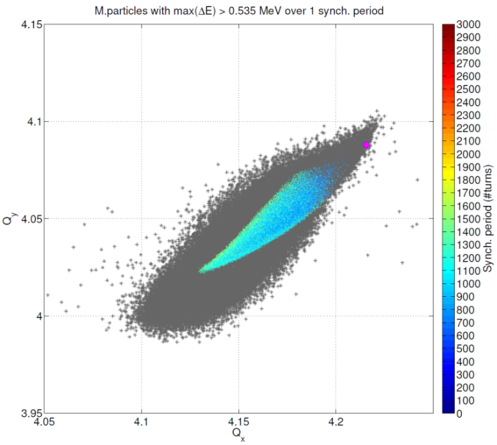
Averaging the phase advance over many turns…
Particles with high (and less modulated) linear density over the synch. period
Particles with fully modulated linear density over the synch. period
PSB space charge studies update
Vincenzo Forte – BE-ABP/LIS meeting – CERN - 04/11/2013
PSB Experiments, 6D Tune evolution with SC
Vincenzo Forte – Space charge meeting – CERN - 20/05/2014

Slide 16
Measurements-simulations benchmark:
the half-integer resonance (2Qy=9)
PSB space charge studies update
Vincenzo Forte – BE-ABP/LIS meeting – CERN - 04/11/2013
PSB Experiments, 6D Tune evolution with SC
Vincenzo Forte – Space charge meeting – CERN - 20/05/2014

Slide 17
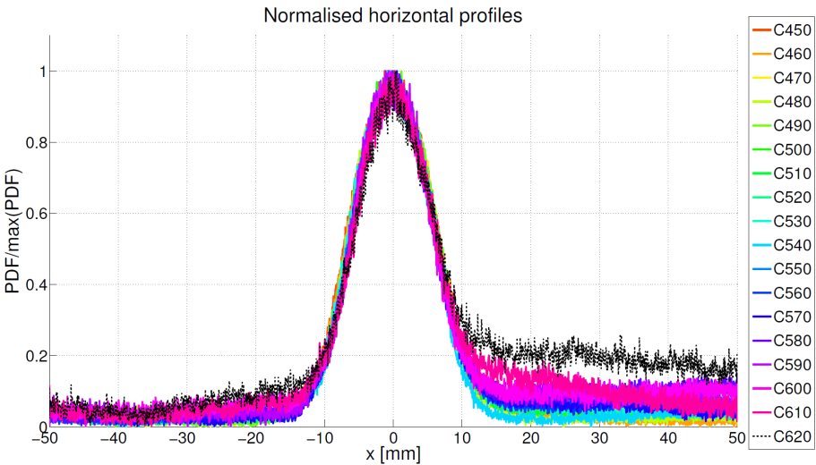
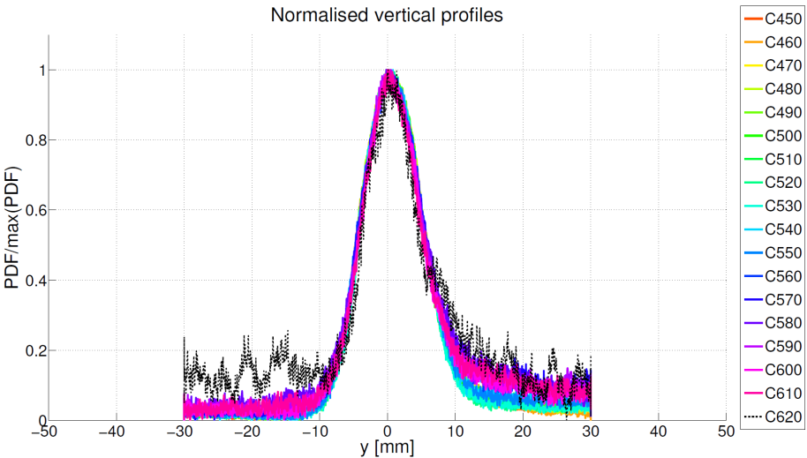
Measurements: intensity – programmed tunes – transverse profiles
QNO8 = normal quad. corrector
QNO8 ON
QNO8 OFF
2Qy=9 crossing
@ C450
(switching off
QNO correctors)
QNO8 = normal quad. corrector
QNO8 ON
QNO8 OFF
Qy = 4.53
Qx = 4.28
The core (1σ) of the beam is preserved during the losses!
@ 160MeV
PSB space charge studies update
Vincenzo Forte – BE-ABP/LIS meeting – CERN - 04/11/2013
PSB Experiments, 6D Tune evolution with SC
Vincenzo Forte – Space charge meeting – CERN - 20/05/2014

Slide 18
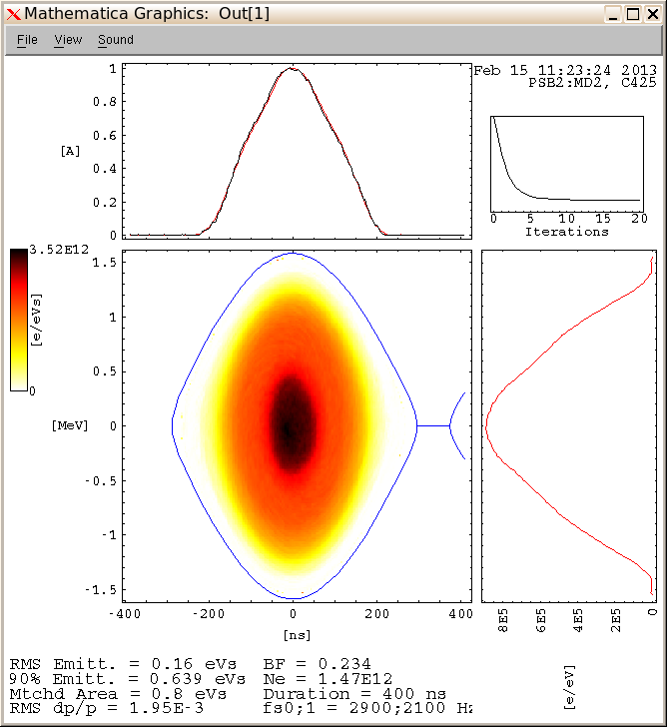
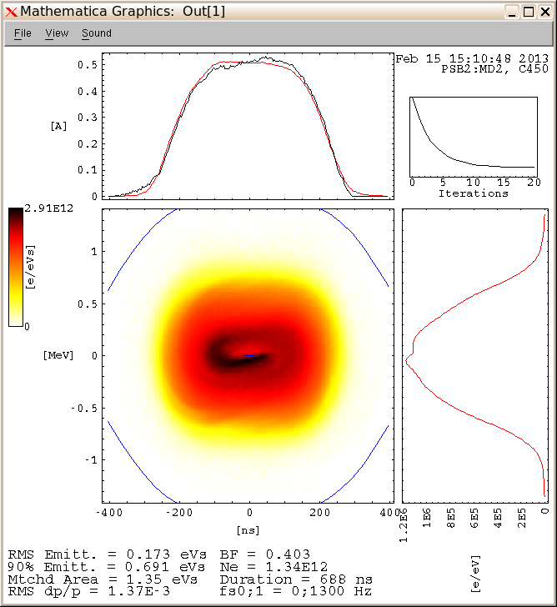
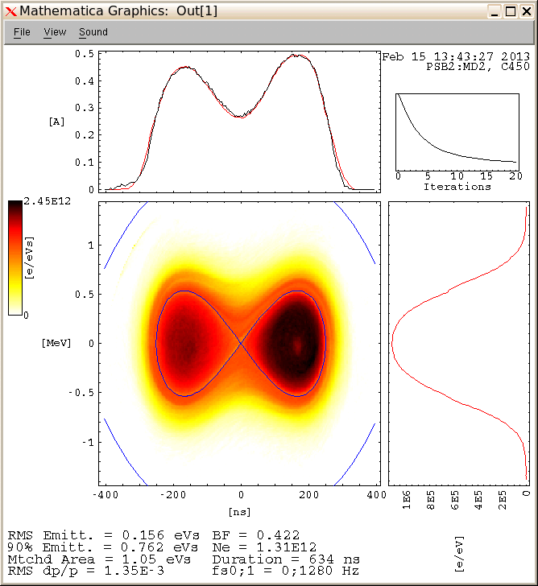
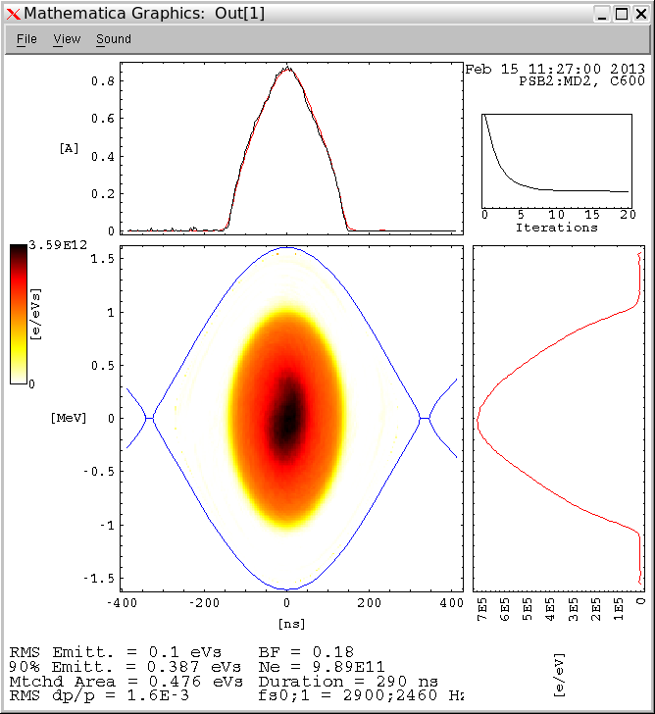

Measurements: longitudinal profiles
8kV/8kV in phase (short)
8kV/4kV in antiphase (long)
DOUBLE HARMONIC RF SYSTEM
8kV/8kV in antiphase (long)
Cases in analysis
PSB space charge studies update
Vincenzo Forte – BE-ABP/LIS meeting – CERN - 04/11/2013
PSB Experiments, 6D Tune evolution with SC
Vincenzo Forte – Space charge meeting – CERN - 20/05/2014

Slide 19
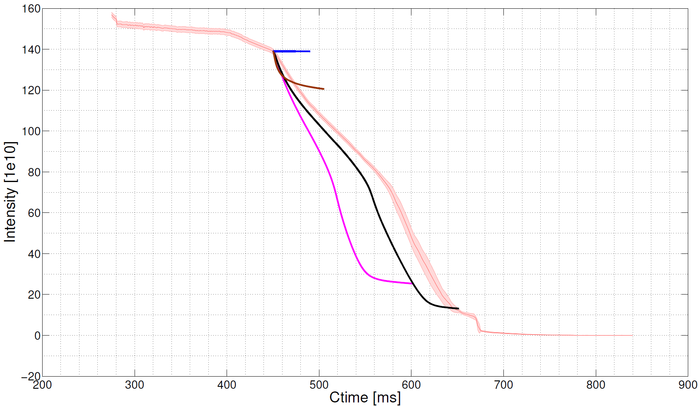
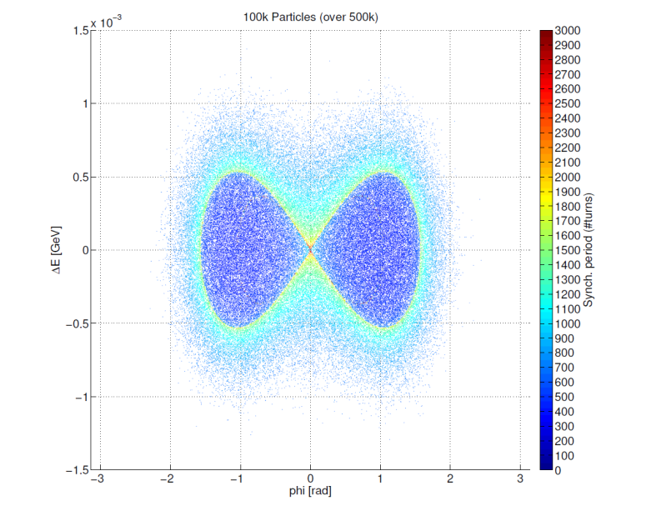
Simulations: losses behavior for long bunch
No errors – With s.c. (4.285, 4.517)
Quad field errors - No s.c. (4.285, 4.517)
Change of losses regime
Quad field errors - With s.c. (4.285, 4.517)
Quad field errors – Misalign. errors – With s.c. (4.284 4.513)
Very good agreement in shape and for initial-final value!
The complete model of the machine is FUNDAMENTAL !!
PSB Experiments, 6D Tune evolution with SC
Vincenzo Forte – Space charge meeting – CERN - 20/05/2014

Slide 20
Simulations: losses behavior for long bunch and short bunch
Quad field errors – Misalign. errors –
With s.c. (4.284 4.513) – Short bunch
~88e10
~90e10
Quad field errors – Misalign. errors –
With s.c. (4.284 4.513) – Long bunch
~50e10
Measurements
Simulations
Short bunches lose more slowly and with different losses profiles.
At C600, the short bunch decreases the losses (w.r.t. the long one) by a factor ~1.8.
PSB Experiments, 6D Tune evolution with SC
Vincenzo Forte – Space charge meeting – CERN - 20/05/2014

Slide 21
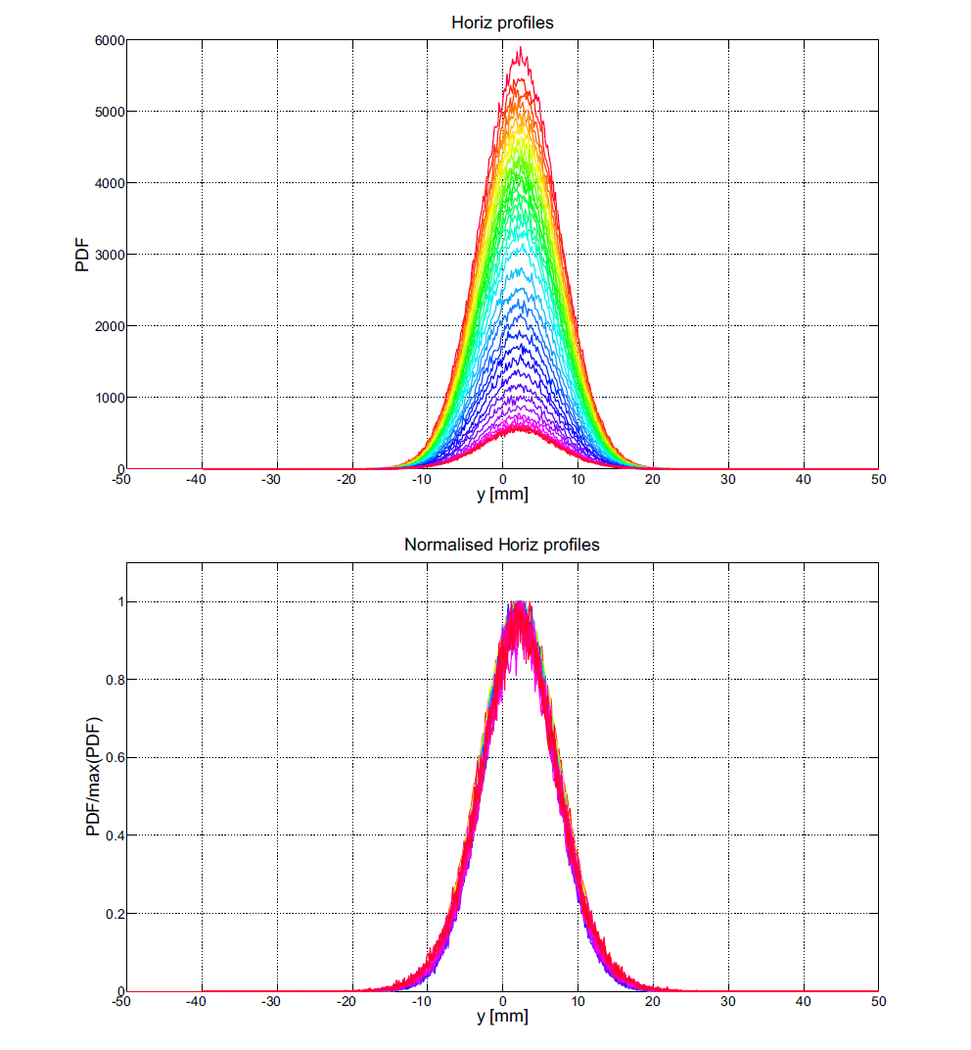
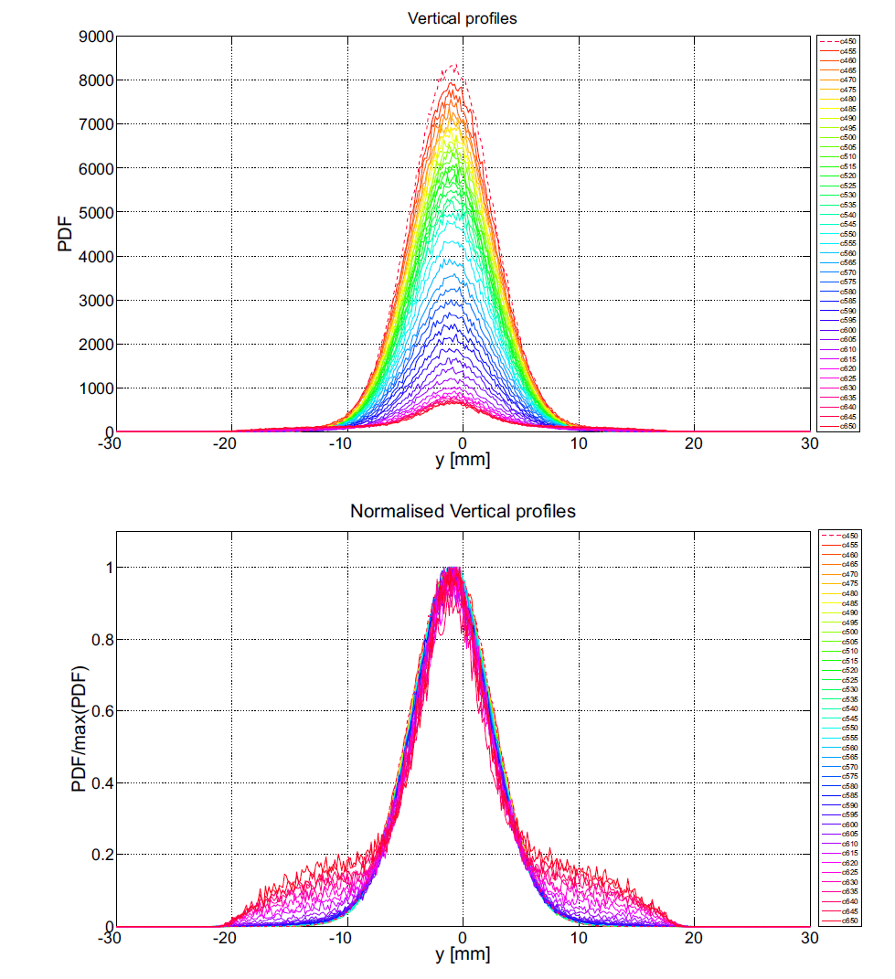
Simulations (with quad fields and misalign. errors): 200 ms transverse evolution
Long bunch
Tails from ~c600
The beam size (1σ gaussian interpolation) is preserved along the cycle, as in the measurements
PSB Experiments, 6D Tune evolution with SC
Vincenzo Forte – Space charge meeting – CERN - 20/05/2014

Slide 22
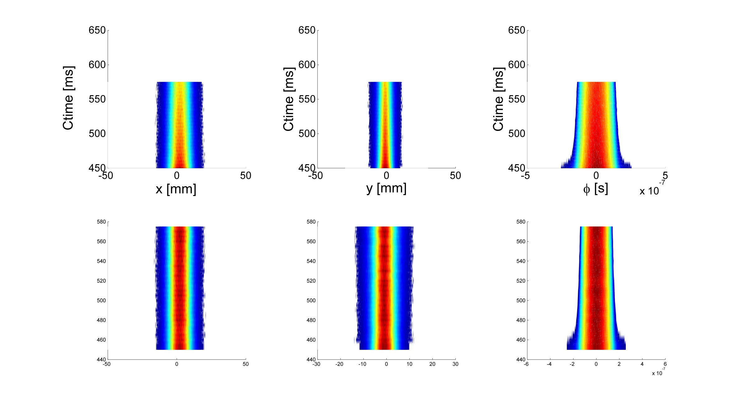
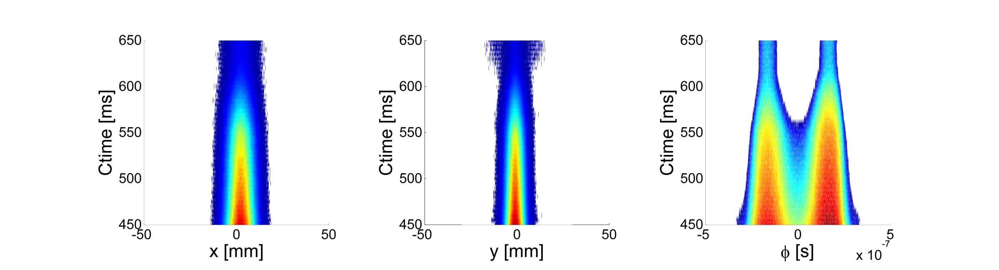
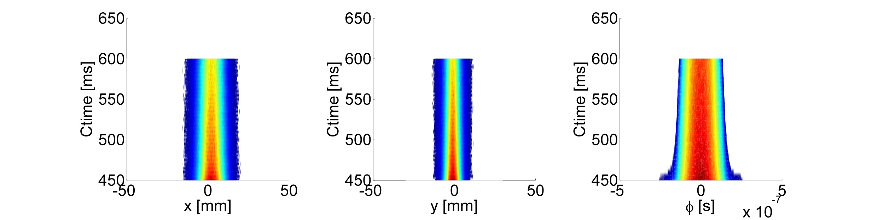
Simulations (with quad fields and misalign. errors): 200 ms waterfall evolution
Long bunch
Short bunch
PSB Experiments, 6D Tune evolution with SC
Vincenzo Forte – Space charge meeting – CERN - 20/05/2014

Slide 23
Simulations: tunes behavior for long bunch
No errors – With s.c. (4.285, 4.517)
Quad field errors - No s.c. (4.285, 4.517)
Tunes computation at
C485 and C565
Quad field errors - With s.c. (4.285, 4.517)
Quad field errors – Misalign. errors – With s.c. (4.284 4.513)
PSB Experiments, 6D Tune evolution with SC
Vincenzo Forte – Space charge meeting – CERN - 20/05/2014

Slide 24
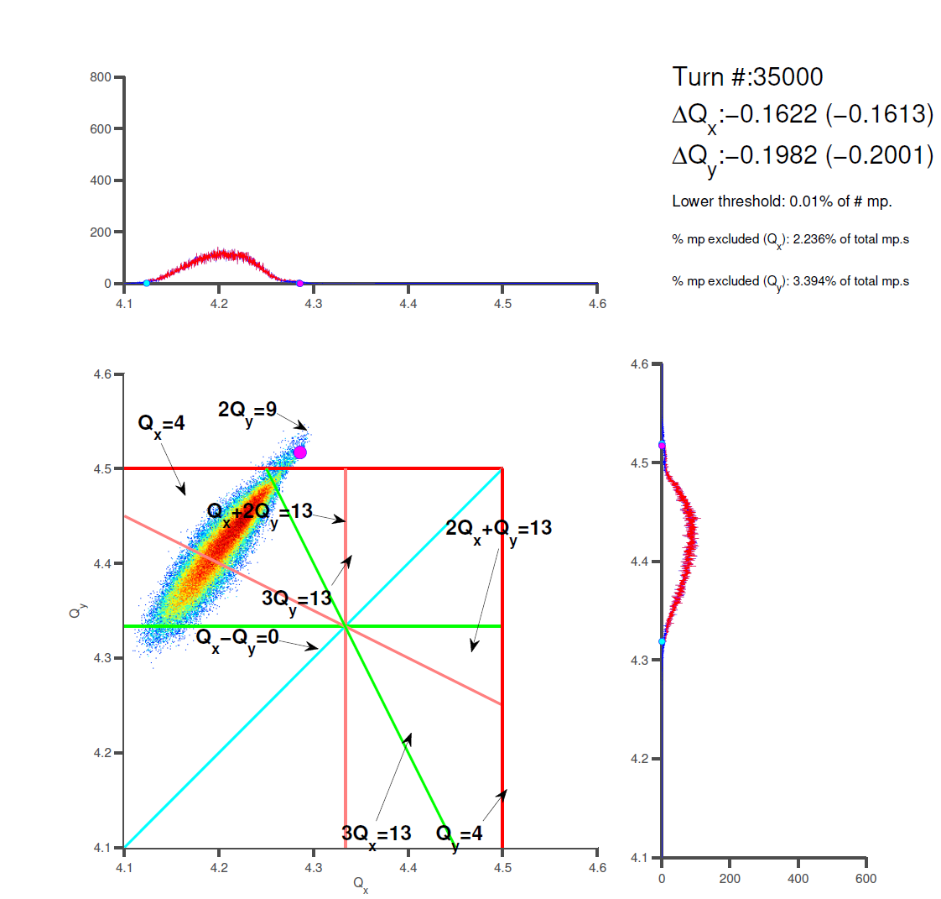
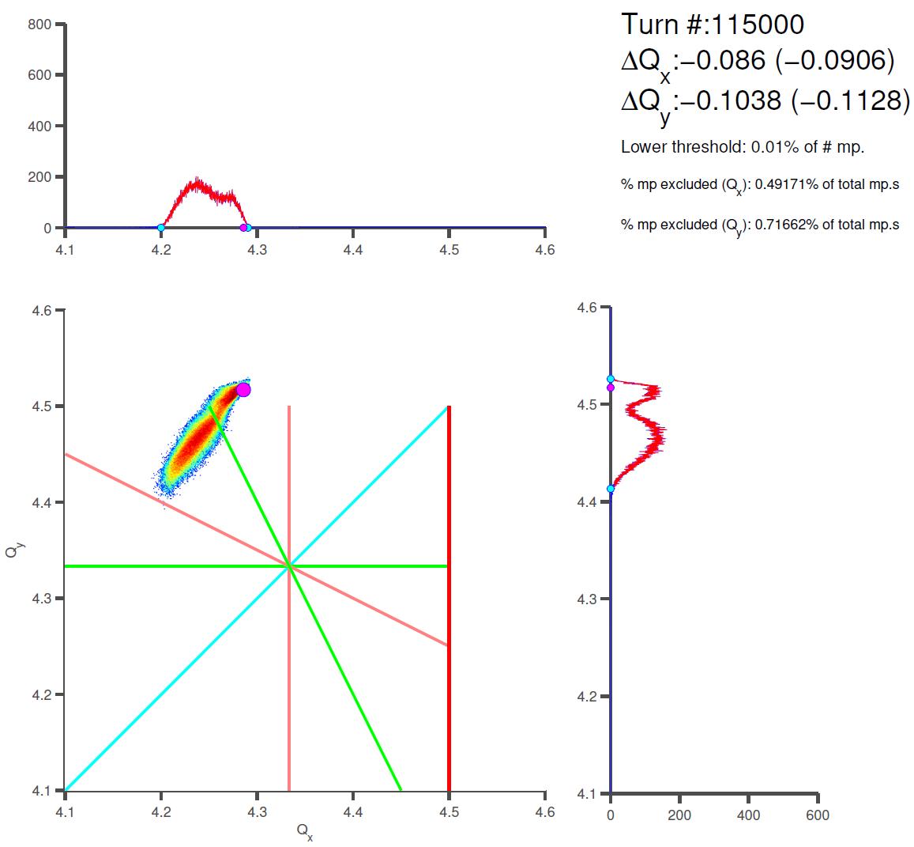
Tunes Simulations (with quad field errors): after ~35ms and ~115ms
C485 on the magenta curve
C565 on the magenta curve
There is a valley on the resonance…
Tunes computation (phase advance per turn)
PSB Experiments, 6D Tune evolution with SC
Vincenzo Forte – Space charge meeting – CERN - 20/05/2014

Slide 25
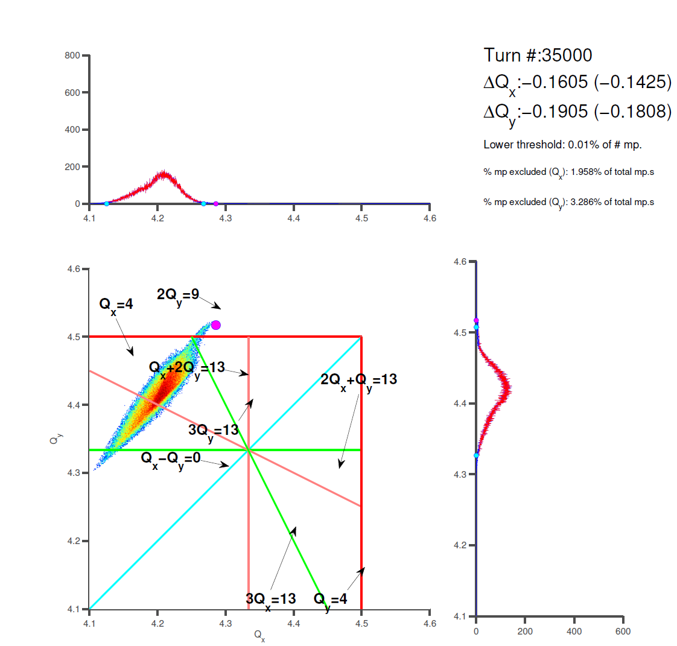
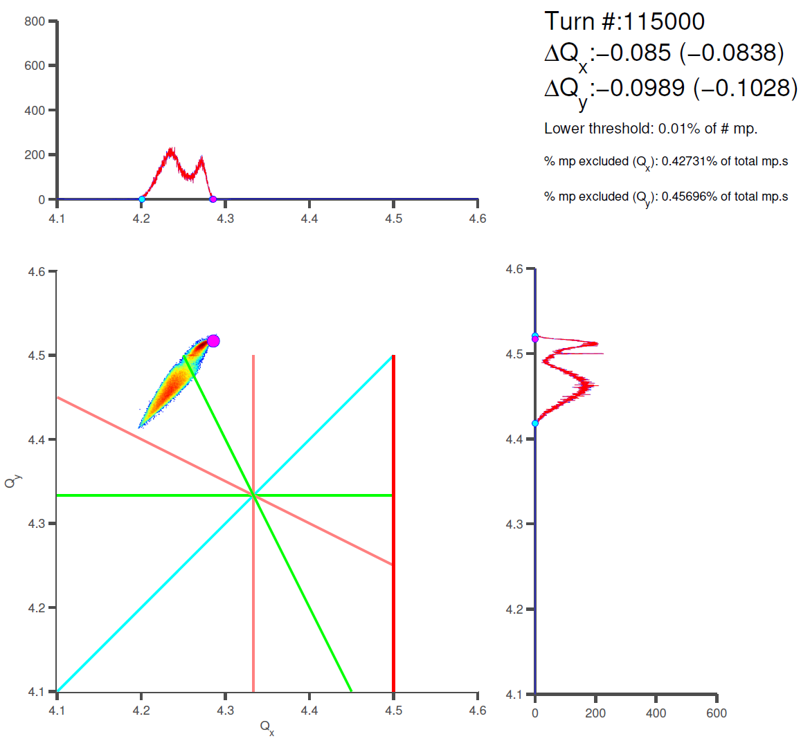
Tunes Simulations (with quad fields): after ~35ms and ~115ms
C485 on the magenta curve
C565 on the magenta curve
A peak comes out at the resonance location
Tunes (avg. over 1500 turns)
PSB Experiments, 6D Tune evolution with SC
Vincenzo Forte – Space charge meeting – CERN - 20/05/2014

Slide 26
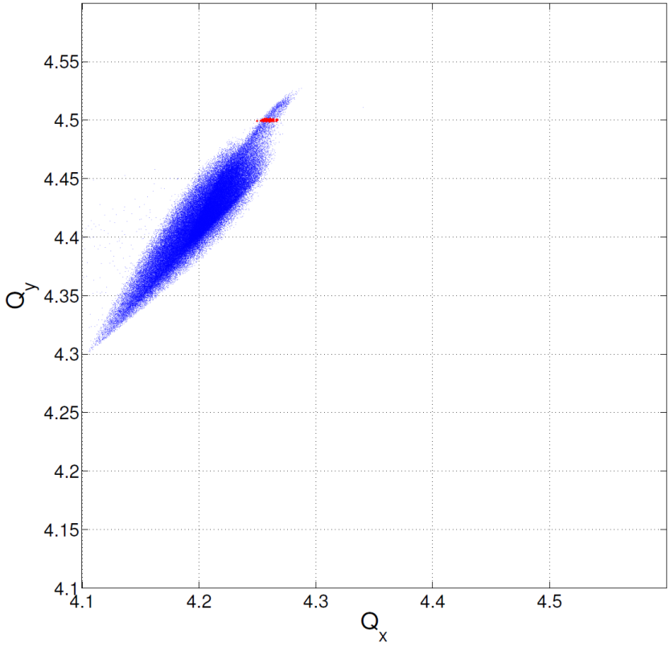
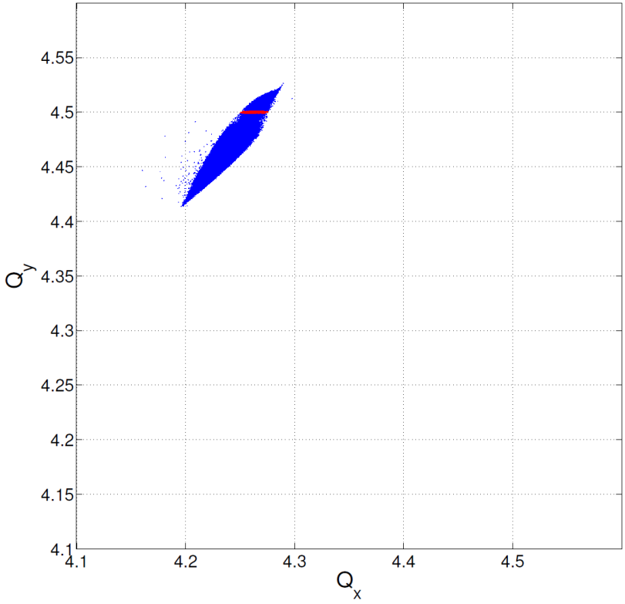
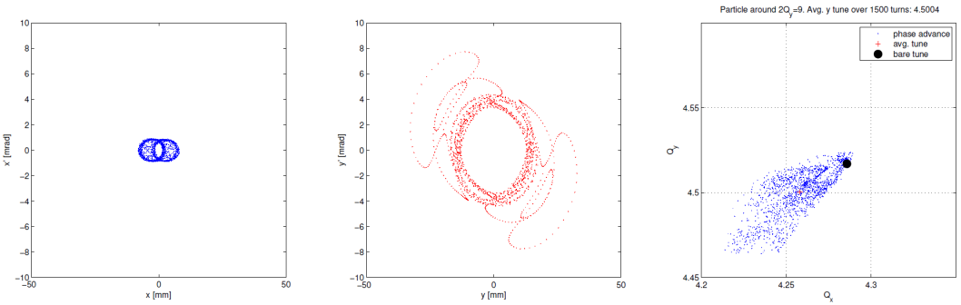
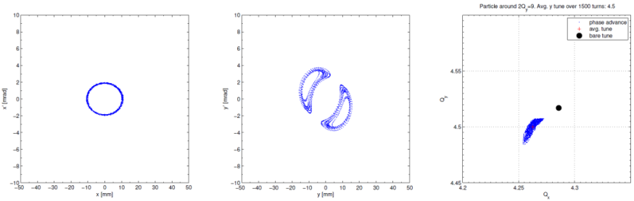
Tunes Simulations (with quad field errors)
C485 on the magenta curve
C565 on the magenta curve
Selecting particles inside Qy=4.5 +/− 0.001…
Particles with smaller spread sit on vertical transverse islands!
Red because it gets lost
PSB Experiments, 6D Tune evolution with SC
Vincenzo Forte – Space charge meeting – CERN - 20/05/2014

Slide 27

Particles which interact with the resonance…
C485
C565
Particles with smaller spread sit on vertical transverse islands!
PSB Experiments, 6D Tune evolution with SC
Vincenzo Forte – Space charge meeting – CERN - 20/05/2014

Slide 28
Summary and conclusions
Tunes evolution in a space charge dominated beam.
  Different positions in 6D phase space cause different location in the necktie.
  The modulation due to the bunched motion is relevant for particles performing large synchrotron oscillations.
  The single turn tunes computation differs from the averaged one.
Measurements-simulations benchmark: the half-integer resonance (2Qy=9)
  Very good agreement between measurements and simulations.
  The quadrupolar fields and misalignment errors play an important role in the simulations.
  Different longitudinal bunch shapes correspond to different losses profiles.
  Tails (islands creation) arise from the simulations when the space charge is highly reduced by losses.
PSB space charge studies update
Vincenzo Forte – BE-ABP/LIS meeting – CERN - 04/11/2013
PSB Experiments, 6D Tune evolution with SC
Vincenzo Forte – Space charge meeting – CERN - 20/05/2014

Slide 29
Appendix
PSB space charge studies update
Vincenzo Forte – BE-ABP/LIS meeting – CERN - 04/11/2013
PSB Experiments, 6D Tune evolution with SC
Vincenzo Forte – Space charge meeting – CERN - 20/05/2014

Slide 30
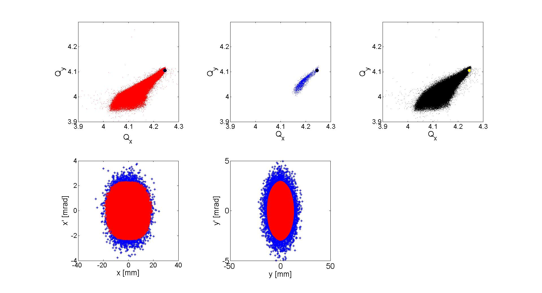
The particles as an ensemble
Cutting the macroparticles in both planes, the blue (external) are the ones closer to the bare tune, having the largest amplitude. The red ones (that are mainly in the core of the bunch) can circulate all around the necktie, spreading because of the longitudinal effect.
PSB space charge studies update
Vincenzo Forte – BE-ABP/LIS meeting – CERN - 04/11/2013
PSB Experiments, 6D Tune evolution with SC
Vincenzo Forte – Space charge meeting – CERN - 20/05/2014

Slide 31
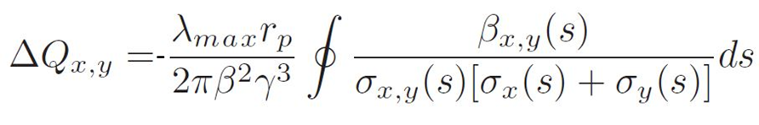
Tunes evolution in a space charge dominated beam
The time-varying quantities (at constant energy and optics) are:
  λ, as the longitudinal linear density (protons/m), that is modulated in time for bunched beams
  σ, as the transverse beam sizes (mm);
The term inside the integral is, in a certain way, the inverse of the beam emittances along the ring.
The direct space charge tune shift is directly proportional to λ, and inversely proportional to the emittances
PTC-Orbit has been used for the analysis, from which is possible to extract the tunes necktie and the raw data useful for the post-processing analysis. The simulations here presented refer to the CERN PS Booster, Ring 2.
Chromatic effects are a not negligible additive component to the space charge tune shift. This must be evaluated because affects the motion of a single particle inside a necktie.
The 4D formalism of the space charge can be seen as a constant linear density λ(s) case.
PSB space charge studies update
Vincenzo Forte – BE-ABP/LIS meeting – CERN - 04/11/2013
PSB Experiments, 6D Tune evolution with SC
Vincenzo Forte – Space charge meeting – CERN - 20/05/2014

Slide 32
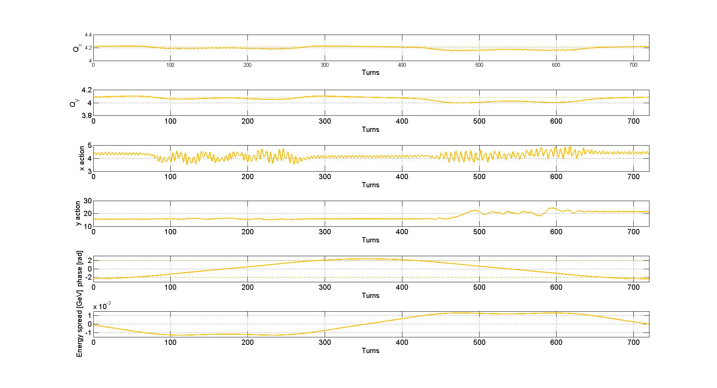
Single macroparticles behaviors
An increase in Jy (vertical action) has place when the particles approaches the integer resonance Qy=4.
1 synch. period
PSB space charge studies update
Vincenzo Forte – BE-ABP/LIS meeting – CERN - 04/11/2013
PSB Experiments, 6D Tune evolution with SC
Vincenzo Forte – Space charge meeting – CERN - 20/05/2014

Slide 33
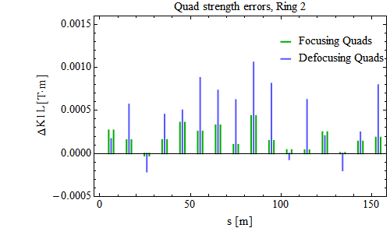
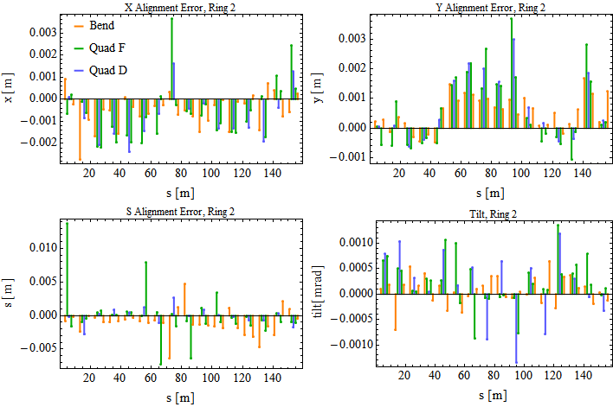
Measurements: quadrupolar field and misalignment errors
To drive the 2Qy=9 resonance a set of quadrupolar errors is necessary. Without these, it would be impossible to appreciate the effect of the resonance on the beam.
The misalignment errors are also provided.
A realistic errors model is used for the simulations.
Courtesy M. McAteer
PSB Experiments, 6D Tune evolution with SC
Vincenzo Forte – Space charge meeting – CERN - 20/05/2014

Slide 34


Simulations (with quad fields and misalign. Errors): 5-200 ms long. profiles
remained particles
PSB Experiments, 6D Tune evolution with SC
Vincenzo Forte – Space charge meeting – CERN - 20/05/2014

Slide 35


Simulations (with quad fields and misalign. errors): 200 ms losses vs y position profiles (long bunch)
Long bunch
Initially the losses are mainly for bigger transverse vertical particles…
…then the spread reduces and also particles in the core start getting lost.
PSB Experiments, 6D Tune evolution with SC
Vincenzo Forte – Space charge meeting – CERN - 20/05/2014

