Slide 1
Indirect space charge induced injection oscillations in the PS
A. Huschauer, S. Gilardoni, C. Hernalsteens
Space Charge Collaboration Meeting, May 20, 2014
Acknowledgements: H. Bartosik, H. Damerau, K. Li, E. Métral, N. Mounet, G. Rumolo, G. Sterbini, R. Wasef, PS/PSB operations team

Slide 2
Overview
Motivation
Measurements at injection and data analysis
HEADTAIL simulations
Conclusions
Outlook

Slide 3
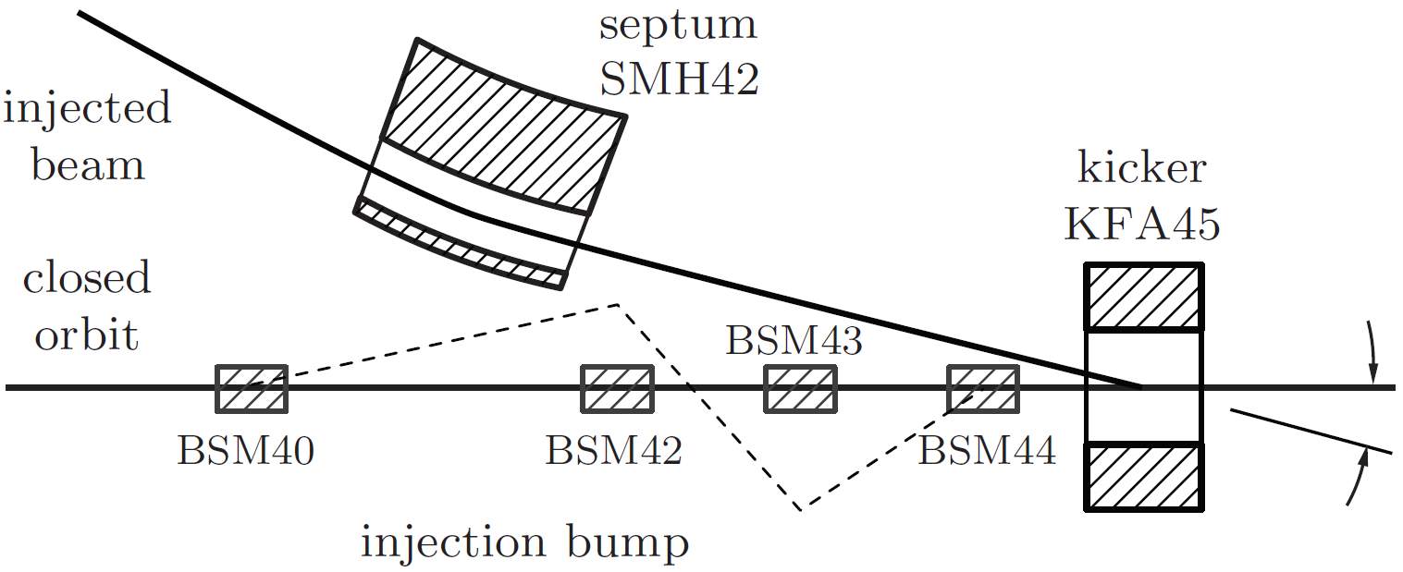
Motivation
slow losses observed for a few 100 μs after injection
losses in the injection region constitute one of the limitations for high intensity beams → access very difficult in case of septum breakdown
single-turn injection process

Slide 4
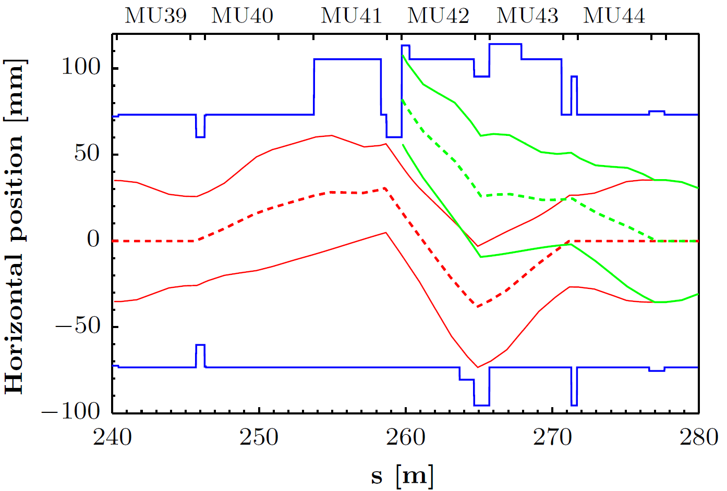
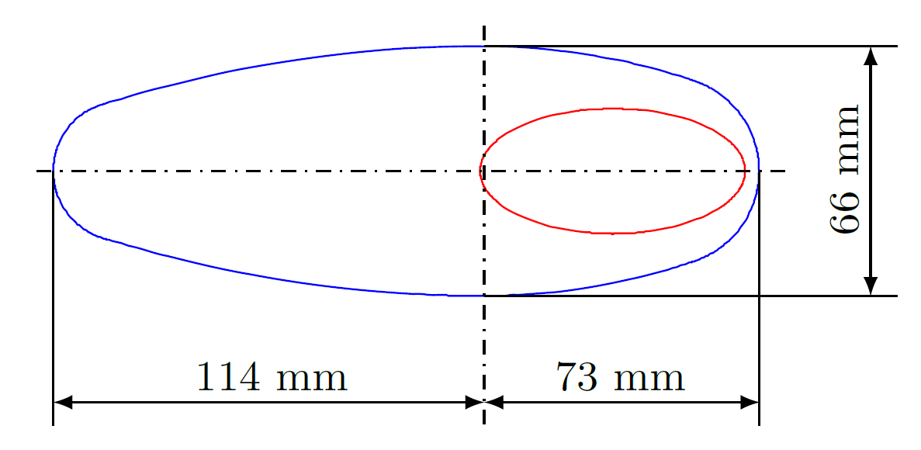
Motivation
slow losses observed for a few 100 μs after injection
losses in the injection region constitute one of the limitations for high intensity beams → access very difficult in case of septum breakdown
aperture and beam envelope in the injection region

Slide 5
Motivation
transverse oscillations observed at injection contribute to these losses → emphasis on vertical oscillations.
oscillations currently cured with the transverse damper
however: underlying mechanism?
    effect on future high intensity beams?
    effect on future beams for the HL-LHC?

Slide 6
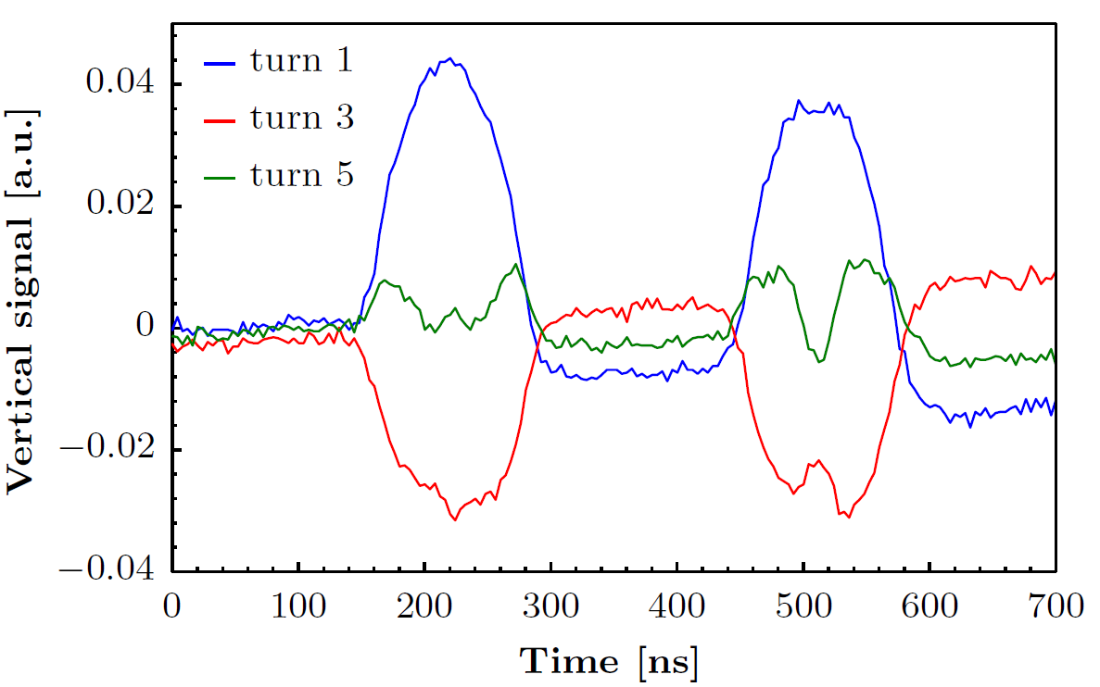
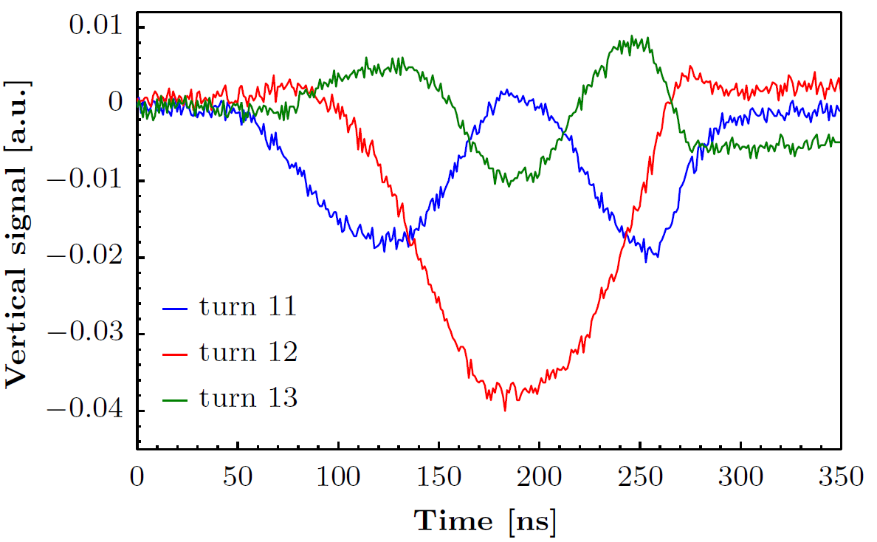
Measurements at injection
measurements done with the operational settings
wide-band PU in SS94 used to observe transverse and longitudinal signals
fast build up of intra-bunch oscillations (few turns after injection)
oscillations primarily observed in the vertical plane
visible on different types of beams and each time the beam is injected → more pronounced for high-intensity users
I_{p} = 375 ∙10¹⁰ ppb
I_{p} = 700 ∙10¹⁰ ppb
CNGS
nTOF

Slide 7
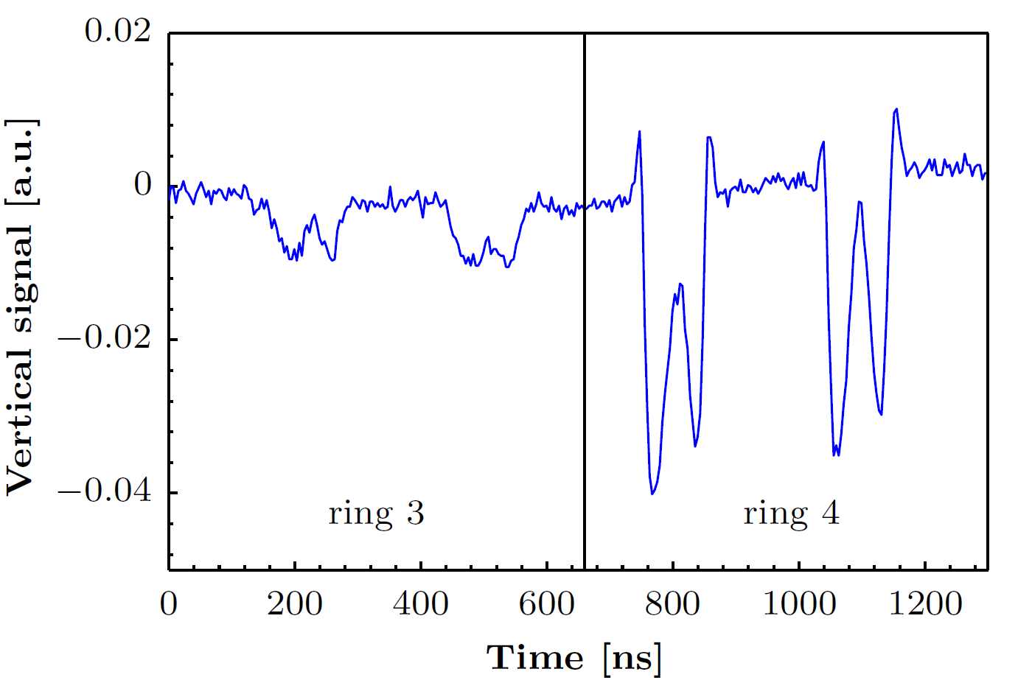
Measurements at injection
different behavior of the oscillations depending on the PSB ring
example: CNGS, I_{p} = 750 ∙10¹⁰ per PSB ring, 2 rings injected
→ optimized steering in the BTP-line reduces these oscillations

Slide 8
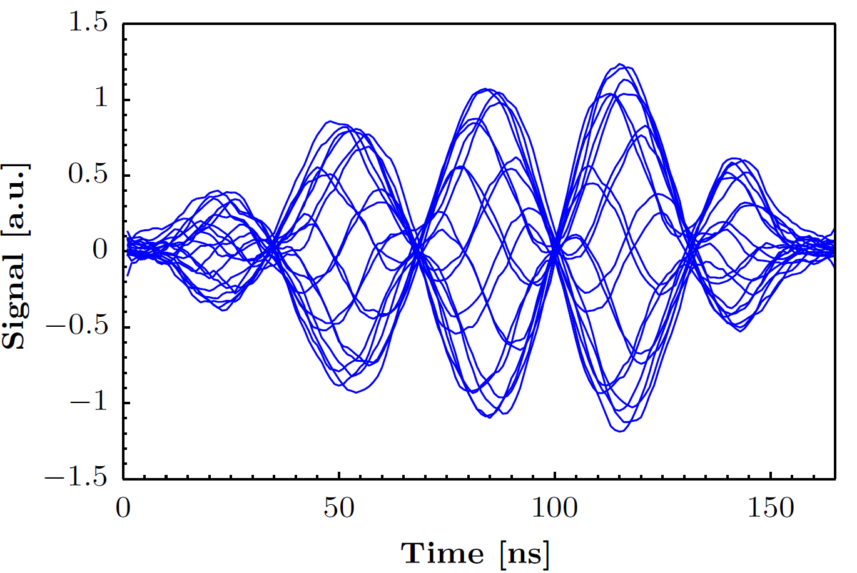
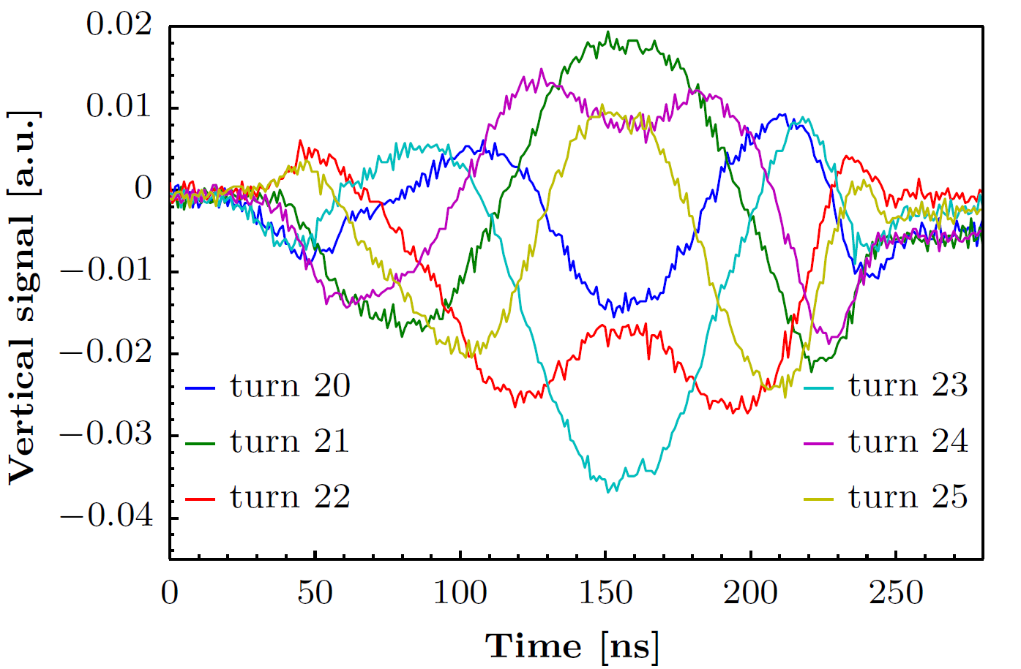
Data analysis
First assumption: observations correspond to head-tail instability
usually observed in the horizontal plane on LHC-type beams (in the absence of stabilizing mechanisms)
LHC
nTOF
G. Sterbini
however:
time scale very short compared to one synchrotron period (~ 400 turns)
no mode structure appearing

Slide 9
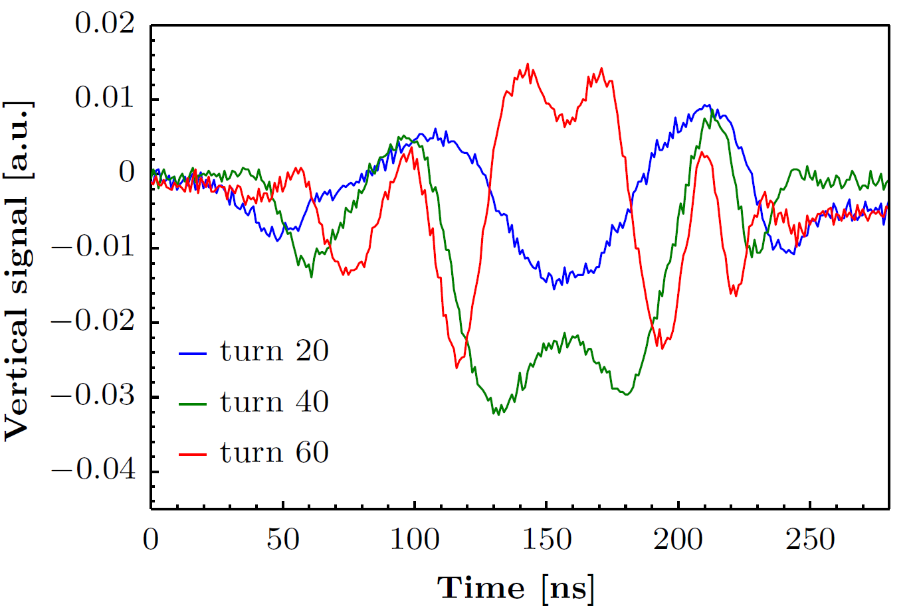
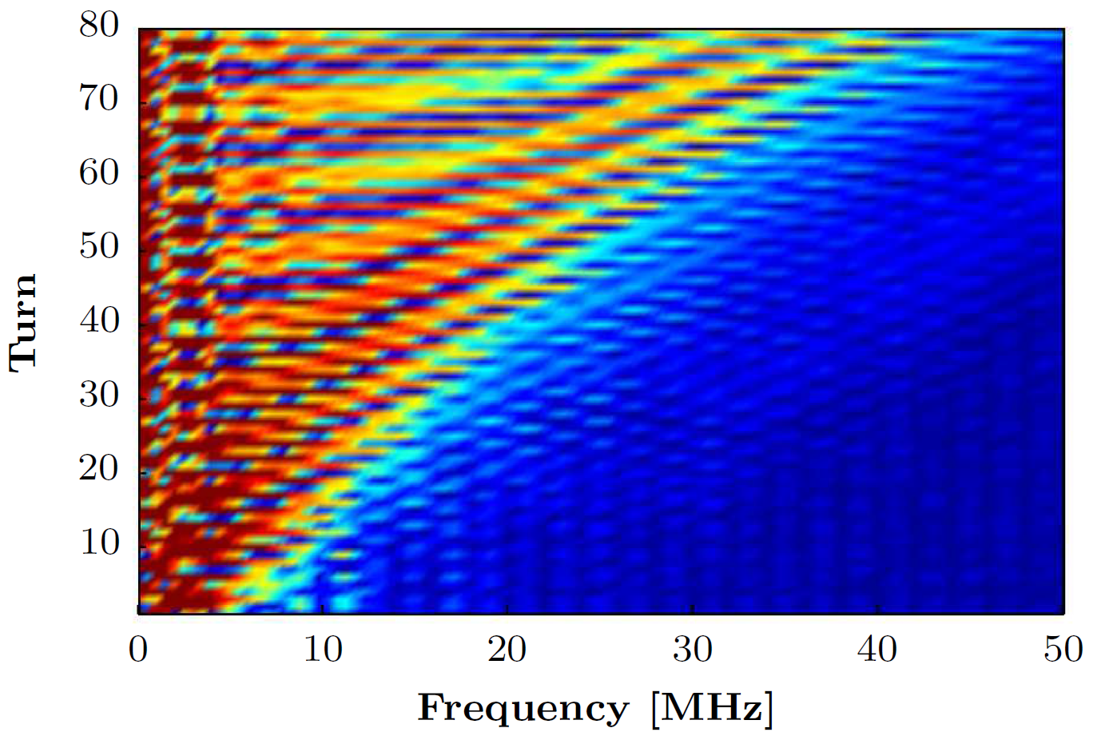
Data analysis
Increasing intra-bunch oscillation frequency (in the vertical plane)
frequency spectrum based on a turn-by-turn FFT → limited resolution due to small number of data points

Slide 10
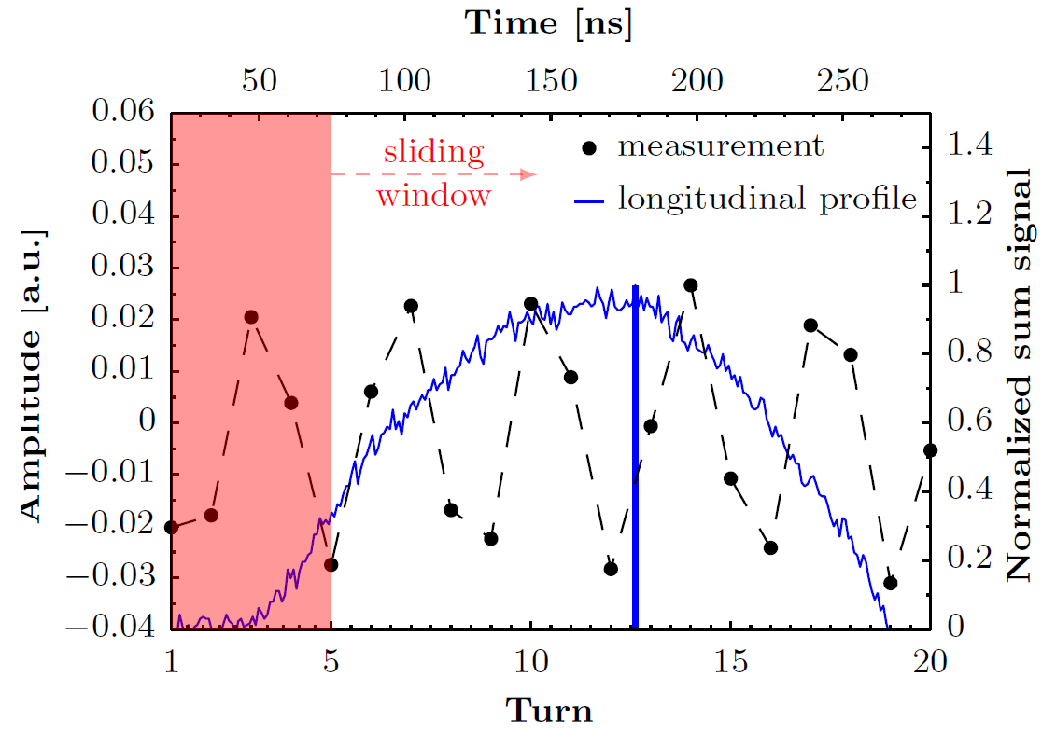
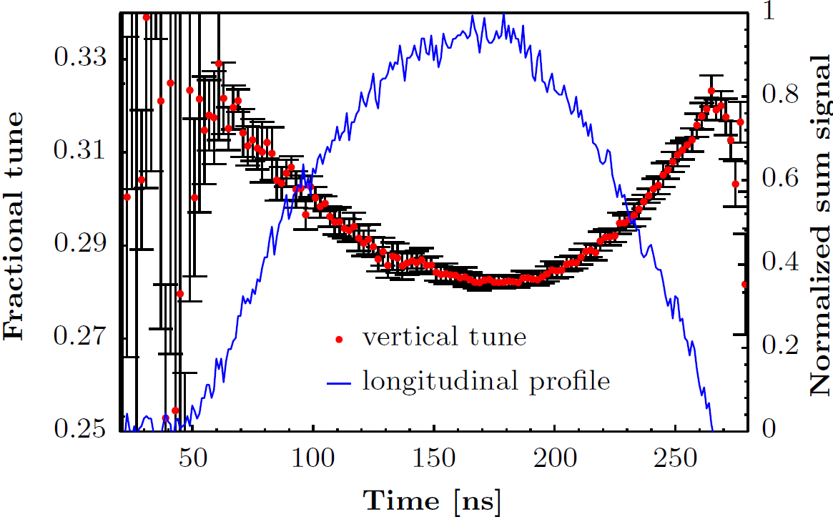
Data analysis
Detuning along the bunch
noise of the baseline
sinusoidal fit computed over a window of 5 turns for each bin
repeated for the first 20 turns → average value
assumption: linear machine, longitudinal motion negligible
programmed: Q_{v}=6.33
parabolic detuning observed (proportional to the line density)

Slide 11
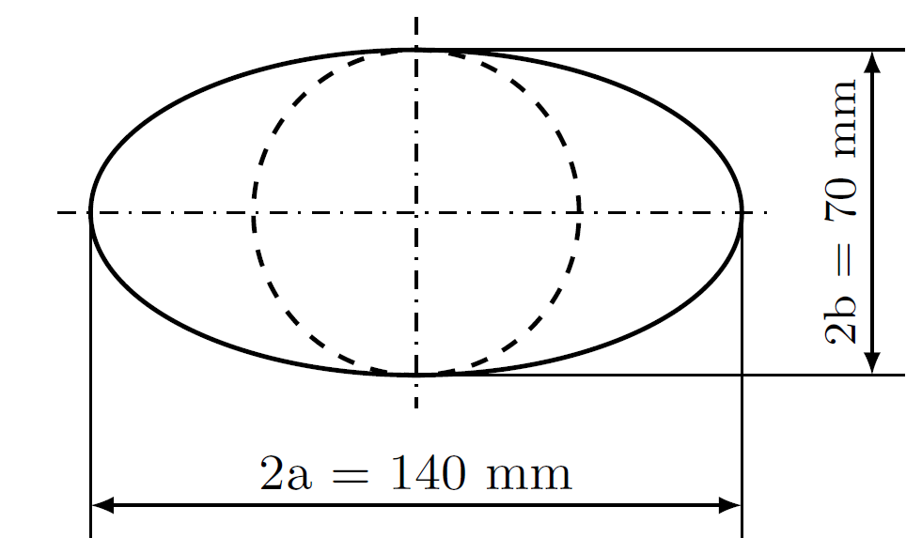
HEADTAIL simulations
HEADTAIL: simulation code for collective effects
bunches are longitudinally sliced
macro particles within each slice receive a kick based on a certain
wake field
ImpedanceWake2D is used to obtain wall impedance and wake functions for a circular chamber
for the case of the PS the wake computations are based on a continuous stainless steel chamber with the shown dimensions (about 70% of the PS is equipped with this type)

Slide 12
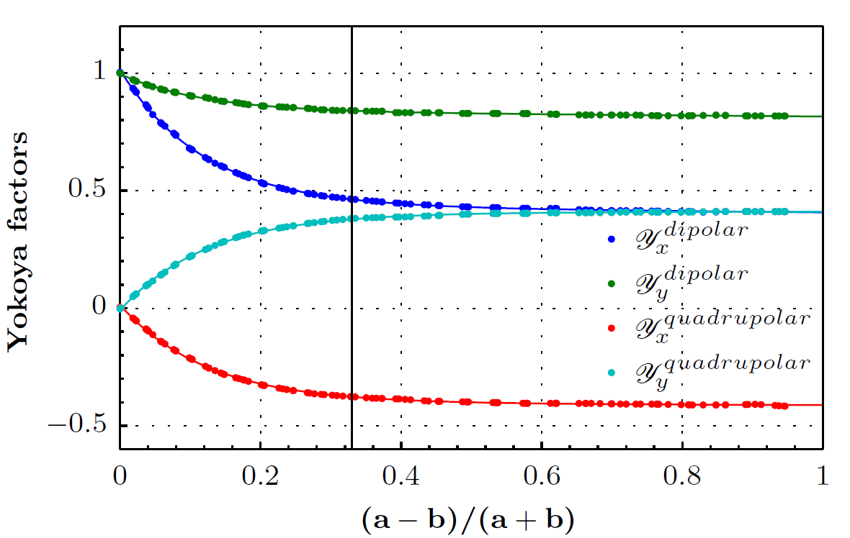
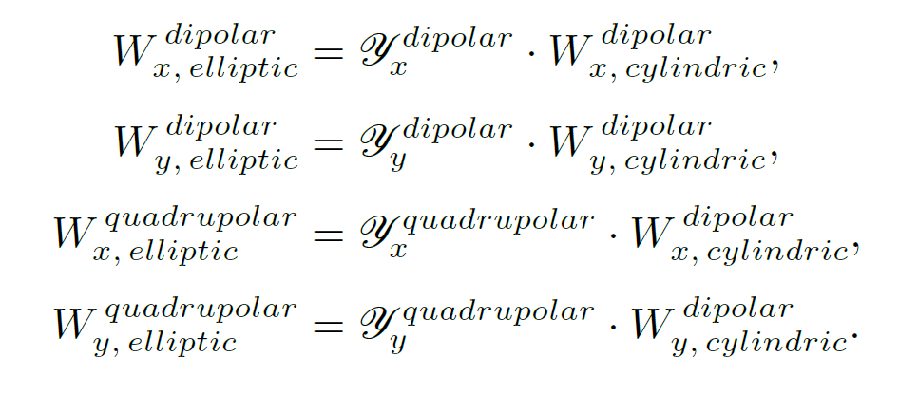
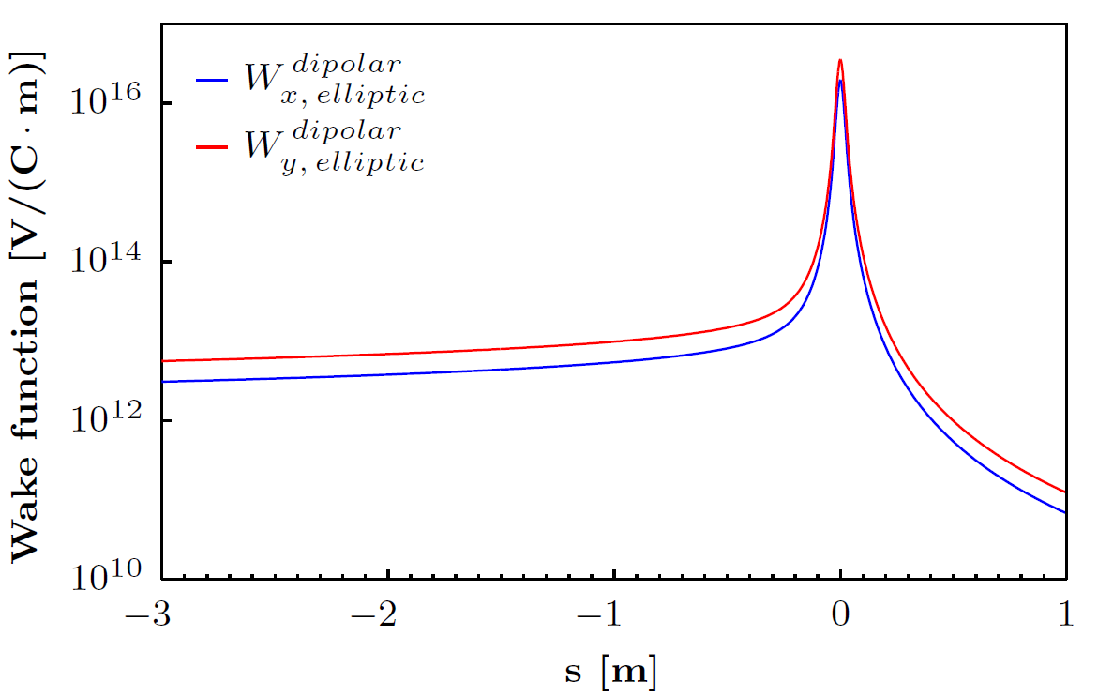
Wake functions
wake functions for an elliptic geometry obtained from the circular one using the appropriate Yokoya factors

Slide 13
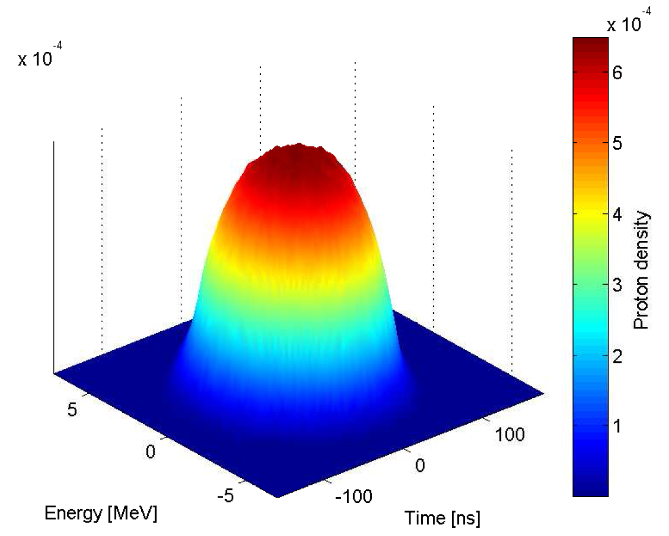
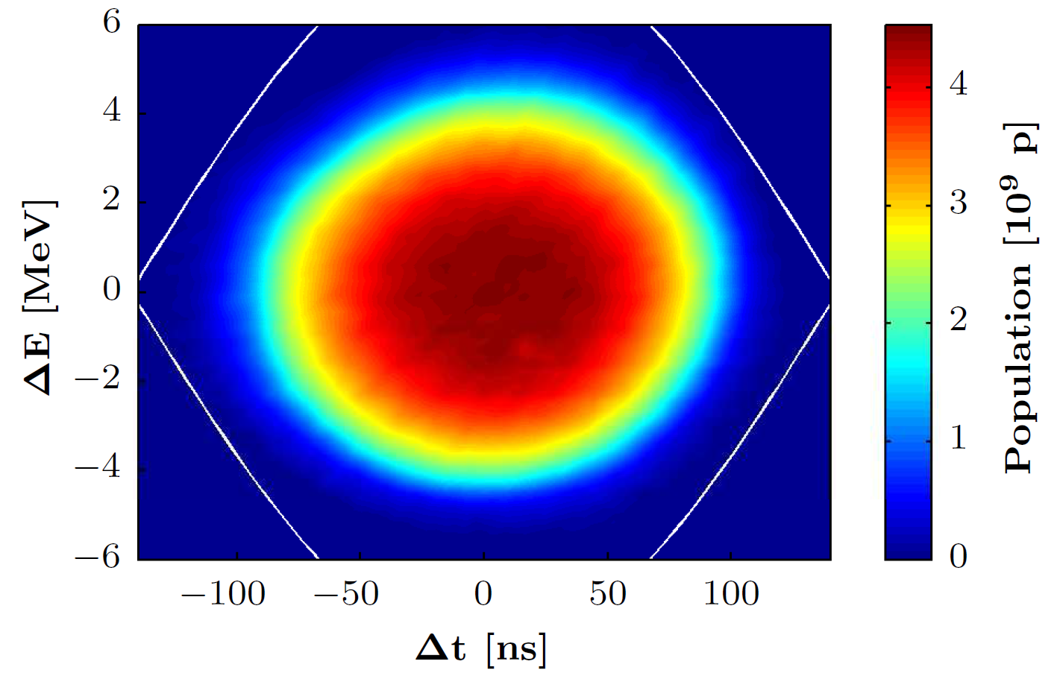
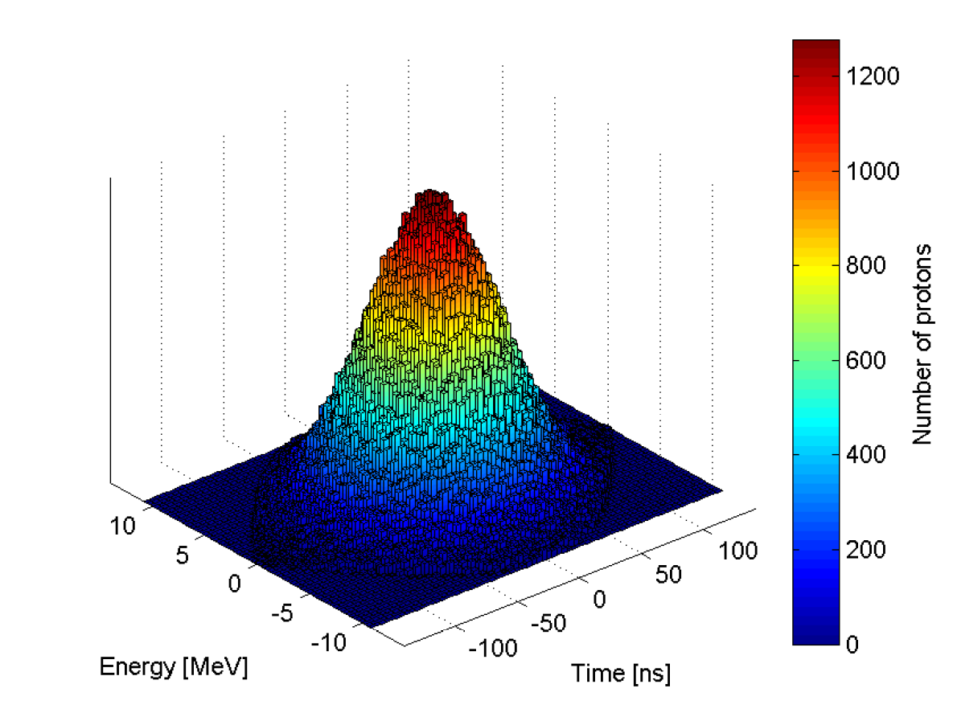
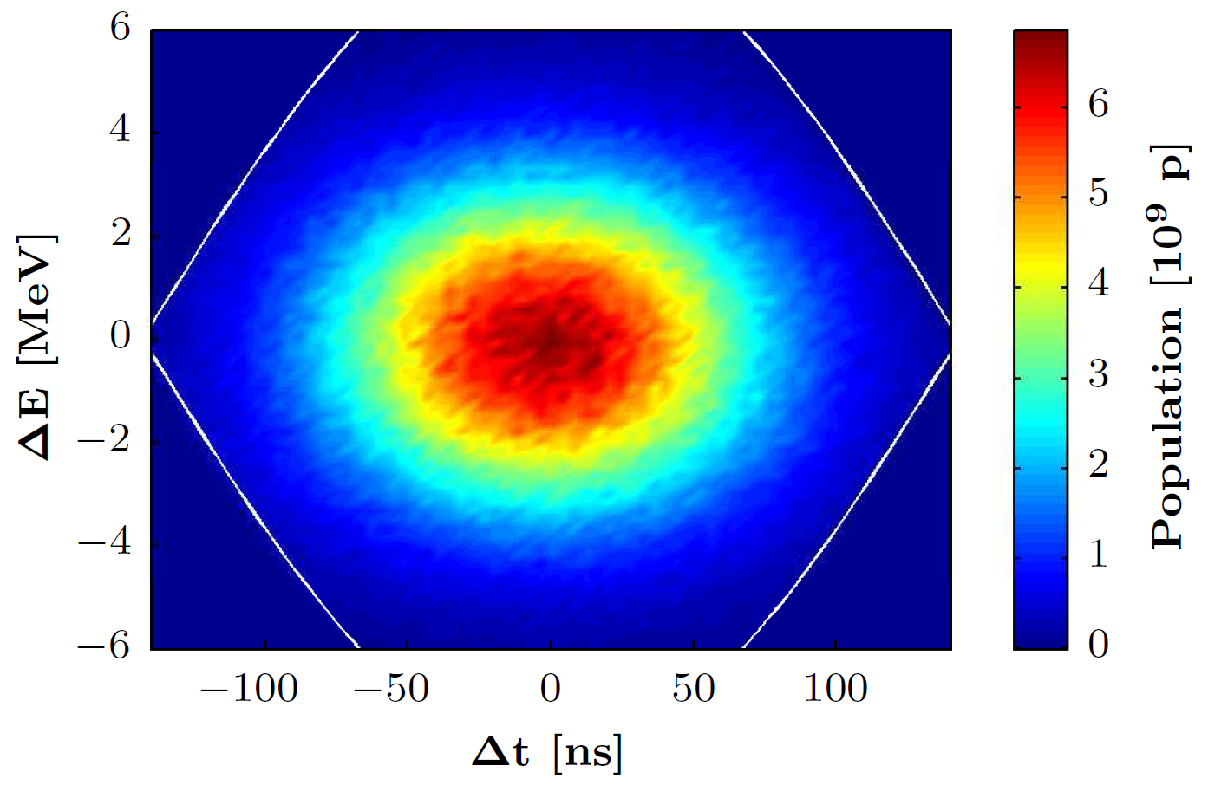
Longitudinal distribution
measurement at PSB extraction
distribution created by HEADTAIL

Slide 14
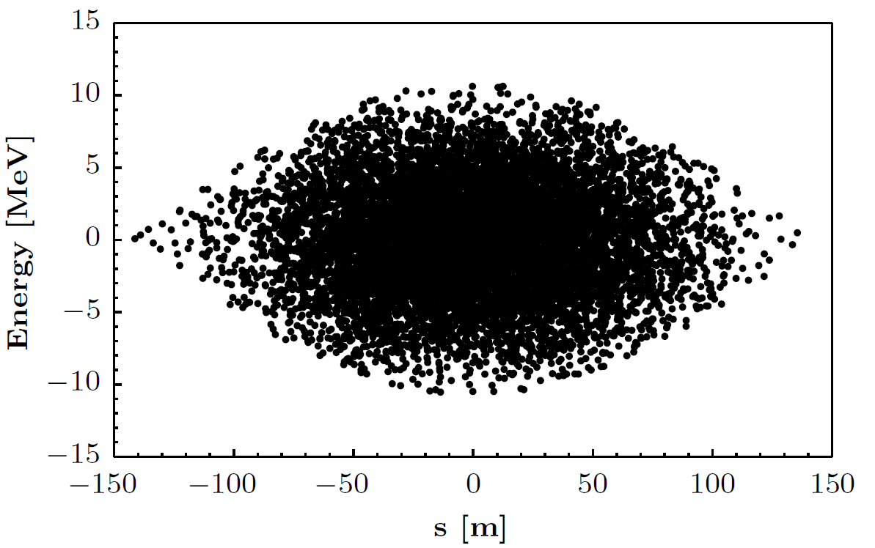
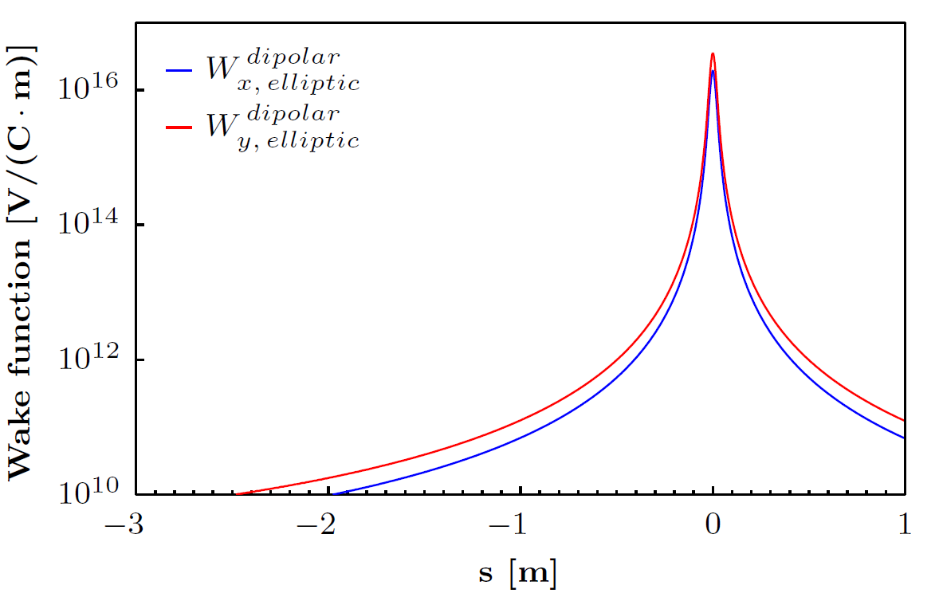
Discrimination between resistive and indirect space charge impedance
Slicing of the bunch
currently considered slice
± 3σ_{z} considered as total bunch length
bunch divided into 1700 equally thick slices
Indirect space charge impedance
decrease of the resistivity of the beam pipe allows determination of indirect space charge impedance only (10⁻⁷ → 10⁻¹⁴ in this case)
effect of these slices on the current one accounts for resistive wall impedance only
indirect space charge impedance is taken into account by using the SC wake function on the left and considering all slices

Slide 15
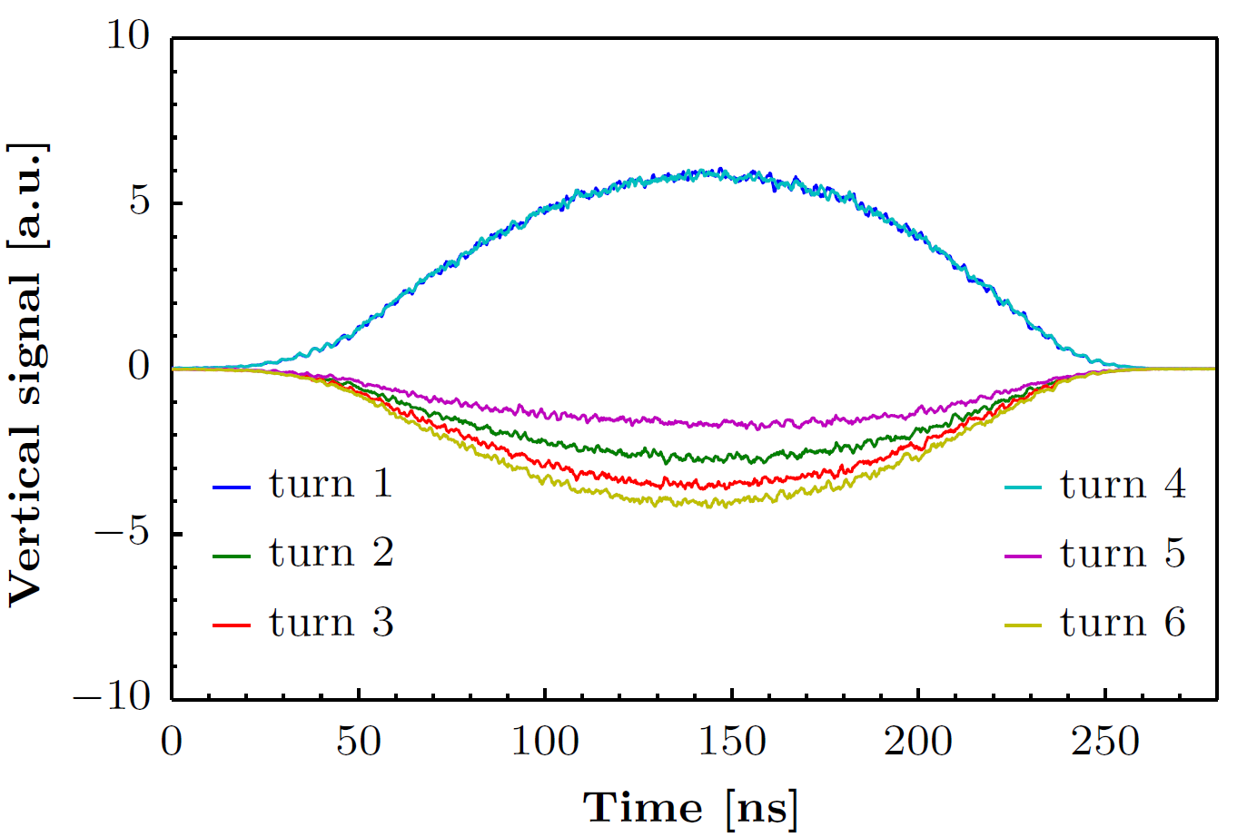
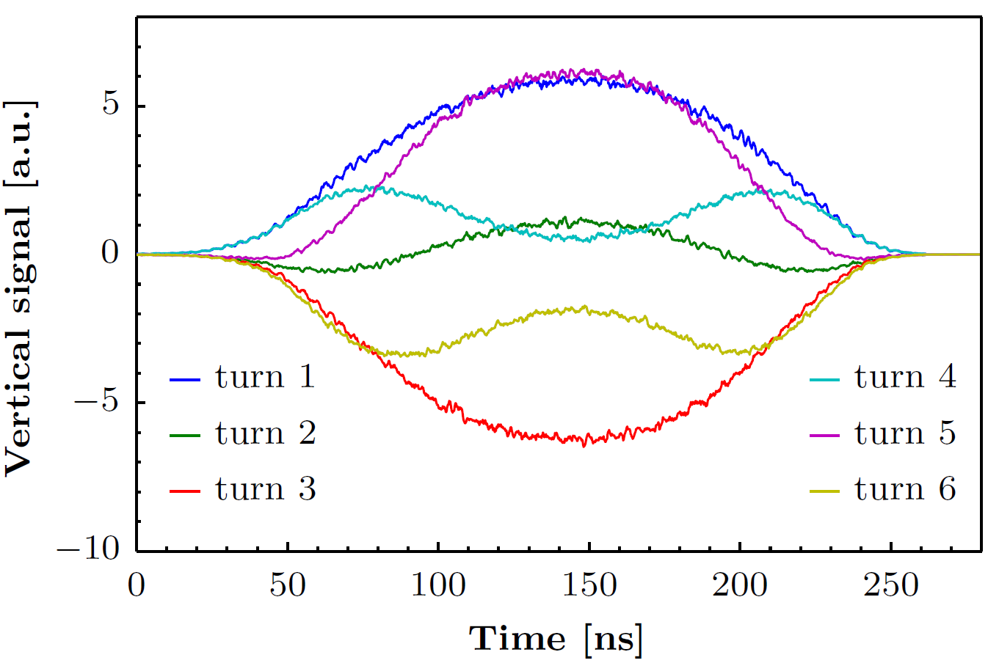
Discrimination between resistive and indirect space charge impedance
resistive wall impedance only
indirect space charge impedance only
decoherence due to chromaticity
very similar results as observed in the machine
Indirect space charge effects are driving the observed phenomenon

Slide 16
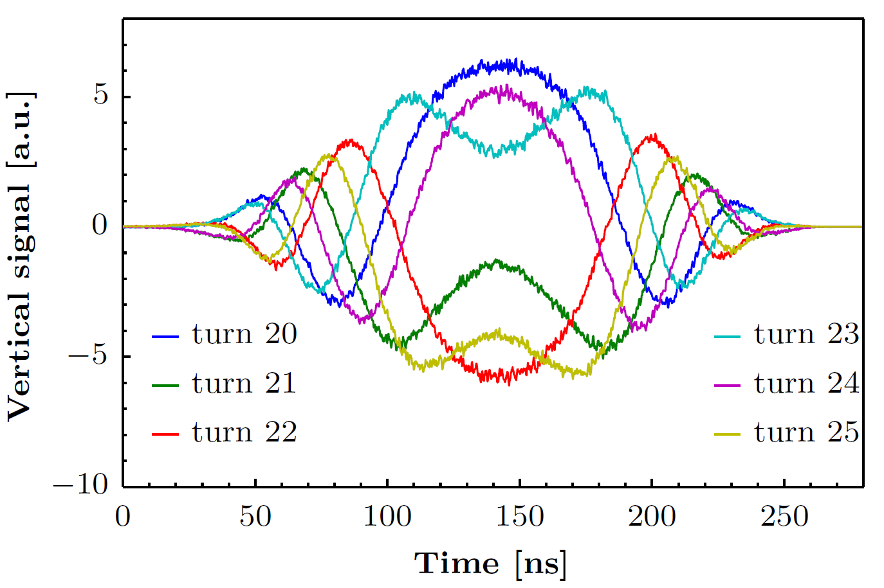
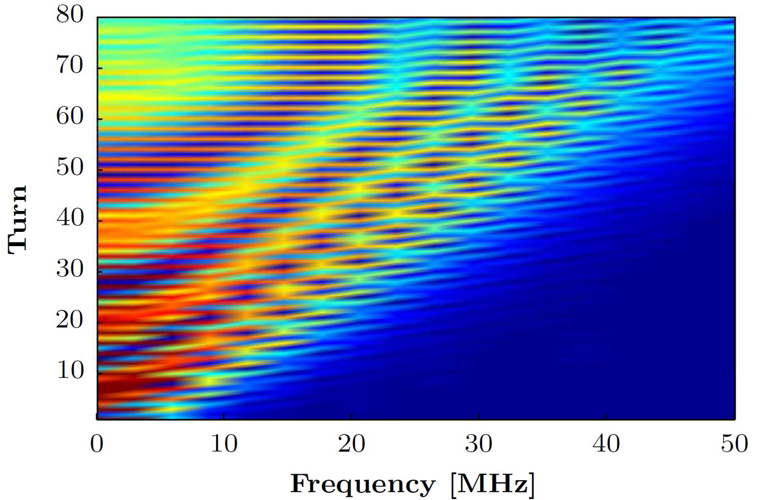
Simulation results
measurement
simulation

Slide 17
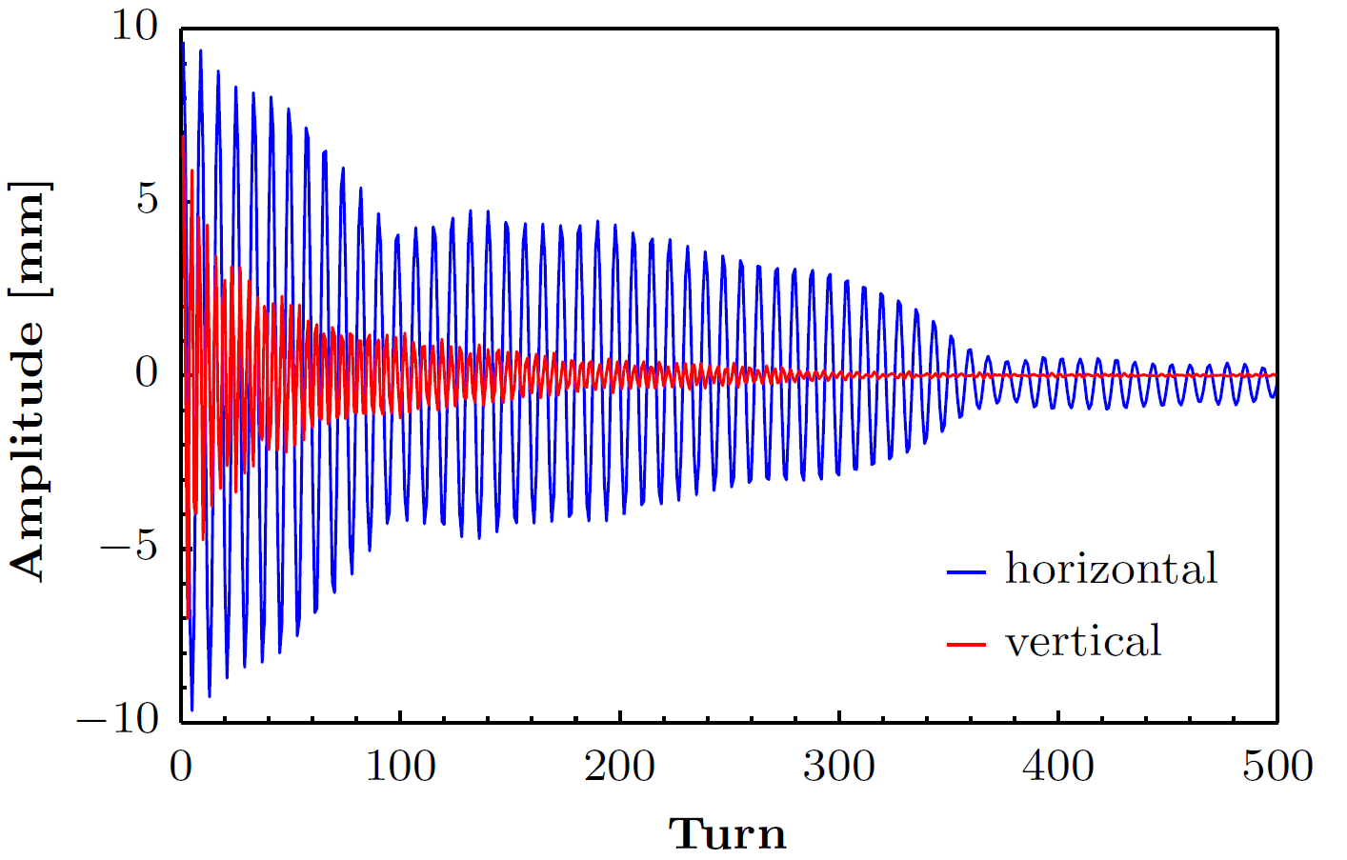
Simulation results
indirect space charge impedance causes a real tune shift
no unstable behavior of the beam observed
centroid motion decays because of natural chromaticity

Slide 18
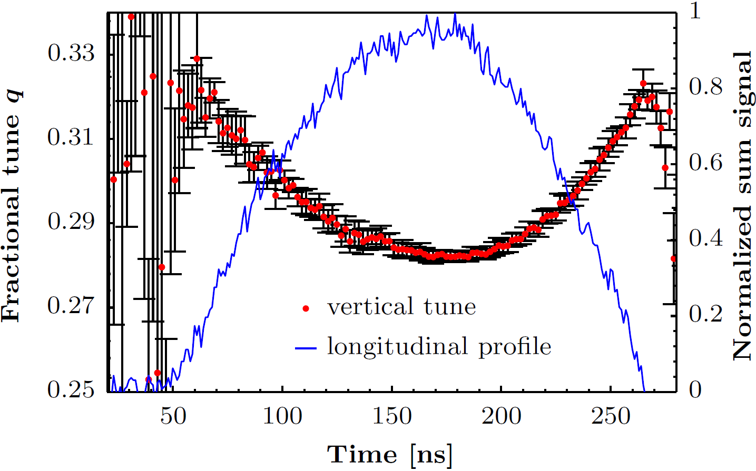
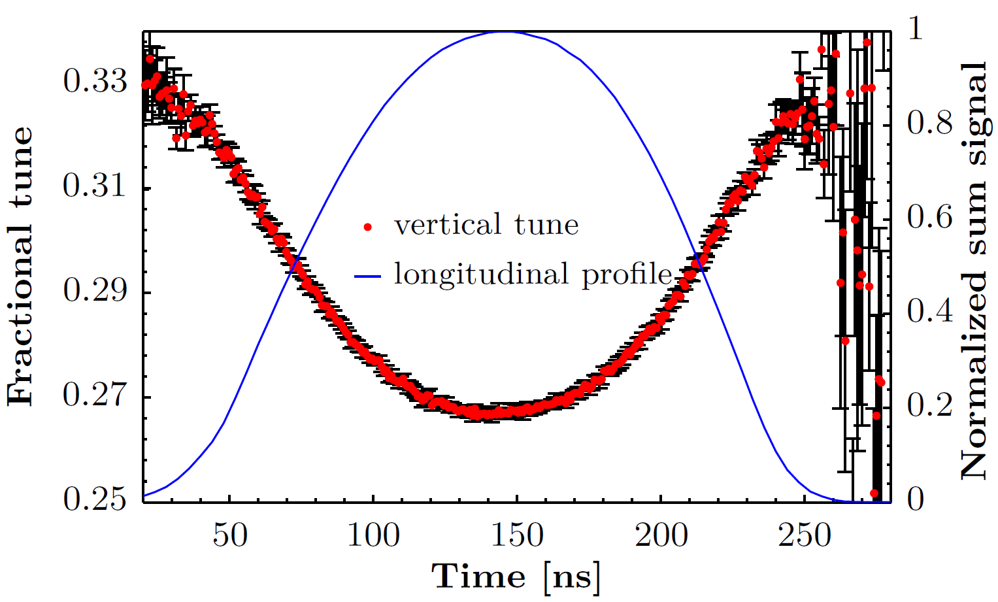
Simulation results
measurement
simulation
max. tune shift in this simulation is approx. 0.01 larger than in the measurement
effect very sensitive to the longitudinal distribution
modelling of the machine vacuum chambers

Slide 19
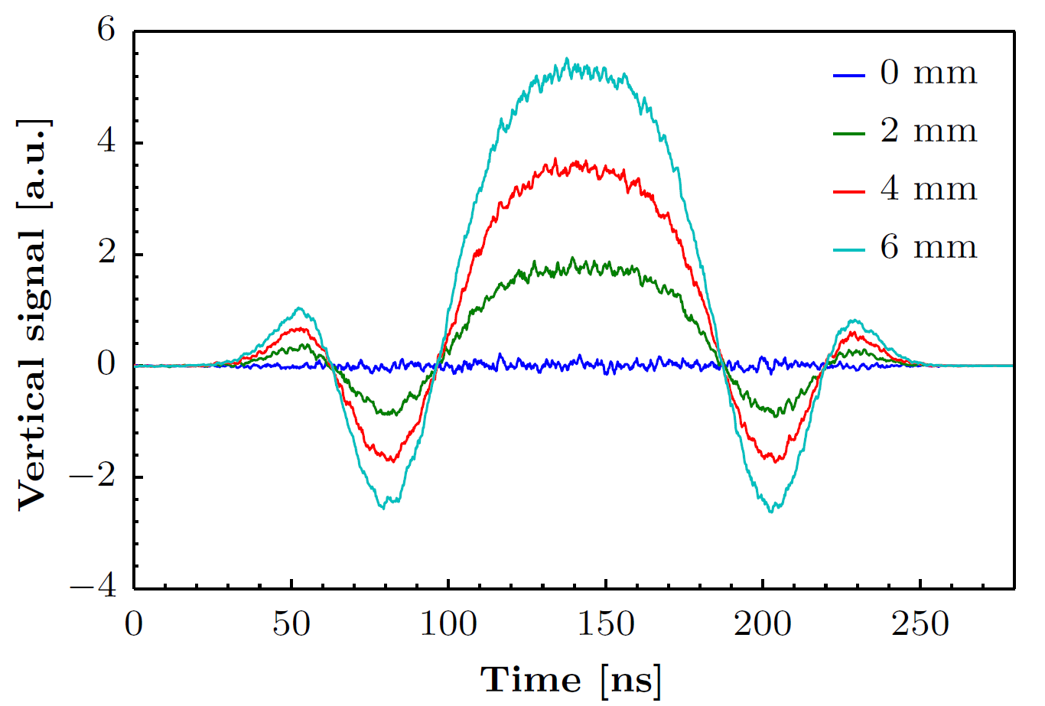
Different injection errors
without injection error no oscillations are observed
amplitude of the oscillation changes depending on the error
frequency remains the same

Slide 20
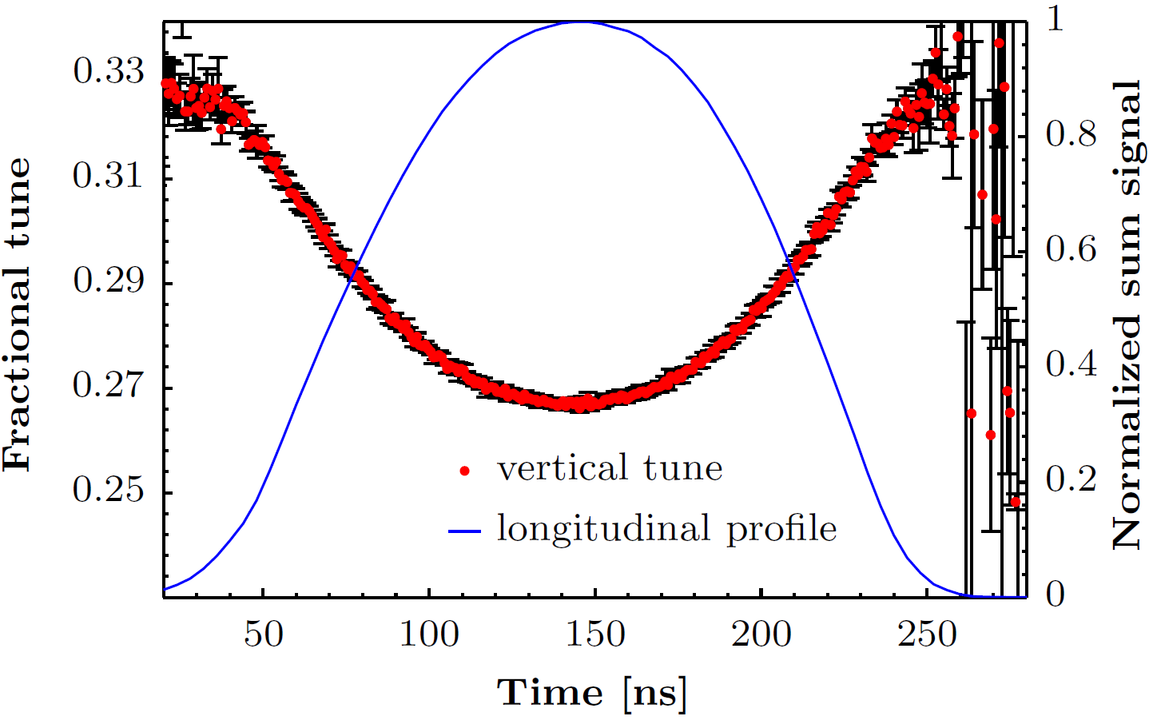
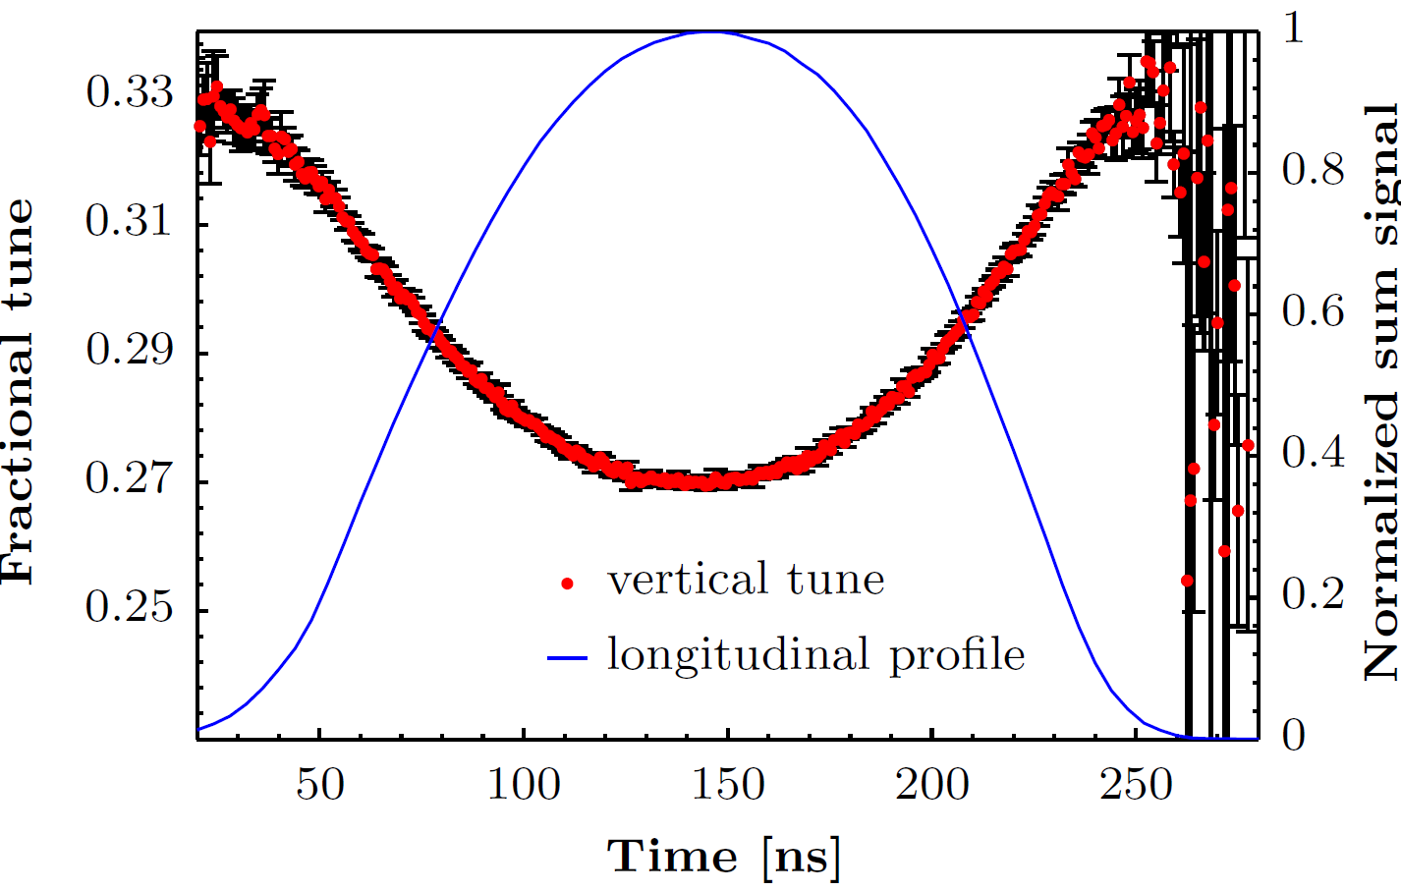
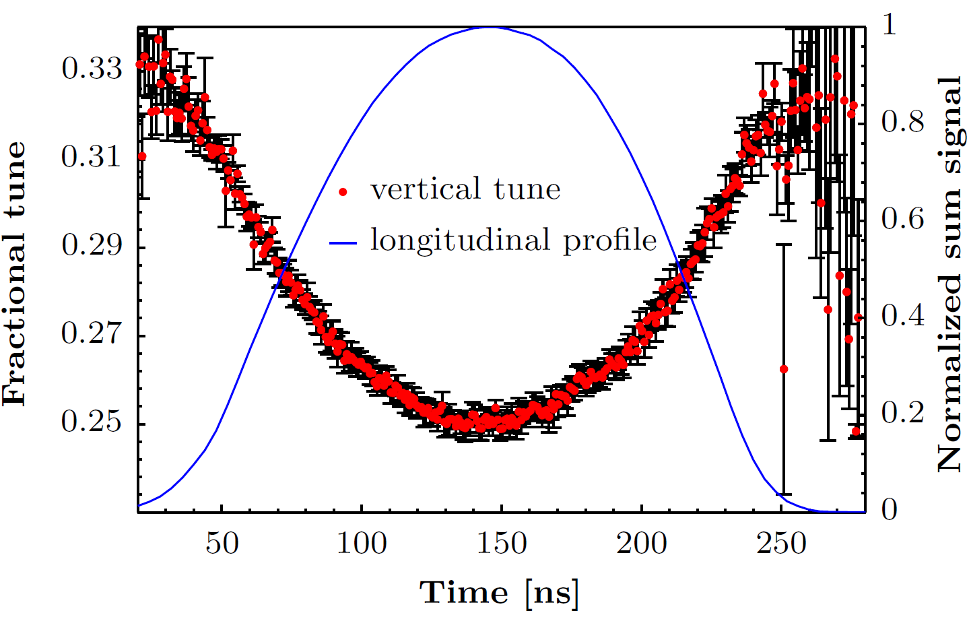
Effect of chromaticity
ξ_{v} = -1.1
ξ_{v} = 0
ξ_{v} = -3

Slide 21
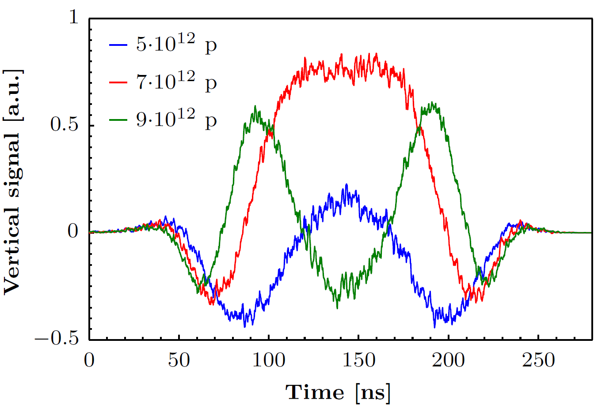
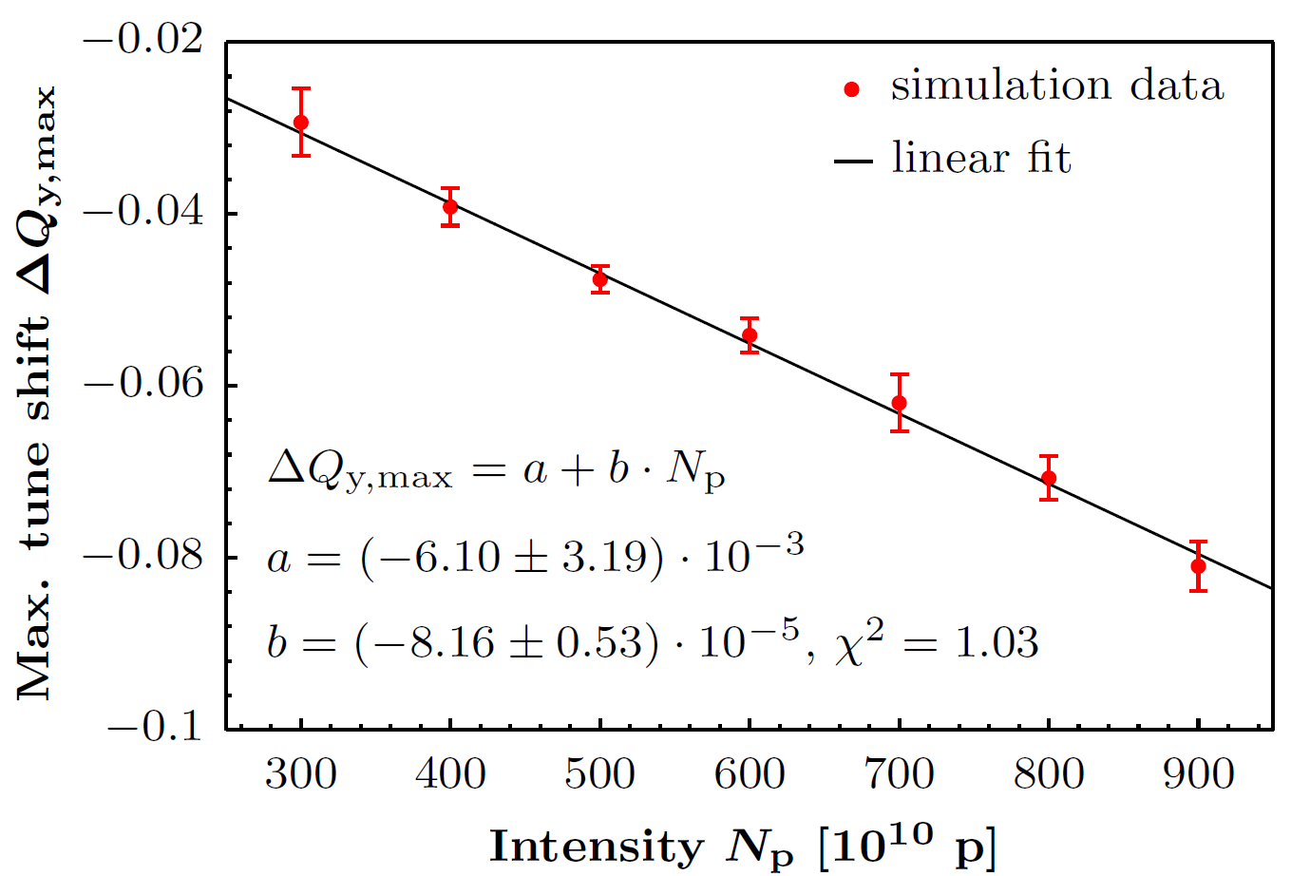
Intensity scan
intra-bunch oscillation frequency depends on intensity
simulations show a linear relationship between intensity and tune shift
recent simulations show that these oscillations will also be present on beams for the HL-LHC → effect on brightness remains to be studied

Slide 22
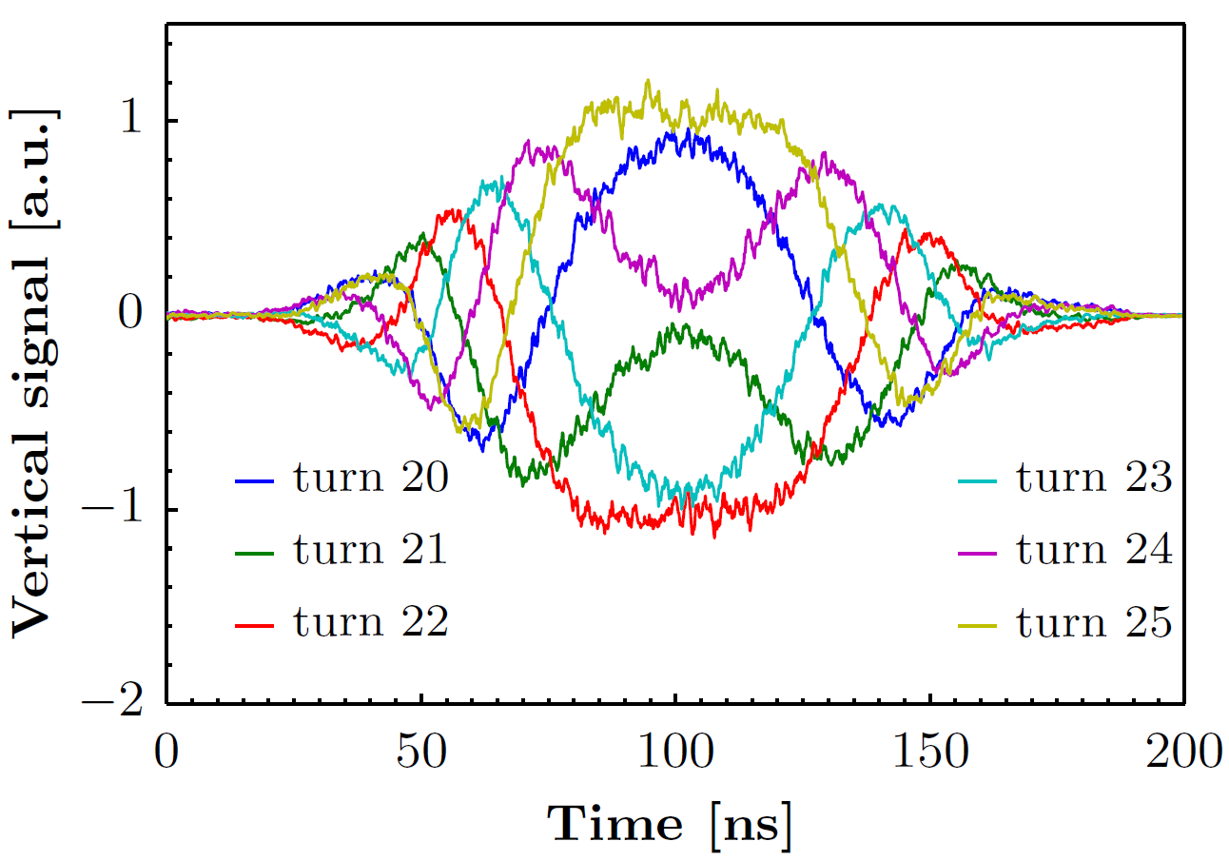
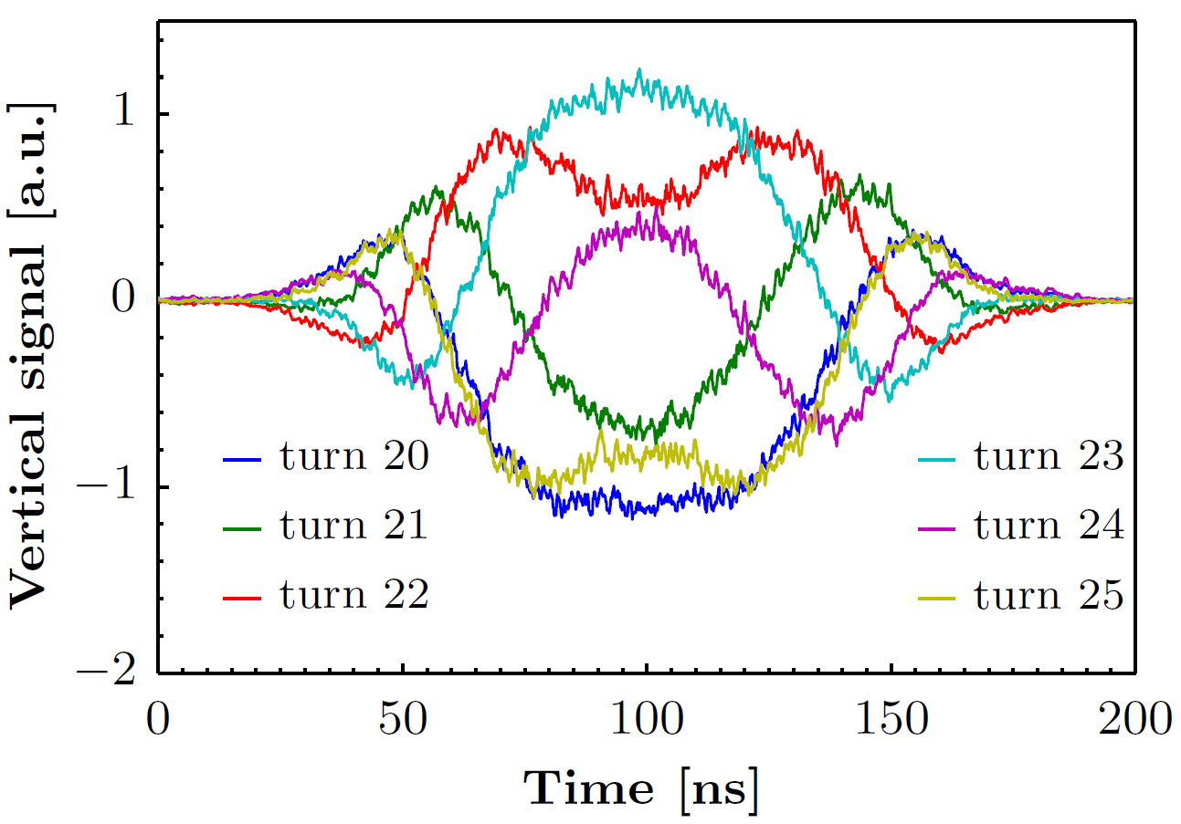
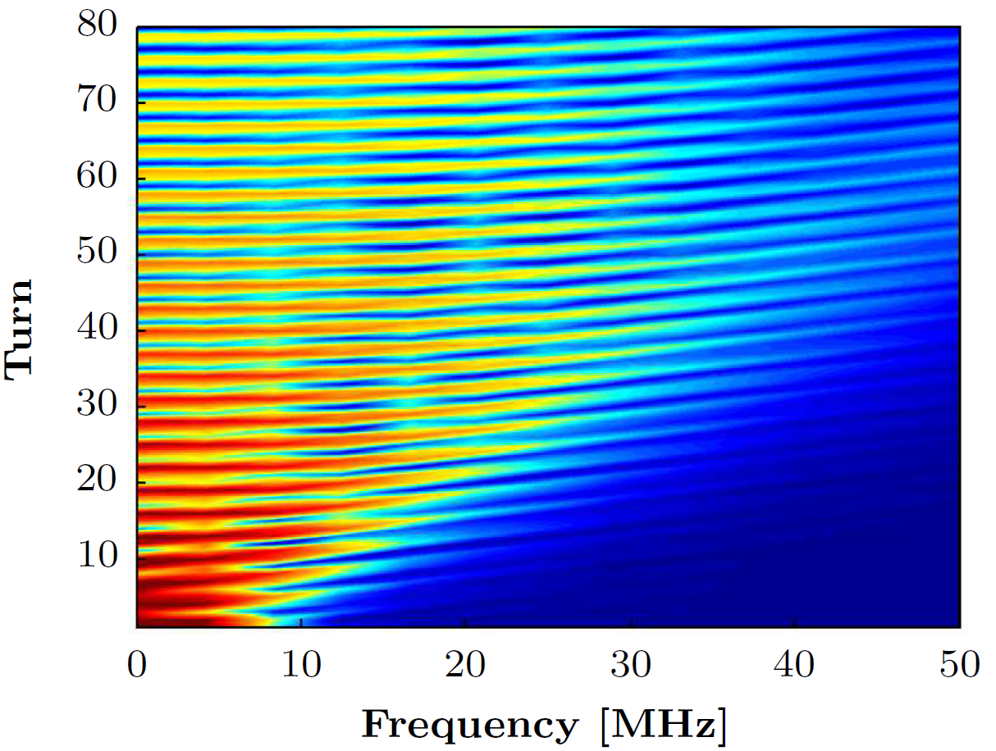
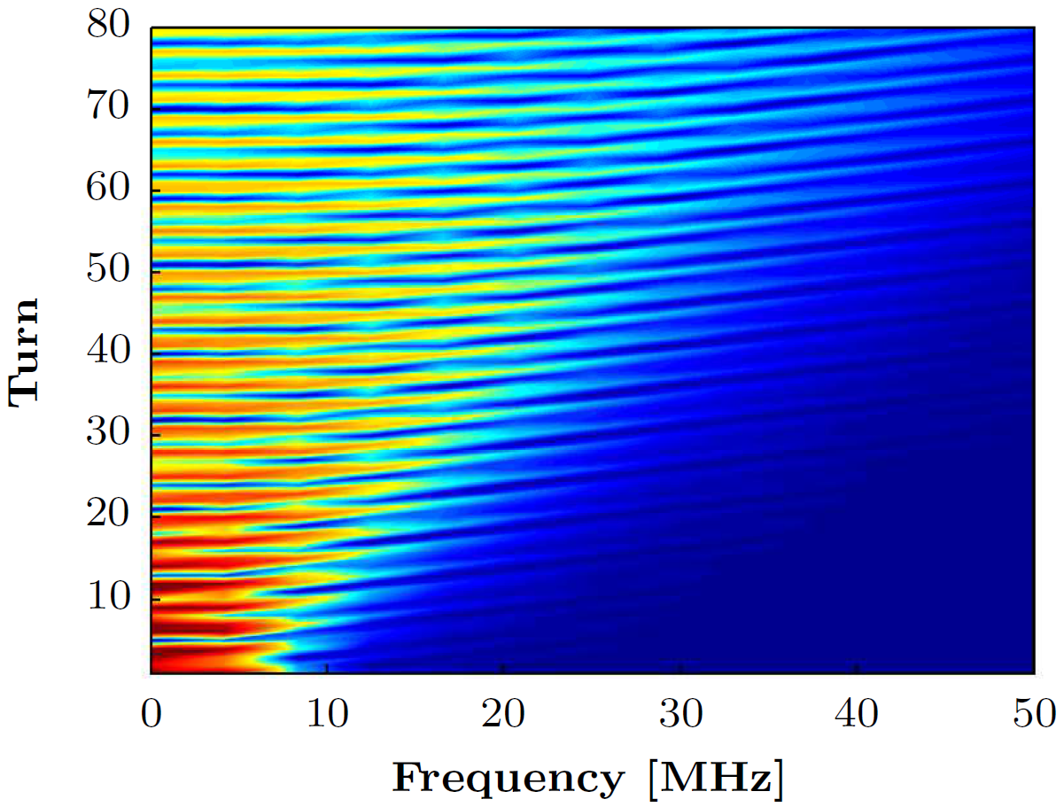
Influence on future beams
Future beam for ν-production at 2 GeV
CNGS at 1.4 GeV
350 ∙10¹⁰ ppb
500 ∙10¹⁰ ppb

Slide 23
Influence on future beams
increase of injection energy more important than increase of intensity
transverse damper able to reduce injection oscillations on today’s CNGS beams
future beams even less demanding for the transverse damper

Slide 24
Conclusion
The observed injection oscillations on high-intensity beams can be explained by the effect of the indirect space charge impedance on a beam injected off-center.
No exponential growth of the centroid motion is observed – the purely imaginary impedance does not cause an instability.
The impedance of a simple elliptic geometry is sufficient to reproduce the measurements.
The oscillation frequency depends crucially on the longitudinal distribution.
The amplitude of the injection error only influences the amplitude of the oscillation and not its frequency.
Publication to PRST-AB submitted in April

Slide 25
Outlook
Additional means to reduce these oscillations: flat bunches?
After LS1: additional measurements on CNGS required to compare with simulations
Further investigation of the different injection errors for bunches arriving from different rings and their effect on the observed oscillations
Additional measurements at different energies.

Slide 27
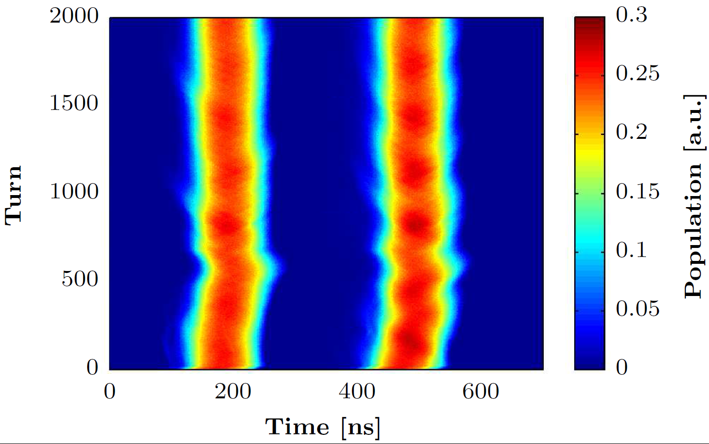
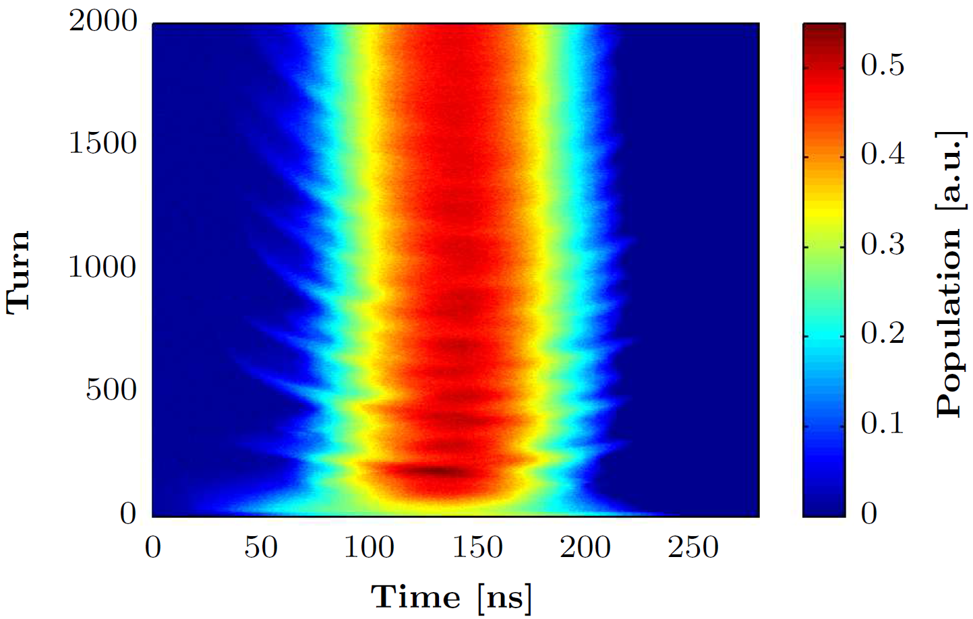
Longitudinal distributions
CNGS
TOF

Slide 28
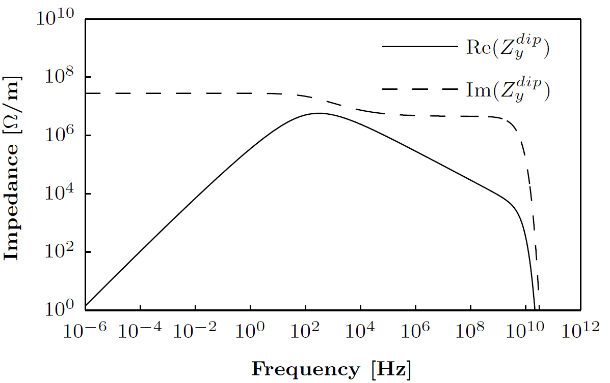
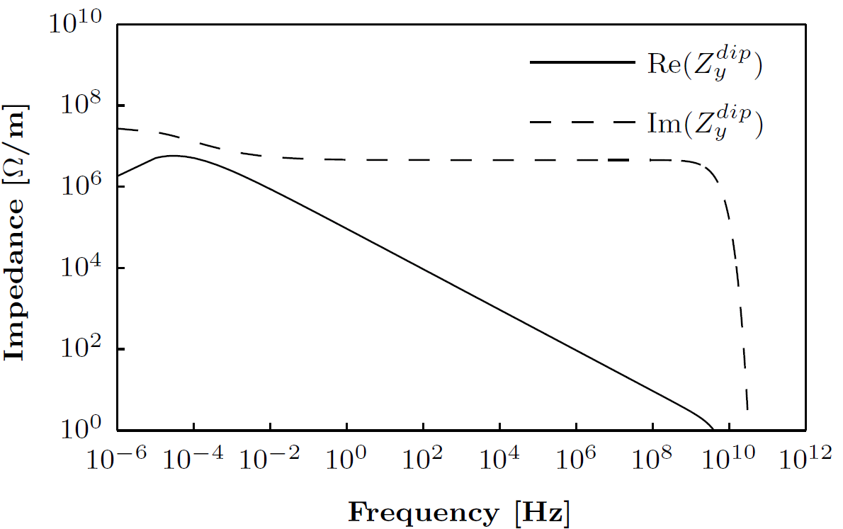
Vertical dipolar impedance
wall impedance
indirect space charge impedance “only”

