Slide 1
GRID INDUCED NOISE in 3D PIC SIMULATION
CERN SC Workshop
20-21 May, 2014
Ingo Hofmann
GSI/TUD Darmstadt

Slide 2
Theory overview
3D bunches in periodic solenoid
Temperature anisotropy
3D in FODO
Conclusions
(work pre-published under arxiv 1405.4153)
Acknowledgment:
O. Boine-Frankenheim (collaborator)
J. Struckmeier (discussions)

Slide 3
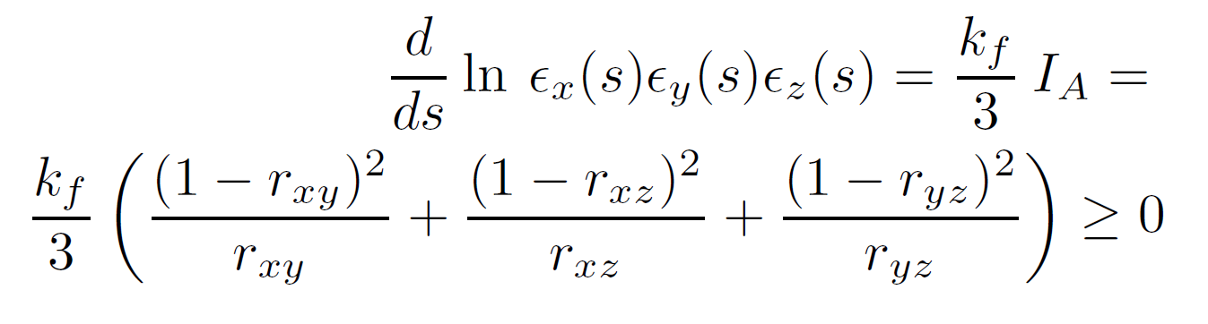
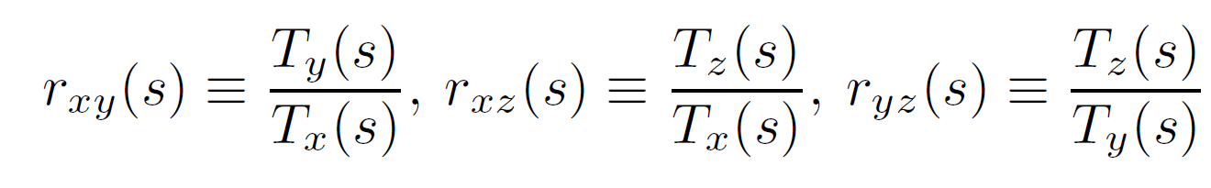
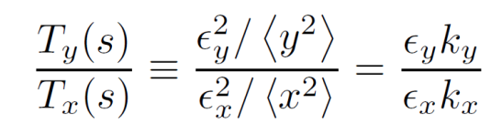
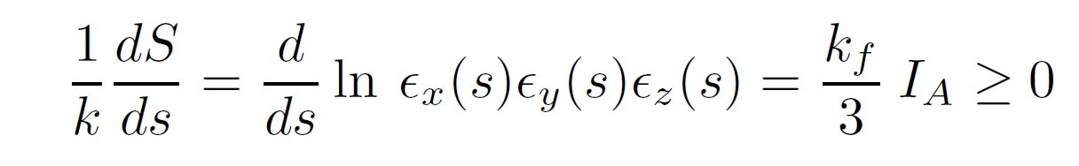
Theory overview following work by Struckmeier (1994,1996,2000)

Slide 4
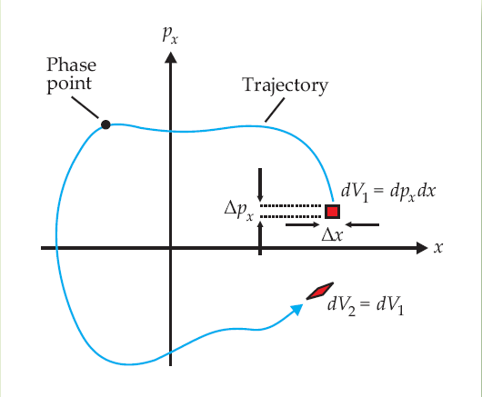
Entropy
Liouville - infinite resolution – coarse graining
Liouville
Liouville: exact area in 2d, 4d, 6d phase space invariant for Hamiltonian flow
for „infinite resolution“ self-consistent space charge potential (as in PIC) exact areas or volumes invariant → no growth of „infinite resolution“ entropy
for exactly resolved motion of directly interacting particles (collisions) in 6d:
  „infinite resolution“ entropy may grow
  in time-independent external potential total energy invariant → ε_{6d,rms} basically constant
for exactly resolved collisional motion in 6Nd no growth of „infinite resolution“ entropy (Hamiltonian flow in 6Nd)
Gibbs entropy in 6Nd needs finite resolution or „coarse graining“ to allow entropy growth

Slide 5
TRACEWIN code (CEA Saclay)
3d PIC code primarily for linac applications („commercial“)
rz and xyz (PICNIC) Poisson solvers and grids
analytical continuation of fields in halo region
hard edge elements or field maps
variable number of space charge kicks per element (drift and field maps)
plots: rms emittance and their products etc.

Slide 6
Periodic solenoid lattice
thin lenses & rf kicks
→ option of identical envelopes and „temperatures“ in x,y,z
1000 cells as reference to determine emittance & entropy growth

Slide 7
Different regimes in anisotropic case
k_{0x,y,z}=60º and ε_{z}/ ε_{xy}=3 → anisotropy generated initially T_{x,y} << T_{z}
space charge: k_{x,y,z}=32º/32º/38º
N=1000: enhances effects over 1000 cells
3 distinct regimes:
  coherent exchange < 20 cells
    resonant equipartition driven by space charge octupole
    → ε_{6d,rms} not suitable as entropy since also decreasing and ~ independent of N
  anisotropy (+ grid) induced noise → cell 500 (equi-partition)
  purely grid induced noise → continuing
coherent
grid induced noise
anisotropy
induced noise
stop-band for resonant coherent exchange of „temperatures“ (→ equipartition)
(2k_{z}-2k_{xy} ~ 0)

Slide 8
Poisson solver grid & noise
Purely grid induced noise:
not included in original „collisional“ approach of Struckmeier
assume several sources:
  non-Liouvillean effect by fluctuating charges on grid
  focussing modulation „fast“
  coherent flow vs. incoherent „temperature“
PIC: replaces infinite resolution charge density by “grid distribution”
Gibbs entropy: replaces fine-grained (infinite resolution) 6N-d phase space by “Coarse Grained"
Phase space remains infinitely resolved
Averaging over cells:
loss of Hamiltonian character of phase space flow
present and future states not connected by Hamiltonian mechanics
→ growth of entropy

Slide 9
Space charge dependency approximately ~ I²
I_{A}=0 (isotropic)
k_{x,y,z}=60º→33º

Slide 10
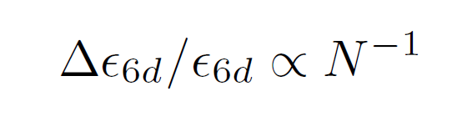
N – dependence grid limitation for large N!
I_{A}=0 (isotropic)
larger N „useless“ unless finer grid
if grid resolution is increased accordingly !
n_{c}=8:
8 cells in r from 0...3σ
8 cells in z from -3σ...+3σ
analytical beyond
charge / macro-particle
N=10⁵

Slide 11
„Grid dominated“ noise
grid dominated
I_{A}=0 (isotropic)
statistics (N) limited

Slide 12

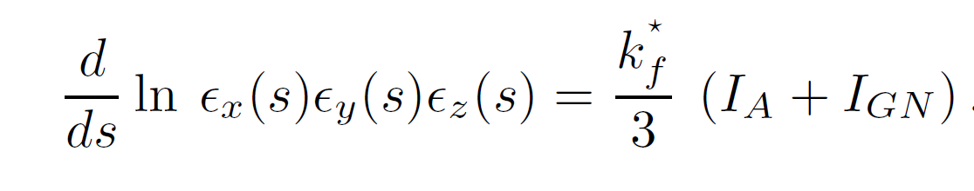
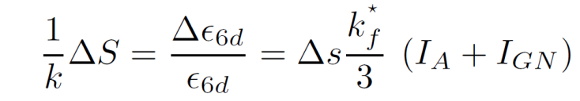
Anisotropy and grid effect
→ fits to theory with I_{GN} and k_{f}* fitted to data
symmetrical external focussing k_{0x,y,z}=60º
k_{x,y,z}=60º→33º
I_{A}=0

Slide 13
Unsymmetrical external focussing k_{0x,y,z}=60º / 60º / 47º
Basis for more unsymmetric focussing (synchrotron motion)

Slide 14
Anisotropy and N
→ grid limitation universal feature

Slide 15
rz → xyz Poisson solver same periodic solenoid lattice → enhanced noise
xyz
~1 particle/cell
rz
~10 particle/cell
grid limited
statistics limited
„optimum“

Slide 16
FODO lattice + xyz Poisson solver same emittances, current, focussing strenghts, cell lengths

Slide 17
Statistics limitation more pronounced
Dependence on # space charge kicks / cell is negligible
2 particles/cell
„flat“ in n_{c} only for > 10⁵ particles

Slide 18
Low # of space charge kicks speeded-up for linac design: DRIFT TUBE LINAC CELL OPTION
1 or 3 kicks per DTL cell (k₀=60⁰)
140 particles/cell
2 particles/cell
20 particles/cell
16 particles/cell
avoid 1 kick/cell and low N: relevant for statistical error studies with 1000‘s of different linacs (error sets)

Slide 19
Conclusions & outlook
6d rms emittance evidenced as practical measure for noise + entropy
„grid induced“ noise differs from „collisional“
  collisional requires temperature anisotropy to drive it
  grid induced noise component not
  I_{A}(r_{xy},r_{xz},r_{yz}) + I_{GN}
Limitations by enhanced non-Liouvillean effects:
  grid resolution limited (small n_{c})
  statistics limited (small N)
Other limitations to be further explored:
  Time step not sufficiently small compared with typical transit time across grid cell
  “Coherent flow” in periodic focusing – against temperature-like incoherent flow

