Slide 2
Space Charge in the PS Booster
E. Benedetto
Contributions from: C. Carli, V. Forte, M. Kowalska, M. Martini, M. Mc Ateer, B. Mikulec, V. Raginel, G. Rumolo
20/5/2014 Space Charge Collaboration Meeting 2014

Slide 3
Outline
Intro PS Booster description & Upgrade plan
Measures against Space Charge
Space Charge studies for the PS Booster
Machine modeling
Computing time

Slide 4
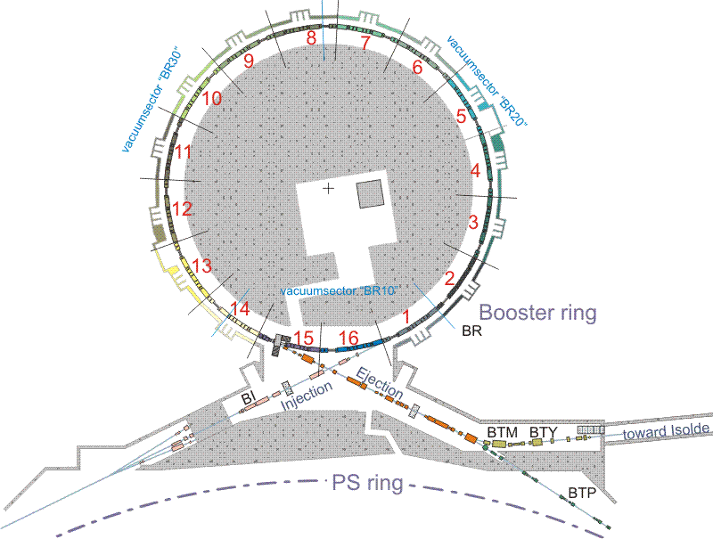
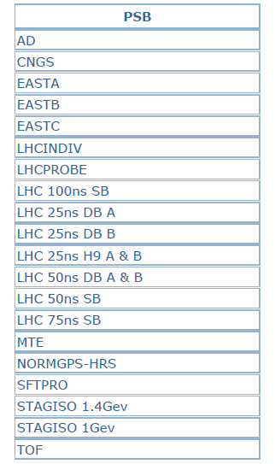
PSB parameters
Circumference: 157m
Super-periodiciy: 16
Injection: conventional Multi-Turn → upgrade to H-
Injection energy: 50 MeV → upgrade to 160 MeV
Extraction energy: 1.4 GeV → upgrade to 2 GeV
Cycle length: 1.2s
# bunches: 1 x 4 Rings
RF cavities: h=1+2, h=16
Tunes at injection: 4.30, 4.45, ~1e-3
Rev. freq. (160 MeV): ~1MHz
# protons/bunch: 50 → 1000 x 1e10
H. emittance: 2 →15 um
V.l emittance: 2 → 9 um
Longitud. emittance: 1 → 1.8 eVs

Slide 5
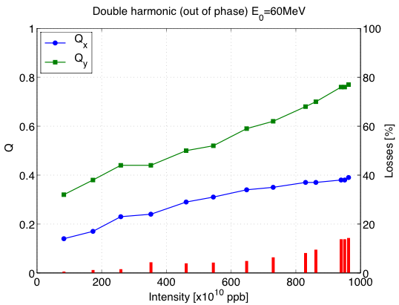
Space Charge limitations in the PSB
Very large tune spread at injection
  Up to 0.4 for LHC beams
  > 0.7 for high intensity (with losses)
B. Mikulec, et al, HB 2012
Injection energy upgrade:
  From 50 to 160 MeV:
    2x intensity (for given emittance)
    1/2 x emittance (for the same intensity)
    Or a combination …

Slide 6
Measures against Space Charge
Double harmonic: h1+h2
Acceleration (no energy flat bottom)
  H- injection directly on accelerating bucket
  Today: MT injection in coast, then adiabatic capture + acceleration
Transverse painting:
  Horiz. Painting + Vert. Steering
  Today: injection offset in both planes (V steering and delay of the bump decay wrt injection timing)
Working point varies with time
Resonance compensation:
  Empirical (based on loss reduction and driven by phyiscs considerations)
  Systematic studies driving terms and response matrix ongoing (M. McAteer)

Slide 7
Areas of investigation
Emittance preservation for LHC beams (increased brightness)
  e.g. during fall of H- inj chicane bump
Losses control for high intensity beams (increase intensity)
  More activation with increased energy
  → See Magda’s talk
Multi-Turn injection dynamics (both present and H-)
  Must include Space Charge
Np=3.4e12 (=2x today)
Ex=1.72 um
Ey=1.72 um
(LIU Parameters, EDMS-1296306)
Np > 1.e13 (today nominal)
Ex= 15 um
Ey= 9 um
Benchmark Simulations w. Measurements & Theory
  → See Vincenzo’s talk
Optics Model (via response matrix and driving terms)

Slide 8
Studies of emittance preservation
ϕ
ϕ
BSW1
-ϕ
-ϕ
BSW2
BSW3
BSW4
Perturbation from chicane magnets
Edge effects (rectangular magnets)
Corrugated Inconel vacuum chamber new baseline (ceramic in the original design) → induced Eddy currents:
  Delay of ~50us
  Higher order field components (sextupolar)
    Quadrupolar feed-down
    Excitation 3rd order resonance
3D magnet simulation by
B. Balhan, J. Borburgh
Chicane ramp-down shape by D. Aguglia, D. Nisbet

Slide 9
Studies of emittance preservation
Simulations with PTC-Orbit:
  Time varying elements
  Accelerating bucket
  Double harmonic
  Optics model as simple as possible
  No errors except in BSW magnets
Ceramic chamber
Inconel, wo correction
Inconel, all corrected.
Results are valid in relative, to discriminate between ceramic and inconel chamber
No showstoppers for inconel chamber found, but compensation is required
  additional trims on main quads QDE3, QDE14

Slide 10
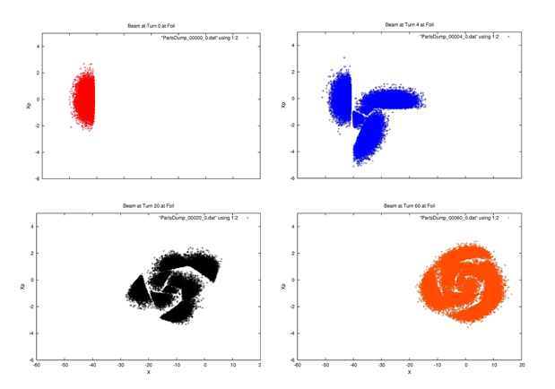
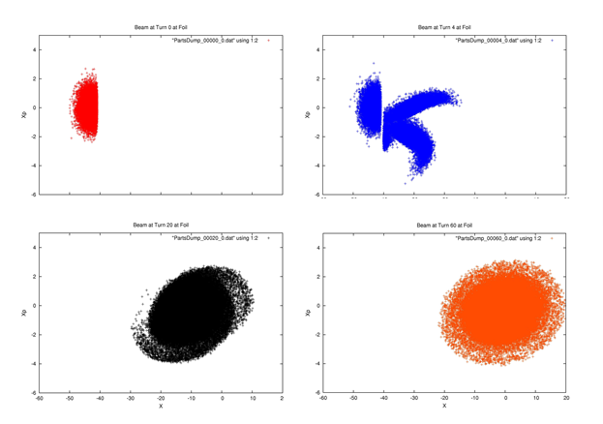
Multi Turn injection (present scheme w. septum)
w/o space Charge
with space Charge
0th turn
4th turn
0th turn
4th turn
20th turn
60th turn
20th turn
60th turn
Differences in beam profiles and losses if space charge is (not) included in the simulations
V. Raginel et al. , CERN note 2013 and PAC’13

Slide 11
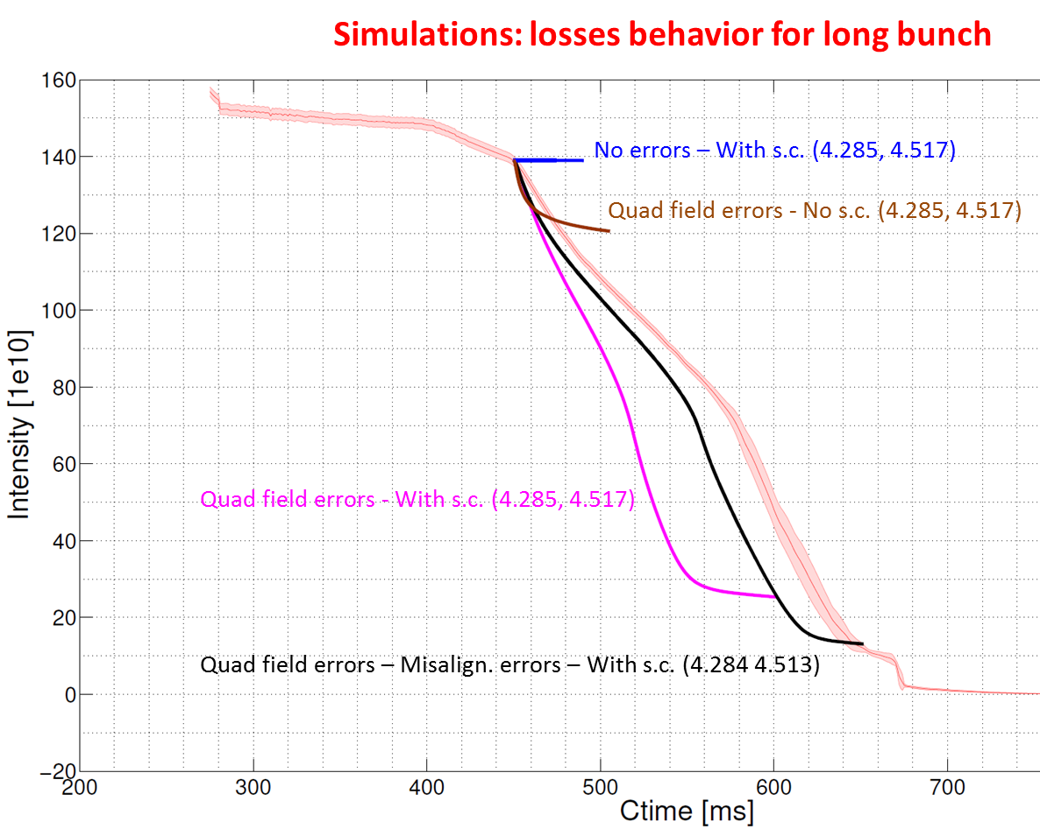
Machine modeling and benchmark
Simulations close to the 0.5 line, beam intensity evolution
→ See V. Forte’s talk
Very good agreement between measurements & simulations when machine model (misalignments and field errors) is implemented

Slide 12
Computing time
Reasonably “short” time scales
PTC-Orbit (migration to PTC-pyOrbit in summer)
Time on our CERN cluster:
  Chicane decay ~7ms=~ 7’000 turns → 8 hours
  Benchmark with measurements ~200ms → >2 weeks (continuous tracking, i.e. dump & load for restart)
  High intensity & emittance beams → x2 time (increase # macroparticles)
# SC nodes: ~200
# macroparticles: 250k → 500k

Slide 13
Conclusions
Goal: improve understanding of current Space Charge limits and predict PSB performance with the new H- injection
  LHC (high brightness) beams → emittance preservation
  High Intensity beams → losses control
  Multi-Turn (conventional or H-) process itself
Benchmark code vs. measurements, was our major effort of MDs in 2012-2013
Optics model (response matrix and driving terms) studies ongoing in //, the aim is to implement resonance compensation scheme
Knowledge of optics model fundamental for accurate prediction of Space-Charge induced losses and beam blow-up

Slide 15
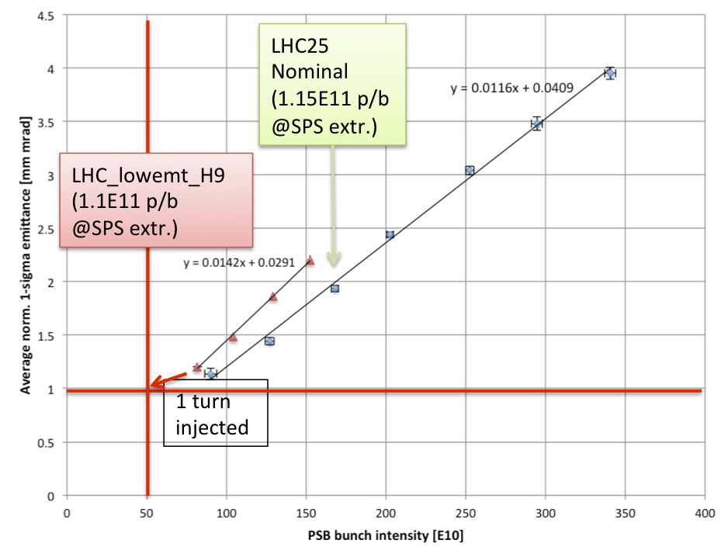
Curve emittance vs. Intensity
B. Mikulec et al.

