Slide 1
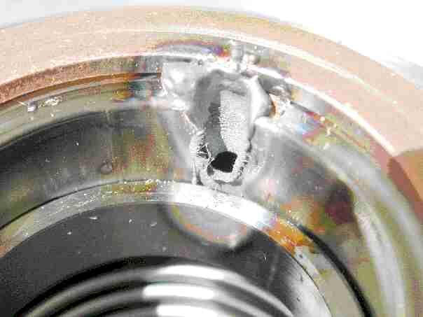
Beam Loss Monitors:
Overview of BLM Technology
Introduction
Dynamic range, sensitivity
Limitations in
  time and/or
  spatial resolution
Challenges associated to measurements of losses (in different machine types)
Radiation hardness
A comprehensive summary of the current state-of-the-art methods
Needs for further development
Kay Wittenburg
3rd oPAC Topical Workshop on Beam Diagnostics
Vienna, 8-9 May 2014

Slide 2
1. Introduction
Beam loss monitor systems are designed for measuring beam losses around an accelerator or storage ring. A detailed understanding of the loss mechanism, together with an appropriate design of the BLM-System and an appropriate location of the monitors enable a wide field of very useful beam diagnostics and machine protection possibilities.
Regular (controlled, slow) loss
Those losses are typically not avoidable and are localized on the collimator system or on other (hopefully known) aperture limits. They might occur continuously during operational running and correspond to the lifetime/transport efficiency of the beam in the accelerator. The lowest possible loss rate is defined by the theoretical beam lifetime limitation due to various effects.
Irregular (uncontrolled, fast) losses
The irregular losses may be distributed around the machine and not obviously on the collimation system. Can be avoided and should be kept to low levels but may reach very high levels in case of an accident.
It is clearly advantageous to have a BLM System which is able to deal with both loss modes. But this means -> High Dynamic Range System!

Slide 3
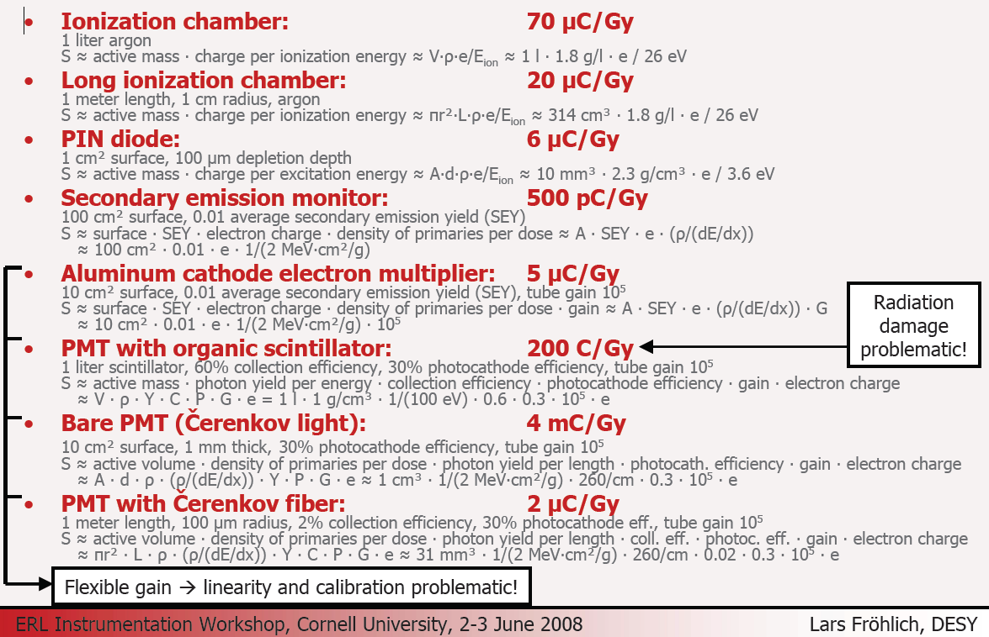
2. Dynamic Range, Sensitivity
In these two references one can find a lot of details on various BLM types!
K. Wittenburg, Beam loss monitors, CAS2008
Specialised Beam Diagnostics School in Dourdan, France, CERN-2009-005
Lars Fröhlich, Beam Loss Monitors
ERL Instrumentation Workshop, Cornell University, 2-3 June 2008
http://tesla.desy.de/~lfroehli/download/ERL_instrumentation_ws_2008_BLMs.pdf
Detector Material | energy to create one electron [eV/e] | number of [e / (cm MIP)] (depends on dE/dx, resp. density) | Sensitivity S (for MIPs) [nC/rad]
Plastic Scintillator: | 250 – 2500 | 10³ - 10⁴ | ≈17·10³ (∙ PMT_{gain}) (1 ltr.)
Inorganic Scint. | 50 - 250 | 10⁴ - 10⁵ | ≈ 100·10³(∙ PMT_{gain}) (1 ltr.)
Gas Ionization: | 22 – 95 | ≈100 (Ar,1 atm., 20⁰C) | ≈ 500 (∙ Elec_{gain}) (1ltr)
Semiconductor (Si): | 3.6 | 10⁶ | ≈ 50 (∙ Elec_{gain}) (1 cm² PIN-Diode)
Secondary emission: | 2-5%/MIP (surface only) | 0.02-0.05 e/MIP | ≈ 2·10⁻³ (∙ PMT_{gain}) (8cm²)
Cherenkov light | 10⁵ - 10⁶ | ≈10 (H₂O) -200 (fused silica) | ≈ 270 (∙ PMT_{gain}) (1 ltr.)
Including Gain
and
1 Gy = 100 rad
>10⁸ Difference in Sensitivity between different types
≈ 0.2·10⁻³ (∙ PMT_{gain}) for 1 m Cherenkov fiber

Slide 4
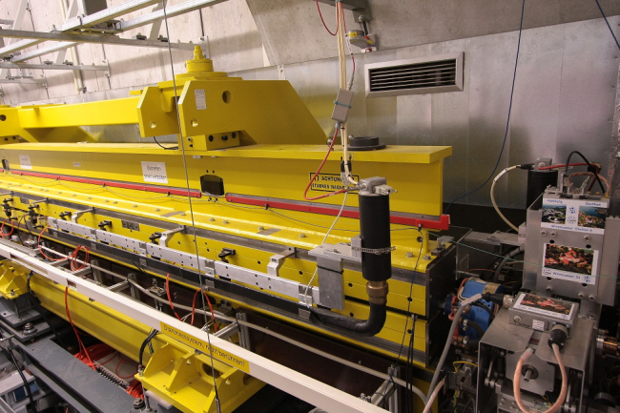
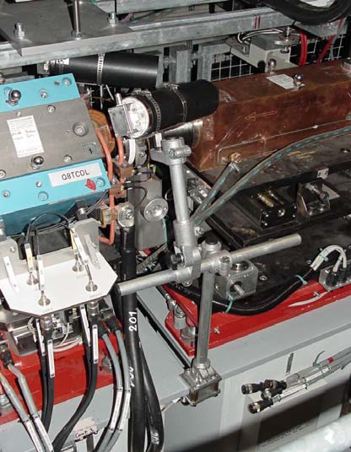
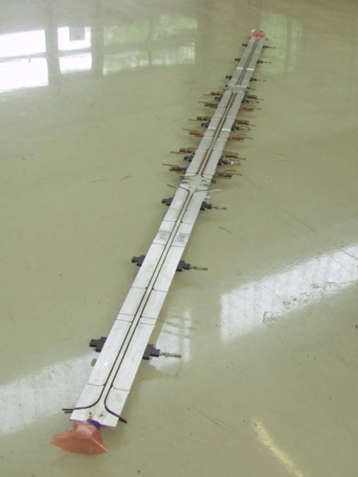
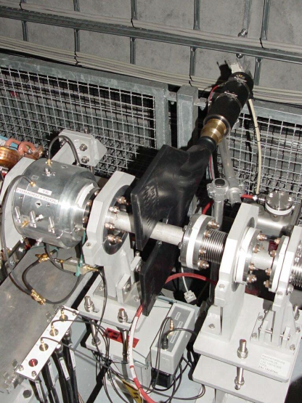
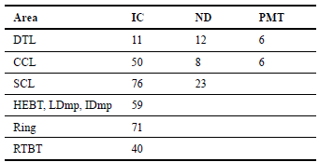
2. High dynamic loss monitoring by
Different BLM types/materials
FLASH FLASH LHC
SNS

Slide 5
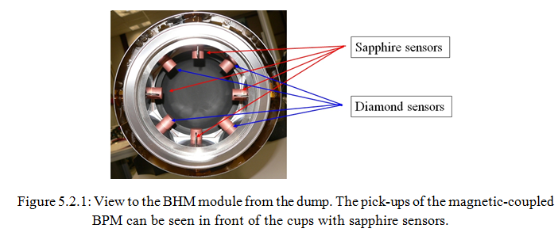
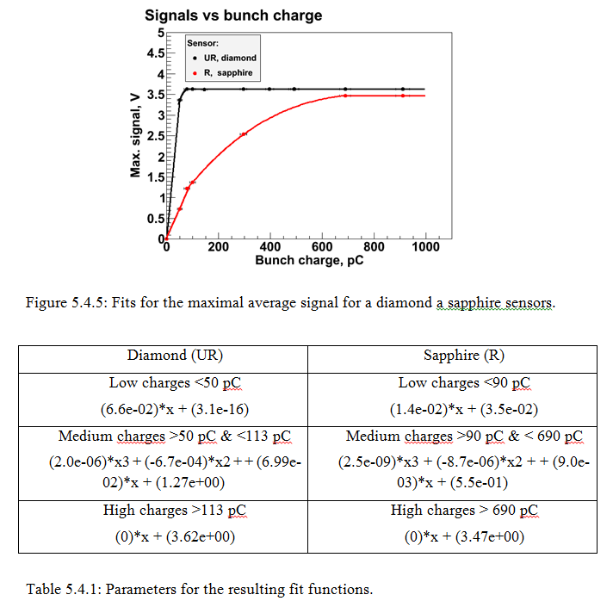
2. High dynamic loss monitoring by
Different BLM types/materials
Diamond and Sapphire
Alexandr Ignatenko
Thesis, 2014
Brandenburgische Technische
Universität Cottbus-Senftenberg

Slide 6
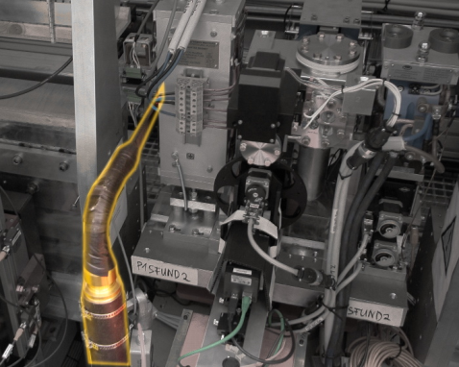
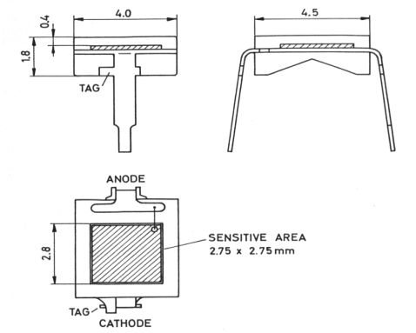
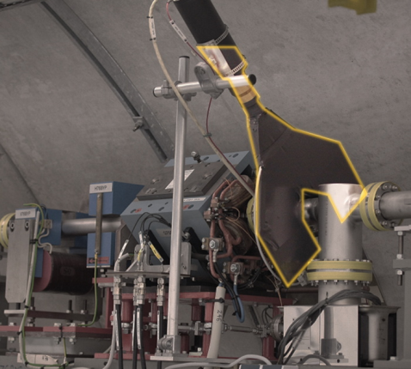
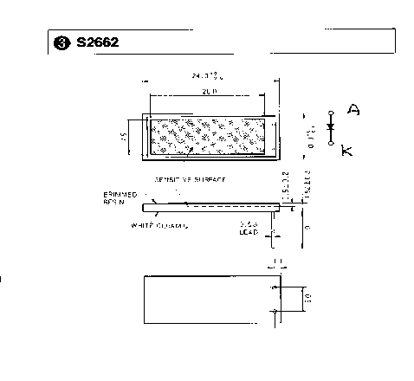
2. High dynamic loss monitoring by
Small and Large
FLASH HERA
7.56 mm²
150 mm²
Note that the flux density of photons into the light guide is
“incompressible” !
=> The cross section of the scintillator should not be larger
than the cross section of the light guide -> I did not proof this rule, any experience with that?

Slide 7
2. High dynamic loss monitoring by
Noise to saturation
Detector:
PMTs:
Noise at max Gain ≈1 mV
Saturation ≈ 1 V
+Active gain variation ≈ 10³
Dynamic range ≈ 10⁶
Ionization chamber (LHC)
Leakage current < 1 pA
Saturation ≈1 mA
Dynamic range ≈ 10⁹
Electronic:
RF Amplifiers
Dynamic range ≈ 10⁴
Log Amp. ≈ 10⁵
ADC
12 bit ≈ 4 x 10³
16 bit ≈ 6 x 10⁴
24 bit ≈ 2 x 10⁷ (SNS: VME ADC but 10 bits noise)
Counting
Dark count rate ≈1 Hz
Signal: Bunch rep. rate ≈10 MHz
Dynamic range > 10⁹ (averaging!)

Slide 8
3a. Limitations in time resolution

Slide 9
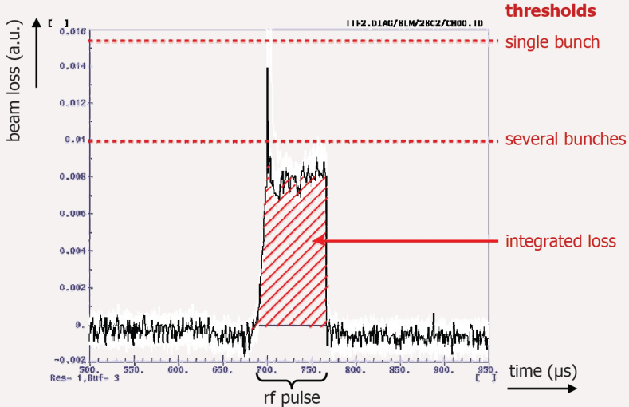
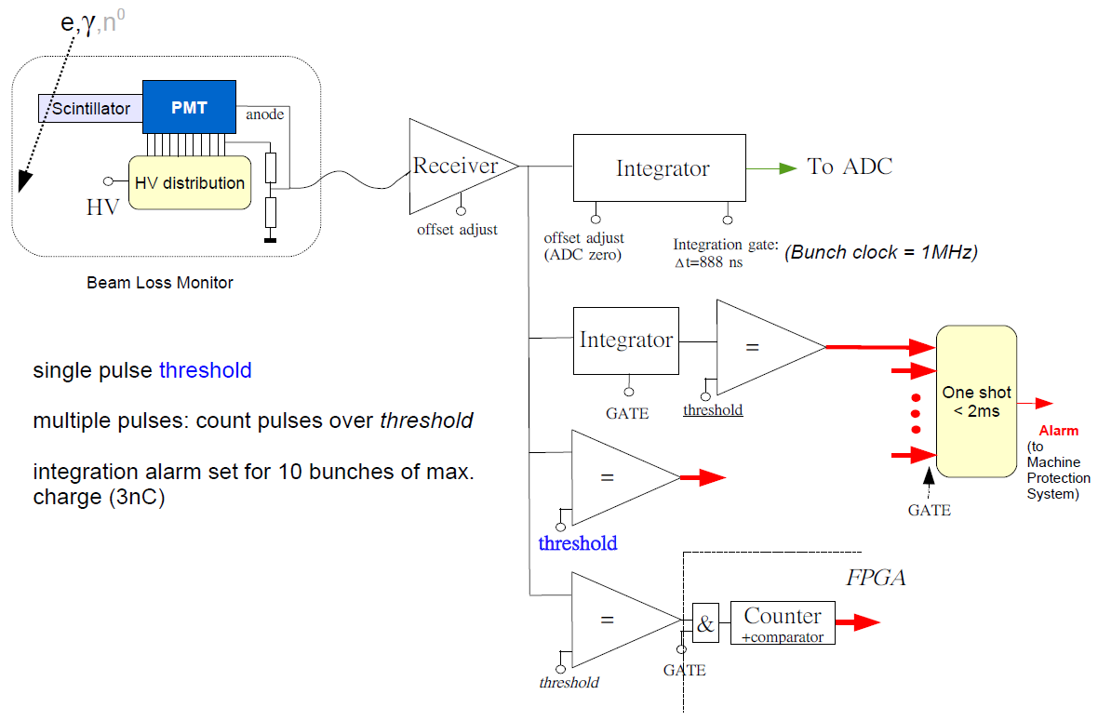
3a. Limitations in time resolution
Typical reaction time of
  Rings: 1 - few turns -> > ≈ 10 μs -> Defines the detector time response
  Linac: Bunch distance (≈ 100 ns at bunch train or ≈ ms at single bunch)
  but important:
    Bunch by Bunch resolution -> Defines the detector time response
    Integration over bunch train
    Integration over some bunch trains
Alexander Kaukher
DESY
7th DITANET Topical Workshop on
Beam Loss Monitoring
December 7, 2011

Slide 10
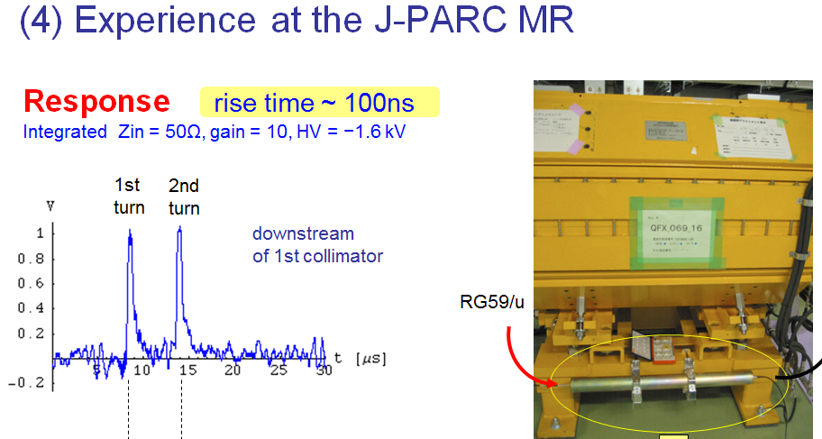
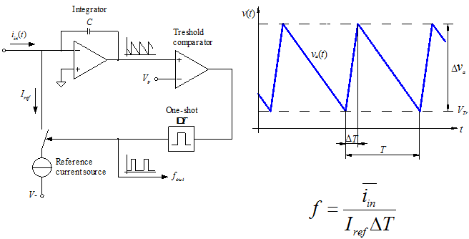
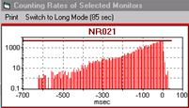
3a. Limitations in time resolution
≥ turn by turn:
  Ionization chambers
  + Low bandwidth ADC allows high dynamic range
  Counting (many bunches)
  Allows super high dynamic range
Pin Diodes at HERA
T. Toyama et al., HB2008
Counting circuit for LHC Ion Chamber

Slide 11
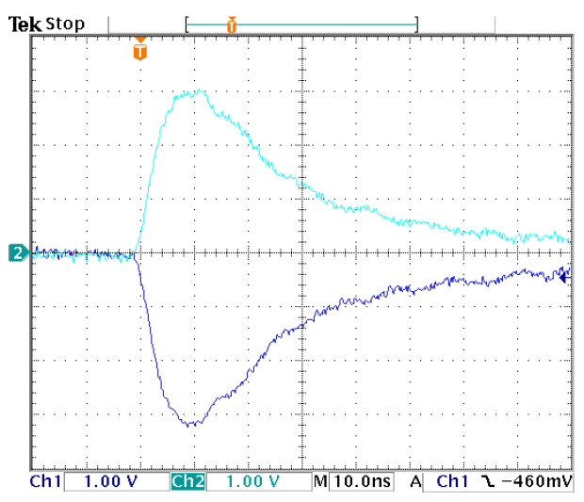
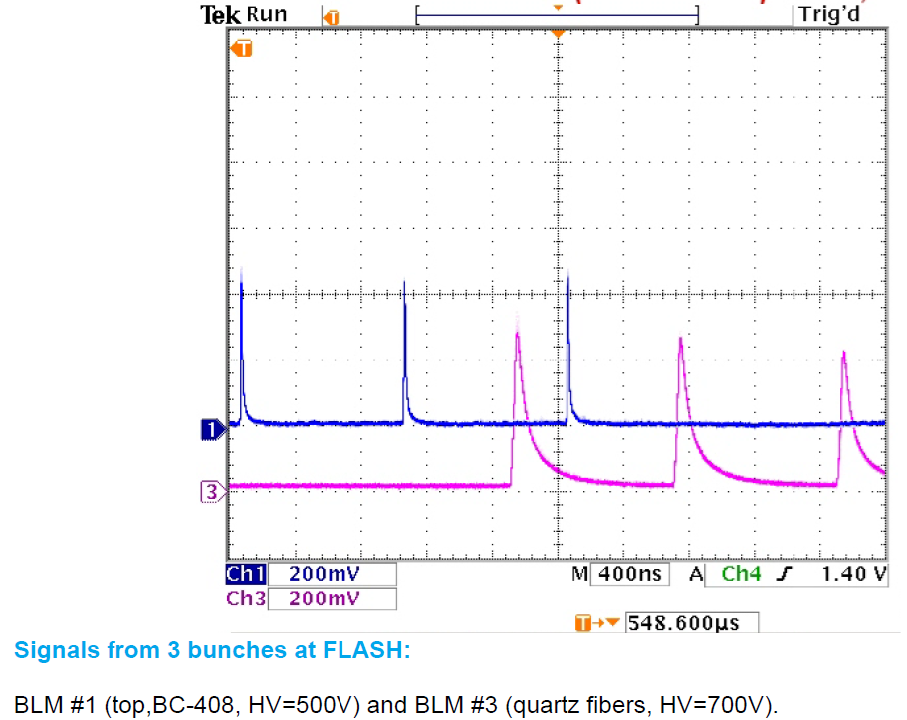
3a. Limitations in time resolution
< 100 ns:
  PMT (or APD) + Cherenkov or Scintillator
  SEM + GHz Amplifier (or SEM-PMT)
  Solid State Detectors + GHz Amplifier
  + GHz ADC (limited dynamic range)!!!
The signal width from the R5900 PMT is as short as 20 ns, even after 50m twisted pair cable.

Slide 12
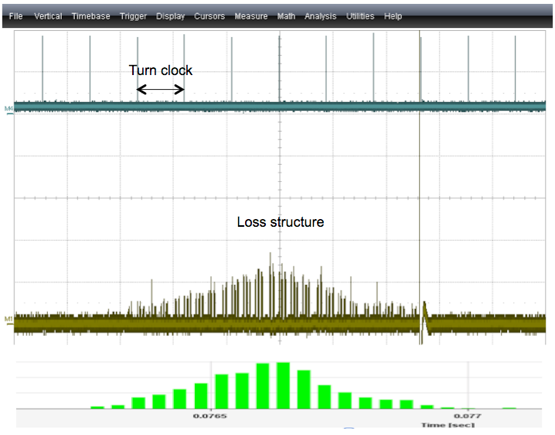
3a. Limitations in time resolution
B.Dehning
Beam Loss: New Developments, Detectors and Electronics ;
7th DITANET Topical Workshop on
Beam Loss Monitoring
December 7, 2011
Loss signal
Diamond signal
Ionisation chamber
(40 us integration time)
Time

Slide 13
3b. Limitations in spatial resolution (where to put BLMs)

Slide 14
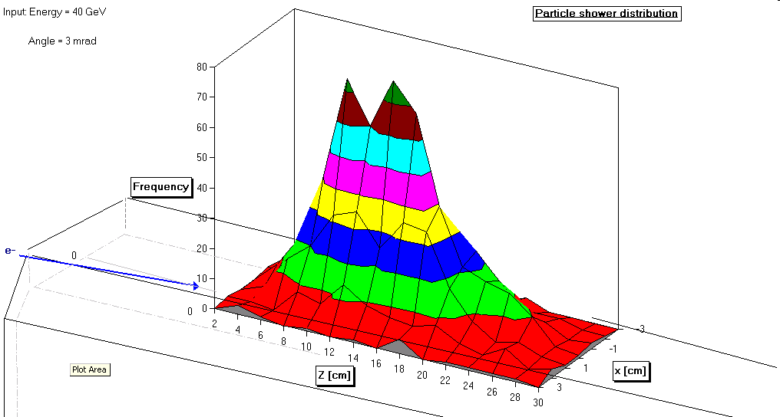
3b. Limitations in spatial resolution (where to put BLMs)
Electron beam = small shower
Beam direction

Slide 15
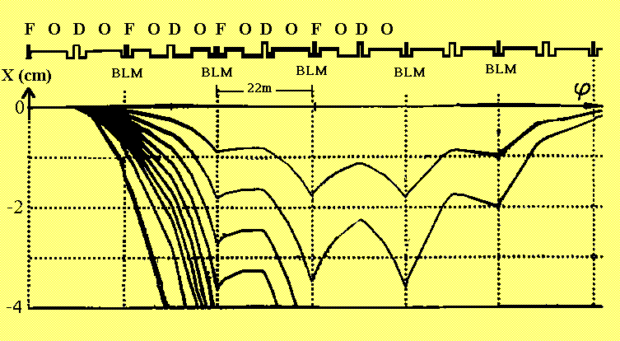
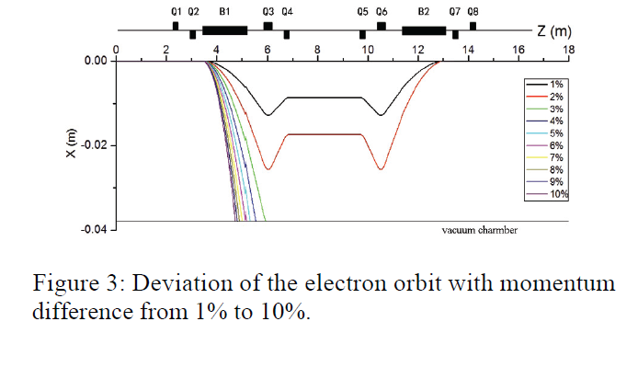
3b. Limitations in spatial resolution (where to put BLMs)
Important:
Beam Optics!
Tracking Codes
Trajectory of Electrons after Energy Loss
Electron Beam Loss Monitors for HERA
F. Ridoutt, W. Bialowons, K. Wittenburg; EPAC 1994
A New Theoretical Design of BLM System for HLS II
Yukai Chen, Lijuan He, Juexin Li, Wei-min Li, Yuxiong Li
IPAC 2013
Beam direction

Slide 16
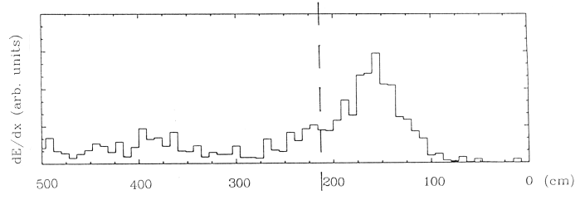
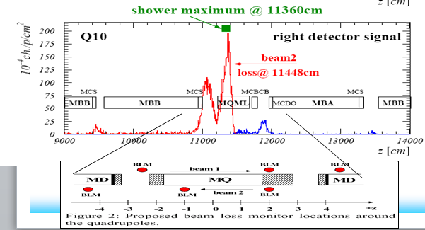
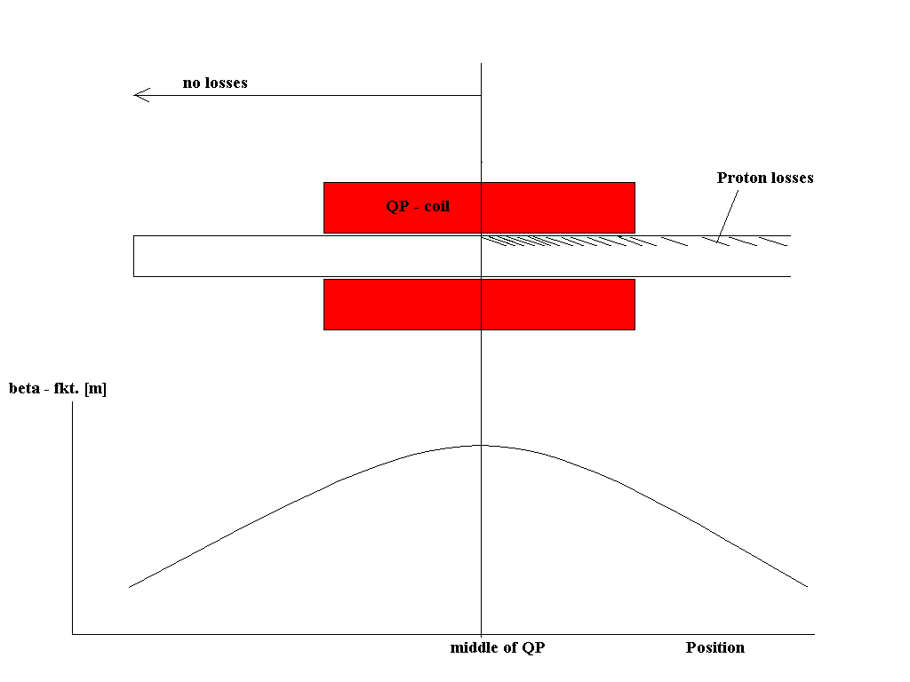
3b. Limitations in spatial resolution (where to put BLMs)
A local orbit distortion creates losses at high beta (in general at aperture limitations)
Important:
Particle Shower
Monte Carlo Codes
High Energy Proton Beam = Large Shower
Secondaries at surface
Beam direction

Slide 17
3b. Limitations in spatial resolution (where to put BLMs)
Important:
Loss signal has to be calibrated by energy
Monte Carlo Codes
Low Energy Proton Beam = Shielded Shower
Loss location = middle of first quadrupole
Loss angle = 1.5 mrad
Loss intensity = 10^12 protons/sec
Technical Note ESS/AD/0032
Beam direction

Slide 18
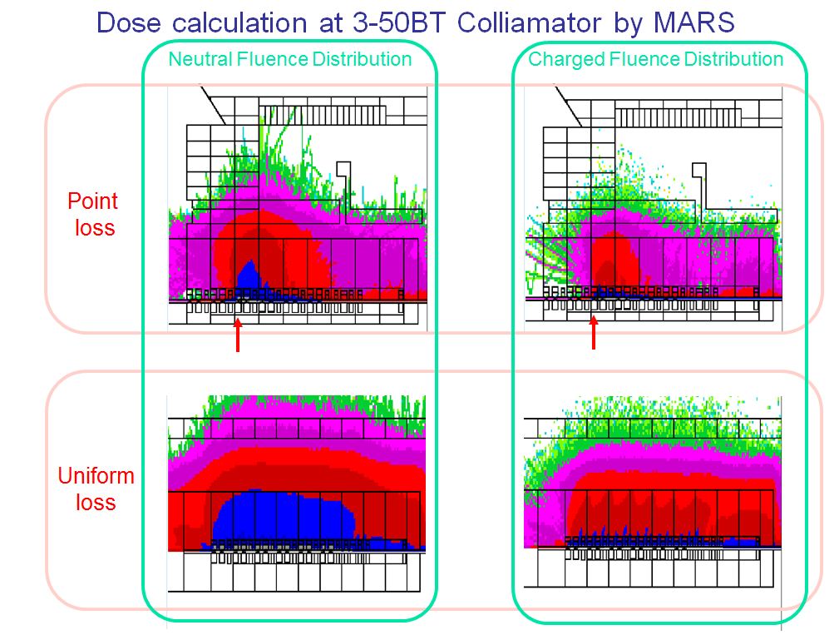
3b. Limitations in spatial resolution (where to put BLMs)
Local measurement
Vs.
Do losses appear somewhere?
Neutrons are everywhere in the accelerator tunnel in case of losses:
Few neutron detector BLMs are sufficient
Beam direction

Slide 19
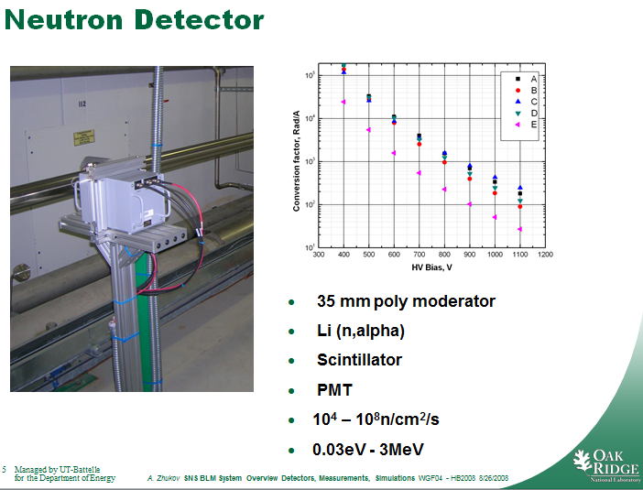
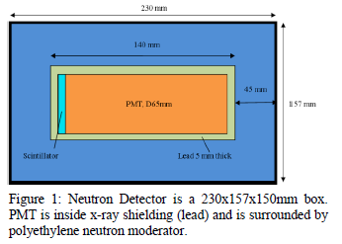
3b. Limitations in spatial resolution (where to put BLMs)
detects the alphas

Slide 20
4) Challenges associated to measurements of losses
Just a small selection:
Very low energy machines
High background

Slide 21
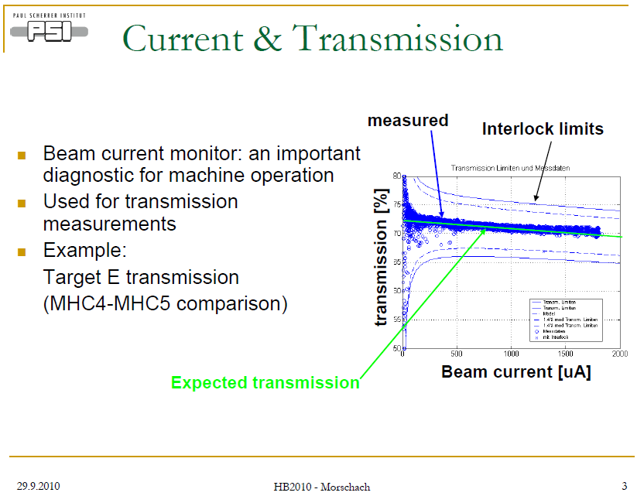
4a) Challenges associated to measurements of losses at low energies
The problem: No or very few secondaries outside the vacuum chamber
Solutions:
Differential current measurement
    Limited position resolution
    LINAC/transport only
BLMs very close to beam pipe
  Risk of wrong position
BLMs sensitive to neutrons
  Limited position resolution
Very sensitive BLMs
Use of BLMs at collimators

Slide 22
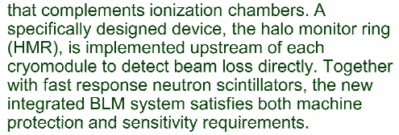
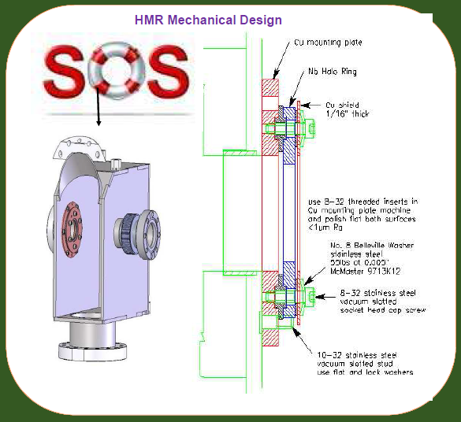
4a) Challenges associated to measurements of losses at low energies
The problem: No or very few secondaries outside the vacuum chamber
Solutions:
Differential current measurement
    Limited position resolution
    Linac/transport only
BLMs very close to beam pipe
  Risk of wrong position
BLMs sensitive to neutrons
  Limited position resolution
Very sensitive BLMs
Use of BLMs at collimators
IBIC 2013 poster
-> Also: Cryogenic BLMs (not at low energy)

Slide 23
4a) Challenges associated to measurements of losses at low energies
The problem: No or very few secondaries outside the vacuum chamber
Solutions:
Differential current measurement
    Limited position resolution
    Linac/transport only
BLMs very close to beam pipe
  Risk of wrong position
BLMs sensitive to neutrons
  Limited position resolution
Very sensitive BLMs
Use of BLMs at collimators
IBIC 2013 poster

Slide 24
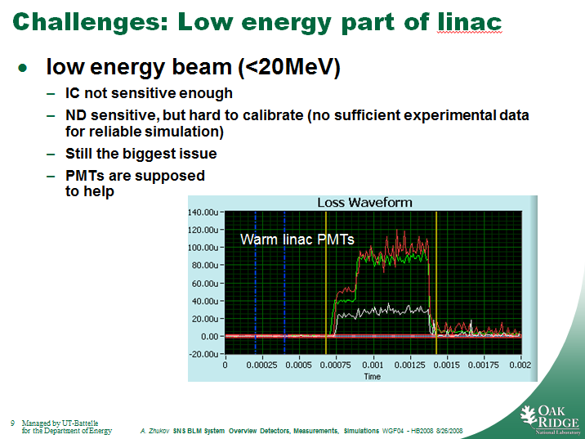
4a) Challenges associated to measurements of losses at low energies
The problem: No or very few secondaries outside the vacuum chamber
Solutions:
Differential current measurement
    Limited position resolution
    Linac/transport only
BLMs very close to beam pipe
  Risk of wrong position
BLMs sensitive to neutrons
  Limited position resolution
Very sensitive BLMs
Use of BLMs at collimators

Slide 25
4a) Challenges associated to measurements of losses at low energies
The problem: No or very few secondaries outside the vacuum chamber
Solutions:
Differential current measurement
    Limited position resolution
    Linac/transport only
BLMs very close to beam pipe
  Risk of wrong position
BLMs sensitive to neutrons
  Limited position resolution
Very sensitive BLMs
Use of BLMs at collimators

Slide 26
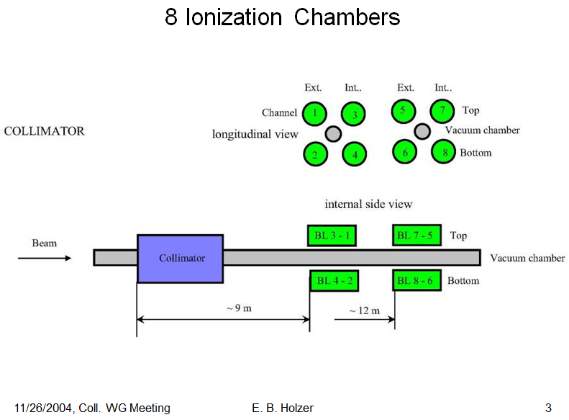
4a) Challenges associated to measurements of losses at low energies
The problem: No or very few secondaries outside the vacuum chamber
Solutions:
Differential current measurement
    Limited position resolution
    Linac/transport only
BLMs very close to beam pipe
  Risk of wrong position
BLMs sensitive to neutrons
  Limited position resolution
Very sensitive BLMs
Use of BLMs at collimators
  Known loss location
  Aperture limit
  Highest loss rate (hopefully)
  Machine + Collimator Protection
“Tails” in distributions are from the beam.
BLM signal is linear with proton intensity.
Left-right asymmetry of the shower depends on the collimator gap size and gap position.
Slight top-bottom asymmetry?
BLM signal depends on the impact position on the jaw.
Compares ~ OK with simulations (TT40).

Slide 27
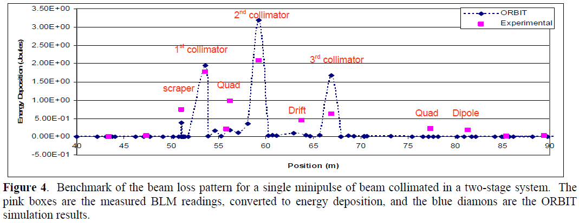
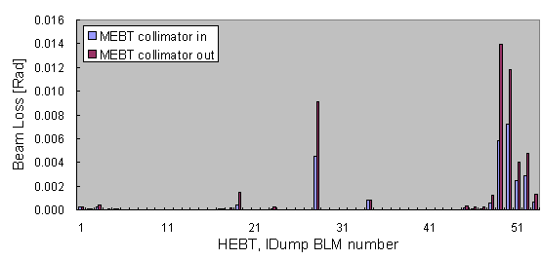
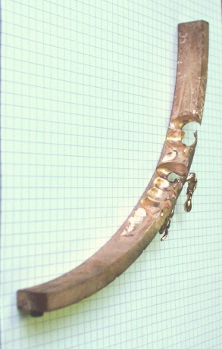
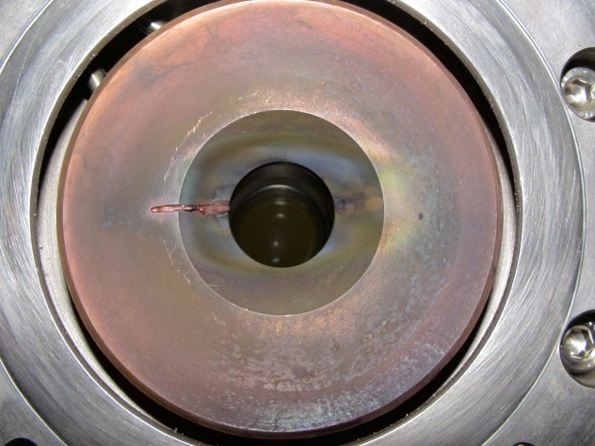
4a) Challenges associated to measurements of losses at low energies
The problem: No or very few secondaries outside the vacuum chamber
Solutions:
Differential current measurement
    Limited position resolution
    Linac/transport only
BLMs very close to beam pipe
  Risk of wrong position
BLMs sensitive to neutrons
  Limited position resolution
Very sensitive BLMs
Use of BLMs at collimators
  Known loss location
  Aperture limit
  Highest loss rate (hopefully)
  Machine + Collimator Protection
SNS PAC07 LINAC10
Plot of measured beam loss along the HEBT and IDump (Injection Dump) with the MEBT collimator in and out. Data shows significant reduction in beam loss in the HEBT and IDump with the MEBT collimation.
0.9 and 72 MEV Proton collimator at PSI Cyclotron (Pic. From R. Dölling-PSI)

Slide 28
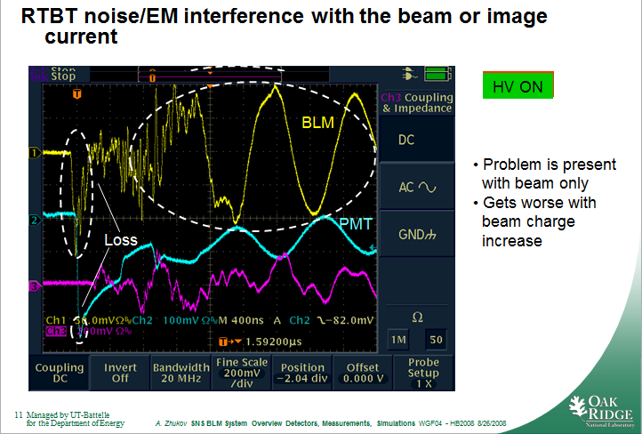
4b) Challenges associated to measurements of losses at high background
The problem: Limits the dynamic range
EM Noise
Reasons:
Shielding
Ground loops
RF
PS ripple (from magnets, from HV)
Kickers, septum
Magic
Ghosts
Sabotage
…
Solutions:
Blame the others!
(not very useful, I know…)

Slide 29
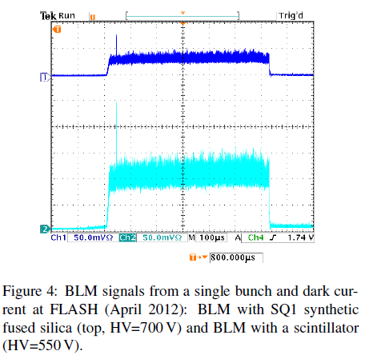
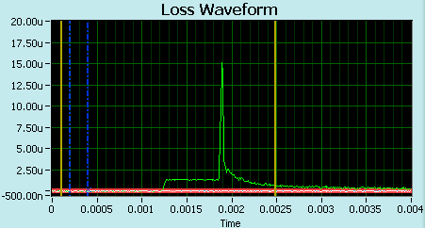
4b) Challenges associated to measurements of losses at high background
The problem: Limits the dynamic range
X-ray from cavities
Reasons:
Released electrons from cavity
Magic
Ghosts
Sabotage
…
Solutions:
Subtraction by software
Use of a x-ray insensitive detector
1 mS
XFEL Beam Loss Monitor System
A. Kaukher, I. Krouptchenkov, D. Noelle (D. Nölle), H. Tiessen, K. Wittenburg
IPAC12
Beam loss
X-ray
SNS

Slide 30
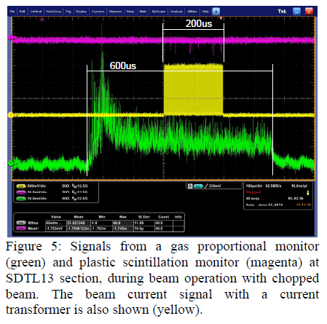
4b) Challenges associated to measurements of losses at high background
The problem: Limits the dynamic range
X-ray from cavities
Reasons:
Released electrons from cavity
Magic
Ghosts
Sabotage
…
Solutions:
Subtraction by software
Use of a x-ray insensitive detector
Beam Loss Detected by Scintillation Monitor
Akihiko Miura, et al.
IPAC´11

Slide 31
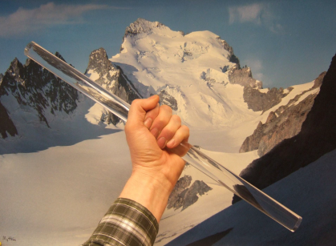
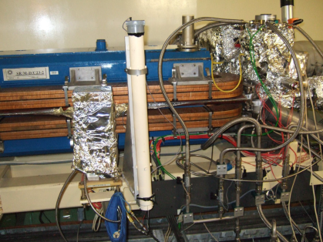
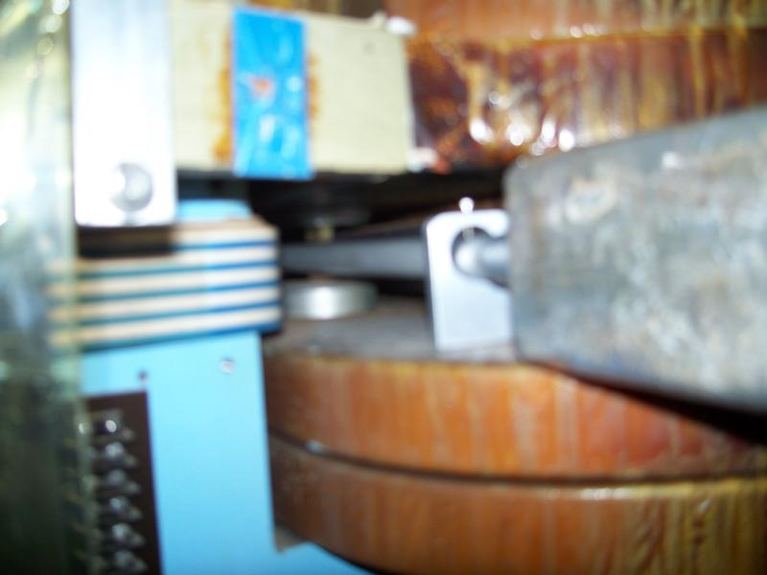
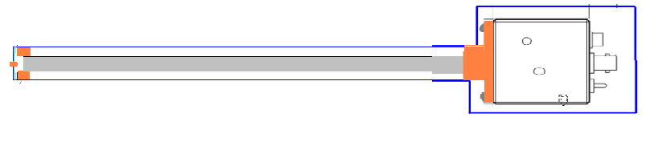
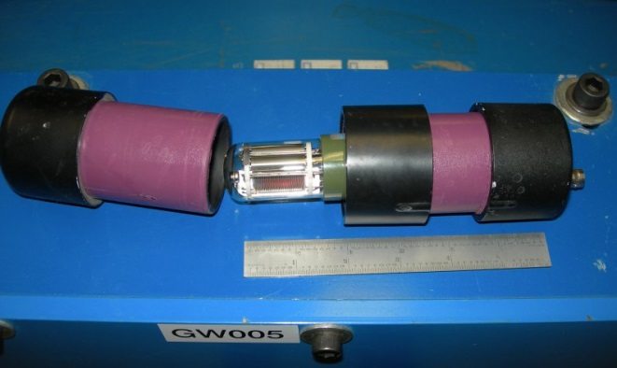
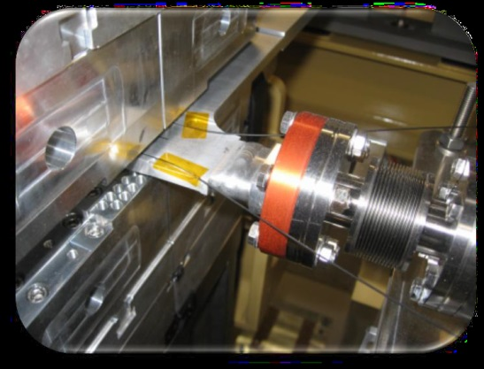
4b) Challenges associated to measurements of losses at high background
The problem: Limits the dynamic range
X-ray from Synchrotron radiation
Reasons:
SR is unavoidable
Solutions:
Subtraction by software
Use of a x-ray insensitive detector:
Cherenkov material: Quartz
Coincidence
K. Scheid, ESRF, 7th DITANET Topical Workshop on Beam Loss Monitoring; 2011
S.L. Krameer NSLS II, 7th DITANET Topical Workshop on Beam Loss Monitoring; 2011
J. Perry, Jlab, PAC93
L. Fröhlich, FERMI, 7th DITANET Topical Workshop on Beam Loss Monitoring; 2011

Slide 32
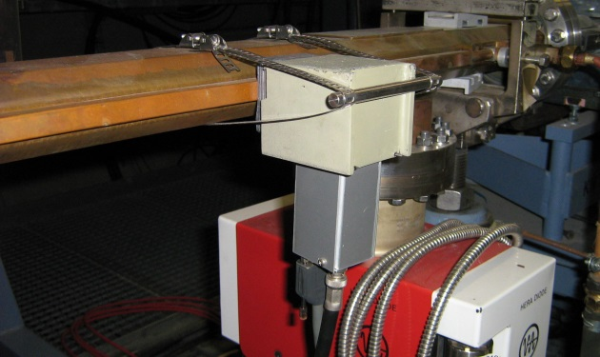
4b) Challenges associated to measurements of losses at high background
The problem: Limits the dynamic range
X-ray from Synchrotron radiation
Reasons:
SR is unavoidable
Solutions:
Subtraction by software
Use of a x-ray insensitive detector:
Cherenkov material: Quartz
Coincidence: Counting
Coincidence technique: SR-Photons stop in one or the other PIN diode and are not counted!
The Beam Loss Monitoring System at ELSA
Dennis Proft , IPAC12
Installation and Test of a Beam Loss Monitor System for the S-DALINAC
Robert Stegmann, IPAC12
Beam Loss Monitors for the HERA Proton Ring
DESY HERA 90-11

Slide 33
5) Radiation hardness

Slide 34


5) Radiation hardness
S. Goulding, R.H. Pohl 1972

Slide 35
6) A comprehensive summary of the current state-of-the-art methods

Slide 36
6) A comprehensive summary of the current state-of-the-art methods
Cannot be answered since all kind of methods are in use (as seen from previous slides)
There is no “best method” since a useful method depends on various accelerator parameters
Therefore: Don’t trust on “state of the art”, often a well established method can be the best (Ion chambers and Scintillators+PMT are the most common BLMs)
However, new problems need new solutions:
e.g. x-ray background-> Cherenkov rods and fibers, PIN-Coincidence
Still searching for a fast and sensitive detector with high dynamic
range and high radiation damage threshold -> Diamonds?
Simulations are important to understand losses and the BLM
response

Slide 37
6) A comprehensive summary of the current state-of-the-art methods
Simulation:
IBIC2013
Beam Delivery Simulation (BDSIM): A Geant4 Based Toolkit for Diagnostics and Loss Simulation
Monte Carlo Simulations of Beam Losses in the Test Beam Line of CTF3
Simulation for Radiation Field Caused by Beam Loss of C-ADS Injector II
Beam Loss Monitoring at the European Spallation Source
IPAC11
Comparative Studies into 3D Beam Loss Simulations
Monte Carlo Simulation of the Total Dose Distribution around the 12 MeV UPC Race-track Microtron and Radiation Shielding Calculations
Beamloss Study at J-PARC Linac by using Geant4 Simulation
b) Fiber based BLMs
IBIC13
Update on Beam Loss Monitoring at CTF3 for CLIC
Optical Fiber Based Beam Loss Monitor for Electron Storage Ring
Cherenkov Radiation for Beam Loss Monitor Systems
BIW12IBIC12
Development of Optical Fiber Beam Loss Monitor System for the KEK Photon Factory
Simulation and Measurement of Beam Loss in the Narrow-Gap Undulator Straight Section of the Advanced Photon Source Storage Ring
c) Diamond BLMs
IBIC12/13
Operation of Silicon, Diamond and Liquid Helium Detectors in the Range of Room Temperature to 1.9 Kelvin and After an Irradiation Dose of Several Mega Gray
A Prototype Readout System for the Diamond Beam Loss Monitors at LHC
Performance of Detectors using Diamond Sensors at the LHC and CMS
IPAC12
Advances in CVD Diamond for Accelerator Applications
BEAM HALO MONITOR FOR FLASH AND THE EUROPEAN XFEL
Investigation of the Use of Silicon, Diamond and Liquid Helium Detectors for Beam Loss Measurements at 2 Kelvin

Slide 38
7) Needs for further development:

Slide 39

7) Needs for further development:
Calibration of BLM signal in terms of lost particles
Dealing with saturation, avoiding, detecting
Extending the useful dynamic range and speed of loss measurements
Quite often, BLMs are used just to minimize losses. Mainly in superconducting hadron accelerators a calibration of the loss signal was done to define thresholds for quenches.
There is a need to calibrate the losses in terms of dose at high intense hadron accelerators to avoid activation, checking the 1W/m rule.
-> Reliable integration of BLMs into MPS
Beam lifetime measured by current and loss monitors agreed by factor 2 in HERAp. I’ve heard about the same at LHC.
BEAM LOSS LIMITS IN HIGH POWER PROTON LINEAR
ACCELERATORS
L. Tchelidze, IPAC2013

Slide 40


7) Needs for further development:
Calibration of BLM signal in terms of lost particles
Dealing with saturation, avoiding, detecting
Extending the useful dynamic range and speed of loss measurements
It is not always obvious if your detector, amplifier, ADC circuit is saturating. PMTs behave crazy at saturation.
It’s known, but how to deal with it in operation?
Not much in literature available.

Slide 41



7) Needs for further development:
Calibration of BLM signal in terms of lost particles
Dealing with saturation, avoiding, detecting
Extending the useful dynamic range and speed of loss measurements

Slide 42

7) Needs for further development.
My final message:
One BLM System is not enough
for
your
accelerator!!!
Thanks for attention, questions?

