Slide 1
Least invasive beam profile measurements:
Ionization Profile Monitors and Beam Induced Fluorescence
P. Forck, C. Andre, F. Becker, T. Giacomini, Y. Shutko, B. Walasek-Höhne
GSI Helmholtz-Zentrum für Schwerionenforschung, Darmstadt, Germany
In collaboration with: T. Dandl, T. Heindl, A. Ulrich, Technical University München
J. Egberts, J. Marroncle, T. Papaevangelou et al., CEA/Saclay
OPAC Workshop Vienna, May 8th, 2014
Outline of the talk:
Ionization Profile Monitor IPM technical realization
→ Beam based measurements at GSI synchrotron and storage ring
Beam Induced Fluorescence BIF monitor realization
→ Energy scaling of signal and background 60MeV/u < E_{kin}< 750MeV/u
→ Spectroscopic investigations for rare gases and N₂
→ Profiles & spectroscopy for pressure range 10⁻³ mbar < p < 30 mbar
Comparison IPM ↔ BIF

Slide 2
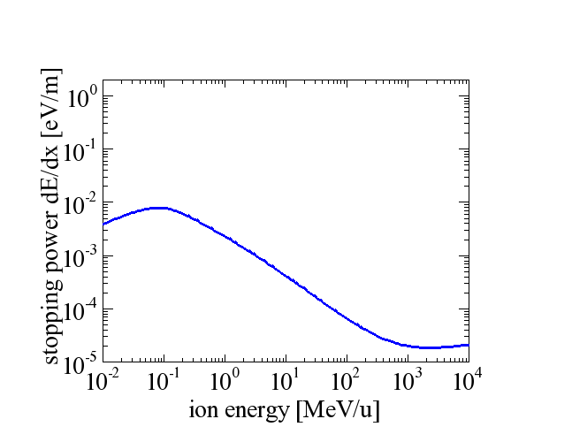
Expected Signal Strength for IPM and BIF-Monitor
Energy loss in 10⁻⁷ mbar N₂ by SRIM
Physics:
Energy loss of ions in gas dE/dx
Profile determination from residual gas
Ionization: roughly ≈ 100 eV/ionization
Excitation + optical photon emission:
roughly ≈ 3 keV/photon
LINAC, cyclotron
ion source
synchrotron
Ionization probability proportional to
dE/dx by Bethe-Bloch formula:
Target electron density:
Proportional to vacuum pressure
⇒ Adaptation of signal strength
∝ 1/E_{kin} (for E_{kin}> 1GeV nearly constant)

Slide 3
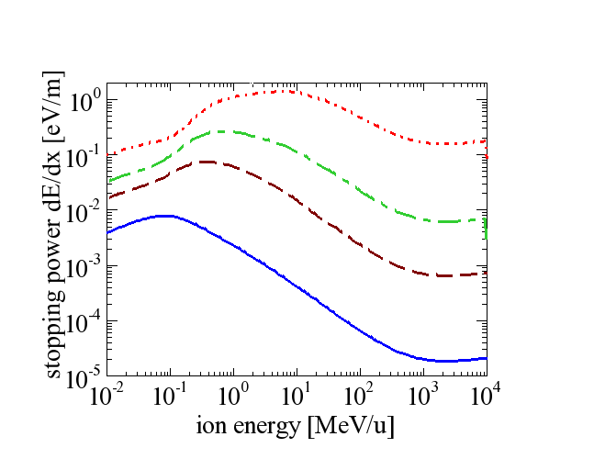
Expected Signal Strength for IPM and BIF-Monitor
Energy loss in 10⁻⁷ mbar N₂ by SRIM
Physics:
Energy loss of ions in gas dE/dx
Profile determination from residual gas
Ionization: roughly ≈ 100 eV/ionization
Excitation + optical photon emission:
roughly ≈ 3 keV/photon
Energy loss for l ≈ 1m: dE/dx⋅ l << E _{kin}
acceptable for single pass beams
Care: synchr.→multi pass; cryogenic envir.
²³⁸U
⁴⁰Ar
¹²C
¹H
Ionization probability proportional to
dE/dx by Bethe-Bloch formula:
Target electron density:
Proportional to vacuum pressure
⇒ Adaptation of signal strength
∝ 1/E_{kin} (for E_{kin}> 1GeV nearly constant)
Strong dependence on projectile charge for ions Z_{p}²
Modification proton ↔ ions: Z_{p}(E_{kin}) . Charge equilibrium is assumed for dE/dx

Slide 4
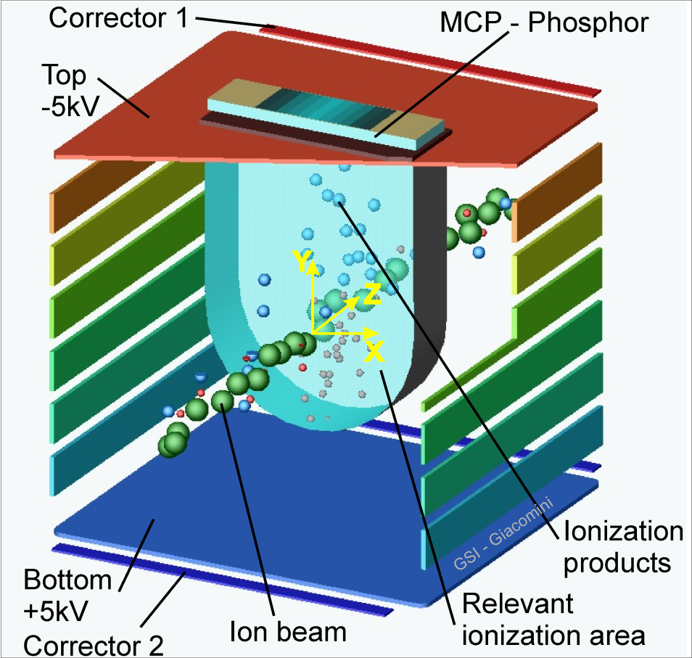
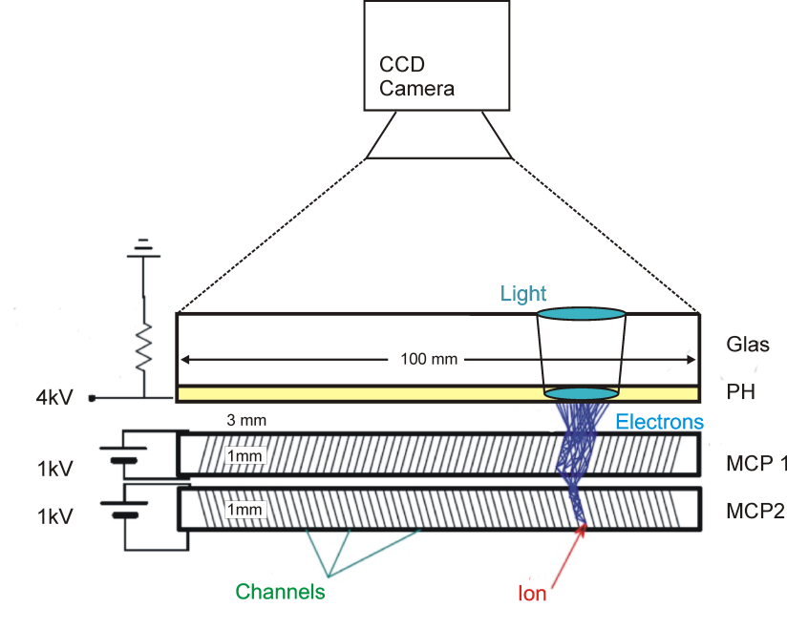
Ionization Profile Monitor: Principle
Advantage: ‘4π-detection scheme’ for ionization products
Detection scheme:
Secondary e⁻ or ions accelerated by E-field
electrodes & side strips E≈ 50… 300 kV/m
MCP (Micro Channel Plate)
electron converter & 10⁶-fold amplifier
either Phosphor screen & CCD
→ high spatial resolution of 100 μm
or wire array down to 250 μm pitch
→ high time resolution
CCD
Light
Ion beam
Phosphor
Electrons
IPMs are installed in nearly all synchrotrons
However, no ‘standard’ realization exists!
MCP 2
MCP 1
Channels ∅10 μm
Residual gas ion

Slide 5
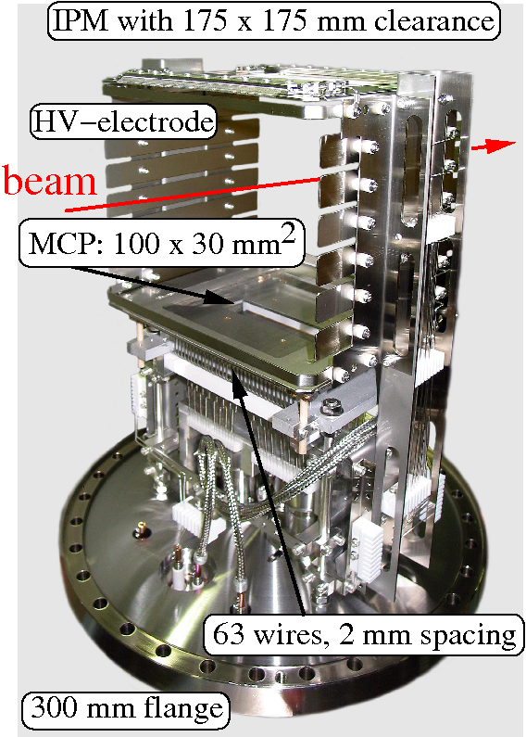
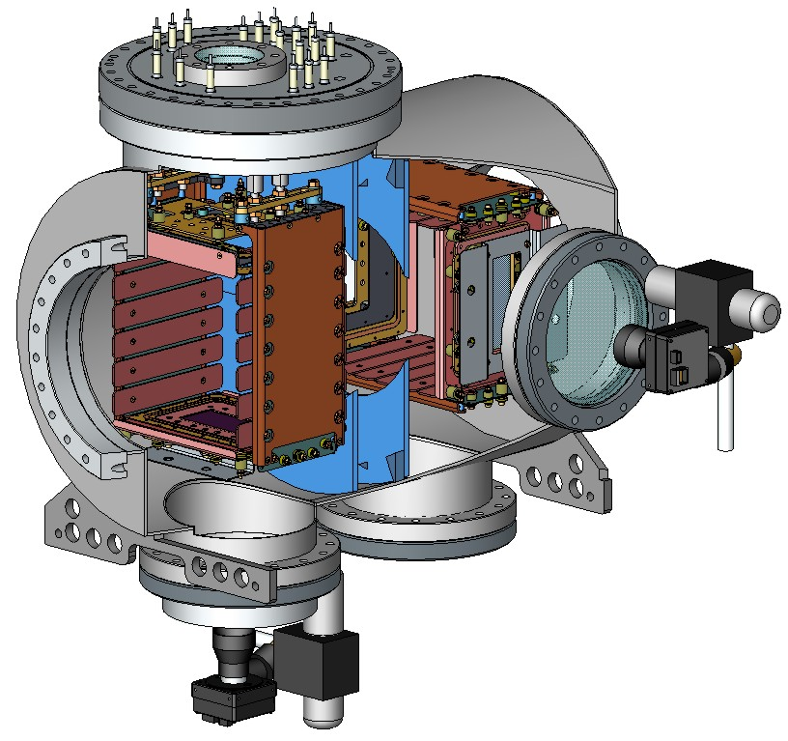
Ionization Profile Monitor Realization at GSI Storage Ring
The realization for the heavy ion storage ring ESR at GSI:
Insertion 650 mm
IPM support
& UV lamp
Ø250 mm
Horizontal IPM:
Vertical IPM
E-field box
Electrodes
beam
175mm
Vertical camera
MCP
E-field separation disks
View port Ø150 mm
Horizontal camera

Slide 6
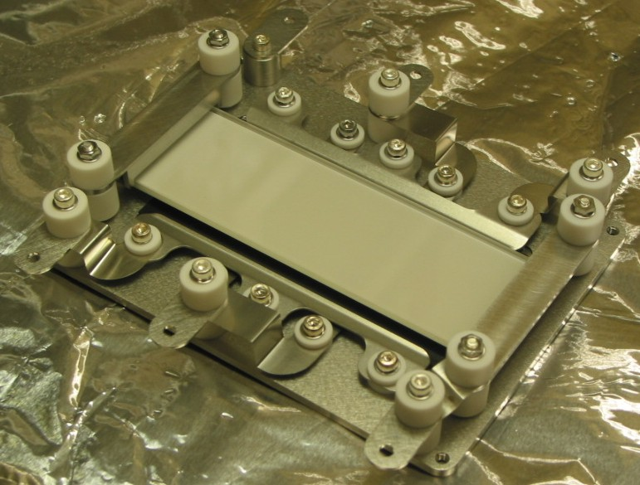
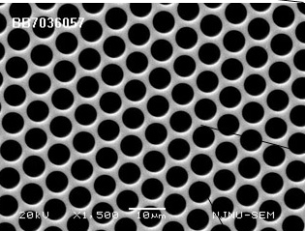
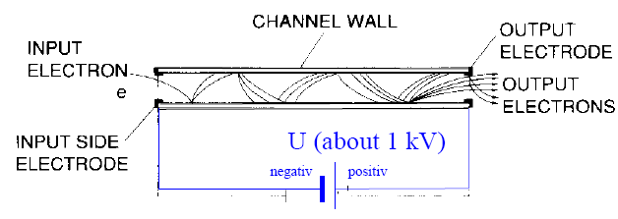
IPM: Multi Channel Plate MCP for Synchrotron Installation
MCP are used as particle detectors with secondary electron amplification.
A MCP is:
1 mm glass plate with ≈10 μm holes
thin Cr-Ni layer on surface
voltage ≈1 kV/plate across
→ e⁻ amplification of ≈ 10³ per plate.
→ resolution ≈ 0.1 mm (2 MCPs)
Anode technologies:
SEM-grid, ≈ 0.5 mm spacing
→ limited resolution
→ fast electronics readout
phosphor screen + CCD
→ high resolution, but slow timing
→ fast readout by photo-multipliers
Electron microscope image:
20 μm
Challenges:
Fast readout with < 100 ns resolution
Proper MCP holder design
Calibration for sensitivity correction
HV switching of MCP to prevent for destruction

Slide 7
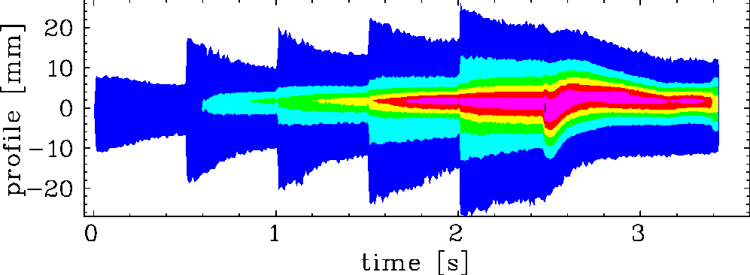
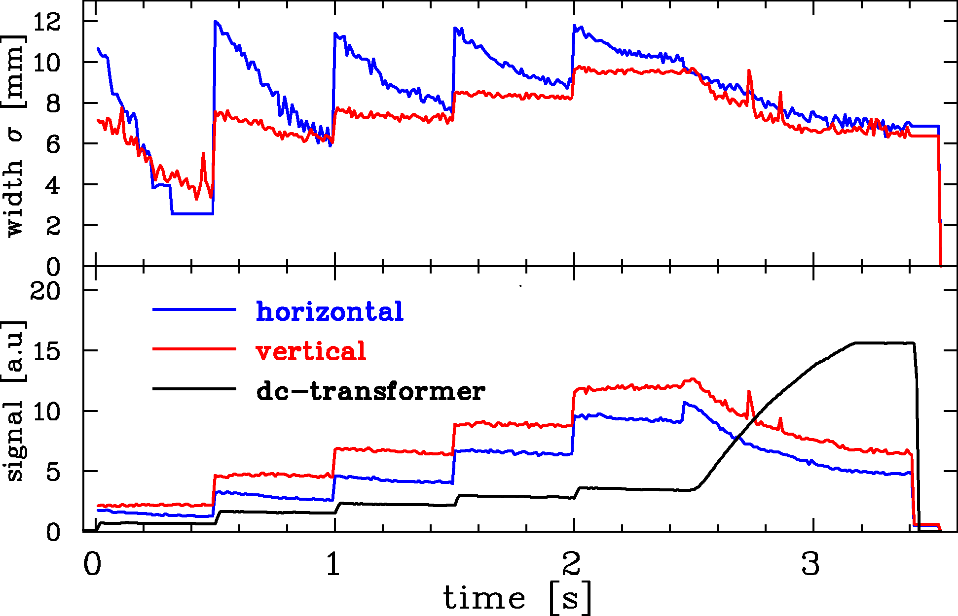
IPM: Observation of Cooling and Stacking
Example:
U⁷³⁺ beam at GSI for intensity increase
stacking by electron cooling
and acc. 11.4 → 400 MeV/u
IPM: Profile recording every 10 ms
measurement within one cycle .
| 5 injections + cooling | | acc. |
Task for IPM:
Observation of cooling
Emittance evaluation during cycle
horizontal
V. Kamerdzhiev (FZJ) et al., IPAC’11
P. Forck (GSI) et al., DIPAC’05

Slide 8
IPM: Turn-by-Turn Measurement
Example: Injection to J-PARC RCS at 0.4 GeV Anode: wire array with 1mm pitch
Important application:
Injection matching
to prevent for emittance enlargement
Observation during ‘bunch gymnastics’
turn–by-turn measurement
Required time resolution ≈ 100 ns
un-matched
matched
9th turn
Turn-by-turn IPMs at
BNL, CERN, FNAL etc.
Not realized at GSI yet!
1st turn
-40 -20 0 20 40
-40 -20 0 20 40
H. Hotchi (J-PARC), HB’08, A Satou (J-PARC) et al., EPAC’08

Slide 9
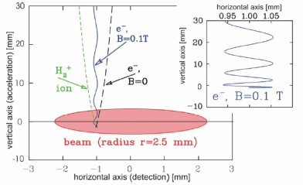
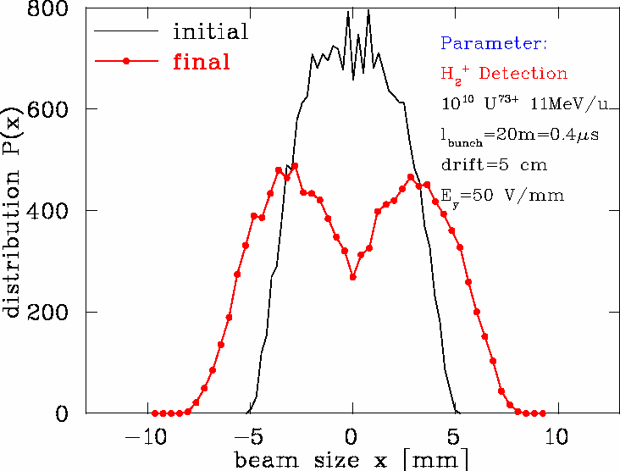
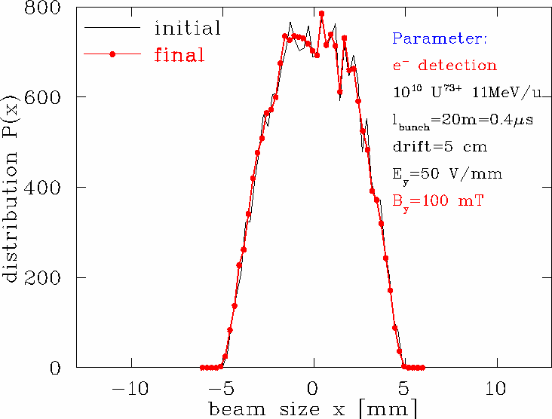
IPM: Space Charge Influence for Intense Beams
Ion detection: For intense beams
⇒ broadening due to space charge
Electron detection:
B-field required for e⁻ guidance toward MCP.
Effects: 3-dim start velocity of electrons
E_{kin}(90%) < 50 eV, θ_{max} ≈ 90⁰
⇒ r_{cyl} < 100 μm for B ≈ 0.1 T
ion detection
B-field & electron detection
Monte-Carlo simulation:
Ion versus e⁻ detection
10¹² charges
⇒ Only e⁻ scheme
gives correct image

Slide 10
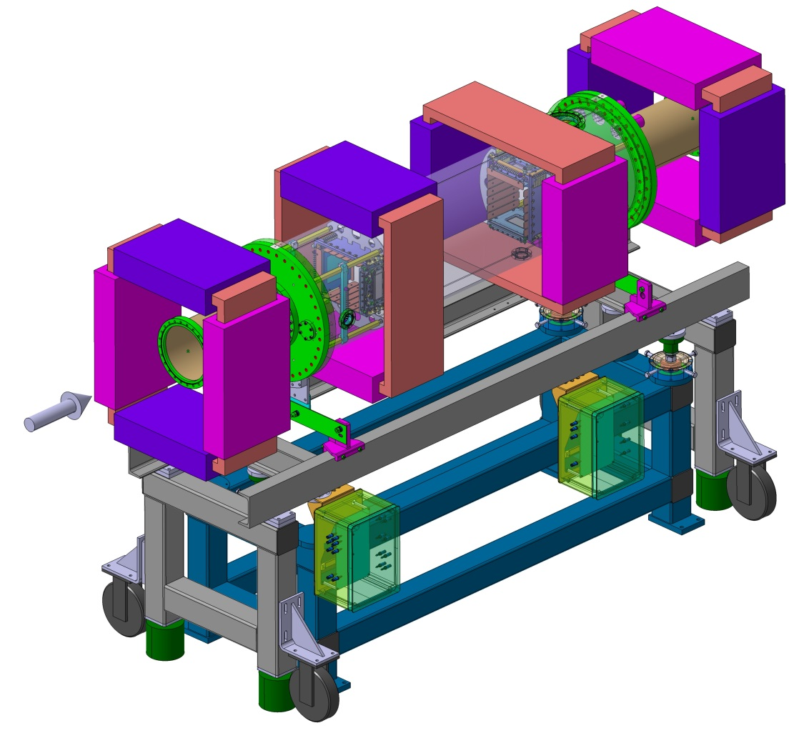
IPM: Magnet Design
Corrector
Magnetic field for electron guidance:
Maximum image distortion:
5% of beam width ⇒ ΔB/B < 1 %
Challenges:
High B-field homogeneity of 1%
Clearance up to 500 mm
Corrector magnets required
to compensate beam steering
Insertion length 2.5 m incl. correctors
For MCP wire-array readout
lower clearance required
Vertical IPM
300mm
Horizontal IPM
Corrector
Insertion length
2.5 m
480mm
At transfer line:
Vacuum pressure up to 10⁻⁵ mbar
IPM without MCP realized
much less mechanical efforts
Design by G. de Villiers (iThemba Lab), T. Giacomini (GSI)
Further types of magnets e.g. K.Satou (J-PARC) et al., EPAC’08, J.Zagel (FNAL) et al., PAC’01,
R.Connolly (RHIC) et al., PAC’01, C. Fischer (CERN) et al. BIW’04

Slide 11
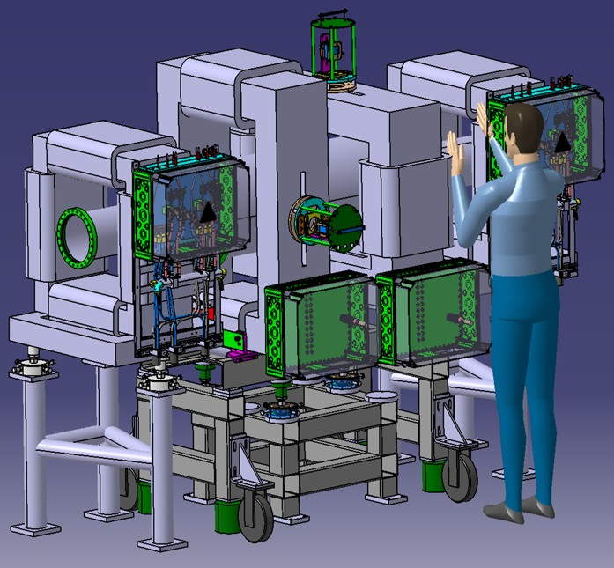
IPM: Magnet Design
Corrector
Magnetic field for electron guidance:
Maximum image distortion:
5% of beam width ⇒ ΔB/B < 1 %
Vertical IPM
300mm
Horizontal IPM
Corrector
Insertion length
2.5 m
480mm
Design by G. de Villiers (iThemba Lab), T. Giacomini (GSI)
Further types of magnets e.g. K.Satou (J-PARC) et al., EPAC’08, J.Zagel (FNAL) et al., PAC’01,
R.Connolly (RHIC) et al., PAC’01, C. Fischer (CERN) et al. BIW’04

Slide 12
Summary Ionization Profile Monitor
Status:
Non-destructive method in operation in nearly all hadron synchrotrons
Proposed or operated in some hadron LINACs (often without MCP)
Physics well understood
For high beam current i.e. high space charge field magnet B ≈ 0.1 T required
⇒ long insertion length
MCP efficiency drops significantly during high current operation
⇒ efficiency calibration & HV switching required
Challenges (no standard realization exists) :
High voltage (up to 60 kV) realization for intense beams
Stable operation for MCP incl. efficiency calibration
Design and tests for correction algorithm for space charge broadening
Remark:
Gas curtain monitor with well localized gas volume realized
Comparable device used for synchrotron light monitor realized

Slide 13
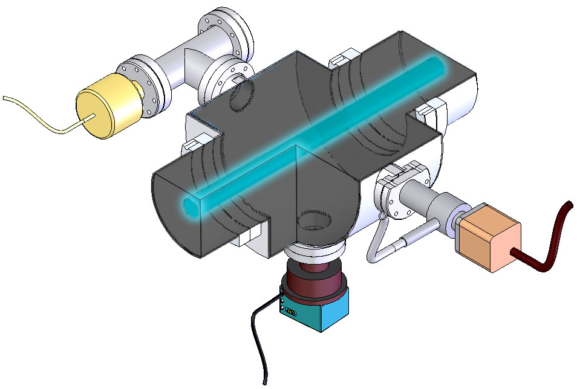
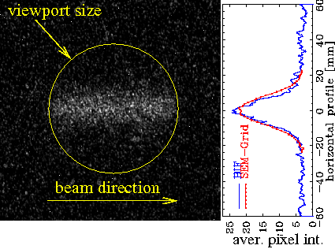
Beam Induced Fluorescence Monitor: Principle
Detecting photons from residual gas molecules, e.g. Nitrogen
N₂ + Ion → (N₂⁺)* + Ion → N₂⁺ + γ + Ion
390 nm< λ< 470 nm
emitted into solid angle Ω to camera
single photon detection scheme
N₂-fluorescent gas
equally distributed
Vacuum gauge
Blackened walls
Valve
150mm flange
Features:
Single pulse observation possible
down to ≈1 μs time resolution
High resolution (here 0.2 mm/pixel)
can be easily matched to application
Commercial Image Intensifier
Less installations inside vacuum as for IPM
⇒ compact installation e.g. 20 cm for both panes
Ion beam
Viewport
Lens, Image-Intensifier
and CCD FireWire-Camera
Beam: 4x10¹⁰ Xe⁴⁸⁺ at 200MeV/u, p=10⁻³ mbar

Slide 14
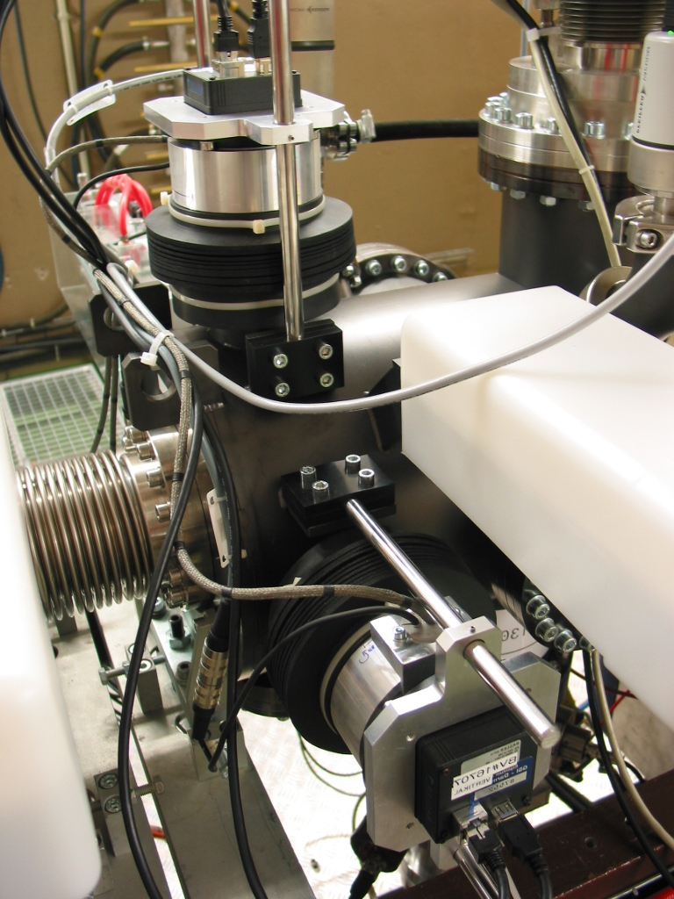
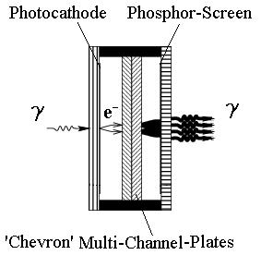
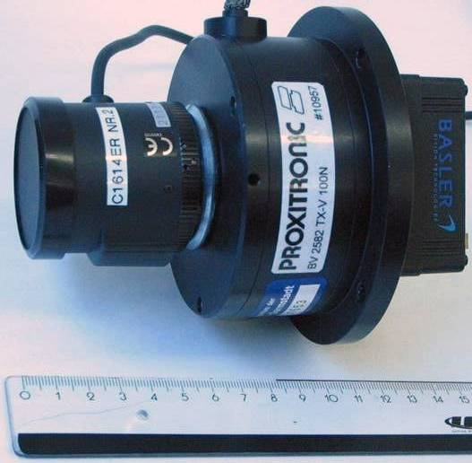
BIF-Monitor: Technical Realization at GSI LINAC
Six BIF stations at GSI-LINAC (length ≈200m):
2 x image intensified CCD cameras each
double MCP (‘Chevron geometry’)
Optics with reproduction scale 0.2 mm/pixel
Gas inlet + vacuum gauge
Pneumatic actuator for calibration
Insertion length 25 cm for both directions only
Advantage: single macro-pulse observation
Horizontal BIF
Image Int. CCD
Vertical BIF
Beam
Image intensifier
Photocathode
γ
e⁻
double
MCP
Phosphor
many γ
F. Becker (GSI) et al., Proc. DIPAC’07, C. Andre (GSI) et al., Proc. DIPAC’11

Slide 15
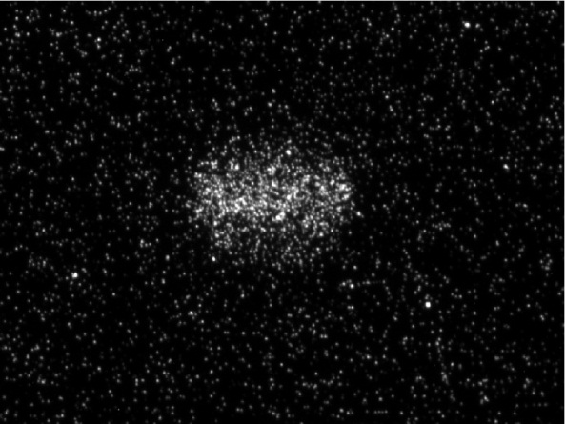
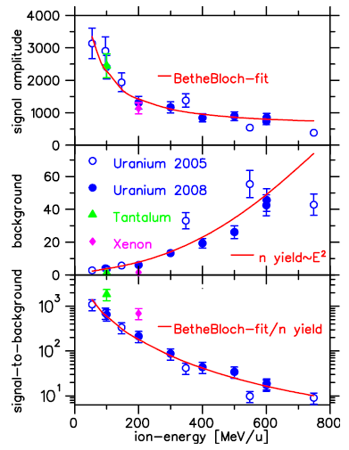
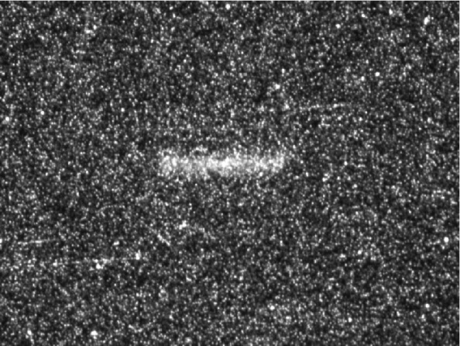
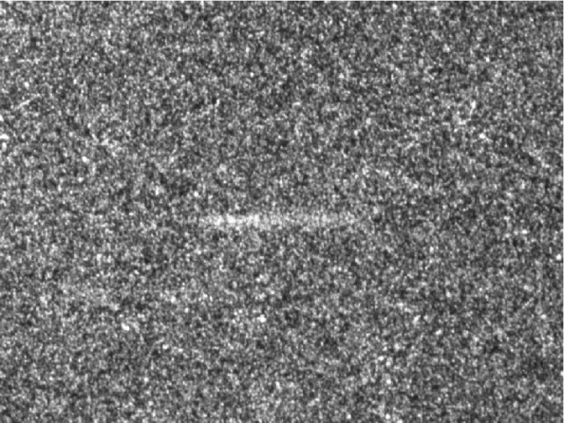
Energy Scaling behind SIS18 at GSI
60 MeV/u
E_{kin} dependence for signal
& background close to beam-dump:
Image from 1·10⁹ U
p= 2·10⁻³ mbar,
mounted ≈ 2 m
before beam-dump:
viewport
350 MeV/u
750 MeV/u
Signal proportional to energy loss
Suited for FAIR-HEBT with ≥ 10¹⁰ ions/pulse
Background prop. E_{kin}² ⇒ shielding required
Background suppression by 1 m fiber bundle
F. Becker (GSI) et al., Proc. DIPAC’07

Slide 16
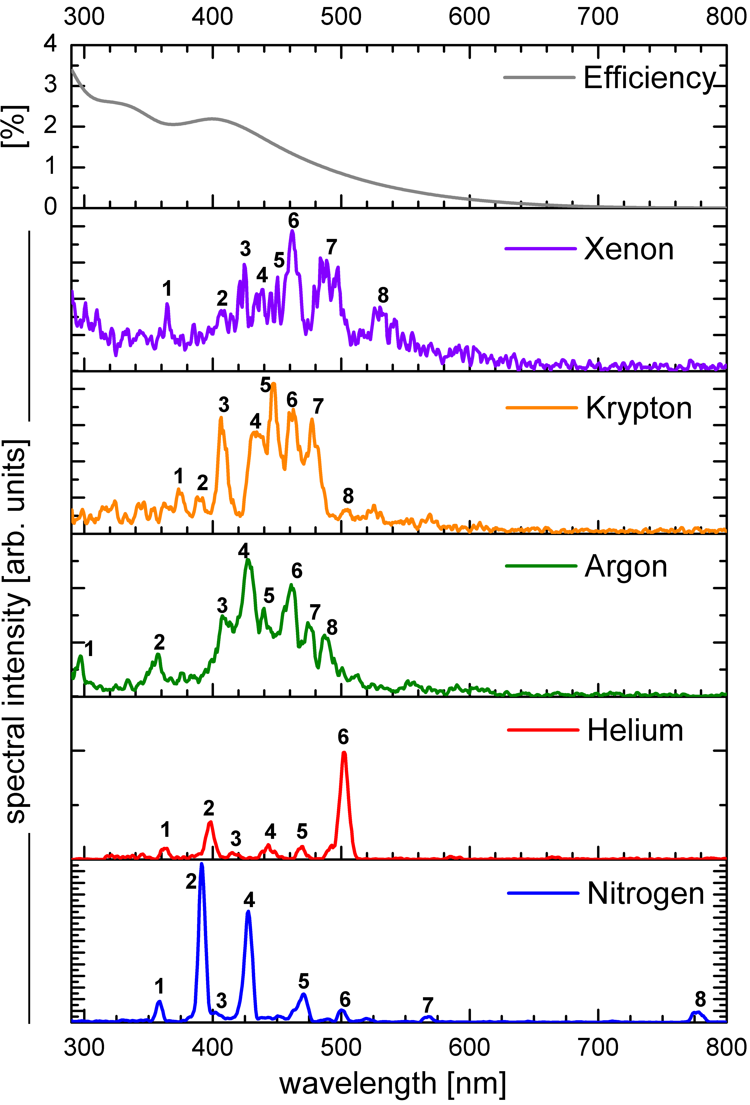
BIF-Monitor: Spectroscopy – Fluorescence Yield
Beam: S⁶⁺ at 5.16 MeV/u, p_{N2} =10⁻³ mbar
Results of detailed investigations:
Rare gases and N₂: green to near-UV
Compact wavelength interval for N₂
Fluorescence yield: N₂ ≈ 4x higher as rare gases
⇒ N₂ and Xe are well suited !
Relative fluorescence yield Y (all wavelength):
gas | Y for p | Y for p/n_{e}
Xe | 86 % | 22 %
Kr | 63 % | 25 %
Ar | 38 % | 30 %
He | 4 % | 26 %
N₂ | 100 % | 100 %
n_{e}: gas electron density ∝ energy loss ⇔ beam influence
F. Becker (GSI) et al., Proc. DIPAC’09, Collaboration with TU-München

Slide 17
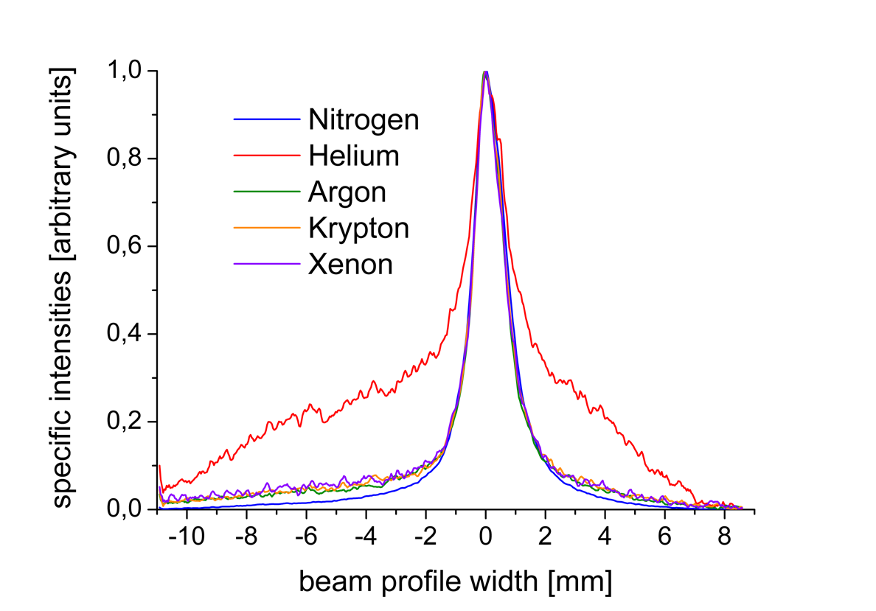
BIF-Monitor: Spectroscopy – Profile Reading
Beam: S⁶⁺ at 5.16 MeV/u, p_{N2} =10⁻³ mbar
Results of detailed investigations:
Rare gases and N₂: green to near-UV
Compact wavelength interval for N₂
Fluorescence yield: N₂ ≈ 4x higher as rare gases
Same profile reading for all gas except He
⇒ N₂ and Xe are well suited !
Normalized profile reading for all λ:
Profile reading equal
for all gases except He
F. Becker (GSI) et al., Proc. DIPAC’09, Collaboration with TU-München

Slide 18
Spectroscopy – Excitation by different Ions
For N₂ working gas the spectra for different ion impact is measured:
Results:
Comparable spectra for all ions
Small modification due to N₂⁺
dissociation by heavy ion impact
Results fits to measurements
for proton up to 100 GeV at CERN
Stable operation possible for N₂
Care: Different physics for E_{kin} < 100 keV/u ⇔ v_{coll} < v _{Bohr}
→ Different spectra measured
M. Plum et al., NIM A (2002) & A. Variola, R. Jung, G. Ferioli, Phys. Rev. Acc. Beams (2007),

Slide 19
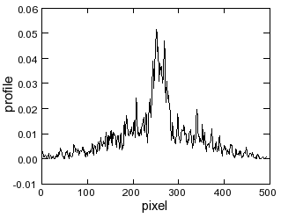
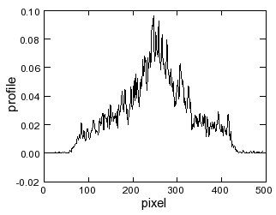
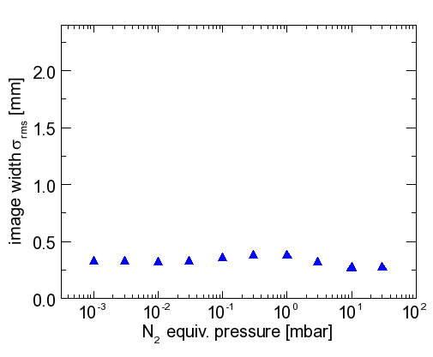
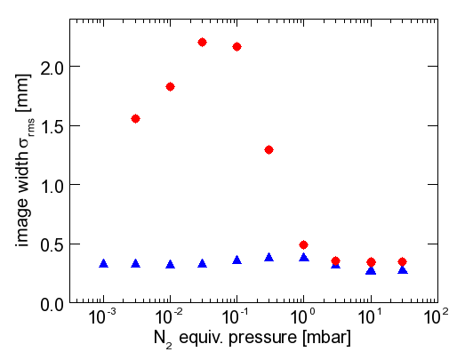
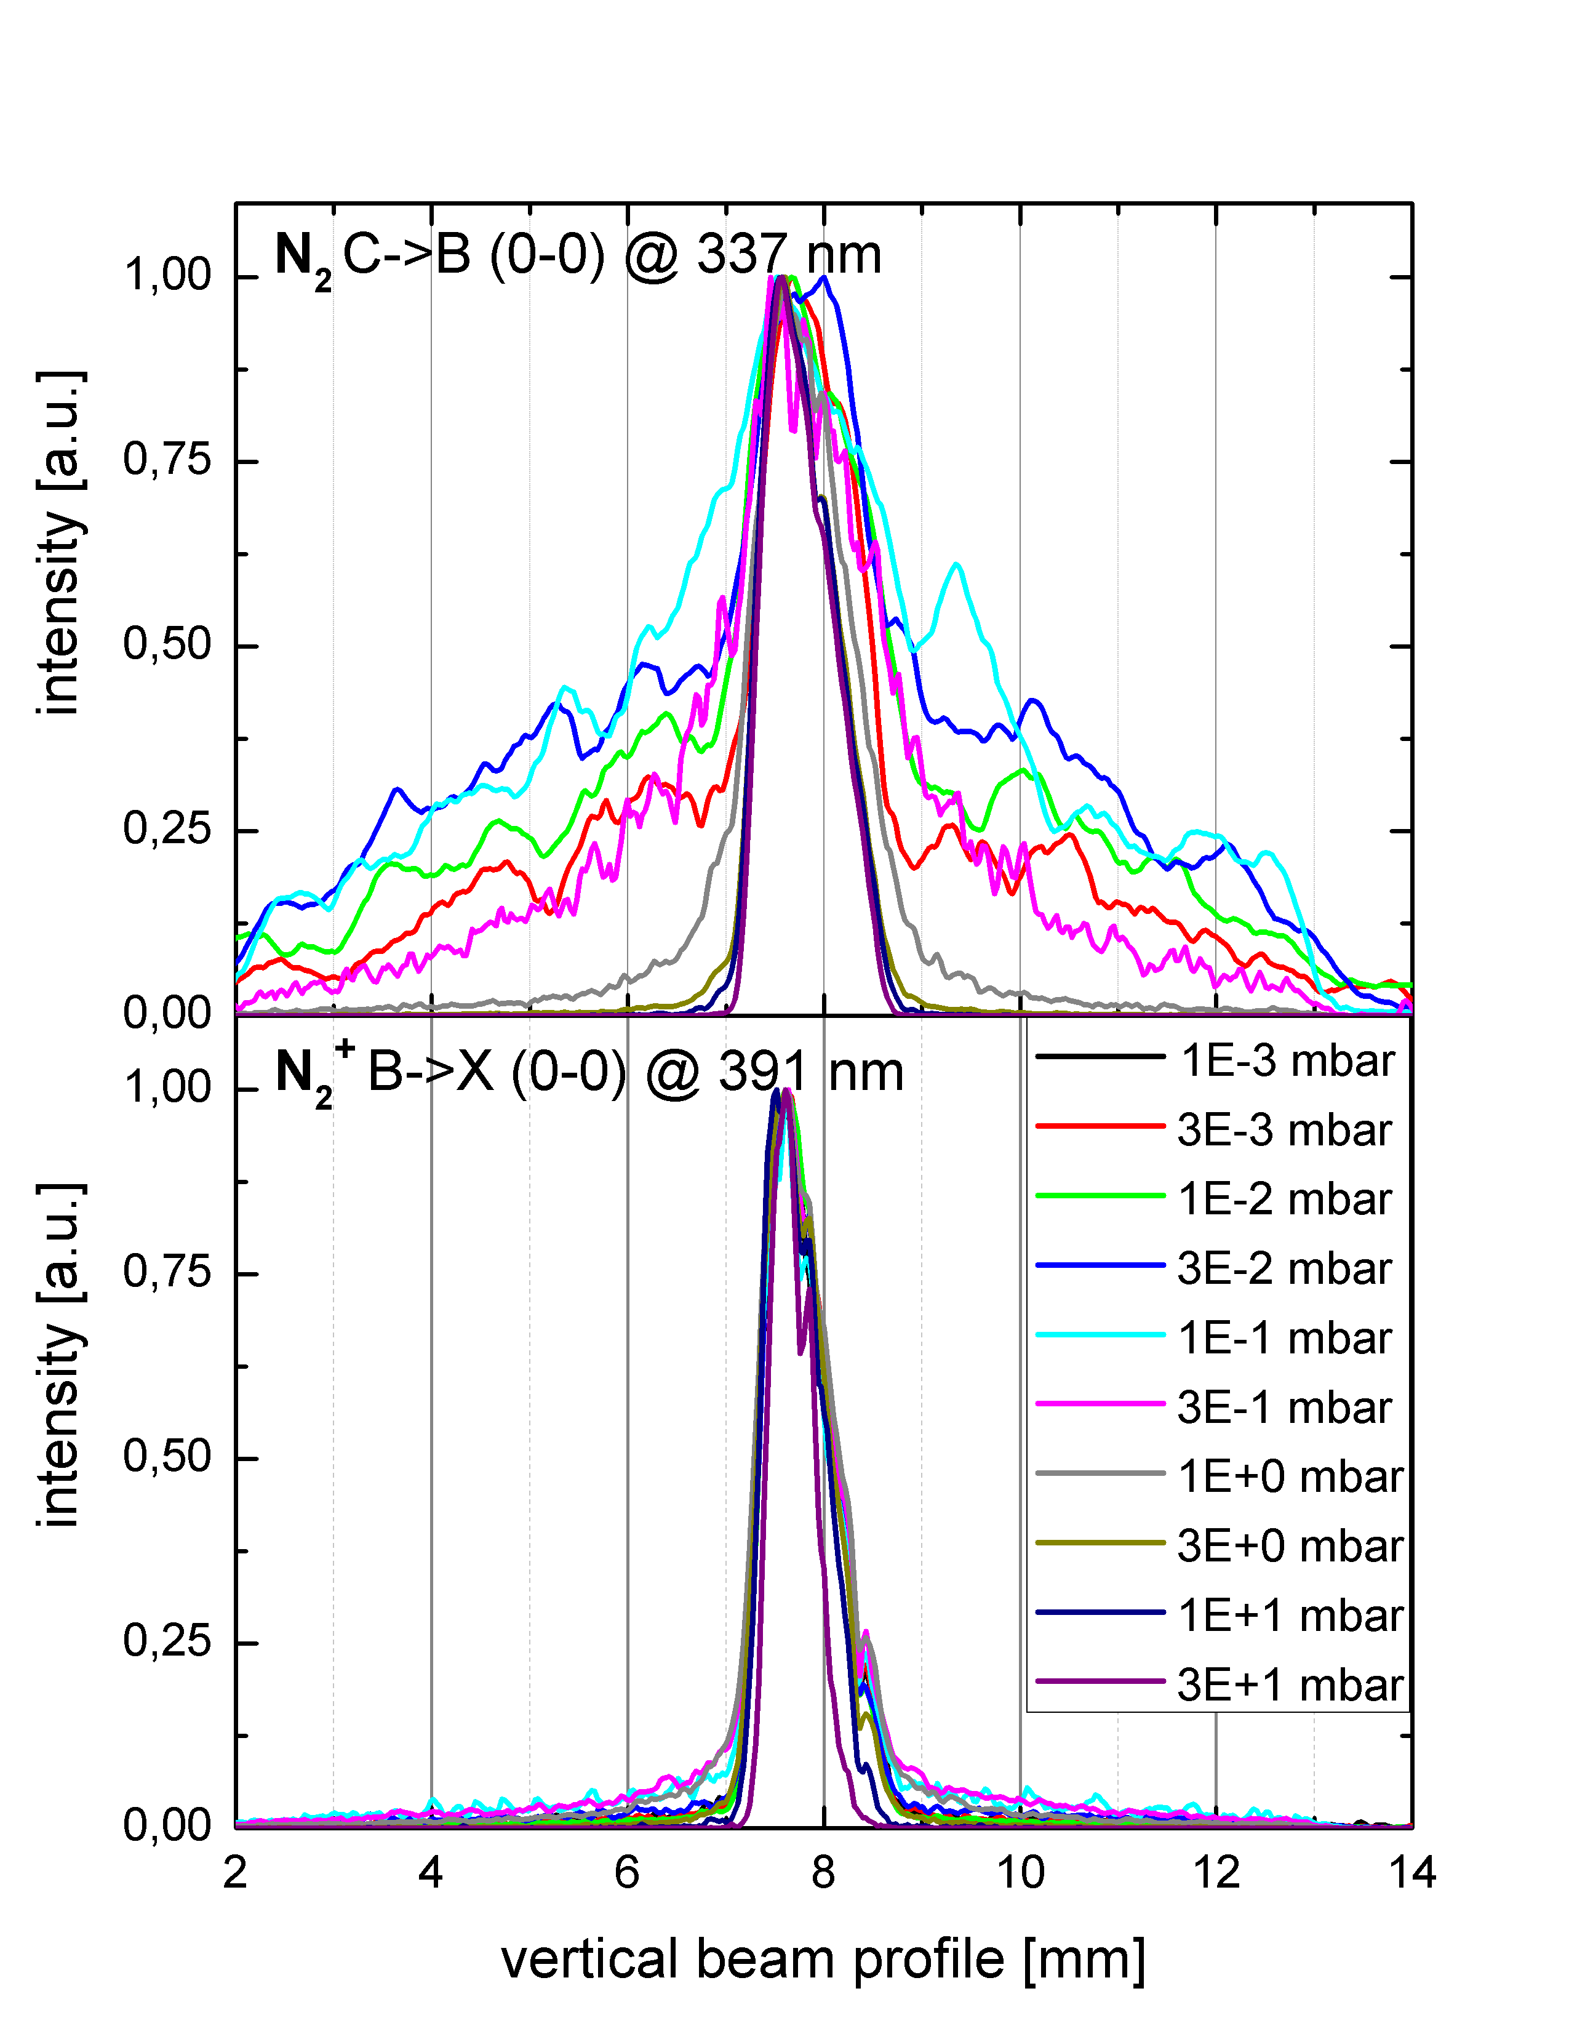
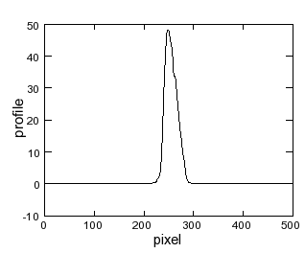
Image Spectroscopy – Different Gas Pressures and Profile Width
Observation: Trans. of ionic states e.g. N₂⁺ → profile width independent on pressure
Trans. of neutral states e.g. N₂ → width strongly dependent on pressure!
Ionic transitions λ=391 nm:
N₂ + ion→(N₂⁺)* +e⁻+ ion→N₂⁺+ γ+e⁻ + ion
N₂⁺ @391nm: B²Σ⁺_{u}(v=0) → X²Σ⁺_{g}(v=0)
large σ for ion-excitation, low for e⁻
N₂
N₂
p = 0.003 mbar
p = 0.1 mbar
N₂
N₂ trans.
@337 nm
p = 30 mbar
Neutral transitions λ=337 nm:
N₂ + e⁻ → (N₂)* + e⁻ → N₂ + γ + e⁻
N₂ @337nm: C³Π_{u}(v=0) → B³Π_{g}(v=0)
large σ of e⁻ excitation., low for ions
at p ≈ 0.1 mbar→ free mean path ≈1 cm!
N₂⁺ trans.@391 nm
F. Becker et al., IPAC’12 &HB’12

Slide 20
Image Spectroscopy – Different Gas Pressures and total Profile Width
Beam: S at 3 MeV/u at TU-München TANDEM
Entire spectral range → effect is smaller
but significant disturbance for He and Ne
Task: To which pressure the methods delivers
a correct profile reproduction?
Results:
avoid 10⁻² mbar < p < 10 mbar ⇔
chose either r_{mfp} >> r_{beam} or r_{mfp}<< r_{beam}
use transition of the charged specious
all transitions
10⁻² mbar
r_{mfp}~30 mm
10⁻¹ mbar
r_{mfp}~ 3 mm
∅30mm
10⁺¹ mbar
r_{mfp}~ 30 μm
∅100mm
F. Becker et al., IPAC’12 and HB’12

Slide 21
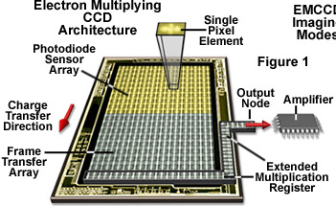
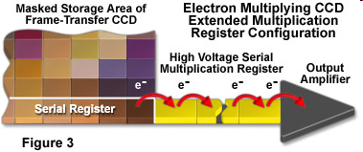
Alternative Single Photon Camera: emCCD
Principle of electron multiplication CCD:
I= 60 μA Ni¹³⁺:
t_{pulse} = 1.2 ms
p=10⁻⁴ mbar
Results: Suited for single photon detection
x5 higher spatial resolution as ICCD
less beam-induced background
more noise due to electrical amplification
⇒ Acts as an alternative
Multiplication by avalanche diodes:
Parameter of Hamamatsu C9100-13
Pixel: 512x512, size16x16μm^{2 , -}80 ^{O}C
Maximum amplification: x1200
Readout noise: about 1 e⁻ per pixel
F. Becker et al., BIW’08

Slide 22
Summary Beam Induced Fluorescence Monitor
Non-destructive profile method in operation for E < 11 MeV/u for typ. p < 10⁻⁵ mbar
Considered for higher beam energies E > 100 MeV/u ongoing
Independence of profile reading for pressures up to 10⁻² mbar for N₂, Xe, Kr, Ar
N₂ is well suited: blue wavelength, high light yield, good vacuum properties
Xe is an alternative due to 10-fold shorter lifetime: less influence in beam’s E-field
He is excluded as working gas due to wrong profile reproduction
Modern emCCD might be an alternative
Topics under development:
Investigation of shielding and radiation hardness of components
Modeling of atomics physics processes for different pressure ranges
Generally: Method proposed or used for:
High current hadron LINAC (e.g. LIPAc, FRANZ, IPHI.....)
Proton synchtrotrons (e.g. CERN...)
Electron sources, LINACs and e-coolers (e.g. Uni-Mainz...)

Slide 23
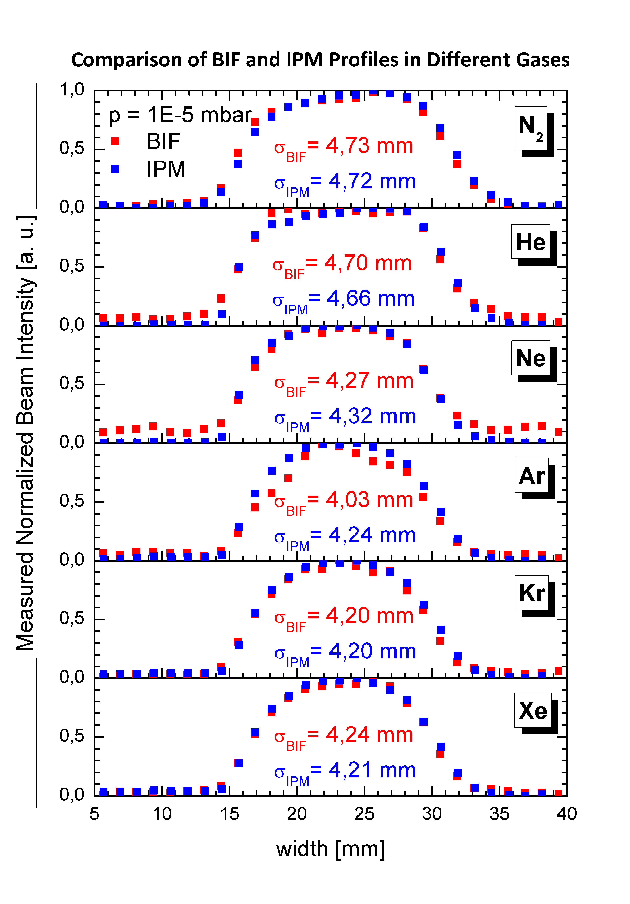
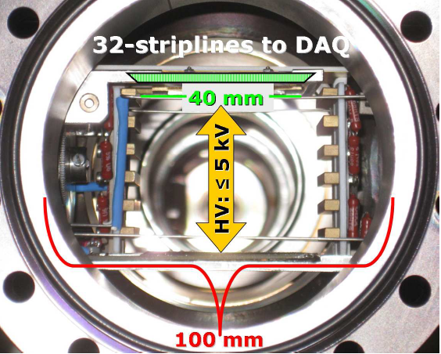
Comparison BIF ↔ IPM at GSI LINAC with 4.7 MeV/u Xe²¹⁺
Test with LIPAc design and various beams
Comparison IPM without MCP and BIF
Advantage IPM: 10 x lower threshold as BIF
Disadvantage IPM: Complex vacuum installation,
image broadening by beam’s space charge
Design by CEA
for LIPAc
Collaboration with J. Egberts, J. Marroncle, T. Papaevangelou CEA/Saclay
J. Egberts (CEA) et al., DIPAC’11, F. Becker (GSI) et al , DIPAC’11
Beam: 1.1 mA Xe²¹⁺, 4.7 MeV/u

Slide 24
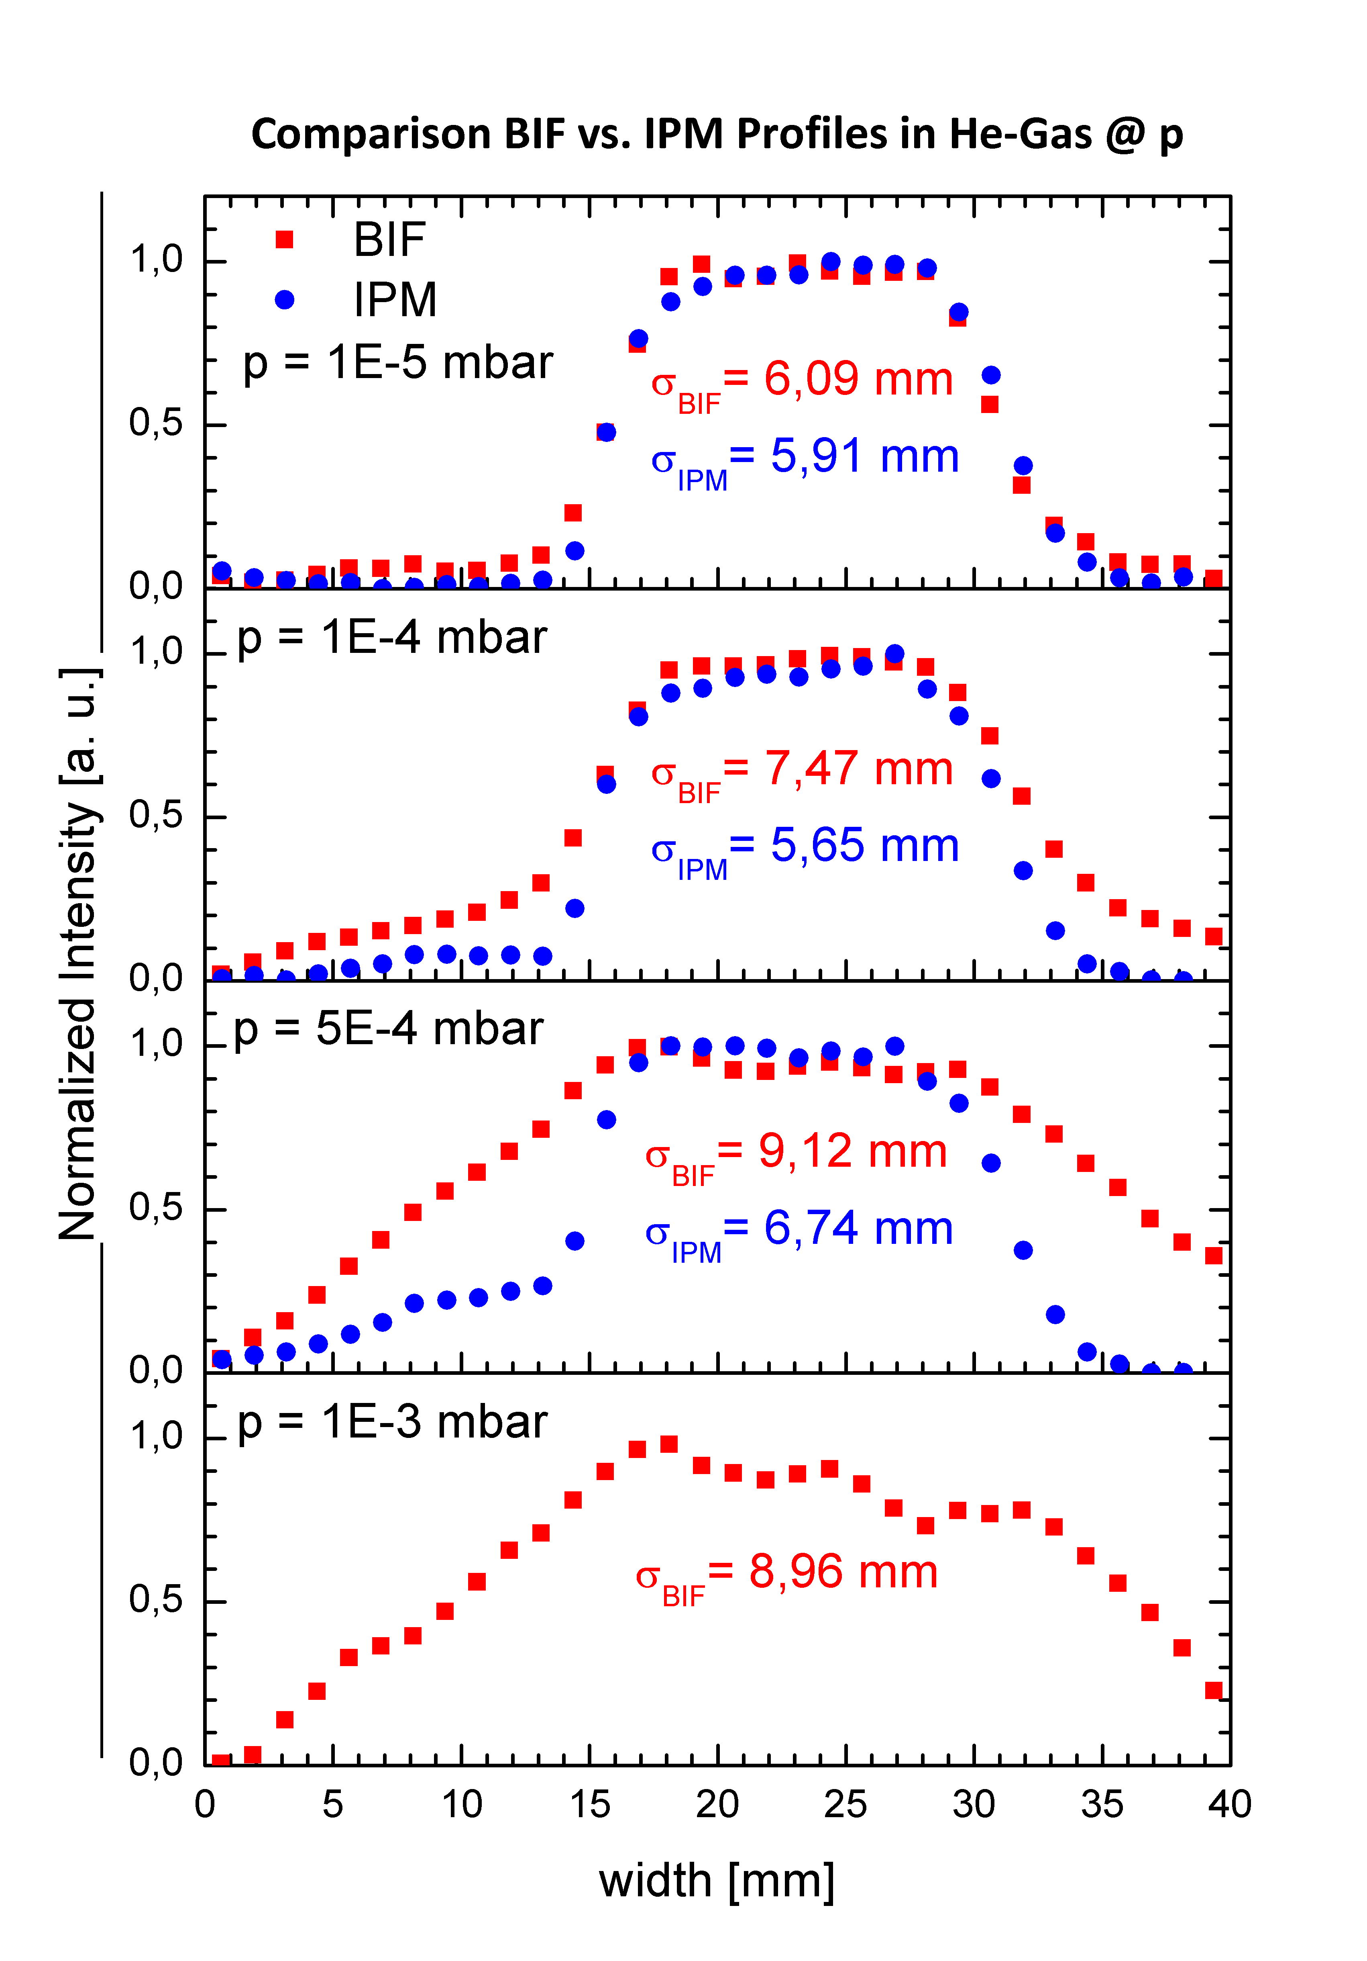
Comparison BIF ↔ IPM for He Gas
Variation of Helium gas pressure:
Profile broadening for both detectors
Large effect for BIF (emission of photons)
Comparison to SEM-Grid and BIF
Helium is not suited as working gas for BIF & IPM
Design by CEA
for LIPAc
Collaboration with J. Egberts, J. Marroncle, T. Papaevangelou CEA/Saclay
J. Egberts (CEA) et al., DIPAC’11, F. Becker (GSI) et al , DIPAC’11
Beam: 1.1 mA Xe²¹⁺, 4.7 MeV/u

Slide 25
Simplified Comparison of BIF and IPM Method
Comparison for application at high current hadron LINAC, transport lines & synchrotrons
 | BIF | IPM
Signal source | γ from residual gas ⇒ Low solid angle Ω ≈10⁻⁴ | e⁻ from residual gas Large Ω = 4π due to E-field
Detector principle | γ → e⁻ → 10⁸ γ by MCP & Phosphor & CCD | γ → e⁻ → 10⁸ γ by MCP & Phosphor & CCD or MCP & I/U converter & ADC
Advantage | Non-destructive Nearly no mechanics | Non-destructive Medium signal strength
Disadvantage | Low signal strength Might need gas inlet Smaller space charge influence for Xe | Complex device Expensive For high currents: Magnet required
Main Application | High current at LINAC No well suited for super-cond. LINAC Target diagnostics | Synchrotons
Thank you for your attention !

