Slide 1

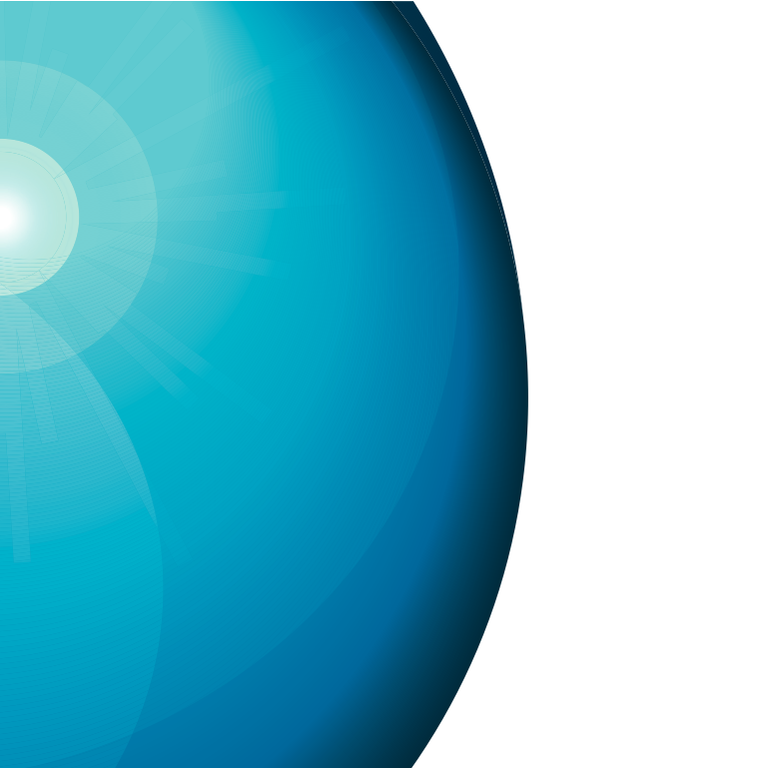






Studies into beam loss studies at European Spallation Source
Michał Jarosz
oPAC Topical Workshop on Beam Diagnostics
Wien, 2014-05-09

Slide 2
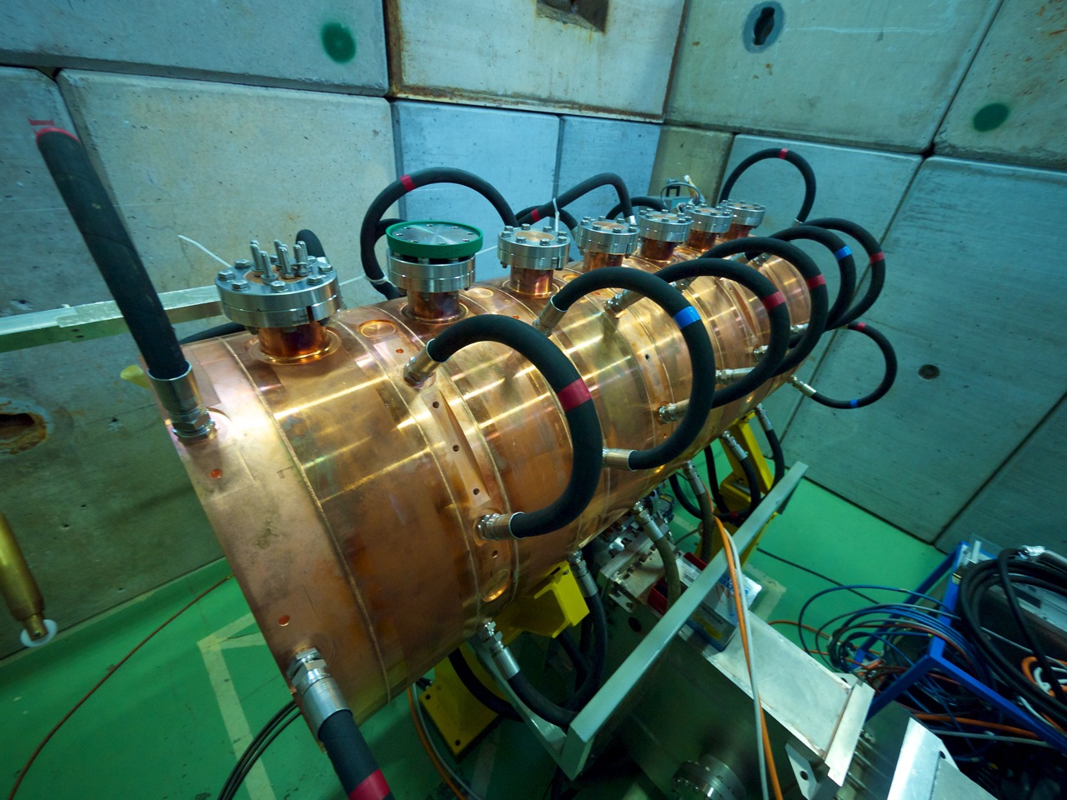
I. Building an accelerator

Slide 3
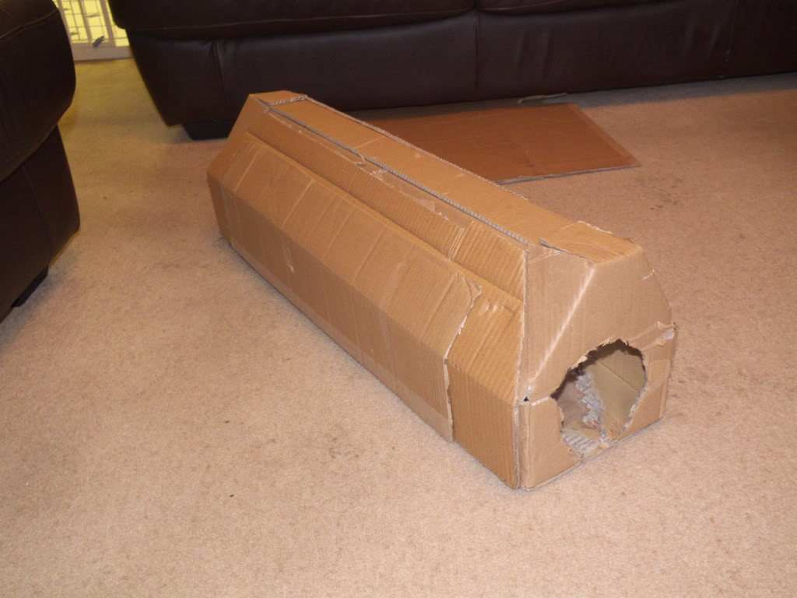
I. Building an accelerator model

Slide 4
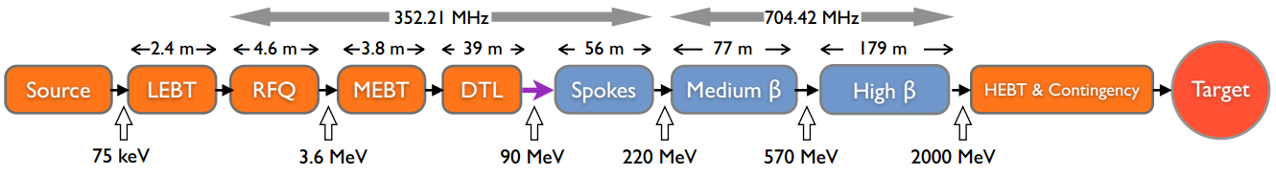
I. Building an Accelerator (Model)
A low-level model in a simulation code:
Very useful in the design phase
Could remain useful during the operation
Can be started early as rough estimation and then updated regularly as more detailed information about the machine parts become available
Coherence – one model utilizing the whole machine; whith strict rules and common depository; modular build

Slide 5
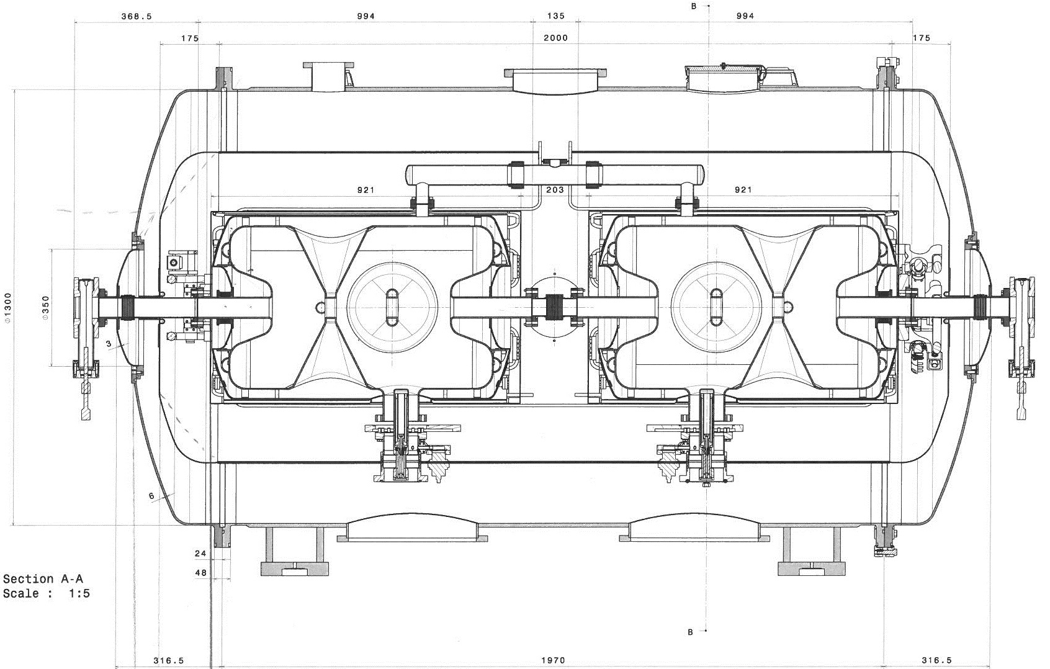
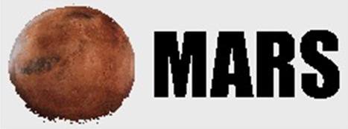
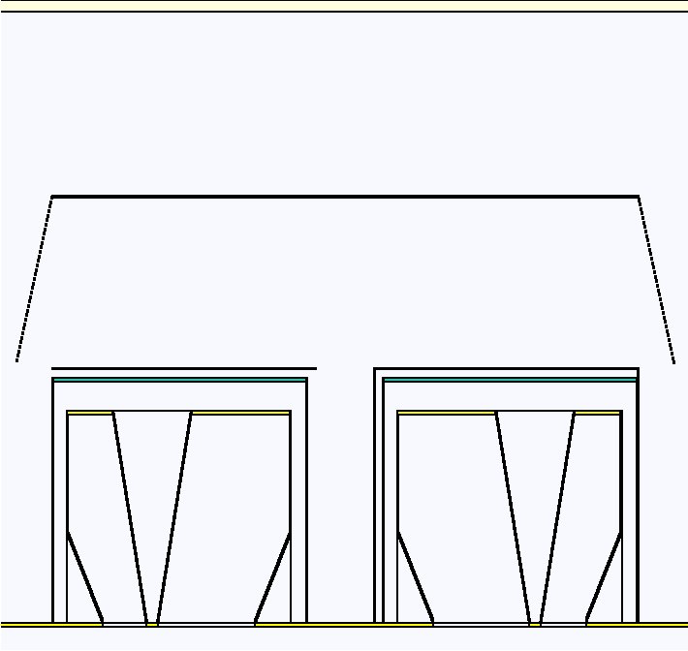
I. Building an Accelerator (Model)
heltankm 2 0 2 0. 0. 19.6 20.9 21.4 92.6 !middle part of helium tank
helcovl 2 0 2 0. 0. 19.6 9.1 21.4 0.5 !helium tank left cover
helcovr 2 0 2 0. 0. 111.7 9.1 21.4 0.5 !helium tank right cover
magshld 2 0 8 0. 0. 19.45 24.25 24.4 92.9 !magnetic shield over cavities
magshll 2 0 8 0. 0. 19.45 9.1 24.25 0.15 !magnetic shield left cover
magshlr 2 0 8 0. 0. 112.2 9.1 24.25 0.15 !magnetic shield right cover
termshld 2 0 9 0. 0. 0. 47.25 47.4 131.8 !thermal shield around

Slide 6
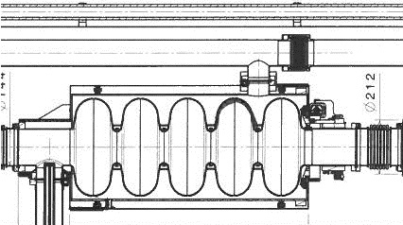
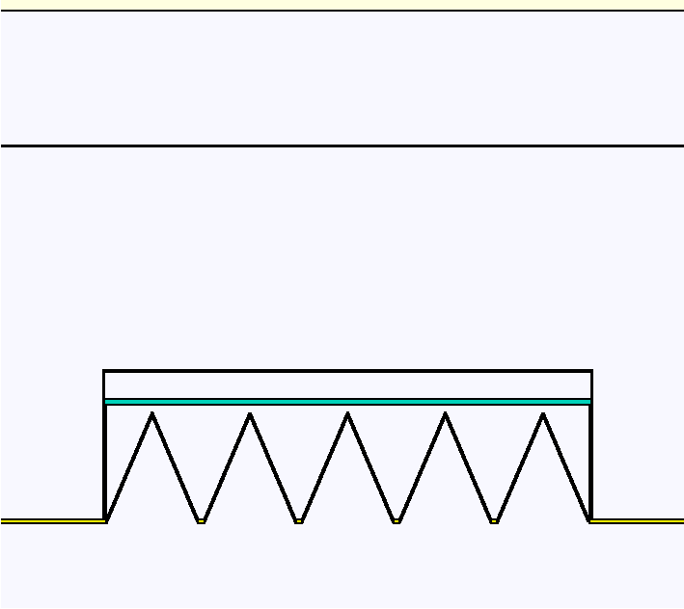
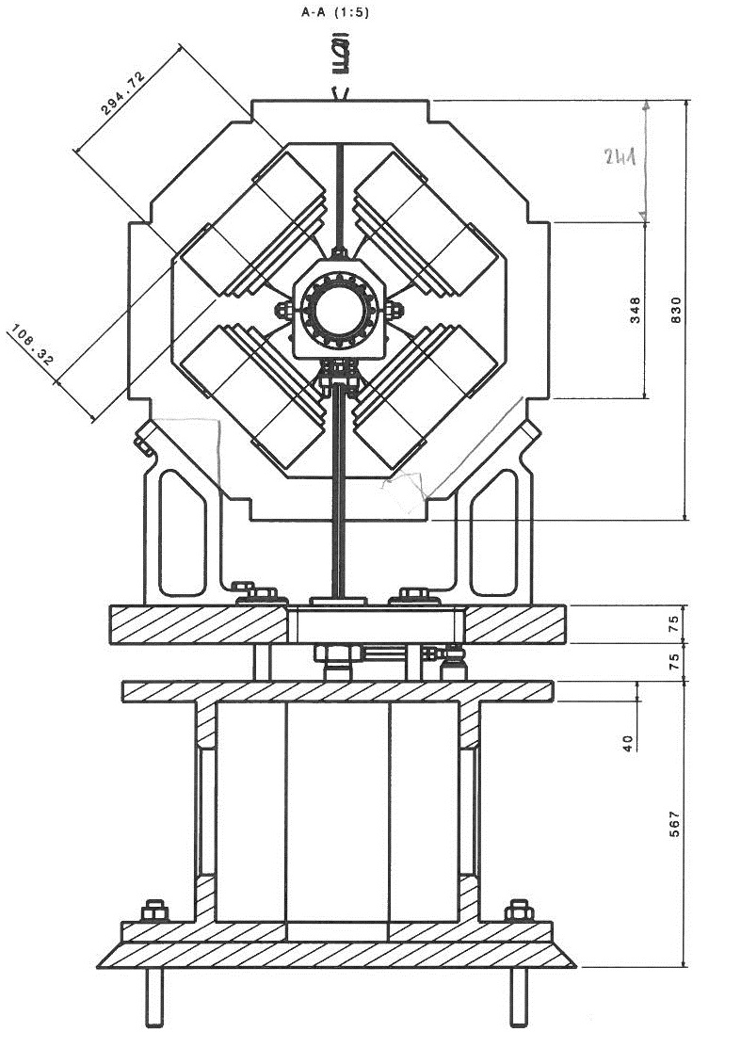
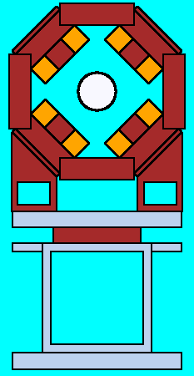
I. Building an Accelerator (Model)
SPOKES
ELLIPTICALS
QUADS

Slide 7
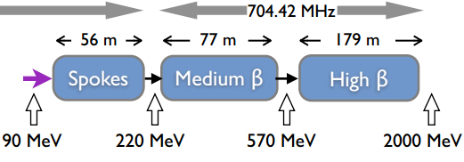
I. Building an Accelerator (Model)
Automated Generation (small python script)

Slide 8
I. Building an Accelerator (Model)
Automated Generation (small python script) – as for now semi-automatic
Planned integration with BLED (Beam Line Elements Database)
Biggest dificulty – MARS representation of the elements

Slide 9
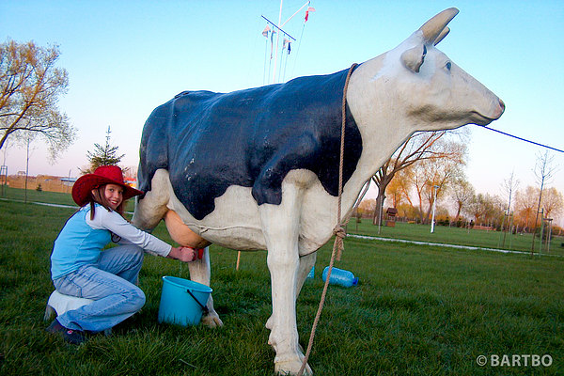
II. Using the accelerator model

Slide 10
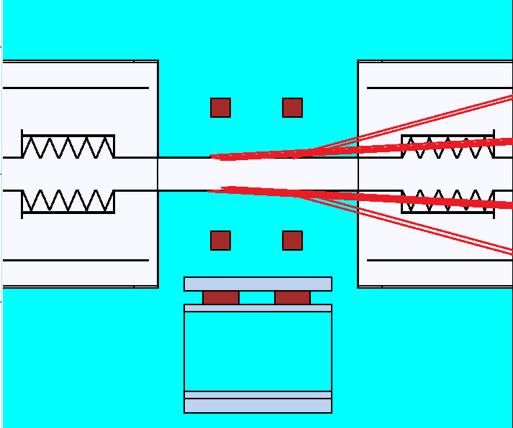
II. Using the accelerator model
A. Studies on the power deposition in the cold parts
Three different loss paterns (uniform, smeared over the gap between cavities, located in the quadrupoles), all obeying 1 W/m rule
Verifying the 0.5 W/m limit for the power deposition in the cryocavities

Slide 11
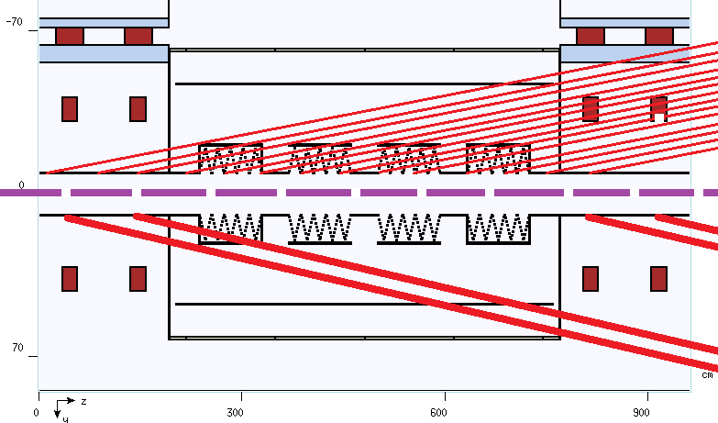
II. Using the accelerator model
A. Studies on the power deposition in the cold parts
Three different loss paterns (uniform, smeared over the gap between cavities, located in the quadrupoles), all obeying 1 W/m rule
Verifying the 0.5 W/m limit for the power deposition in the cryocavities

Slide 12
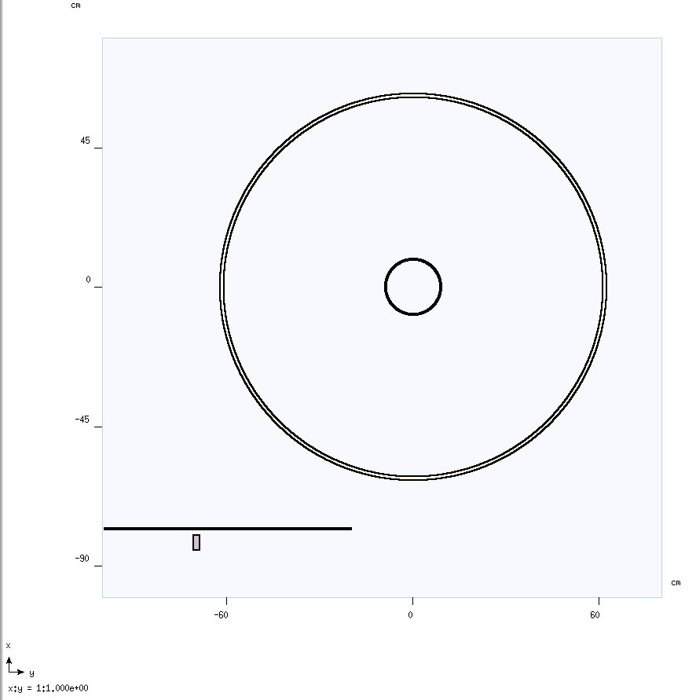
II. Using the accelerator model
B. Determining the cryovalves life
Providing information about the dose absorbed by the element during normal, long operation of the accelerator

Slide 13
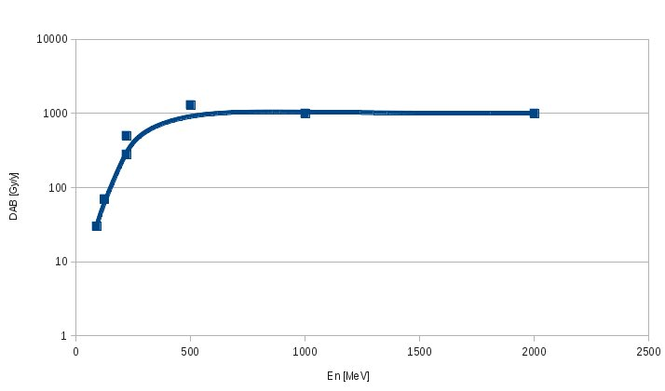
II. Using the accelerator model
Results:

Slide 14
II. Using the accelerator model
Results:

Slide 15
II. Using the accelerator model
Results:

Slide 16
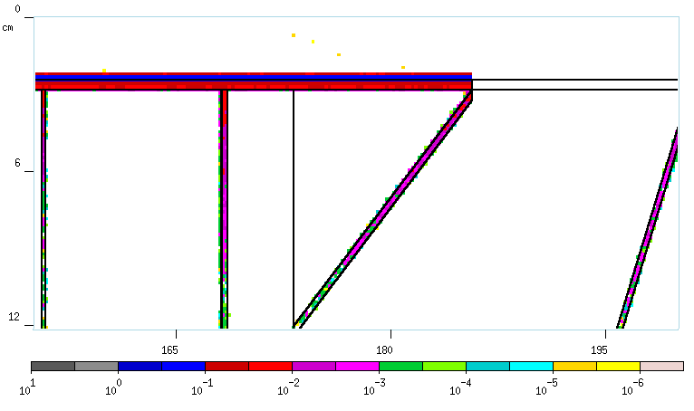
II. Using the accelerator model
Results:

Slide 17
II. Using the accelerator model
Results:
Reminder to self: even being too conservative is sometimes possible !

Slide 18
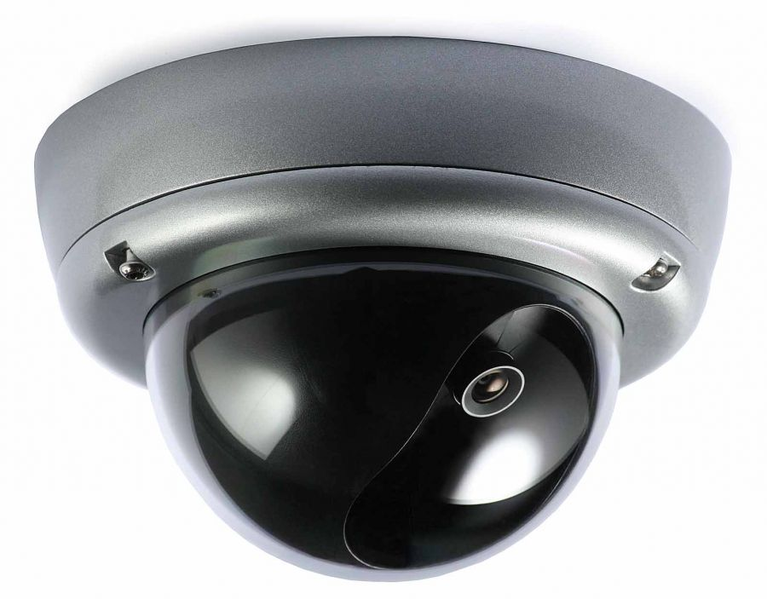
III. Beam Loss Monitoring

Slide 19
III. Beam Loss Monitoring
Beam loss monitoring at ESS:
LHC-type ionization chambers in cold sections up to the target (well tested; known response functions; ordered)

Slide 20
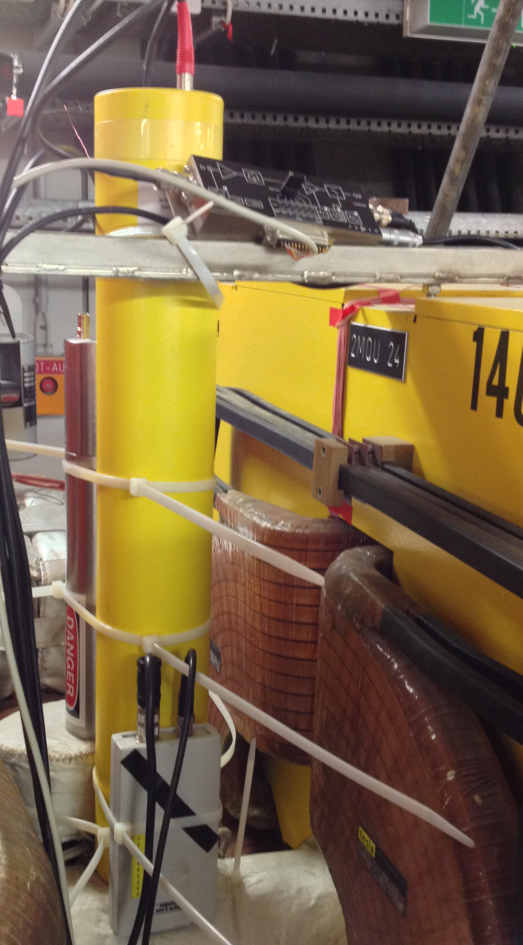
III. Beam Loss Monitoring
Beam loss monitoring at ESS:
LHC-type ionization chambers in cold sections up to the target (well tested; known response functions; ordered)

Slide 21
III. Beam Loss Monitoring
Beam loss monitoring at ESS:
LHC-type ionization chambers in cold sections up to the target (well tested; known response functions; ordered)
Ionisation chambers + additional lower energy detector in warm sections

Slide 22
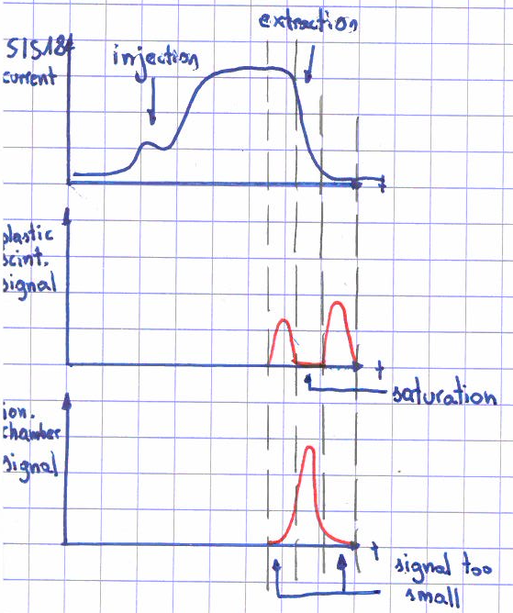
III. Beam Loss Monitoring
Beam loss monitoring at ESS:
LHC-type ionization chambers in cold sections up to the target (well tested; known response functions; ordered)
Ionisation chambers + additional lower energy detector in warm sections

Slide 23
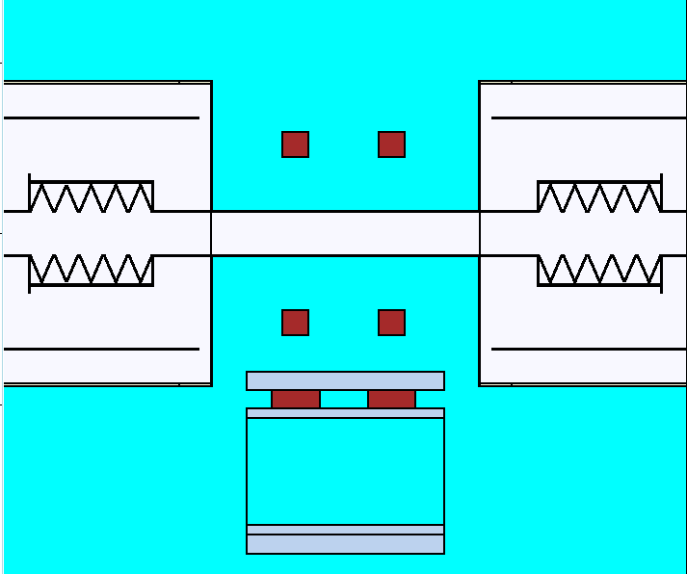
III. Beam Loss Monitoring
Beam loss monitors positioning
?
?
?
?

Slide 24
III. Beam Loss Monitoring
Plans:
Research on the front end, warm part to inspect BLM needs
Fully automated accelerator model generation using BLED data
Investigation on influence of x-rays from cavities on the detectors performance

Slide 25
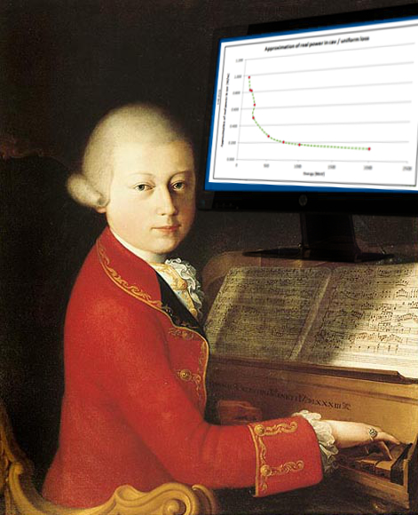
Thank you for attention

