Slide 1
A Time-Multiplexed Track-Trigger architecture for CMS
G Hall, M Pesaresi, A Rose
Imperial College London
D Newbold
University of Bristol
Thanks also to the many who have helped make these ideas a reality, especially Greg Iles, John Jones,…

Slide 2
Outline
The problem to be solved
Introduction to TMT
Status of CMS calorimeter TMT
Application to CMS Track-Trigger
Demonstrator system and readiness
Possible algorithm implementation
Open issues

Slide 3
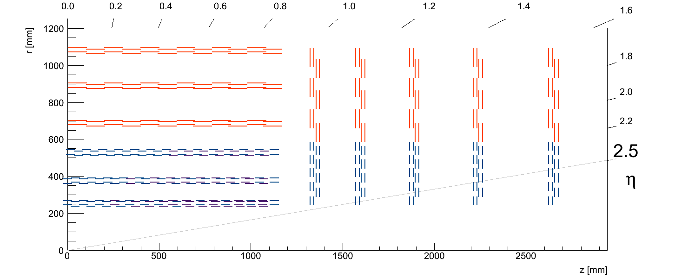
CMS Phase II Outer Tracker design
~15000 modules transmitting
  p_{T}-stubs to L1 trigger @ 40 MHz
  full hit data to HLT @ 0.5-1 MHz
~7100 PS-modules
(D Ceresa talk)
~8400 2S-modules
(D Braga talk)

Slide 4
What Is A Time Multiplexed Trigger?
Multiple sources send to single destination for complete event processing
  as used, eg, in CMS High Level Trigger
Requires two layers with passive switching network between them
  can be “simple” optical fibre network
  could involve data processing at both layers
  could also be data organisation and formatting at Layer 1, followed by data transmission to Layer 2, with event processing at Layer 2
  illustration on next slide

Slide 5
Time-multiplexing
1
5
1
5
1
5
1
5
All data for 1bx from all regions in a single card!
Everything you need!
6
6
6
6
1
2
2
2
2
7
7
7
7
3
3
3
3
4
4
4
4
1
5
1
5
1
5
1
5
All data for 1bx from all regions in a single card!
Everything you need!
6
2
2
6
6
6
2
2
2
7
3
7
3
7
7
3
3
4
4
4
4
1
5
1
5
1
5
1
5
6
6
All data for 1bx from all regions in a single card!
Everything you need!
2
2
6
6
2
2
7
7
3
3
7
7
3
3
4
4
4
4
1
5
1
5
1
1
5
5
6
6
6
6
2
2
2
2
7
7
7
7
3
3
3
3
4
4
4
4
BX:6
BX:1
BX:2
BX:3
BX:4
BX:5
BX:7
5

Slide 6
What are advantages of TMT?
“All” the data arrive at a single place for processing
  in ideal case avoids boundaries and sharing between processors
  however, does not preclude sub-division of detector into regions
    which may be essential for a large data source like a tracker
Architecture is naturally matched to FPGA processing
  parallel streams with pipelined steps at data link speed
Single type of processor, possibly for both layers
  L1= PP: Pre-Processor L2 = MP: Main Processor
One or two nodes can validate an entire trigger
  spare nodes can be used for redundancy, or algorithm development
Many conventional algorithms explode in a large FPGA
  timing constraints or routing congestion for 2D algorithms
Synchronisation is required only in a single node
  not across entire trigger

Slide 7
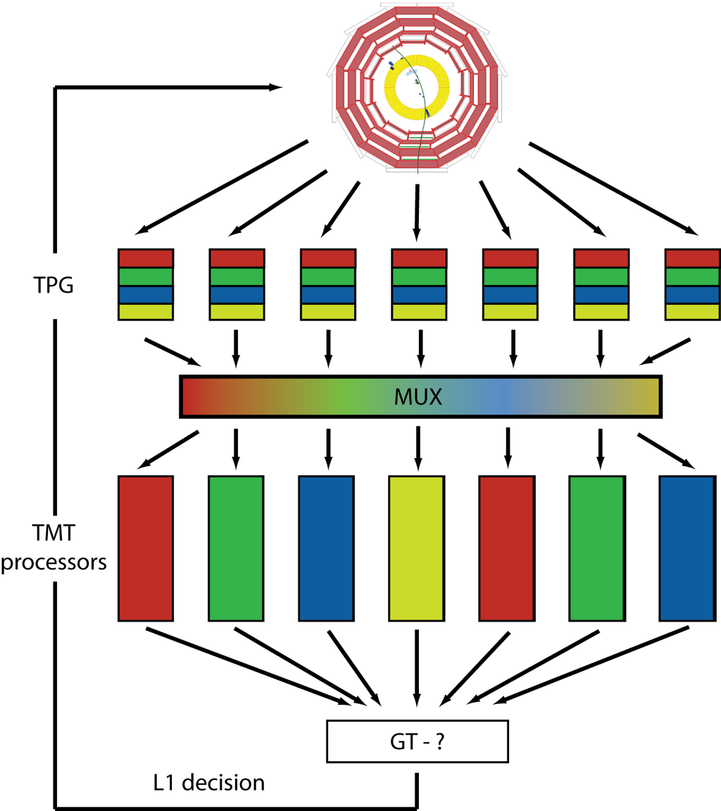
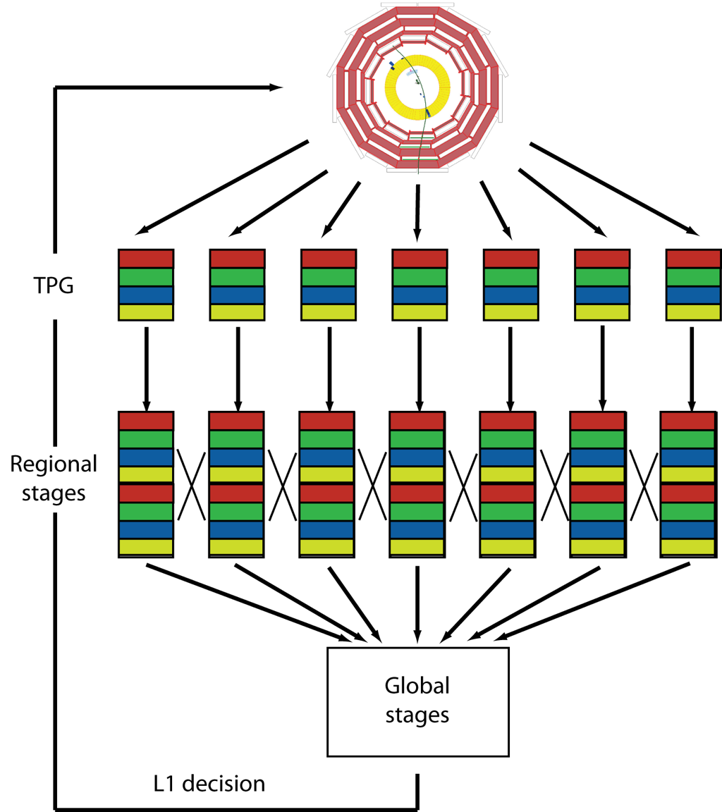
Conventional versus TM Trigger Architecture
Options:
CT
TMT

Slide 8
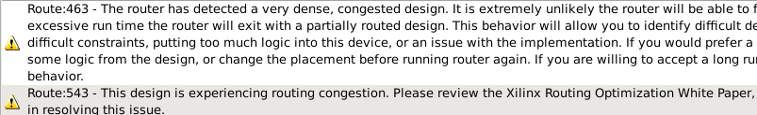
A simple example of Routing Congestion: 1
(G Iles) Created simple design to find routing limit
  30x36 2x2 tower clusters (“electrons”) with 10bit energy
  432 Gb/s (without 8B/10B)
    Approximately ¾ of CMS
  Sum 16 clusters to create “pseudojets”
  No other firmware (e.g. no sort, no transceivers, no DAQ, etc)
  XC7VX485T – Place & Route fails even though LUT usage only at 29%
Bare minimum “physics” algorithm
but number of LUTs is not the whole story…
A bigger FPGA may not solve all the problems…

Slide 9
Routing Congestion 2 : A nasty example..
……
(G Iles) Implemented a proposed circular isolation algorithm
  using pipelined design
Searches every tower location in 56 x 72 region
  4032 sites
Counts the number of objects above threshold within a circular ring of diameter 9 towers or clusters
  Result passed into LUT with the energy to determine object status
φ
72 towers
η
56 towers
……
Operates up to 400MHz
Compact: < 1% of the FPGA
Low latency - 9 clks (no overlap)
1.5 BX @ 240 MHz
* Only synthesised 36 towers in eta, rather than 56, but in the small FPGA

Slide 10
Why was Time Multiplexed Trigger not already used?
Mainly technology limitations
  It is reliant on high performance hardware
    large & powerful FPGAs
    many high speed (optical) links
More recent objections to latency penalty in L1-L2 transmission
  but this is mostly a myth!
  If properly organised, data processing does not need to wait for entire event data.
  It can begin as soon as first cycle’s worth of data arrive

Slide 11
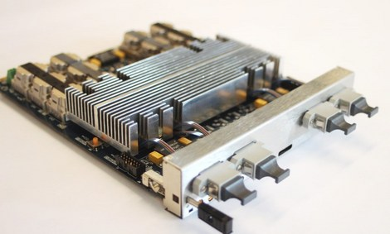
Today’s hardware
MP7 (Virtex-7 XC7VX690T)
future generations will improve, but don’t yet know precisely how
purpose-built µTCA card for CMS upgraded L1 calorimeter trigger
TM performance & calo algorithms demonstrated in recent integration tests
- 72 input/72 output optical links
-all links operate at 12.5 Gbps
(10 Gbps in CMS)
- total bandwidth > 0.9 Tbps
tested, currently in production

Slide 12
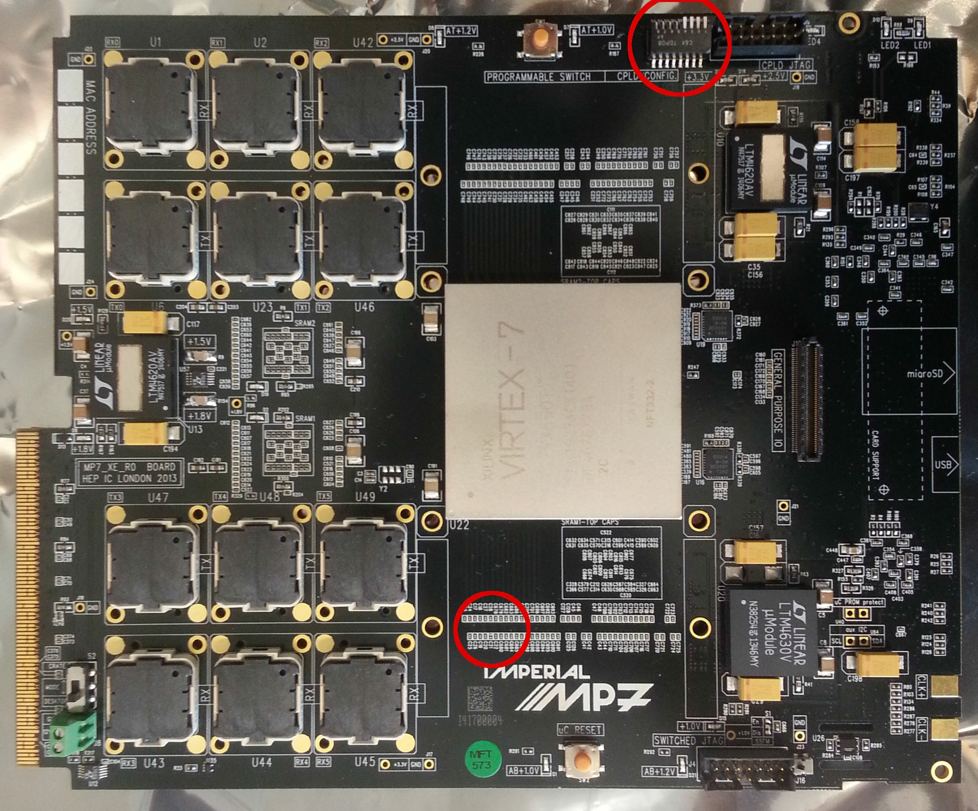
MP7-XE
First card of production order

Slide 13
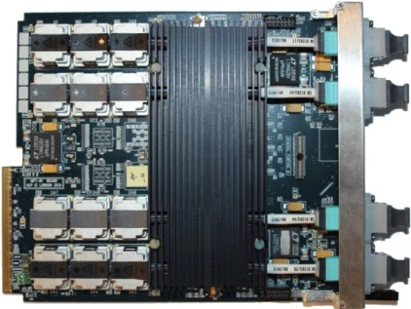
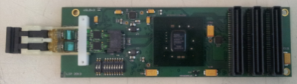

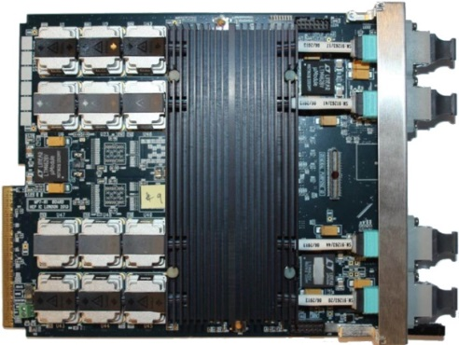
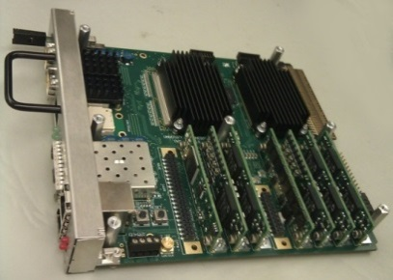

CMS Calo TMT demonstrator (Sep 2013)
MP7 used as PP & MP
TPG input to PP not part of test
Test set-up @ 904
PP-B
Simulating half of the PP cards with a single MP7
oSLB
uHTR
MP
Demux
Simulating half of the PP cards with a single MP7
PP-T

Slide 14
Current status of TMT jet algorithms
Jets
  9×9 sum of trigger towers at every site
  Fully asymmetric jet veto calculation
  Local (“Donut”) or Global pile-up estimation
  Full overlap filtering
  Pile-up subtraction
  Pipelined sort of candidates in φ
  Accumulating pipelined sort of candidates in η
Ring sums
  Scalar and Vector (“Missing”) ET
  Scalar and Vector (“Missing”) HT
P
P
P
P
P
P
P
P
P
P
P
P
P
P
P
P
P
P
P
<
<
<
<
<
<
<
<
<
P
P
≤
<
<
<
<
<
<
<
<
P
P
≤
≤
<
<
<
<
<
<
<
P
P
≤
≤
≤
<
<
<
<
<
<
P
P
≤
≤
≤
≤
C
<
<
<
<
P
P
≤
≤
≤
≤
≤
≤
<
<
<
P
P
≤
≤
≤
≤
≤
≤
≤
<
<
P
P
≤
≤
≤
≤
≤
≤
≤
≤
<
P
P
≤
≤
≤
≤
≤
≤
≤
≤
≤
P
P
P
P
P
P
P
P
P
P
P
P
P
P
P
P
P
P
P
9×9 jet at tower-level resolution
50% LUT utilization INCLUDING links , buffers, control, DAQ, etc.
Runs at 240 MHz

Slide 15
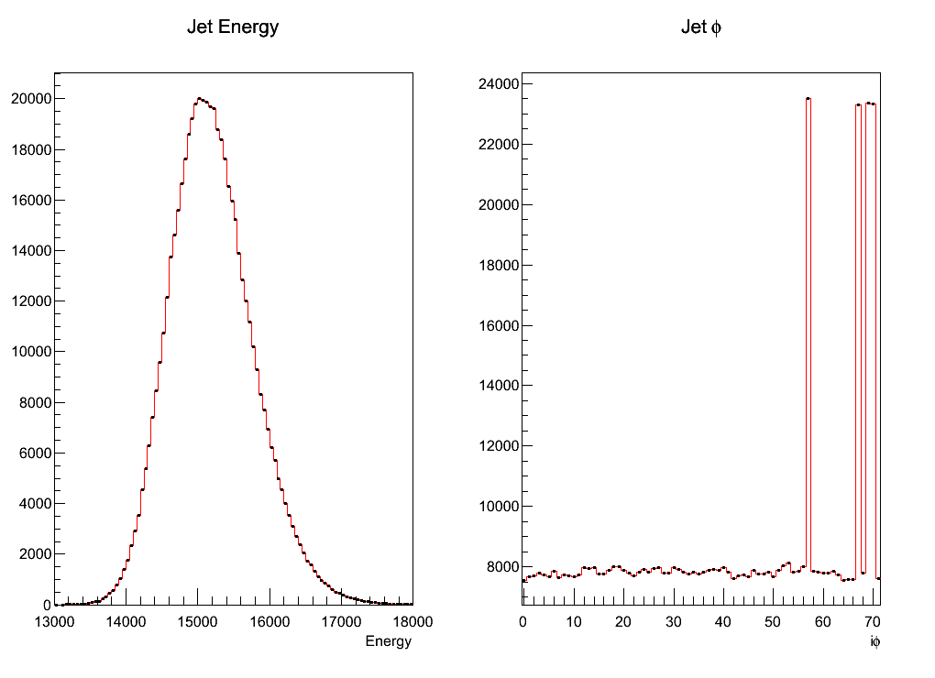
Results (from September test)
Random data passed through an emulator was used in the testing of the algorithms
Circle jet algorithm (8x8)
Data injected into PP
Time-multiplexed
Optical Fibre
Sort
Capture
Compared emulated results (solid line) with those from the MP7 (markers)
C++ emulator and hardware match precisely

Slide 16
Results – Latency Measurement
36

Slide 17
Possible layout of CMS TM Track-Trigger

Slide 18
model elements
two stages of trigger processor
Pre-Processor (or FED)
- GBT links as input
- formats event fragment for DAQ
- formats, orders and time-multiplexes trigger data
- possible first stage trigger processing
Main Processor
takes links from all PPs as input
event is assembled over TM period
algorithms process pipelined data
output is still to be defined
  tracks, processed data,…?
FE links
3.2Gbps per link
bidirectional DAQ links
10Gbps per link
PP/FED
TRG links
>10Gbps per link
MP
undefined
TRG links from PPs
>10Gbps per link

Slide 19
trigger regions
tracker has 15,508 modules => ~230 PP/FEDs
maximum number of input links to the MP7 = 72
limits the number of pre-processor cards to be connected
(without resorting to an intermediate stage and data compression)
assume 10 Gbps for conceptual design
define suitable trigger regions…
MP
output
TRG links from PPs
10Gbps per link

Slide 20
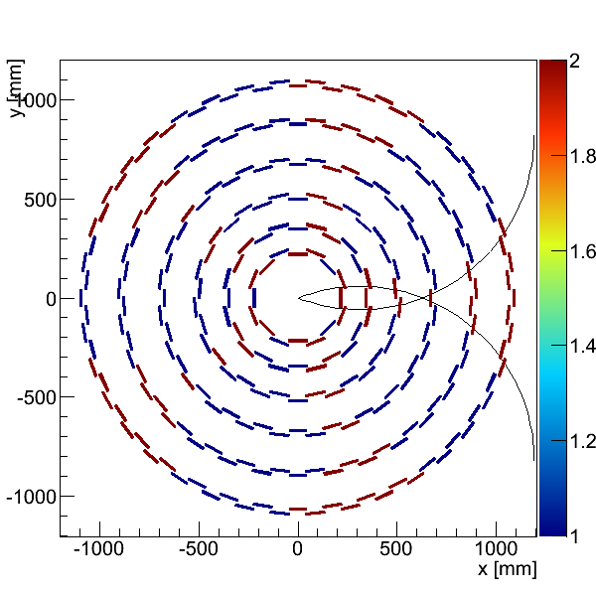
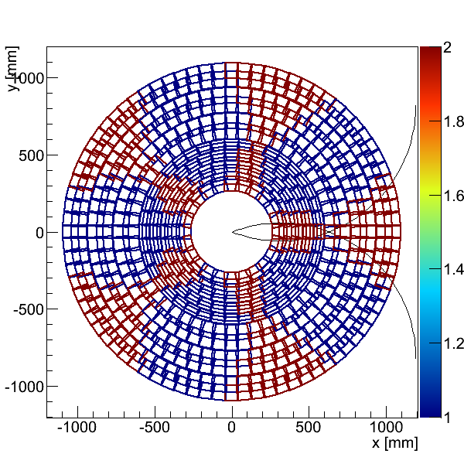
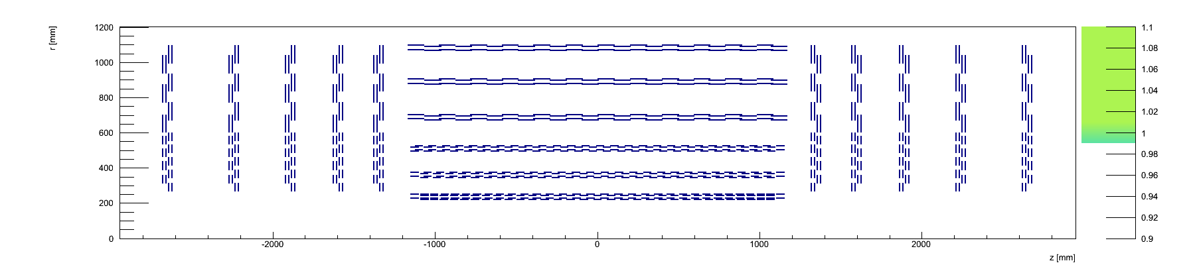
trigger regions
split tracker into phi regions
constrained problem by looking at minimum number of trigger regions (TRs) required, and imposed constraint that one module cannot be shared across more than two TRs
1 GeV/c
- 5 TRs in phi only
- 1 GeV/c boundary region assumed
- e.g. could allow for better reco @ 2GeV/c in case of e⁺/e⁻, brem, low p_{T}, multiple scattering etc.

Slide 21
time multiplex period
the time multiplex period is not a completely free parameter
small TM period | large TM period
full event must be quickly assembled into one MP | could allow more efficient processing of pipelined data into MP
reduces data volume per event from PP to MP (or requires increased number of links) | increases data volume per event from PP to MP (or reduces number of links)
reduces latency | increases latency
reduces number of MPs | increases number of MPs
min ~15bx (PP output bandwidth without more Trigger Regions) | max ~34bx (68 links/2 Trigger Regions)
preferred direction
TM period of 24BX chosen for case study (could be optimised in future)

Slide 22
PP/FEDs
from non-shared modules
68 FE links
3.2Gbps per link
4 bidirectional DAQ links
10Gbps per link
PP/FED
to one TR
24 TRG links
10Gbps per link
from shared (boundary) modules
68 FE links
3.2Gbps per link
4 bidirectional DAQ links
10Gbps per link
PP/FED
to two TRs -
24 TRG links to each
4 DAQ links per PP/FED allows a maximum bandwidth of 40Gbps (~588Mbps available per tracker module)
48 TRG links
10Gbps per link

Slide 23
MPs
24 links per PP/FED (1 to each TM node)
up to 72 PP/FEDs per Trigger Region
PP/FED
PP/FED
PP/FED
MP
PP/FEDs
MP
MP
24 MPs per Trigger Region
MP
MP
MP
MP
MP
MP
MP
MP
MP
MP
PP/FED
PP/FED
PP/FED
PP/FEDs
each TM node takes up to 72 links
(reads in data from up to 72 PP/FEDs)
24BX TM period allows a maximum fixed TRG bandwidth of 240Gbps per PP/FED
(well below MP7 capacity)
=> ~3.5Gbps per tracker module max equivalent

Slide 24
Organisation for 5 TRs in Phi & 24BX TM Period
# FE links
1865
1194
1930
1156
1944
1102
1954
1170
1865
1328
# PP/FEDs
28
18
29
17
29
17
29
18
28
20
# PP->MP links
672
696
696
696
672
432
432
408
408
408
408
432
432
480
480
# PP links/ MP
66
64
63
64
66
# PP->MP links total
1584
1536
1512
1536
1584
# TM nodes
24
24
24
24
24
(numbers from tkLayout…)
φ1
φ2
φ3
φ4
φ5

Slide 25
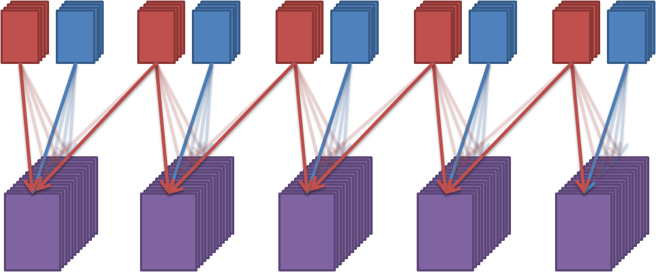
Summary
φ1
φ2
φ3
φ4
φ5
full tracker L1 and trigger data can be read out with a total of 353 MP7s
after 24BX, all trigger data from tracker from first event are assembled into 5 MPs
each MP corresponds to a trigger region in phi
But processing should have started earlier than BX 25
subsequent events are available in next set of 5 MPs after one extra BX
no boundary sharing is required after duplication in PP;
no post-TM removal of duplicates necessary
What processing is possible in MPs?
track-finding? track fitting? data processing before an AM stage?

Slide 26
Implementation of demonstrator
Only a fraction of the system is needed to fully demonstrate it
unlike many other architectures
The demonstrator is already available
but not yet used for this application

Slide 27
demonstrator
5 MP7s emulate event data from full tracker, one out of every 24BX
< 72 links out so 1 MP7 sufficient
# emulated PP/FEDs
46
46
46
47
48
# PP->MP links
46
18
46
17
46
17
47
18
48
20
# PP links/ MP
66
64
63
64
66
# PP->MP links total
66
64
63
64
66
# TM nodes
1
1
1
1
1
φ1
φ2
φ3
φ4
φ5

Slide 28
demonstrator
# emulated PP/FEDs
46
46
46
47
48
# PP->MP links
46
18
46
17
46
17
47
18
48
20
# PP links/ MP
66
64
63
64
66
# PP->MP links total
66
64
63
64
66
# TM nodes
1
1
1
1
1
φ1
φ2
φ3
φ4
<72 links in
so 1 MP7 sufficient
φ5
5 MP7s process event data from full tracker, one out of every 24BX

Slide 29
even simpler demonstrator
2 MP7s emulate event data from 1 out of 5 regions, one out of every 24BX
# emulated PP/FEDs
46
46
# PP->MP links
18
46
This demonstrator already exists
  just need to program source data to be ready to try algorithms
# PP links/ MP
64
# PP->MP links total
64
# TM nodes
1
φ1
φ2
φ3
φ4
φ5

Slide 30
Firmware design
Still to establish the best way of finding tracks at HL-LHC
  latency and efficiency, as well as (firmware) programming challenges
  we know from MP7 that large FPGAs present serious challenges, e.g.:
    exceeding RAM resources
    logic fails to synthesize within timing constraints after many hours
Possible approach based on Hough transform
  locate series of hits on a trajectory, for which y = mx + c
    For fixed (m,c): every “y” corresponds to single “x”
    For fixed (x,y): every “c” corresponds to single “m”
  point (m,c) -> line (x,y) point (x,y) -> line (m,c)
    All hits from a real track have same (m,c)
  For each data point (x,y), hypothesize “m” and calculate “c”
    When multiple hits have same (m,c), send for fitting
    identify by histogramming entries into array

Slide 31
Data
C(M₀)
Presort
Hist Cell
Hist Cell
Hist Cell
Hist Cell
Data
C(M₀)
Hist Cell
Hist Cell
Hist Cell
Hist Cell
Data
C(M₀)
Hist Cell
Hist Cell
Hist Cell
Hist Cell
Data
C(M₀)
Hist Cell
Hist Cell
Hist Cell
Hist Cell
Data
C(M₀)
Hist Cell
Hist Cell
Hist Cell
Hist Cell
Data
C(M₀)
Hist Cell
Hist Cell
Hist Cell
Hist Cell
Data
C(M₀)
Hist Cell
Hist Cell
Hist Cell
Hist Cell
Data
C(M₀)
Hist Cell
Hist Cell
Hist Cell
Hist Cell
Data
C(M₀)
Hist Cell
Hist Cell
Hist Cell
Hist Cell
Fully pipelined!
No iteration!
All data-transfers local!
Realistic for implementation in an FPGA
C
M

Slide 32
Histogramming local logic
In_{up}
Out_{up}
Hist Cell
No
Arbitration buffer
Signal matches
C(M_{N}) and M_{N}
for this cell?
Histogram
In_{left}
Yes
Out_{right}
Calculate C(M_{N+1})
No
In_{down}
Out_{down}
Logic is defined for efficiency in populating array
  Step through each M_{N} for each incoming data set
  Assign data to point in array
  Pass data values with sufficient entries in histogram location to track fitting step
Will high pile-up conditions generate too many matching combinations?

Slide 33
Next steps
The TMT is now a proven architecture in CMS
  will operate in the CMS calorimeter trigger from 2016
The hardware is very flexible and can be deployed for a TMTT
  only a fraction of the system is required to validate the concept
  installing and building should only require replicating identical nodes
    a tracker implementation would have locally specific algorithm parameters
The next challenge is to prove suitable algorithms can be implemented
  or that alternative approaches can be shown to be required

Slide 34
Backup

Slide 35
Latency when performing data reduction
Imagine jet clustering @ double tower spacing
Need to sort 1440 jets (40 in eta x 36 in phi)
CT: 1440 => 4
One large sort potentially spread over several cards
TMT: 36+4 => 4
40 small sorts executed sequentially
Only the last sort contributes to latency
Latency of TMT sort is less than CT sort

Slide 36
Routing congestion
FPGA internal interconnects are not unlimited
CT operates on areas of data
TMT operates on rows of data
2D design is really a 3D design when you consider sequence of tasks => Danger of routing congestion
1D design becomes 2D design when you add sequential tasks.

Slide 37
Synchronisation & Structure
Synchronization is only required per-time-node, not across the whole trigger
  De-synchronization of a node only affects that node.
  A timing glitch in a CT disrupts the whole trigger.
The efficient pipelined logic should lead to lower latency, and the eventual clock speed can be as fast as the FPGA allows.
Firmware build times should be significantly shorter due to the pipelined, as opposed to combinatorial, nature of the architecture.

