Slide 1
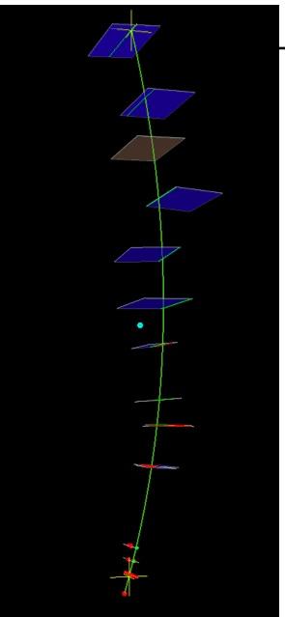
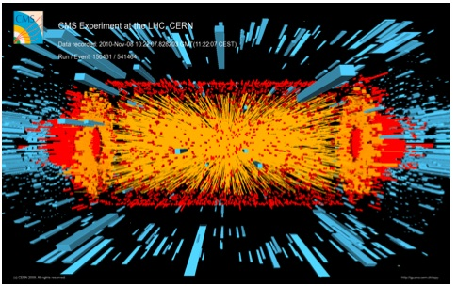
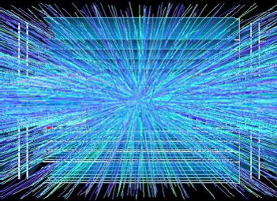
System Architecture and Vertical
Slice Demonstration for CMS L1
Silicon-based Tracking Trigger
Ted Liu (FNAL)
May 14, 2014
Workshop on Intelligent Tracker (WIT), Upenn

Slide 2
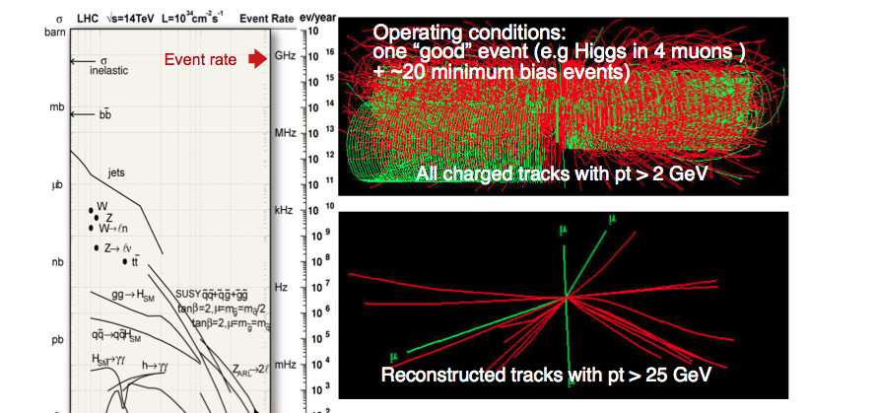
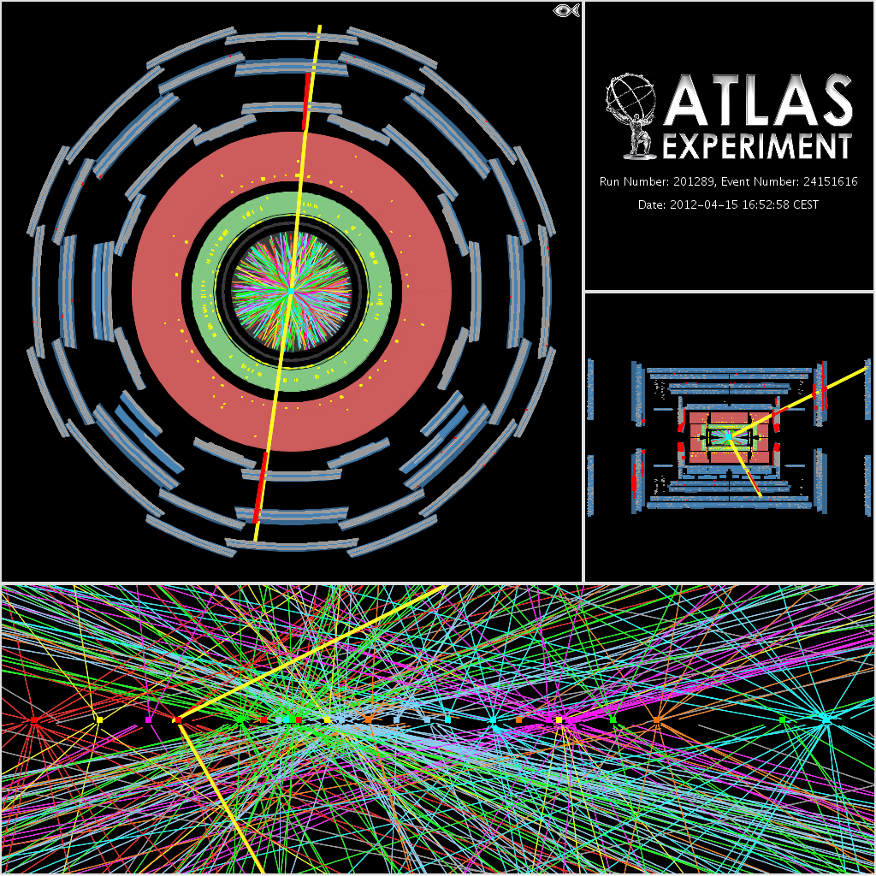
CMS L1 Tracking Trigger:
Will need to reconstruct charged particle trajectories “on-the-fly” for every beam crossing (25 ns, or 40 Million beam crossings per second), from an ocean of input data (bandwidth required to transfer up to ~ 50-100Tb/s)
This requires extremely
fast high bandwidth data communication as well as massive pattern recognition power,
with lots known patterns to be compared against the multiple input data streams simultaneously with near zero latency (~ few μs)
This is challenging!
Pileup at HL-HC: > ~ 140 (only 20 shown here)

Slide 3
High Performance Computing
→ from US “Report to the President and Congress” by President’s
Council of Advisors on Science and Technology, Dec. 2010 (page 65)
Compute-intensive
  massively parallel computation involving very large number of processing elements;
Communication-intensive
  high-speed transfer of data among processing elements;
Data-intensive
  high-speed manipulation of very large quantities of data
HL-LHC L1 Tracking Trigger is High Performance Computing
(Non-von Neumann approach)
but with very Low Latency and in Real Time
HL-LHC requires the most advanced Real Time processing technology

Slide 4
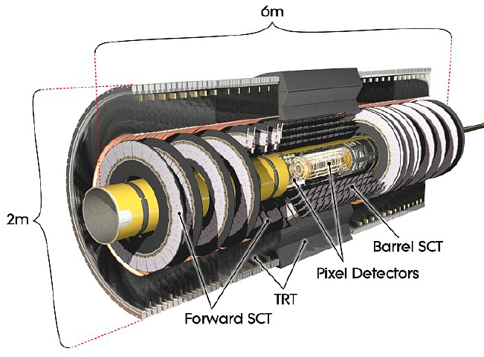
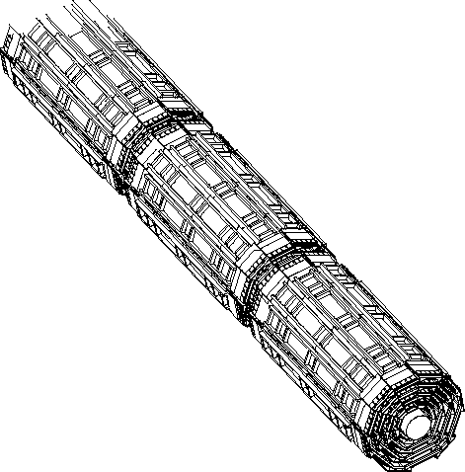
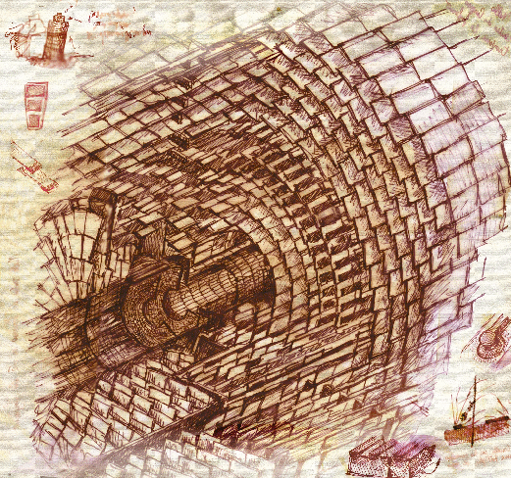
Detector design for triggering
Silicon Based Tracking Trigger at Hadron Colliders
CDF SVXII
Partition detector into
trigger towers/sectors
Beam spot
Pick your favorite method:
Associative Memory (AM) Approach
Hough Transformation
tracklet-based
Adaptive Pattern Recognition
Biology Inspired …
your choice here…
Data transfer
Data formatting
Pattern Recognition
Finer pattern recognition
Track
Fitting
FPGA vs GPU vs CPU
Will use Associative Memory approach
as an example in this talk
HLT

Slide 5
The AM approach
Pattern Recognition Associative Memory
  Based on CAM cells to match and majority logic to associate hits in different detector layers to a set of pre-determined hit patterns (simple working unit, yet massively parallel)
  Pattern Recognition finishes right after all hits arrive (fast data delivery important)
  Potentially good approach for L1 application (require custom ASIC)
  A PR engine naturally handles a given region: divide & conquer
Road!
CAMs
Layer 1
Address 4
Layer 1
Address 4
Match
Match
Match
Match
Match
Match
Match
Match
Match
Match
Match
Match
Match
Match
Match
Match
Match
Layer 2
Address 1
Layer 2
Address 1
Layer 2
Address 4
Layer 2
Address 4
Match
Match
Match
Match
Match
Match
Match
Match
Match
Match
Match
Match
Match
Match
Match
Match
Match
Match
Match
Match
Layer 3
Address 7
Layer 3
Address 7
Layer 3
Address 9
Layer 3
Address 9
Match
Match
Match
Match
Match
Match
Match
Match
Match
Match
Match
Match
Match
Match
Match
Match
Match
Match
Match
Match
Match
Match
Match
Match
Match
Match
Match
Match
Match
Match
Match
Match
Match
Match
Match
Match
Layer 4
Address 4
Layer 4
Address 4
Match
Match
Match
Match
Match
Match
Match
Match
Match
Match
Match
Match
Match
Match
Match
Linearized track fitting can follow each road found (FPGA implementation)

Slide 6
PRAM+TF/FPGA
The PRAM stage:
  Massive parallel processing to tackle the intrinsically complex
  combinatorics of track finding algorithms, avoiding the typical power
  law dependance of execution time on occupancy
  and solving the pattern recognition in times roughly proportional to the number of hits, making the downstream task much easier
  Usually requires custom ASIC
The Track Fitting stage (FPGA) after AM:
  Finer pattern recognition
  Examples: linearized track fitting, Hough transform, Retina … etc
  The more powerful the AM stage, the less demand on TF/FPGA
  The more powerful the TF/FPGA, the less demand on AM
Some proposed algorithms do not have the AM stage
  Example: Track-let based track finding + linearized track fitting (see next talk by Jorge)

Slide 7
Comparison of the two approaches being currently explored at CMS
AM + TF approach
Tracklet +TF approach
Proven approach for
silicon based track finding
AM pattern recognition
algorithm: simple, fast and
flexible
Can combine with different
track fitting algorithms
New approach for hardware
silicon based track finding
Software simulation promising
Can be implemented in FPGA
in principle: no need for
custom designed chips
advantages
Requires custom ASIC:
high performance AMchip
Track Fitting speed in FPGA
to be demonstrated for L1
New architecture (see below)
It is new
Feasibility to be demonstrated
in hardware (FPGA)
New architecture
challenges
Common: Fast Data delivery/sharing to Pattern Recognition Engines
The rest of the talk …

Slide 8
Detector design for triggering
Silicon Based Tracking Trigger at Hadron Colliders
CDF SVXII
Partition detector into
trigger towers/sectors
Beam spot
Pick your favorite method:
Associative Memory (AM) Approach
Hough Transformation
tracklet-based
Adaptive Pattern Recognition
Biology Inspired …
your choice here…
Data transfer
Data formatting
In this talk (focus on off-detector)
(1) Pattern Recognition + Track Fitting options
-- AM + linearized track fitting (FPGA): traditional
-- AM + Hough transform (FPGA): new, being studied
-- Tracklet-base approach (FPGA): new, being studied
(2) Data Formatting and System Architecture:
-- FPGA based Full-mesh enabled ATCA approach (Pulsar 2)
-- MicroTCA based (MP7): developed for CMS L1 CAL trigger upgrade (Geoff’s talk)
(3) Summary (Vertical Slice Demonstration)
Pattern Recognition
Finer pattern recognition
Track
Fitting
FPGA vs GPU vs CPU
HLT

Slide 9
Detector design for triggering
Silicon Based Tracking Trigger at Hadron Colliders
CDF SVXII
Partition detector into
trigger towers/sectors
Beam spot
Pick your favorite method:
Associative Memory (AM) Approach
Hough Transformation
tracklet-based
Adaptive Pattern Recognition
Biology Inspired …
your choice here…
Data transfer
Data formatting
Pattern Recognition
Finer pattern recognition
Track
Fitting
Need massive parallelism: to process in parallel
different regions of the detector for
the same beam crossing (regional multiplexing, L1&L2),
and different crossings (time multiplexing, L1).
Requires high bandwidth, low latency, and flexible real time communication
HLT

Slide 10
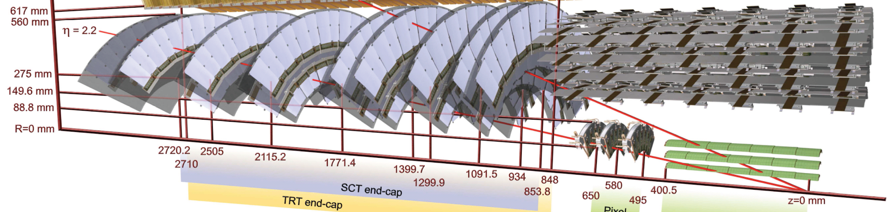
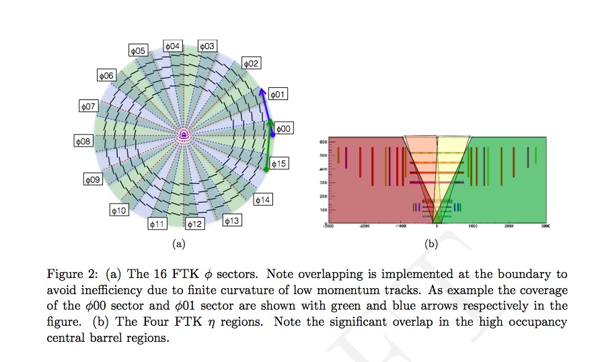
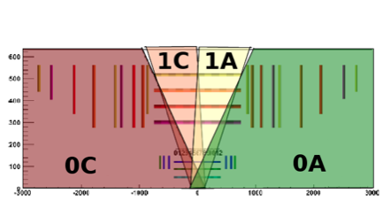
First take a look at: Data formatting challenges for Atlas FTK at L2
Input data from all silicon detector modules has to
be formatted into 64 η-φ trigger towers after
reformatting and sharing, ready for downstream
pattern recognition
4 in η

Slide 11
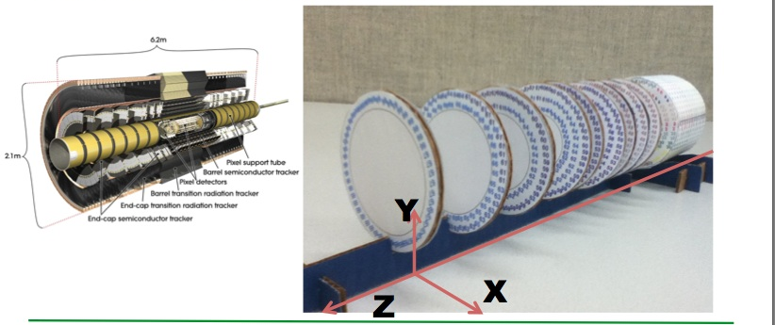
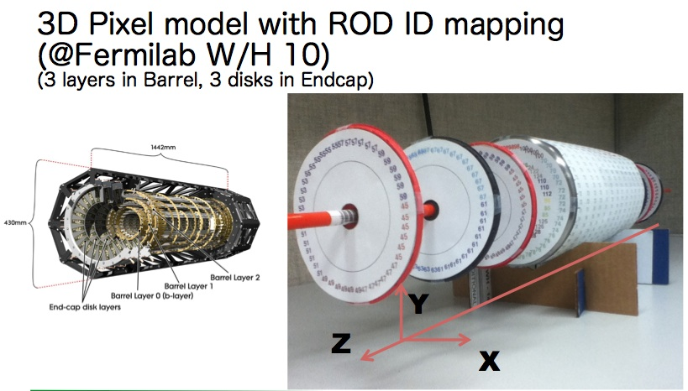
FTK Data Formatting Challenges
3D paper models at Fermilab with detailed ROD ID mapping, to
help us understand the issues
By Yasu Okumura

Slide 12
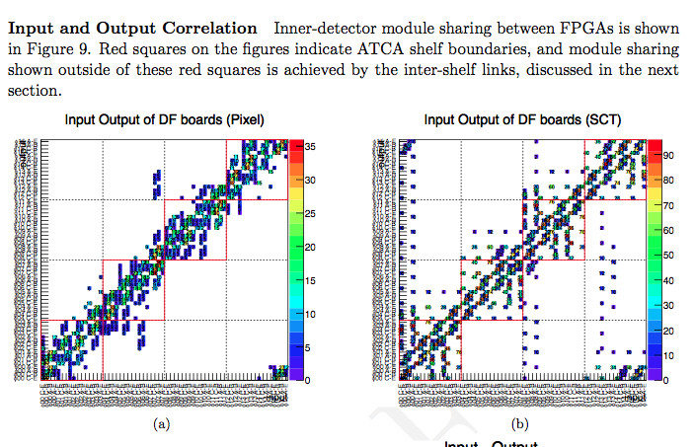
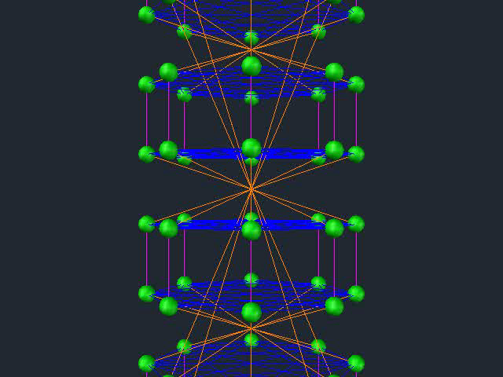
Atlas FTK 64 Trigger Towers (TT) data sharing needs
64 TT
64 TT
Detailed beam data analysis using exact module/ROD cable mapping to trigger towers
From “Data Formatter Design Specification”, Fermilab-TM-2553-E-PPD.

Slide 13
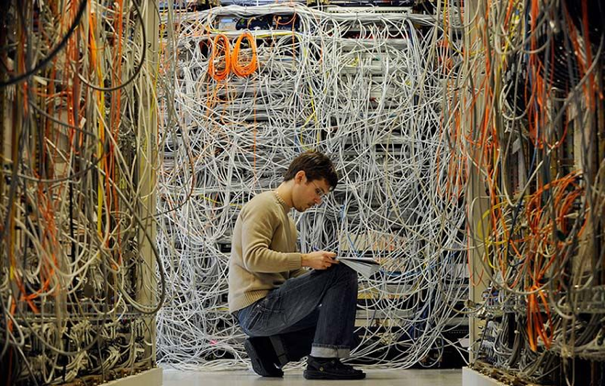
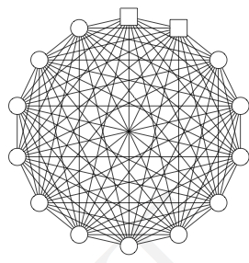
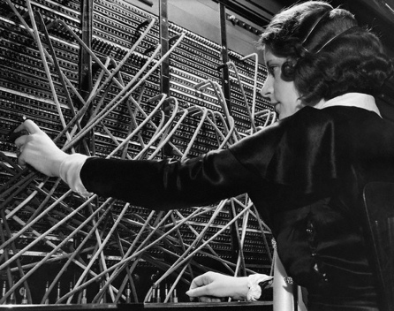
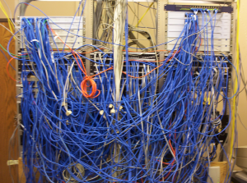
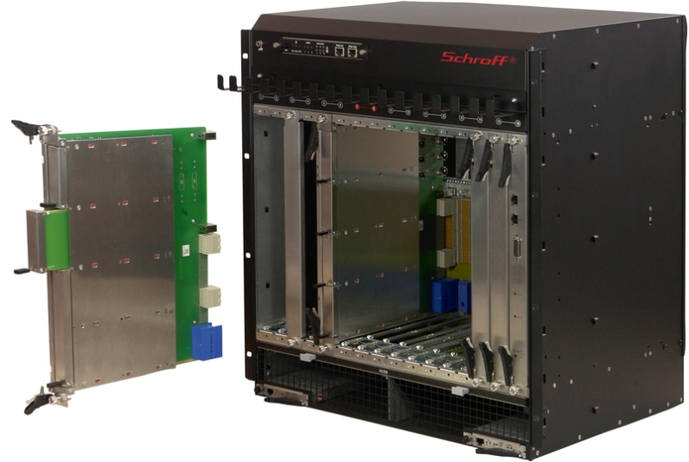
Data sharing/switching techniques
Traditional data sharing
Data sharing with ATCA
  high speed full-mesh backplane
  ~ 40 Gbps point to point
Advanced
Telecommunication
Computing
Architecture

Slide 14
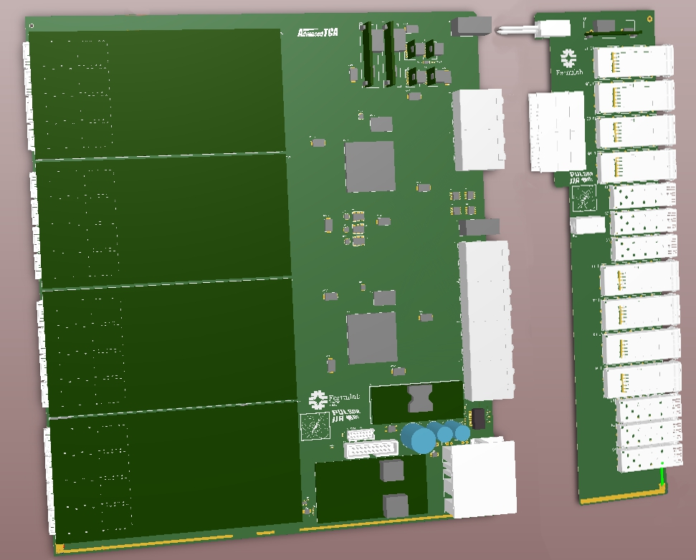
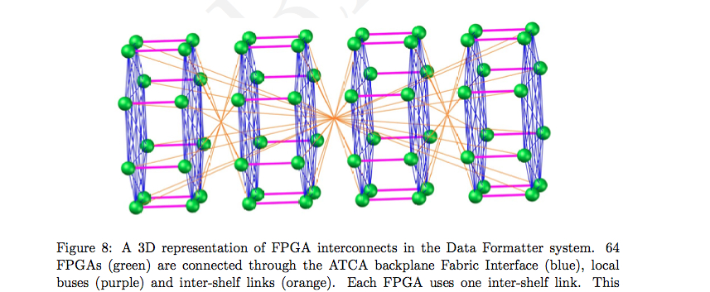
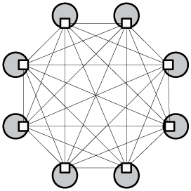
Fermilab (2011)
Data Formatter
Concept:
ATCA-based
How to use ATCA backplane for data sharing
(1 FPGA per trigger tower, 2 trigger towers per board,
32 boards needed over 4 ATCA shelves)
ATCA
Full-mesh
backplane
Only data sharing links shown, not inputs/outputs

Slide 15
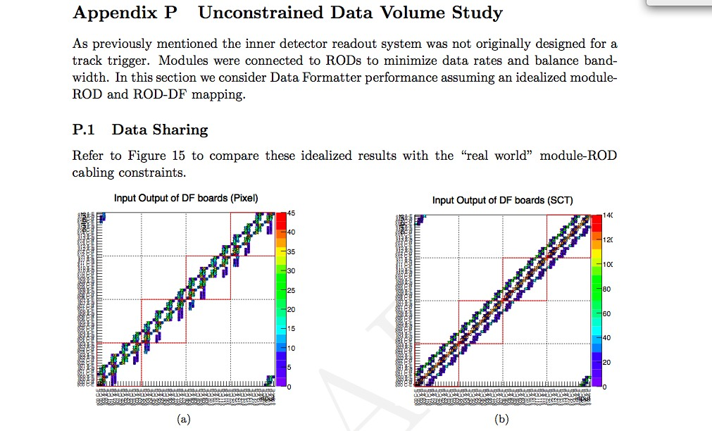
The band would be much cleaner without ROD constraints:
The cabling was done to optimize for DAQ readout, not trigger
From “Data Formatter Design Specification”, Fermilab-TM-2553-E-PPD, page 78.
Available at: http://www-ppd.fnal.gov/EEDOffice-w/Projects/ATCA/
(Pulsar IIa design spec)

Slide 16
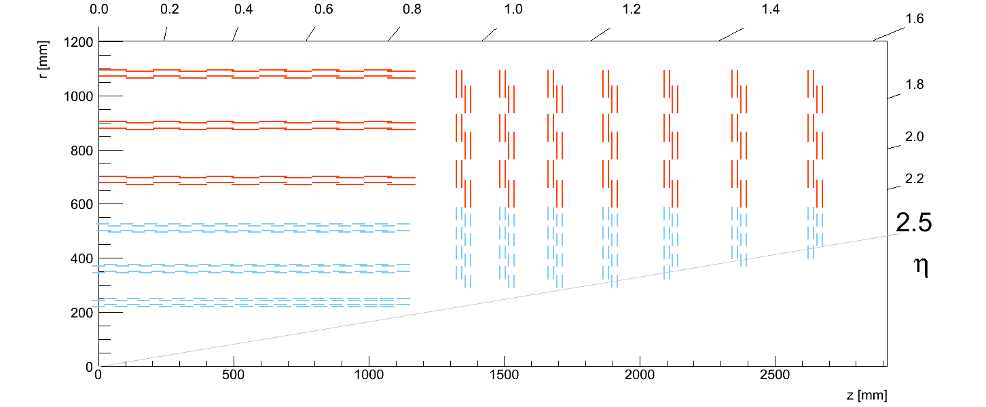
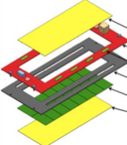
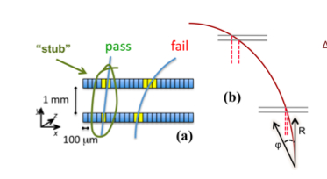
CMS: Module design vs Tracker design vs Trigger processing
Module Design Tracker Design Track Finding
Pt stub finding reduce the data volume by ~ 10-20,
making it possible to transfer the data out for off-detector L1 track finding
~15K modules involved
Back-end
Off-detector
Track Finding
stubs
CMS new tracker design
Working assumptions:
~15K fibers to trigger,
3.2Gbps payload each,
~ 50 Tbps input bandwidth
Block synchronous data
transfer scheme …
See Davide’s talks earlier

Slide 17
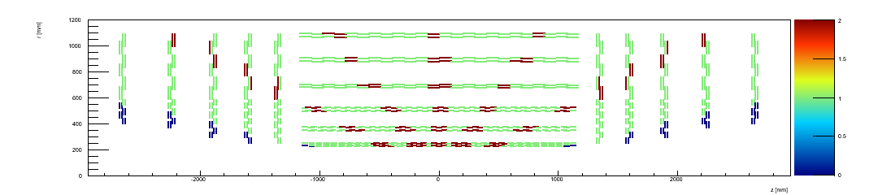
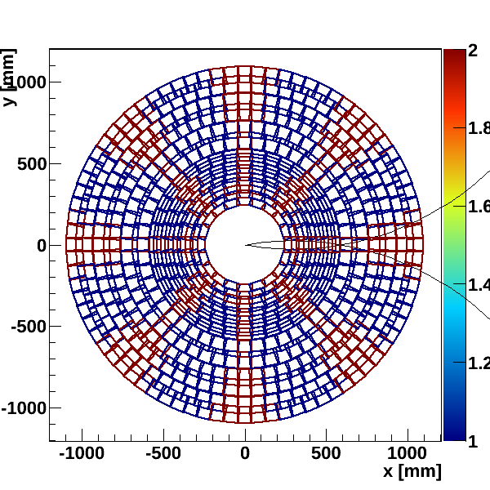
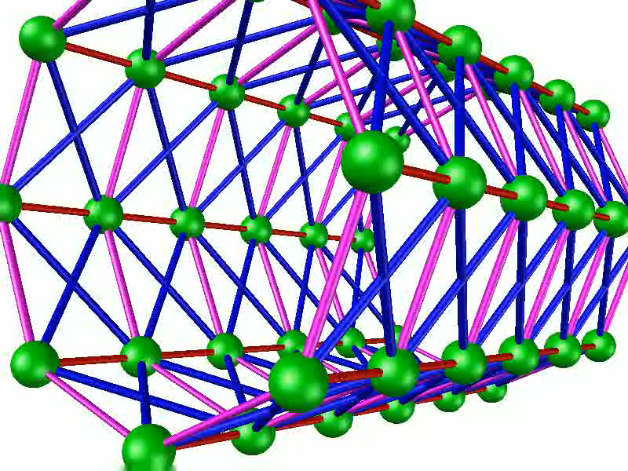
CMS Tracker Layout and Trigger Tower (6 in eta x 8 in phi)
15K modules
What we learned from FTK data formatting helps to understand CMS L1 case

Slide 18
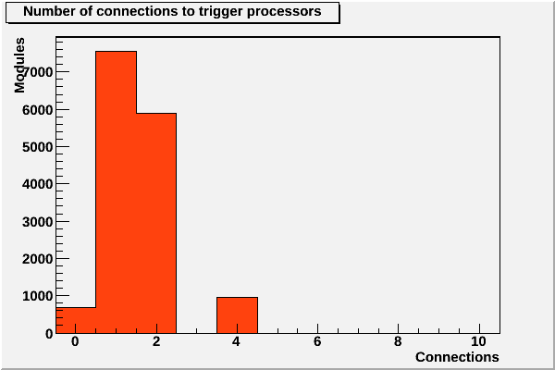
CMS Tracker Layout and Trigger Tower (6 in eta x 8 in phi)
15K modules/fibers
What we learned from FTK data formatting helps to understand CMS L1 case
For a given stub (on a module),
how many trigger towers
need it.

Slide 19
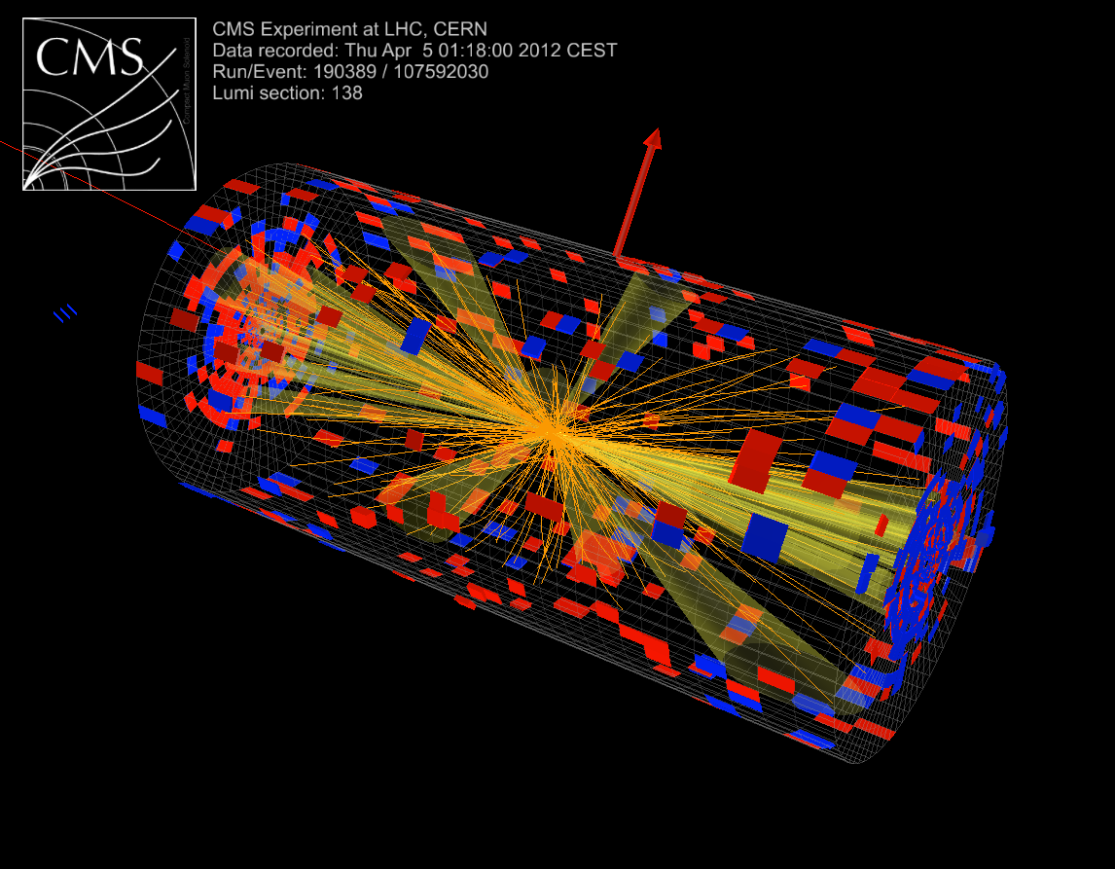
CMS L1 tracking trigger for Phase II:
6 (in eta) x8 (in phi) = 48 Trigger towers &
their interconnections
Data coming from a given trigger
tower may need to be delivered
to multiple trigger towers.
This happens,
when a stub comes from a detector
element is close to the border
Between trigger towers, due to the
finite curvature of charged particles
in the magnetic field and finite size
of the beam luminous region
along the beam axis.

Slide 20
Comparison: ATLAS L2 FTK and CMS L1 Track Trigger
Tracker/cabling
not designed for
Tracking Trigger
Tracker/Cabling
designed for
Tracking Trigger
4 η x 16 φ = 64 trigger towers
6 η x 8 φ = 48 trigger towers
This leads to new Architecture….

Slide 21
General considerations for the tower processor Platform
for silicon based tracking trigger system
The tower processor platform must support large numbers of fiber
transceivers, used for receiving input links and data sharing
A flexible, high bandwidth backplane is desirable to quickly transfer
data between boards
The boards should be large enough to support pattern recognition engines and fiber connections, in a comfortable way
A Full Mesh, 14 slot ATCA shelf is a natural fit as the platform with
12 slots available for processor or payload blades
This applies to both Atlas FTK and CMS L1 TT,
but architecturally they are very different:
Atlas FTK: full-mesh used for data sharing
CMS L1 TT: full-mesh mostly used for
time-multiplexing
14 slot full mesh
ATCA backplane:

Slide 22
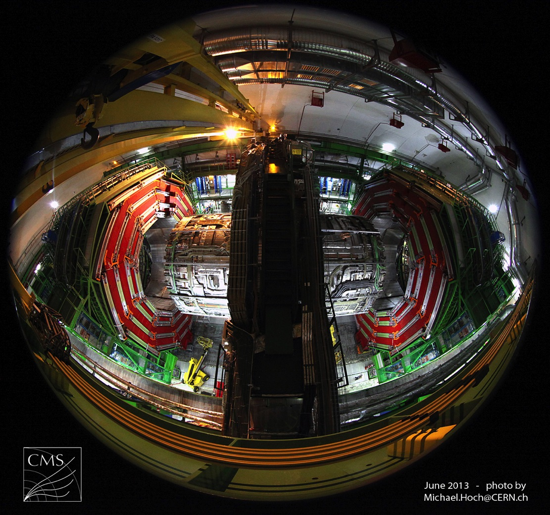
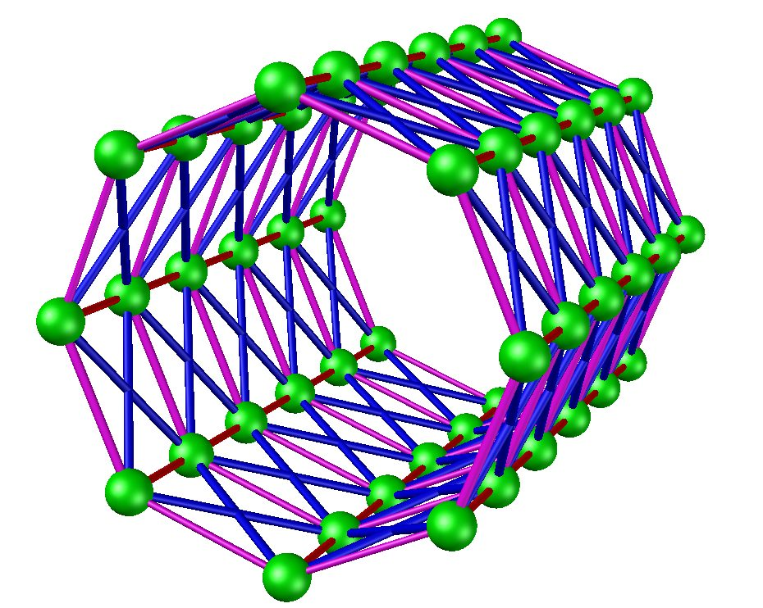
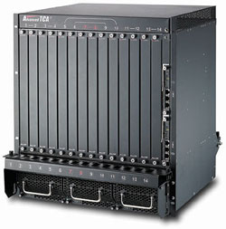
CMS
Tracking Trigger Towers
For simplicity, let’s assume one crate is assigned to one trigger tower
ATCA

Slide 23
Simple
Trigger Tower
Interconnections.
Each box represents
a trigger tower.
φ
η

Slide 24
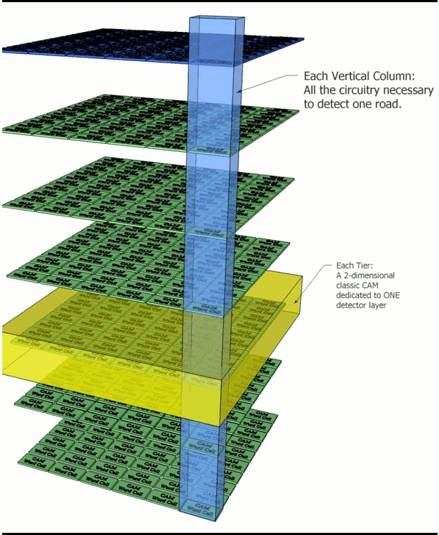
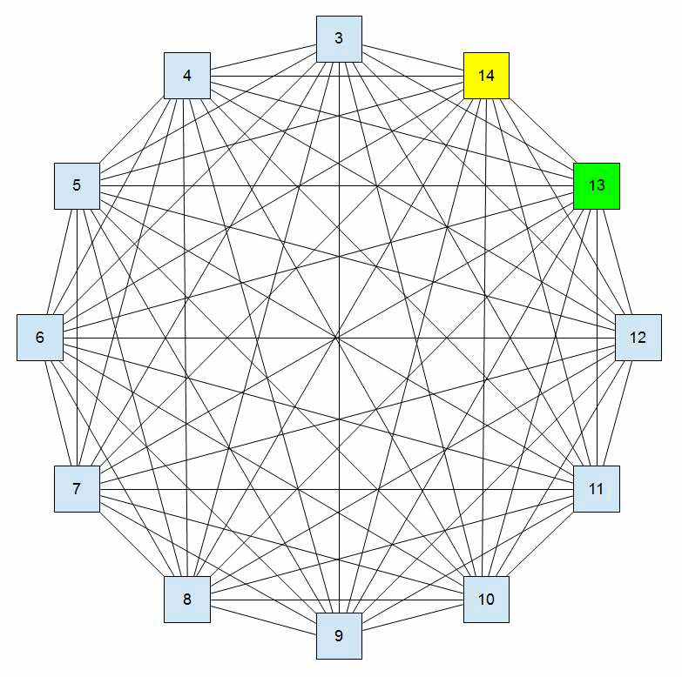
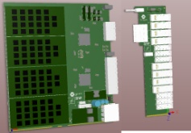
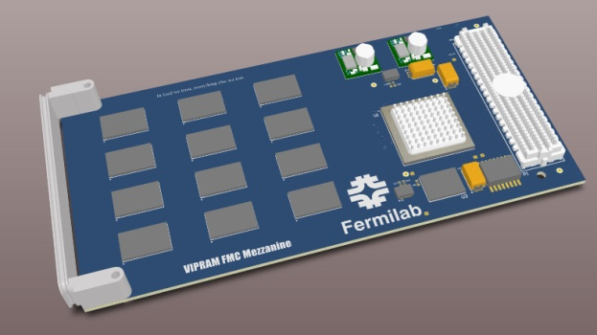
CMS
Tracking Trigger Towers
AM or other track finding approaches implemented on mezzanine (PR engine)
ATCA

Slide 25
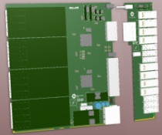
Commericial HUB boards
One simple configuration
as an example
4 Pattern
Recognition
Boards
ATCA
Full-Mesh
Backplane
8 Data
Input
Boards
What’s inside
one trigger
tower/crate
Fibers from upstream
40Gbps

Slide 26
Commericial HUB boards
One simple configuration
as an example
4 Pattern
Recognition
Boards (PRB)
8 Data
Input
Boards
Fibers from upstream

Slide 27
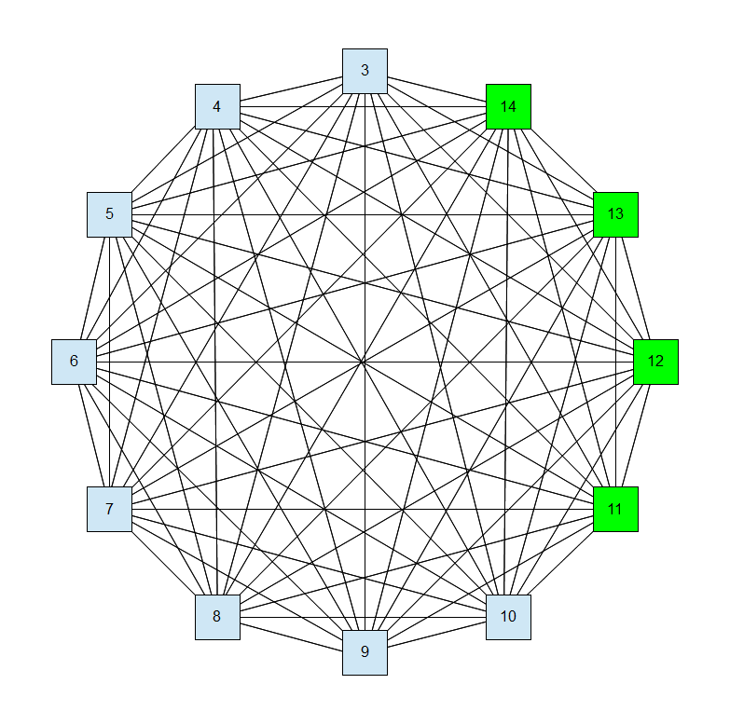
Commericial HUB boards
One simple configuration
as an example
4 Pattern
Recognition
Boards
8 Data
Input
boards
Fibers from upstream

Slide 28
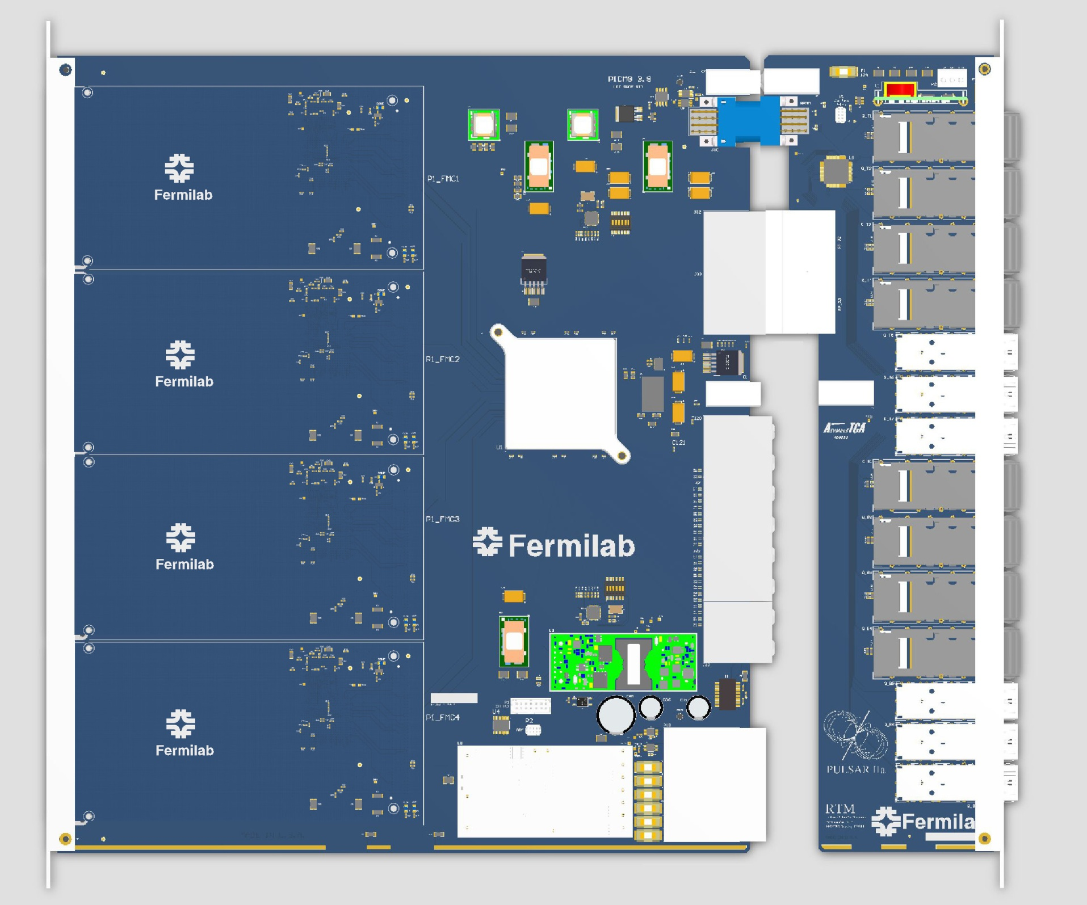
Data Input board Close-up
RTM:
Fibers
from upstream
(FPGA)
Fabric backplane

Slide 29
Pattern Recognition Board (PRB) data flow
Neighbor
data sharing
to/from
another
Trgger Tower
AM based

Slide 30
More advanced configuration
Ten Processors and the Gateway send the event to the target Processor Blade in a round robin scheme.
To/from eight neighbor
towers
Each processor receives
data directly from upstream
on RTM,
and then take turn to handle
different event for each trigger
tower
The full mesh based architecture is highly flexible.
Many performance and bandwidth bottlenecks can be solved/avoided/relaxed simply by better configurations.
This also makes an early technical demonstration feasible using today’s technology.
The flexible architecture is a good platform for a vertical slice demonstration and beyond.
Note: animated GIF, view as slideshow in PowerPoint

Slide 31

Pattern recognition mezzanine concept
L6
L5
L4
L3
L2
L1
Associative Memory chip
AM2
AM1
in coming
data
Group the patterns and configure the
AM Chips in such a way that
only relevant stubs/hits sent to the
relevant AMchip.

Slide 32
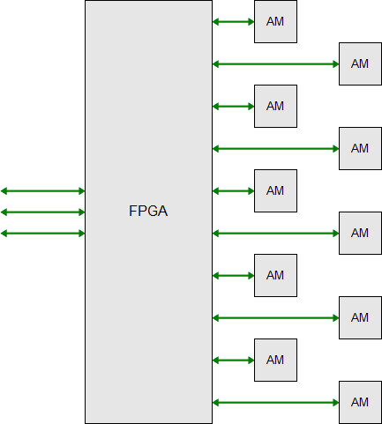
Pattern Recognition Mezzanine (PRM)
Relaxed Performance Requirements (in the case of 10 PRBs with ~40 PRMs):
40MHz input handled by 40 PRM mezzanines in round robin, each handles
~1MHz event input rate
Event Processing >= 1MHz (out of 40MHz)
Input BW >= 16Gbps
In the case of AM approach:
~10 AM chips / PRM
~200k patterns / AMchip
~ 2M patterns / tower
(2M x 48 towers ~ 100M patterns)
System size shrinks with better
AMchip performance:
If 2X more AM pattern density,
or 2X higher AM speed,
2 x less system size
(48 crates → 24 crates)
The relaxed performance requirement would make
early technical demonstration easier for different
track finding approaches.

Slide 33
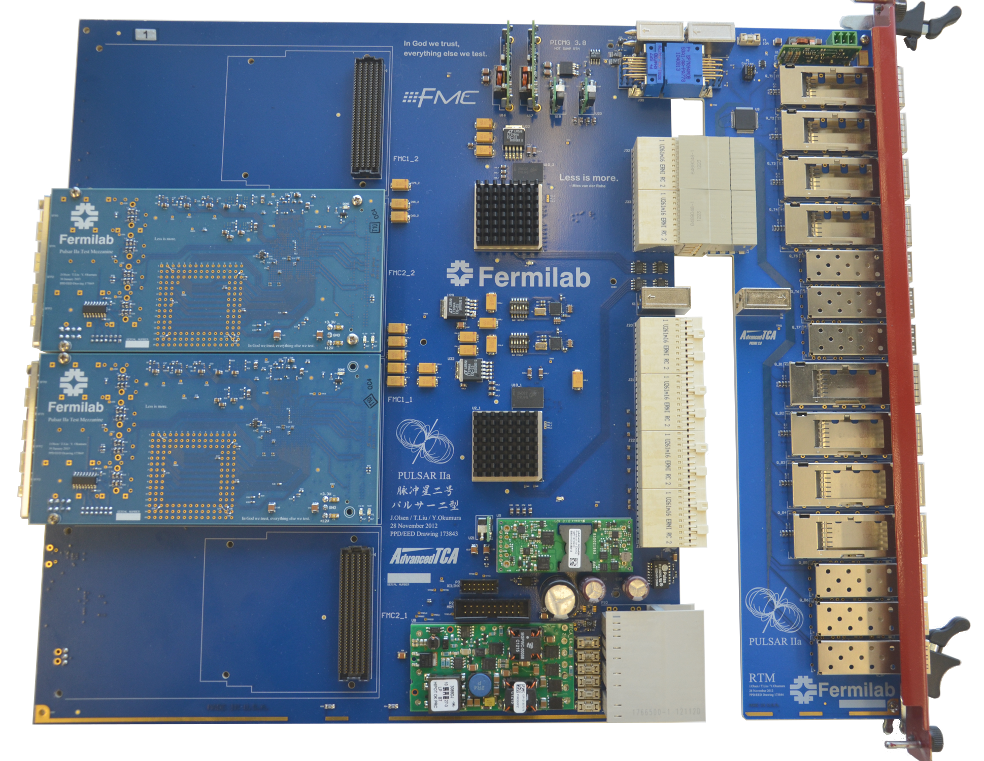
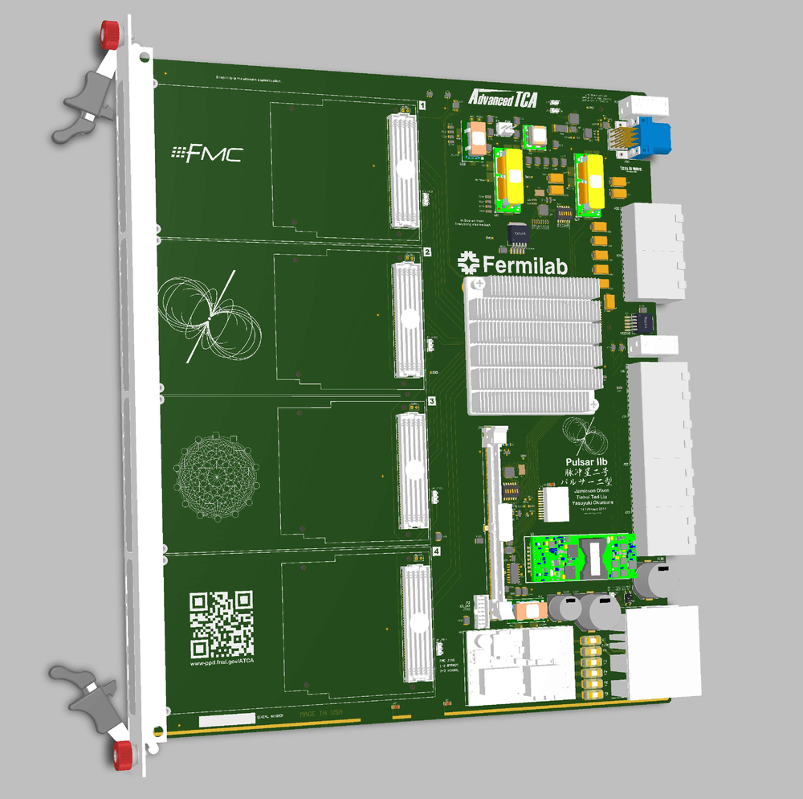
Pulsar 2a prototypes work well: “plug & play” (summer 2013)
Pulsar 2a
(Kintex 7 FPGAs)
Pulsar 2b design
http://www-ppd.fnal.gov/EEDOffice-w/Projects/ATCA/
Pulsar 2b:
  Vertex 7 FPGA (XC7VX690T)
80 GTH lines
Compatible with LAPP IPMC module
FMC TTC compatible, backplane clock dist.
CMS IPBus user interface
General purpose design
I/O ~ 1 Tbps
How
full-mesh
used in
CMS
L1 TT
case

Slide 34
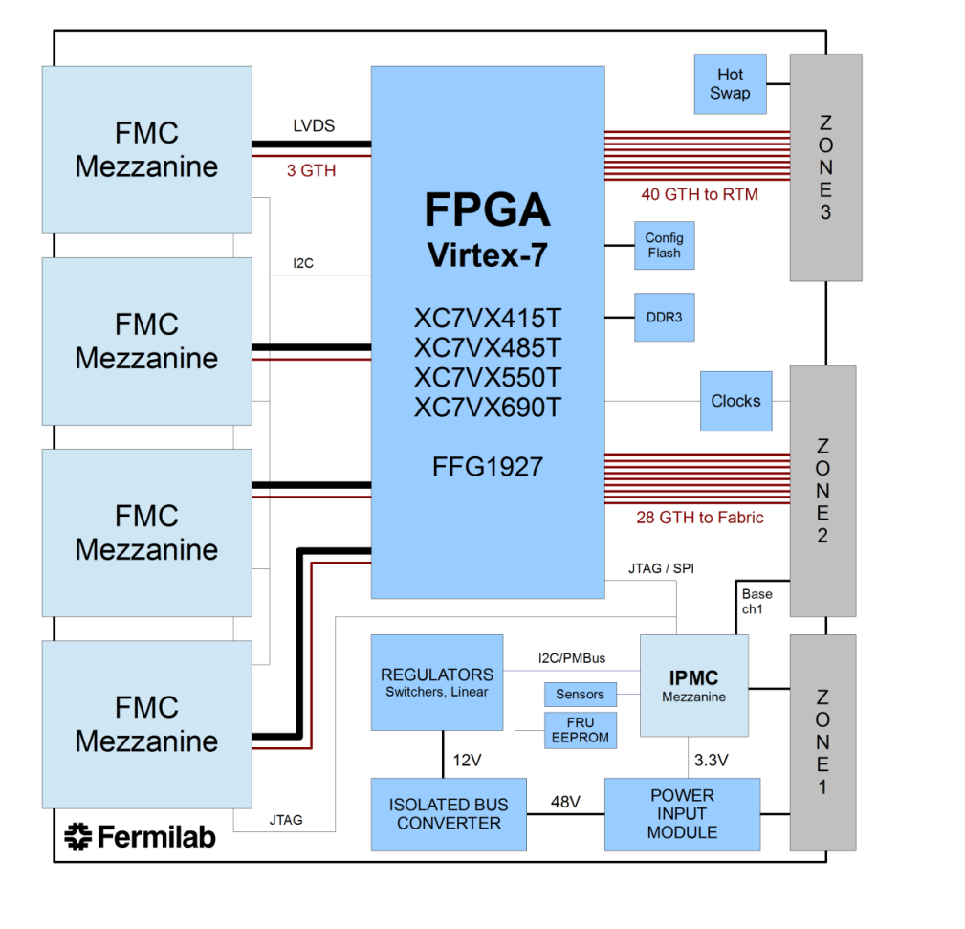
Pulsar 2b Block Diagram
60 Gbps
RTM Optical Transceivers
Full Mesh Fabric Interface
I/O: ~ 1 Tbps

Slide 35
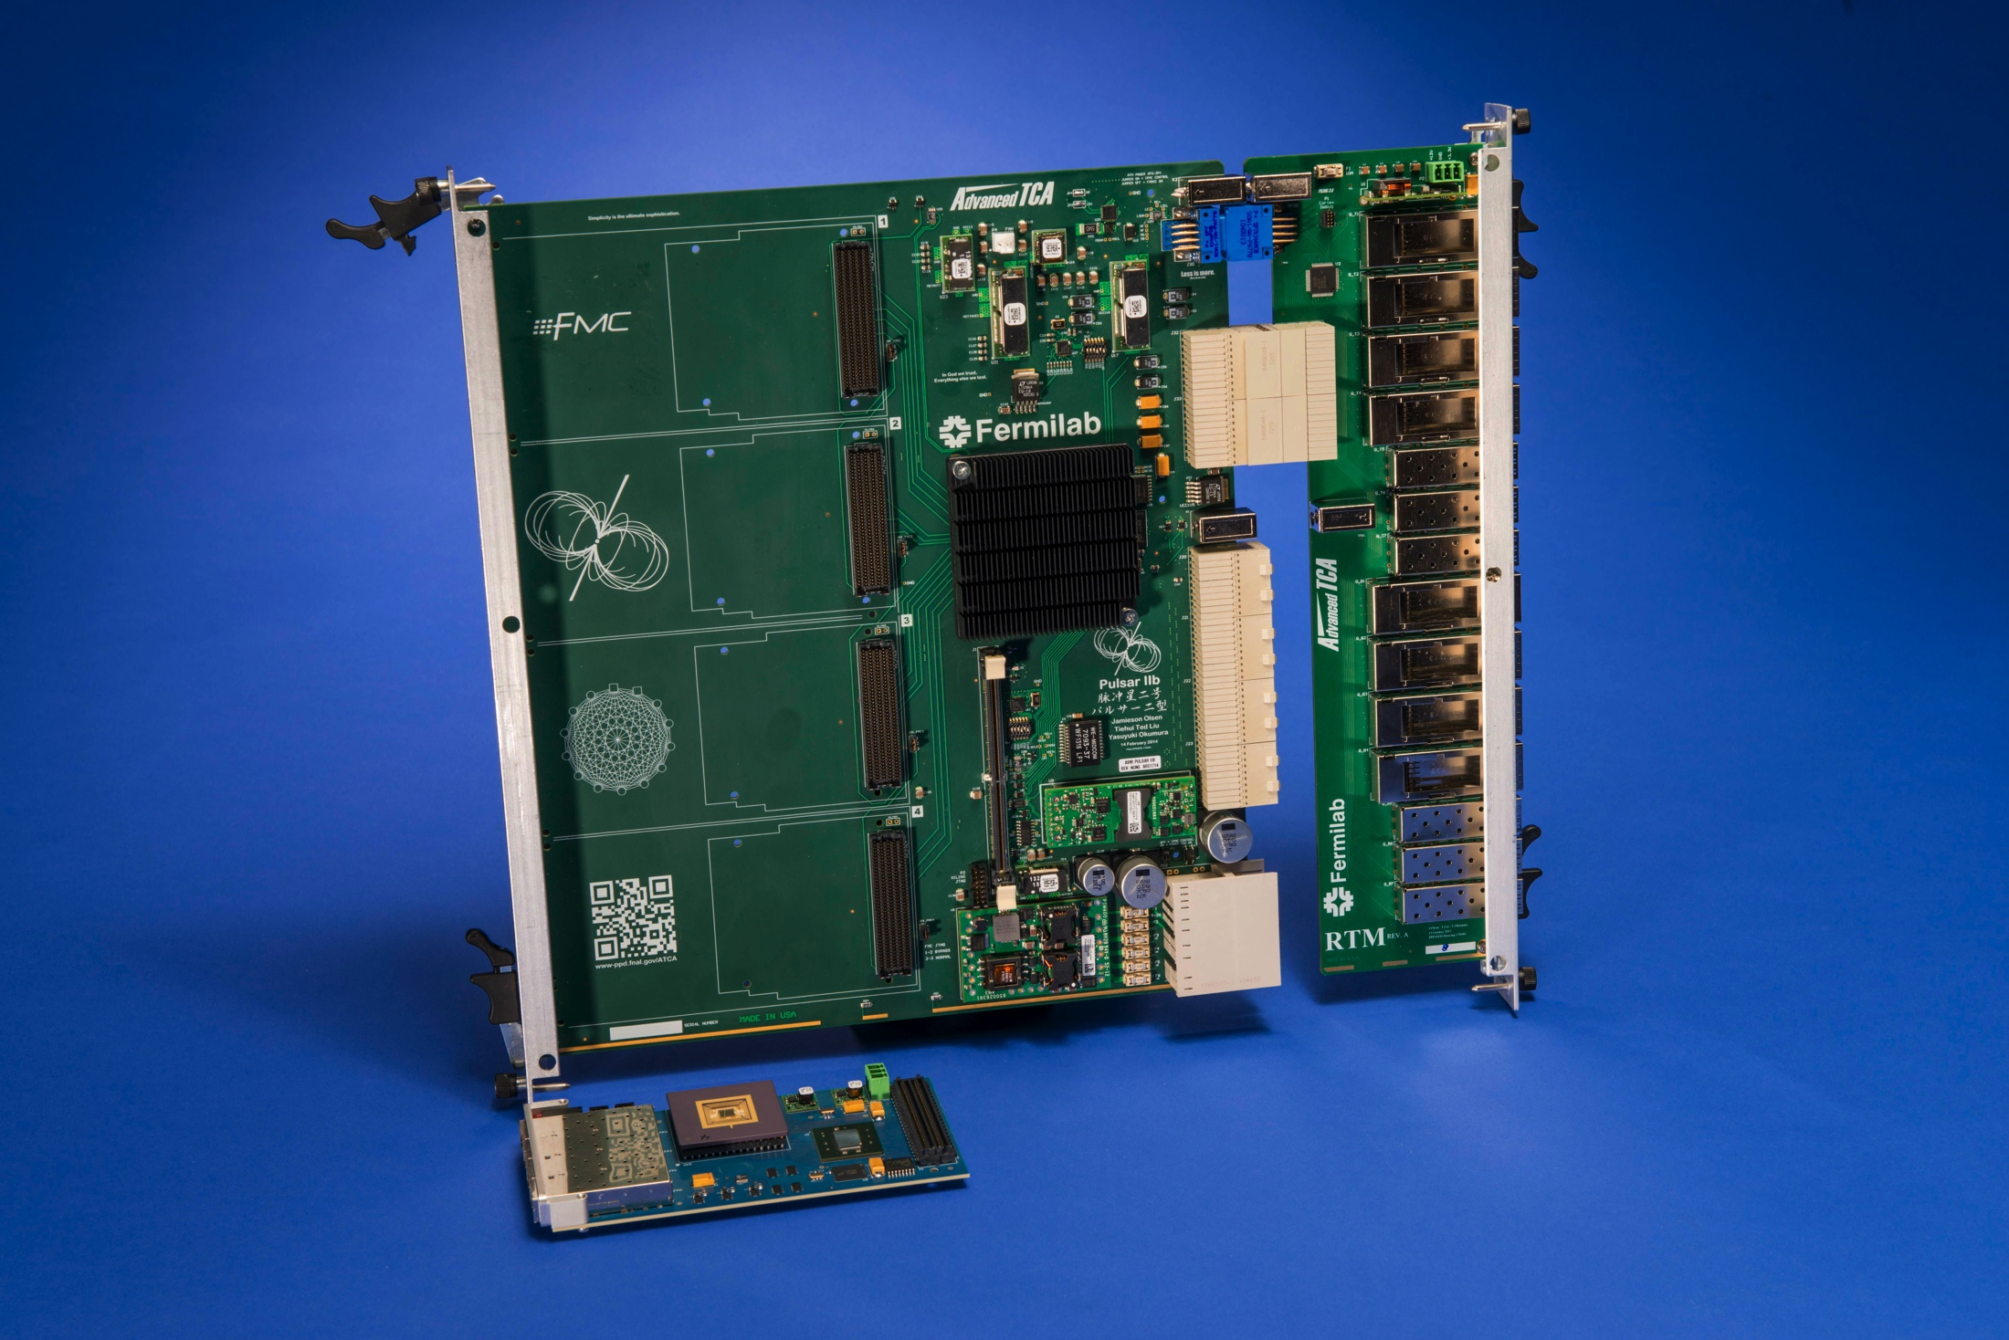
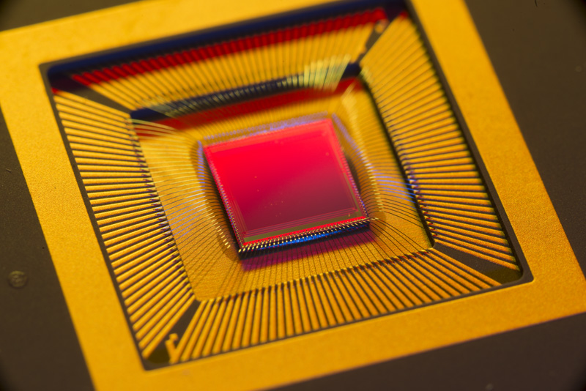
http://www-visualmedia.fnal.gov/VMS_Site/gallery/stillphotos/2014/0000/14-0089-24D.hr.jpg
Pulsar 2b arrived 3 weeks ago

Slide 36
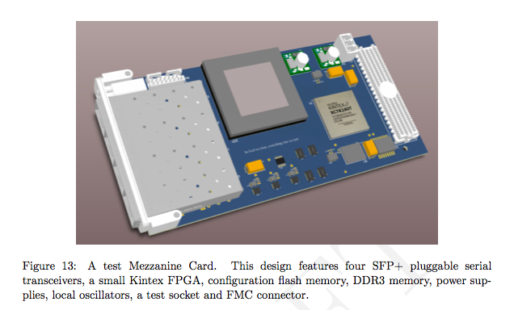
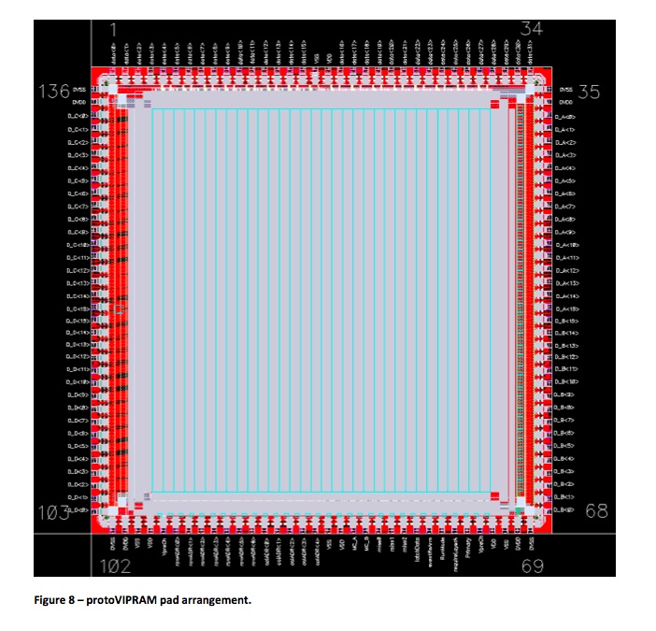


74 mm x 149 mm
Test mezzanine card
VIPRAM
test socket
design
actual card
protoVIPRAM chip
SVT in a mezzanine
Future versions being designed
Two new mezzanines planed using:
INFN L2 FTK AMchip05/06 (by INFN)
FNAL CMS AMchip dedicated for L1
Being used for testing new AM chips at FNAL

Slide 37
Some related abstracts for TWEPP 2014
Pulsar 2b design and performance
Pulsar 2b mezzanine design for AMchip05/6 (by INFN)
Pulsar 2b application for FTK Data Formatter
ProtoVIPRAM1: design and testing results
Next version of protoVIPRAM for CMS L1 demonstration
Power and Thermal analysis results for ProtoVIPRAM (SMU EE)
details will be presented at TWEPP 2014 this Sept.

Slide 38

Vertical Slice System Demonstration over next few years
Core trigger tower
Can and will be Implemented in stages:
mezzanine, board, crate and multi crate level
With the goals:
  Performance study (latency, efficiency etc)
  Identify issues/bottlenecks
  Guide future R&D, find solutions
  A common platform to explore
  new ideas/algorithms/approaches
  An important step towards TDR and beyond
  A major undertaking !
  CMS people involved:
  Lyon/INFN/Cornell/Northwestern/
  Florida/Purdue/KIT/UK/CERN/FNAL …
Data Source stage

