Slide 1
BGV production

Slide 2
Deliveries
3D forged Aluminium 2219:
delivery on the 24th or 27th of January
17/01 metallographic + tensile test results on block 1
23/01 metallographic+ tensile test results on block 2
Bimetallic flanges:
Ship on Thursday 17th of January

Slide 3
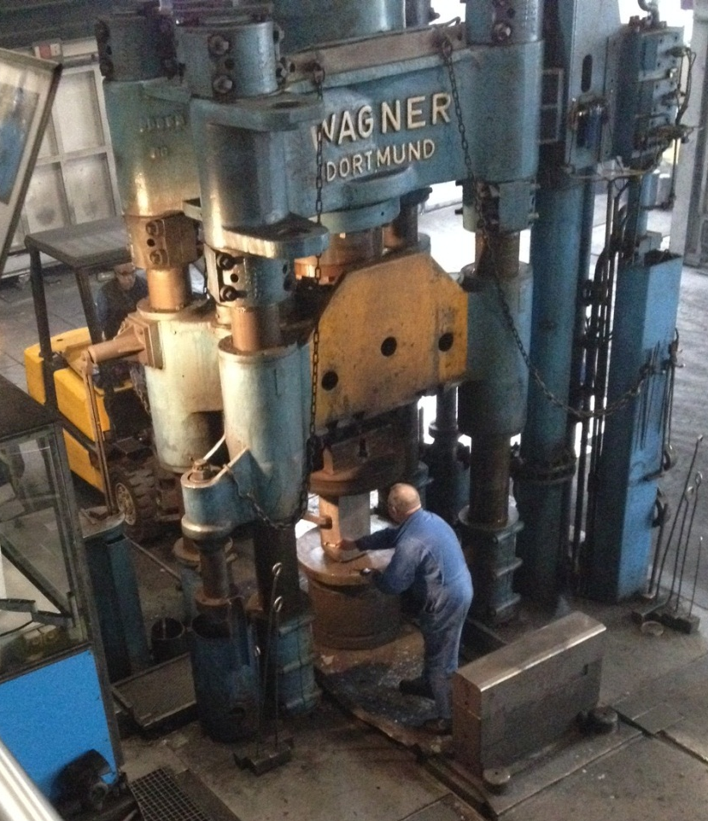
3D forging Al 2219

Slide 4
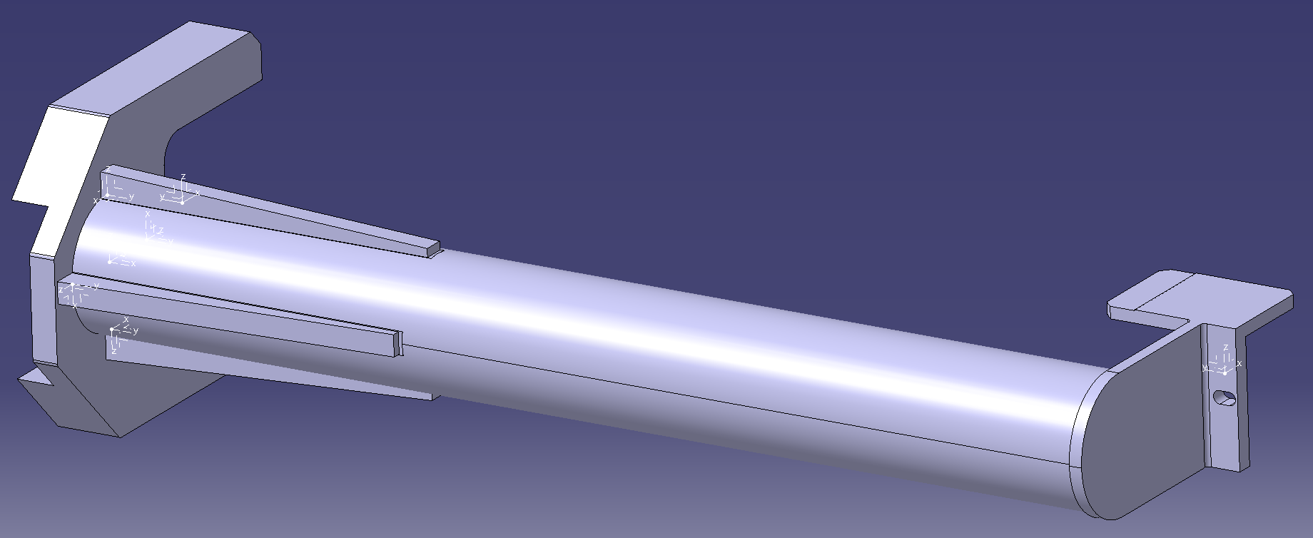
Support

Slide 5
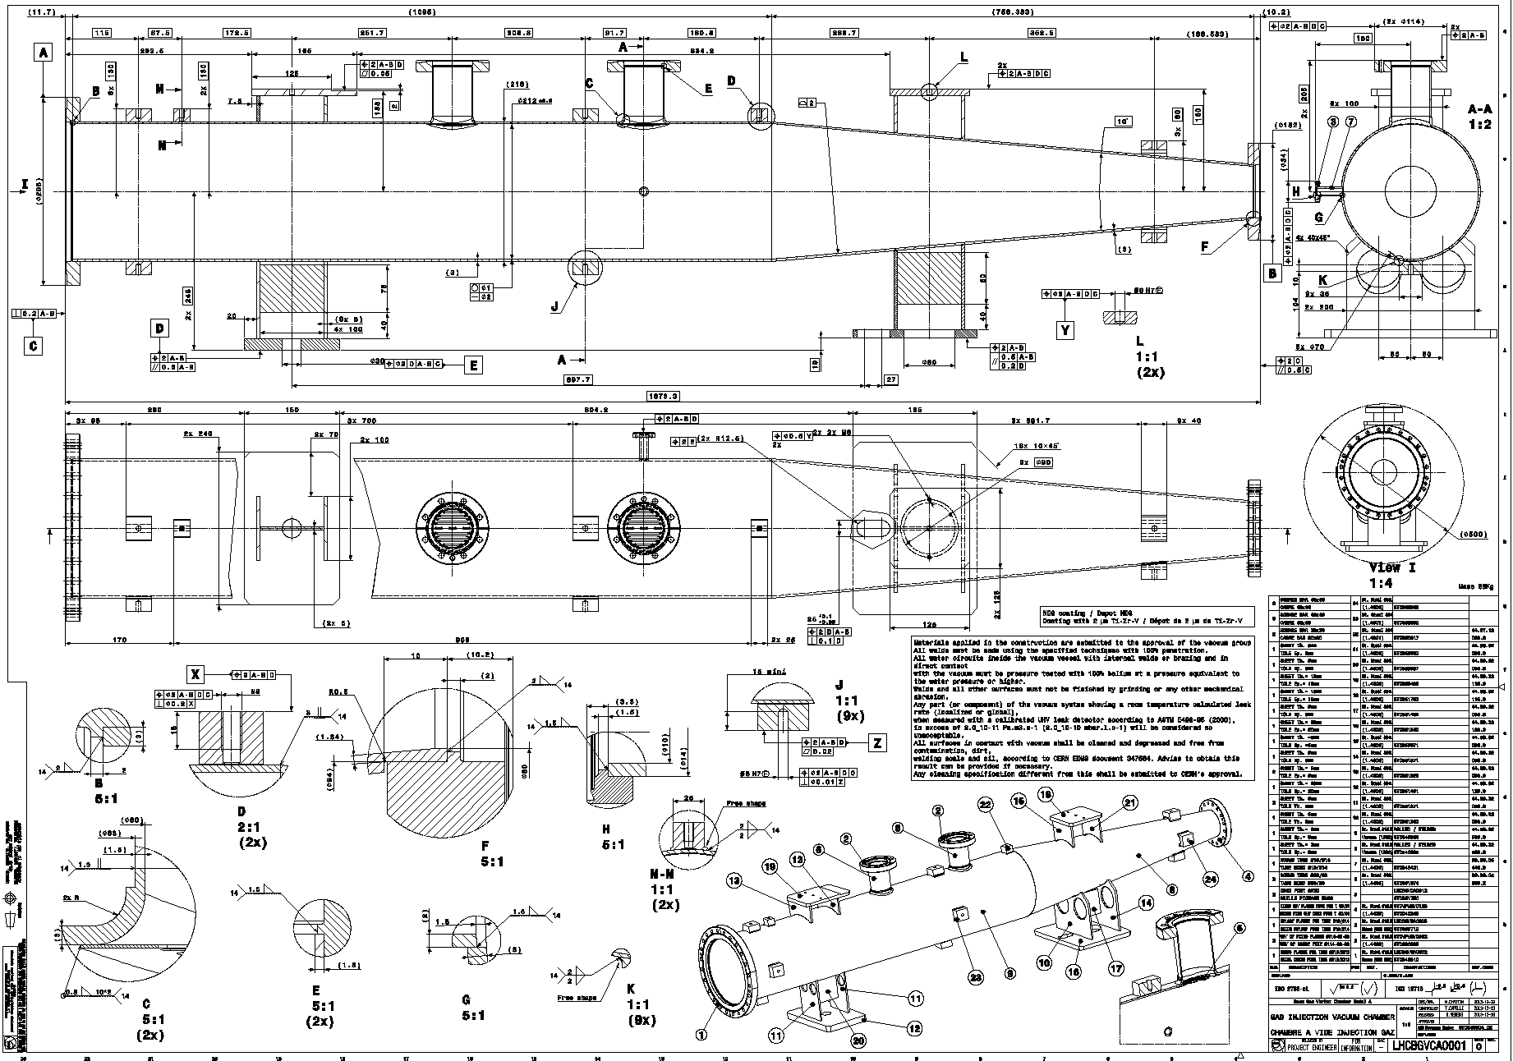
LHCBGVCA0001: GAS INJECTION VACUUM CHAMBER
Comments
- Massimo Giovanozzi: It would have been useful to note the inner diameter of the aperture of the flange on cross section B
- Plamen Hopchev: Ok in terms of length, diameter and ports
No reply yet from: Massimiliano Ferro-Luzzi, Jean Frederic Fuchs, Benoit Salvant

Slide 6
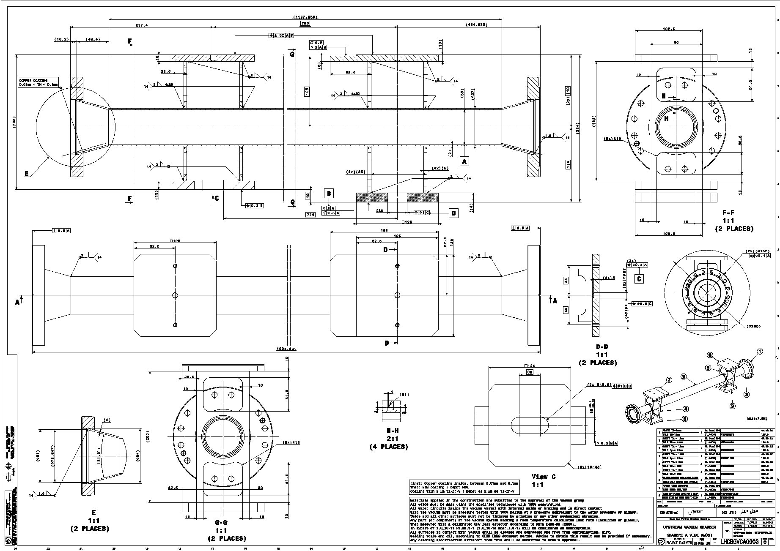
LHCBGVCA0003: UPSTREAM VACUUM CHAMBER
Comments
- Massimo Giovanozzi: The tube with ID 53 is longer than what has been studied but it should be fine in terms of aperture.
- Plamen Hopchev: Ok in terms of length and diameter
No reply yet from: Massimiliano Ferro-Luzzi, Jean Frederic Fuchs, Benoit Salvant

Slide 7
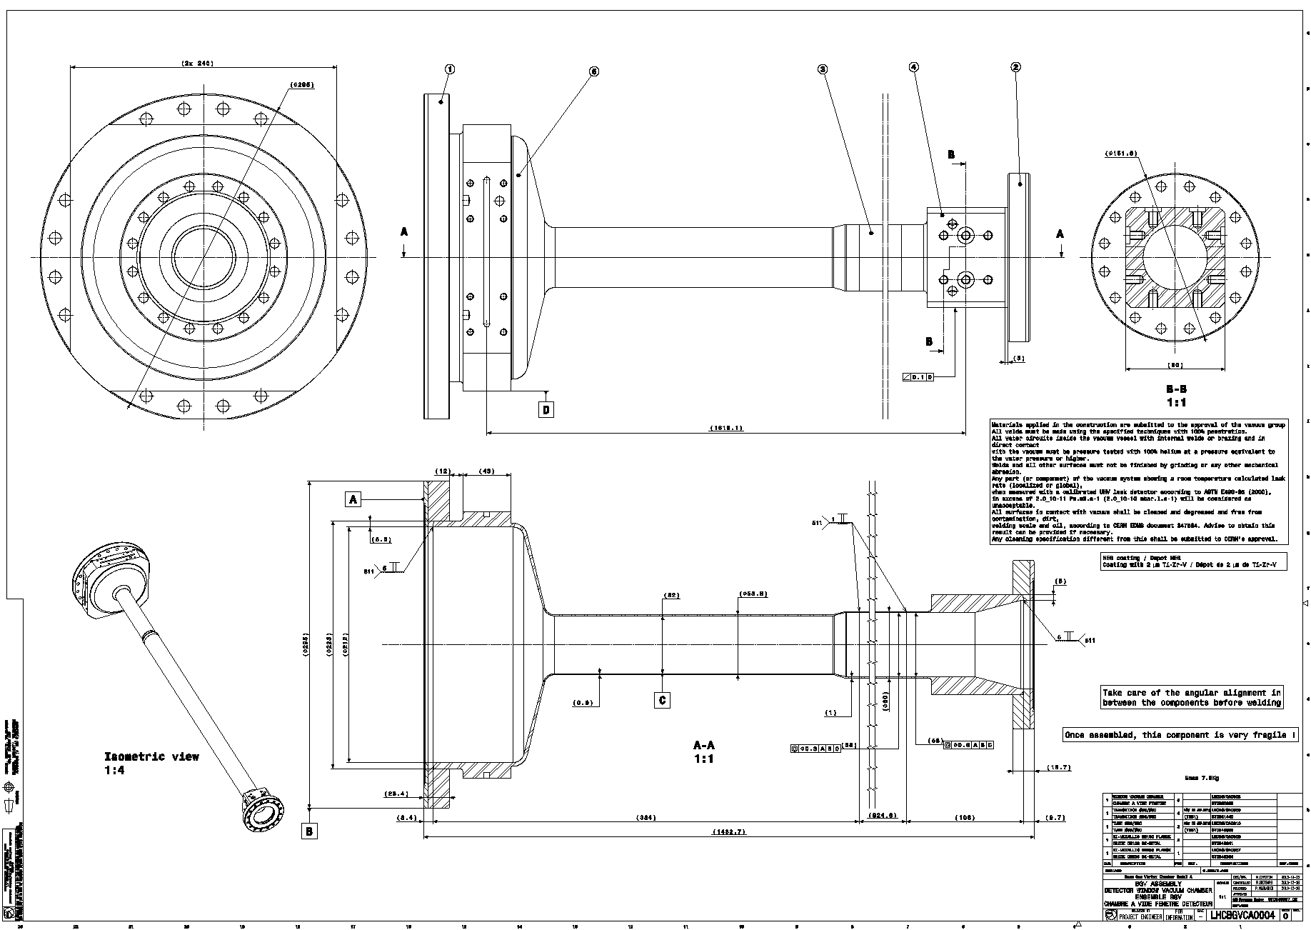
LHCBGVCA0004: BGV ASSEMBLY - DETECTOR WINDOW VACUUM CHAMBER
Comments
- Massimiliano Ferro-Luzzi: would be useful to indicate something so that one can extract the thickness versus radius, the curvatures and the inclination angle of the exit window
- Massimo Giovanozzi: from the drawing it is not possible to know the exact length of the tube of ID 52 mm. It would be nice to add this piece of information
- Plamen Hopchev: Ok in terms of length and diameter
No reply yet from: Jean Frederic Fuchs, Benoit Salvant

