Slide 1



CALICE Digital Hadron Calorimeter: Calibration and Response to
Pions and Positrons
Burak Bilki
Argonne National Laboratory
University of Iowa
(S)DHCAL Meeting
January 15, 2014
Lyon, France

Slide 2
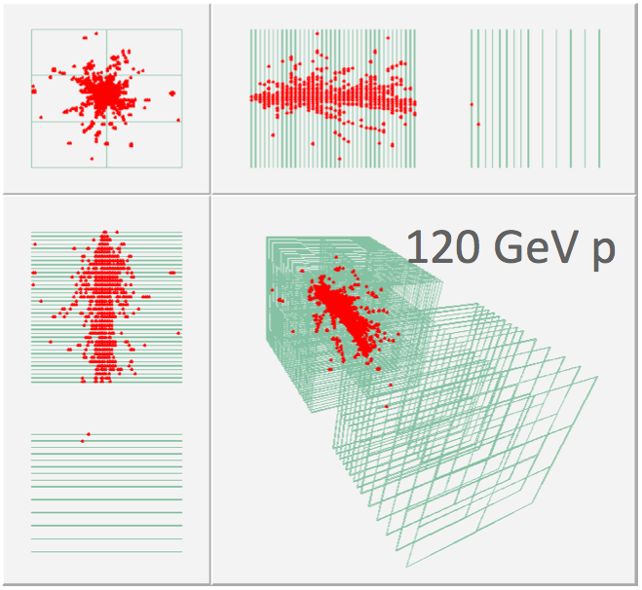
Digital Hadron Calorimeter (DHCAL)
Each layer with an area of ~ 1 x 1 m² is read out by 96 x 96 pads.
The DHCAL prototype has up to 54 layers including the tail catcher (TCMT) ~ 0.5 M readout channels (world record in calorimetry!)
Concept of the DHCAL
Imaging hadron calorimeter optimized for use with PFA
1-bit (digital) readout
1 x 1 cm² pads read out individually
(embedded into calorimeter!)
Resistive Plate Chambers (RPCs) as active elements, between steel/tungsten

Slide 3
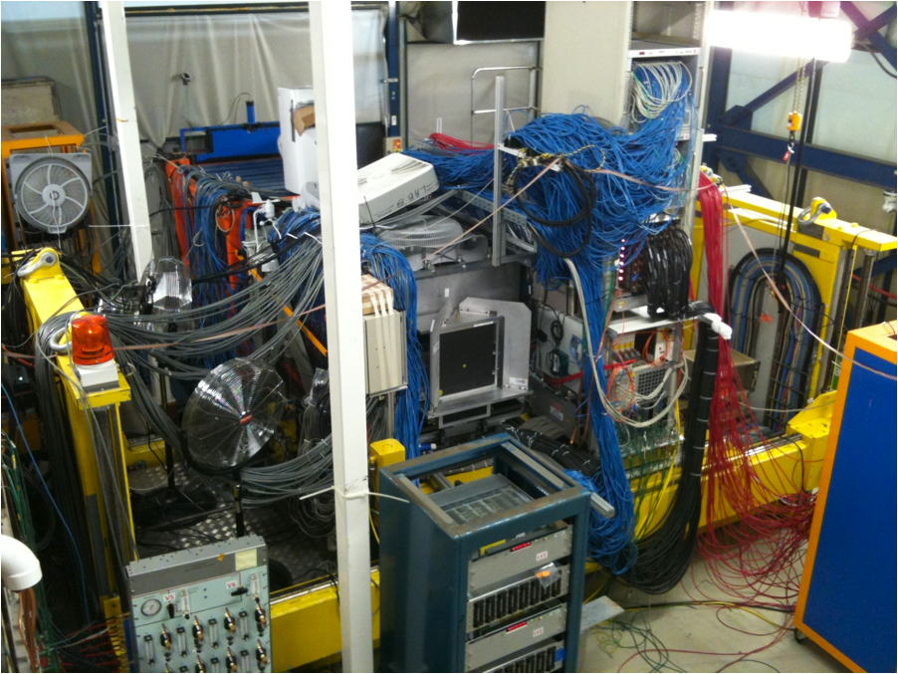
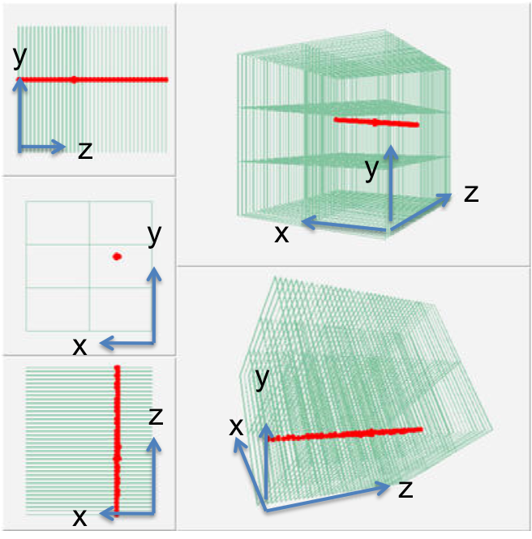
DHCAL Data
Muon Trigger:
2 x (1 m x 1 m scintillator)
Secondary Beam Trigger:
2 x (20 cm x 20 cm scintillator)
y
z
x
Nearest neighbor clustering in each layer
Event
Particle ID: Čerenkov/μ tagger bits
Hit: x, y, z, time stamp
Cluster: x, y, z

Slide 4
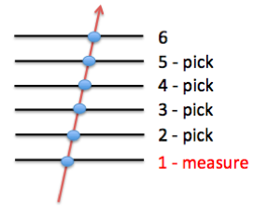
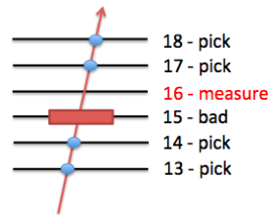
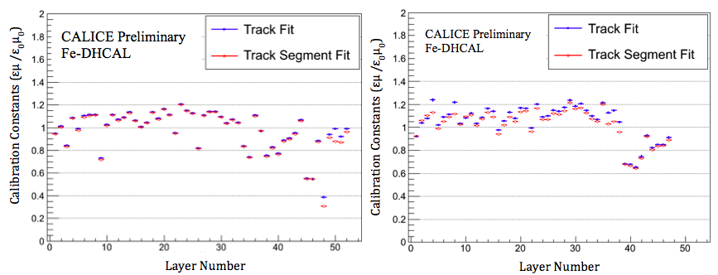
Calibration/Performance Parameters
Efficiency (ε) and pad multiplicity (μ)
Track Fits:
specifically for muon calibration runs
Identify a muon track that traverse the stack with no identified interaction
Measure all layers
Track Segment Fits:
for online calibration
Identify a track segment of four layers with aligned clusters within 3 cm
Measure only one layer (if possible)
Fit to the parametric line: x=x₀+a_{x}t; y=y₀+a_{y}t; z=t
A cluster is found in the measurement layer
within 2 cm of the fit point?
Yes
No
ε=1
μ=size of the found cluster
ε=0
No μ measurement
muon
8 GeV secondary beam

Slide 5
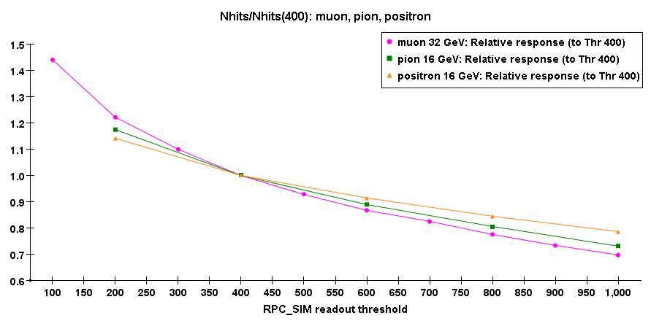
Calibration of the DHCAL
RPC performance
Efficiency to detect MIP ε ~ 96%
Average pad multiplicity μ~ 1.6
Calibration factors C = εμ
Equalize response to MIPS (muons)
Calibration for secondary beam (p, π±,e±)
If more than 1 particle contributes to signal of a given pad
→ Pad will fire, even if efficiency is low
→ Full calibration will overcorrect
Simulation
Full calibration
H_{i} … Number of hits in RPC_{i}
More sophisticated schemes

Slide 6
Calibration Procedures
1. Full Calibration
2. Density-weighted Calibration:
Developed due to the fact that a pad will fire if it gets contribution from multiple traversing particles regardless of the efficiency of this RPC. Hence, the full calibration will overcorrect. Classifies hits in density bins (number of neighbors in a 3 x 3 array).
3. Hybrid Calibration:
Density bins 0 and 1 receive full calibration.
H_{i} … Number of hits in RPC_{i}

Slide 7
Density-weighted Calibration Overview
Warning:
This is rather COMPLICATED
Derived entirely based on Monte Carlo
Assumes correlation between
Density of hits ↔ Number of particles contributing to signal of a pad
Mimics different operating conditions with
Different thresholds T
Utilizes the fact that hits generated with the
Same GEANT4 file, but different operating conditions can be correlated
Defines density bin for each hit in a 3 x 3 array
Bin 0 – 0 neighbors, bin 1 – 1 neighbor …. Bin 8 – 8 neighbors
Weighs each hit
To restore desired density distribution of hits

Slide 8
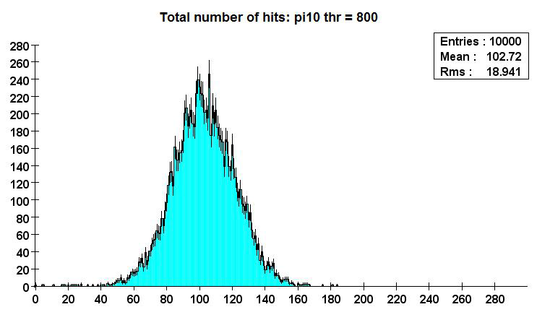
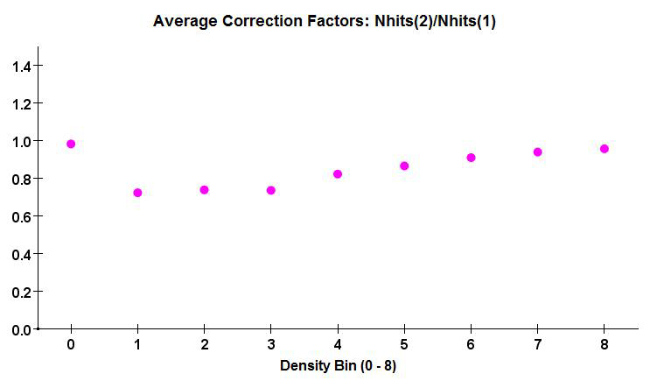
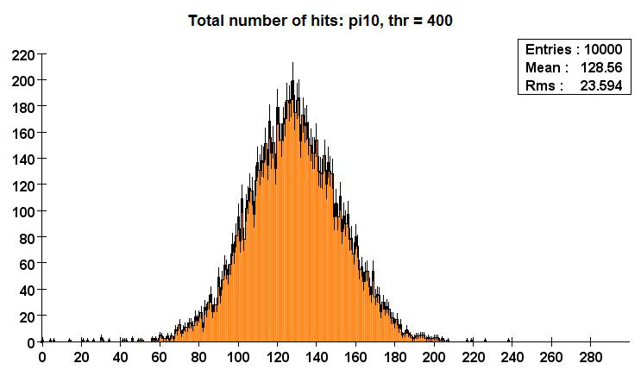
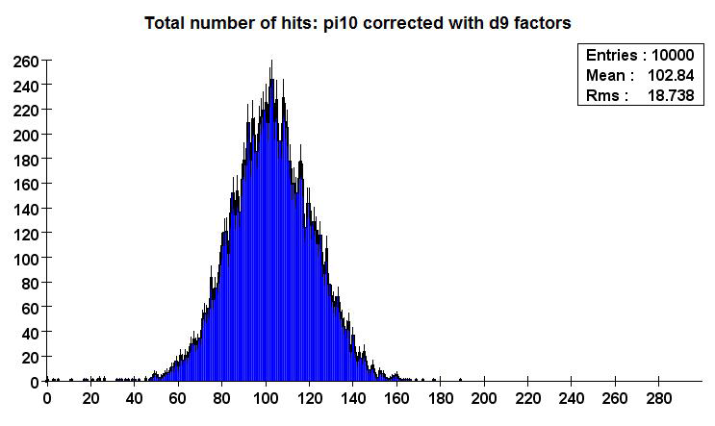
Density-weighted Calibration Example:
10 GeV pions: Correction from T=400→ T=800
Mean response and the resolution reproduced.
Similar results for all energies.

Slide 9
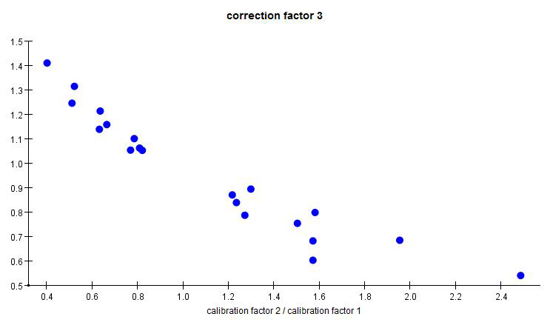
Density-weighted Calibration Expansion:
To large range of performance parameters
GEANT4 files
Positrons: 2, 4, 10, 16, 20, 25, 40, 80 GeV
Pions: 2, 4, 8, 10, 10, 25, 40, 80 GeV
Digitization with RPC_sim
Thresholds of 200, 400, 600, 800, 1000 (~ x 1fC)
Calculate correction factors (C)
for each density bin separately
as a function of ε_{i}, μ_{i}, ε₀ and μ₀ (i : RPC index)
Plot C as a function of R = (ε_{i}μ_{i})/(ε₀μ₀)
→ Some scattering of the points, need a more
sophisticated description of dependence of
calibration factor on detector performance
parameters
π: Density bin 3
25 GeV
R = (ε_{i}μ_{i})/(ε₀μ₀)
Only very weak dependence on energy:
Common calibration factors for all energies!

Slide 10
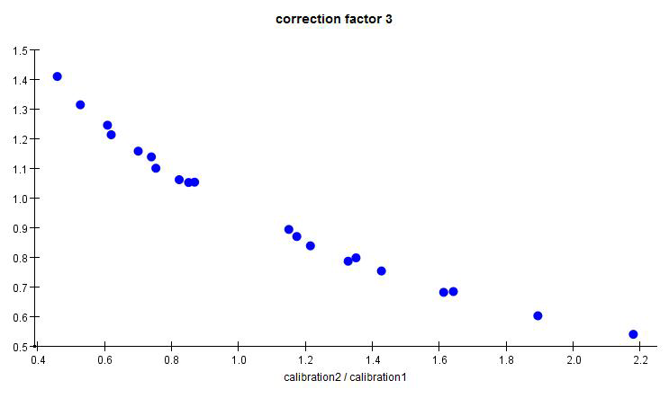
Density-weighted Calibration:
Empirical Function of ε_{i}, μ_{i}, ε₀, μ₀
π: Density bin 3
25 GeV
Positrons
Pions
Calibration factors
R = (ε_{i}μ_{i})/(ε₀μ₀)
π: Density bin 3
Functional dependence of calibration factors depends on particle type!
(Due to different shower topologies: Different density distribution leads to different impact of performance)
Calibration factors
R = (ε_{i}^{0.3}μ_{i}^{1.5}) /(ε₀^{0.3}μ₀^{1.5})

Slide 11
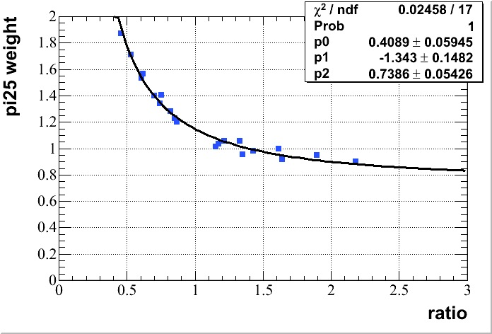
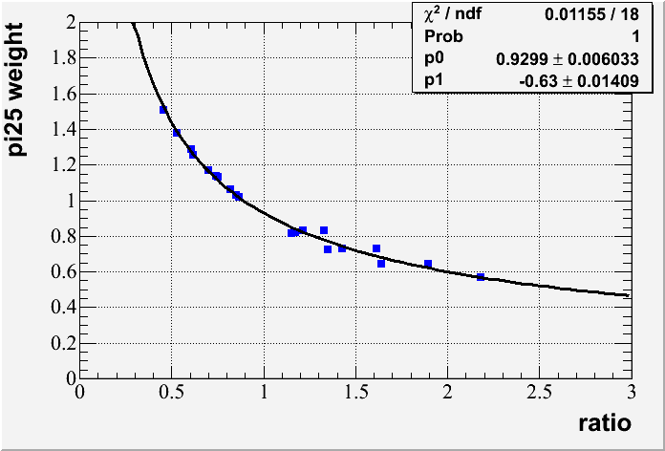
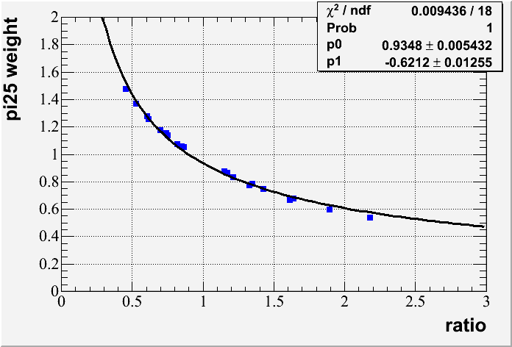
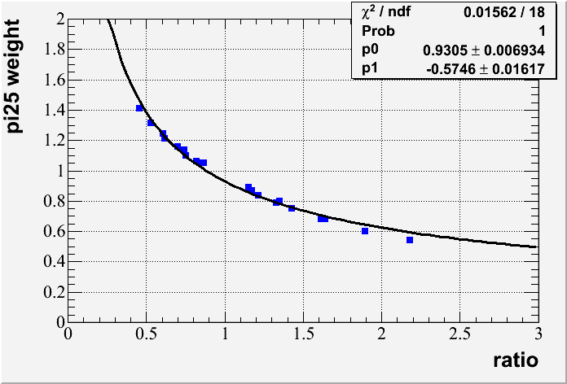
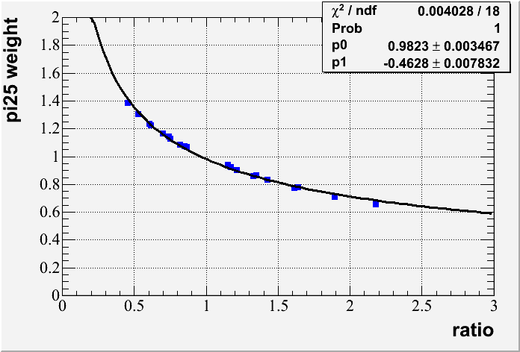

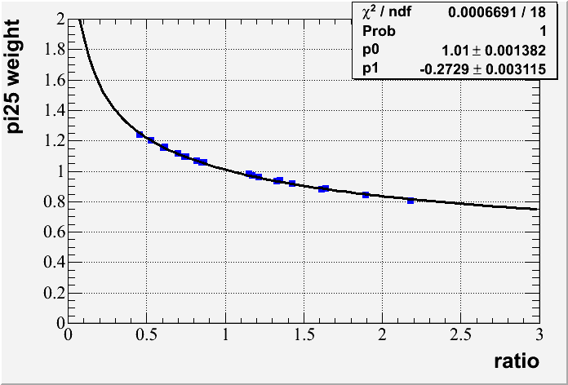
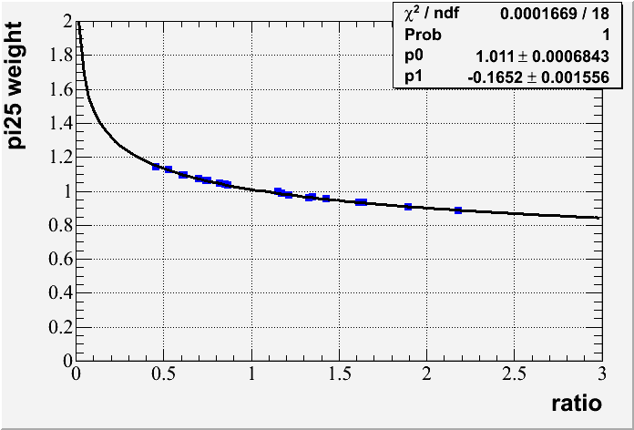
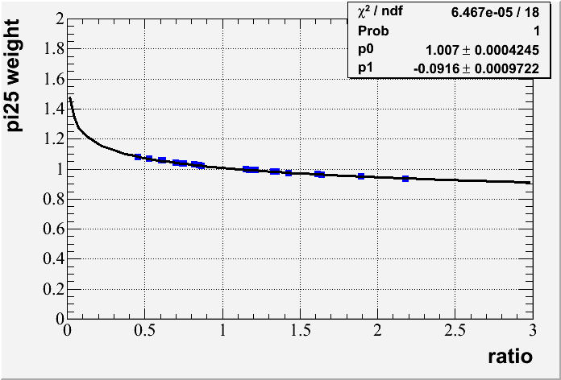
Density-weighted Calibration:
Fits of Correction Factors as a Function of R
Power law
Fit results for p=pion, similar results for p=positron
Correction Factors
R_{π+}
R_{π+}
R_{π+}
Correction Factors
R_{π+}
R_{π+}
R_{π+}
Correction Factors
R_{π+}
R_{π+}
R_{π+}

Slide 12
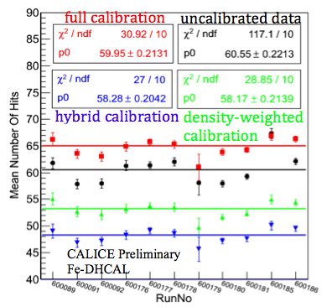
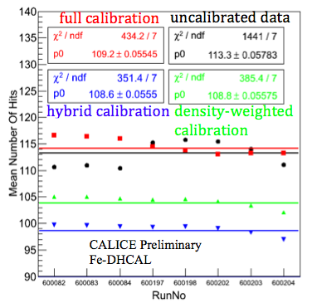
Calibrating Different Runs at Same Energy
4 GeV π⁺
8 GeV e⁺
Uncalibrated response (No offset in y)
Full calibration (+5 offset in y)
Density – weighted calibration (-5 offset in y)
Hybrid calibration (-10 offset in y)

Slide 13
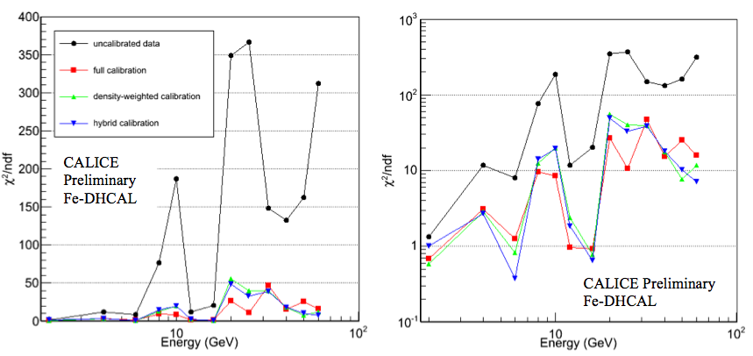
Comparison of Different Calibration Schemes
χ²/ndf of constant fits to the means for different runs at same energy
→ All three schemes reduce the spread of data points: Benefits of calibration!
No obvious “winner”: Similar performance of different techniques

Slide 14
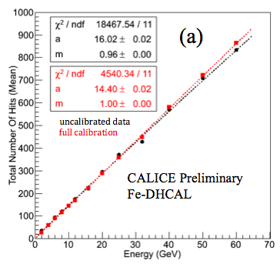
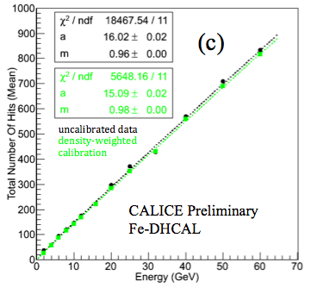
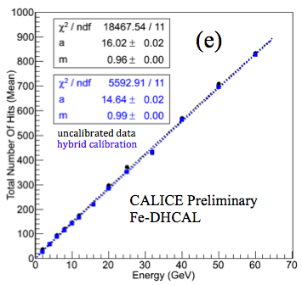
Linearity of Pion Response: Fit to N=aE^{m}
Uncalibrated response
4% saturation
Full calibration
Perfectly linear up to 60 GeV (in contradiction to MC predictions)
Density- weighted calibration/Hybrid calibration
1 – 2% saturation (in agreement with predictions)

Slide 15
Backup

Slide 16
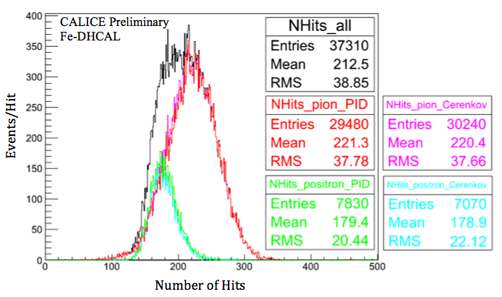
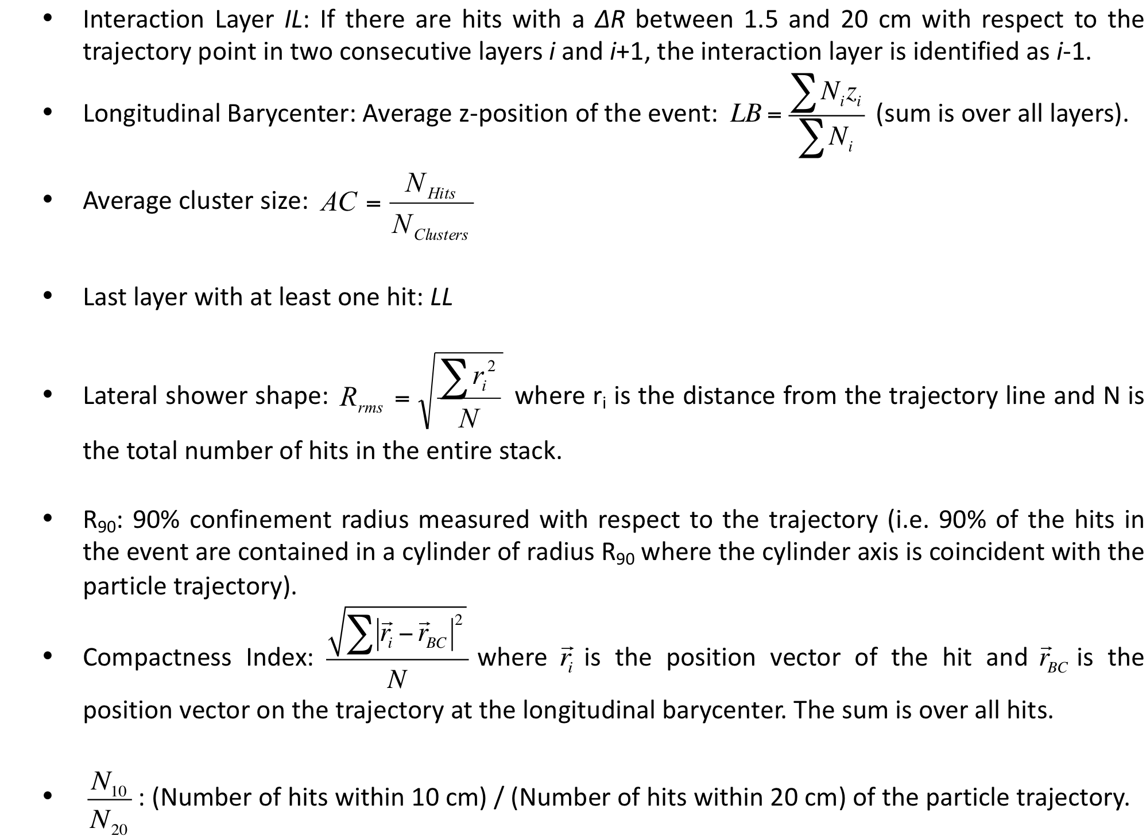
Particle Identification (PID)
0. Čerenkov counter based PID (good for 6, 8, 10, 12, 16, and 20 GeV)
1. Topological PID: Starts with the trajectory fit (used for 2, 4, 25 and 32 GeV)
Topological Variables
16 GeV
Visually inspect the positron events in the ~10% excess in the topological PID
They are positrons
10 % compatible with the inefficiency of the Čerenkov counter, which was ≥ 90% for most energies
Topological PID works nicely!

