Slide 1


DHCAL - Resolution
Burak Bilki, José Repond and Lei Xia
Argonne National Laboratory
(S)DHCAL Meeting
January 15, 2014
Lyon, France

Slide 2
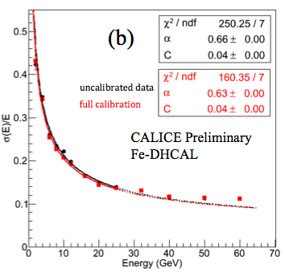
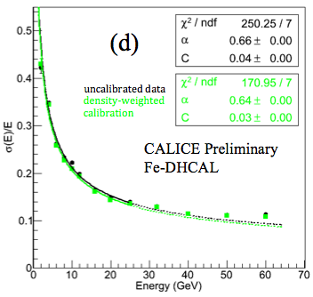
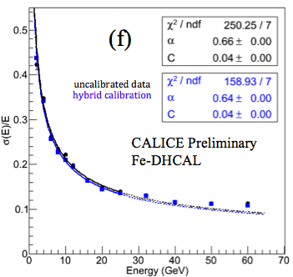

Resolution for Pions
Calibration
Improves result somewhat (no dramatic effect)
Monte Carlo prediction
Around 58%/√E with negligible constant term
Saturation at higher energies
→ Leveling off of resolution
→ Can be mitigated with software compensation

Slide 3
Introduction to SW Compensation
Single particle energy resolution of a traditional calorimeter can be optimized by hardware/software compensation
  Equalize EM and Hadronic responses -> e/h ~ 1
The DHCAL is quite a unique/different device
  Non-linear response for EM shower
    Measured energy of a 10 GeV photon E(10)
    E(10) ≠ E(5) + E(5) ≠ E(2) + E(2) + E(2) + E(2) + E(2)
    Correction can be applied for single EM showers
    No obvious way to correct for pi0’s generated in hadronic showers
  Hadronic response close to linear
  -> Ratio of EM to hadronic response changes with energy
  Software compensation not likely to be very successful without first taking care of the non-linearity of the EM response

Slide 4
Linearizing the EM response I
The non-linear response of EM showers is due to finite readout pad size → multiple particles hitting same pad → saturation
Need ways to account for multiple particles on the same pad
  Assumption: Hit density (hit fraction in a given local space) is related to the local particle density
  (Density weighted calibration proved good correlation between hit density and local particle density)
  Start with simple hit density definition
    d9: number of hits in the surrounding 3pad x 3pad area, centered on the hit being studied (d9 = 0 – 8)
  Start with MC simulation for Fe absorber setup
    RPC response: RPC_sim_4 (single exponential) – not the best…
    Positron sample: 2, 4, 6, 8, 10, 12, 16, 20, 25, 32, 40, 60 (GeV)
    Pion sample: 2, 4, 6, 8, 10, 12, 16, 20, 25, 32, 40, 60, 80, 100 (GeV)

Slide 5
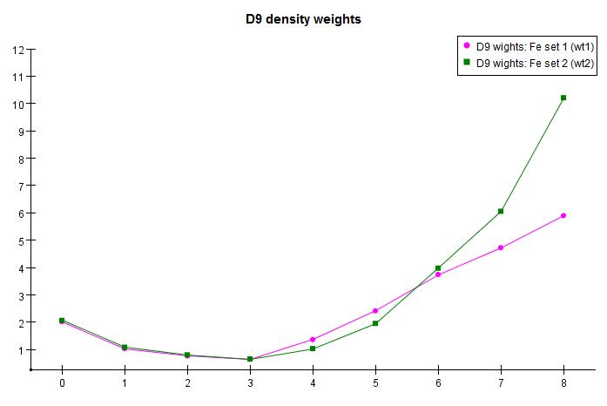
Linearizing the EM response II
Chose two sets of positron energy points, adjust weights for each D9 bin to achieve linear response
  Set I (wt1): 2, 6, 10, 16, 25 (GeV)
  Set II (wt2): 2, 6, 16, 32, 60 (GeV)
  Target response: 14.74 hits/GeV (arbitrary)
Very high weight for
high density bins:
correction for saturation
High weights for
isolated hits
Low weights for medium density: mostly due to hit multiplicity ~ 1.6
Everything as expected

Slide 6
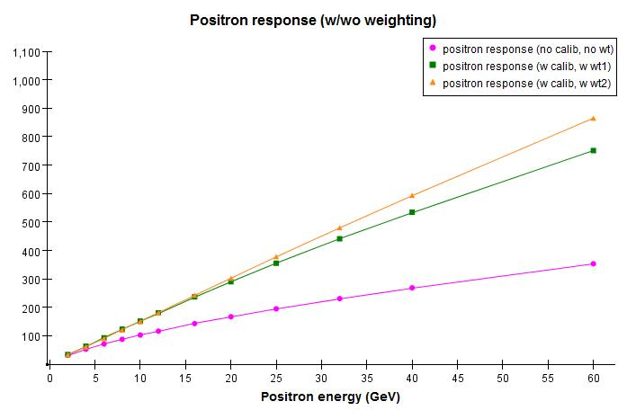



Positron response after weighting
$$16.687 ×E^{0.966}$$
$$20.240 ×E^{0.885}$$
$$20.866 ×E^{0.692}$$
Fits to power
law
(β=1 means linear)
Things are exactly as expected:
Linearity significantly improved
wt2 gives better linearity in larger energy range than wt1

Slide 7
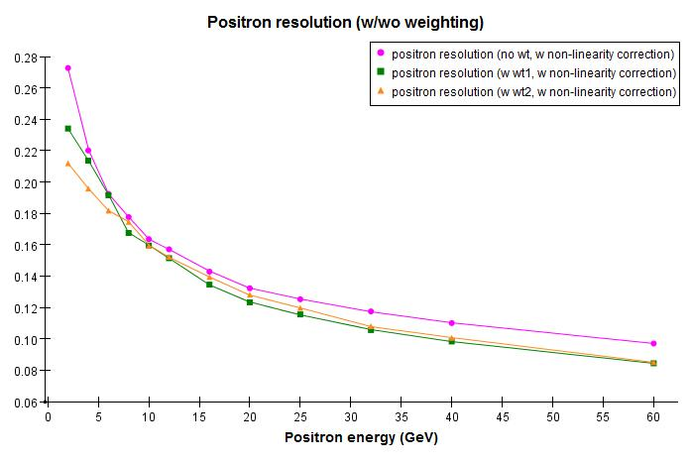
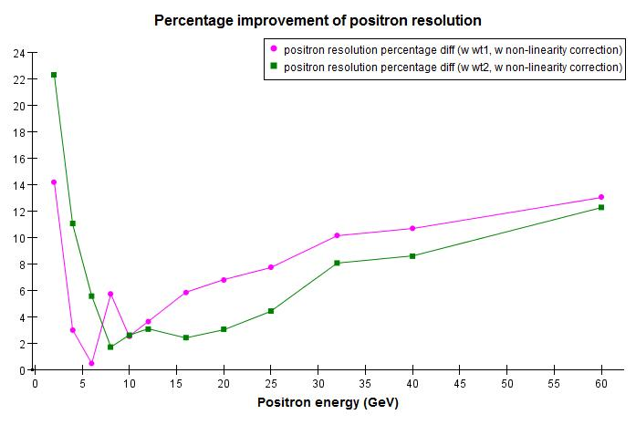
Positron resolution after weighting
Non-linearity correction is included (this is very important!)
Positron energy resolution modestly improved (2 – 11%)
Not much difference between wt1 and wt2
All energy resolutions were calculated from full-range Gaussian fit
Fit at low energies are not very reliable

Slide 8
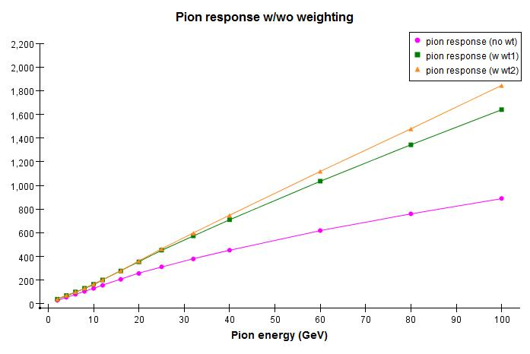



Pion response
$$17.690 ×E^{1.010}$$
$$20.500 ×E^{0.954}$$
$$22.918 ×E^{0.799}$$
Pion linearity (no weighting) is much worse than in data
(most likely due to inaccurate positron simulation)
Linearity fits are not as good as the positrons
* Applied leakage cut: no more than 10 hits in tail catcher

Slide 9
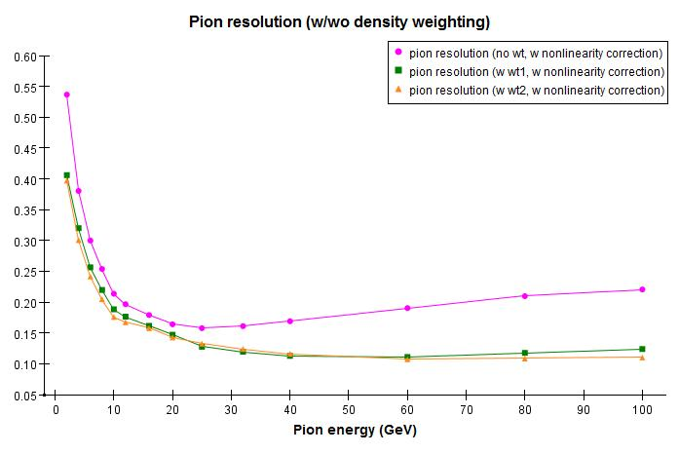
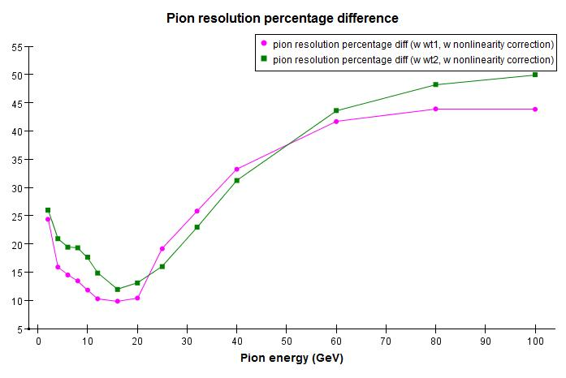
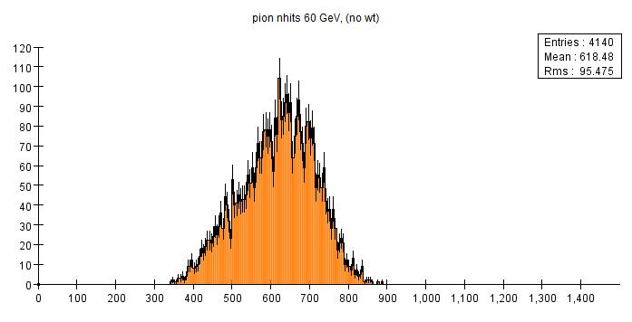
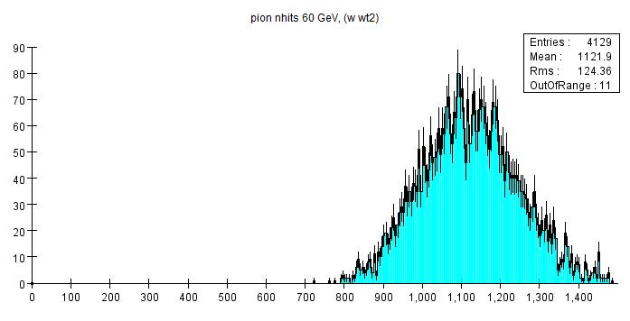
Pion resolution
Example: 60 GeV response
Pion resolution and linearity are both greatly improved in (not very good) simulation: 10 – 50%
At higher energies, distributions become much more symmetric after weighting

Slide 10
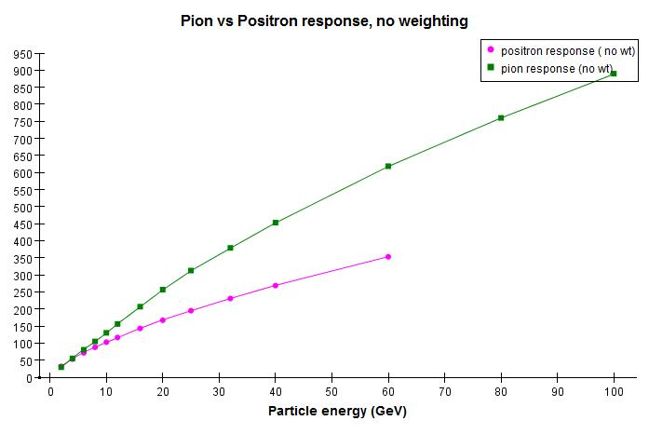
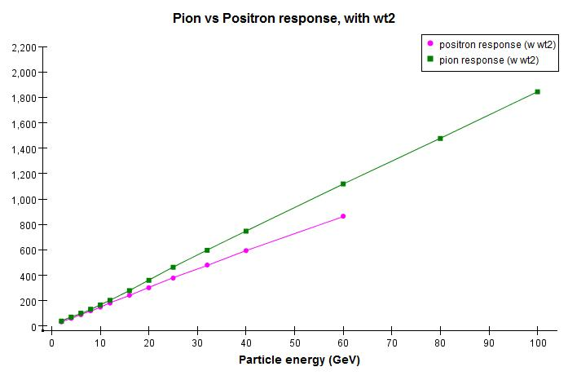
Pion vs. Positron response
Before weighting
After weighting
Pion and Positron responses are brought closer by weighting, but not equal yet
(weighting changes both pion and positron responses)
Room for software compensation: work in progress (pretty optimistic on further improvement)

Slide 11
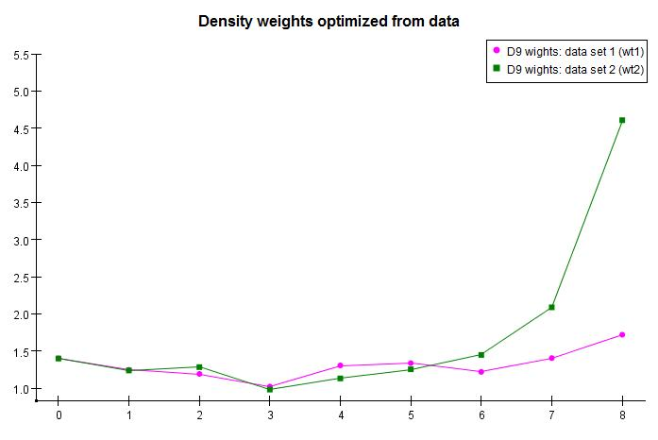
Next step: data
Burak kindly provided Fe data sample
  Particle identification and quality checks were all done
  Hit density, calibration constants were pre-calculated
  Positron energy: 2, 4, 6, 8, 10, 12, 16, 20, 25, 32, 40 (GeV)
  Pion energy: 2, 4, 6, 8, 10, 12, 16, 20, 25, 32, 40, 50, 60, 120 (GeV)
  Only used first 10K events (if there are that many) of each energy point
Weights were optimized with 2 sets of positron data (calibrated)
  Set I (wt1): 2, 4, 6, 8, 10, 12 (GeV)
  Set II (wt2): 2, 4, 6, 10, 16, 25 (GeV)
  Weighting is based on calibrated data (density calibration)
Set I energies are probably all too low

Slide 12
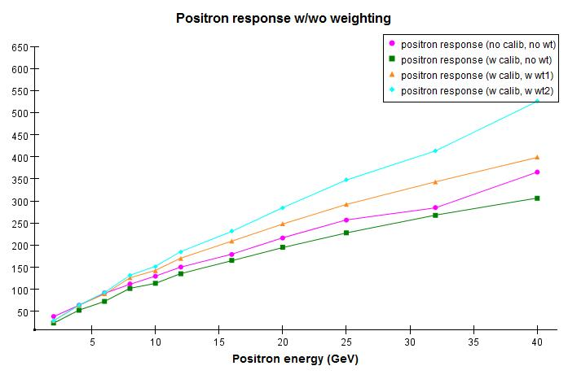




Positron response
$$19.82 ×E^{0.886}$$
$$25.34 ×E^{0.753}$$
$$24.06 ×E^{0.730}$$
$$21.45 ×E^{0.727}$$
It would probably be better if we had higher energy positron data

Slide 13
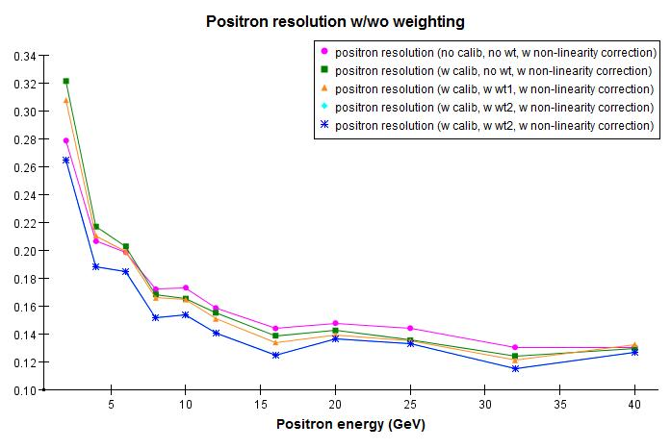
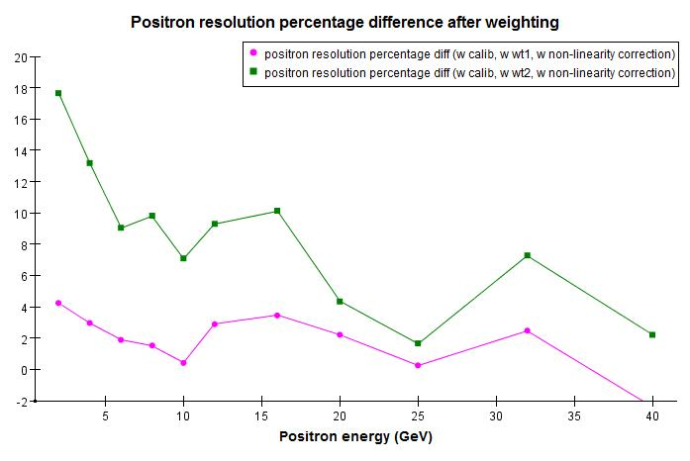
Positron resolution
Similar to simulation: no big gain for positrons

Slide 14
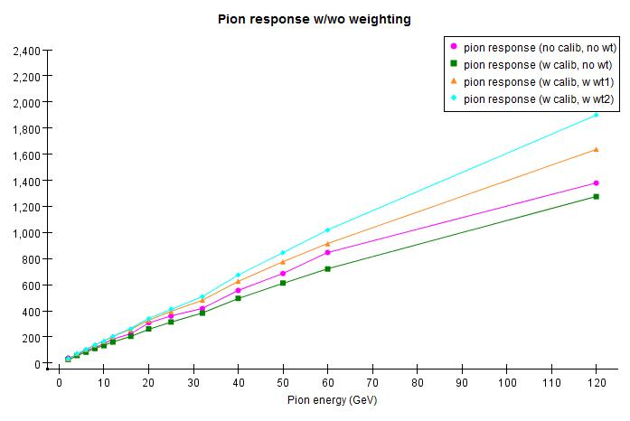




Pion response
$$15.94 ×E^{1.014}$$
$$18.41 ×E^{0.954}$$
$$15.74 ×E^{0.968}$$
$$15.12 ×E^{0.944}$$
As usual, pion fits are not very good compare to positron fits
120 GeV points are systematically low → Excluded from fits
Data points before calibration are quite scattered, fit value pulled up by 60 GeV point
Calibrated points (including the weighed points) are much smoother
Fit to entire distribution including tails (leading to higher apparent saturation
in calibrated data)

Slide 15
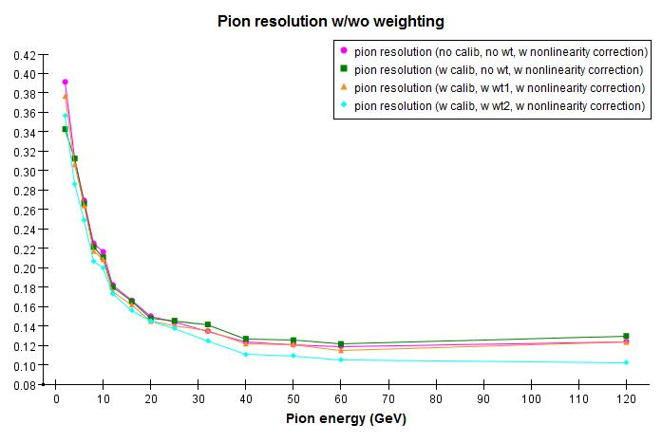
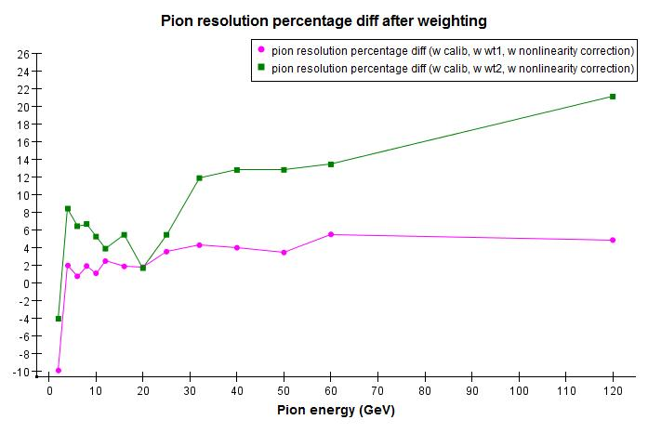
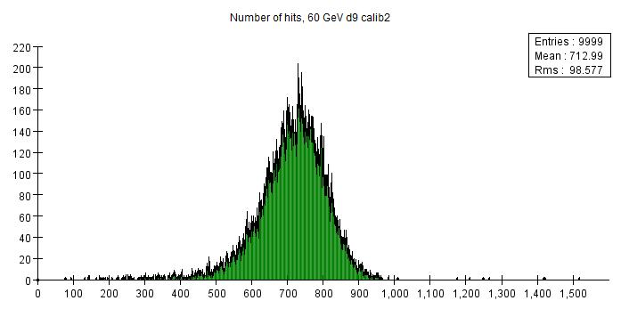
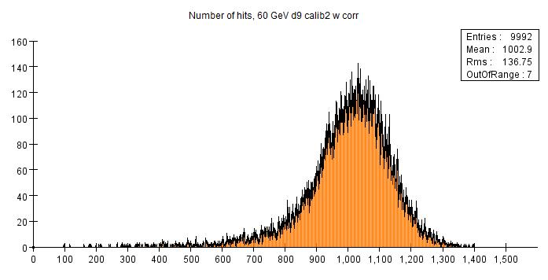
Pion resolution
Example: 60 GeV
Don’t see nearly as much improvement, but still systematically improved
Nhits distribution much more symmetric to start with
Weighting makes distribution more symmetric, but a long tail remains

Slide 16
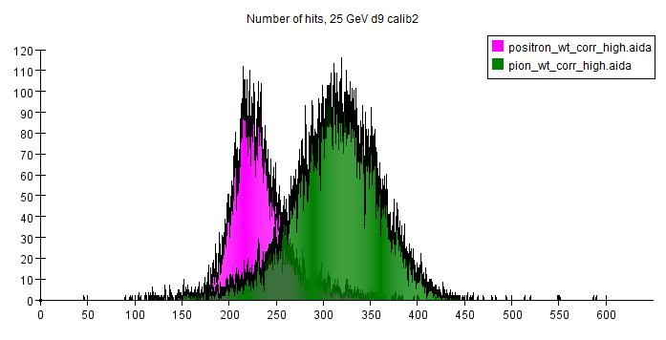
Possible reason I: data quality issue?
See long high-end tail in positron sample
Long low-end tail in pion sample
Both are absent in simulation
Could it be contamination?
The long tails seem to be a limiting factor for further resolution improvement

Slide 17
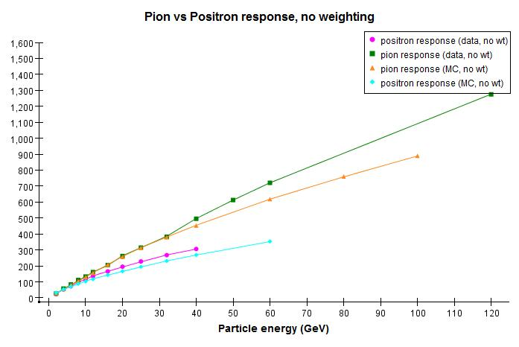
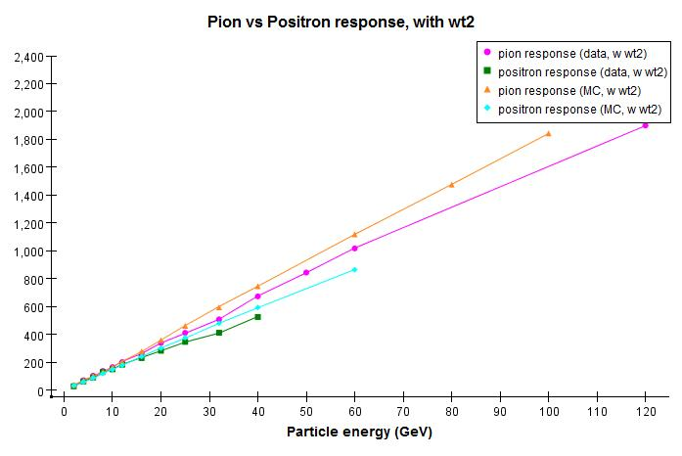
Possible reason II: EM response
Pion simulation agrees with data below 32 GeV
Positron simulation systematically lower than data and has worse linearity
e/p difference larger in simulation → worse pion linearity
e/p improved by weighting, in both data and simulation
Software compensation should further improve data resolution

Slide 18
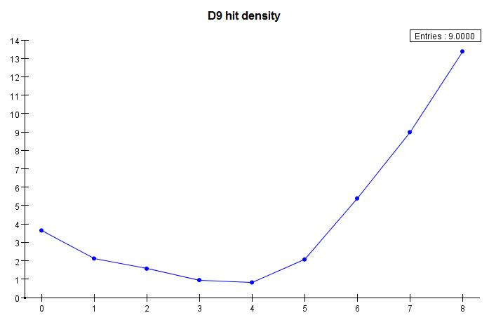
More density weighting
It seems that things work best with very different e/p responses and very non-linear EM response
One obvious place is W-DHCAL data: studies using simulated events
  Electron sample: 2, 4, 6, 8, 10, 20, 30, 40, 50, 60, 80, 100 (GeV)
  Pion sample: 8, 10, 20, 30, 40, 50, 80, 100, 120, 150, 180, 300 (GeV)
  Weights tuned with electron energy points: 4, 10, 30, 50, 80 (GeV)
weights
Density bin d9

Slide 19
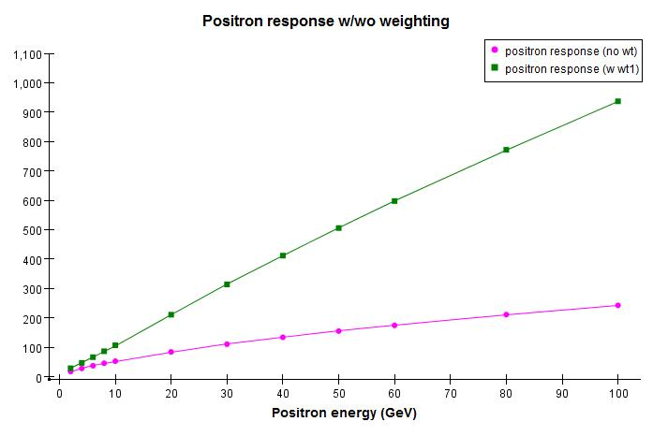


Electron response
$$13.780×E^{0.918}$$
$$11. 522×E^{0.663}$$
Response is highly non-linear without weighting
Weighting does a good job, as with the Fe-DHCAL
(tuning target was 10 Hits/GeV, again, arbitrary)

Slide 20
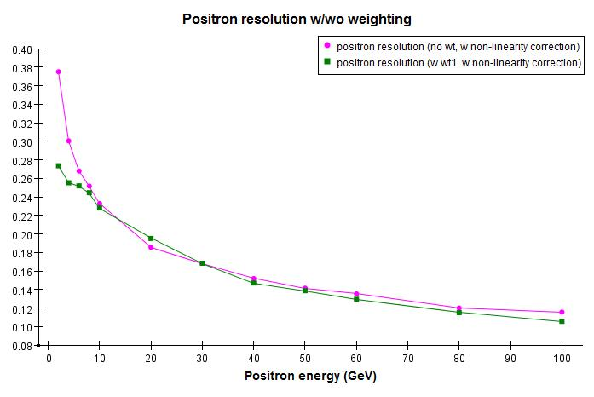
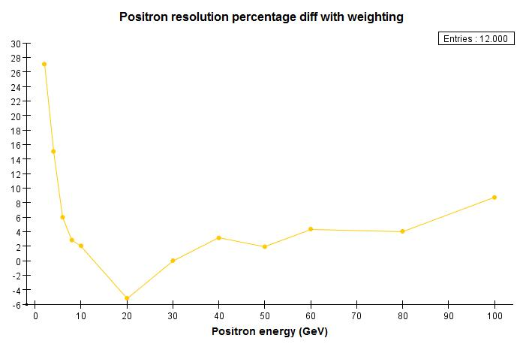
Electron resolution
As with the Fe-DHCAL, no significant improvement
Fits at low energy points are not reliable

Slide 21
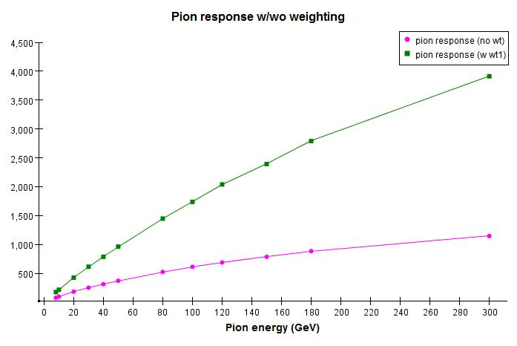


Pion response
$$35.520×E^{0.842}$$
$$22.826×E^{0.708}$$
As usual, fits are not great as compare to electron fits
300 GeV point systematically low → Excluded from fits
All high energy points are low probably due to bias from leakage cut
Fit parameters are also systematically low, probably due to the above reason
Nevertheless, linearity did improve significantly

Slide 22
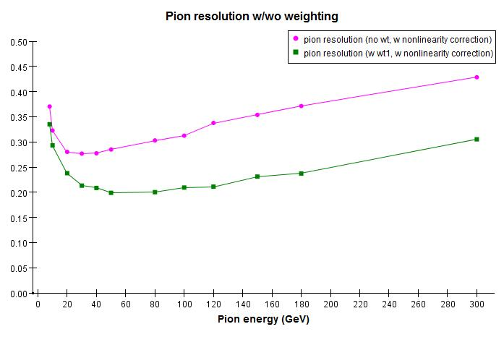
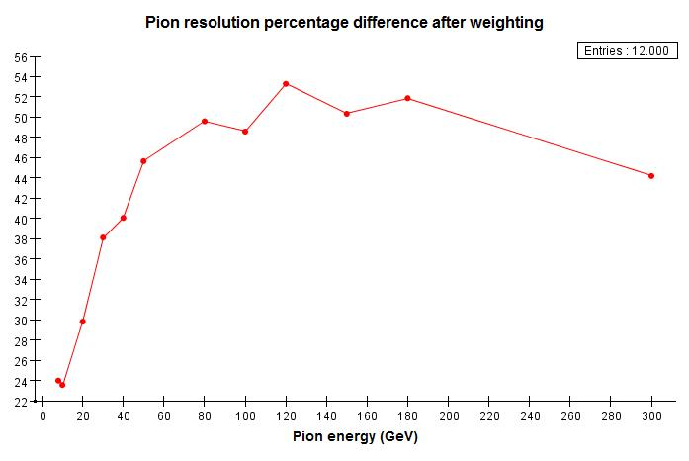
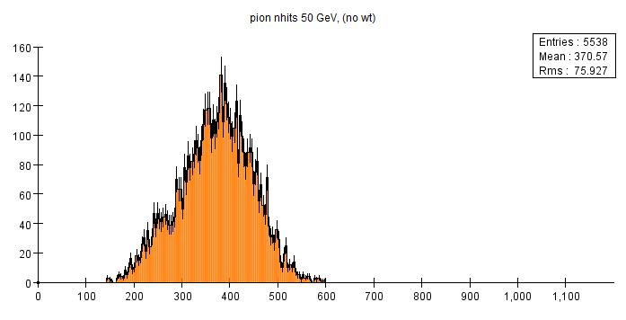
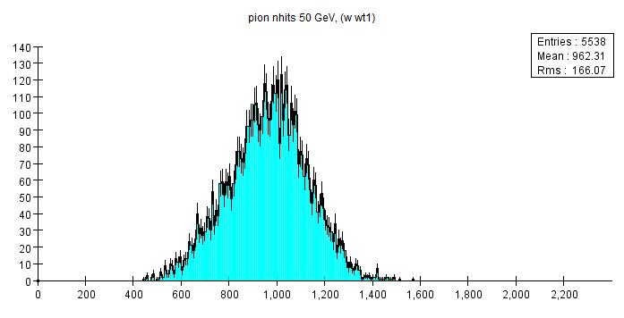
Pion resolution
Example: 50 GeV response
Energy resolution greatly improved over large energy range: 24 – 54%
Weighing improved distribution, but didn’t totally remove low end tail

Slide 23
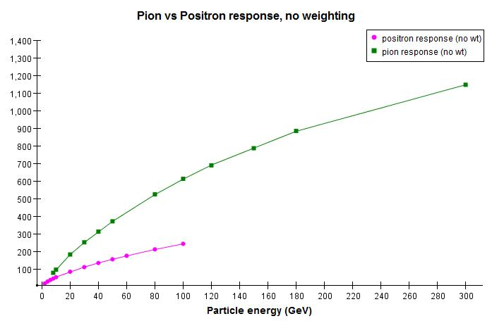
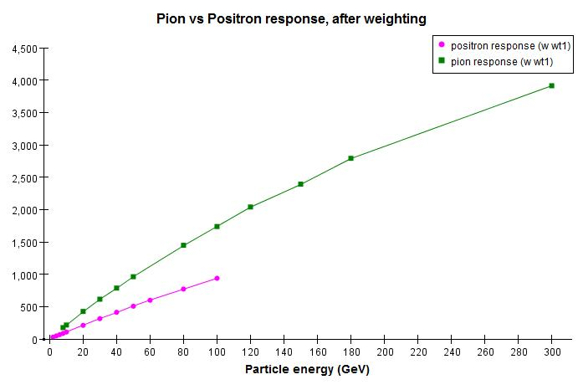
Pion vs. electron responses
Before weighting
After weighting
e/h improved with density weighting
Difference is still very large → ideal test bed for software compensation

Slide 24

Summary
Density weighting is able to achieve close to linear EM shower response for DHCAL
Using the same weights can improve linearity and energy resolution of pion showers
  Significant (~ 25 - 50%) improvement observed with Fe-DHCAL and W-DHCAL simulation
  Applying the same technique for test beam data results in somewhat more modest improvements (contamination of samples? MC simulation of em showers off?)
Pion and EM shower response are still quite different after weighting
  Chance for software compensation: work started
Once we have the method to get optimized energy resolution for DHCAL, we should think of optimizing the DHCAL design itself…

Slide 25
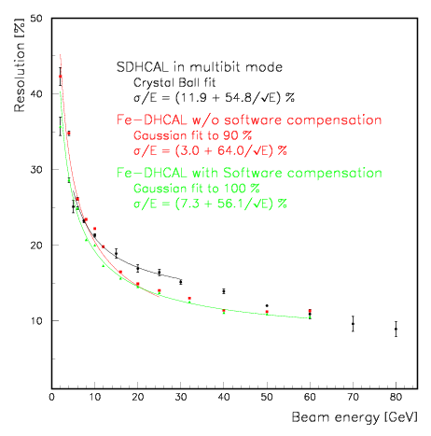
Comparison of Resolutions
Results with software
compensation still has
tails. Fit to 90% of entries
will result in significant
improvements.
Results with software
compensation not yet
preliminary. Additional
improvements very likely.

