Slide 1
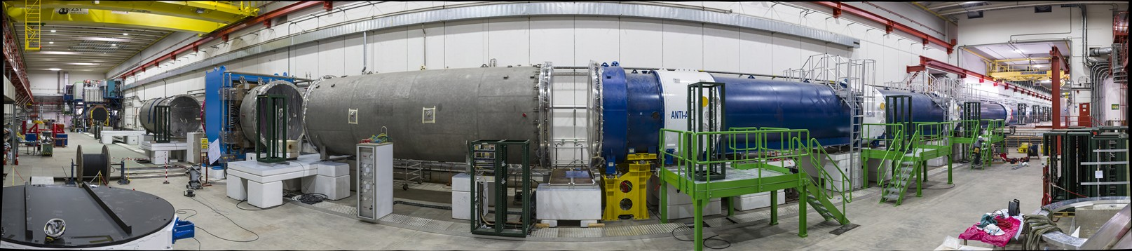

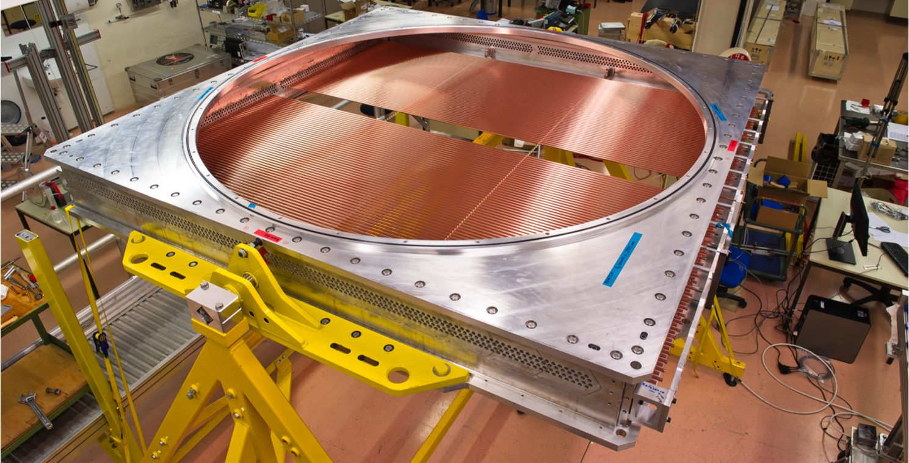
A Straw Tracker in NA62
From idea to detector
Notes:
1

Slide 2
Content
Introduction and first ideas Hans
Design and drawings Jordan
Construction and testing Jerome
On behalf of the NA62 straw team and PH-DT colleagues, in particular F. Perez Gomez, E. David and N. Dixon.
Notes:
2

Slide 3

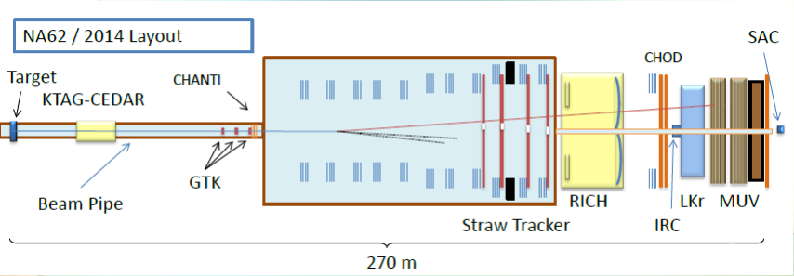
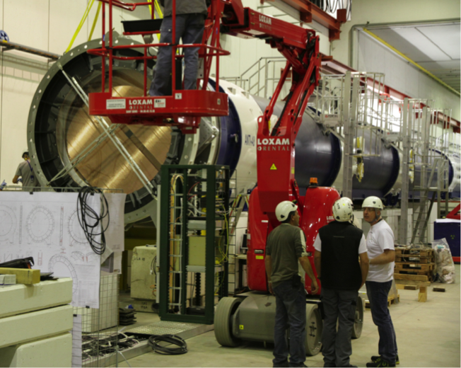
The NA62 experiment
NA62 is a fixed target experiment at CERN SPS
The main goal is to measure the branching ratio of the ultra rare kaon decay: with a precision better than 10% (BR ~10⁻¹⁰) i.e., ~1/10000000000
2012

Slide 4

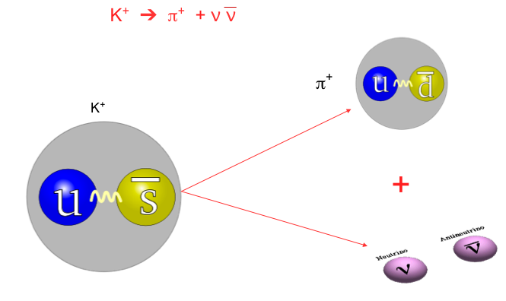
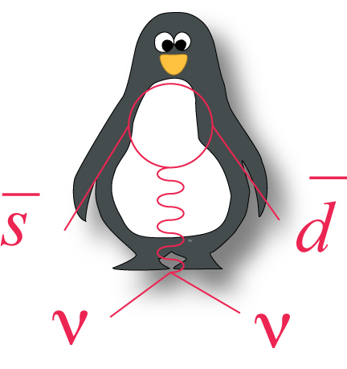
The study of Kaons

Slide 5
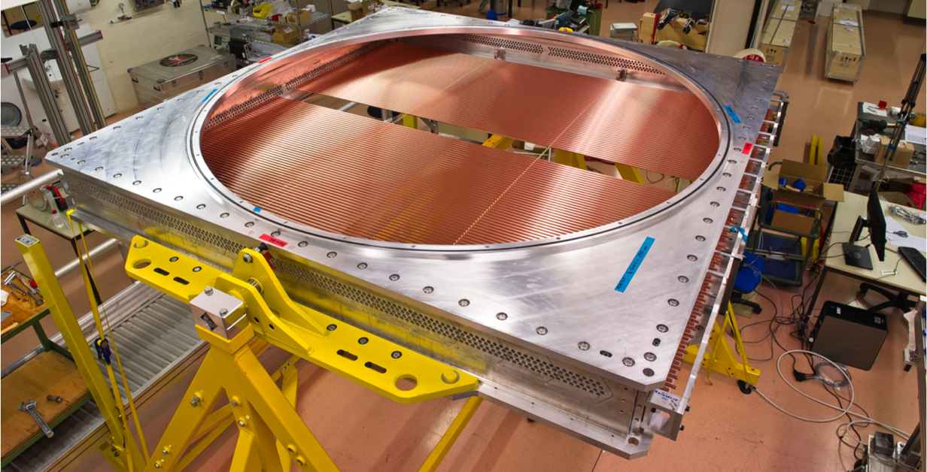
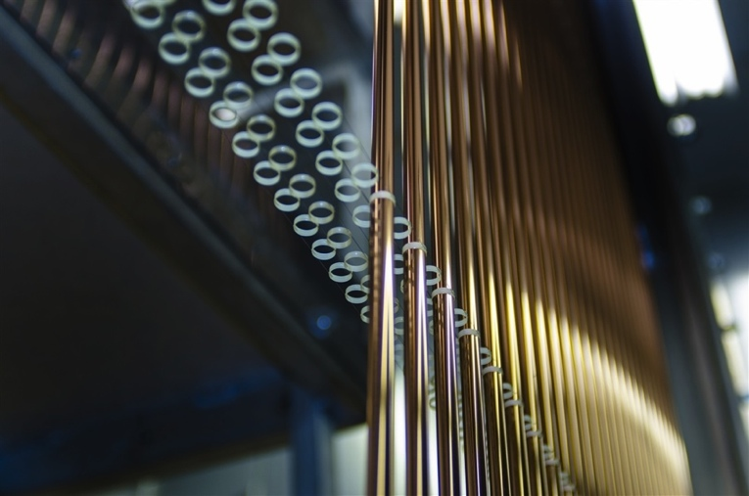
First ideas and design considerations
What is really new is the straw…in vacuum (10⁻⁵mbar)!
Modular design (16 straws) for safe operation as the straws will be operated in direct contact with the decay vacuum at ~1 atmosphere above the surrounding vacuum! Leak: < 1.5 cm³/day
Minimum amount of material
  Apply pre-tension to the straws (1.5 kg) to get straight straw with minimum supporting material (spacer)

Slide 6
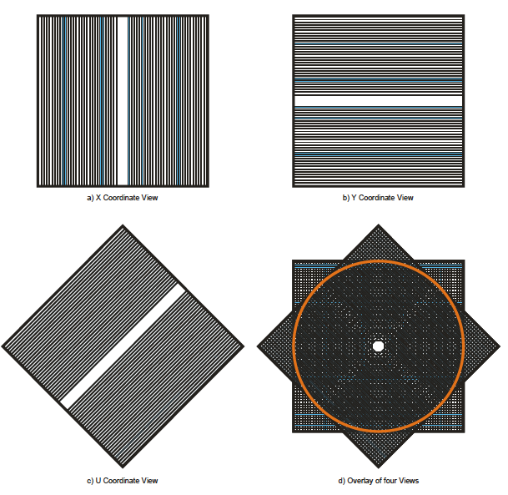
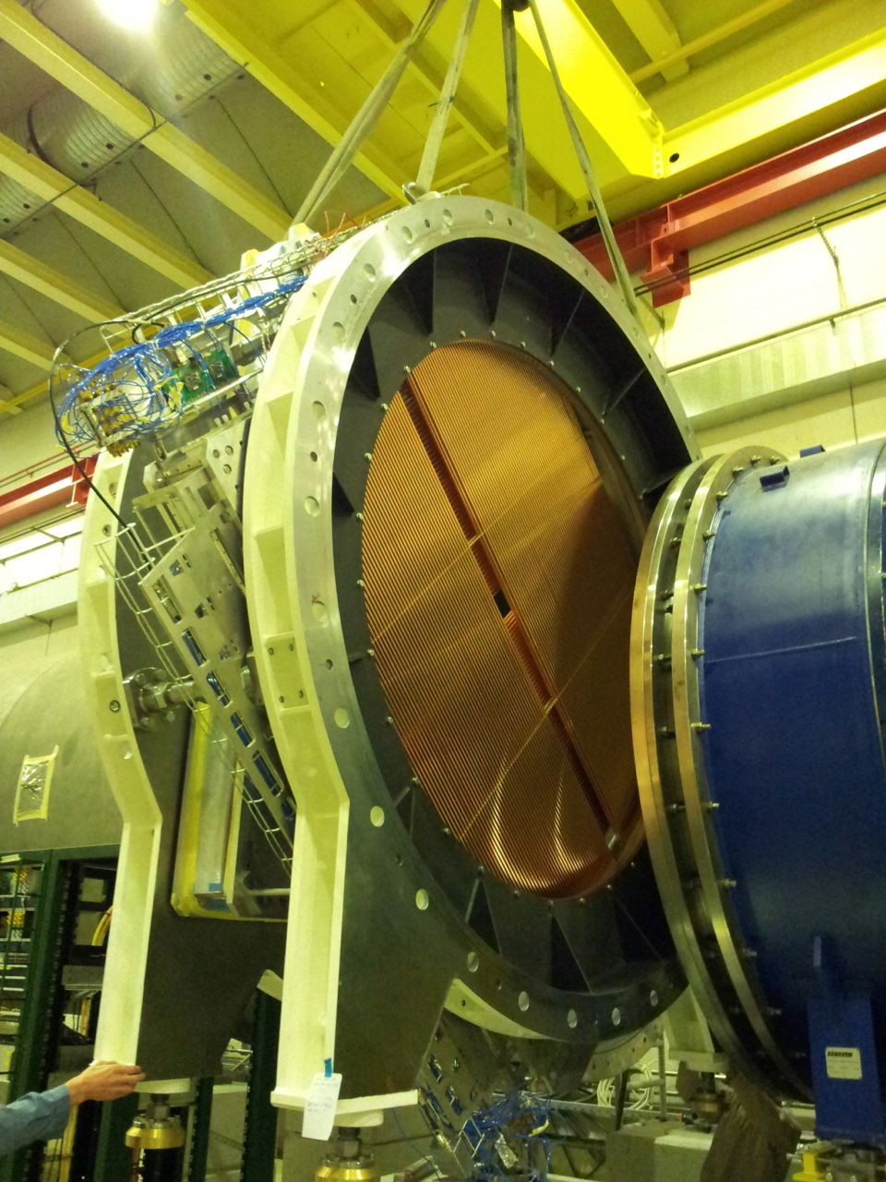
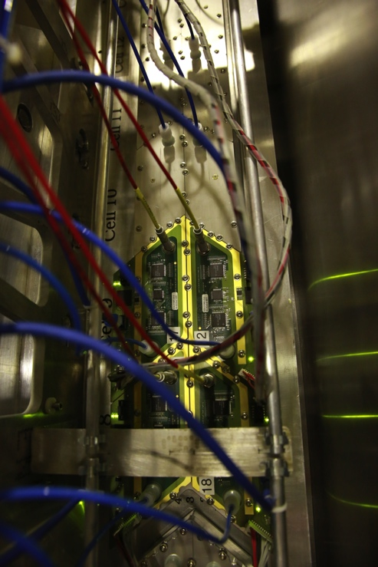
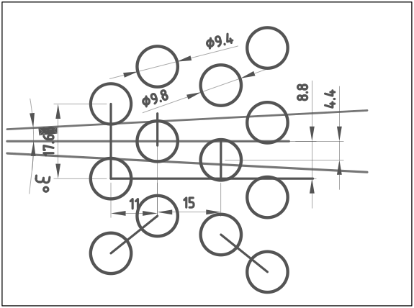
The detector layout
4 views: x,y,u,v
Each view (448 straws) gives one coordinate
x
y
2.1m
u,v
Straw layout in one view
π⁺

Slide 7
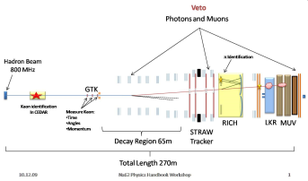
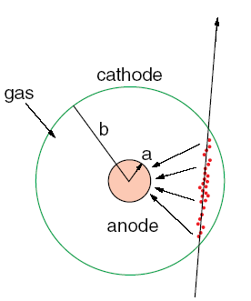
The straw
Straw construction
  2.1 m long tube with a diameter of 9.8 mm
  The base material is Poly Ethylene Terephthalate (PET) with thickness of 36 μm
  The foil is coated on the inside with 50 nm of Cu and 20 nm of Au by sputtering
The electrical properties and operation
  The anode wire is 30 μm in diameter and made from gold-plated tungsten
  Resistivity of anode: 50 Ohm and resistivity of cathode: 70 Ohm
  HV 1750 V and gas mixture: Ar (70%)+ CO₂ (30%)
36 μm PET
50 nm Cu
20 nm Au

Slide 8
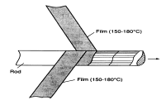
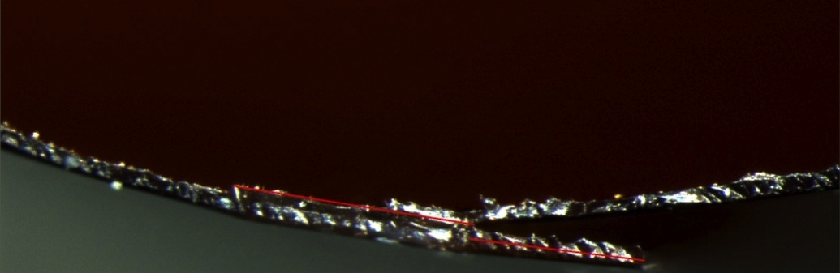
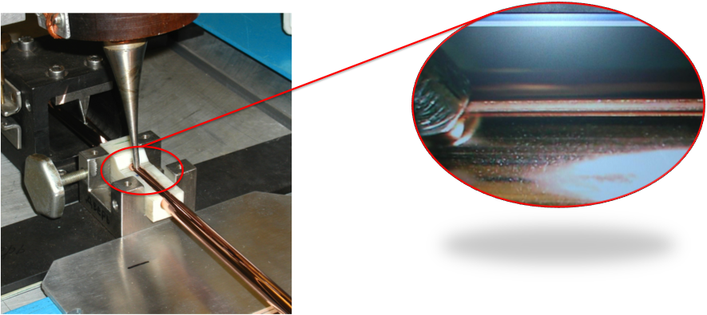
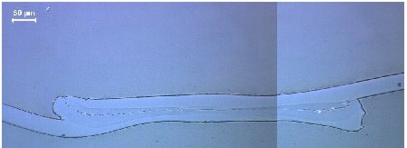
Ultrasonic welding of straws
“Classical straw winding”
Microscope pictures of a straw cross- section for quality control of the weld
Ultrasonic welding
600 μm
Straw Quality Control:
  All straws are leak tested after a short (15 min) pressure test at 3 bar
  The strength of the weld is verified at both straw ends (traction test)
  The electrical conductivity between the two straw ends is measured

Slide 9


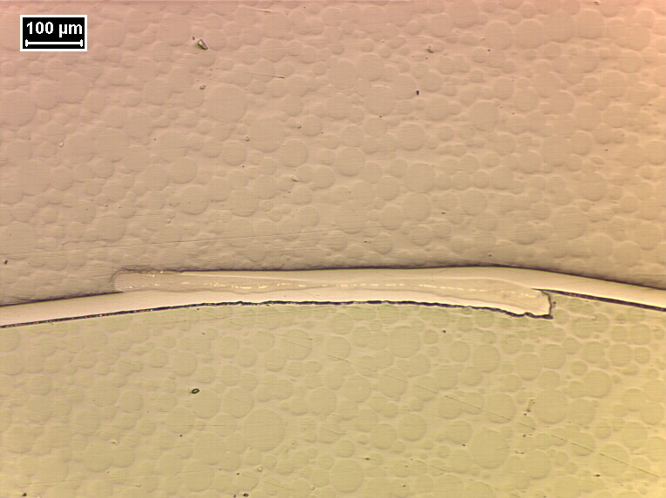
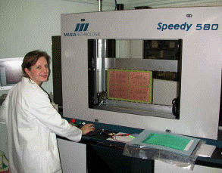
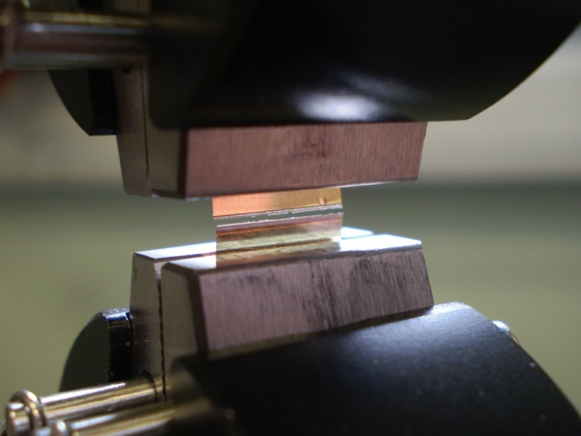
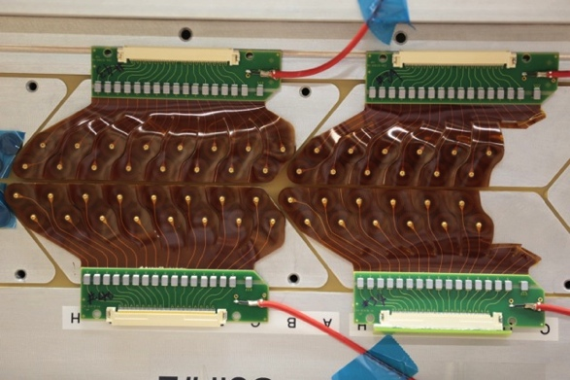
Strategy
Use the competence at CERN. Three examples:
PCB work shop! Since 1/1/2014 PH-DT !! ☺
Notes:
9

Slide 10
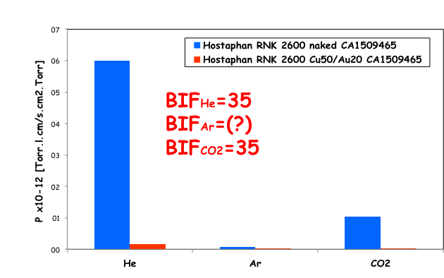
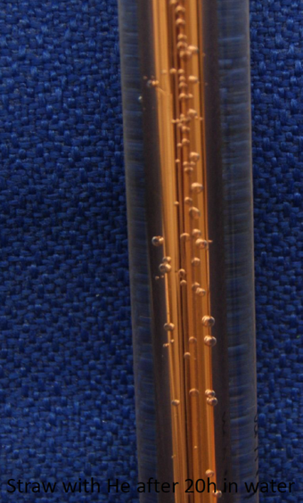
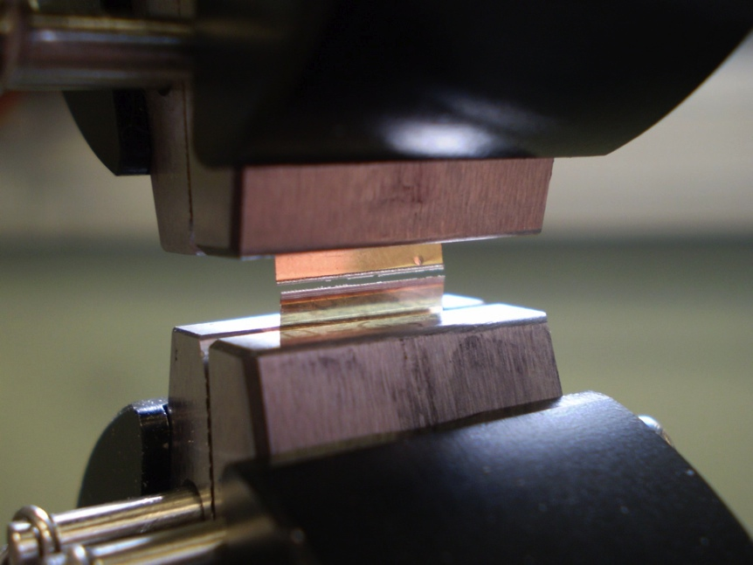
Straw development – 3 years of studies!
Company SEFAR (CH)
TE-VSC
EN-MME
16 km of welded
straws !!!!!!!

Slide 11
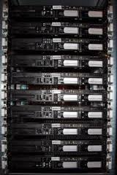
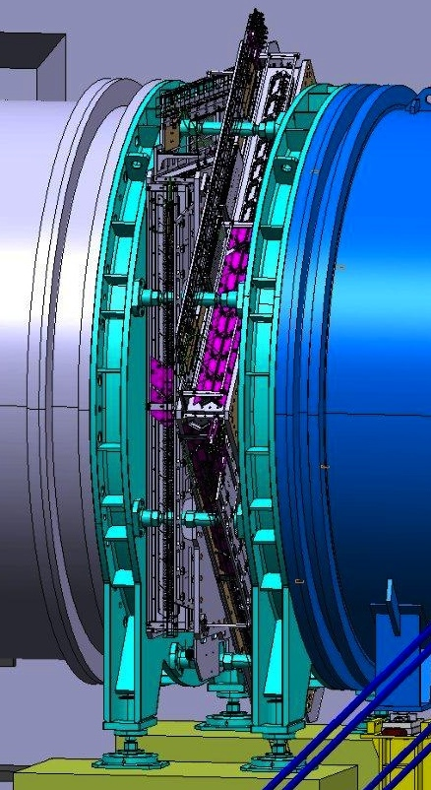
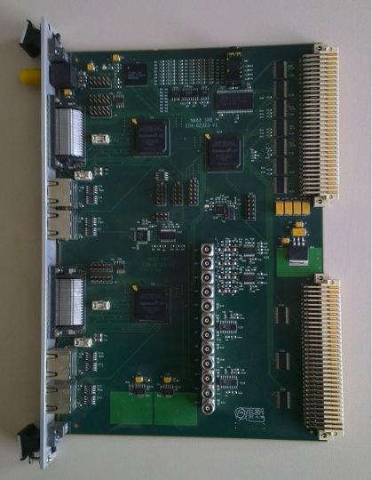
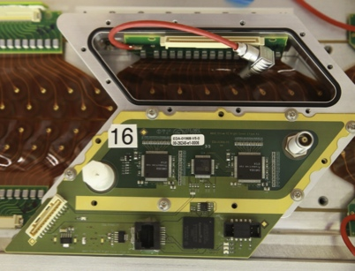
NA62 straw electronics and readout
PH-DT + PH-ESE
PC farm
Each “cover” has two 8-channel front–end chips, “CARIOCA”, developed for the LHCb muon tracker (MWPC).
On-detector TDC based on FPGA with a <1ns intrinsic resolution
Straw
Readout (+control) Boards
2 SRB/view
30 Front-End “covers”/view
2 Fibers
2 Gbit/s
Serial link

Slide 12
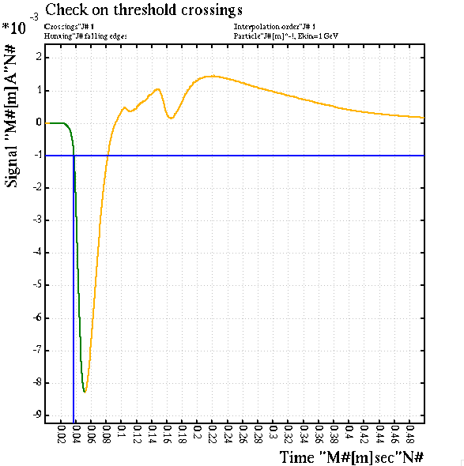
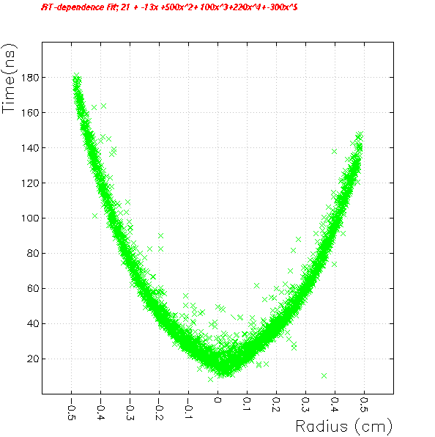
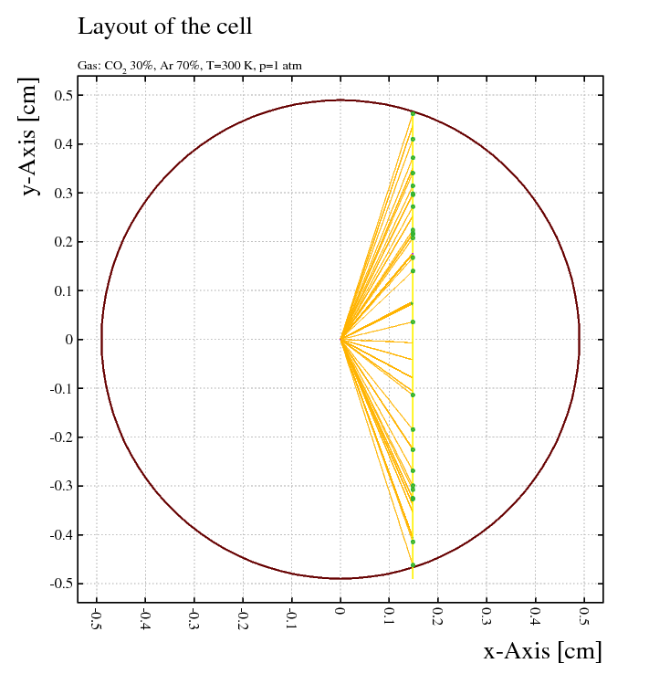
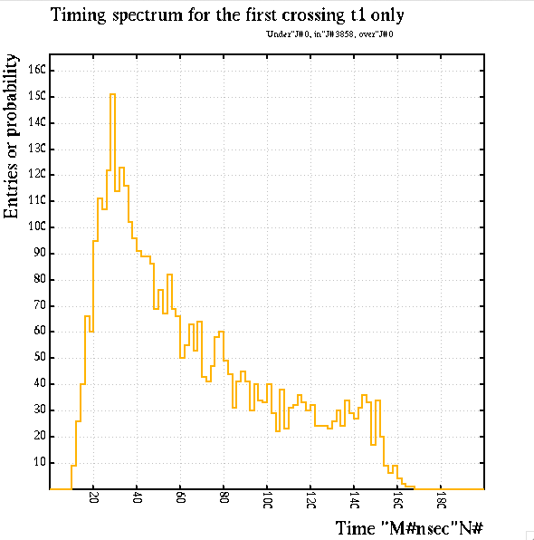
Simulations with Garfield
Cluster production
R-t dependence
Time spectra
FE electronics response

Slide 13
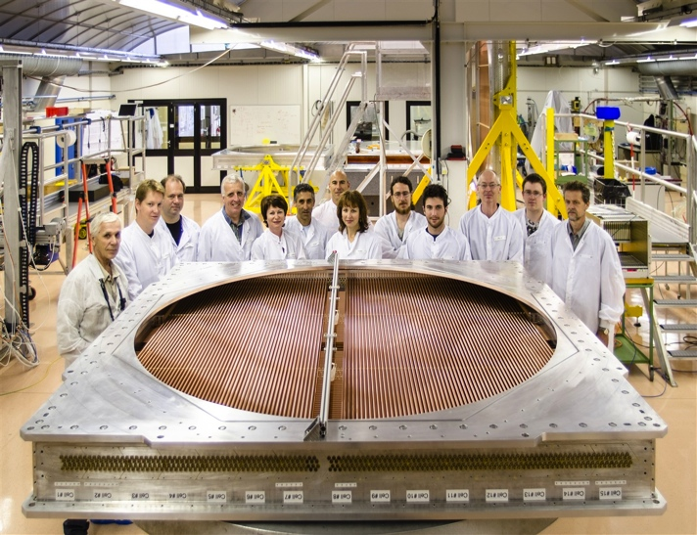
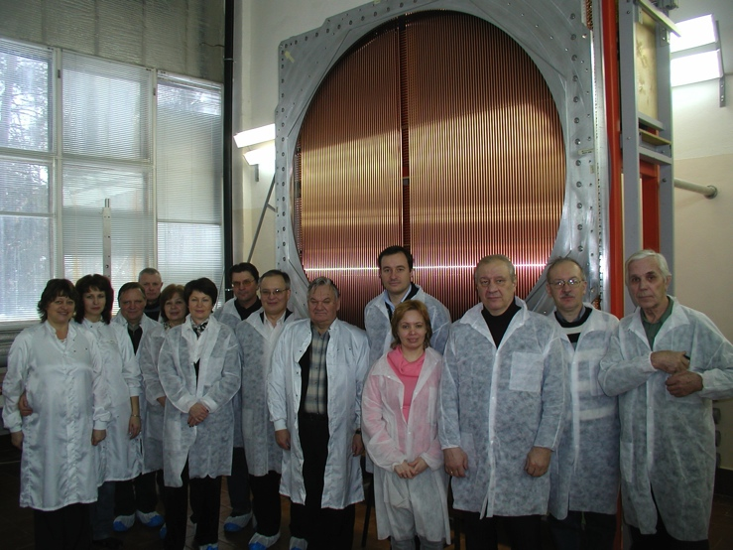
The NA62 Straw Collaboration
CERN
  PH/DT: Design, development, prototyping, procurement, coordination, assembly…
  PH/ESE: development electronics, readout
Dubna: straw production , module assembly, software
Notes:
13

Slide 14
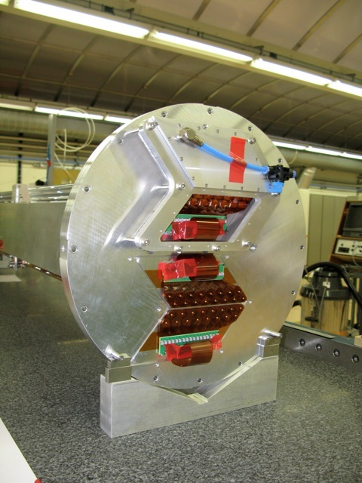
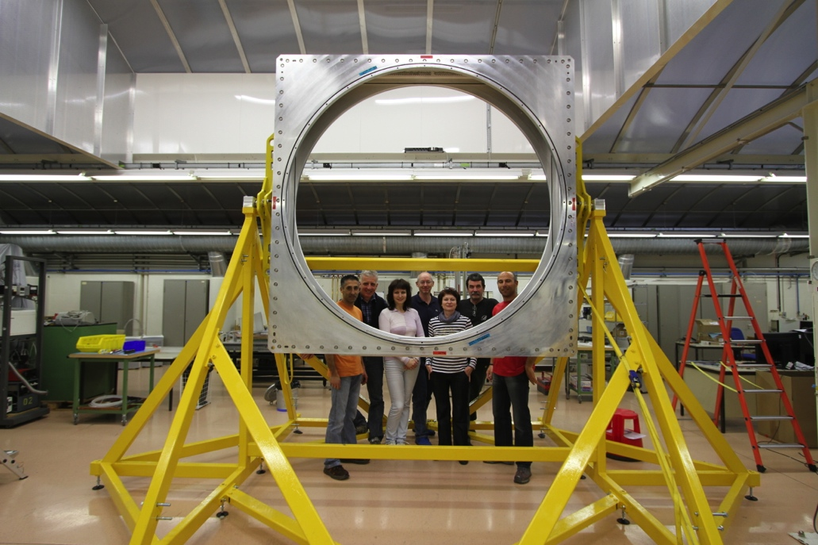
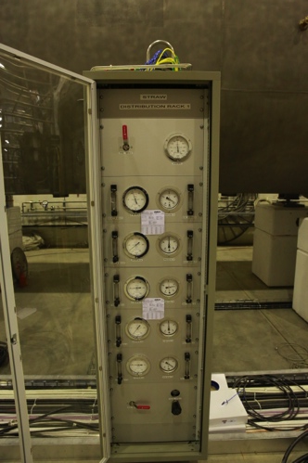
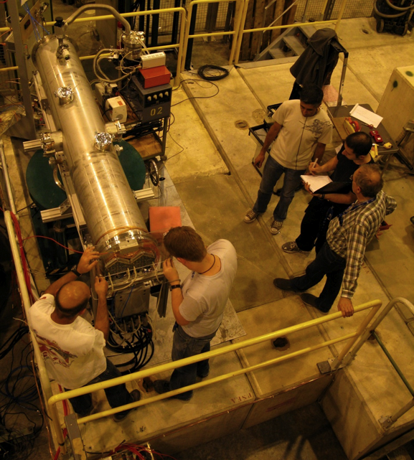
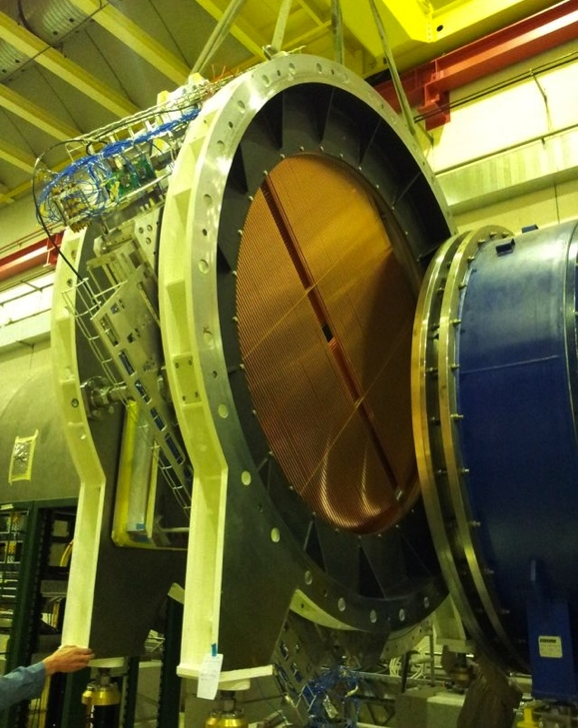
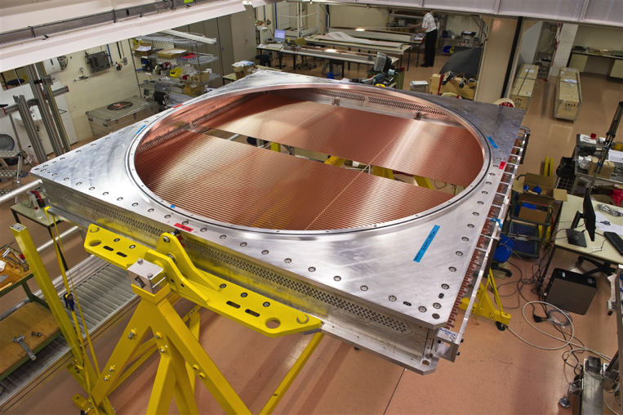
Time line
Pre-study 2007-2008
Prototypes 2009-2010
Module 0 in 2011-2012
Construction & installation 2013-2014 (now!)

Slide 15
The PH-DT involvement :
Detector layout and development
Mechanical design and FEM calculations
Prototyping and tooling
Gas system
Testing and QC
Simulations of detector performance
Aging studies
Test beam and performance studies (cosmics)
Detector cosntruction
Integration assembly commissioning…..

Slide 16
Design and Drawings
Jordan

Slide 17
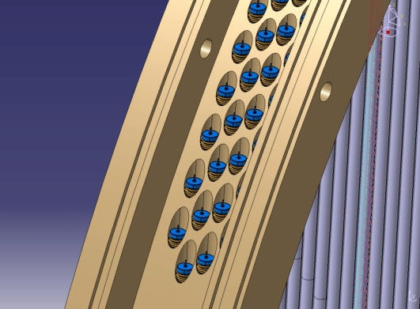
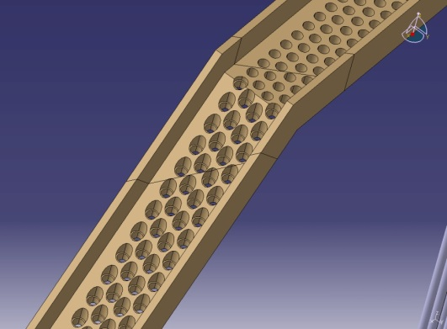
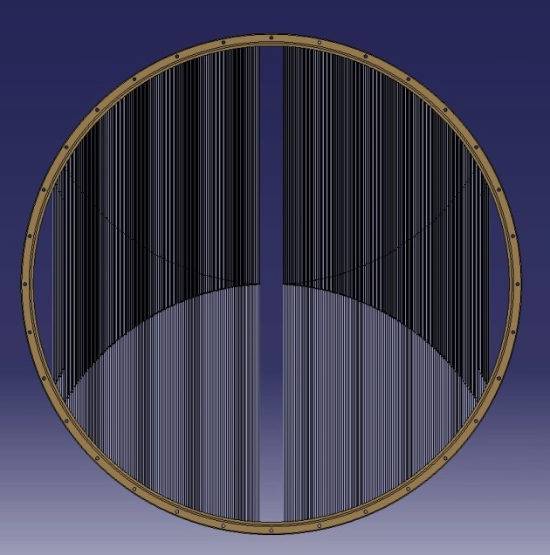
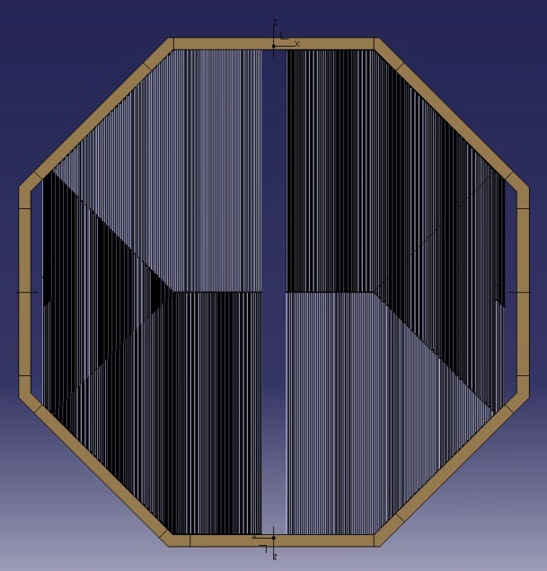
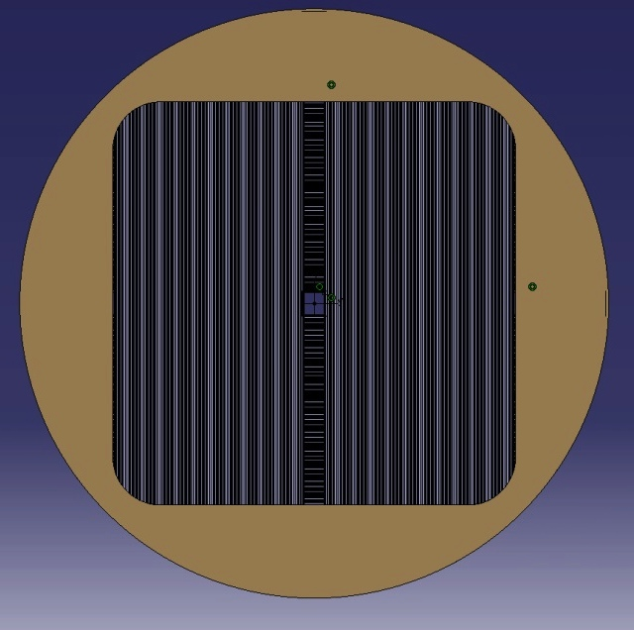
2007
Avant-Projet:
3 propositions en fin d’année.
4 modules Ronds
4 modules Octogonaux
2 modules Carrés

Slide 18
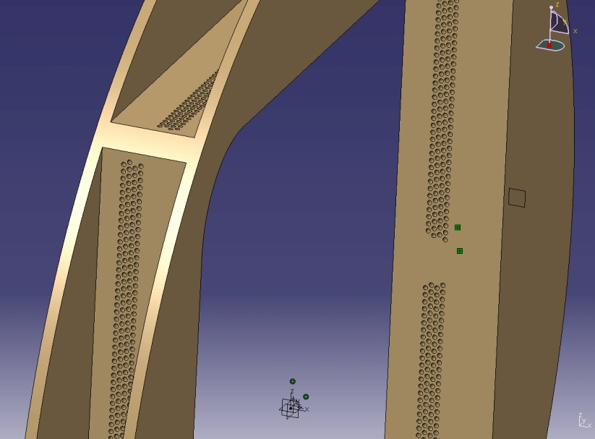
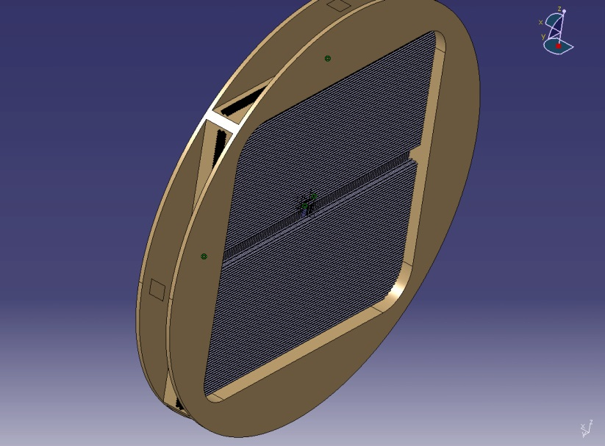
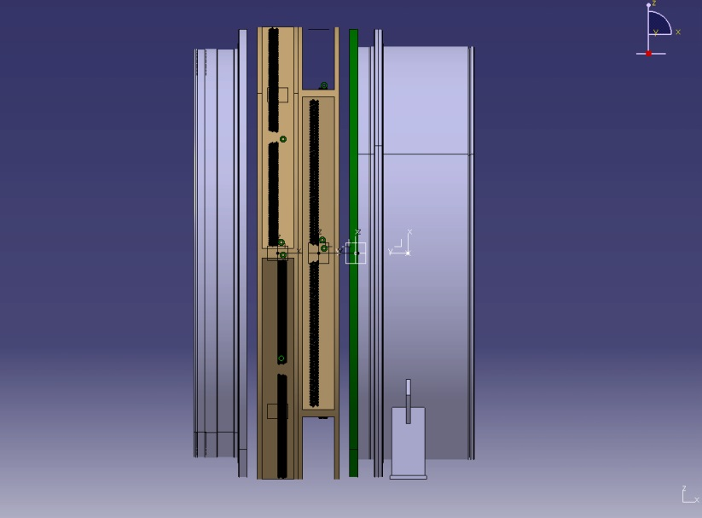
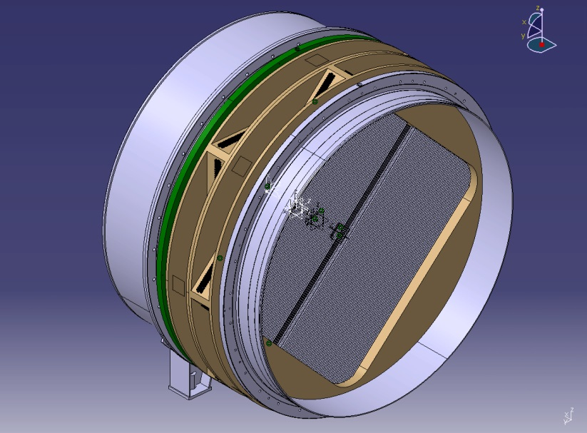
2008
Choix du module Carré.

Slide 19





2008
Choix du module Carré.

Slide 20

2009
Réalisation d’un prototype

Slide 21

2009
Réalisation d’un prototype

Slide 22
2009
Réalisation d’un prototype

Slide 23


2009
Développement du circuit WEB:

Slide 24


2009
Création Plug HV.

Slide 25


2009
Réutilisation des Pins de
sertissage du TRT d’ATLAS
Création Plug HV.

Slide 26

2010
Début de l’étude
Position des pailles sur le module:

Slide 27

2010
Début de l’étude
Assemblage d’un module:
Notes:
Un module est donc composé de 4 poutres support précisément positionnées et boulonnées entre deux flasques.
Des usinages dans ces deux flasques permettent d’assembler deux modules entre eux, et d’assurer l’étanchéité avec un o-ring de +ou- 7m de long.

Slide 28

2010
Début de l’étude
Usinage partitions :

Slide 29



2010
Pièces de connexion:
Etude réalisée par l’institut de DUBNA

Slide 30

2010
Pièces de connexion:
Etude réalisée par l’institut de DUBNA

Slide 31
2010
Pièces de connexion:
Etude réalisée par l’institut de DUBNA
Notes:
Ces pièces permettent de fixer une chambre (2modules) sur les xxxxxxxxxxxxxxxxxxxxxxxxxxxxxxxx

Slide 32

2011
Recherche de partenaires pour la fabrication.
Suivi de la réalisation des premières pièces prototypes.
Contrôle qualité des pièces livrées
Suivi du premier montage.
Mise au point Modifications Améliorations
Suivi du lancement des pièces séries.
Reception 1:er module 03/2011
Notes:
Durant l’année 2011, il a fallu rechercher des partenaires pour la fabrication des éléments composant un module.
Une fois les partenaires trouvés, il a fallu suivre le déroulement de la fabrication, contrôler les pièces livrées, commencer le montage du Module 0.
Une fois le module 0 monté, testé, il a été validé, puis il a été décidér de le passer en Module 1. Il est donc devenu le module U-V de la première chambre.
Il a ensuite fallu relancer la fabrication des 15 modules restant, et recommencer le même processus, suivi de fabrication, contrôle, et montage.

Slide 33




2012
Outillage de «STACKING»:

Slide 34
2012
Outillage de «STACKING»:

Slide 35
2012
Outillage de «STACKING»:

Slide 36


2012
Outillage de «STACKING»:
Notes:
Le montage des modules se réalisant en partie dans le bâtiment 154, il a fallu concevoir et réaliser un outillage permettant de le montage de deux pièces de connexions, ainsi que 2 modules en position horizontal.
Grace à une rotation motorisé et deux contre-poids, il fut possible de repositionner cet assemblage de 5T (3.8T pour les deux pièces de con. + 1.4T pour la chambre) pour permettre l’élingage et le transport jusqu’à l’ECN3.

Slide 37

2013
Service
Active Side
Notes:
Pour la partie Service, il y a deux versions, le coté ACTIF, avec les patch panel HV et LV, les manifolds pour le retour GAZ, ainsi qu’un chemin de câble pour l’acheminement des câbles nécessaire.
Cet élément est non solidaire de la chambre, il est assemblé en 154, il permet le montage des pieds de renfort après sa mise en place .

Slide 38

2013
Service
Passive Side
Notes:
Et le coté PASSIF, avec l’assemblage des manifolds pour l’entrée de Gaz.
L’alimentation jusqu’aux manifolds est faite depuis les rack GAZ, et ensuite la distribution sur chaque cover est faite par un enroulement d’un capilaire formé pour chaque position (ils font tous 3m de long).

Slide 39

2014
Notes:
Voila donc un ensemble complètement équipé !

Slide 40
Jérôme
Prototype 64 Straws
Gluing and Vacuum Test
Assembly and Testing
Quality control and testing during assembly
Leak Test and Repair
High Voltage measurement the Front End cover
Current status

Slide 41



Prototype 64 Straws:
- 32 Straws Cern
- 32 Straws Dubna
Straws
Side Dubna
Partition Prototype
with 1 cover
Side Cern
Spacers
Web Prototype

Slide 42




Gluing and Vacuum Test
2- Vacuum Test
. pressure 10⁻³ mbar
. ~3 days
1- Sealing Angles
. DP 490 Epoxy 3M
. ~ 160 m of gluing
3- Module on frame
. Rotation 360°
. Wight ~ 1,5t

Slide 43





Assembly 1
. Spacers & Straws installation:
. 128 spacers (15360 rings)
. ~ 7200 straws for 8 modules
Cutting End-Straws
28 straws
1 Layer

Slide 44


Assembly 2
. Wiring Machine:
. ~ 16 km of wire
. Thickness 30µm ( W/Au)
.Installation WEB:
. 480 pcs

Slide 45




Module assembly at CERN (4pcs)
The straws are inserted straight in horizontal position and glued in vertical position
Dedicated tooling keep the straws under tension, during the gluing process (1,5kg)
Each straw is guided in two points along its length by light weight spacers anchored in the module frames.
The straws are floating with respect to the spacer and are positioned with a precision of ~ 20μm

Slide 46



Module assembly at Dubna (4pcs)
The straws are inserted straight in vertical position and glued
Dedicated tooling keep the straws under tension, during the gluing process (1,5kg)
Each straw is guided in two points along its length by light weight spacers anchored in the module frames.
The straws are floating with respect to the spacer and are positioned with a precision of ~ 20μm
. The module rotate about Z axis

Slide 47

Quality control and testing during assembly
Leak testing at different stages
  The Aluminum frames and the straws are leak tested before wire installation
  Specifications: 1mbar x cm³/min/straw (mainly diffusion of CO₂)
Straw straightness measurement
Straw tension verification
  An infrared emitter/receiver measures the natural frequency of the straws and the straw tension is calculated
  A straw is replaced if tension is < 70% of its nominal value
Wire tension measurement
  A mechanical test of the wire tension is used by applying a fixed force (F) on the crimp tube (visual inspection)
High Voltage (HV) tests
  A first HV test is carried out once the web are installed and a second HV test after the wires are inserted. The current is measured. In a second test, the front-end cover board is read out in order to look for micro discharges.
F

Slide 48



Quality Control
. HV Test
. Straw straightness and tension measurement
. Leak Test & HV Test

Slide 49




Measurement of the straw straightness
A laser device measures the distance to the straws and the x-position of the center is found
A decoder measures the x-position in each straw layer (top, center and bottom position)
The nominal distance between two adjacent straws is 17.6 mm

Slide 50




Leak Test and Repair
Test 4 Cells and more..
Test 1 Straw
Leak Measurement
Search leak

Slide 51


High Voltage measurement the with FE cover
The final high voltage test is performed with the front-end cover installed
A threshold scan is performed to detect activity on individual channels. Noisy wires are replaced
Time: 1s/ch

Slide 52




Modules in 154
Ch1, Ch3 ready to receive FE covers
Ch2 module UV (tested and validated) ready to receive FE covers
Ch1 XY & Ch2 UV
Installation 2014!!
Ch3 XY
Ch3 UV
Ch1 UV

Slide 53



Stacking Bldg. 157
Chamber in vertical position
The Team who prepare the Stacking
2012

Slide 54


Detector handling & transport
. Handling by GS Group
Technical Run
. Truck goes to ECN3

Slide 55


Installation and integration
. Integration between two sections (blue tubes)
. Final installation services
ECN-3

Slide 56




Education & Visit
It’s with pleasure that we welcome you to visit our assembly area….
Every year, many students come to visit us…
Building 154
EDIT school 2011

Slide 57
Spares

Slide 58



Technical Run in November 2012
One module (896 straws) was successfully operated in vacuum for > 2 months
Measured leak = 1.56x10⁻² mbar x l/s
A measurement of the beam profile was performed using the straw chamber
Beam center

Slide 59





Picture of straw layout hand drawing 2007-2009

Slide 60


Slide 61



Stacking

