Slide 1
New Baseline Design for the
H⁰/H⁻ Beam Dump
Wim Weterings TE-ABT
Presenting work from: Bruno Balhan; Elena Benedetto; Jan Borburgh;
Chiara Bracco; Melanie Delonca; Robert Froeschl; Marco Garlache;
Brennan Goddard; Jan Hansen; Klaus Hanke; Cesare Maglioni;
Bettina Mikulec; Antony Newborough; Alexandre Ouzia; Benoit Riffaud; Federico Roncarolo; Laurent Zucalli; Francesca Zocca
LIU-PSB meeting 118, 23-01-2014

Slide 2
Introduction
The ISSUE:
- Low Z material initially specified for RP considerations;
- SiC was selected;
- Problems with swelling and risk of breaking;
- Estimates are 1-2 years lifetime, before preventive maintenance is needed;
Goal to have a 4 year operational lifetime to match LHC cycle;
Friday Morning PBU Injection Meeting:
Proposal for external metallic dump, using Titanium, but some potential issues to solve….

Slide 3
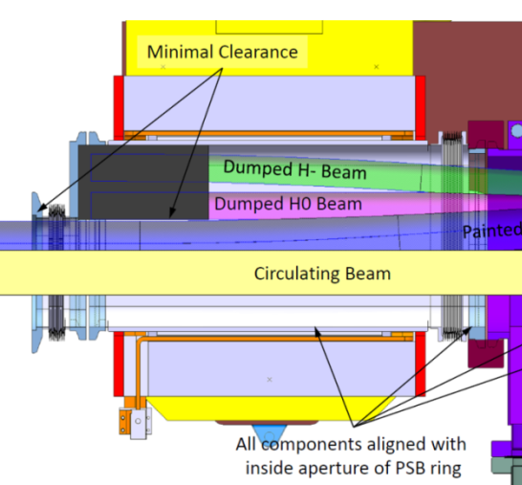
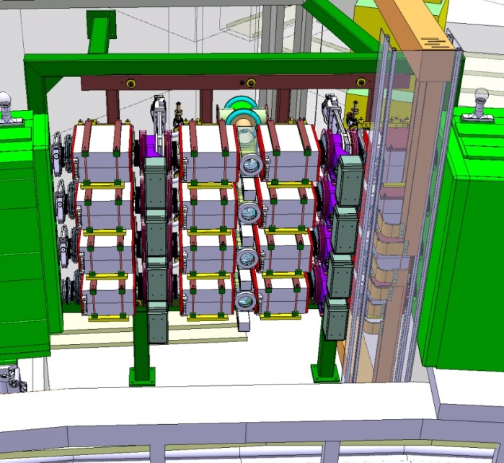
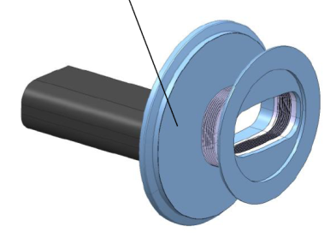
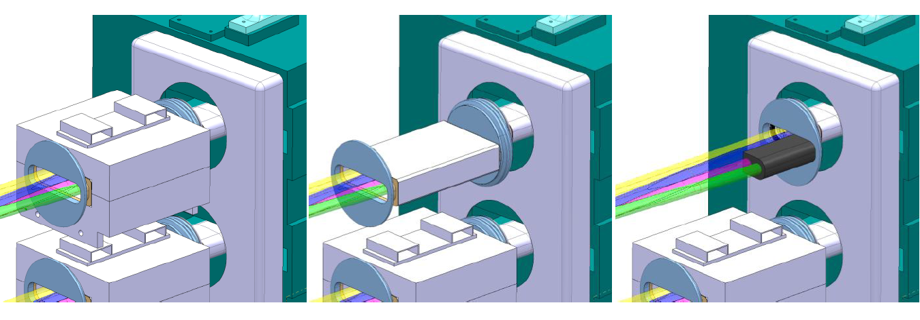
Current Baseline Concept
EDMS: 1163508
Cooling system
(on the back) ?
KSW4 Magnet
Inconel chamber
H0/H- dump inside BSW4 magnet
Instrumentation for foil efficiency monitoring
(on the front)

Slide 4
History of changes
EDMS: 1320006
2010 - First conceptual study, AlN, BN or Graphite – Graphite is retained due to RP and other considerations here, here , here and here.
2011 – No pumping is possible for the added degassing from a graphite dump, brazing is problematic → new material study started
2012 – Al2O3 : high risk of electrical charging
2013– SiC : baseline retained by reviewers,
swelling issue to be studied
Outcome of Internal Review,
INDICO 244116

Slide 5
Possible design concepts
EDMS: 1320006
Actual Baseline :
Bulk SiC dump inside the magnet (review)
Under study :
Alternative 1) Sliced SiC dump inside the BSW4
Alternative 2) outside⊕ metal + sliced SiC dump inside
  → need 5cm behind BSW4
Alternative 3) Full metal dump outside⊕ the magnet
  → need 8-9cm behind BSW4
⊕ outside = in the space between BSW4 and BHZ11

Slide 6
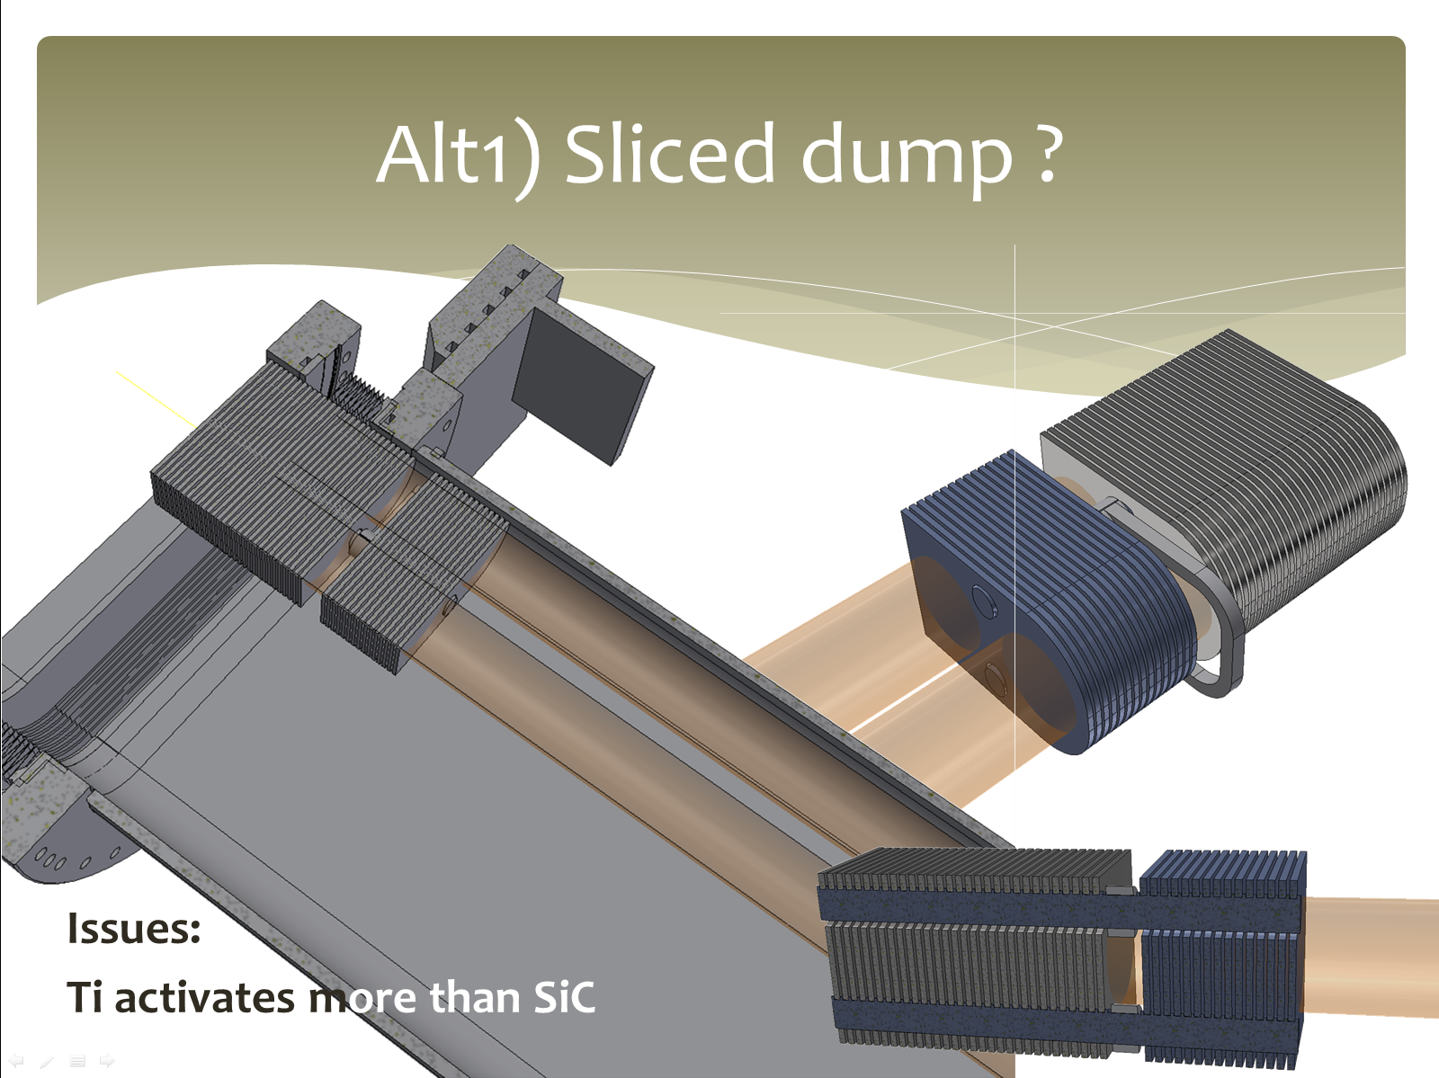
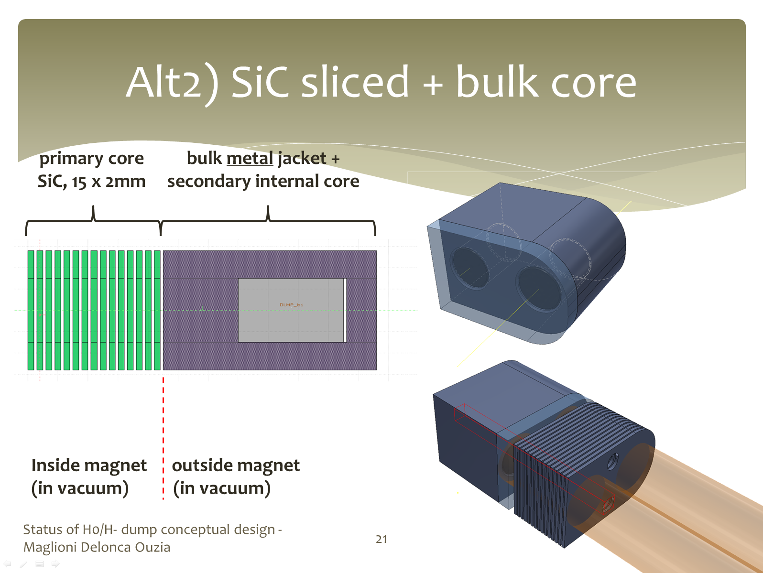
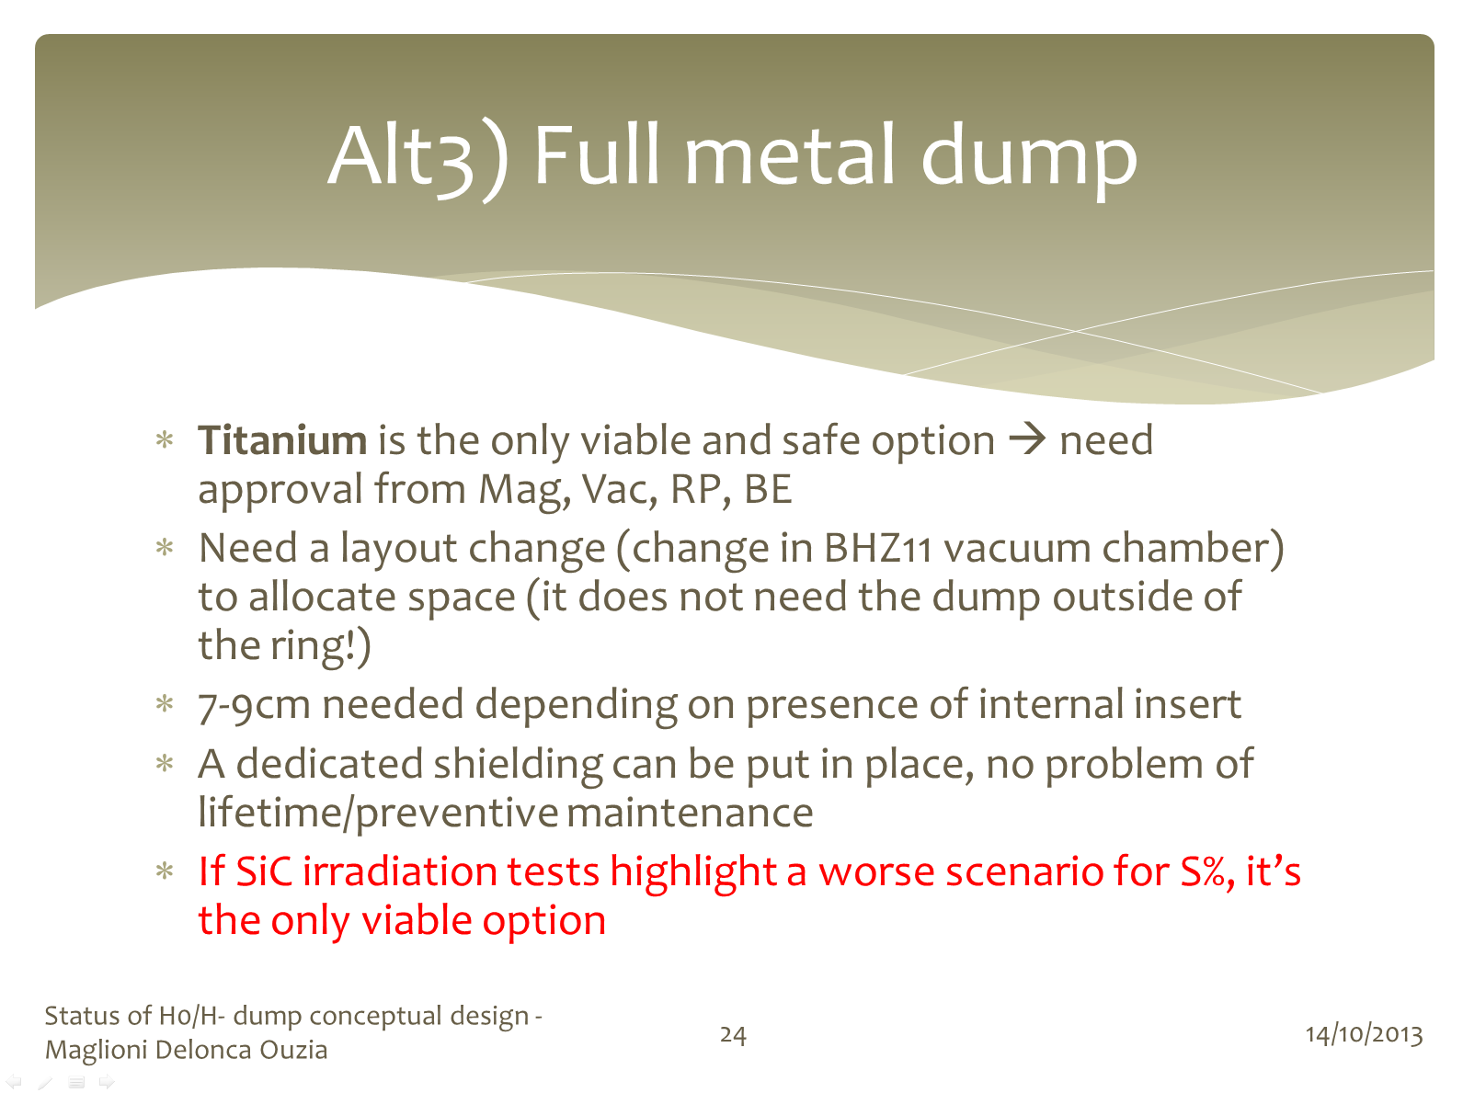
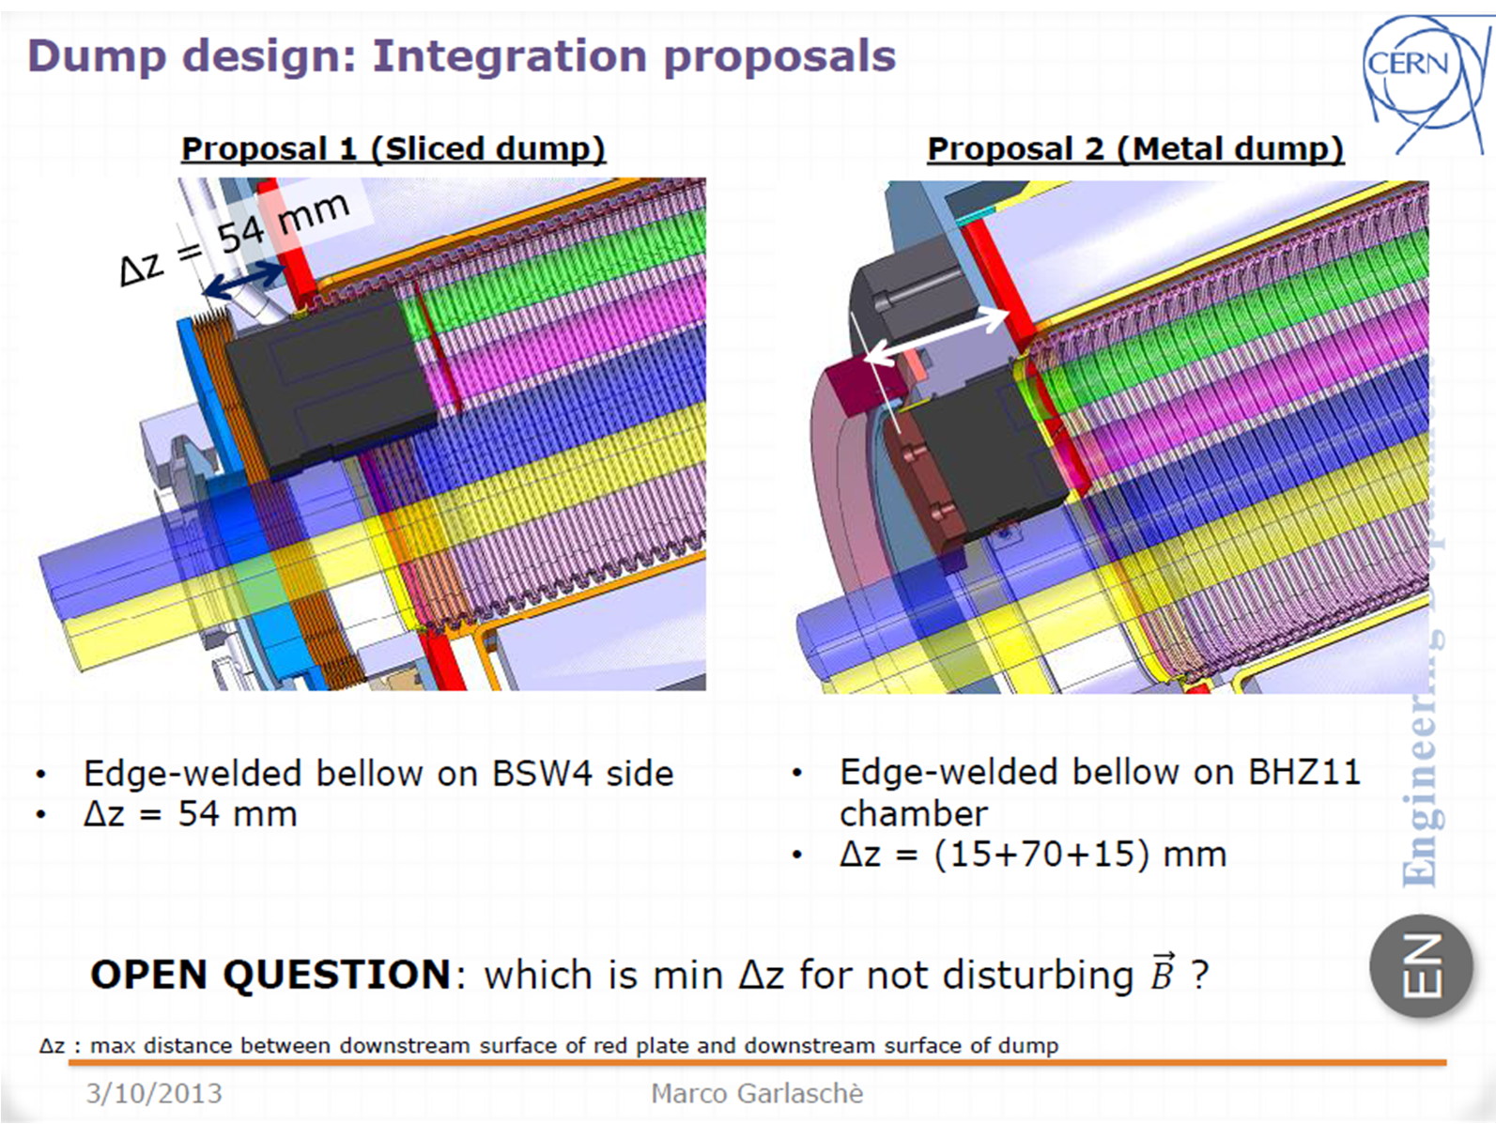
EDMS: 1320006

Slide 7
Solution Comparison
EDMS: 1320006
New Proposal
 | Baseline: SiC bulk | Alt 1: sliced SiC | Alt 2: sliced Sic + metal | Alt 3: full metal
Swelling - lifetime | 1-2y* | 1-2y* | ~4 y*
RP | (with no PM) | (with no PM) | ? | ?
Shielding | BSW4 | BSW4 | BSW4 + difficult | Dedicated
LAYOUT | Baseline / op1 | Baseline / op1 | Baseline / op1 | Op2**
optics / field |  |  | ? | ?
VACUUM
BSW4 | inside | Inside | Partly outside | outside
Chamber cooling | needed | needed | needed | needed
BHZ protection
Monitor support | feasible | feasible | feasible | easy
* Need preventive maintenance. Figure may change after SiC irradiation campaign results.
** Following misalignment measurement, BHZ11 chamber may need to be changed anyway, see PSB H- Injection Tech Meeting, 03/10/13, here
C. Maglioni, M. Delonca, A. Ouzia

Slide 8
Issues to be Solved
PBU Injection Meeting of 29/11/2013; a proposal for new baseline was made:
Full metal dump outside the magnet
Main outstanding issues were identified:
Integration feasibility study (A.Ouzia, B. Riffaud)
RP, Activation and intervention scenarios (R. Froeschl)
dose to downstream BHZ coils (R. Froeschl, A. Newborough)
Magnet field perturbation (B. Balhan)
Optic perturbation (E. Benedetto)
Position of Instrumentation (F. Zocca)
Vacuum, (J. Hansen, declared OK)

Slide 9
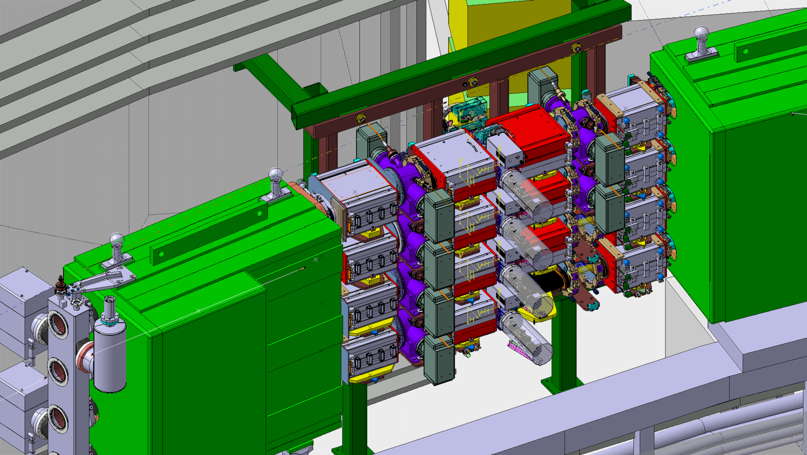
Mechanical Design
BSW1
BSW2
BSW3
BHZ162
BSW4
BHZ11

Slide 10
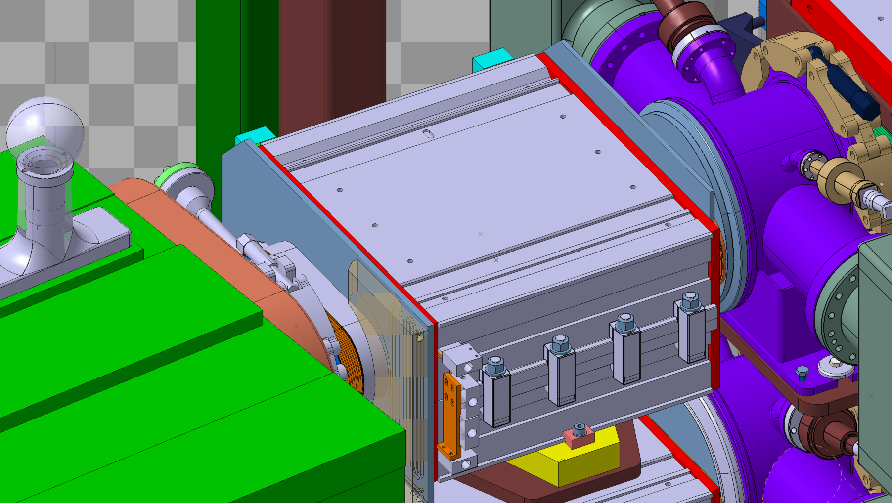
Mechanical Design, KSW Magnet
KSW4

Slide 11
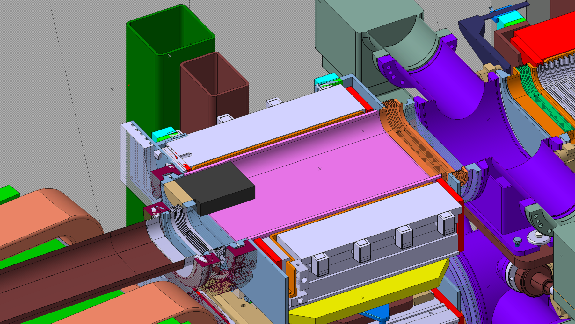
Mechanical Design, Current Baseline
Mb Insert
SiC dump
Inside BSW
Existing BHZ chamber

Slide 12
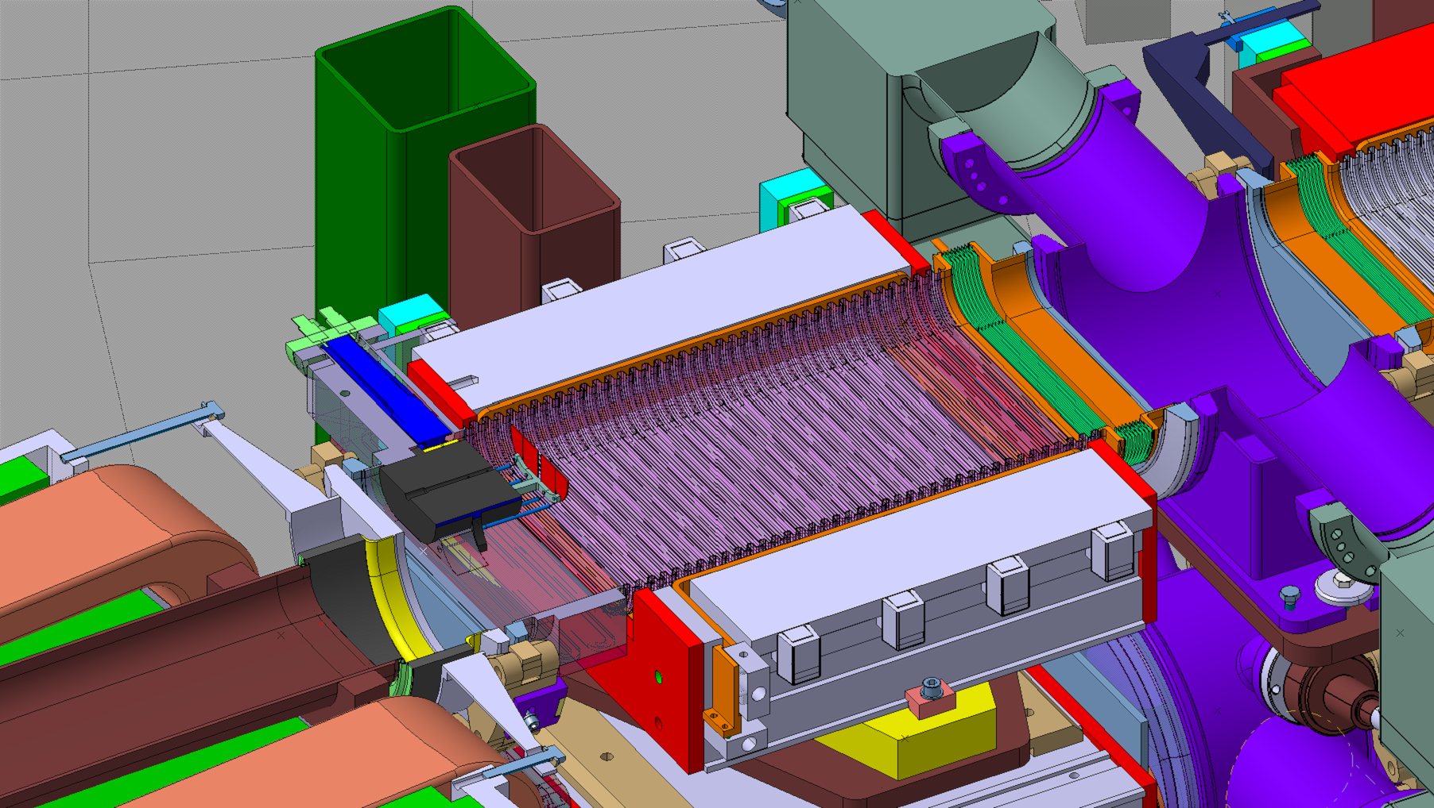
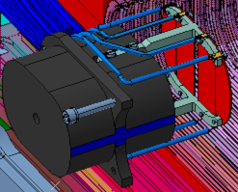
Mechanical Design, Proposed Baseline
H⁰H⁻ monitor
Ti Dump
Outside BSW
Modified BHZ chamber
Shielding & Cooling

Slide 13
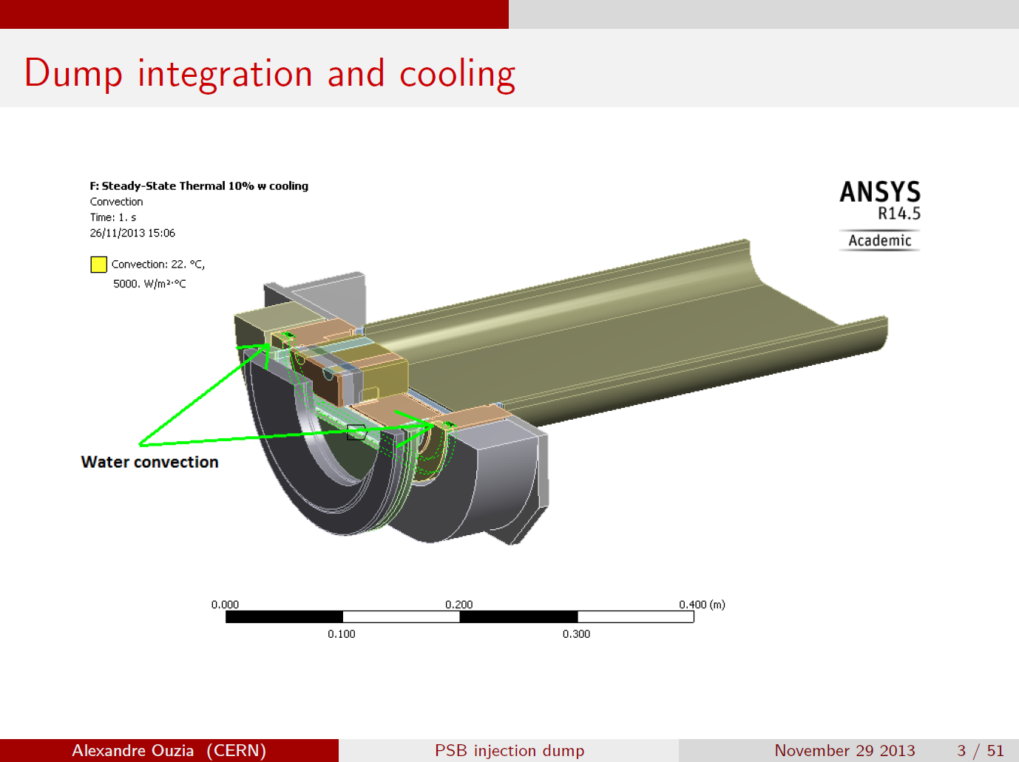
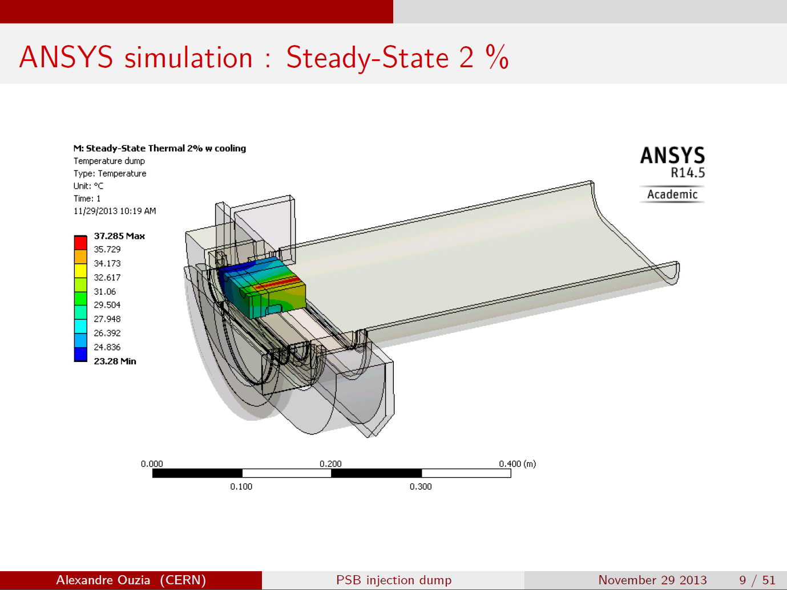
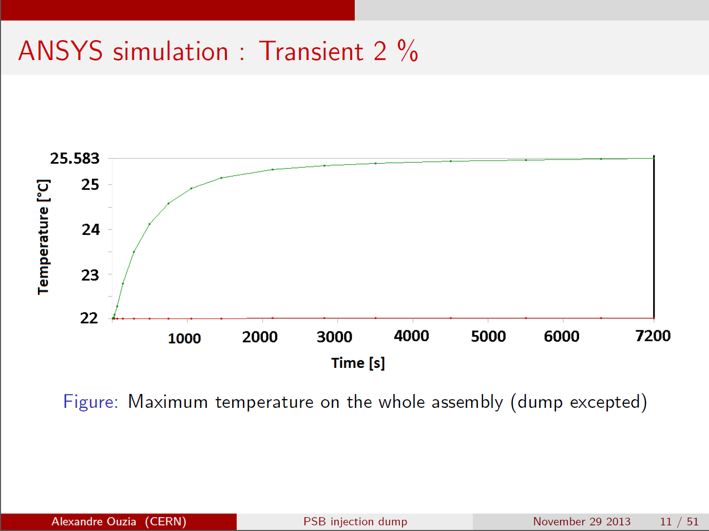
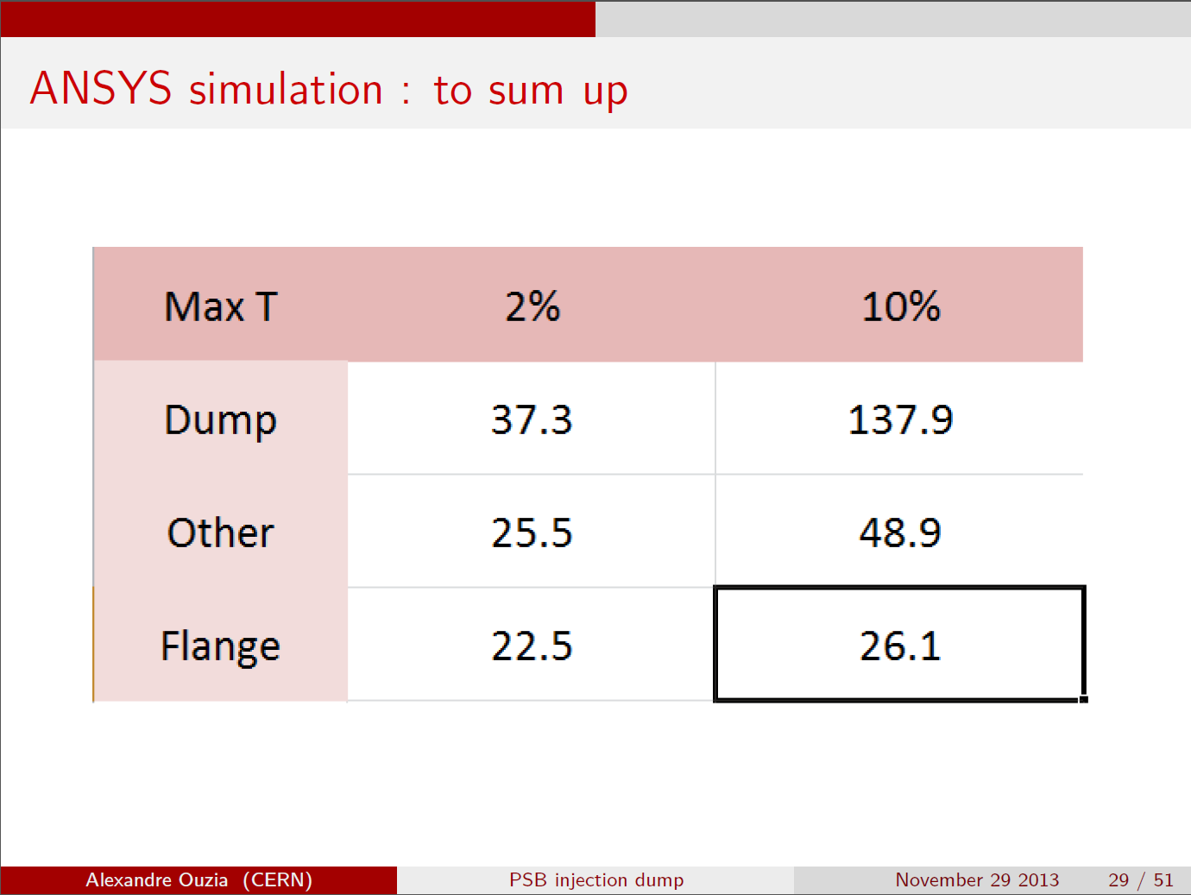
A. Ouzia
[°C]

Slide 14
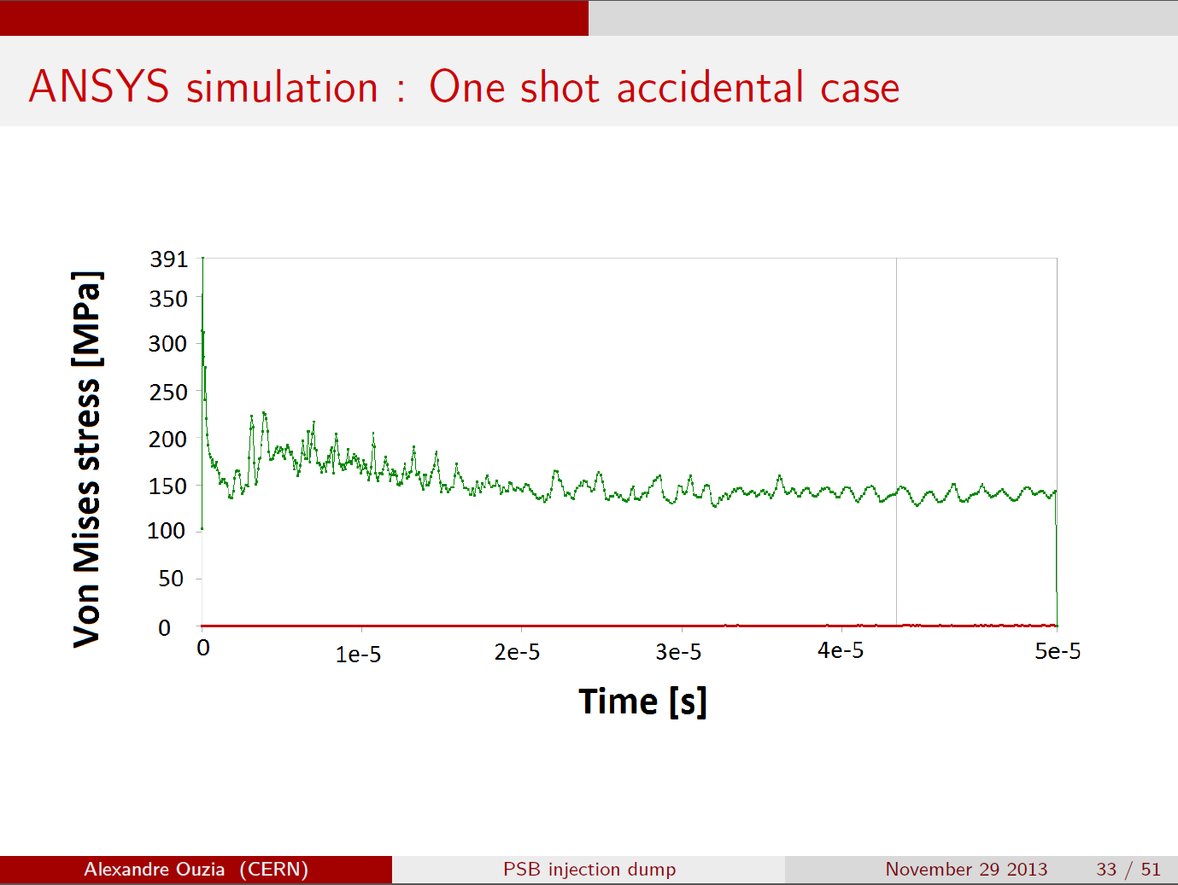
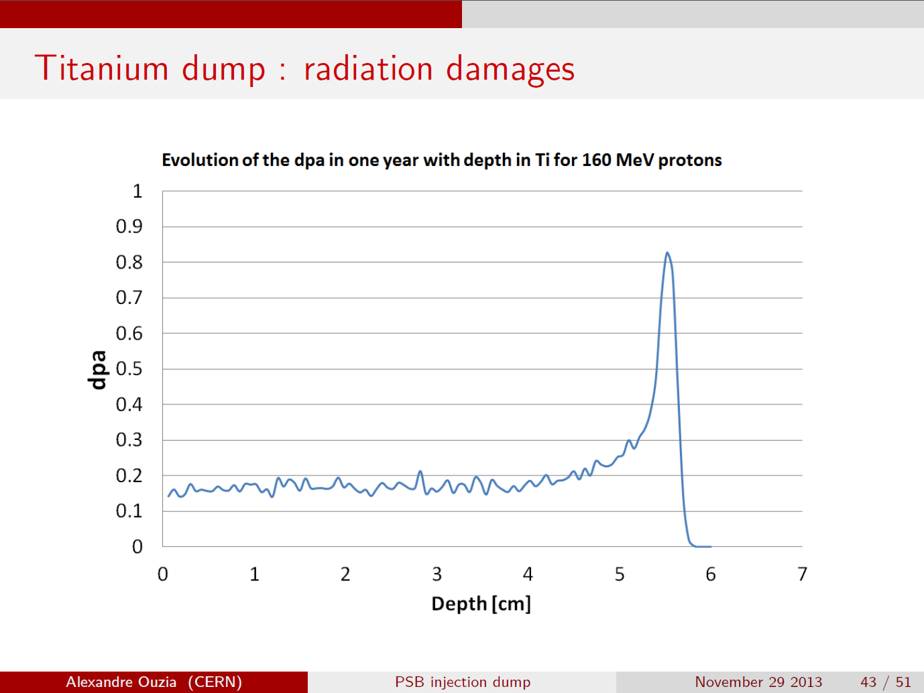
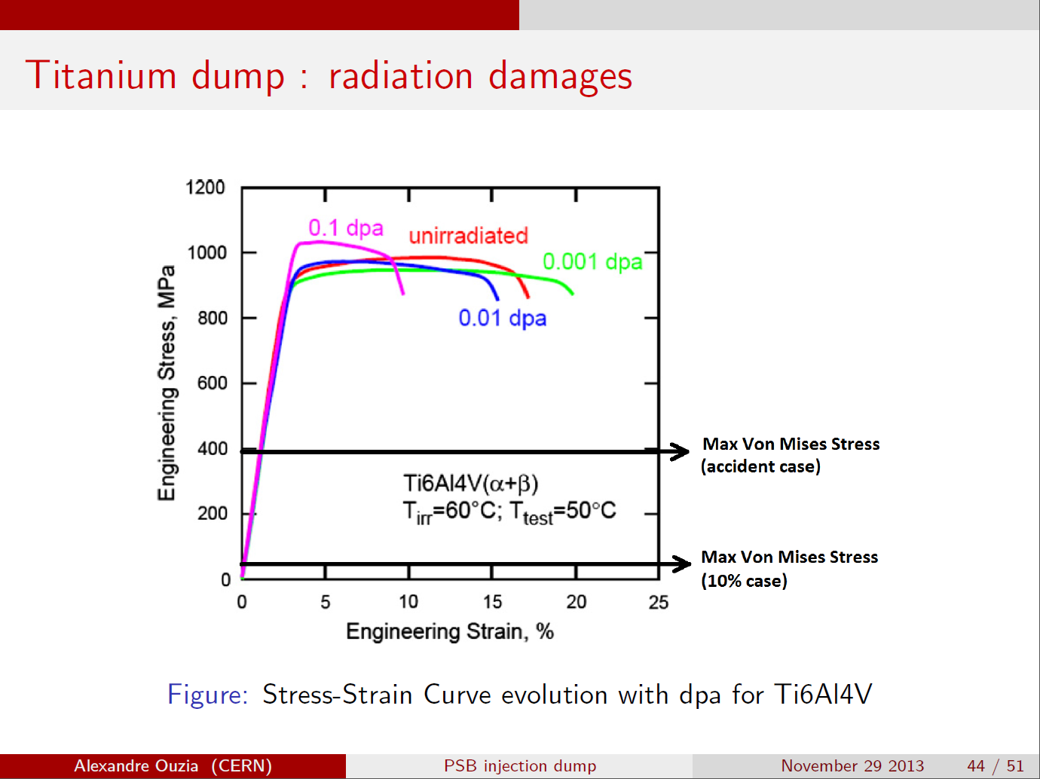
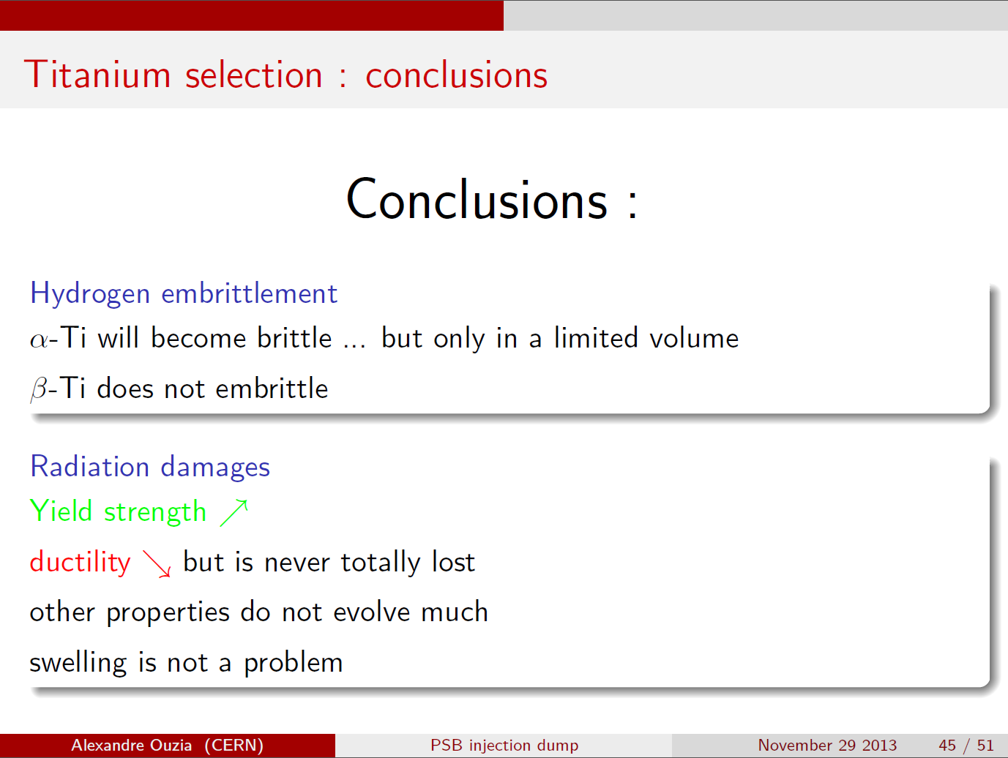
A. Ouzia

Slide 15
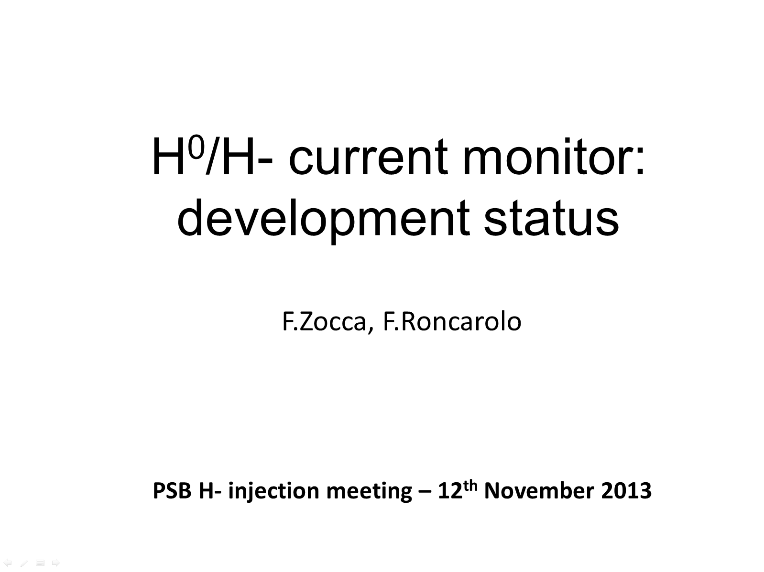
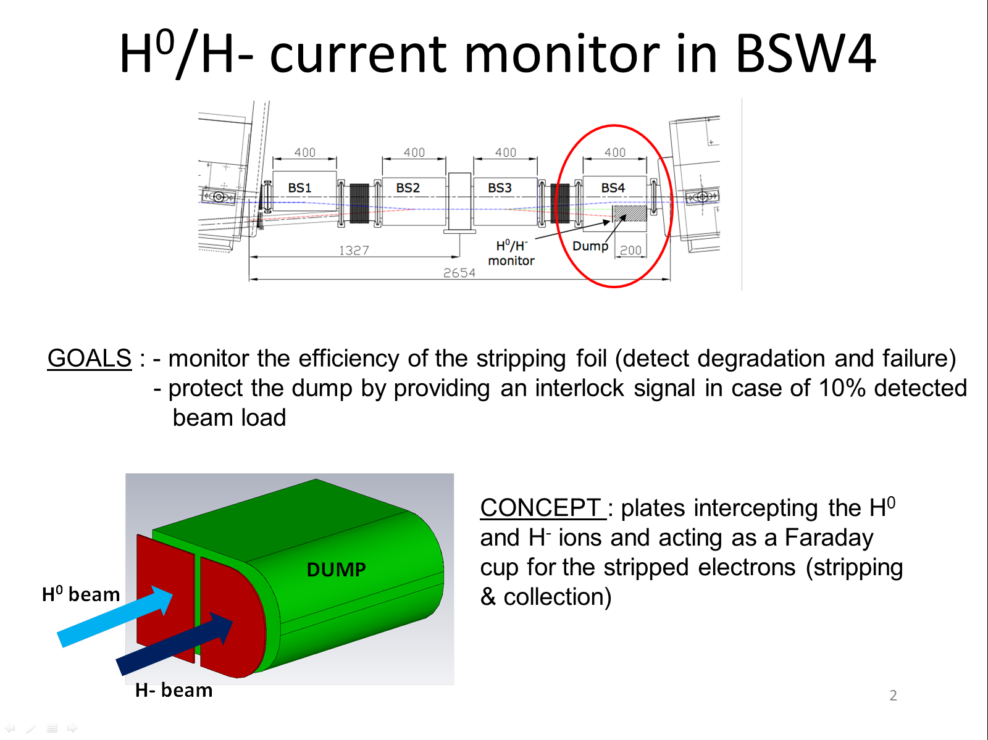
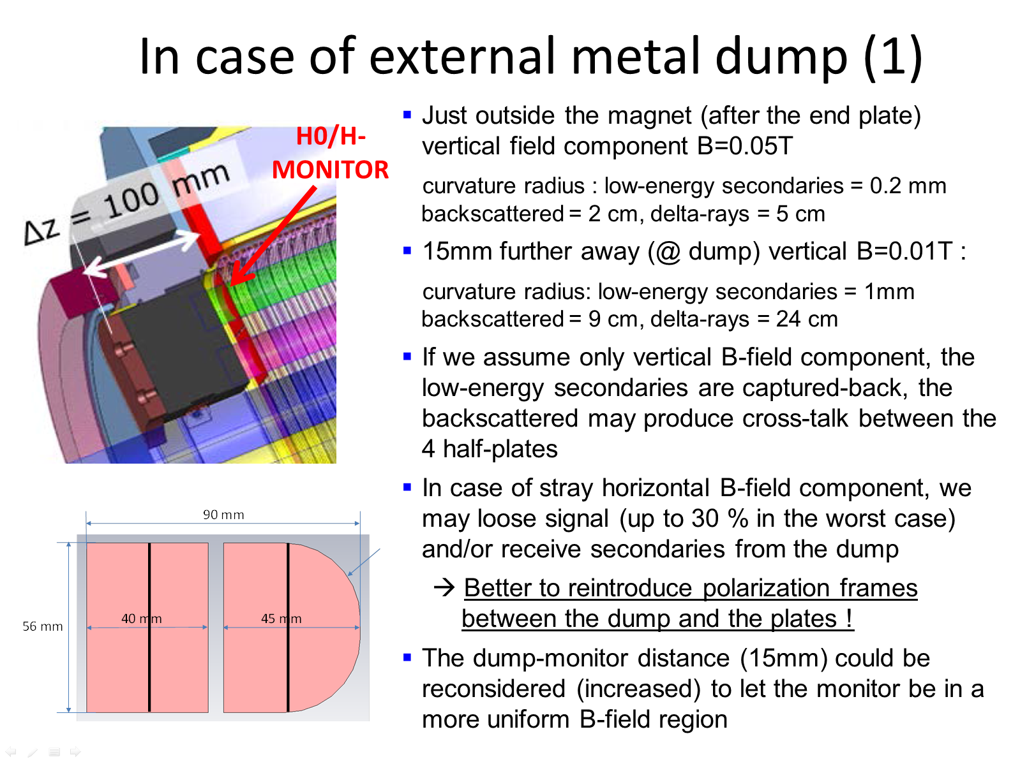
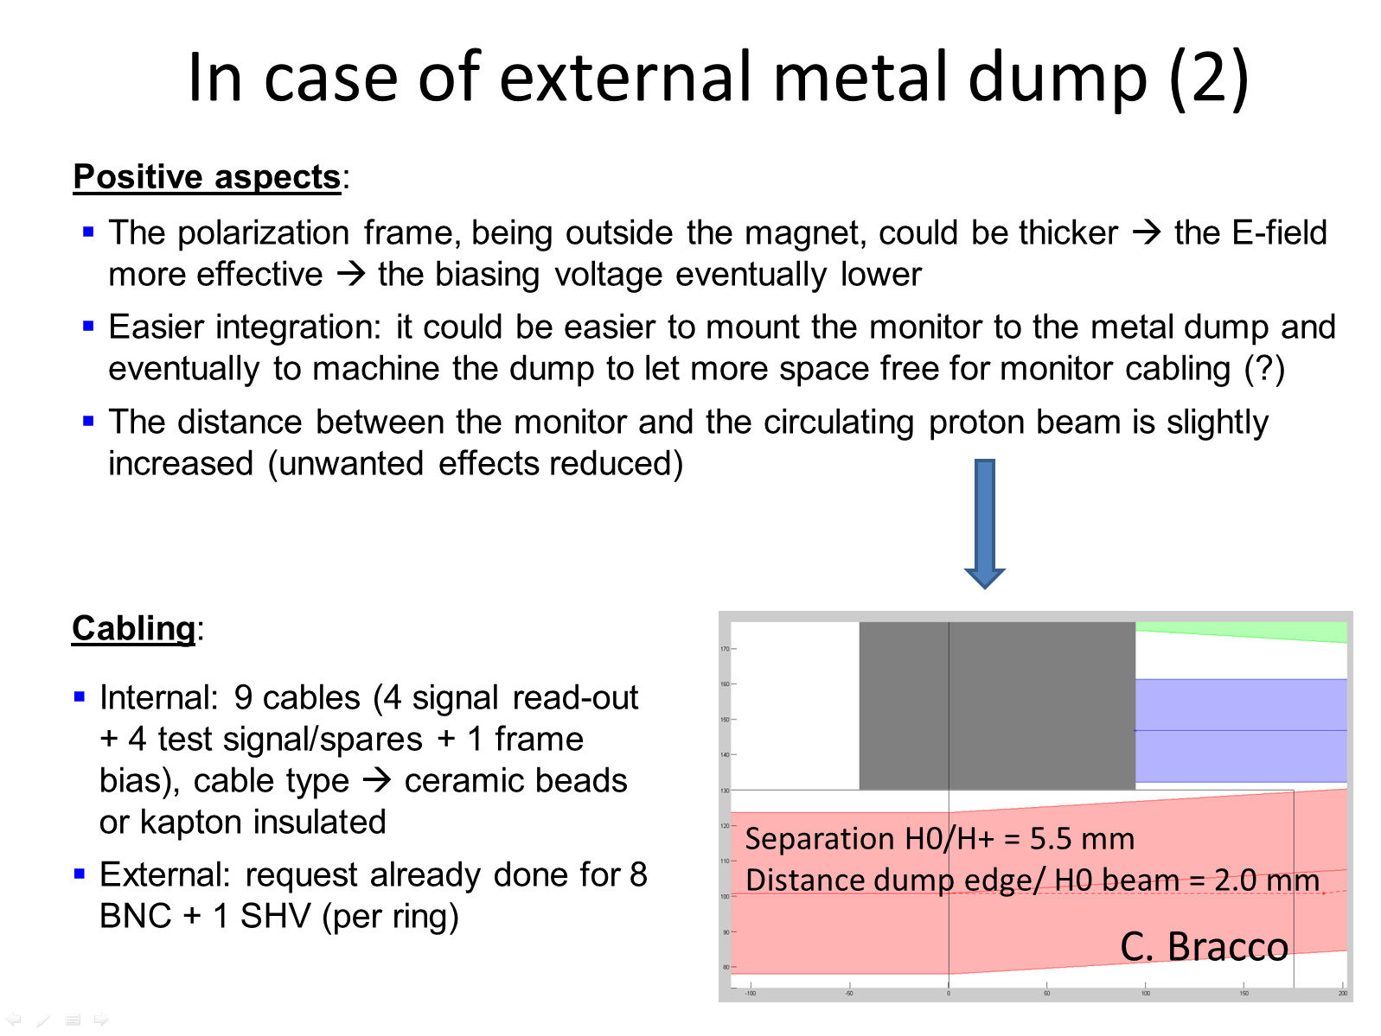

Slide 16
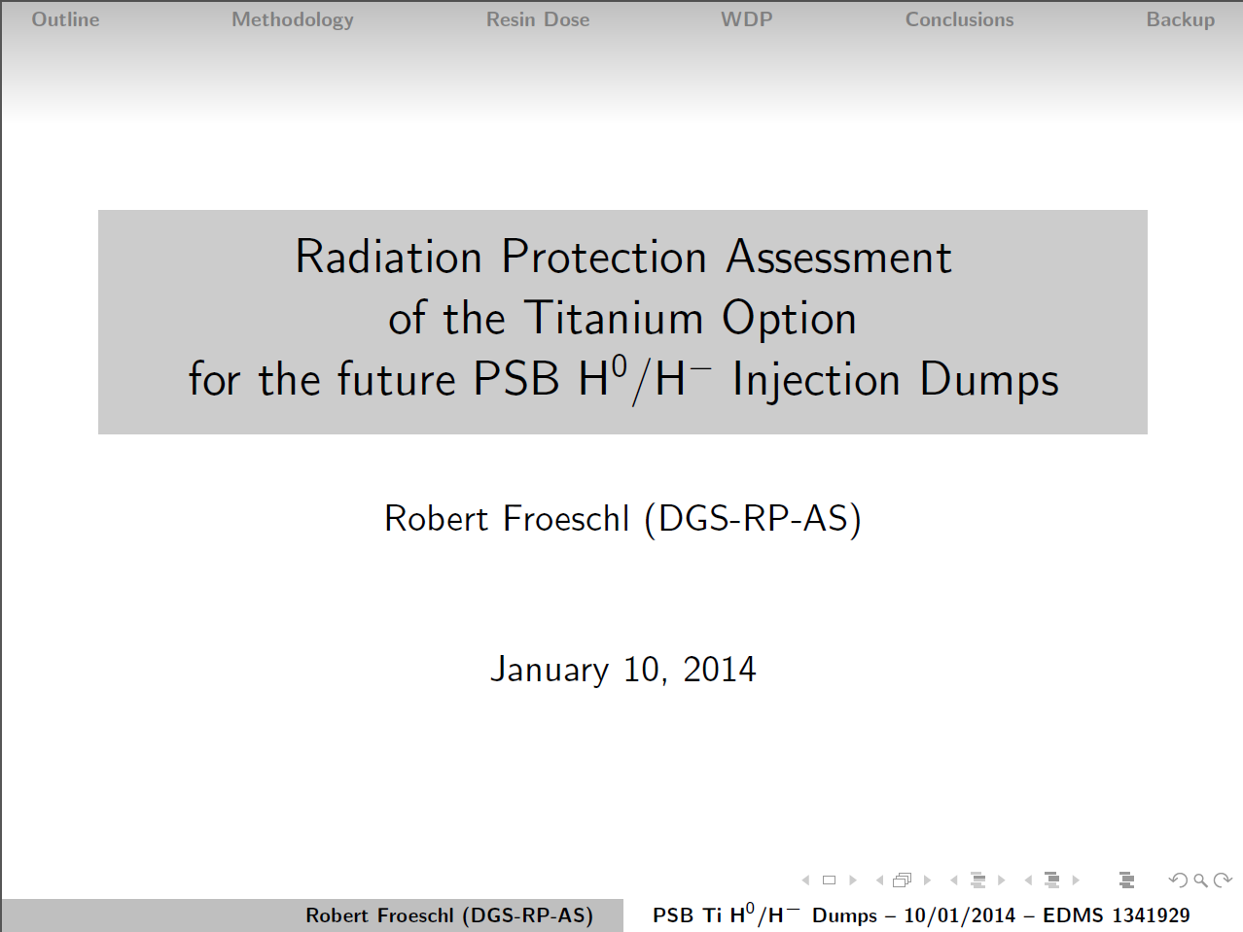
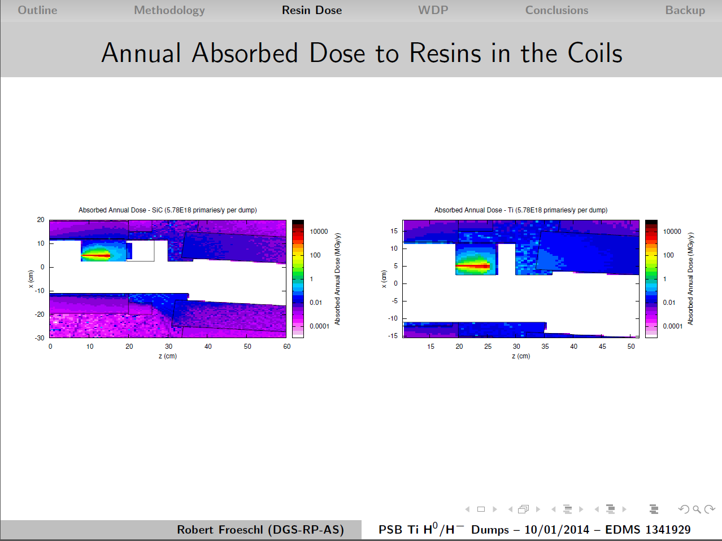
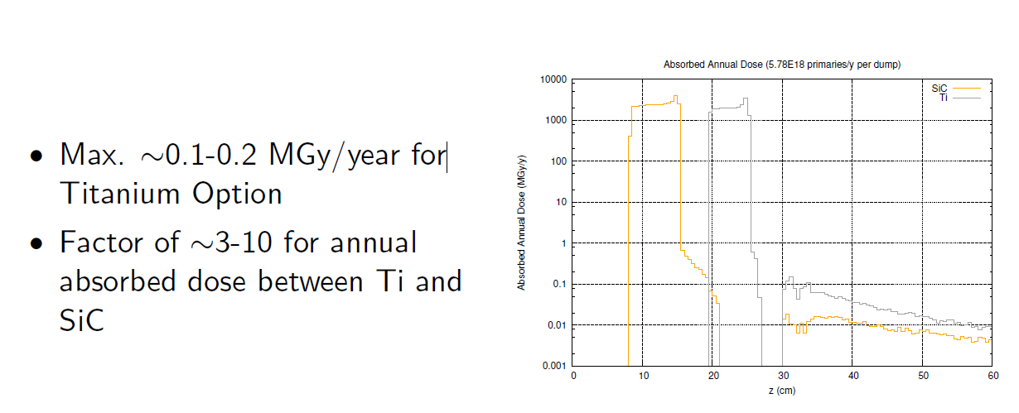
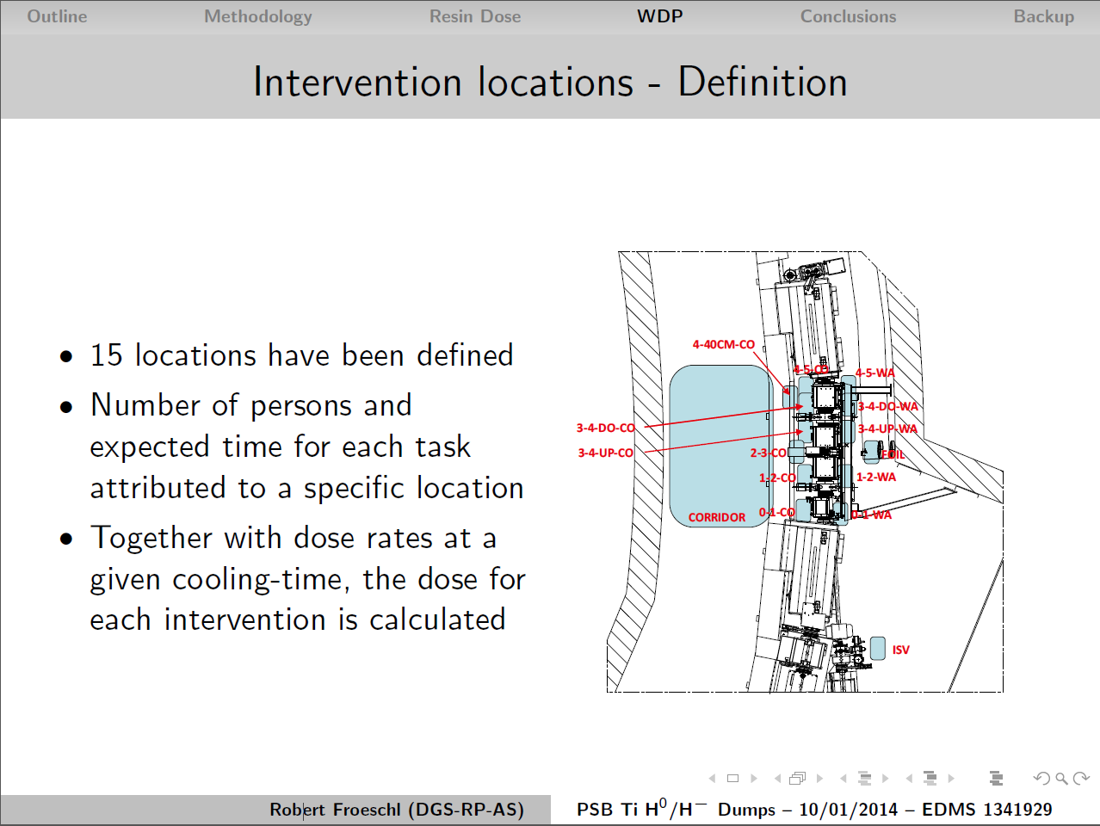
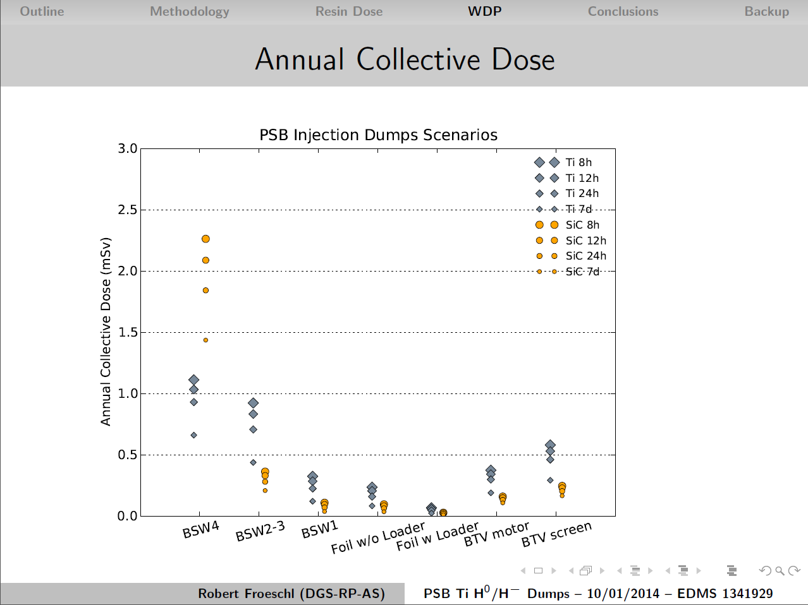
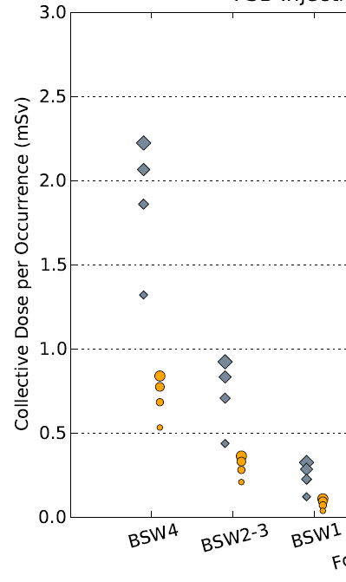
Resin limit is 20 MGy
(PSB integrated ~1MGy)
Beam parameters (EDMS 963395 v3.1)
Geometry (EDMS 1157402)

Slide 17
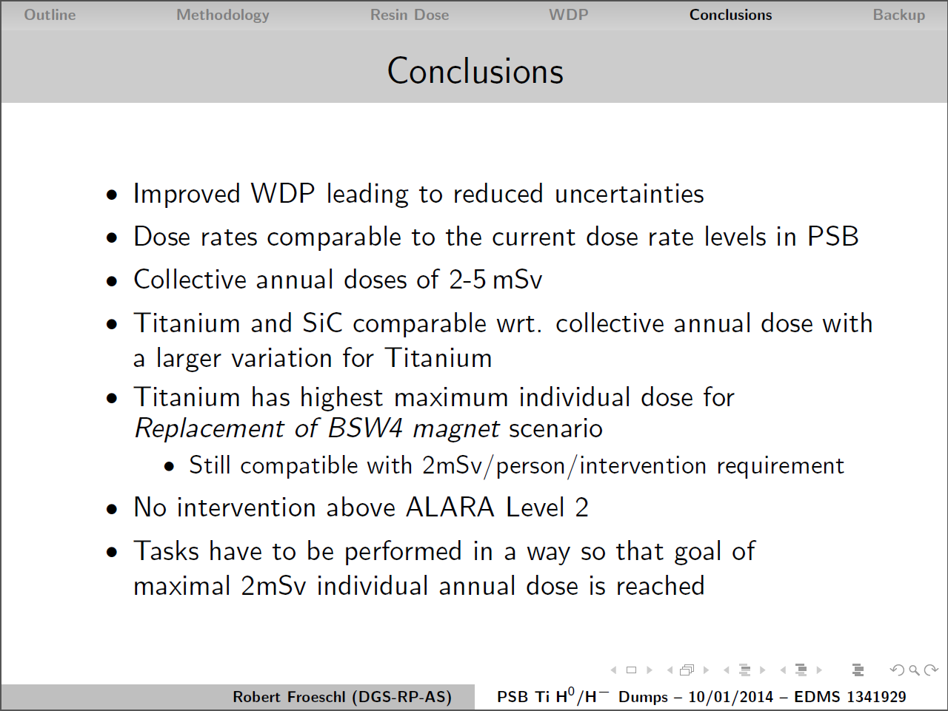
(RP Issues)

Slide 18
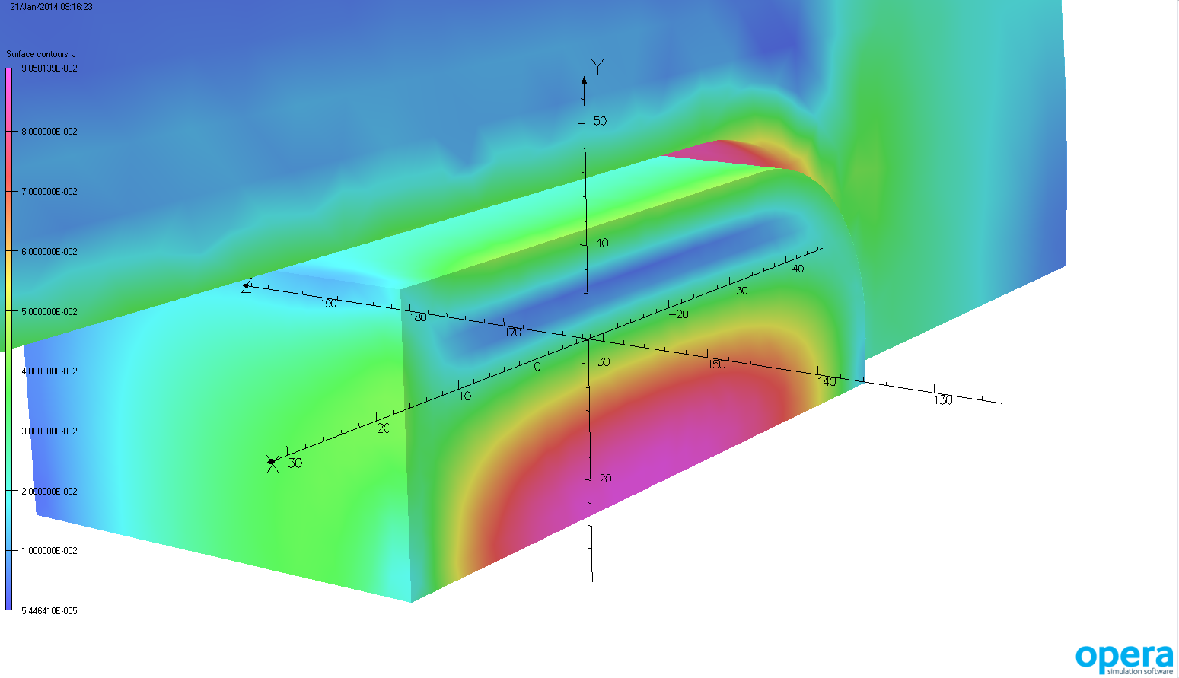
B. Balhan
Influence of dump position on Field homogeneity
using Ti6al4v block, with electric conductivity of 6E5 [S/m]
Dissipated Energy and Forces in Ti block
has been evaluated vs position
9.058E-002 A/mm²
 |  | 0 mm from end plate | 10 mm from end plate
Energy (∫B.H/2 dv) | [J] | 2.9E-02 | 7.4E-03
Power loss (∫J.E dv) | [W] | 2.2E-01 | 7.8E-02
x-Lorentz force (∫JxB dv) | [N] | 1.8E-03 | 7.5E-04
y-Lorentz force (∫JxB dv) | [N] | 0.0E+00 | 0.0E+00
z-Lorentz force (∫JxB dv) | [N] | -4.3E-02 | -1.3E-03
Current density in TI block and external flange
5.446E-005 A/mm²
Differences in field homogeneity, using a simplified model, without Inconel chamber, compared to having no dump installed:
  Dump at 0 mm from endplate, no significant differences.
  Dump at 10 mm from endplate, no influence.
In order to extract accurate polynomial component, a global calculation with the full geometry and instrumentation is foreseen when design will be frozen.
Mid-plane integrated Field distribution along z axis

Slide 19
Summary (1)
Mechanical design
New design is feasible.
But modification of BHZ11 vacuum chambers will be required.
Dump Design:
Cooling can be integrated in the shielding design.
In this case, no real heating issues are identified.
Mechanical forces and radiation damage are negligible.
H⁰H⁻ Current Monitor
New position creates more aperture for PSB circulating beam.
Distance between dump and screen give minor changes to H⁻ beam trajectory.
Monitor in uniform B-field, Polarization frame not required.

Slide 20
Summary (2)
Radiation & Shielding considerations:
BHZ resin gets ~0.1-0.2 MGy per year, factor 3-10 worse than for SiC.
Resin limit is 20 MGy (integrated today ~1MGy), so even 0.2 Mgy/year is acceptable.
BSW4 magnet replacement (dump change) 5 times lower.
No ALARA level 3 interventions for any scenario.
Annual collective dose for Ti or SiC ~2-3 mSv (comparable to current PSB annual collective dose levels for this region)
Shielding shall be included and fixed to the BSW4 magnet.
Effect on magnetic Field and Optics:
Front face of the dump ~10 mm from the end of the magnet field clamp.
Negligible effect, but still waiting for the multipole expansion (should be no show-stopper).

Slide 21
Conclusion
We propose to approve as new baseline:
Full metal Ti dump;
Starting at least 1cm outside the BSW4 magnet;
  Thus outside the BSW magnetic field;
Located inside the vacuum chamber;
With the H⁰H⁻ monitor ~5cm in front of the dump;
  Thus inside the BSW magnetic field
Dump Shielding should be at least equivalent ~5cm Pb collar;
Shielded transport container for BSW4, including dump, is required;
Modify BHZ11 chambers to create required space;
  Is not included in Cost to Completion (approx. 150kChF)

