Slide 1
Status work for the RPC lab in Helwan
Yasser Assran
Suez University

Slide 2
Outlines
Our goal.
What we have in Helwan lab.
What we have done .
What we need to complete the system.
Our plan.

Slide 3
Our Goal
To setup a complete cosmic stand in Helwan University laboratory, which enable us to test the RPC gaps as well as the complete RPC chamber.
QC
Gap QC
Leak test
Spacer test
Efficancy
Chamber QC
HV test
Cluster size
Strip profile
HV test

Slide 4
What we have in Helwan lab.
CAEN HV power supply.
4 scintillators 50x50 square cm with photomultipliers.
Osciliscope .
NIM crate.
Some NIM modules (OR , coincidence, discriminator, Scaler, fan in-fan out and receiver).
Gas system with two mixers.
One complete RPC and two gaps.

Slide 5
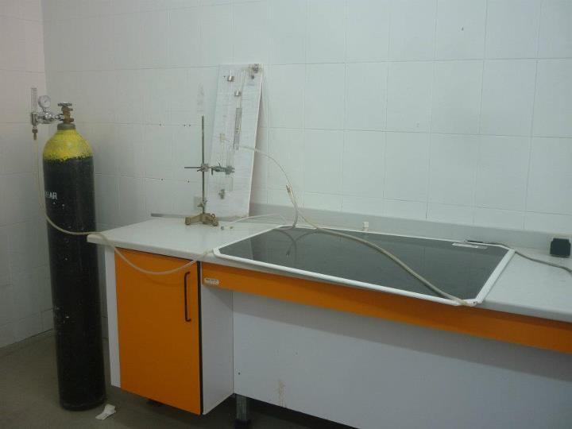
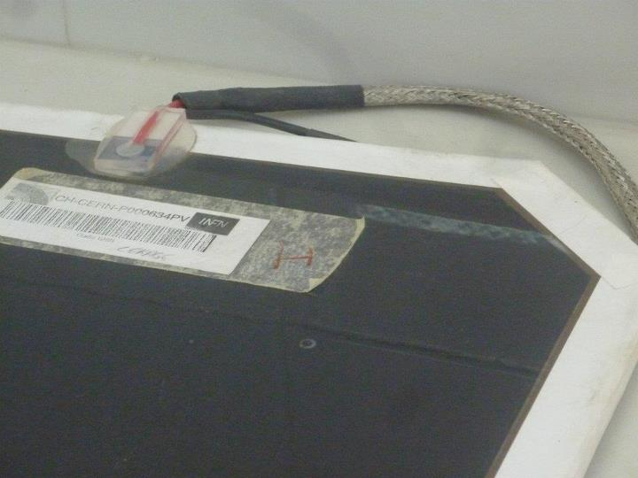
What we have done .

Slide 6
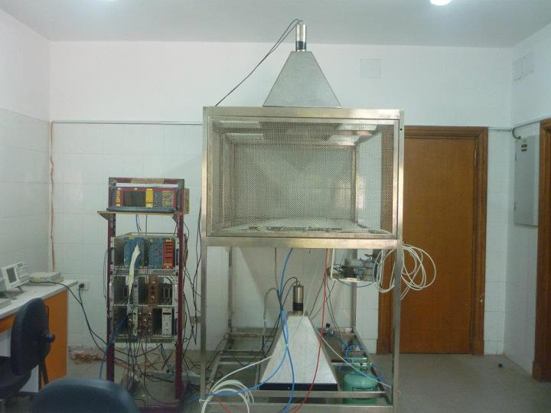

Slide 8
What we need to complete the system.
VME crate (rent from electronic pool)
TDC (bought)
Controller with PCI card (bought)
PC with the needed software (bought)
NIM-ECL-NIM module (rent from electronic pool)
Dual timer (rent from electronic pool)

Slide 9
Our plan.
Set up the complete system at 904 lab.
Clone the software and run it on our pc (after add the desired modifications).
Take some data at 904.
Transfer the system to the GIF and test some chambers there.
Finally transfer the working system to Helwan lab.
Thank you

