Slide 1
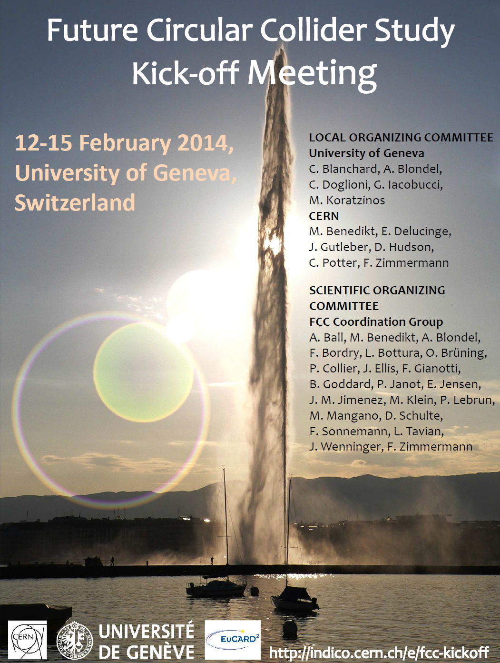
306 registrants
about
50 TLEP-ex
55 TLEP-acc
40 pheno

Slide 2
Friday afternoon and Saturday morning at University
14:00 break out sessions (coffee break at 16:00)
-- Technical infrastructure and civil engineering Lebrun
-- Hadron collider design (+ SC magnet technology, + injectors) Schulte
-- Lepton collider design (+ SC RF technology + injectors) Wenninger
-- Hadron Physics, Experiments, Detectors Ball +Gianotti
-- Lepton Physics, Experiments, Detectors Blondel+Janot
-- e-p Physics, Experiments, Detectors Klein
-- FCC Overall physics and phenomenology Ellis + Mangano
Saturday morning 9:00 (coffee break at 11:00)
-- reports by conveners
-- Warp-up and next steps (Michael Benedikt)

Slide 3
Study Organisation – Committees, Boards (i)
International
Collaboration Board
International
Steering Committee
International
Advisory Committee
Study
Coordination Group
Study Support
Office
Hadron Collider Physics Experiments
Lepton Collider
Physics Experiments
e-p
Physics Experiments Machine aspects
Hadron
Injectors
Hadron
Collider
Lepton
Injectors
Lepton
Collider
Accelerator
R&D
Technologies
Infrastructures
Operation
Costing Implementation
Planning
Benedikt

Slide 4
Names and logo
The idea is to assemble an International Board meeting by September 2014
and to give plenty of space for the stakeholders to make contributions
and decide names etc..
-- DGs instructed Michael that the official name will be
FCC-hh, FCC-ee, FCC-eh
suggest we write for now FCC-ee (TLEP) TLEP being an unofficial alias
-- logo as in the corner.
Based on the first idea by Patrick, but in CERN’s tradition it is all blue and white
Very important that all three machines are explicit in the logo

Slide 5
Study Organisation – Committees, Boards
Hadron collider coordination
Hadron Collider Physics Experiments
Lepton Collider
Physics Experiments
e-p
Physics Experiments Machine aspects
Hadron
Injectors
Hadron
Collider
Lepton
Injectors
Lepton
Collider
Accelerator
R&D
Technologies
Infrastructures
Operation
Costing Implementation
Planning
Lepton collider coordination
has not met yet.
Hadron Collider Physics Experiments
Lepton Collider
Physics Experiments
e-p
Physics Experiments Machine aspects
Hadron
Injectors
Hadron
Collider
Lepton
Injectors
Lepton
Collider
Accelerator
R&D
Technologies
Infrastructures
Operation
Costing Implementation
Planning
Accelerator coordination
Hadron Collider Physics Experiments
Lepton Collider
Physics Experiments
e-p
Physics Experiments Machine aspects
Hadron
Injectors
Hadron
Collider
Lepton
Injectors
Lepton
Collider
Accelerator
R&D
Technologies
Infrastructures
Operation
Costing Implementation
Planning
Physics coordination
will meet next Wednesday 5 February
Hadron Collider Physics Experiments
Lepton Collider
Physics Experiments
e-p
Physics Experiments Machine aspects
Hadron
Injectors
Hadron
Collider
Lepton
Injectors
Lepton
Collider
Accelerator
R&D
Technologies
Infrastructures
Operation
Costing Implementation
Planning

Slide 6
In general effort to coordinate pp and e+e- studies as much as possible
-- phenomenology break-out session at the kick off meeting
-- physics study coordination
-- We will start regular ee-FCC (TLEP) specific meetings with the physics study WG conveners.

Slide 7
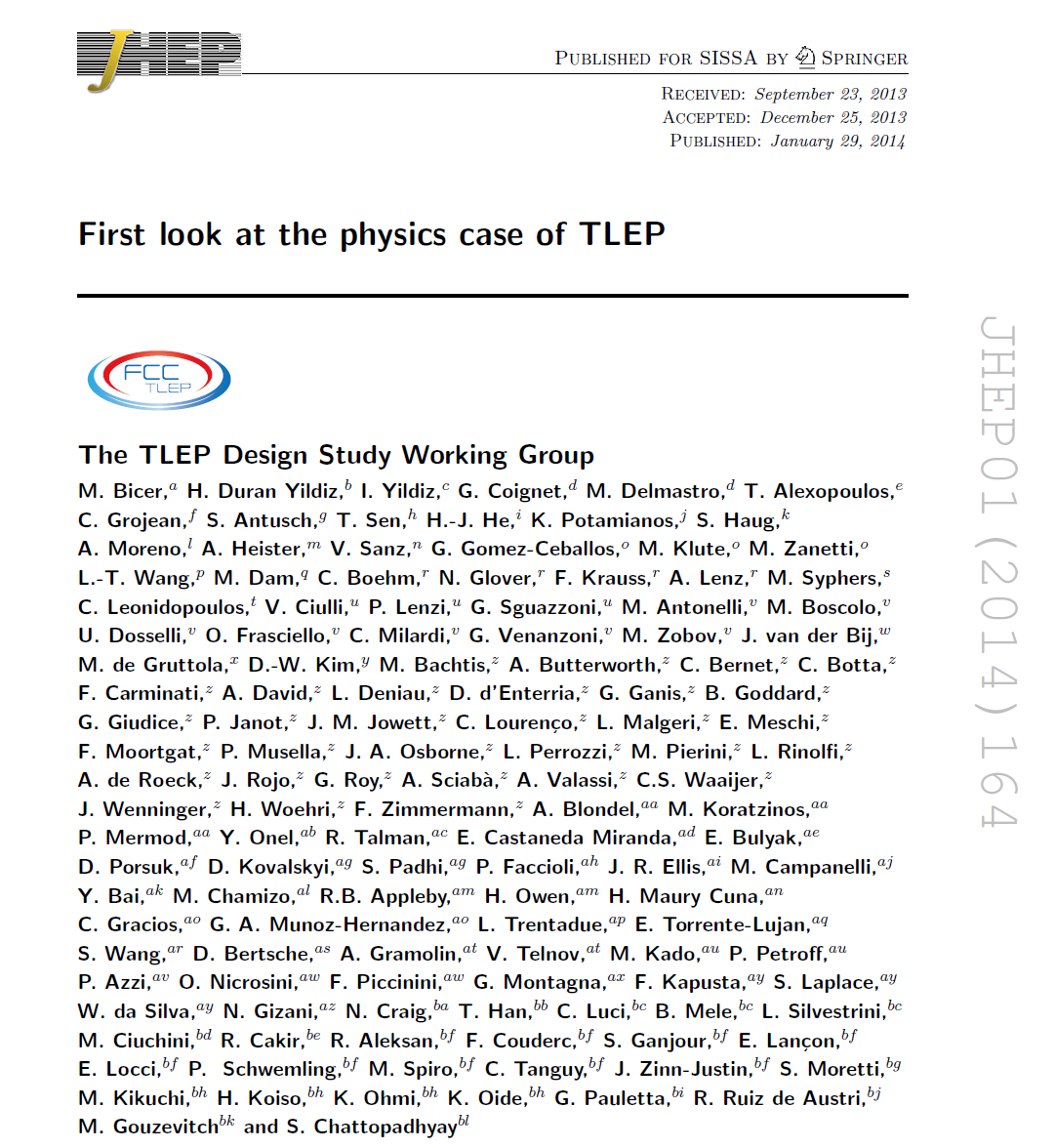
PUBLISHED!
congratulations to
Patrick!
and to all!

