Slide 1
Baseline Parameter Update for TLEP / FCC-ee
J. Wenninger
Acknowledgements: B. Holzer, A. Blondel, M. Koratzinos

Slide 2
Luminosity
Constant synch. radiation power
H ≤ 1
Hour-glass
F ≤ 1
Crossing angle
2Φ
Beam-beam parameter

Slide 3
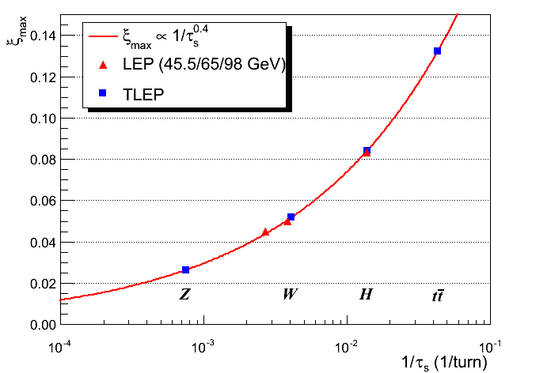
Beam-beam parameter
The beam-beam parameter measures the strength of the field sensed by the core particles due to the counter-rotating bunch.
Beam-beam parameter limits are empirically scaled from LEP data (also 4 IPs).
Limits are consistent with results of first simulations
τ_{s} = damping time

Slide 4
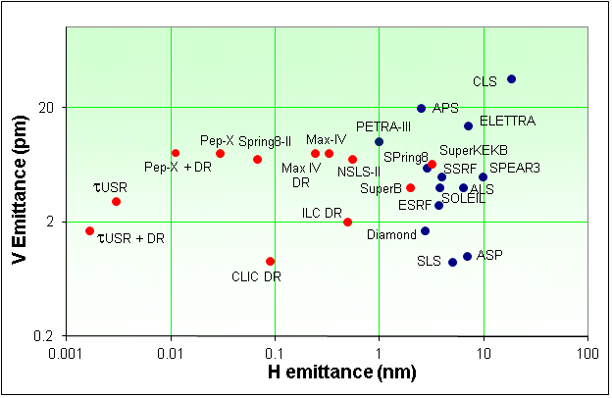
Emittances
TLEP is a large machine, scaling of achievable emittances (mainly vertical) is not straightforward.
Limits applied to define baseline parameters:
  ε_{y}/ε_{x} ≥ 0.001 , ε_{y} ≥ ~ 2 pm
TLEP
R. Bartolini, DIAMOND

Slide 5
Parameter updates
Aim to have a consistent set, with input from the 6th TLEP workshop.
Z: the beam-beam tune shift was lowered from 0.068 to 0.03. This is consistent with a) LEP scaling and b) first simulations.
  Bunch population ~ halved, bunch number ~ doubled.
The optics parameters (lattice) were updated based on the first lattice design. This made the bunches longer at all energies (Hourglass factor reduction), requiring some parameter tuning and lowering some luminosities.
The lattice at the H was made identical to the ttbar. This lowered the bunch length (Hourglass factor increase !) and the emittances. To keep the tune shifts under control → lower bunch intensity and larger bunch number (> 1000 !).

Slide 6
Key parameter table
Parameter | Z | W | H | tt | LEP2
E (GeV) | 45 | 80 | 120 | 175 | 104
I (mA) | 1400 | 152 | 30 | 7 | 4
No. bunches | 16’700 | 4’490 | 1’330 | 98 | 4
β*_{x/y} (mm) | 500 / 1 | 500 / 1 | 500 / 1 | 1000 / 1 | 1500 / 50
ε_{x} (nm) | 29 | 3.3 | 1 | 2 | 30-50
ε_{y} (pm) | 60 | 7 | 2 | 2 | ~250
ξ_{y} | 0.03 | 0.06 | 0.09 | 0.09 | 0.07
L (10³⁴ cm⁻²s⁻¹) | 28 | 12 | 5.9 | 1.8 | 0.012
→ At the Z : 20 ns (or smaller) spacing

Slide 7
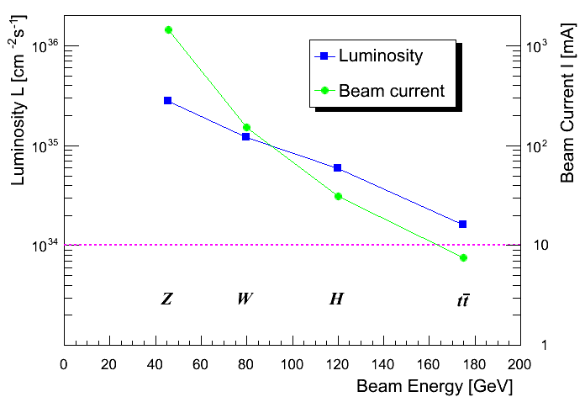
Luminosity
Number of bunches : ~17’000 at 45 GeV ⇒ ~100 at 175 GeV
The large number of bunches at Z, W (& H) requires 2 rings

Slide 8
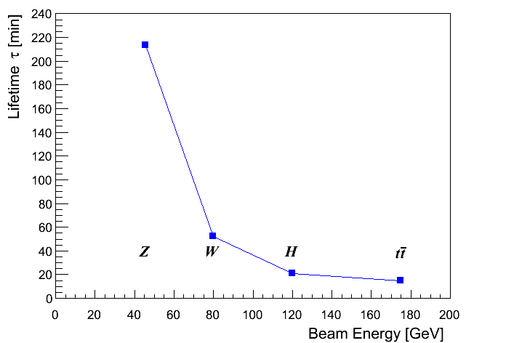
Lifetime - luminosity
Lifetime from luminosity depends on radiative Bhabha scattering total cross-section σ_{ee} ≈ 0.21 (b) ≈ constant with energy (LEP).
⇒ Lifetimes down to ~15 minutes.
Continuous injection (top-up)
n_{ip} = 4

Slide 9
Summary
New official parameter set based on first lattice, scaling from LEP and results from first simulations. See appended document (not quite final – but only for the text).
Parameters for Z, W and H require 2 separate rings that are combined around the IR.
  Bunch separation ~20 ns for Z !
  Single ring option probably limited to ~30-300 bunches. Single ring limits will be evaluated during the study.
To lower the number of bunches without loosing luminosity, it may be possible to use schemes based on large crossing angles (10’s of mrad) → similar to SuperKEBK. TBC.

