Slide 1
FCC news (e⁺e⁻ flavour)

Slide 2

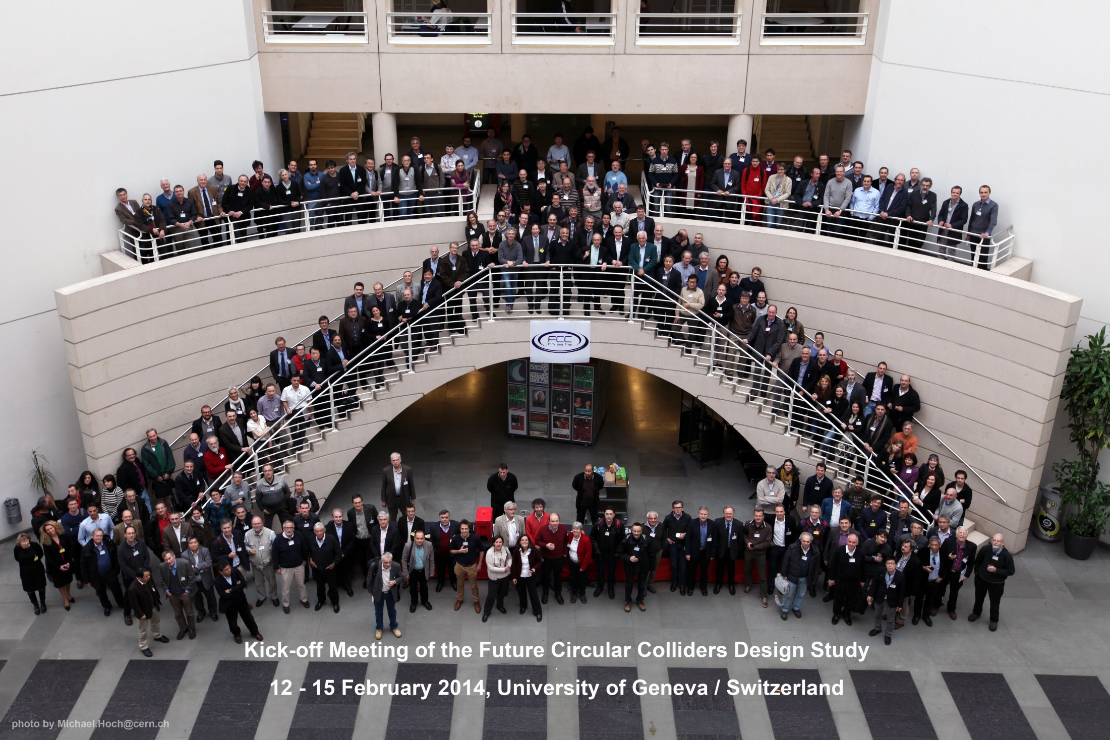
330 registered participants

Slide 3
Workshop Goals presented 12 Jan 2014
Discussion of all FCC aspects
include all safety aspects from start
Refine scope of the study
done, consensus on studying now all options, parameters, physics,…
Define schedule, WBS, milestones of the study
challenges pointed out, several
priorities defined
Rolf Heuer

Slide 4

Proposal for FCC Study Time Line
2014 |  |  |  | 2015 |  |  |  | 2016 |  |  |  | 2017 |  |  |  | 2018
Q1 | Q2 | Q3 | Q4 | Q1 | Q2 | Q3 | Q4 | Q1 | Q2 | Q3 | Q4 | Q1 | Q2 | Q3 | Q4 | Q1 | Q2 | Q3 | Q4
Prepare
Kick-off, collaboration forming,
→study plan and organisation
Ph 1: Explore options
“weak interaction”
Workshop & Review →identification of baseline
Ph 2: Conceptual study of baseline “strong interact.”
Workshop & Review, cost model, LHC results → study re-scoping?
Ph 3: Study
consolidation
4 large FCC Workshops distributed over participating regions
Workshop & Review
→ contents of CDR
Report
Release CDR & Workshop on next steps

Slide 5
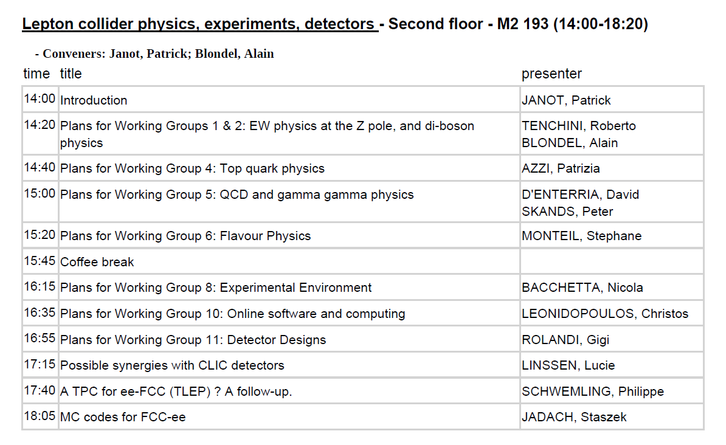

Slide 6
conveners jobs is to assemble collaborators
and find co-conveners in a global way

Slide 7
A recurrent theme is the entry level of FCC-ee,
as it is perceived as difficult to imagine starting
with (for the RF) the full 100MW and or the full 12 GV.
A «running up» plan may be introduced in parallel
with the running plan.
physics with 1% of full luminosity, with 10%, etc...
--Next slide physics plan as discussed in ‘TLEP physics case’
needs to be reviewed
in terms of present estimates of performance
in terms of running-up

Slide 8
recall: A possible TLEP running programme
1. ZH threshold scan and 240 GeV running (200 GeV to 250 GeV)
5+ years @2 10^35 /cm2/s => 210^6 ZH events
++ returns at Z peak with TLEP-H configuration
for detector and beam energy calibration
2. Top threshold scan and (350) GeV running
5+ years @5 10^34 /cm2/s ➔ 10^6 ttbar pairs ++Zpeak
3. Z peak scan and peak running , TLEP-Z configuration ➔ 10^12 Z decays
→ transverse polarization of ‘single’ bunches for precise E_beam calibration
2 years
4. WW threshold scan for W mass measurement and W pair studies
1-2 years ➔ 10^8 W pairs ++Zpeak
5. Polarized beams (spin rotators) at Z peak 1 year at BBTS=0.01/IP => 10¹¹ Z decays.
6. more and upgrades….
Higgs boson HZ studies
+ WW, ZZ etc..
Top quark mass
Hvv Higgs boson studies
Mz, Γ_{Z} R_{b} etc…
Precision tests and
rare decays
M_{W}, and W properties
etc…
A_{LR}, A_{FB}^{pol} etc

Slide 9
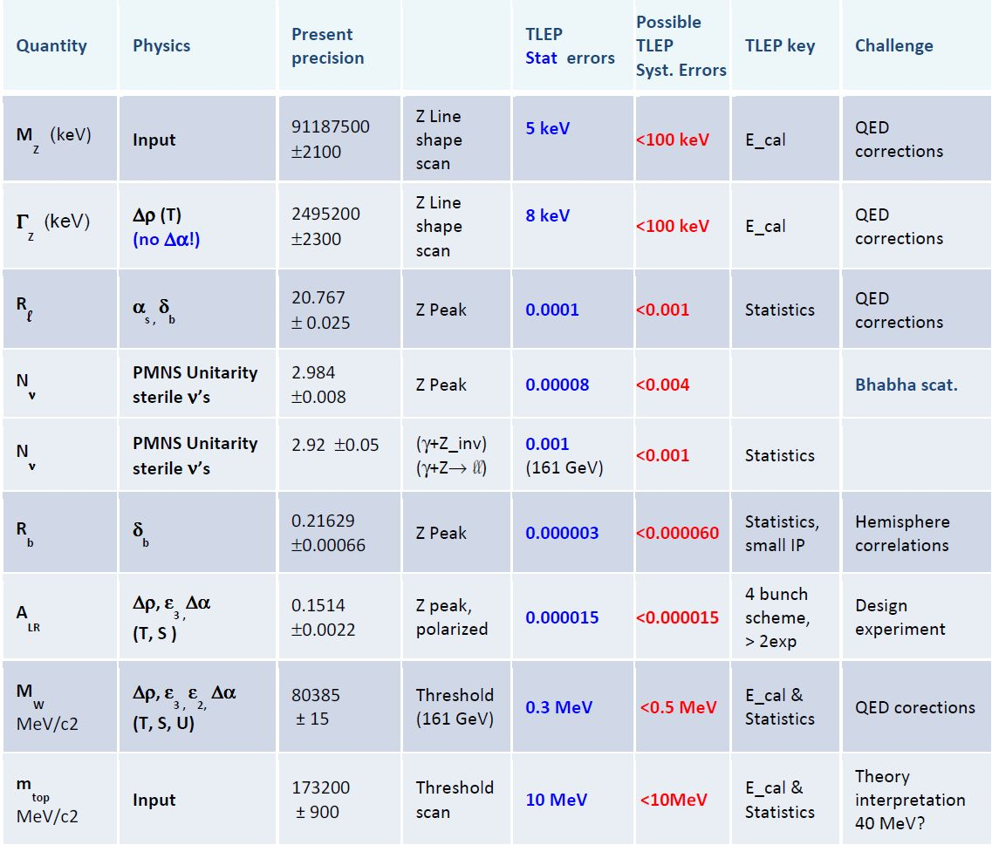

Slide 10
Some news...
Web site being refurbished (still far from completion)
Towards nice integration with FCC
While assuring continuity TLEP -> FCC-ee
see http://tlep.web.cern.ch
2. discussions under progress towards help
from CERN-PH and CERN-IT for software …
3. News from ICFA (see next slide)

Slide 11
At its meeting on February 21, 2014 at DESY, ICFA issued a statement that “ICFA supports studies of energy frontier circular colliders and encourages global coordination.”
ICFA also approved the 55th ICFA Advanced Beam Dynamics Workshop on High Luminosity Circular e⁺e⁻ Colliders.
It will take place October 8-11, 2014 in Beijing and be hosted by the Institute of High Energy Physics (IHEP).
The focus will be on Higgs factory.

Slide 12
Next steps
1- Complete assembly of conveners, e.g.,
H(126) properties and Offline software
are still missing in « Experiments »
2- organize next FCC-ee events
Physics discussions
Machine-Detector interface
Accelerator design etc...

