Slide 1

Overview of JAI activity
Pavel Karataev
John Adams Institute for Accelerator Science
At Royal Holloway, University of London
oPAC Advanced School on Accelerator Optimisation
7-11 July 2014, Royal Holloway College, Egham, UK

Slide 2




John Adams Institute for Accelerator Science
University of Oxford
Royal Holloway University of London
Imperial College London

Slide 3
JAI Faculty

Slide 4
Main JAI Objectives
Research in Accelerator Science and Technology
  Generic research experience and expertise
  Mobility and international experience
Training-through-research at Masters and PhD level
  Academic training programme at universities
  Research projects at national and international laboratories
Links with Industry
  Direct collaboration with companies
  Provide consultation service
Outreach & Dissemination

Slide 5
International Linear Collider

Slide 6
Compact Linear Collider
CLIC - 3 TeV

Slide 7
Beam instrumentation
Transverse beam size measurement
  Laserwire, OTR monitors, ODR monitors, imaging techniques and interferometers
  Non-invasive diagnostics
Longitudinal beam profile measurements
  Coherent radiation spectrum: CDR, CTR, CSR, CSPR
  Streak camera, RF pickup and RF deflectors
Beam position diagnostics
  Cavity BPMs, Strip line BPMs, EO BPMs, and Cherenkov Diffraction Radiation technique
Ultrafast Feedback and Feedforward systems

Slide 8
KEK-ATF2 facility in Japan

Slide 9
CLIC Test Facility (CTF3, CERN)

Slide 10
VELA facility -> CLARA

Slide 11
R&D with industry potential
Cavity BPMs + signal processing electronics
Strip-line BPMs
Amplifiers and low latency digital boards
Ultra-fast room temperature detectors
Novel Compact THz and X-ray sources

Slide 12
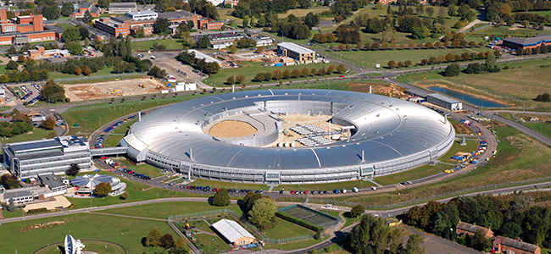
Light Sources in the UK
Diamond Light Source – the largest Accelerator Facility in the UK

Slide 13
Light Sources in the UK
Short Angstrom Pulsed Photon for Innovative Research
SAPPHIRE
e-beam
500 MeV
1.2 GeV
RF-GUN
X01
■
S01 S02 S03
50 m UNDULATOR
BC1
S04 S05 S06
BC2
S07 S08 ...
Normal conducting S-band (C-band) technology
Photon Energy 12 keV (7-8 GeV electrons in ~800 m)
Repetition rate 100-400 Hz
<10 - 100 fs pulses with good emittance (<1μm) and high peak charge (few kA)
10 pC – 1 nC bunches (exceeding 10¹² photon per pulse at 12 keV)

Slide 14
Multi-pulse Laser Wakefield Acceleration (MP - LWFA)
Advanced experience and expertise in OU and ICL
High power lasers are available
Consultation on the LWFA strategy is ongoing
Accelerator Science Laboratory is being designed at OU

Slide 15
Accelerator Science Laboratory

Slide 16
Muon Ionization Cooling Experiment
(MICE)

Slide 17
Ion accelerators
High Luminosity LHC upgrade
  Advanced Beam Optics Studies
  Collimation studies
  SPS head-tail monitors
  Electro-optic BPMs
  Cherenkov radiation bunch length and position monitor
Front-End-Test-Stand (FETS) – H⁻ facility
  Ion source
  RFQ
  Beam diagnostics
Linac4 – injector upgrade for HL-LHC
  Beam position monitors
  Laser-Wire transverse emittance scanner
Medical accelerators
  Compact accelerators for medical applications
  Low and medium energy beam transport lines

Slide 18
Future plans and directions
Future Linear Collider projects
Engage into the FCC project
  European strategy – CERN led efforts
  CDR and cost by 2018
Advance Laser Plasma acceleration technology
MICE experiment
Spallation sources (ISIS, ESS)
Diamond and other light sources
Closer collaboration with RAL, ASTEC, and Cockroft Institute

