Slide 1
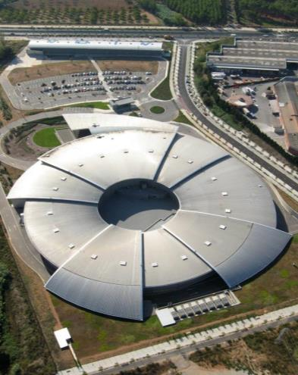
3rd Generation Synchrotron Light Sources
Francis Perez

Slide 2
Outline
2
Synchrotron Radiation
Synchrotron Light Sources
1st, 2nd, 3rd and Next Generation
Enabling technologies
Insertion devices
Vacuum (NEG coating)
Electronics (BPMs, LLRF, FOFB)
Top UP
Simulation tools
…

Slide 3
Synchrotron Radiation
3
The theoretical basis for synchrotron radiation traces back to the time of Thomson's discovery of the electron. In 1897, Larmor derived an expression from classical electrodynamics for the instantaneous total power radiated by an accelerated charged particle. The following year, Liénard extended this result to the case of a relativistic particle undergoing centripetal acceleration in a circular trajectory. Liénard's formula showed the radiated power to be proportional to (E/mc²)⁴/R², where E is particle energy, m is the rest mass, and R is the radius of the trajectory
Arthur L. Robinson

Slide 4
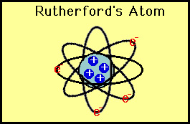
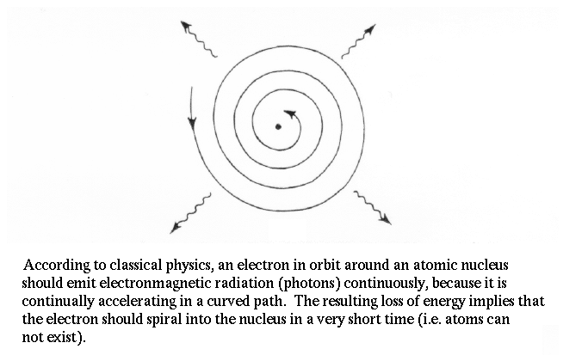
Synchrotron Radiation
4
Early 20th century

Slide 5
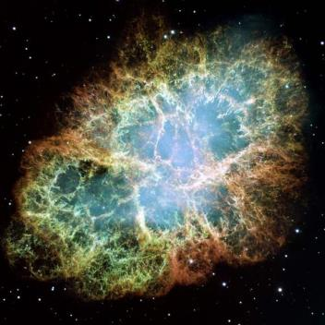
Synchrotron Radiation
CRAB Nebulae
Radiation from the Crab Nebulae is actually the synchrotron radiation of ultra relativistic electrons in interstellar magnetic fields
Recorded by Chinese astronomers in 1054

Slide 6
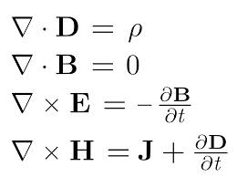
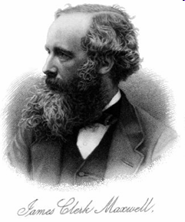
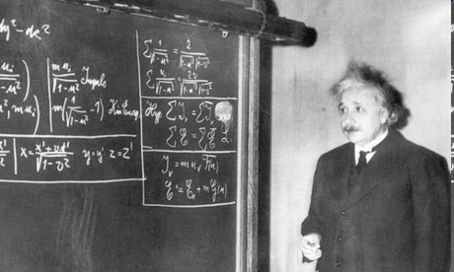

Synchrotron Radiation
Why an accelerator?
“Synchrotron radiation are the electromagnetic waves emitted by a charged particle that moves in a curved trajectory at a speed close to the speed of light”
Maxwell equations +
Relativity equations

Slide 7

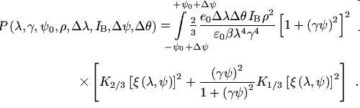
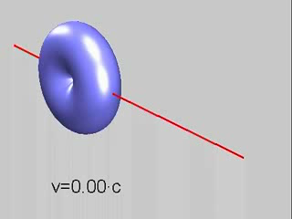
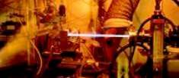
Why an accelerator?
And combine both in an accelerator!
ESRF

Slide 8
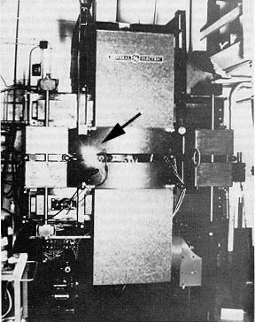
1st man-made synchrotron light
Synchrotron light from the 70-MeV electron synchrotron at GE
Synchrotron radiation was named after its discovery in a General Electric synchrotron accelerator built in 1946 and announced in May 1947 by Frank Elder, Anatole Gurewitsch, Robert Langmuir, and Herb Pollock in a letter entitled "Radiation from Electrons in a Synchrotron".

Slide 9
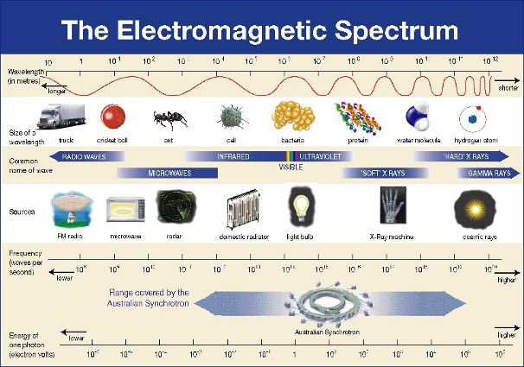
Synchrotron Radiation
Why an accelerator?
Synchrotron radiation

Slide 10

Why Synchrotron Radiation
Interaction photons with matter
Diffraction
Reflection
Photoemission
Photon beam
SAMPLE
fluorescence
Small angle dispersion
Absorption
Dispersion
Information about sample properties

Slide 11

Why synchrotron light?
Why Synchrotron Radiation
Continuous Spectrum: From infrared to X-rays
E_{crit} (keV) = 0.665 E² (GeV) B(T)
Intense
Highly collimated: as a narrow stable beam
Θ(rad) = 0.51/E (MeV)
Polarized in the orbital plane
With temporal structure

Slide 12
Why Synchrotron Radiation
Huge range of scientific disciplines, including condensed matter physics, chemistry, nanophysics, structural biology, engineering, environmental science and cultural heritage.
Diamond Light Source dixit

Slide 13
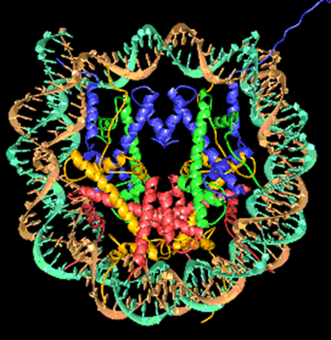
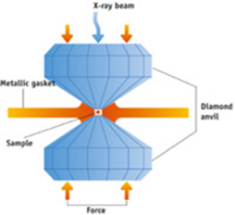
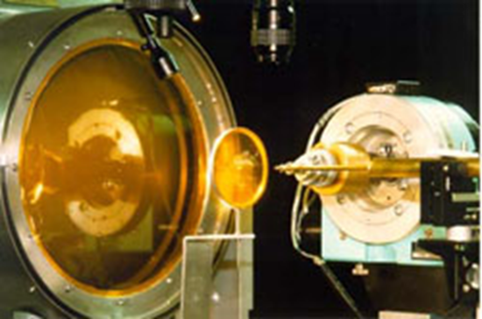
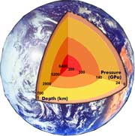
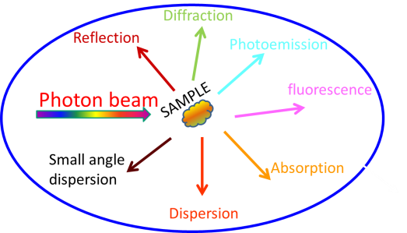
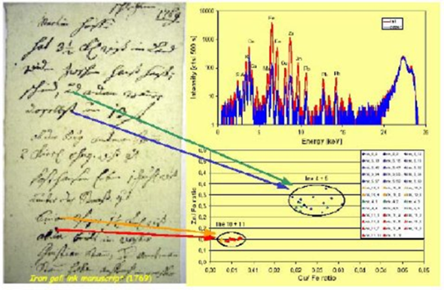
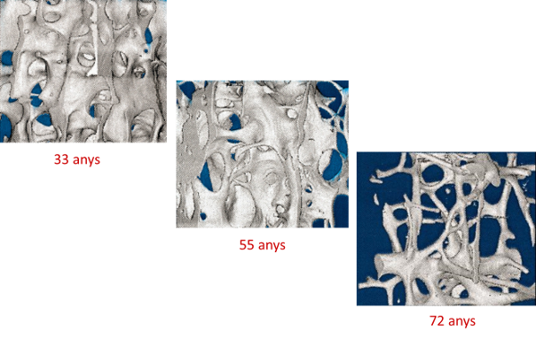
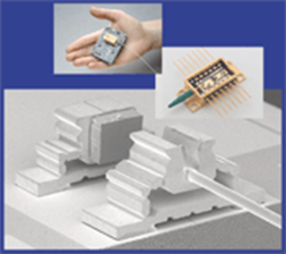
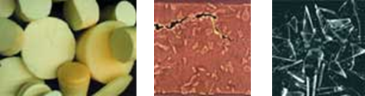
Applications
BIOLOGY
CHEMISTRY
GEOLOGY
Catalysis
High pressure
High temperature
Nucleosome
ART
microfluorescence
MEDICINE
INDUSTRY
Manuscript 1679
Osteoporosys
MATERIAL SCIENCE
…and more
Micromechanics

Slide 14
Synchrotron Generations
1st generation light sources (1956 - )
Accelerator built for High Energy Physics
used parasitically for synchrotron radiation
2nd generation light sources (1981 - )
Accelerators built as synchrotron light sources
3rd generation light sources (1994 - )
Optimised for high brilliance
with low emittance beam and Insertion Devices

Slide 15
Synchrotron landmarks
15
1946 | First synchrotron operates in Woolwich, UK.
1947 | First observation of synchrotron light.
1956 | First experiments using synchrotron light take place at Cornell, US.
1964 | The DESY synchrotron in Germany begins operation for both high-energy physics and synchrotron-light experiments.
1966 | First experiments in the UK at Glasgow synchrotron.
1968 | Tantalus, 1st synchrotron light facility
1981 | The Synchrotron Radiation Source (SRS) starts operating in Daresbury, UK. It is the first dedicated X-ray producing synchrotron source.
1994 | The first third-generation synchrotron source, the ESRF in Grenoble, France, goes into operation.
2000 | The SASE principle for an FEL is successfully demonstrated at DESY.
2001 | Swiss Light Source introduce Top Up for users
2005 | FLASH, the first FEL in the soft X-ray range, goes into operation at DESY (4th Generation LS, but not a “synchrotron”…)
2014 | Max IV, “next generation” under construction

Slide 16
Evolution
Brightness
Emittance
1980 100 nmrad
1990 10 nmrad
2000 3 nmrad
2010 1 nmrad
…
2020 0.1 nmrad

Slide 17
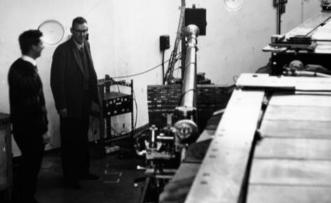
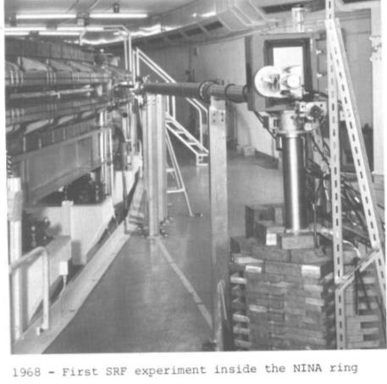
1st Generation LS (1956 – …)
17
1968 Synchrotron Light experiment at NINA
Ian Munro + Scott Hamilton
(Manchester University)

Slide 18
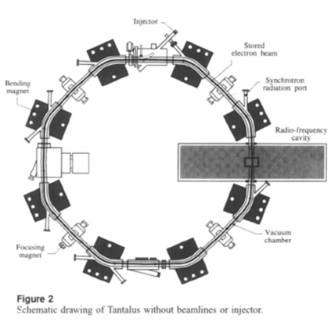
1st Generation LS
1968 Tantalus 1st Synchrotron Light Facility
“Tantalus not only pioneered the use of synchrotron radiation, but created a research facility where both scientists and graduate students could perform hands-on work”
A. Oswald
5 m

Slide 19
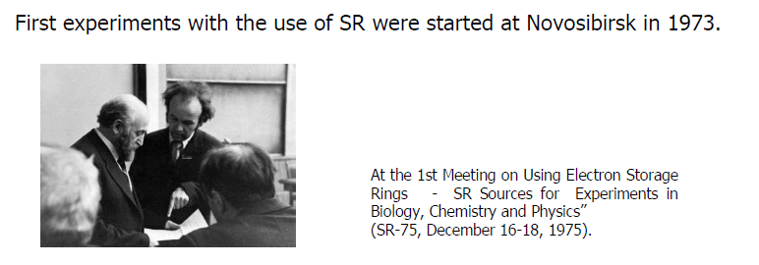
1st experiments at Russia

Slide 20
2nd Generation LS (1981 – …)
SRS at Daresbury, UK
1st built accelerator for production of Synchrotron Light in the XR energy range
Initially conceived for using the light from the bending magnets
Bending magnet at SRS

Slide 21
2nd Generation LS (1981 – …)
SOR-Ring Tokyo Japan 1976
SRS Daresbury UK 1981
DCI – LURE Orsay France 1981
NSLS Brookhaven USA 1982
BESSY Berlin Germany 1982
Photon Factory at KEK Tsukuba Japan 1982
MAX-I MAX-lab Sweden 1986
…

Slide 22
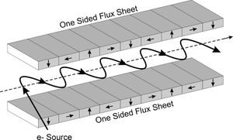
1st Wiggler (1979)

Slide 23
1981
ESRF

Slide 24
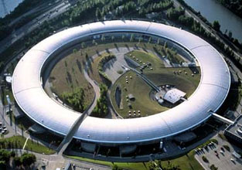
3rd Generation LS (1993 – …)
1993 ESRF EU (France) 6 GeV
ALS US 1.5-1.9 GeV
1994 TLS Taiwan 1.5 GeV
ELETTRA Italy 2.4 GeV
PLS Korea 2 GeV
MAX II Sweden 1.5 GeV
1996 APS US 7 GeV
LNLS Brazil 1.35 GeV
1997 Spring-8 Japan 8 GeV
…
ESRF

Slide 25
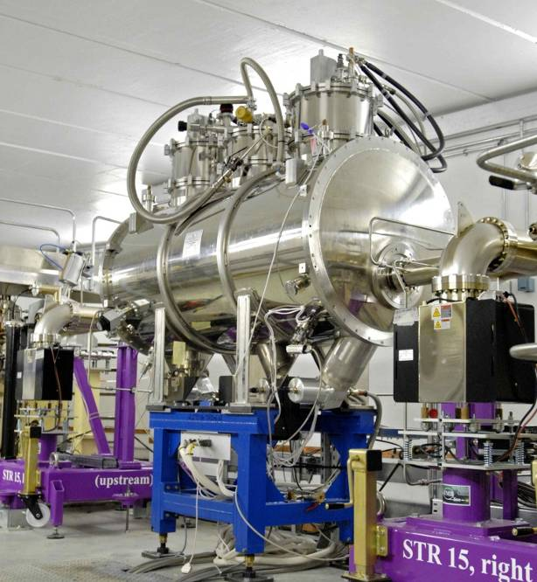
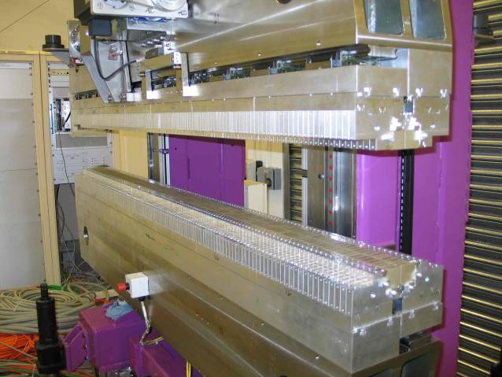
Insertion Devices
WIGGLER
to reach high photon energies
UNDULATORS
to generate high brilliance radiation

Slide 26
1998 NEG Coating
Benvenuti C, Chiggiato P, Cicoira F, L’Aminot Y. J Vac Sci Technol A 1998;16:148.
Coating the internal surface of a vacuum chamber with a Non Evaporable Getter (NEG) thin film. After thermal activation the oxide layer present at the NEG surface is dissolved, reducing significantly the secondary electron yield, the photon and the electron induced desorptions, and additionally providing high pumping speeds for the main gas species present in UHV systems.

Slide 27
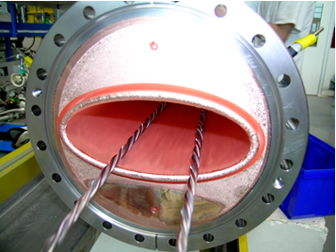
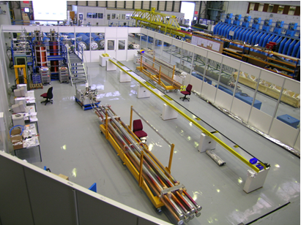
NEG Coating
Figure 1 – Global view of the coating facilities in building 181.

Slide 28
NEG Coating
Since 2002, following collaboration and the purchase of a license from CERN, which holds the TiZrV NEG coating technology patent, the ESRF has been producing NEG coated vacuum and now many synchrotrons are usign it for narrow gap inserion devices.

Slide 29
1995
In 1995, Einfeld et al. PAC

Slide 30
Several developments were needed before considering it possible, since micron beam size required submicron beam stability
Orbit measurement
Beam stability
Beam lifetime
Reliable simulations
…

Slide 31
DIGITAL ELECTRONICS

Slide 33
Thermal drifts
ALBA data

Slide 34
EPAC 1996

Slide 35
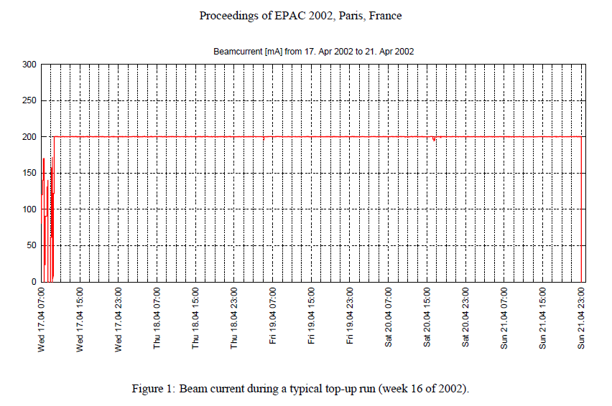
2001 SLS, Switzerland Users operation
Top Up for User Operation

Slide 36
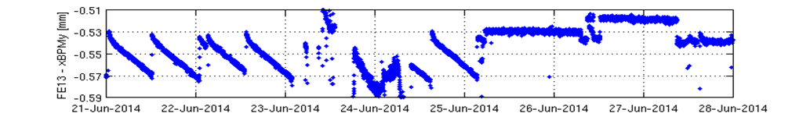
Thermal Stability
XALOC: xBPM_{(y)}
Machine day
Decay mode
Top-up
(jumps are due to changes in the ID gap, which needs recalibration of the xBPMs)
ALBA data

Slide 37
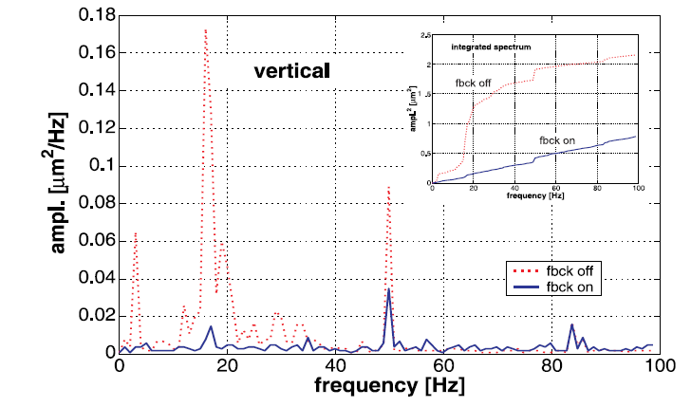
2003 Fast Orbit Feedback
Up to 100 Hz

Slide 38
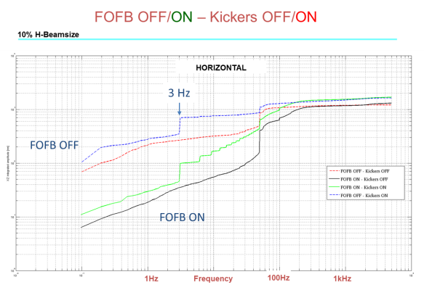
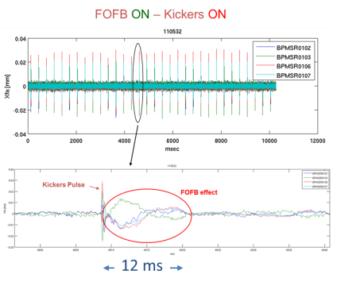
Fast Orbit FeedBack
3 Hz horizontal
kicker induced noise
ALBA data
Notes:
38

Slide 39
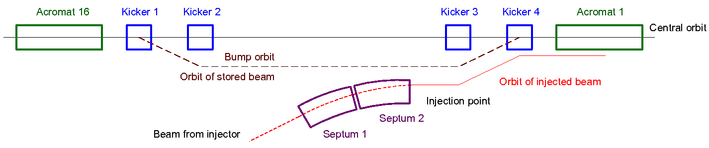
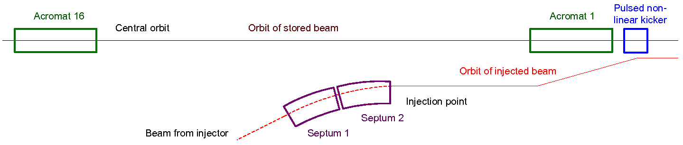
Injection schemes
Conventional
Pulsed Quad
Oscillation from
injection point to
non-linear kicker
*Phys. Rev. ST Accel. Beams 10, 123501, ‘New injection scheme using a pulsed quadrupole magnet in electron storage rings’, K. Harada, Y. Kobayashi, T. Miyajima, S. Nagahashi, Photon Factory, 2007.
39
39

Slide 40
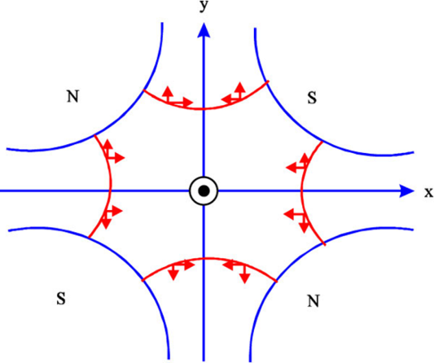
2005 Pulsed Quad Kicker
Proof of principle, but still no synchrotron light source has implemented it
Stored beam
unperturbed
Injected beam
receives a kick

Slide 41
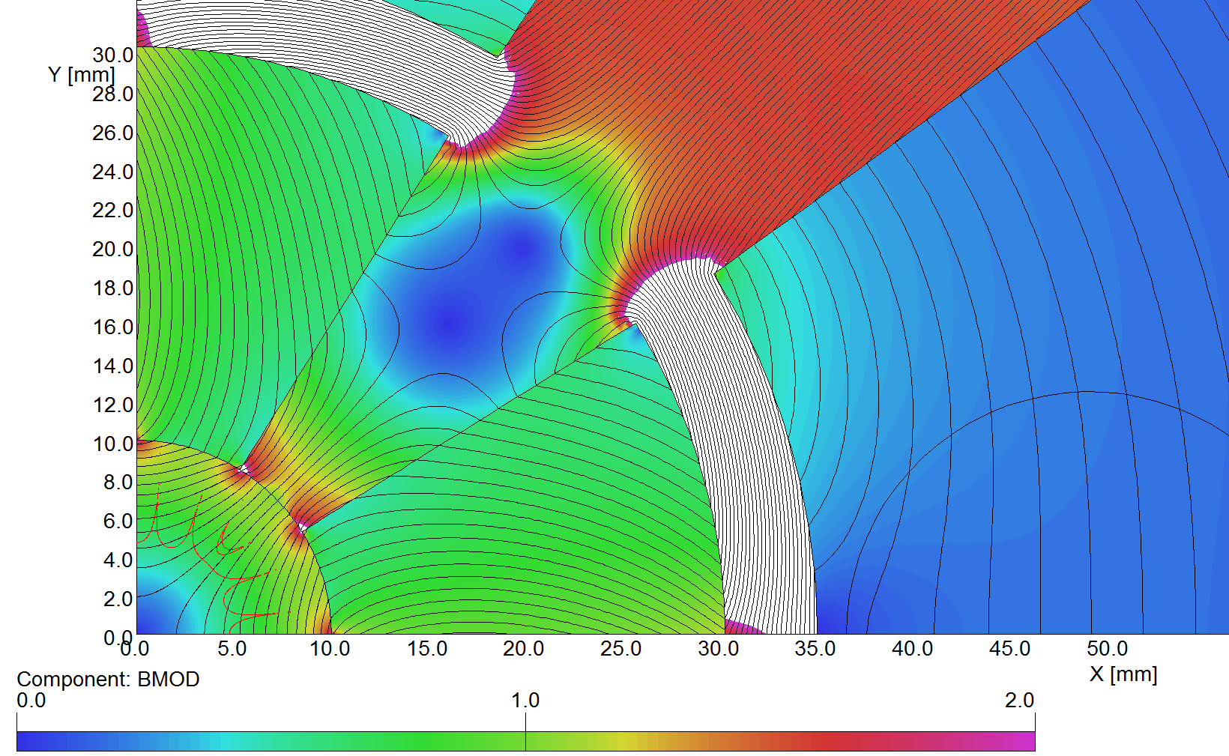
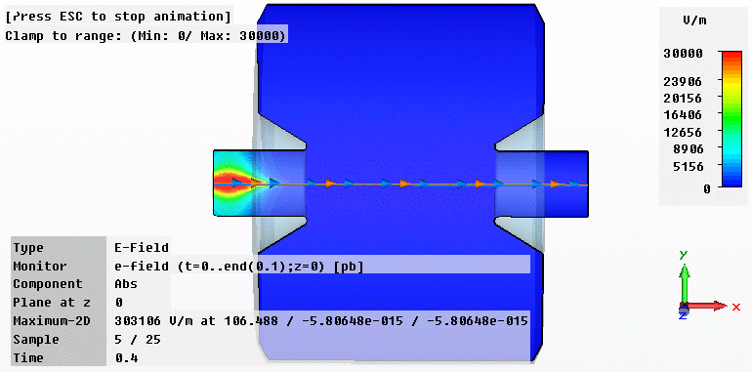
Computation
Computation capabilities increasing rapidly, allowing reliable simulations

Slide 42
MAX IV

Slide 43
MAX IV
NEG Coating to reduce vacuum chamber dimensions and use of small magnets
Multibend achromat, to reach 1 nmrad emittance
Block magnet construction, relying fully on simulations
Last generation of undulators
Top Up
Fast Orbit Feed back
Multipole kicker injection (with standard injection as backup)
…

Slide 44
Next: even lower emittance lattices
We need to master Nonlinear beam dynamics in order to optimise dynamic aperture and Touschek lifetime
MOGA – Multi-Objective (multi-parameters) Genetic Algorithms
Objectives: Dynamic aperture
  Momentum aperture and lifetime
  Tune shift with amplitude, dnx,y/dJx,y
  Linear optics parameters
Variables: Sextupoles, Octupoles, Quadrupoles
Deterministic – Hamiltonian resonance driving terms analysis

Slide 45
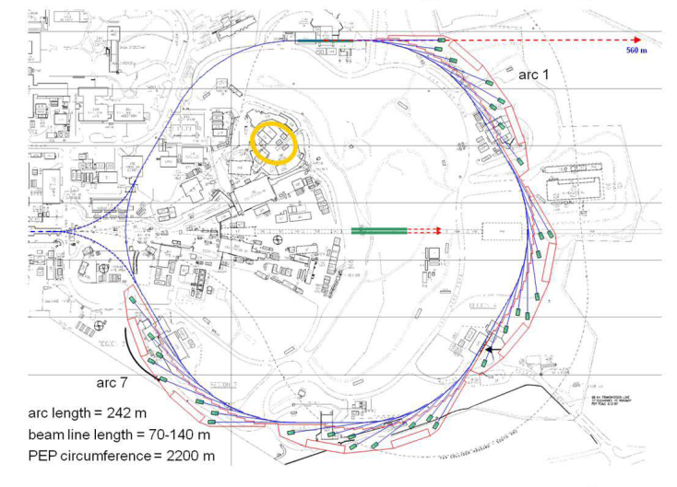
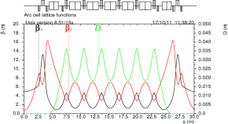
PEP - X
7 Bend Achromat

Slide 46
Cancellation of resonances
PEP-X: Baseline (2008)
PEP-X: USR (2011)
The dynamic aperture is in unit of sigma of the equilibrium beam size. The USR design
is built with 4th-order geometric achromats and therefore no 3rd and 4th order
resonances driven by the sextupoles seen in the scan.

Slide 47
Next Generation Light Sources

Slide 48
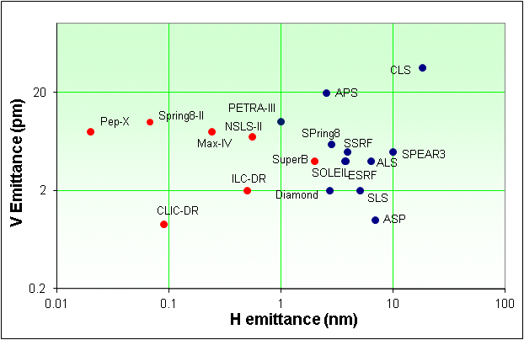
Next Generation Light Sources
Tevatron ULS
3 pm
Ultimate LS: Diffraction limited lattices
8 pm at 1 Angstron

Slide 49
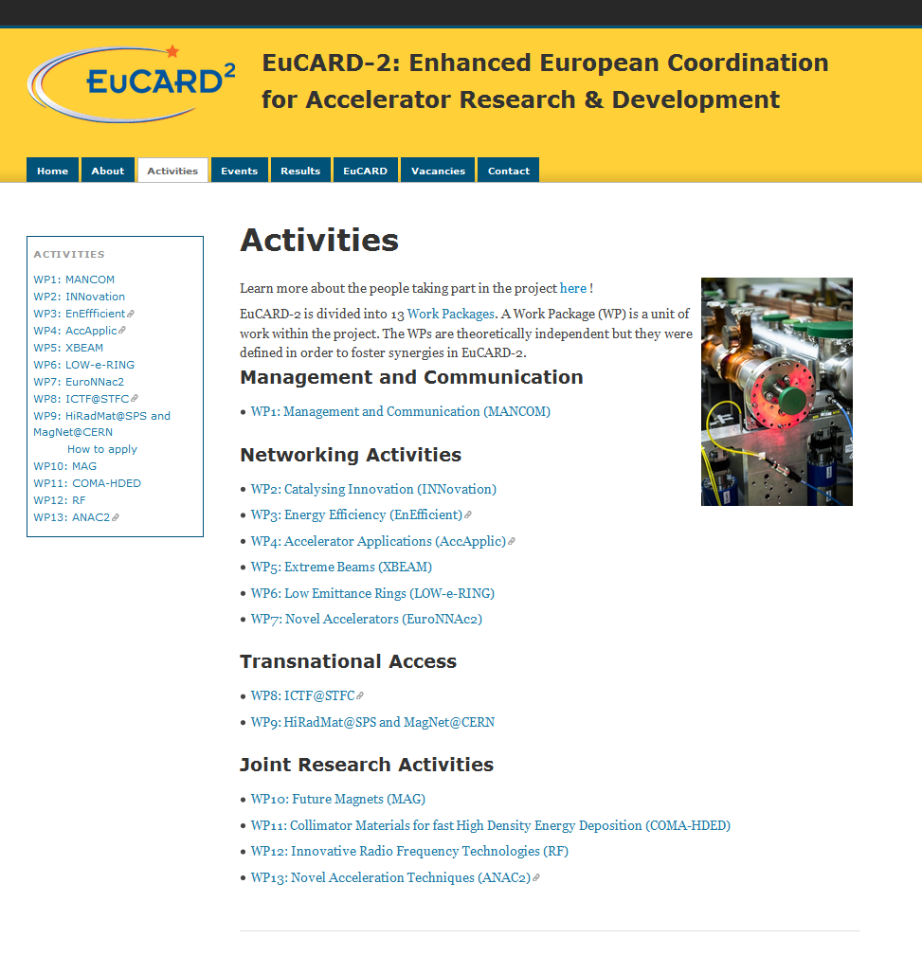
eucard2.web.cern.ch/

Slide 50
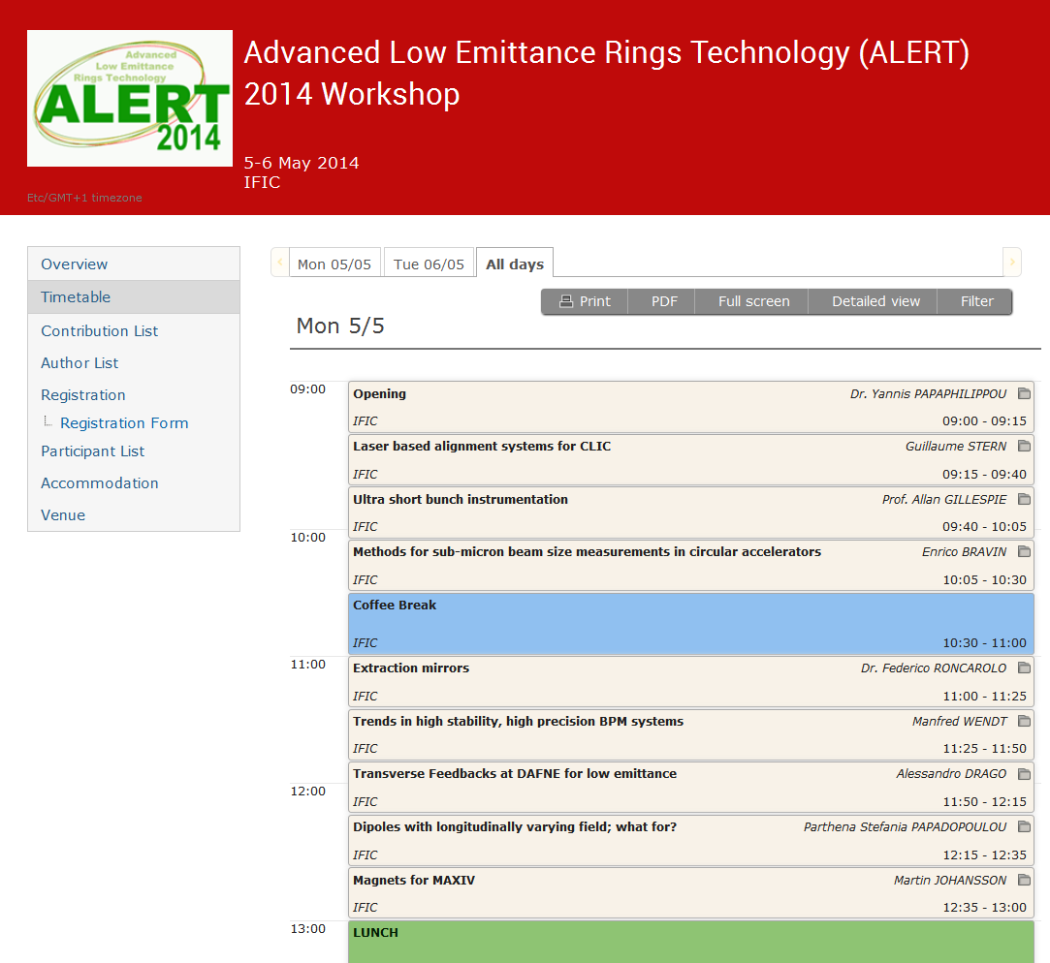
Workshop sessions included:
Insertion devices, magnets and alignment
Instrumentation for Low Emittance Rings
Kicker systems
RF system design, including low-level RF systems
Vacuum design
Feedback systems

Slide 51
Conclusion
There are over 50 synchrotron worldwide (still some of the 1st generation)
Science with synchrotron light is in the forefront
Synchrotron Light Sources have been and are evolving continuously
Evolution is based on R&D effort in different fields and on the new requirements of the users
Still lots to do…

Slide 52
References
52
http://abyss.uoregon.edu/~js/glossary/bohr_atom.html/rutherford-model.html
http://www.iun.edu/~cpanhd/C101webnotes/modern-atomic-theory/
Synchrotron Radiation, Philip J. Duke, Oxford Science Publications
Daresbury Laboratory, 50 years. Science & Technology Facilities Council
Accelerator Science at Daresbury - the early years. Vic Suller.
http://www.lightsources.org/
X-Ray Data Booklet, Arthur L. Robinson, http://xdb.lbl.gov/
http://en.wikipedia.org
http://www.iop.org/publications/iop/2011/page_47511.html
http://invention.smithsonian.org/resources/fa_tantalus_index.aspx
The History of the Synchrotron Radiation Center, Eric Verbeten. History of Science, University of Wisconsin. 2009.
The evolution of dedicated synchrotron light source, G. Margaritondo, Physics Today, 2008.
History of Synchrotron Radiation Sources, R. Hettel, SSRL, USPAS 2003
Wigglers and Undulators Magnets, H.Wininck et al. Physics Today, 1981.
Ricardo Bartolini, John Adams Institute Lecture, 2010
Top Up Operation Experience at the Swiss Light Source, A.Lüdeke, M.Muñoz, EPAC 2002
NEG Coating of the non-standard LSS vacuum chambers, P. Costa Pinto et al. CERN TS-Note-2005-030, May 2005
www.esrf.fr
Vacuum Science and Technology for Accelerators, Yulin Li, USPAS 2013.
F. Mazzolini, NEG pumps and coatings, CAS 2006
Magnets Studies, M.Modena, CLIC – CERN
ICFA Workshop Future Light Sources, 2012, www.conferences.jlab.org/FLS2012
and more…

Slide 53
Thank you
Francis Perez

