Slide 1



Next Generation Light Sources
Jim Clarke
ASTeC, STFC Daresbury Laboratory and
The Cockcroft Institute
9th July 2014, RHUL

Slide 2
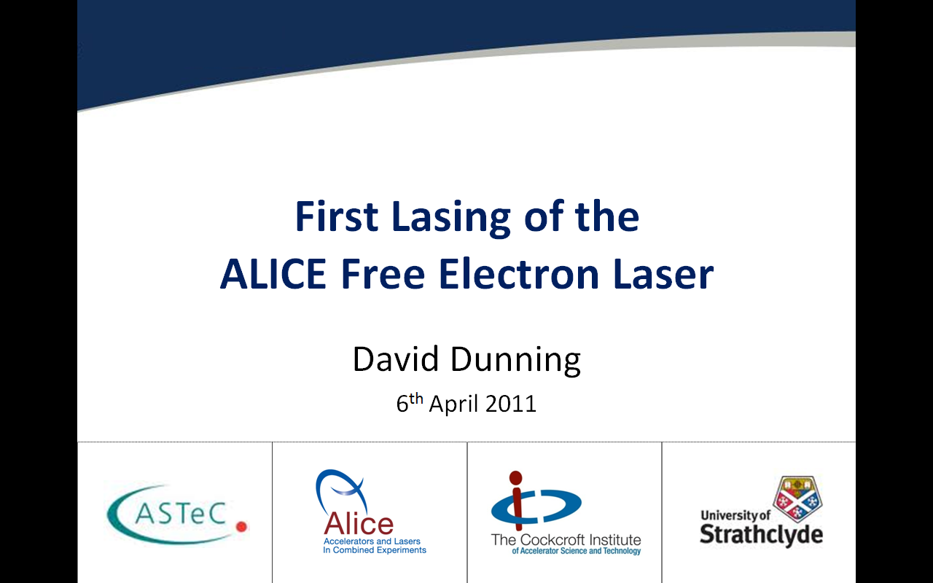
Motivation
3rd generation light sources (3GLS) provide scientists with access to intense, stable, tuneable, monochromatic, light across a very broad spectral range (THz to X-ray)
The science that has become possible since 3GLS came on stream is dazzling in its breadth and reach
The impact of this science is clear simply by counting the Nobel prizes that have been awarded …

Slide 3
The Impact of X-Rays on Science
21 Nobel Prizes so far for X-rays
1901 Rontgen (Physics)
1914 von Laue (Physics)
1915 Bragg and Bragg (Physics)
1917 Barkla (Physics)
1924 Siegbahn (Physics)
1927 Compton (Physics)
1936 Debye (Chemistry)
1946 Muller (Medicine)
1962 Crick, Watson & Wilkins (Medicine)
1962 Perutz and Kendrew (Chemistry)
1964 Hodgkin (Chemistry)
1976 Lipscomb (Chemistry)
1979 Cormack and Hounsfield (Medicine)
1981 Siegbahn (Physics)
1985 Hauptman and Karle (Chemistry)
1988 Deisenhofer, Huber & Michel (Chemistry)
1997 Boyer and Walker (Chemistry)
2003 Agre and Mackinnon (Chemistry)
2006 Kornberg (Chemistry)
2009 Yonath, Steitz & Ramakrishnan (Chemistry)
2012 Lefkowitz and Kobilka (Chemistry)
These last 5 all used synchrotron radiation, 2 of them used the SRS at Daresbury

Slide 4
4th Generation Light Sources
Since 3GLS are so successful, what more could a 4GLS possibly offer?
The most significant feature of 4GLS is the increase in the intensity of the light – more photons on the sample!
This enables scientists to attempt experiments on samples which would otherwise not give a usable signal – maybe they are too dilute or too small
Typically
  3GLS ~ 10⁶ photons per pulse
  4GLS ~ 10¹² photons per pulse
Can take a diffraction pattern in a single shot, for example
The second major advantage is the reduced duration of the photon pulses
Typically
  3GLS ~ 10 ps (sub-ps in special operating modes)
  4GLS ~ 10 fs already demonstrated but in principle schemes already exist for <100 as for single pulses of even sub-as for pulse trains (zeptoseconds!)
This enables scientists to attempt experiments which have previously been impossible – watching the fastest of chemical reactions, for example (molecular movies!)

Slide 5
Free Electron Lasers
4th generation light sources are based upon free electron lasers (FELs)
  These are devices which use relativistic electron beams and undulators similar to 3GLS
  But, they are able to make the light emitted COHERENT – the output is proportional to the square of the number of electrons
  They have the advantage over conventional lasers of being able to emit at any wavelength like 3GLS – including X-rays!

Slide 6
Coherent Emission
If the emitting electron bunch is shorter in length than the wavelength emitted then the output intensity is proportional to the number of electrons SQUARED
In a 3GLS this condition is not met (except at very long millimetre wavelengths) since electron bunches are typically 10 ps long
If you want to emit coherently at say 12 keV (~0.1nm) then need electron bunch to be shorter than 0.3 attoseconds!
It is not possible to generate such short relativistic bunches in an accelerator directly but it is possible to generate them indirectly – this is what the FEL does
The FEL takes an electron bunch and manipulates it such that it forms discrete periodic microbunches within it that are shorter than the wavelength emitted and are separated by that wavelength

Slide 7
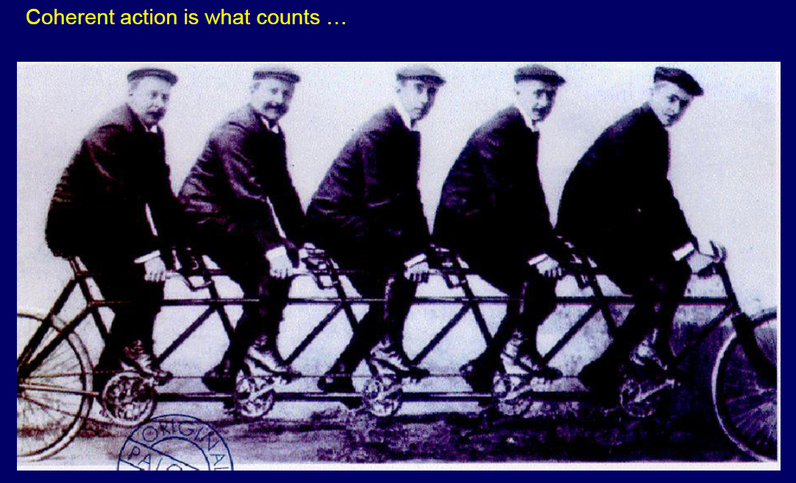

Slide 8
What is an FEL?
A beam of relativistic electrons
co-propagating with
an optical field
through
a spatially periodic magnetic field
  Undulator causes transverse electron oscillations
  Transverse e-velocity couples to E-component (transverse) of optical field giving energy transfer.
  Interaction between electron beam and optical field causes microbunching of electron beam on scale of radiation wavelength leading to coherent emission

Slide 9
How does an FEL work?
y
B
x
Basic components
E
v_{x}
v
S
N
S
N
S
z
N
S
N
S
N
B field
Electron path
E field

Slide 10
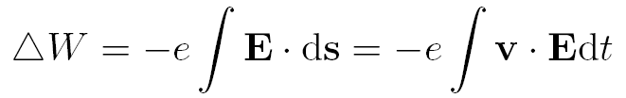
How does an FEL work?
  Basic physics: Work = Force x Distance
    Sufficient to understand basic FEL mechanism
    Electric field of light wave gives a force on electron and work is done!
  No undulator = No energy transfer
  i.e. If electron velocity is entirely longitudinal then v.E = 0
  Basic mechanism very simple!!

Slide 11
How does an FEL work?
Basic mechanism described explains energy transfer between SINGLE electron and an optical field.
But in practice need to create right conditions for:
CONTINUOUS energy transfer
in the RIGHT DIRECTION
with a REAL ELECTRON BEAM

Slide 12
How does an FEL work?
Q. Which way does the energy flow?
A. Depends on electron phase
  Depending on phase, electron either:
    Loses energy to optical field and decelerates: GAIN
    Takes energy from optical field and accelerates: ABSORPTION
E_{x}
v_{x}
v_{x}
time1
z
time2
time3

Slide 13
Types of FEL
AMPLIFIER (HIGH GAIN) FEL
    Commonly called Self Amplified Spontaneous Emission (SASE)
    Long undulator
    Spontaneous emission from start of undulator interacts with electron beam.
    Interaction between light and electrons grows giving microbunching
    Increasing intensity gives stronger bunching giving stronger emission
    >>> High optical intensity achieved in single pass
    Note, SASE is basic mechanism, there are numerous enhancements applied to improve output (e.g. seeding, harmonic jumping, HB-SASE, …)
OSCILLATOR (LOW GAIN) FEL
    Short undulator
    Spontaneous emission trapped in an optical cavity
    Trapped light interacts with successive electron bunches leading to microbunching and coherent emission
    >>> High optical intensity achieved over many passes

Slide 14
The Oscillator FEL
First demonstrated in 1977 at Stanford
electron bunch
output pulse
optical pulse
Random electron phase: incoherent emission
Electrons bunched at radiation wavelength: coherent emission

Slide 15

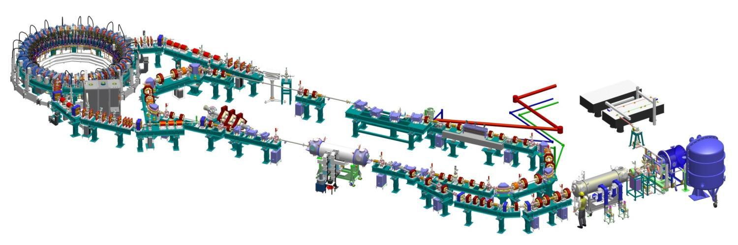
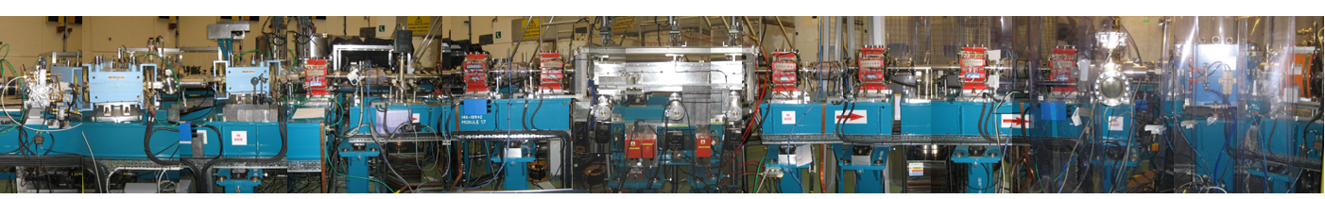
Example: ALICE accelerator and FEL
EMMA non-scaling FFAG accelerator
Daresbury, Laboratory, UK
1st arc: TBA on translation stage
Bunch compression chicane
THz beamline
PI laser
6.5MeV
dump
FEL optical cavity
FEL beamline
Buncher cavity
2nd arc
Linac: 2 9-cell SC L-band cavities →27.5MeV, ER
230 kV DC GaAs cathode gun
Booster: 2 9-cell SC L-band cavities →6.5MeV
Upstream mirror
Downstream mirror
Undulator
Electron path

Slide 16

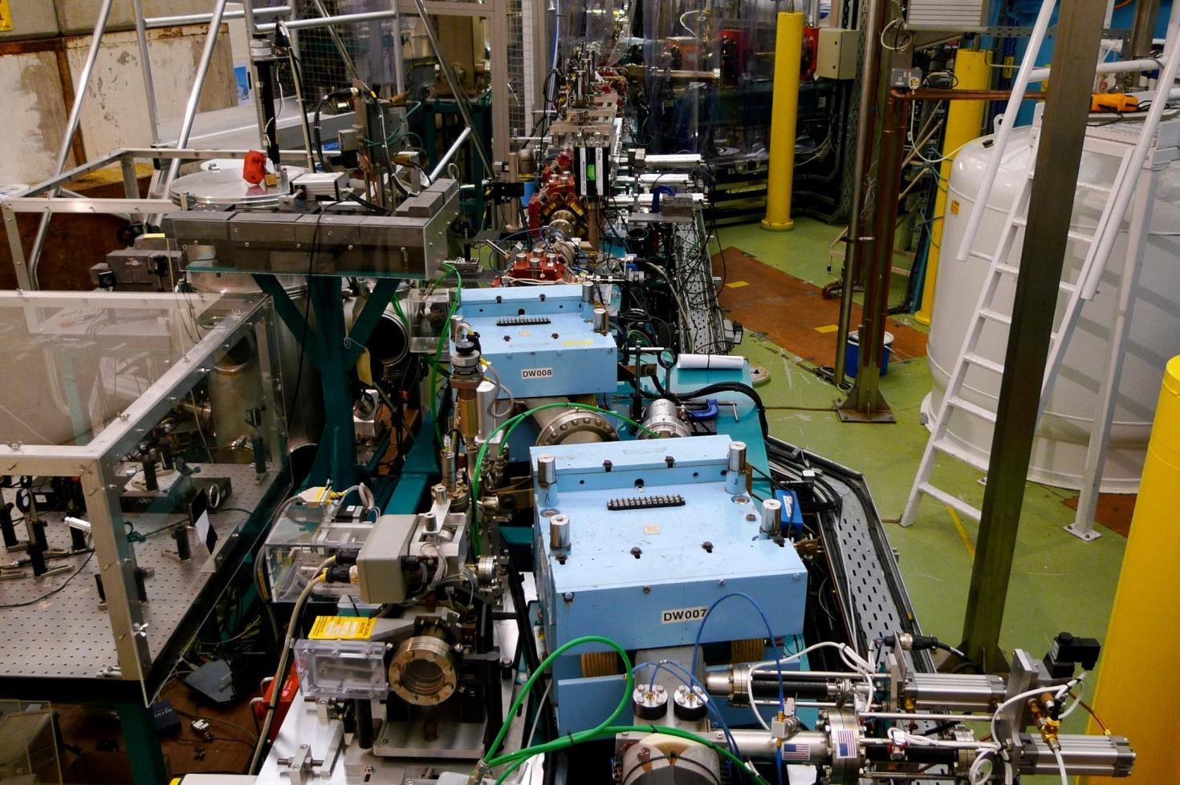
Electron Beam
Downstream mirror
Electron beam at FEL
Energy | 27.5MeV
Bunch Charge | 60-80pC (@16.25MHz)
FWHM Bunch Length | ~1ps
Normalised Emittance | ~12 mm-mrad
Energy Spread | ~0.5% rms
Repetition Rate | 81.25MHz/ 16.25MHz
Macropulse Duration | ≤100µs
Macropulse Rep. Rate | 10Hz
Undulator
Upstream mirror
Bunch Compressor
Electron path

Slide 17
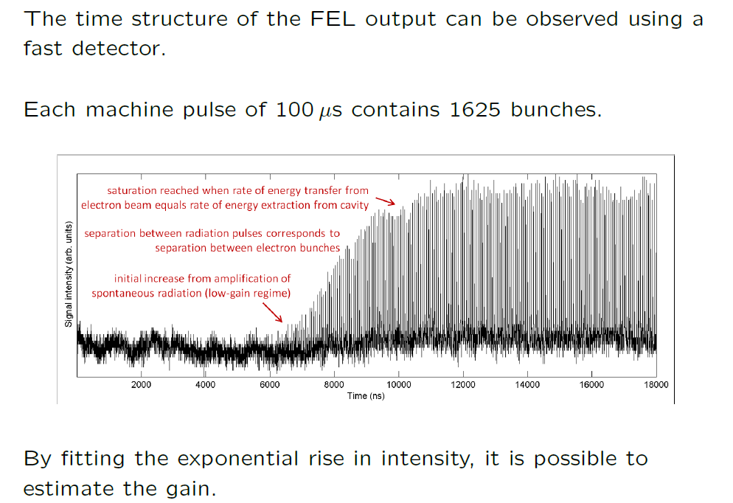
How the FEL Ouput Builds Up in ALICE
FEL emits over wavelength range ~6 to ~12 μm (infra- red) – user chooses wavelength

Slide 18
The Oscillator FEL
  For oscillator FEL the single pass gain is small.
  The emitted radiation is contained in a resonator to produce a FEEDBACK system
  Each pass the radiation is further amplified
  Some radiation extracted, most radiation reflected
  Increasing cavity intensity strengthens interaction leading to exponential growth:
Energy transfer depends on cavity intensity

Slide 19
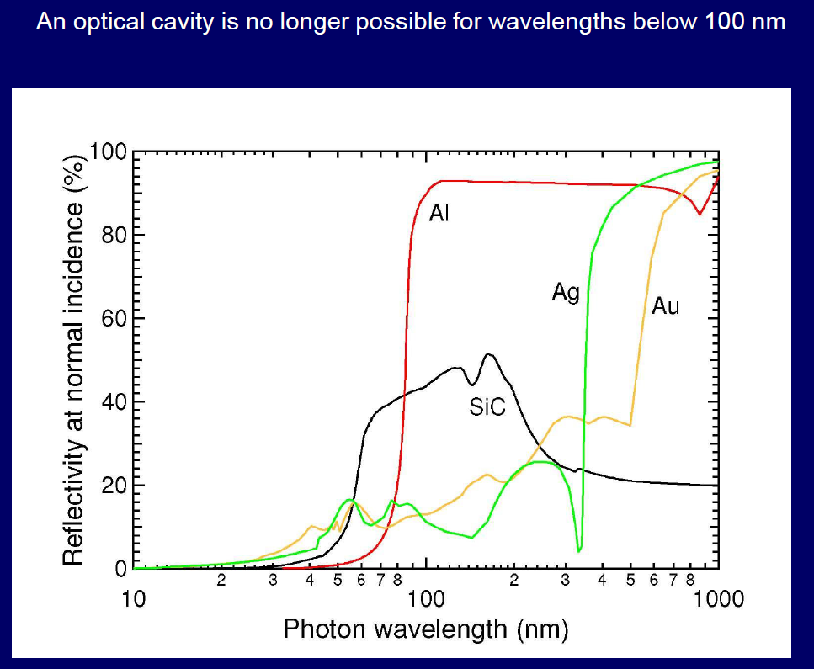
Oscillator FELs Need Mirrors !

Slide 20
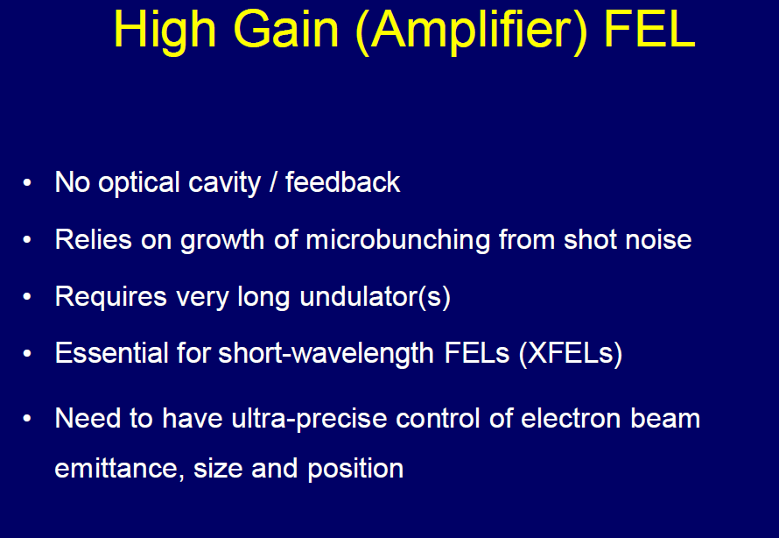

Slide 21
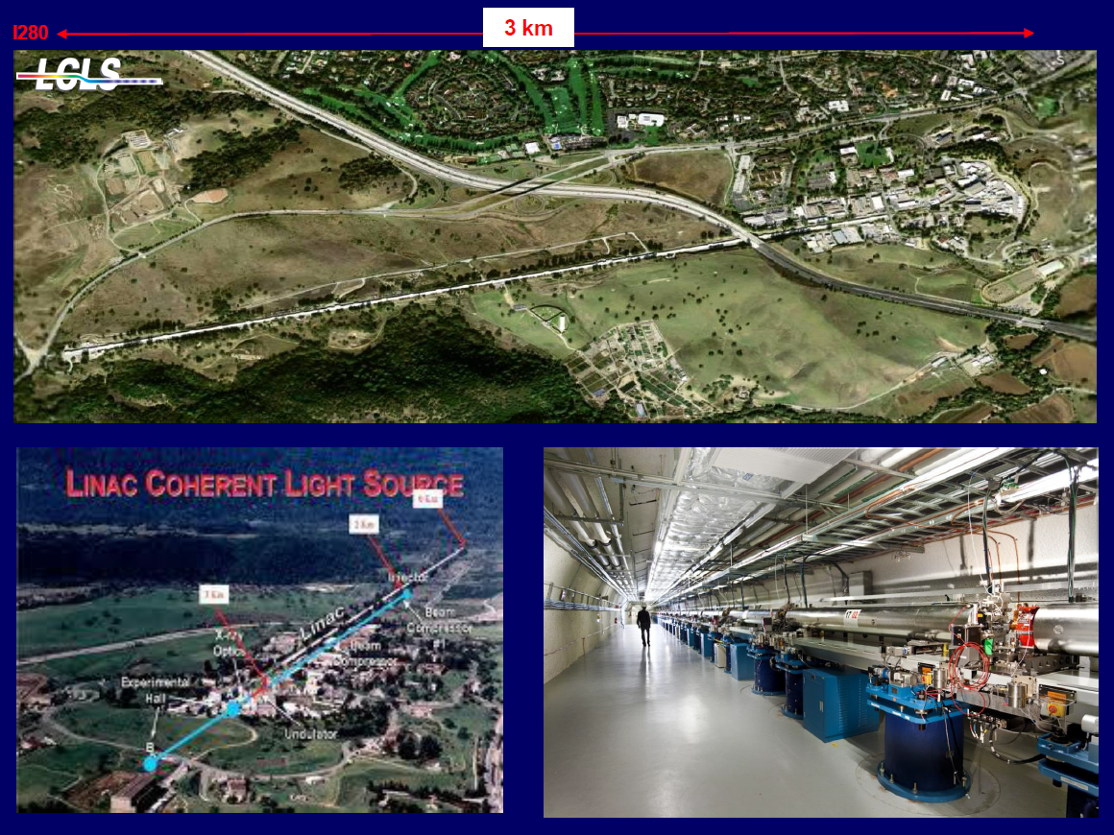
X-Ray FELs Are Big !

Slide 22
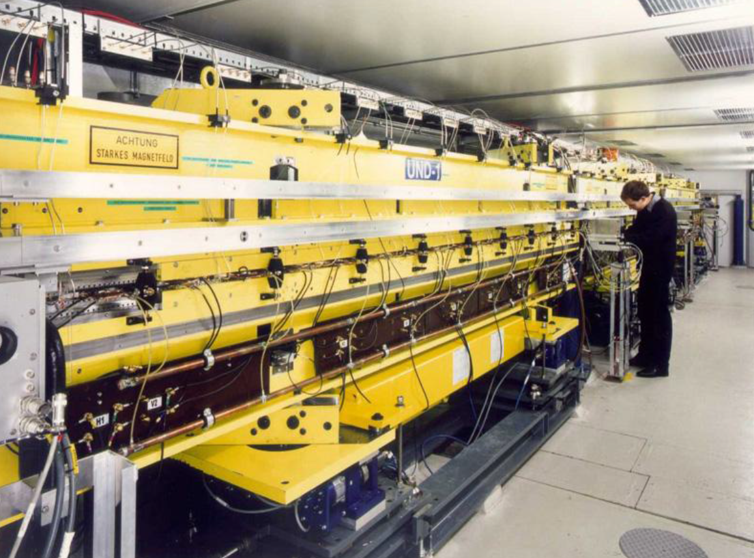
Undulators Are Long !

Slide 23
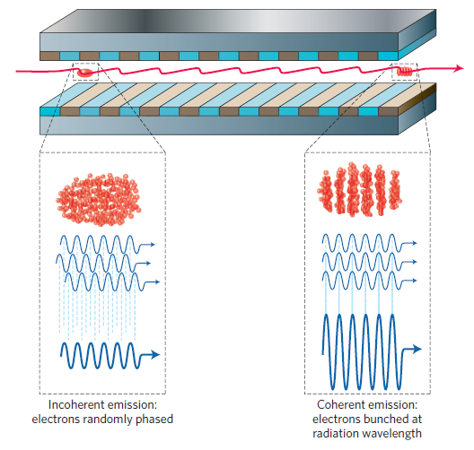
FEL Process (SASE)

Slide 24
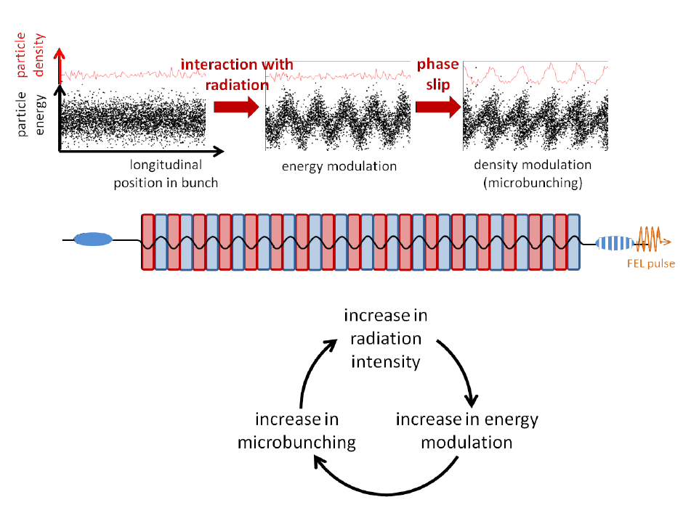
FEL Process (SASE)

Slide 25
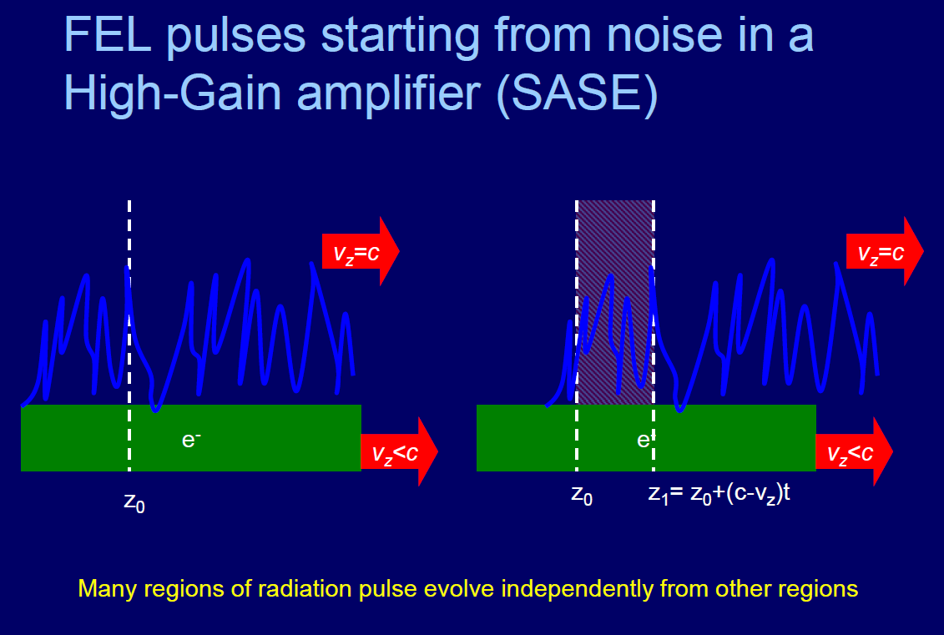
Coherence Length

Slide 26
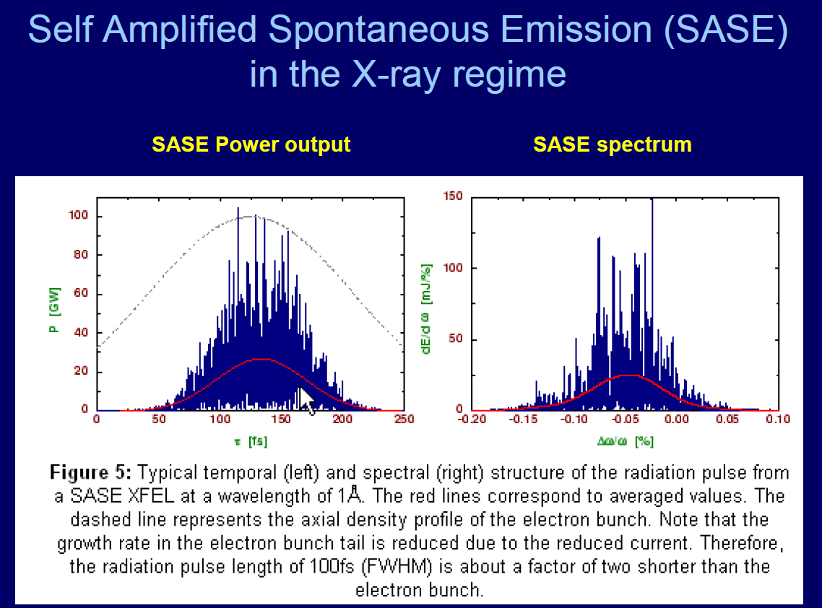
SASE FEL Output Is Noisy

Slide 27
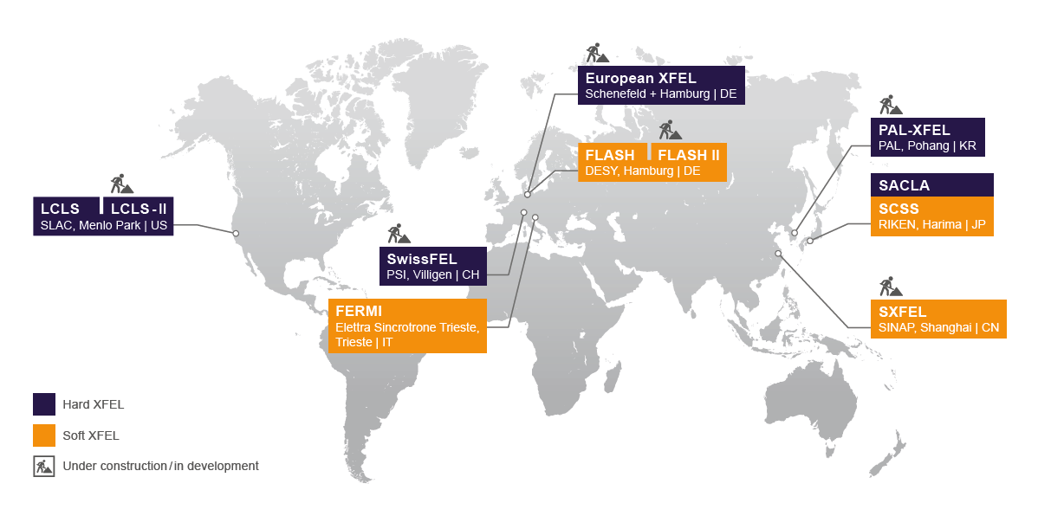
SASE FELs Around the World

Slide 28
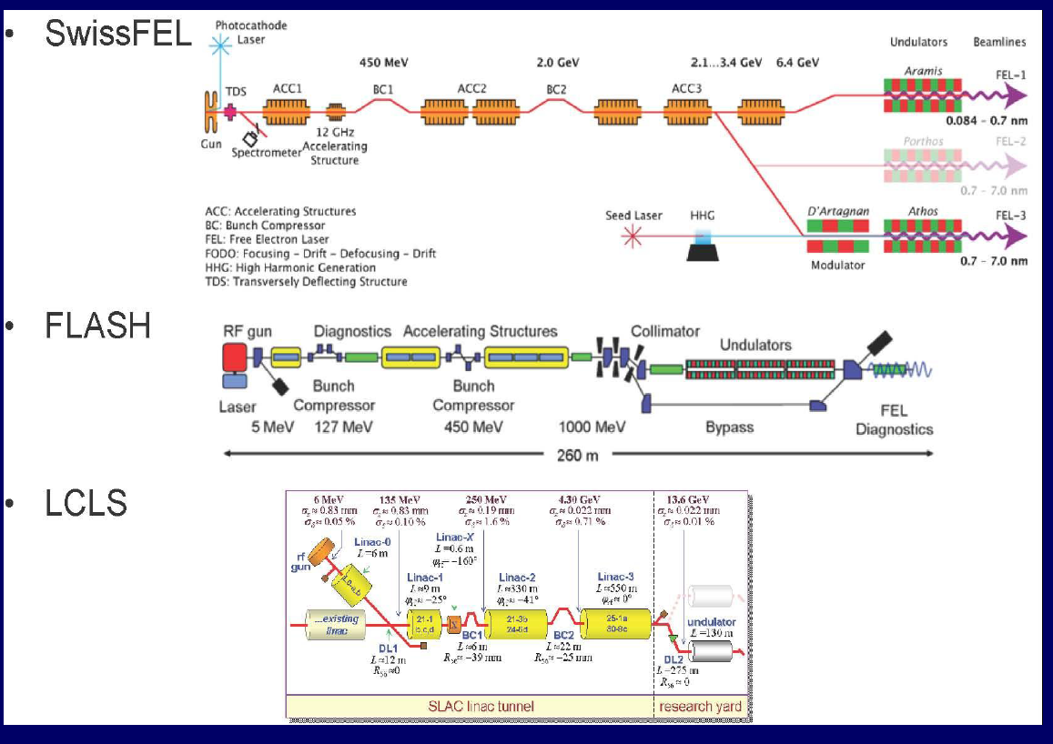
Schematic SASE FEL Layouts – Always Based on Linacs

Slide 29
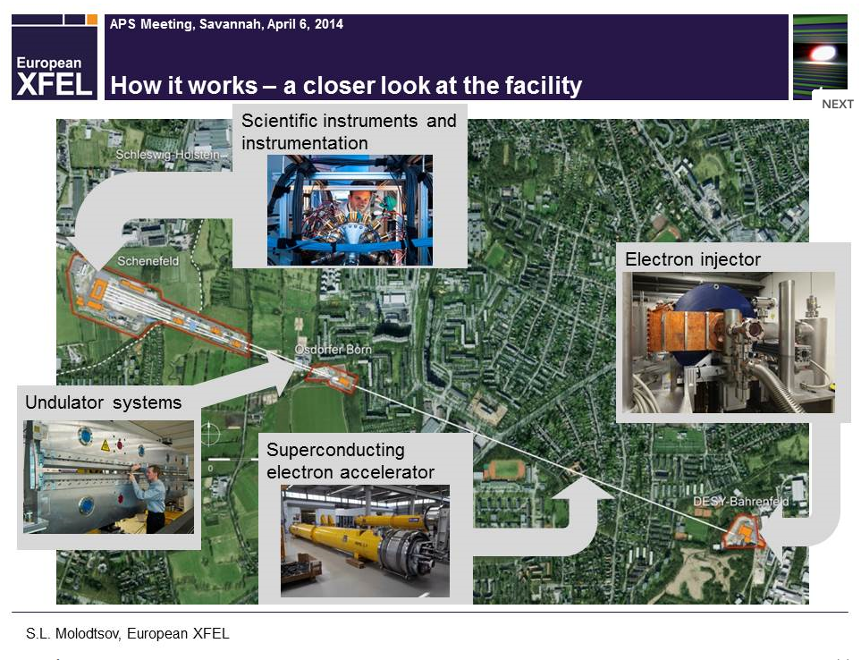
European XFEL

Slide 30
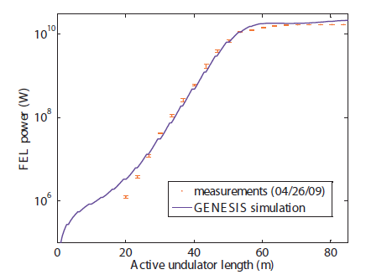
LCLS Power vs FEL Length
Measured FEL power vs Undulator Length (log scale)

Slide 31
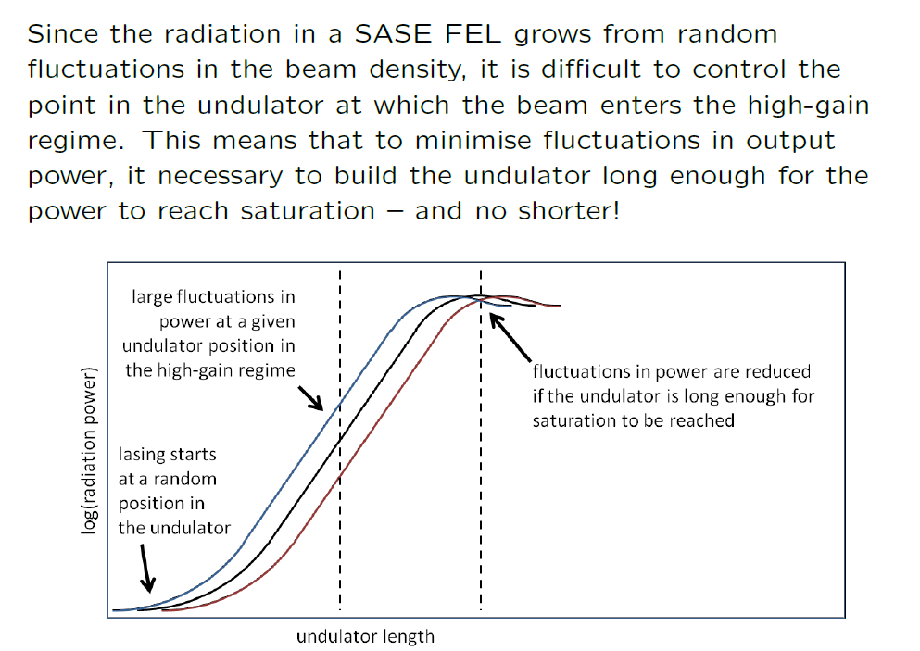
Saturation

Slide 32
FELs – What Next?
FELs have made huge advances in the past few years
  First X-ray FEL in 2009 (LCLS) then SACLA in 2011
  More X-ray facilities are under construction
  Advanced soft X-ray facilities are also now operating routinely for users as well (SCSS, FLASH & FERMI)
The potential for improvements is enormous
  Better temporal coherence (monochromaticity)
  Better wavelength stability
  Increased power
  Better intensity stability
  Much shorter pulses of light
  Two-colour or Multi-colour output
  …

Slide 33
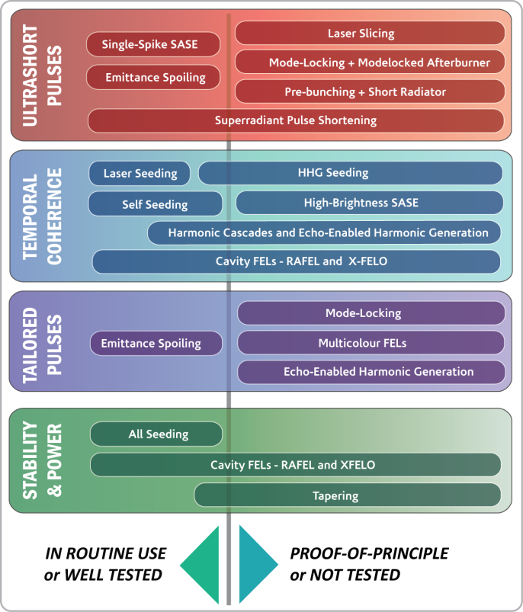
The Case for an FEL Test Facility
FELs are remarkable scientific tools
There are still many ways their output could be improved:
  Shorter Pulses
  Improved Temporal Coherence
  Tailored Pulse Structures
  Stability & Power
There are many ideas for achieving these aims, but many of these ideas are untested
Most FELs have users and little time for R&D – too much demand from users !

Slide 34
CLARA
The UK accelerator & light source community has proposed that Daresbury hosts a new dedicated flexible FEL Test Facility
  Capable of testing the most promising new schemes
CLARA is strategically targetted at ultra short pulse generation
  We are looking at the longer term capabilities of FELs, not short term incremental improvements
  Taking FELs into a new regime
  By demonstrating this goal we will have to tackle all the challenges currently faced by state of the art FELs (and a few more!)

Slide 35
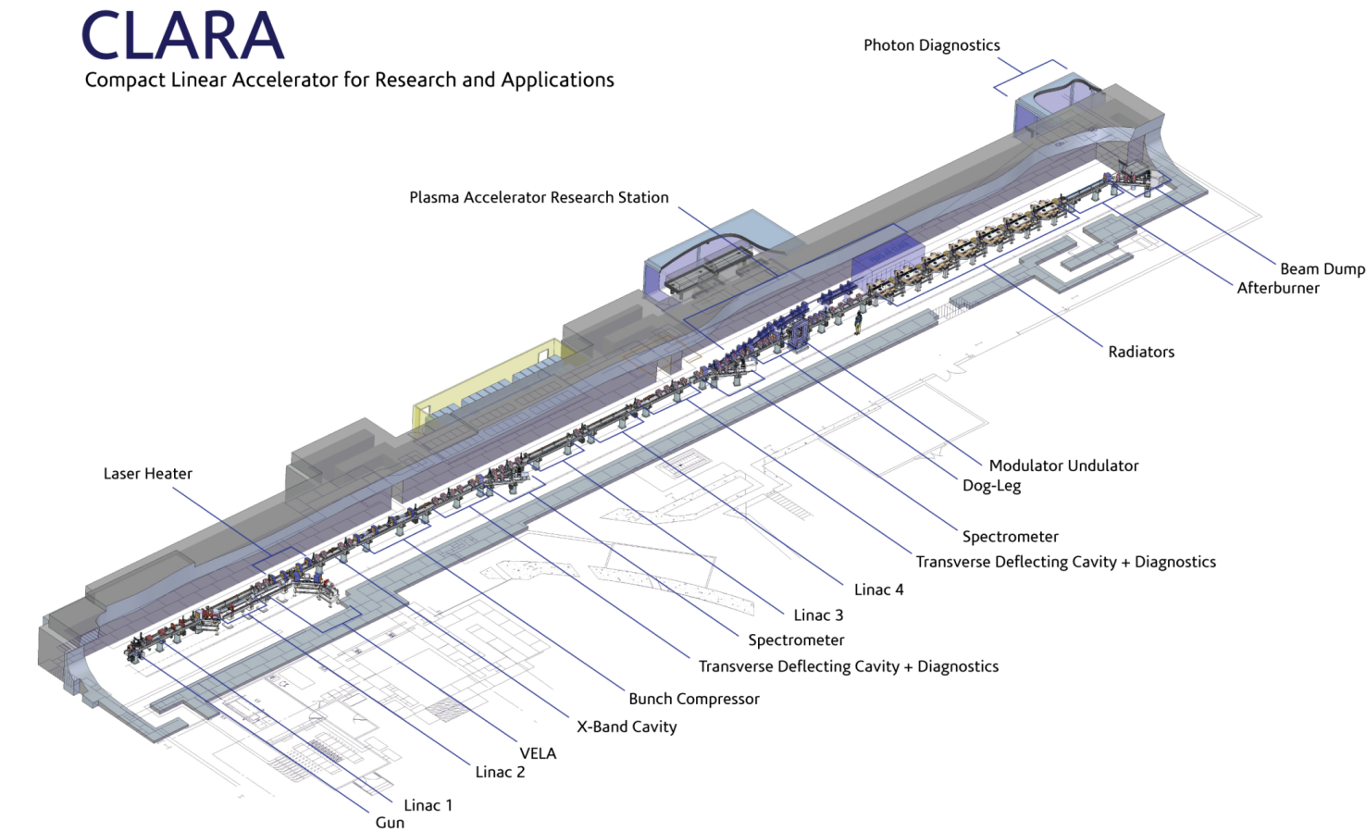
CLARA Layout
FEL OUTPUT STUDIED
FEL OUTPUT GENERATED
INTERACTIONS WITH LASER BEAMS
ELECTRONS ACCELERATED AND MANIPULATED
ELECTRONS GENERATED HERE
Total Length ~90m

Slide 36
Beyond 4GLS
The next major change in light source technology (5GLS?) looks more likely to come from a shift in accelerator technology rather than a new method of light production
There are several novel methods under investigation for accelerating charged particle beams without the need for RF cavities
The trick is to transfer energy from the ‘source’ to the ‘beam’ efficiently
The ‘source’ of the future could be an intense laser or another beam of particles rather than an RF power source and accelerating cavity

Slide 37
Acceleration with a Laser
The alternative accelerator which has received the most attention so far is driven by a laser – Laser Wakefield Accelerator (LWFA)
Another option is similar but instead of using a bunch of photons it uses a bunch of electrons (or even protons) - PWFA
The long term motivation for LWFA is generally for high energy physics, such as a future TeV scale lepton collider but it is recognised that they may be applicable to FELs in the short term

Slide 38
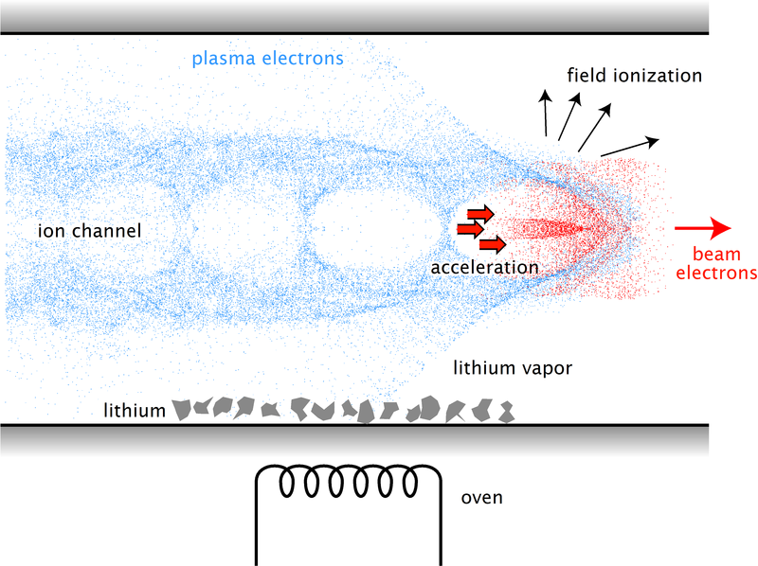
How does LWFA work?
Plasma with ions and electrons but macroscopically charge neutral
Strong transverse EM laser field separates electrons (light) and ions (heavy)
Waves of very high charge separation propagate through the plasma similar to the traveling-wave concept in a conventional accelerator
Plasma electrons experience a massive attractive force back to the center of the wake by the positive plasma ions
This forms a full wake of an extremely high longitudinal (accelerating) and transverse (focusing) electric field.
(Some) Plasma electrons are trapped and accelerated (surfing the wave!)
Electric fields of ~50GeV/m achieved

Slide 39
Can LWFA be used as an FEL Driver?
It is hoped that an LWFA would be cheaper and much smaller than a conventional accelerator and so make FELs more affordable and more widely available
But, the electron beam quality for a FEL is very demanding
LWFA beams can be several GeV from a single laser pulse so energy is enough, the emittance appears to be good enough but the energy spread is always much larger than required and the pulse lengths may be too short
If these can be fixed by LWFA experts then FEL should be ok
Alternatively, there might be a clever FEL design that is more tolerant to large energy spread & the short bunches
Another approach is to manipulate the beam after the plasma to reduce energy spread and lengthen pulse – this may make a FEL possible but the manipulation takes a lot of space so maybe the advantage of LWFA will be lost?
Another big drawback is the shot to shot variation – it might be possible in the future to generate coherent light but LWFA is not currently predictable/repeatable in terms of energy (and so wavelength) – this will also need to be solved before they can be considered as potential user facilities

Slide 40
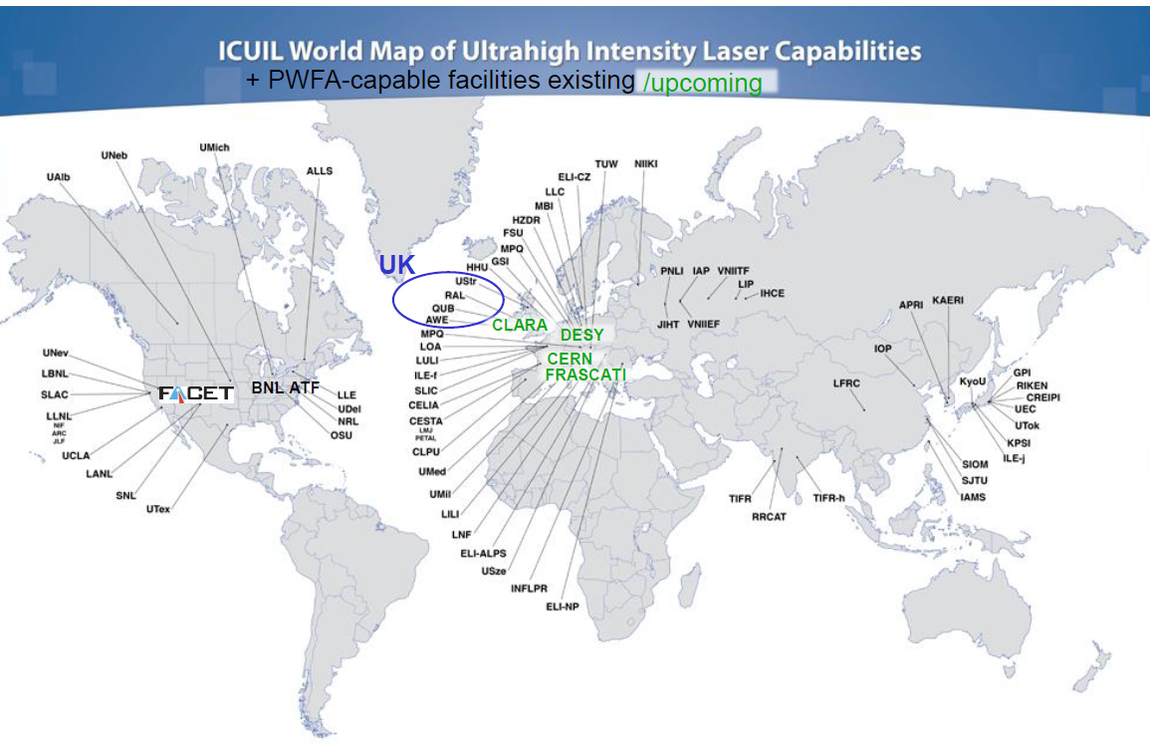
LWFA (& PWFA) Worldwide

Slide 41
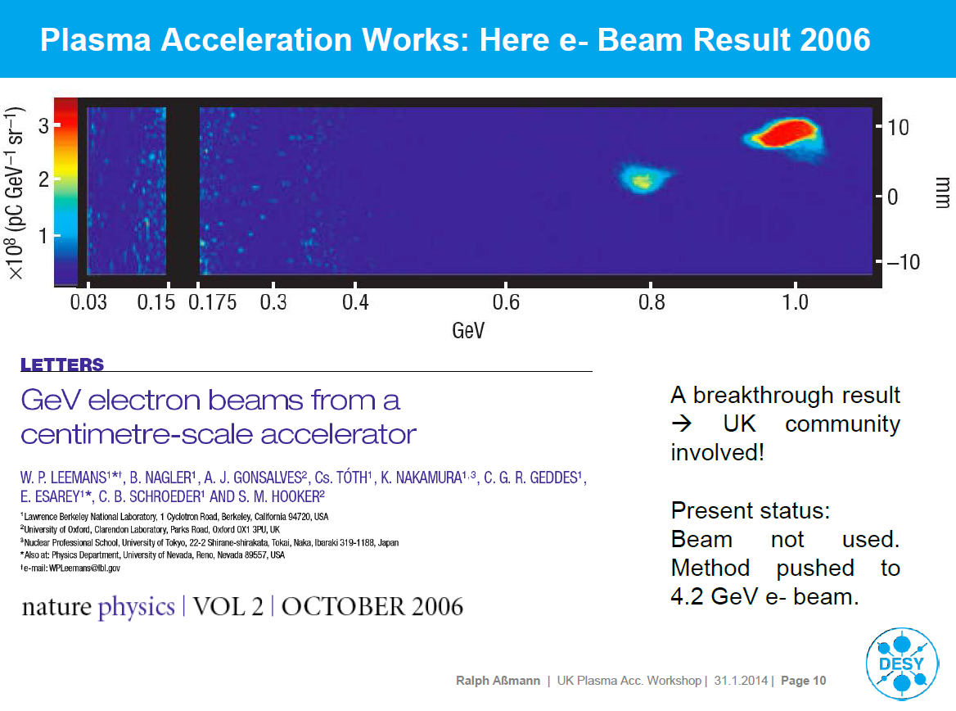
GeV Beams Possible

Slide 42
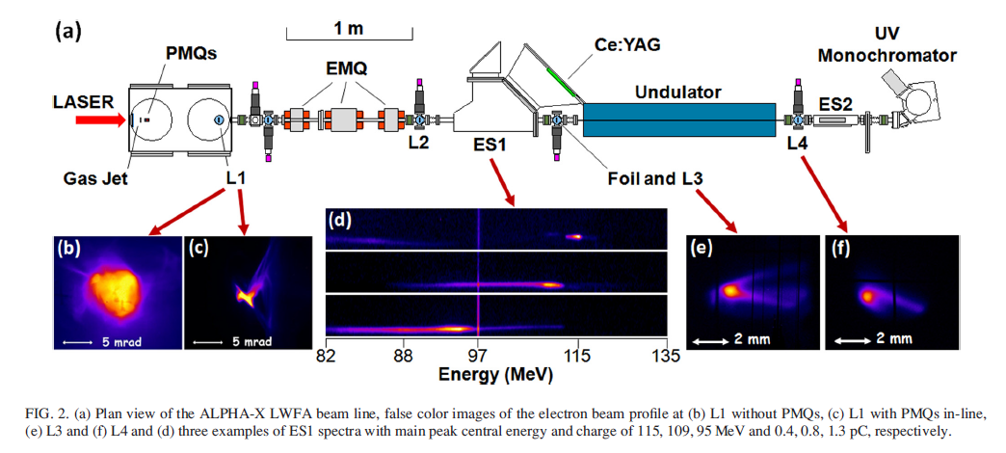
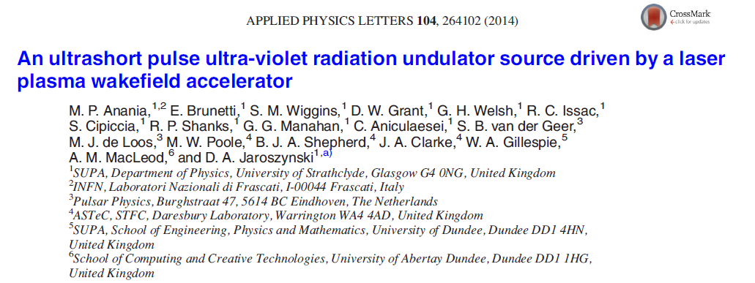
Real LWFA Output – Not a FEL
ALPHA-X facility at Strathclyde University, Glasgow

Slide 43
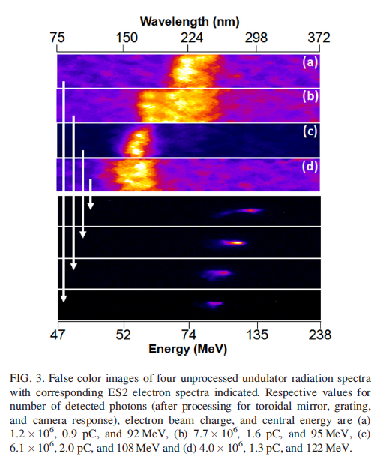
Real LWFA Output – Not a FEL
Large shot to shot energy variation and energy spread variation
Output wavelength not constant
Beam qualilty not sufficient for FEL interaction

Slide 44
Is there hope for 5GLS?
LWFA has made great progress in terms of absolute energy (4.2 GeV has been achieved) but progress seems to have stalled at reducing energy spread below the % level.
New types of (more tolerant) undulators have been proposed to make FEL possible – plenty of room for new ideas!
Active experimental programmes in several locations
Alternative plasma acceleration based upon electron beam may give better quality beams?
Schemes which combine laser & electron driver or LWFA with injected high quality electron bunch also being actively considered – again plenty of room for new ideas!

Slide 45
Summary
4th Generation Light Sources exist now and are based upon free electron lasers
Several XFELs are under construction and more are planned
The basic mechanism is relatively simple but the electron beam conditions that are required to sustain the interaction between the electrons and light beam are very demanding and has required years of sustained development
High gain FELs are needed for wavelengths shorter than ~100nm
These FELs are still immature and there is plenty of scope for improvements.
What comes after 4GLS is not yet clear
Could be a change in accelerator technology rather than a new light source mechanism
Acceleration by lasers (or electron beams) is a reality but will take years of effort to displace RF based acceleration
Major breakthroughs are required to bring plasma accelerators into mainstream use

Slide 46
Acknowledgements
Many of the slides I have used have been taken from excellent presentations by the following very nice people. I’m sorry I didn’t ask permission before using them!
Neil Thompson
Dave Dunning
Brian McNeil
Allan Gillespie
Andy Wolski
Ralph Assmann
S Molodtsov
Bernhard Hidding

