Slide 1
Using FAX to test intra-US links
Ilija Vukotic
on behalf of the atlas-adc-federated-xrootd working group
Computing Integration and Operations meeting
February 19, 2014

Slide 2
Idea
US FAX infrastructure
  All running with Rucio enabled N2N
  All ready for tests
Try to check connectivity between sites using IO intensive jobs
Check realistic physics analysis bandwidth needs

Slide 3
Connectivity tests
Test:
  Using site specific 744 FDR files (2.7 TB)
  Reading 10% events using 30MB TTC
  Jobs submitted using ATLAS connect
  Running at MWT2 UC only
  One job one file

Slide 4
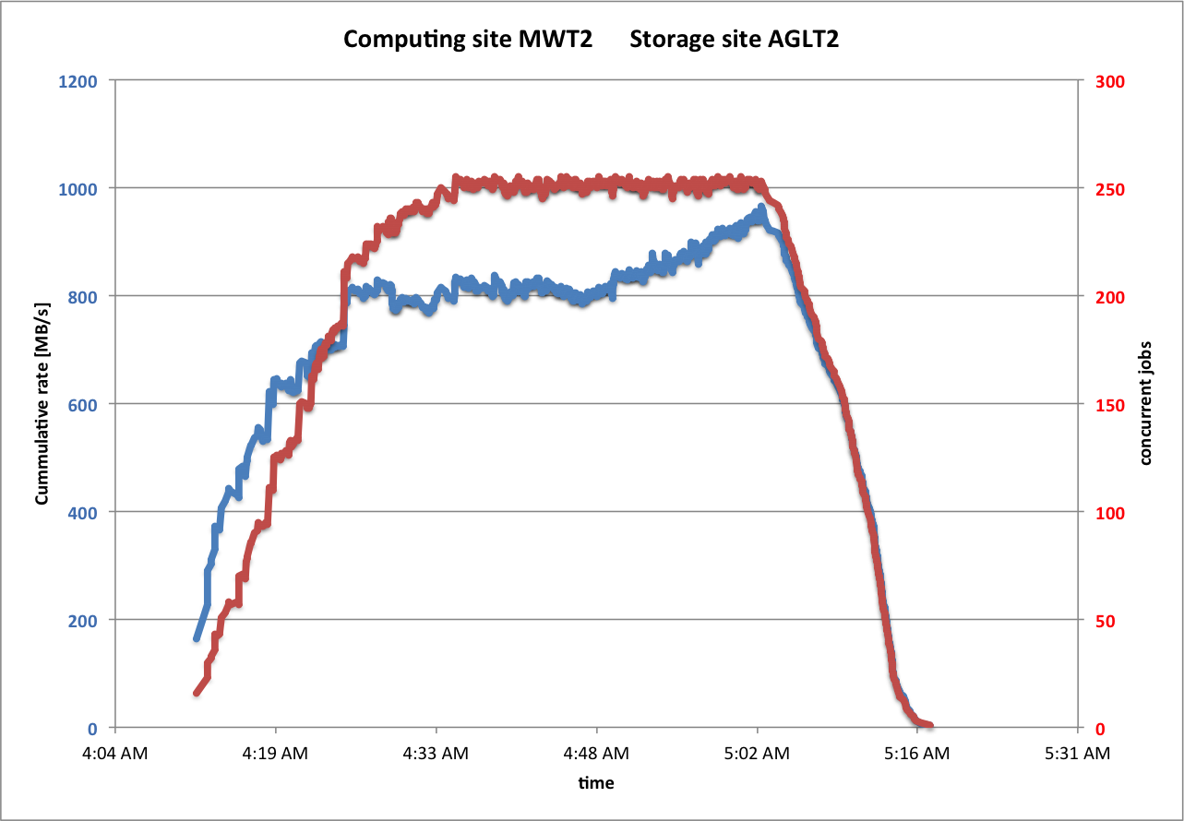
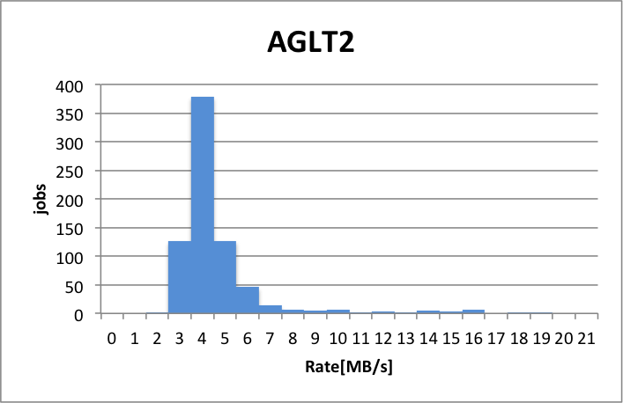
Connectivity tests – results – AGLT2 Stress 1

Slide 5
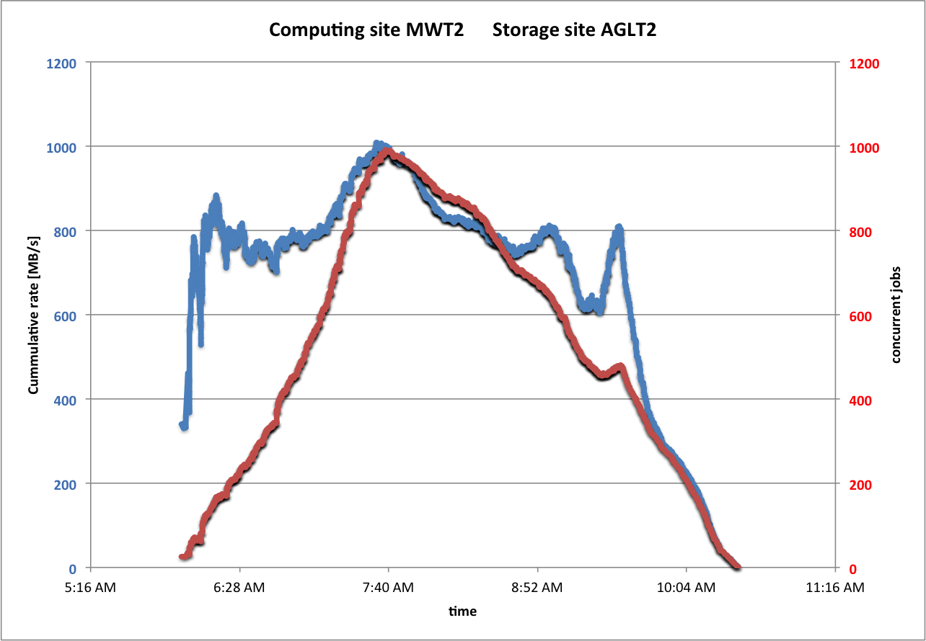
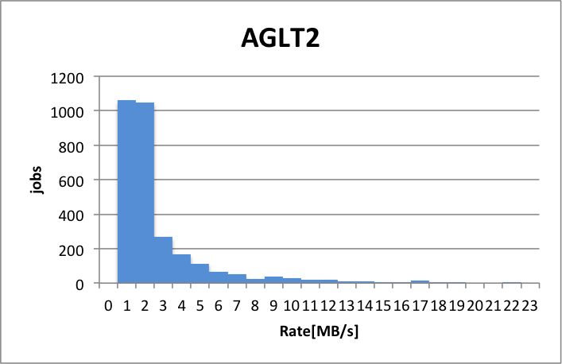
Connectivity tests – results – AGLT2 Stress 2
Stress 2
3974 jobs

Slide 6
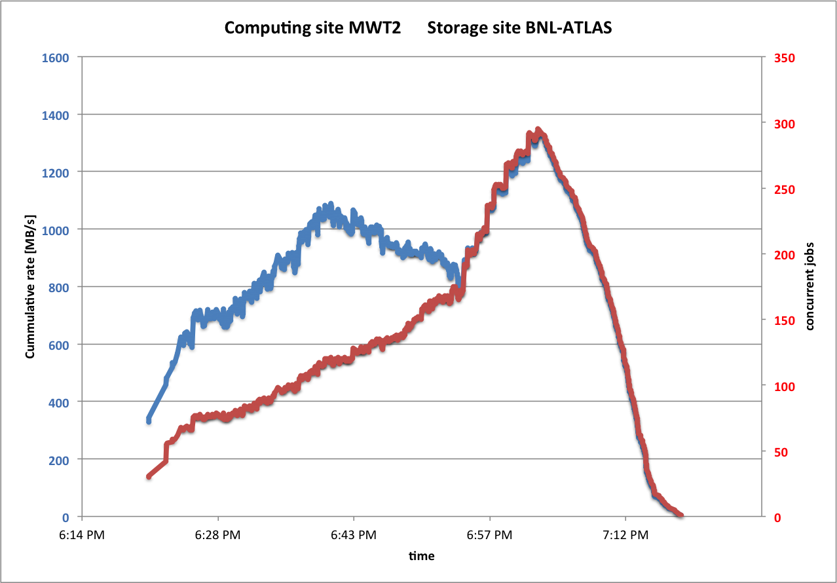
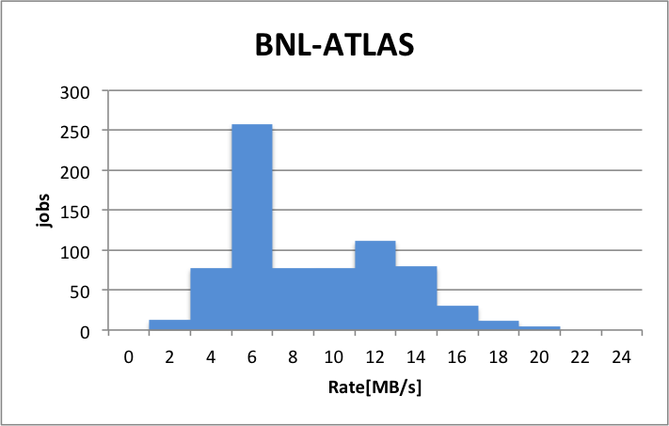
Connectivity tests – results – BNL

Slide 7
Connectivity tests – results – BNL
We repeatedly tried to obtain higher bandwidth from BNL
Used resources of MTW (UC, IU) + AGLT2 + Fresno
In the process discovered and fixed several FAX endpoint configuration issues
Found that BNL connection has 10Gbps limit
Will repeat the test when 100Gbps gets established

Slide 8
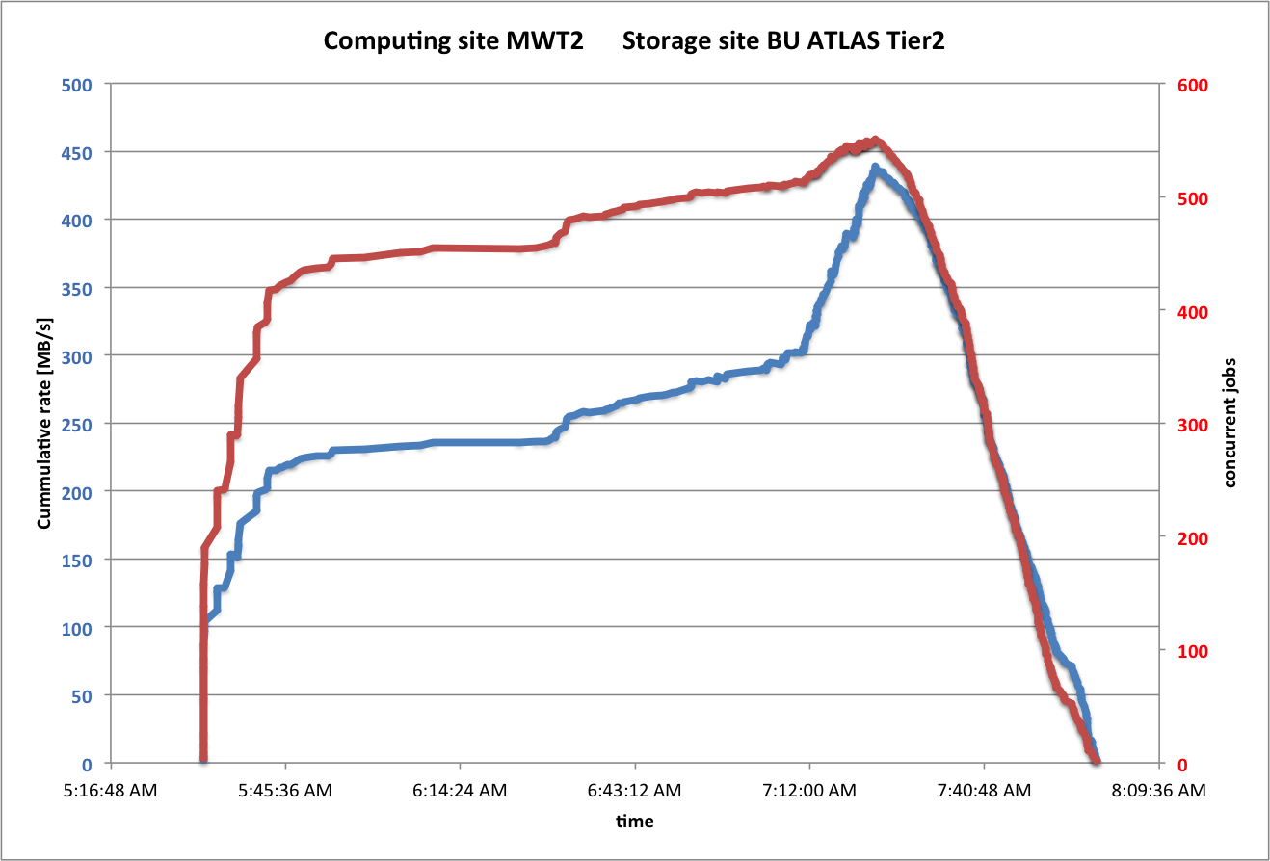
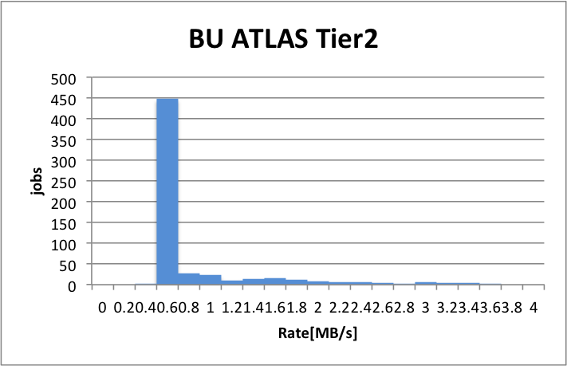
Connectivity tests – results – BU

Slide 9
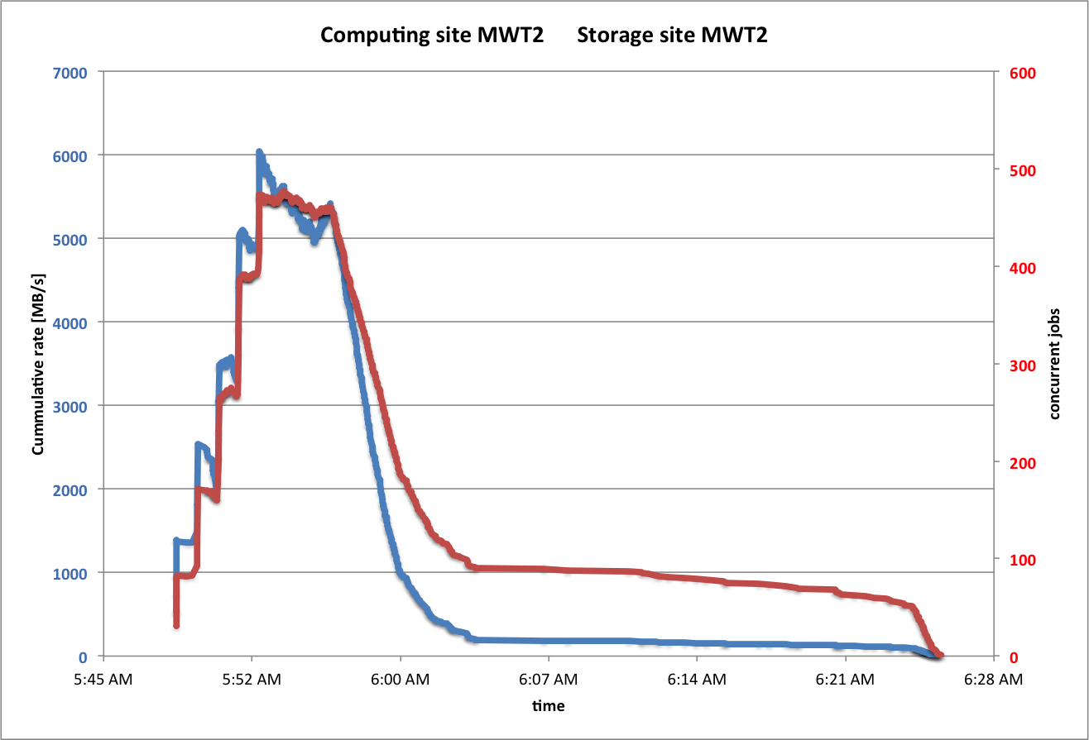
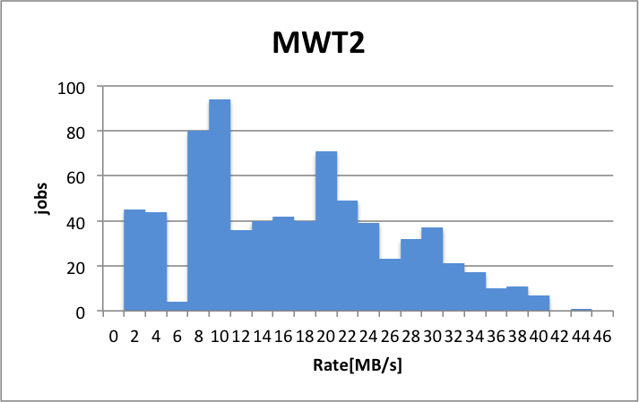
Connectivity tests – results – MWT2
Jobs running at IU reading from UC. Test performed before bandwidth upgrade

Slide 10
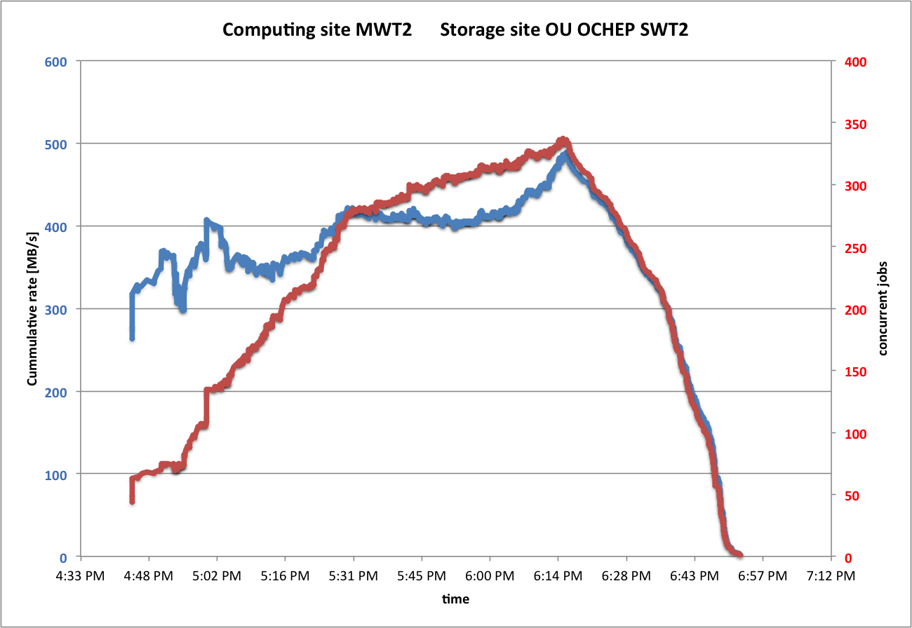
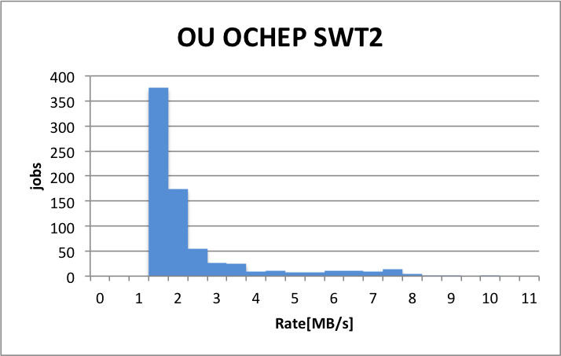
Connectivity tests – results – OU_OCHEP_SWT2

Slide 11
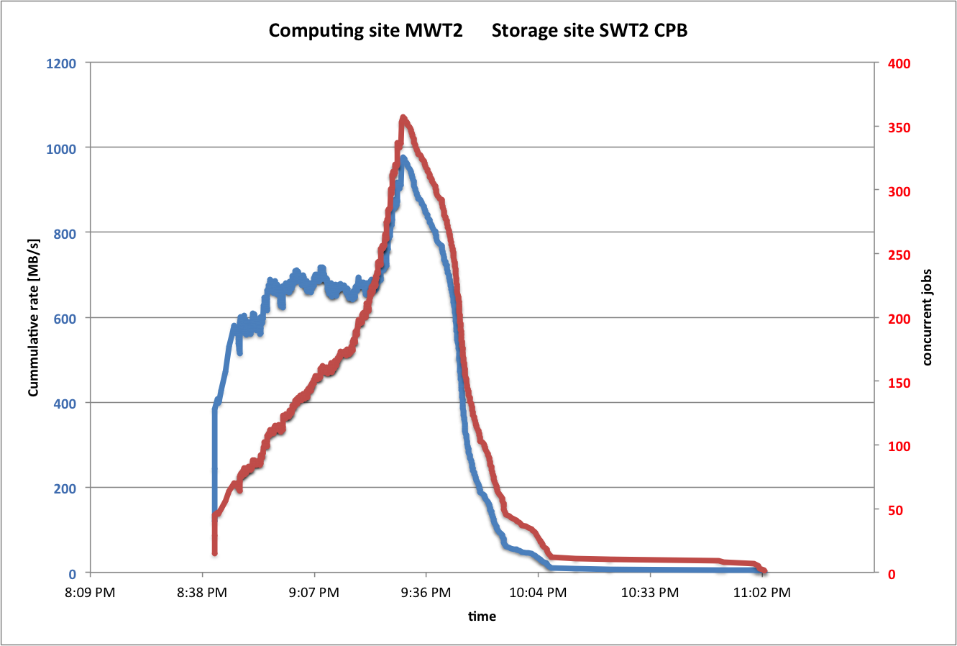
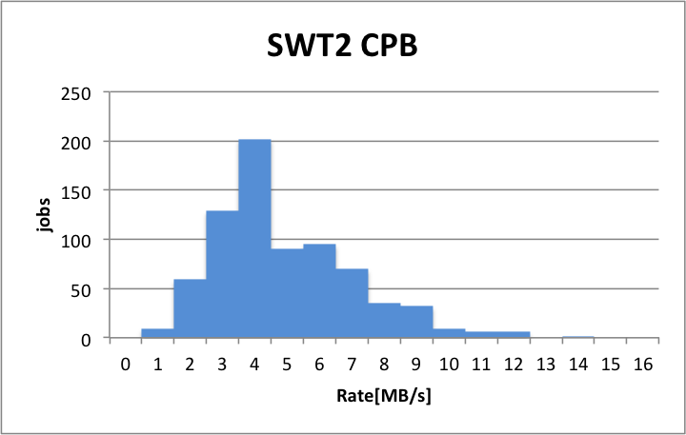
Connectivity tests – results – SWT2_CPB

Slide 12
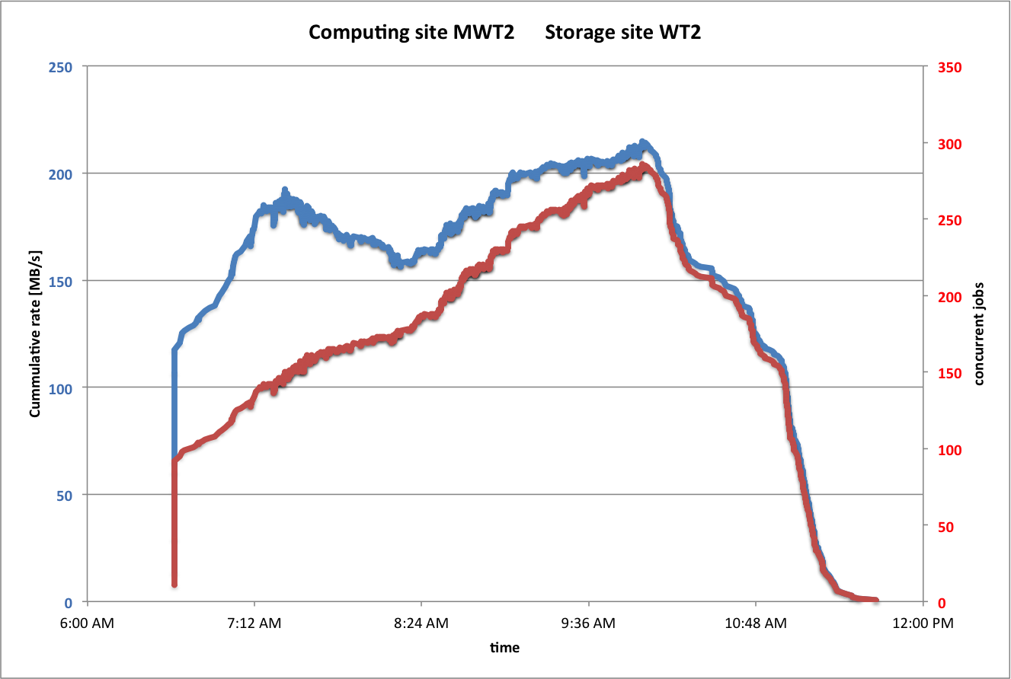
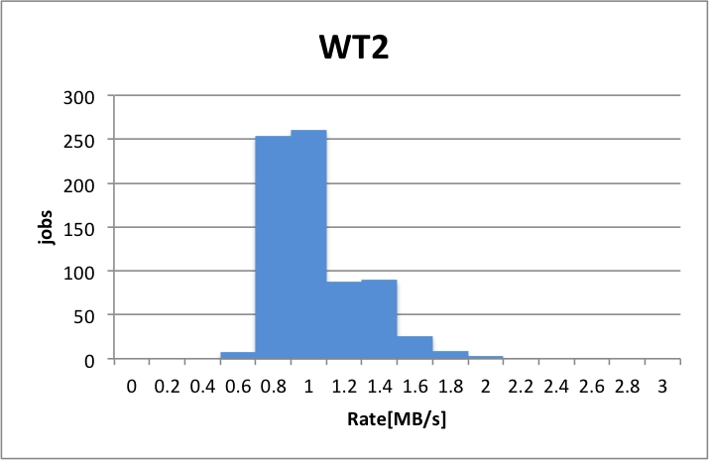
Connectivity tests – results – WT2

Slide 13
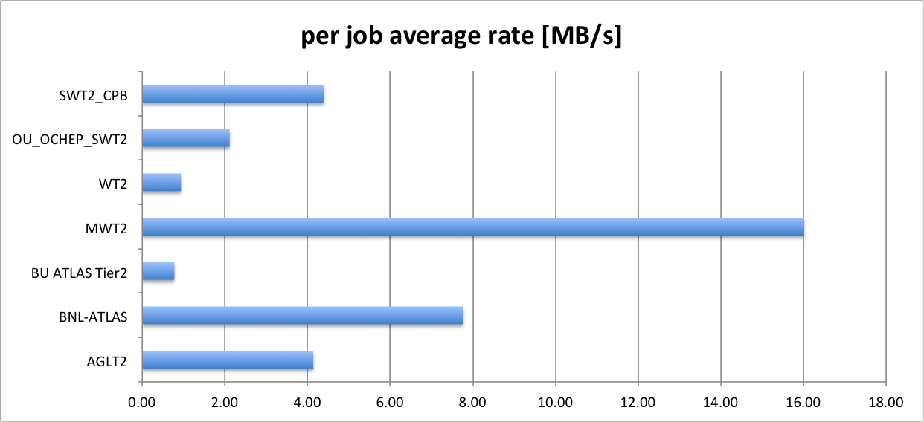
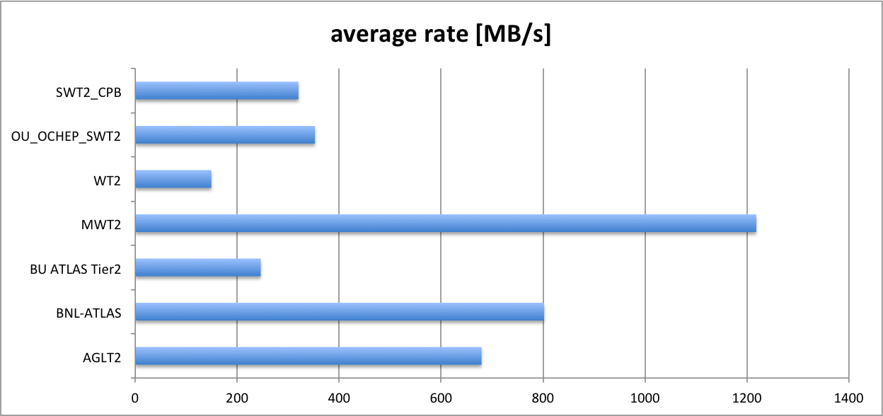
Connectivity tests - summary
Very low failure rate from all endpoints
Surprisingly small bandwidth from BU and WT2

Slide 14
Realistic analysis tests
Friedrich’s Higgs to WW analysis
  Using RootCore framework
  All corrections applied
  Reads 512 from 8543 branches (13% of total size)
  Writes out <1% events and a number of histograms/TTrees
  10MB TTC (suboptimal)
  Default learning phase (100 events - suboptimal)

Slide 15
Realistic analysis tests – results
Having the data file cached in memory
  1300 ev/s
  20.2 MB/s of useful data
Having the data on a local disk – single spindle, no other activity
  600 ev/s
  8.6 MB/s of useful data
  CPU efficiency 58%

Slide 16
Realistic analysis tests - results
WAN access
run at IU reading data from UC (5ms RTT)
Each job analyzing:
  25 files
  90.5 GB
  832 kEvents
Slowly ramping up in order to see when we hit a bottleneck

Slide 17
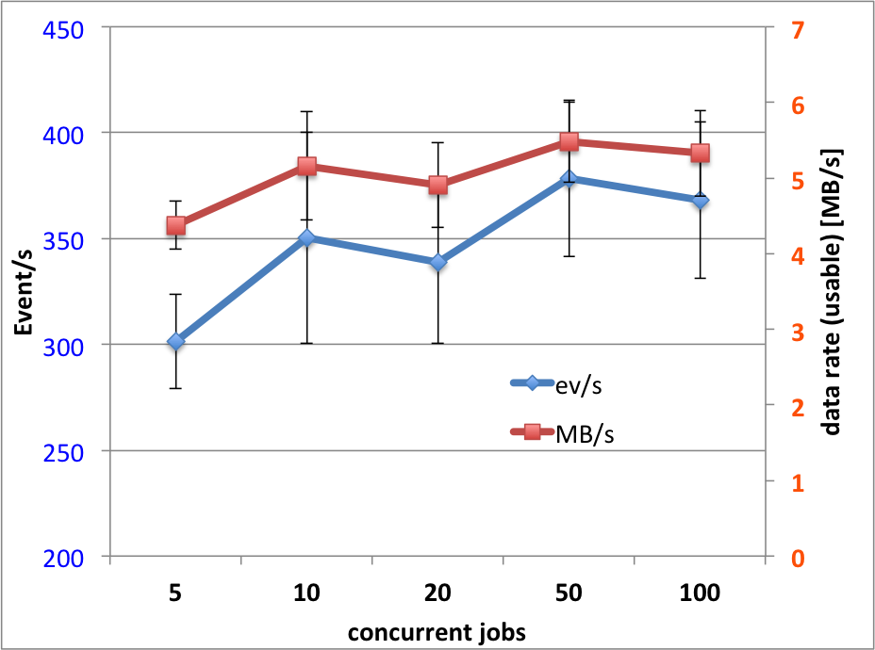
Realistic analysis tests - results
Basically flat up to 500-600 MB/s
Much larger scale needed to saturate the link now that we have confirmed 60 Gbps .
Not much slower than local disk
With default TTC and shorter learning phase should approach 10MB/s. Will test.
concurrent jobs | ev/s | err ev/s | MB/s | err MB/s
5 | 301 | 22 | 4.4 | 0.3
10 | 350 | 50 | 5.2 | 0.7
20 | 339 | 39 | 4.9 | 0.6
50 | 378 | 37 | 5.5 | 0.5
100 | 368 | 37 | 5.3 | 0.6

Slide 18
Conclusions
FAX endpoint at US sites much more stable now.
Stability and low failure rate make it good enough for direct access use.
With special direct access test was able to reach the link limits of most endpoints.
Realistic analysis used less bandwidth (5MB/s) than expected 10 MB/s.
Will repeat the tests at larger scale with/without further optimization.
Will try to saturate 100Gbps MWT2-BNL link when it comes online.

Slide 19
Reserve

Slide 20
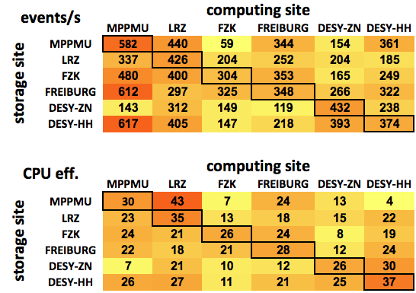
WAN Testing in DE cloud
Functional HC tests by Friedrich
We should expect similar numbers from US

Slide 21
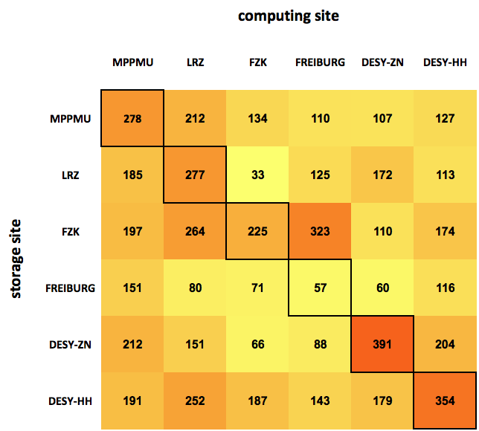
WAN Load Test (200 job scale) – DE cloud
Some uncertainty of #concurrently running jobs (not directly controllable)
Indicates reasonable opportunity for re-brokering

Slide 22
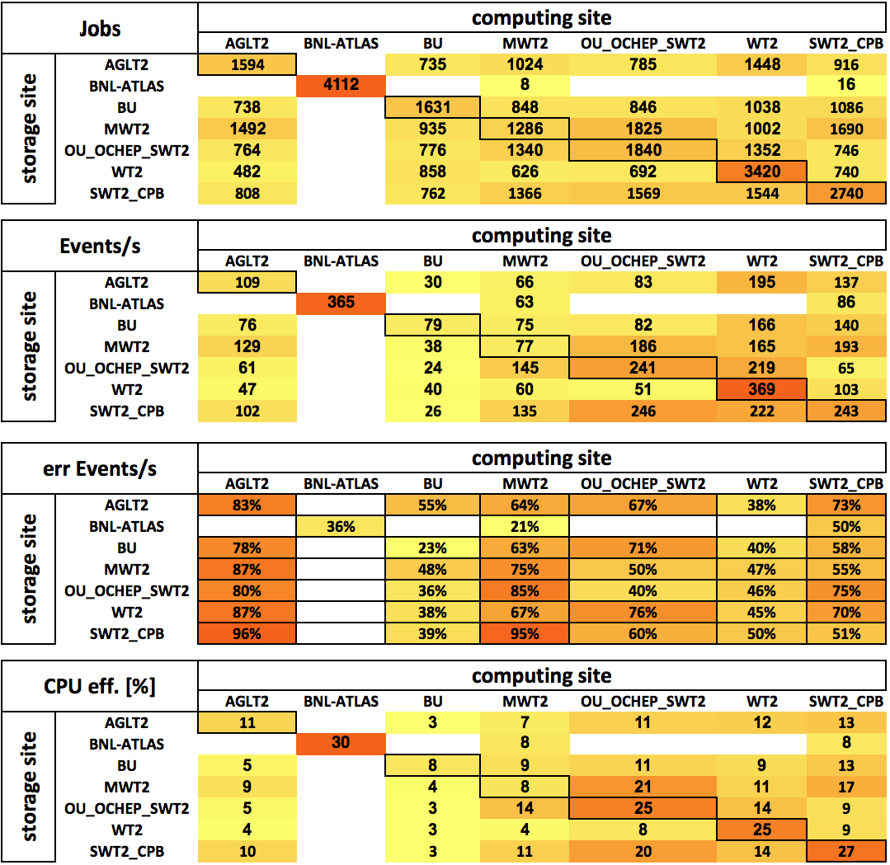
WAN Testing in US cloud
Numbers lower than in DE cloud.
Possible explanations:
  Diagonal elements – maybe we overprovision CPU at the larger scale than DE
  Off-diagonal elements - suboptimal TTC size and learning phase result in larger than optimal RTT penalty. Size of US makes this price higher for US cloud.
  …

Slide 23
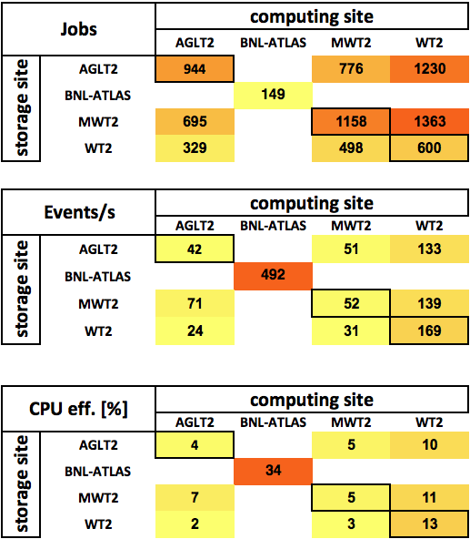
WAN Load Test (200 job scale) – US cloud
Surprisingly low figures
Under investigation

