Slide 1
HL Parameter & Layout + TC Committee organisation in 2014

Slide 2
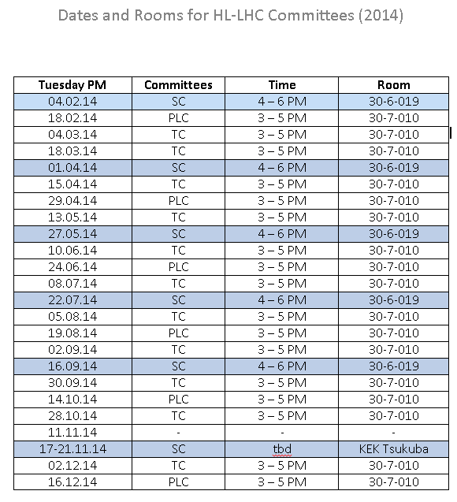
New and common slot for all HL-LHC meetings (TUE afternoon in 30-7-010)
As agreed in Daresbury, TCs will alternate with PLCs and will be jointly organized
  O.Bruning (Chair)
  I.Bejar Alonso and M.Zerlauth (Co-chairs and scientific secretaries)
TC membership to be reviewed, depending on topic additional equipment experts

Slide 3
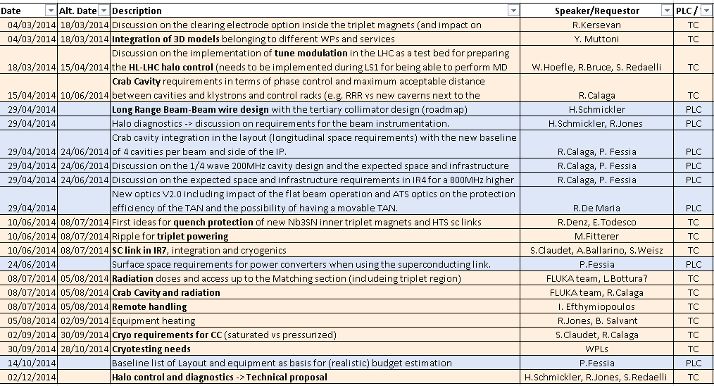
Tentative Topics for 2014 (tbc)

