Slide 1
Conceptual Specification
From Conceptual stage to Development stage
Creating the first baseline for requirements

Slide 2
Life cycle
Every system follows a life cycle, evolving from its initial conceptualization through its eventual retirement.
Life cycle models help managing the evolution of the system. Movement from one stage to another represents a decision point with specific criteria to be satisfied before it is allowed to move to the next stage.
A life cycle model, then, is a decision-linked segmentation of the systems requirements.

Slide 3
HL-LHC Life cycle
Moving from the concept to the development stage implies an assessment and a validation of the requirements.
Concept Stage
Development Stage
Production Stage
Support Stage
Retirement stage
Utilization stage
Requirements definition
Functional specification
Engineering specification
Fabrication, Assembly and Verification
Installation - Comissioning
Operation & Maintenance
Dismantling
Organizational Project-Enabling Processes
Project Processes: Planning, Measurements, Assessment, Control, Risk, Configurarion, Information, Decision Management
Acquisition Process

Slide 4
Moving from Concept to Development
This validation shall at least include a common agreement on the following requirements:
Performance parameters
Technical parameters
Configuration and installation constrains
Interface parameters
Cost and Schedule constrains

Slide 5
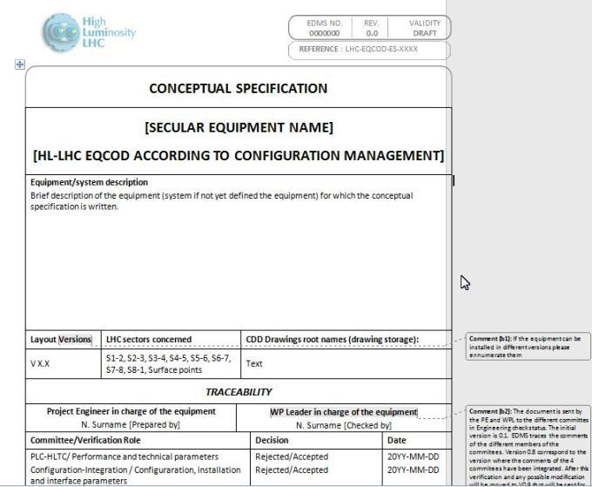
Conceptual Specification
https://edms.cern.ch/file/1311290/0.4/LHC-PM-QA-517.V04.21.01.2014.docx

Slide 6
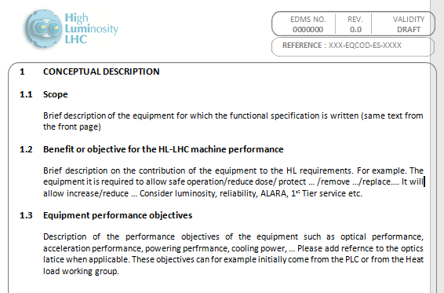
Conceptual Specification

Slide 7
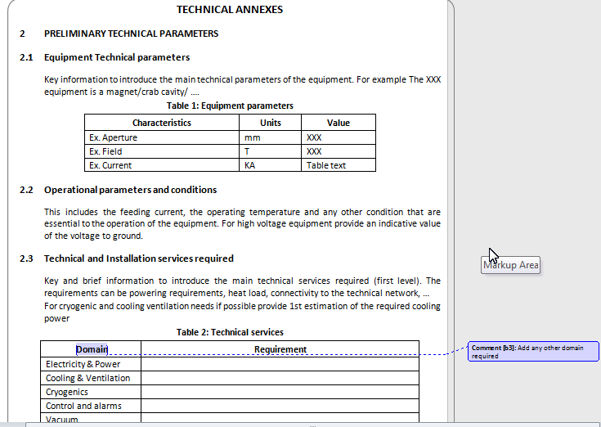
Conceptual Specification

Slide 8
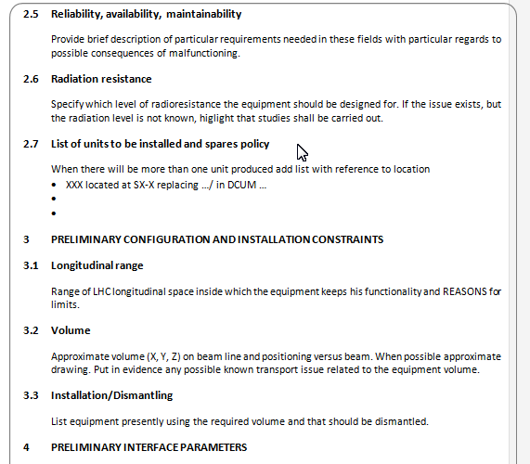
Conceptual Specification

Slide 9
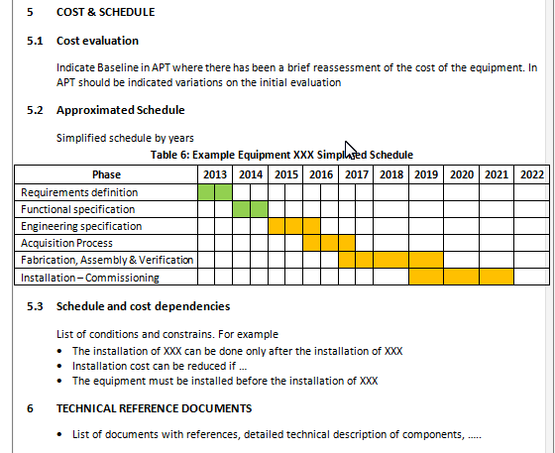
Conceptual Specification

Slide 10
Baselines
This validation will:
Create the first baseline for the Performance, technical and interface parameters
Allow to check the configuration and installation constrains
Allow the preparation of the first Cost and Schedule baseline (future EVM)
Give the green light to the development stage.

Slide 11
Implementation
Presentation in the SC on the 4th February.
Presentation in the PLC on the 18th February
Meetings with the WPLs during next two weeks to establish the architecture and the number of Conceptual Specifications to prepare.
Assessment on TC and dedicated meetings from 15/04 to 13/05.

Slide 12
HL-LHC Standards and best practices
Workshop

Slide 13
Workshop
The purpose of the HL-LHC Standards and best practices workshop is to share and when possible reach an agreement on:
Standards to be used in the different technical domains and equivalence between standards.
Best Practices and Engineering methods applicable for the Design of HL-LHC components
Data sharing of technical parameters. Common tools, tools interfaces, data transfer ….
The 3 days workshop will be on 11-12-13th June.
It is intended for the “main drivers” of the design and integration of HL-LHC equipment.
https://indico.cern.ch/event/302808/

