Slide 1
BI TB on injector start
BI systems after LS1
Present injector schedule
  Dry-runs
    Control system (CO/BI/OP/)
  Hardware commissioning
    Machine closed (OP/GS/EPC) allowing RF + magnet + kicker powering
  Start-up with beam
First-line support for BI
  Expert lists per system
  Front-ends (generic?)
Conclusions and follow-up

Slide 2
BI systems after LS1
Main purpose is providing instruments that are operationally integrated
  Applications and clients/daemons provided and maintained by BE-OP and BE-CO
Hopefully most design and implementation questions are behind us now (!)
Installation and hardware commissioning on-going
Team-work (HW/SW) to get systems towards state ready for beam

Slide 3
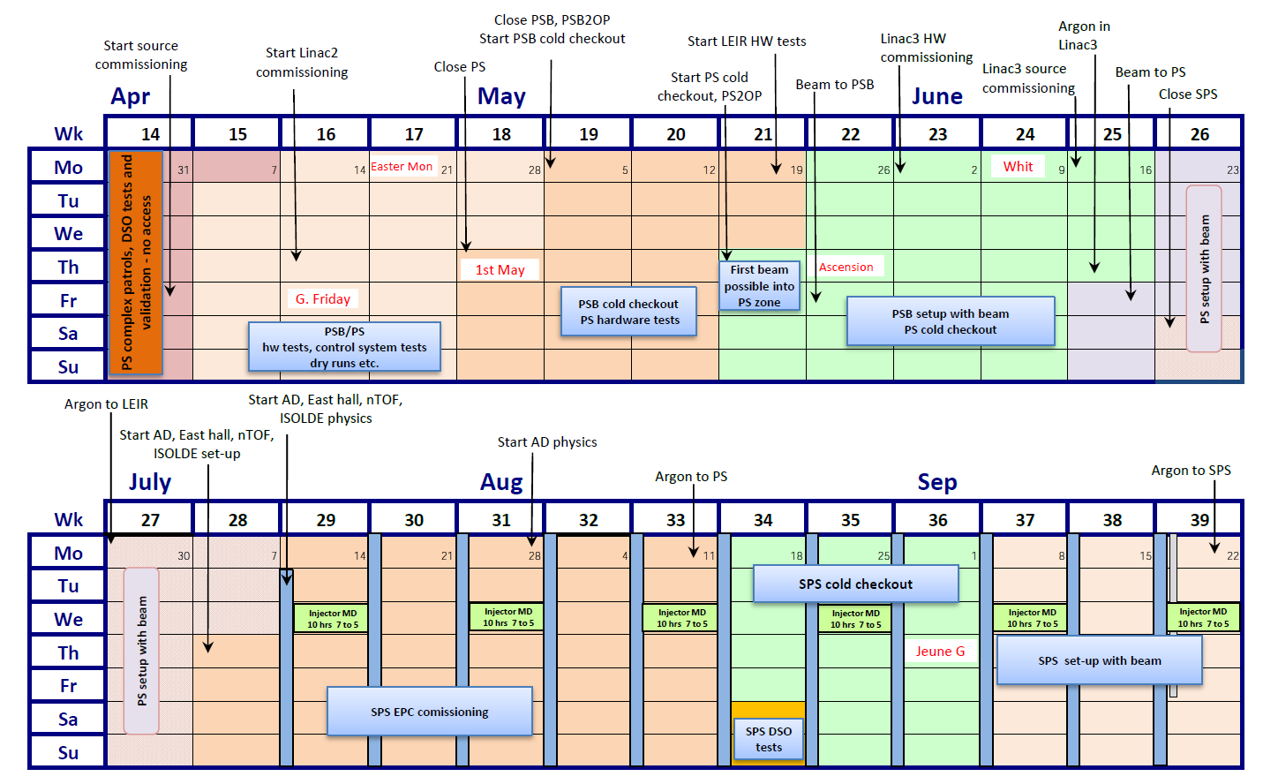
Schedule (LN2/PSB/PS)
https://espace.cern.ch/be-dep/BEDepartmentalDocuments/BE/2014-injector-schedule_v0.7.pdf
BI

Slide 4
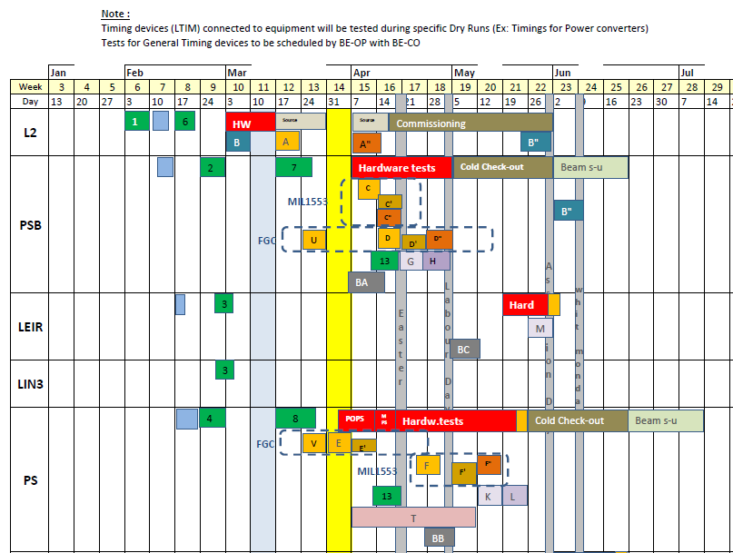
BE/CO dry-runs #1
EDMS links (C. Dehavay):
https://edms.cern.ch/file/1340573/1/dry_run_skeleton_BeCo.pdf
https://edms.cern.ch/file/1340573/1/Dry_Run_ID.pdf
BI (PSB): Week starting Monday 07-Apr-2014
BI (CPS): Week starting Monday 19-Apr-2014
BI (LEIR): Week starting Monday

Slide 5
Dry-runs
Many (!) changes to control system during LS1 (problems!)
  BE-CO organising dry-runs (worries)
What can be tested?
  Control system (timing, network)
  OP applications (‘noise’ traces/values)
  Logging (timber)
  Goals: resolving integration issues and understanding how BI systems are used
Prerequisites
  Power in racks and timing
  All electronics installed and connected
  Software devices configured and running
Who?
  BI hardware and software experts with OP/ABP members
Keep track?
  Produce check-list for each system identifying what works and not!

Slide 6
Start-up with beam
How do we handle it ?
  Stick to ‘best effort’ effort
  Presence in the CCC/PS (working hours)
First-line support for BI
  No CO piquet after LS1
  Organise BE/BI front-end team?
    Training by BE/BI and BE/CO
    Access to BE/CO spare room

Slide 7
Conclusions and follow-up
IEFC meeting foreseen late February to discuss status after LS1
Instrument responsible to finalise installation and connection by early March
How do we best communicate changes to OP/CO/ABP?
  Document which systems changed and not
Dry-runs seen as necessary step to ensure operational integration of BI systems
  Resolve issues with BI front-ends and OP/CO applications/clients
  Instrument responsible to produce checklist
Performance of BI systems after LS1 will affect our reputation
  Permanent presence in CCC during start-up periods?
    LN2, PSB, PS

