Slide 1
Update on failure cases for asynch dump on collimators – worst case vs realistic
85th LHC Machine Protection Panel Meeting
L. Lari
IFIC (CSIC-UV) & CERN
R. Bruce, S. Redaelli
Thanks to C. Bracco and B. Goddard

Slide 2
Outline
Introduction/Scope of the work.
Summary of the of past results.
Worst case for Post LS1 optics and HLLHCv1.0 optics.
Towards more realistic cases.
Conclusions.

Slide 3

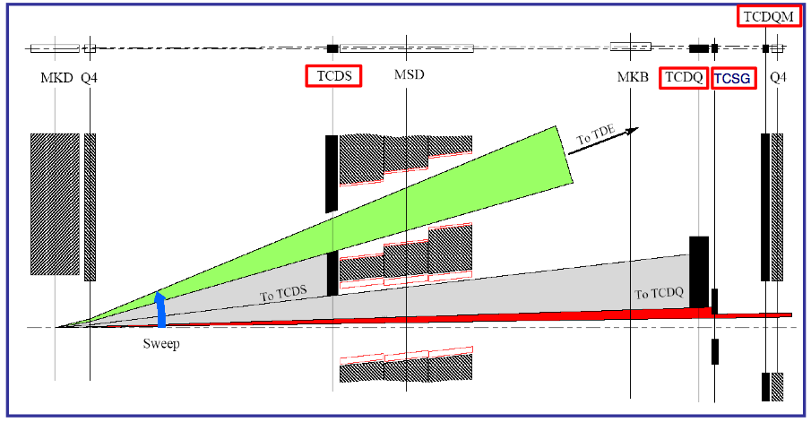
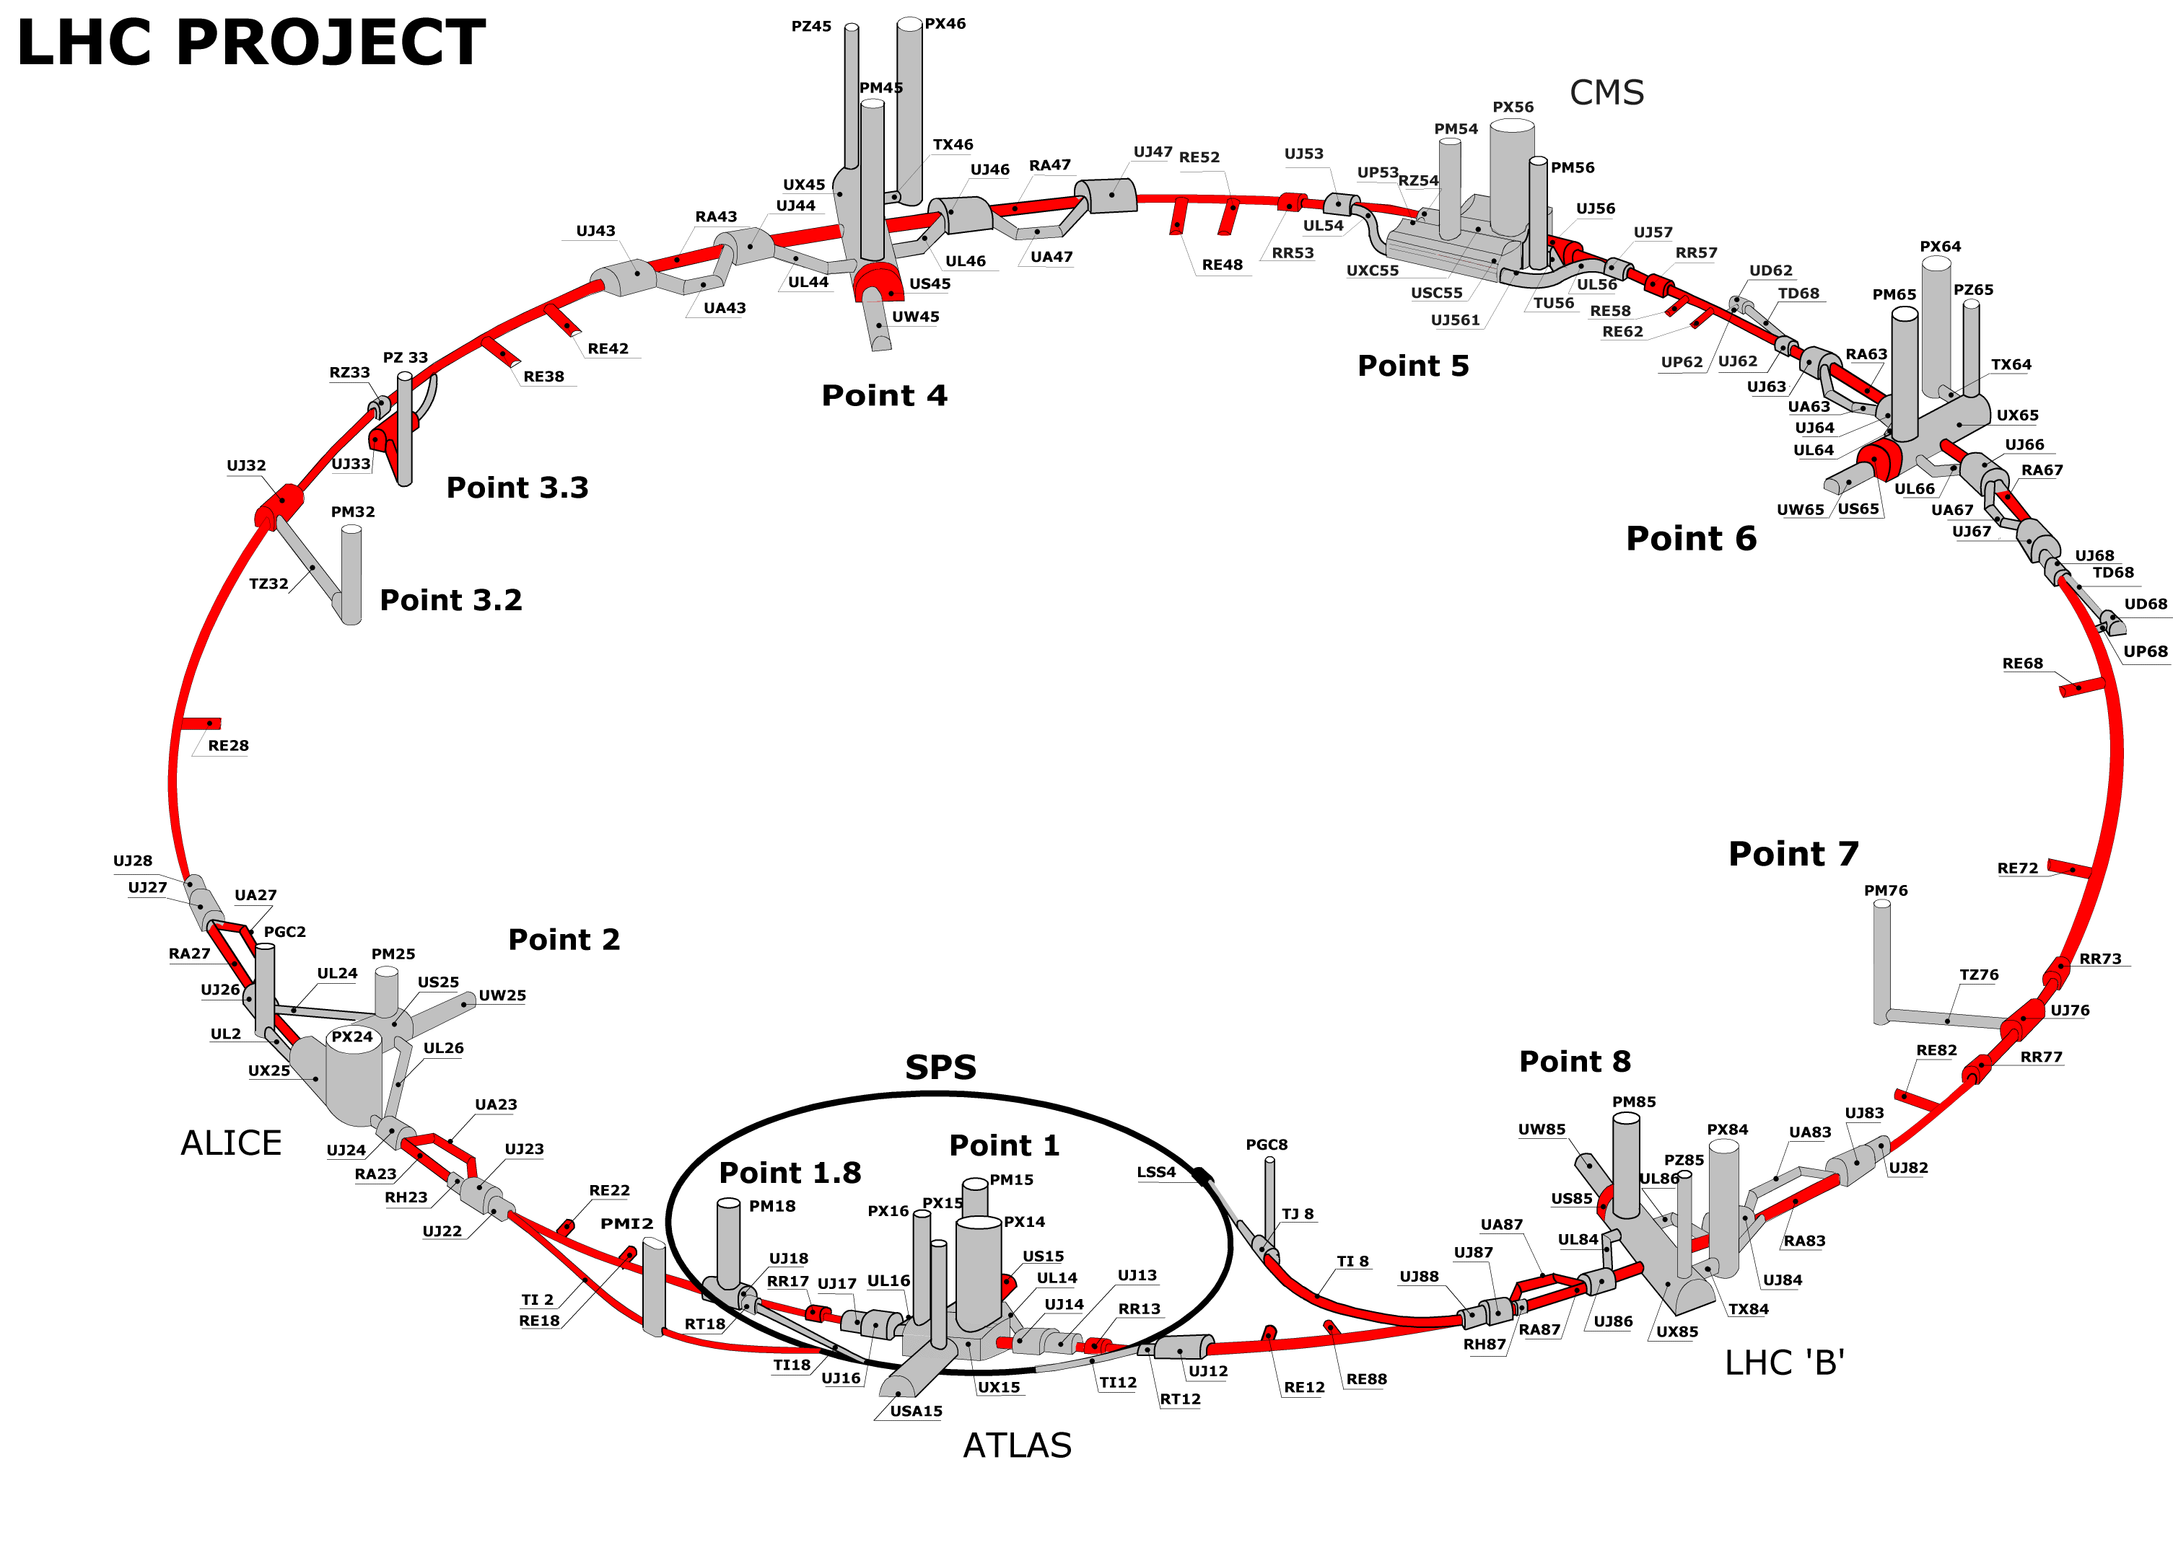
Introduction / Scope of the work
…is to understand the beam loads in different collimators in case of asynchronous beam dump, in order to improve the LHC collimation system design by understanding realistic loss cases.
Not looking at that from the beam dump point of view, but from the whole LHC collimation system point of view!

Slide 4
How?
Using a modified SixTrack collimation routine to allow studies of asynchronous dump with the whole collimation system in place, including the study of different errors.
Input from the MKD pulse form applied @ each MKD and in case of single module pre-firing → considering the retriggering delay of (650+50-*n) [ns] where n is the number of generators away from the one which pre-triggered.
MKD pulse form - Courtesy B. Goddard
kick for a single MKD magnet
~3 μs extraction kicker rise time

Slide 5
Few reminders: worst cases for the 15 MKDs firing simultaneously
presented @ 83th LHC Machine Protection Panel Meeting
Both loss maps refers to a very pessimistic scenario in which:
Retraction of 1.2mm @ IP6
+ Retraction of 1mm @IP7 for “critical” collimators
+ TCTHs @IP1 and @IP5 of 1 σ closer to the beam
Optics error (R. Bruce) → Results refer to the worst case out of 1000 optics configuration with random errors
Beam1
Post LS1
Nom. setting
Beam2
HLLHCv1.0
Nom. setting
IP6
IP6
IP5
On TCTH.4R5
Max @ 4e+11 p+
(results normalized @ 2.2e+11)
IP1
IP7
IP7
limit only for the W collimators
limit only
for the W collimators
On TCTH.4L1
Max @ 1.5e+11 p+
(results normalized @ 1.15e+11)
Physics run with 0.60 m β* in IP1/IP5
Physics run with 0.15 m β* in IP1/IP5

Slide 6
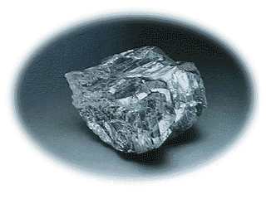
Few reminders: Collimation setting considered
For Beam1 and Beam2
= Tungsten
Nom. setting
2σ retraction
TCP.IP7 | 6 | 5.7
TCSG.IP7 | 7 | 7.7
TCLA.IP7 | 10 | 10.7
2*80cm W DS @IP7 | 10 | 10.7
TCP.IP3 | 15 | 15
TCSG.IP3 | 18 | 18
TCLA.IP3 | 20 | 20
TCT.IP1/IP5 | 8.3 | 10.5
TCT.IP2/IP8 | 30 | 30
TCL.IP1/IP5 (2 Cu +1 W) | 15 | 15
TCLI/TDI.IP2 | Tot opened | Tot opened
TCDQ.IP6 | 8 | 9
TCSG.IP6 | 7.5 | 8.5

Slide 7
In the next slides….
…will be presented a comparison between worst scenarios in terms of loads on delicate collimators for the cases in which:
all the MKDs
MKD fire (single module pre-firing + re-triggering)
15
1

Slide 8
Beam 1 – Post LS1 optics
Results are normalized to 1.x15¹¹ p+ (25 ns)
Nom. setting
IP6
On TCTH.4L1
Max @ 1.5e+11 p+
IP7
IP1
  Limit for fragment ejection: 2x10¹⁰ p+
  Onset of plastic damage on Tungsten collimators : 5x10⁹ p+
limit only for the W collimators
15
[REF: A. Bertarelli et al. Updated robustness limits for collimator material, LHC Machine Protection Workshop, Annecy, France]
Beam 1
Nom. setting
IP6
Note that the peak on IP1 TCT is factor ~2.9 higher with 1 MKD firing than with all 15
IP1
On TCTH.4L1
Max @ 4.3e+11 p+
IP7
limit only for the W collimators
TCDQs
O6
A6
1
MKDs

Slide 9
Beam 2 - HLLHCv1.0 optics
Results are normalized to 2.2x10¹¹ p+ (25 ns)
Nom. setting
IP6
IP5
On TCTH.4R5
Max @ 4e+11 p+
  Limit for fragment ejection: 2x10¹⁰ p+
limit only for the W collimators
  Onset of plastic damage on Tungsten collimators : 5x10⁹ p+
IP7
15
[REF: A. Bertarelli et al. Updated robustness limits for collimator material, LHC Machine Protection Workshop, Annecy, France]
Beam 2
Nom. setting
Note that the peak on IP5 TCT is factor ~3.5 higher with 1 MKD firing than with all 15
IP6
IP5
On TCTH.4R5
Max @ 1.5e+12 p+
IP7
limit only for the W collimators
TCDQs
O6
A6
1
MKDs

Slide 10
Beam 2 - HLLHCv1.0 optics
Results are normalized to 2.2x10¹¹ p+ (25 ns)
Nom. setting
IP6
IP5
On TCTH.4R5
Max @ 1e+12 p+
limit only for the W collimators
TCDQs
IP7
O6
A6
1
MKDs
Beam 2
Nom. setting
IP6
IP5
On TCTH.4R5
Max @ 1.5e+12 p+
Note that the peak on IP5 TCT is factor ~1.5 higher with the 1 MKD firing closer to the TCDQs than with the 1 MKD firing at the O6 position.
IP7
limit only for the W collimators
1

Slide 11
More realistic imperfections
R. Bruce
Preliminary analysis of probabilities for orbit drifts
Considering 2012 BPM data at TCTs and in IR6, joint with the 5% RMS beta-beat converted to mm, to estimate cumulative distribution function of total drifts.
Results :
  Probability of 1 sigma drift at TCT combined with 1.2mm in IR6 is below numerical error of model (~1e-3)
  Probability of 0.2mm drift at TCT and 0.9mm in IR6 has approximately 1% probability. Study this case for more realistic errors.

Slide 12
Beam 1 – Post LS1 optics
Results are normalized to 1.15x10¹¹ p+ (25 ns)
Nom. setting
IP6
On TCTH.4L1
Max @ 3e+10 p+
IP7
IP1
limit only for the W collimators
TCDQs
O6
A6
1
MKDs
Beam 1
Nom. setting
IP6
On TCTH.4L1
Max @ 9.4e+9 p+
Note that the peak on IP1 TCT is factor ~1.5 higher with the 1 MKD firing closer to the TCDQs than with the 1 MKD firing at the O6 position.
IP7
IP1
limit only for the W collimators
1

Slide 13
Beam 2 - HLLHCv1.0 optics
Results are normalized to 2.2x10¹¹ p+ (25 ns)
TCDQs
O6
A6
MKDs
2σ retraction
IP6
On TCTH.4R5
Max @ 4.5e+9 p+
Preliminary results using a 2σ retraction collimation setting show that we are closer to the limit for W collimators (5e+9 p+) .
IP7
IP5
limit only for the W collimators
1

Slide 14
Conclusions
A preliminary comparison between worst scenarios in terms of loads on delicate collimators for the cases in which all the 15 MKDs or 1 MKD fire (single module pre-firing + re-triggering) not synchronously with the abort gap, were presented.
A factor ~3 higher with the with 1 MKD firing than with all 15 MKDs was found.
In terms of protection from an asynchronous dump accident, the 2 σ retraction collimation settings (baseline for the startup, if no impedance problem) is more tolerant for the Post LS1 and HLLHCv1.0 optics.
The tools developed for this studies are applied to the recent HL-LHC optics, working in collaboration with the HSS optics team with the scope of supporting and improving the development of HL-LHC optics.
Realistic error scenarios chosen are based on BPM 2012 data analysis made by R. Bruce, that will be presented in the detail in a future collimation related meeting.
For the realistic errors scenarios studies for both optics (i.e. HLLHCv1.0 and Post LS1), the SixTrack outputs are available for future FLUKA and structural analysis study on actual W TCTs @IP5 (Beam2) and @ IP1 (Beam1).

Slide 15


Slide 16


Phase advance
Calculated from the MKD.4O6 (the furthest away form TCDQs)
Improved!
Post LS1 optics
 | 7TeV nominal → 55 cm | SLHC_3.1b → 15 cm | HL-LHC v1.0 → 15 cm
Beam1
TCTH.4L1.B1 | 55.8 | 97.2 | 208.8
TCTH.4L2.B1 | 257.3 | 182.8 | 265.7
TCTH.4L5.B1 | 47.3 | 145.6 | 244.6
TCTH.4L8.B1 | 335.7 | 166.5 | 213.1
Beam2
TCTH.4R1.B2 | 198.1 | 303.2 | 139.6
TCTH.4R2.B2 | 170.4 | 184.7 | 230.9
TCTH.4R5.B2 | 175.8 | 220.4 | 103.5
TCTH.4R8.B2 | 18.7 | 225.2 | 215.2
[See also R.Bruce et al. Collimation requirements for the IR1/5 layout and on-going WP5 studies, 8th HL-LHC Extended Steering Committee meeting, 13/08/2013, CERN]

Slide 17
Possible mitigation actions to be evaluated & some future possible steps
New collimation materials for TCT jaws with higher limit damage.
MDs for Beam2 to benchmark simulation results in IP5.
BPM buttons used to improve control on orbit.
Tighter collimation position limit.
Improve the phase advance @TCTH in IP5 for the HLLHCv1.0 optics.
Include as first the BPM buttons in the critical collimation locations.

