Slide 1
Cosmology Basics
Coherent story of the evolution of the Universe that successfully explains a wide variety of observations
This story injects 4-5 pieces of new physics (Beyond the Standard Model) to account for anomalies even though almost no BSM physics has been discovered in 40 years
Solutions to the observed anomalies may require new approaches of looking at several of these together

Slide 2
Cosmology Basics
Friedmann-Robertson-Walker (FRW) Metric and Expansion
Constituents of the Universe
Evolution, including Dark Energy
Thermal History: Recombination, BBN, e⁺/e⁻ annihilation
Neutrinos
Thermal History: Neutrino Abundance
Leptogenesis
Thermal History: Weakly Interacting Massive Particles
Inflation
CMB Anisotropies
Structure Formation
Alternatives

Slide 3
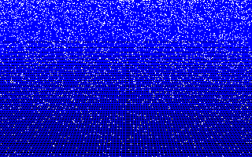
The Universe is Expanding

Slide 4
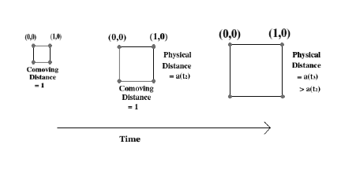
Scale Factor a quantifies expansion

Slide 5
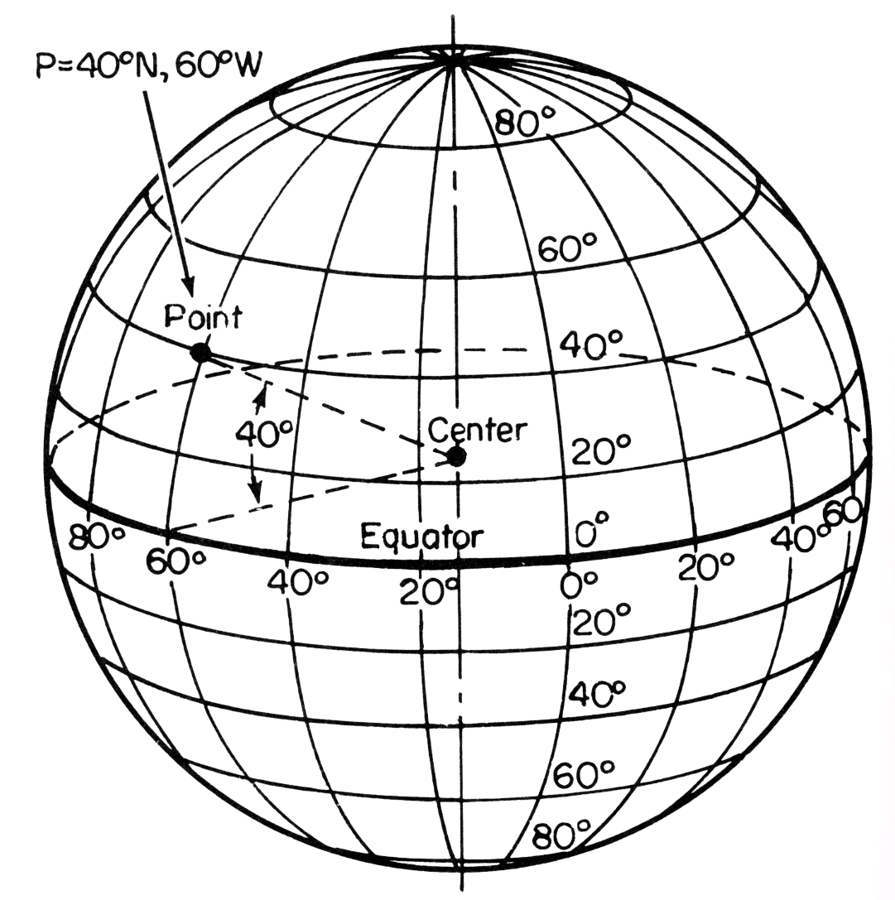
Comoving Coordinates/Distances
The coordinate differences on the grid are called comoving distances. They are the equivalent of longitude & latitude.
To get a physical distance dl from a set of coordinate differences (dθ,dφ), use the metric.

Slide 6
The scale factor a(t) is the key function in the Friedmann-Robertson-Walker metric
In a flat universe (our universe) k=0, and the metric reduces to
ħ=c=k_{B}=1
or

Slide 7

Comoving Coordinates/Distances
Since we set the scale factor today, a₀=1, the comoving distance between 2 objects is the physical distance one would get today if an infinitely long tape measure was placed between the objects.
A tape measure placed between the same 2 objects early on would find a physical distance of (a(t) x comoving distance)

Slide 8
The evolution of a is determined by Einstein’s Equations
Ricci Tensor
Newton’s Constant
Ricci Scalar
Energy Momentum Tensor

Slide 9
General Relativity in 1 Slide
Metric inverse

Slide 10
General Relativity in 1 Slide
Metric inverse
Raise/lower indices with metric/inverse

Slide 11
General Relativity in 1 Slide
Metric inverse
Raise/lower indices with metric/inverse
Christoffel Symbol

Slide 12
General Relativity in 1 Slide
Metric inverse
Raise/lower indices with metric/inverse
Christoffel Symbol
Ricci Tensor

Slide 13
General Relativity in 1 Slide
Metric inverse
Raise/lower indices with metric/inverse
Christoffel Symbol
Ricci Tensor
Ricci Scalar

Slide 14
Example: Christoffel Symbol

Slide 15
Example: Christoffel Symbol
since off-diagonal elements of the metric vanish

Slide 16
Example: Christoffel Symbol
But this also kills the first two terms …
And g⁰⁰=-1 and g_{ij}=δ_{ij}a², so

Slide 17
Time-Time Component of Einstein Equations

Slide 18
Time-Time Component of Einstein Equations
Exercise: Show that

Slide 19
Time-Time Component of Einstein Equations
Exercise: Show that
Plug in to get the Friedmann equation:

Slide 20


Friedmann Equation
Exercise: Show that if we had left curvature in the metric, we would have an extra term:
Curvature is measured to be zero, so the extra term vanishes and the energy density today is fixed to be

Slide 21
Space-Space Component of Einstein Equations
where P is the diagonal space-space component of the energy momentum tensor.

Slide 22
Space-Space Component of Einstein Equations
where P is the diagonal space-space component of the energy momentum tensor.
Exercise: Combine with the Friedmann equation to get

Slide 23
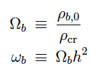
Constituents of the Universe
Cosmologists measure densities in units of the critical density
where h defines the Hubble constant
Two popular ways of writing the baryon density are:
h=0.7

Slide 24
Constituents of the Universe
Can count baryons: stars in galaxies, gas in galaxy clusters, gas in the intergalactic medium
Can “count” total matter: weigh galaxies and/or galaxy clusters
Evidence for two forms of matter: baryonic and dark
Ω_{baryon} = 0.049±0.002
Ω_{dark matter} = 0.267±0.01
Counting directly is not very precise; these accurate numbers come from the Cosmic Microwave Background

Slide 25
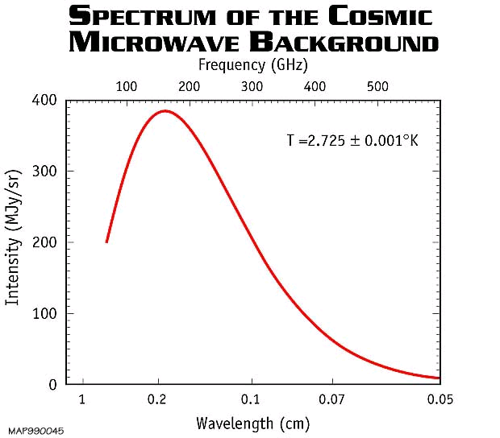
Constituents of the Universe
The Cosmic Microwave Background (CMB) itself contributes to the energy density.
The temperature of the CMB has been measured extremely well. Turn this into a measurement of the energy density.
=2.35x10⁻⁴ eV

Slide 26
Constituents of the Universe
Energy density of a gas of bosons in equilibrium:
Spin states
Bose-Einstein distribution
Sum over phase space
For massless particles, E=p, so
π⁴/15

Slide 27
Constituents of the Universe
Ω_{dark matter} = 0.267±0.01
Ω_{baryon} = 0.049±0.002
Ω_{γ} = (5.0±0.2)x10⁻⁵
Exercise: Show that this result combined with the definition of the critical density leads to

Slide 28
Constituents of the Universe
But the total energy density is equal to the critical density (since the Universe is flat): the sum of the Ω’s should be equal to one.
We are missing something!
Ω_{dark matter} = 0.267±0.01
Ω_{baryon} = 0.049±0.002
Ω_{γ} = (5.0±0.2)x10⁻⁵

Slide 29
Constituents of the Universe
Ω_{dark matter} = 0.267±0.01
Ω_{baryon} = 0.049±0.002
Ω_{γ} = (5.0±0.2)x10⁻⁵
0.001 < Ω_{ν} < 0.02
Neutrinos contribute.
We are still missing something

Slide 30
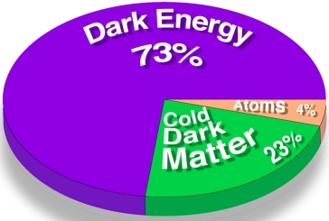
Constituents of the Universe
Ω_{dark matter} = 0.267±0.01
Ω_{baryon} = 0.049±0.002
Ω_{γ} = (5.0±0.2)x10⁻⁵
0.001 < Ω_{ν} < 0.02
Ω_{dark energy} = 0.68±0.02

Slide 31
In the Past
This is a snapshot of energy budget today. What did this look like in the past?

Slide 32
In the Past
Exercise: Differentiate the Friedmann equation and then use the space-space equation to get a differential equation for the density:
Equation of state: w=P/ρ

Slide 33
In the Past
Exercise: Differentiate the Friedmann equation and then use the space-space equation to get a differential equation for the density:
Equation of state: w=P/ρ
This has solution

Slide 34
Example 1: Non-relativistic matter
The pressure of non-relativistic matter is very small
compared to the energy density (T<<m), so w=0.
Consistent with simple dilution by volume expansion

Slide 35
Example 2: Relativistic particles
To determine w, recall that the pressure is:
For relativistic particles, E=p, so P=ρ/3, or w=1/3.
Volume dilution PLUS wavelength stretching
T~1/a

Slide 36
Equation of State of Dark Energy
Recall the equation for acceleration
Deceleration unless ρ+3P is negative

Slide 37
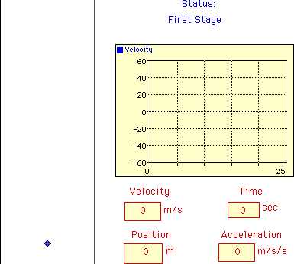

That gravity typically decelerates is intuitive

Slide 38
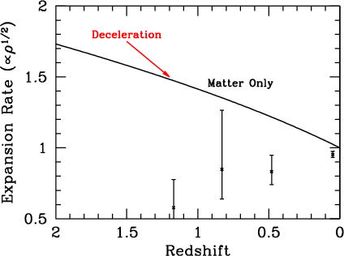

Ordinary Matter would induce deceleration

Slide 39
Example 3: Cosmological Constant
One possibility is that the dark energy is a cosmological constant with w=-1.
Empty space contains energy

Slide 40
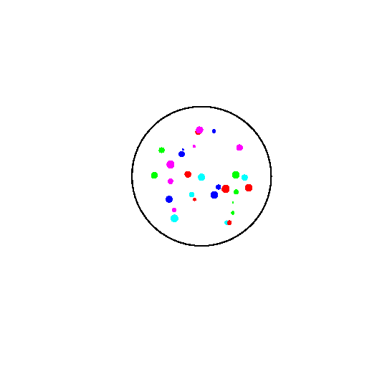
Example 3: Cosmological Constant
More generally, the equation of state of the dark energy is close to -1, which means the density does not get diluted as the universe expands

Slide 41
Example 3: Cosmological Constant
Expect non-zero contribution to the vacuum energy due to quantum fluctuations
Amplitude is too large (by 120 orders of magnitude!)

Slide 42
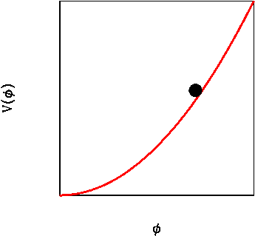
Quintessence: Scalar Field
For acceleration, require
ρ
P

Slide 43
Quintessence: Scalar Field
Equation of motion for a scalar field in an expanding Universe (can get by using conservation of T_{μν} with V=m²φ²)
Friction term must be large or else field behaves like cold dark matter, so require m<H~10⁻³³eV. Then getting the right energy density requires φ~m_{Pl}

Slide 44
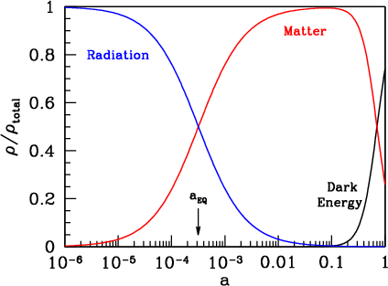
Thermal History of the Universe
The equation of state of dark energy is -1 to within 20%
Structure begins to grow when the universe becomes matter dominated
At very early times, the universe is dominated by radiation

Slide 45
Thermal History of the Universe: Recombination
At high temperatures, photons have energy above ε₀=13.6 eV so can ionize hydrogen, so all electrons and protons are free. At lower temperature, neutral hydrogen forms.
Can determine abundance by assuming equilibrium:
Number of electrons equal to number of protons. Cross sections are related, so

Slide 46
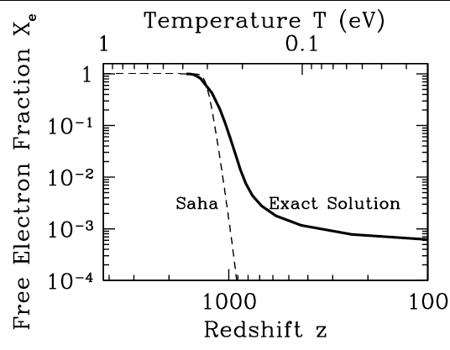
Thermal History of the Universe: Recombination
This equilibrium solution is called the Saha approximation.
It breaks down – as do all equilibrium approximations in cosmology – when the reaction rates fall below the Hubble rate
Free electrons can’t find increasingly rare free protons to track equilibrium so the free electron fraction freezes out.
Exercise: Determine electron fraction in Saha approximation

Slide 47
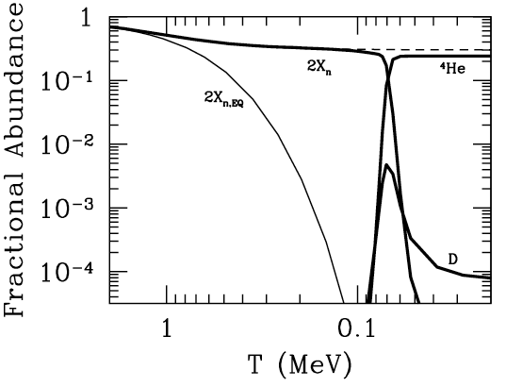
Thermal History of the Universe: Nucleosynthesis
Same principle at higher temperatures.
Neutron/proton ratio is exponentially suppressed
(e^{-Δm/T}) as long reactions are fast
Neutrons that freeze-out turn into helium via deuterium production
Some deuterium freezes out
Exercise: Equate weak interactions to Hubble rate to obtain estimate for neutron freeze-out

Slide 48
Thermal History of the Universe: e⁺-e⁻ Annihilation
Annihilation is rapid so electrons and positrons are in equilibrium until much below their temperature
But, there is an asymmetry, an excess of electrons over positrons, so a small fraction of electrons remain

Slide 49
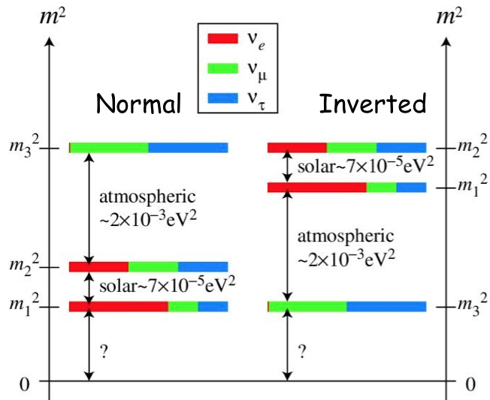
Neutrinos
There are 3 generations of neutrinos with two mass squared differences measured

Slide 50
Neutrinos
In the Standard Model, left-handed neutrinos interact weakly, while right-handed neutrinos – if they exist – are singlets so are sterile. Mass terms can be written in terms of the vector
Generally the mass matrix (for a single generation) can be written as

Slide 51
Neutrinos
Majorana Mass: m_{L}=m; m_{D}=m_{R}=0
Dirac Mass: m_{D}=m; m_{L}=m_{R}=0
In both of these cases, there are only two degrees of freedom per generation

Slide 52
Neutrinos
Neutrinos were produced in the early universe
Alpher, Herman, & Gamow 1953
Assume there are no neutrinos initially when the temperature is much larger than m_{e}. The rate for producing them via, e.g.,
Z
is of order

Slide 53
Neutrinos
Compare this to the expansion rate:
since the universe is radiation dominated at early times
The ratio of the neutrino production rate to the expansion rate is therefore

Slide 54
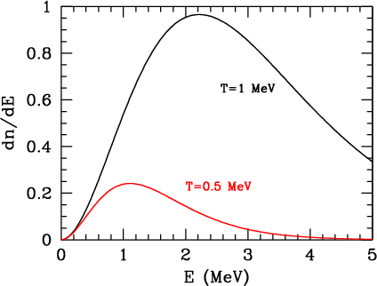
Neutrinos
At T above 5 Mev, the neutrinos have a Fermi-Dirac distribution with temperature T equal to the electron/photon temperature.
After the neutrinos decouple from the rest of the plasma (T<MeV), they still maintain Fermi-Dirac distribution with T~1/a.

Slide 55
Neutrinos
You might think neutrinos would have the same temperature as photons today, but photons gained energy from electron/positron annihilation when T~m_{e}
Use entropy conservation: sa³=constant
Together with the fact that the neutrino temperature does scale as a⁻¹

Slide 56
Neutrinos
photons
electrons/positrons
Before electron positron annihilation:
neutrinos
Afterwards:
Equate the two to get:

Slide 57
Neutrinos
Exercise: Calibrate off the well-known CMB temperature and find
Number of species of weakly interacting neutrinos
There are ~ a hundred quadrillion cosmic neutrinos (flux of 115x3c = 10¹³ cm⁻² sec⁻¹) passing through this screen (~10⁴ cm²) every second.

Slide 58
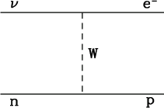
Neutrinos
Unfortunately, we can’t detect these directly because the cross section is too small
So the detection rate is of order

Slide 59
Neutrinos
But they do contribute to the energy of the universe. At early times, they are relativistic, so (Exercise:) their energy density is
This follows from the entropy calculation
N_{eff} is actually a little greater than 3 because neutrinos share a bit of the energy when electrons and positrons freeze-out: N_{eff}=3.046
Anisotropies in the CMB are sensitive to N_{eff}

Slide 60
Neutrinos
They also contribute to the energy of the universe at late times. The energy density of massive neutrinos today is:

Slide 61
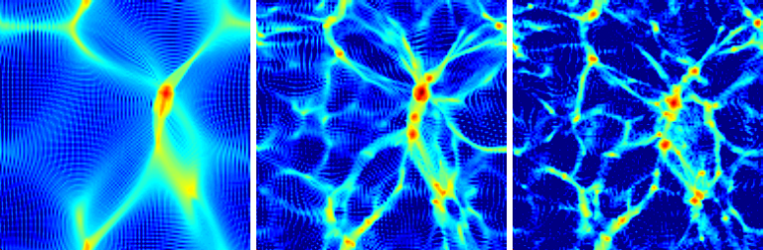
Neutrinos
It is unlikely though that a ~20 eV neutrino is the dark matter, because hot dark matter removes structure on small scales, which does not agree with observations, and because the upper limit on the electron neutrino mass is ~2eV

Slide 62
Neutrinos
This impact on large scale structure may be observed even if neutrinos constitute only a small fraction of the dark matter. I.e., we can hope to constrain neutrino masses by observing large scale structure

Slide 63
Neutrinos
Majorana Mass: m_{L}=m; m_{D}=m_{R}=0
Dirac Mass: m_{D}=m; m_{L}=m_{R}=0

Slide 64
Neutrinos
Majorana Mass: m_{L}=m; m_{D}=m_{R}=0
Dirac Mass: m_{D}=m; m_{L}=m_{R}=0
See-Saw Mechanism: m_{D}=m; m_{R}=M; m_{L}=0
Explains why observed neutrino masses (m²/M) are so small. I.e., if m is of order quark and lepton masses and M is of order GUT scale, observed masses of order 10⁻³eV
Majorana mass terms (m_{L} or m_{R}) violates lepton number

Slide 65
Leptogenesis
Where did the electron-positron (equivalently baryon asymmetry) come from?
Sakharov laid down 3 principles for an asymmetry to develop:
Lepton (or baryon) number violation
CP violation
Out-of-Equilibrium

Slide 66
Leptogenesis
Where did the electron-positron (equivalently baryon asymmetry) come from?
Sakharov laid down 3 principles for an asymmetry to develop:
Lepton (or baryon) number violation
Happens naturally because heavy fermions have Majorana masses
CP violation
3x3 mass matrices allow for complex phases; these produce asymmetries when the heavy neutrinos decay
Out-of-Equilibrium
Lifetimes are long, so particle decay out of equilibrium

Slide 67

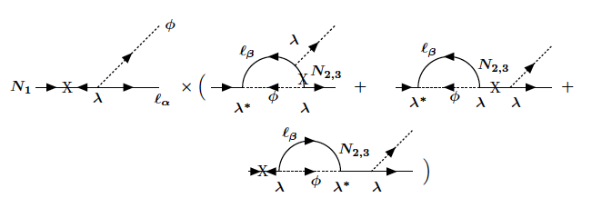
Leptogenesis
The decays of a heavy neutrino N produce an asymmetry in the light leptons l

Slide 68
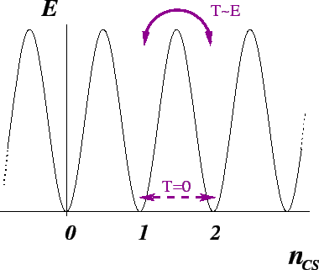
Leptogenesis
Sphalerons are in equilibrium down to the time of the electroweak phase transition and transform lepton number into baryon number (i.e., both B and L are violated but B-L is conserved)

Slide 69
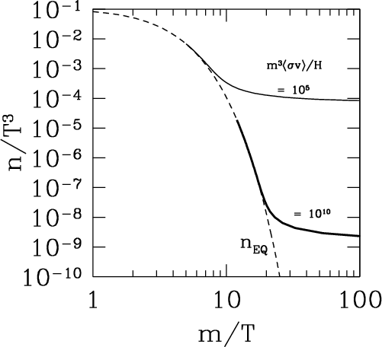
Dark Matter: Weakly interacting massive particles
All particles start with density roughly equal to photon density
When temperature drops beneath mass, annihilations deplete density …
until freeze-out

Slide 70
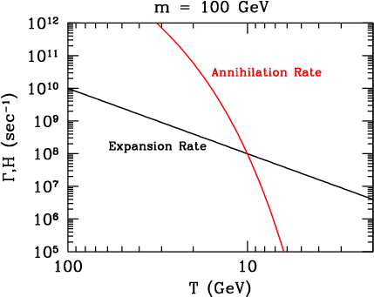
Dark Matter: Weakly interacting massive particles
Particles remain in equilibrium until annihilation rate comparable to expansion rate

Slide 71
Dark Matter: Weakly interacting massive particles
Freeze-out takes place when the rates are equal
After freeze-out, WIMP number density dilutes with expansion, just like photon number density

Slide 72
Multiply by mass to estimate the contribution to the energy density today
Exercise: Plug in numbers
Mild mass dependence, but mostly depends on cross-section only.

Slide 73
Dark Matter: Weakly Interacting Massive Particles
Note that the thermally averaged cross-section times velocity is
This (actually a more careful estimate is a factor of 3 larger) will play a key role in indirect detection

Slide 74
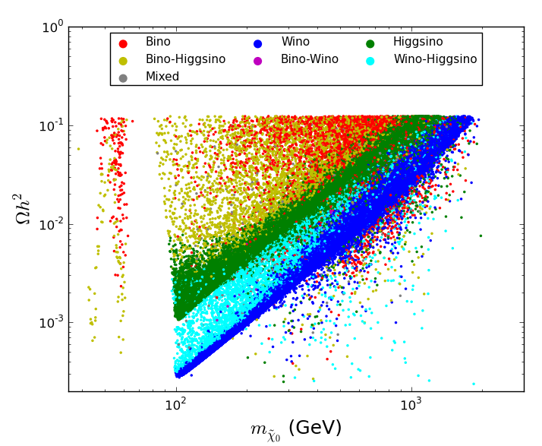
Easy to get correct dark matter abundance in supersymmetric models
Snowmass: Dark Matter Complementarity

