Slide 1



Searches for Physics Beyond the Standard Model at the Large Hadron Collider
42nd SLAC Summer Institute
August 4th-15th, 2014
Mark Cooke
(LBNL)
on behalf of the ATLAS and CMS collaborations

Slide 2
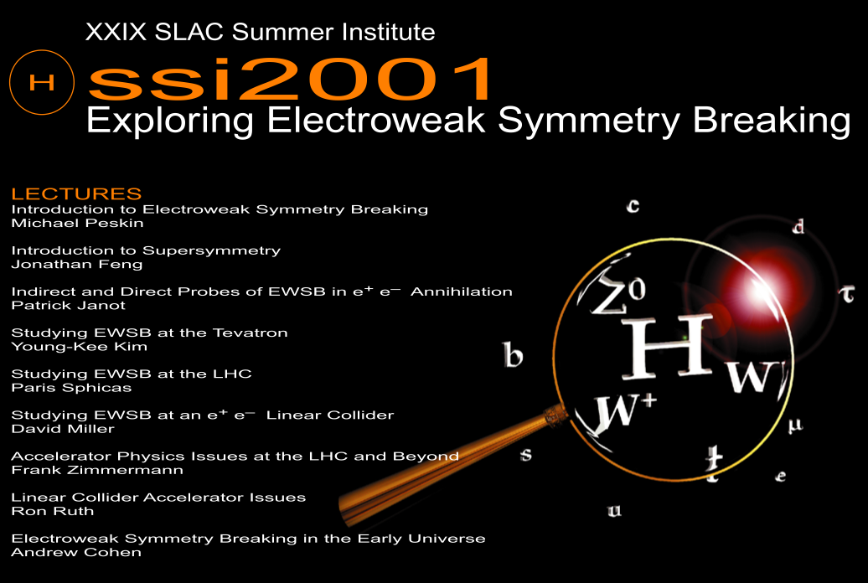
Flashback: my first SSI while an undergraduate working at SLAC’s End Station A.
Pleasure to be here again!
Slide 2

Slide 3
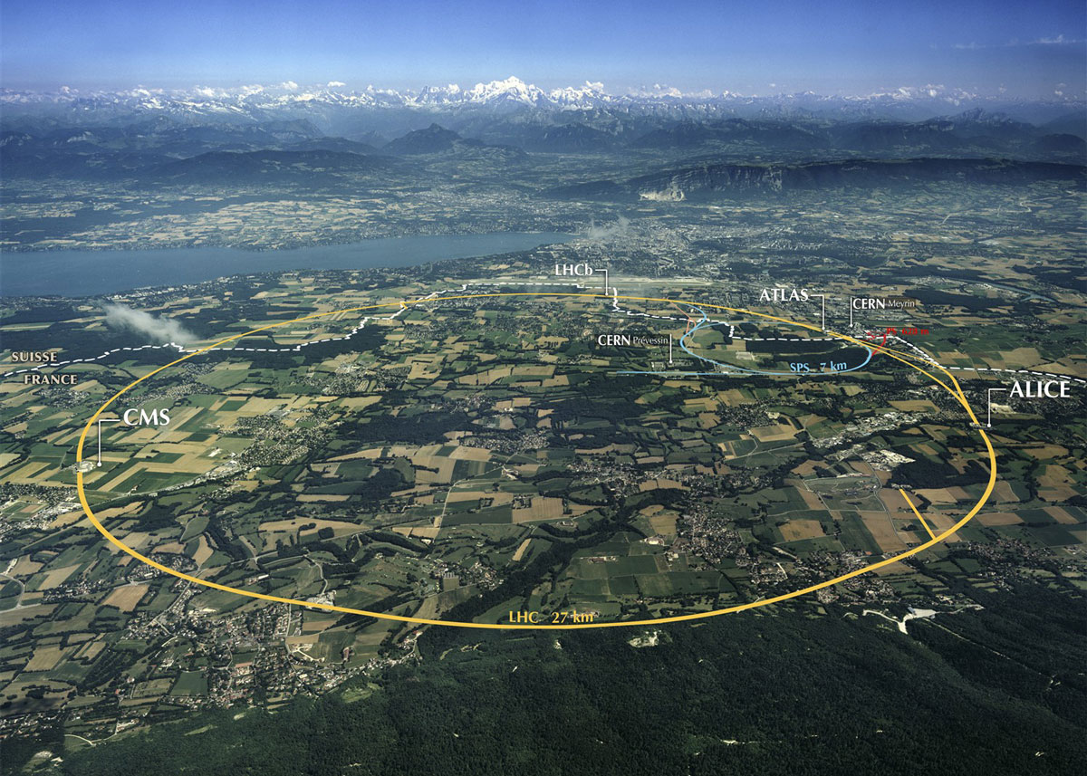
The LHC: built to understand electroweak symmetry breaking
Parameter: Run 1 (design)
Beam Energy [TeV] : 3.5, 4 (7)
Bunch spacing [ns] : 50 (25)
# bunches : 1380 (2808)
p⁺ / bunch [10¹¹] : 1.5, 1.7 (1.2)
Peak Lumi [10³³ cm⁻²s⁻¹] : 4, 8 (10)
Max <N_{int}> / bc : 17, 37 (19)
Slide 3

Slide 4
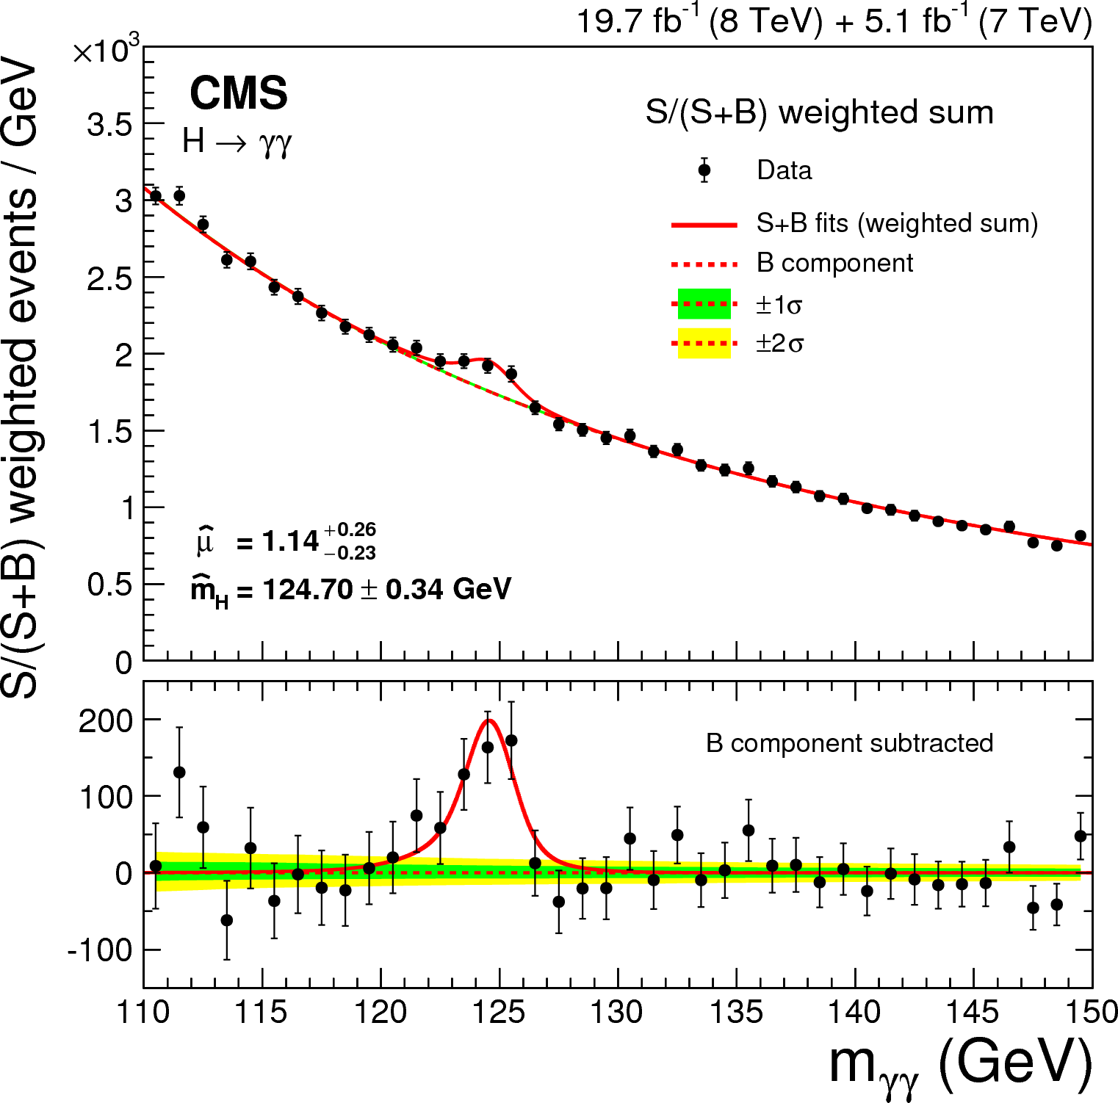
And we were not disappointed
…
Slide 4

Slide 5
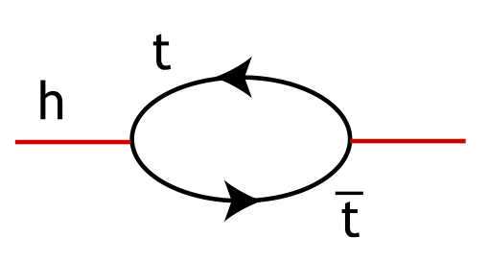
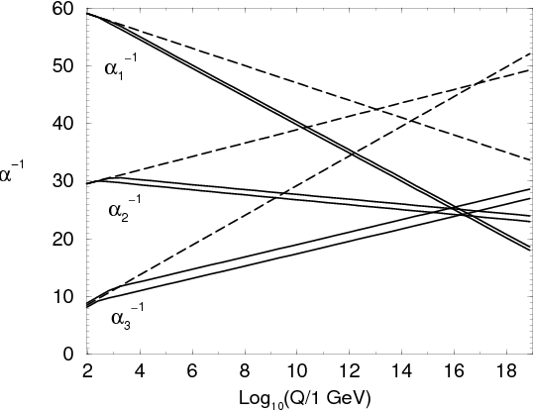
But … there are still so many unanswered questions!
Naturalness:
SM Higgs field receives large mass-squared corrections at energies above EW scale; requires fine-tuning to compensate. Is this a problem?
Gauge Unification:
SM
The SM is based on a product of gauge groups: SU(3)_{c} x SU(2)_{L} x U(1)_{Y} . Can this be embedded in a unified theory?
Fermion flavor & baryogenesis:
MSSM
Why 3 fermion generations and mixing patterns? Relation to matter-antimatter asymmetry?
Gravity
Why is gravity so weak? Connected to the weak scale via extra space-time dimensions?
Searches for BSM Physics @ LHC : M. Cooke (LBNL)
Slide 5

Slide 6
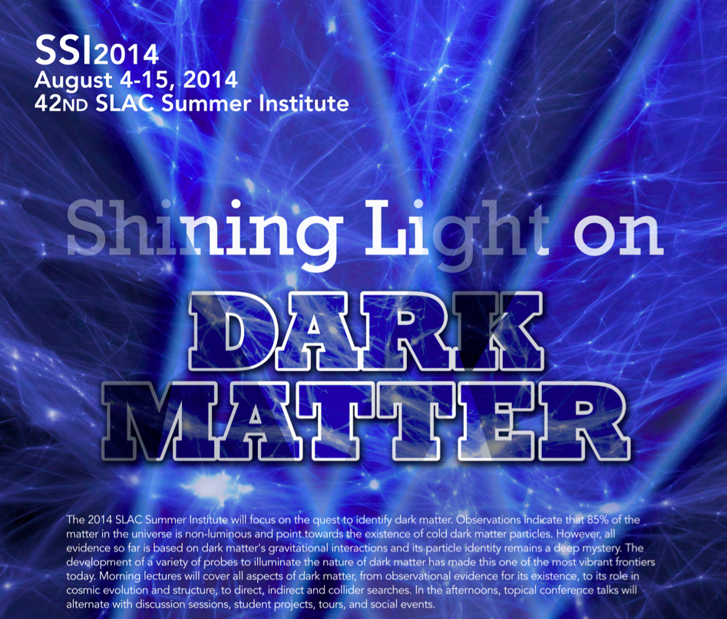
Oh yeah, and that other question.

Slide 7
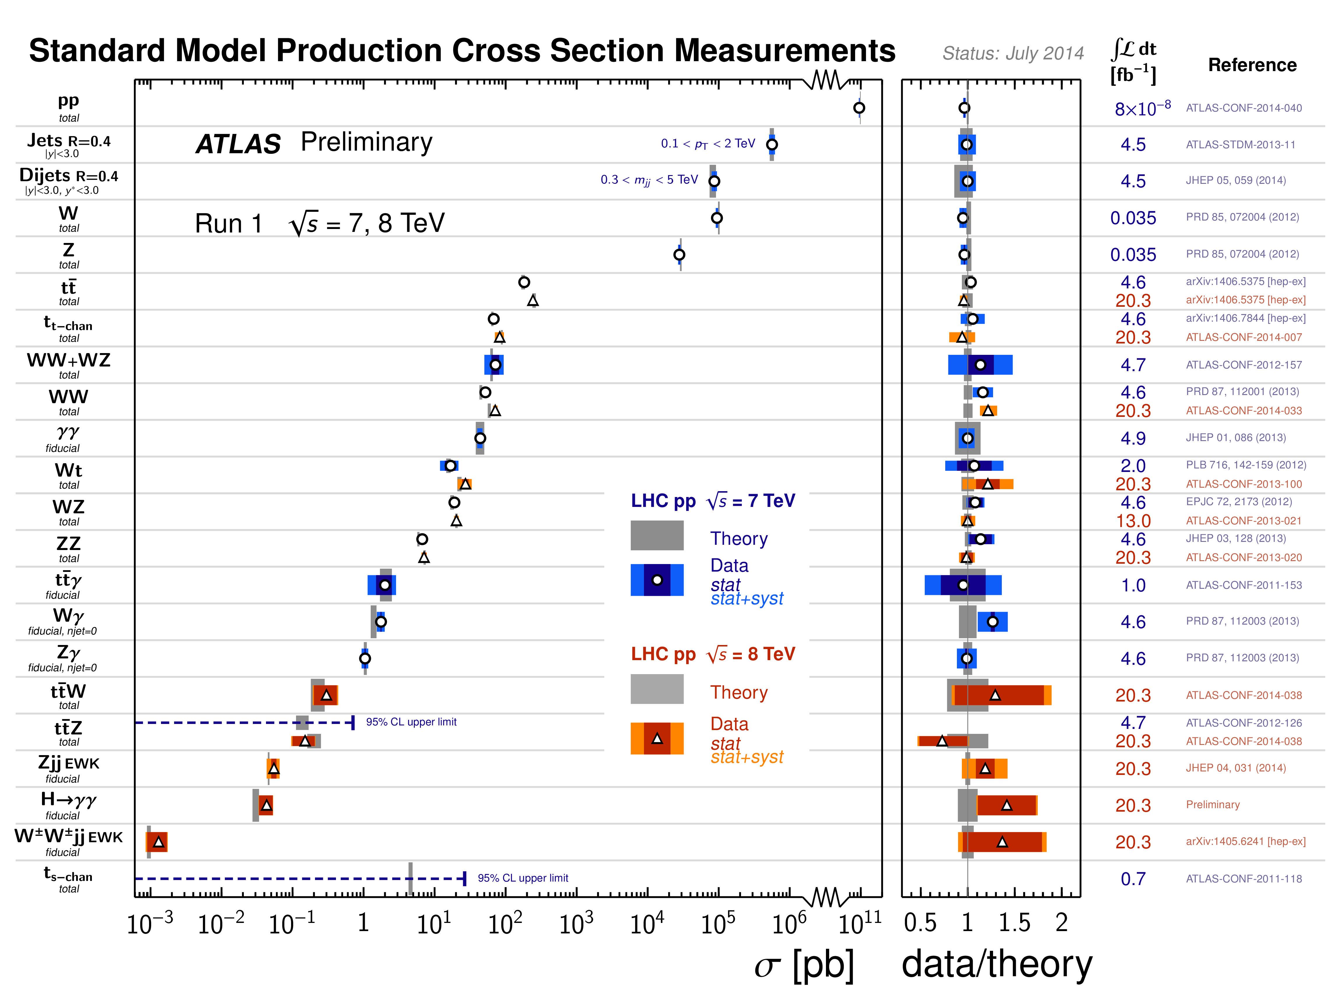
LHC Run 1 data generally well described by Standard Model processes
Still room for contributions from sources of new physics? Where / how to look?
Searches for BSM Physics @ LHC : M. Cooke (LBNL)
Slide 7

Slide 8
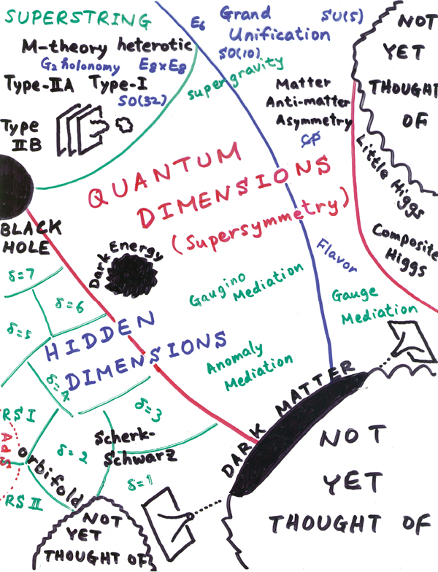
Where/how to look?
Our theorist friends have plenty of ideas [decades worth].
Some ideas appear to address all our questions in one fell swoop, others maybe just one.
Ultimately they provide a Lagrangian with some new state(s) / interaction(s) coupled to the SM.
Calculate consequence for pp collisions at the LHC. Get experimentalist friend to perform search.
H. Murayama
Slide 8

Slide 9
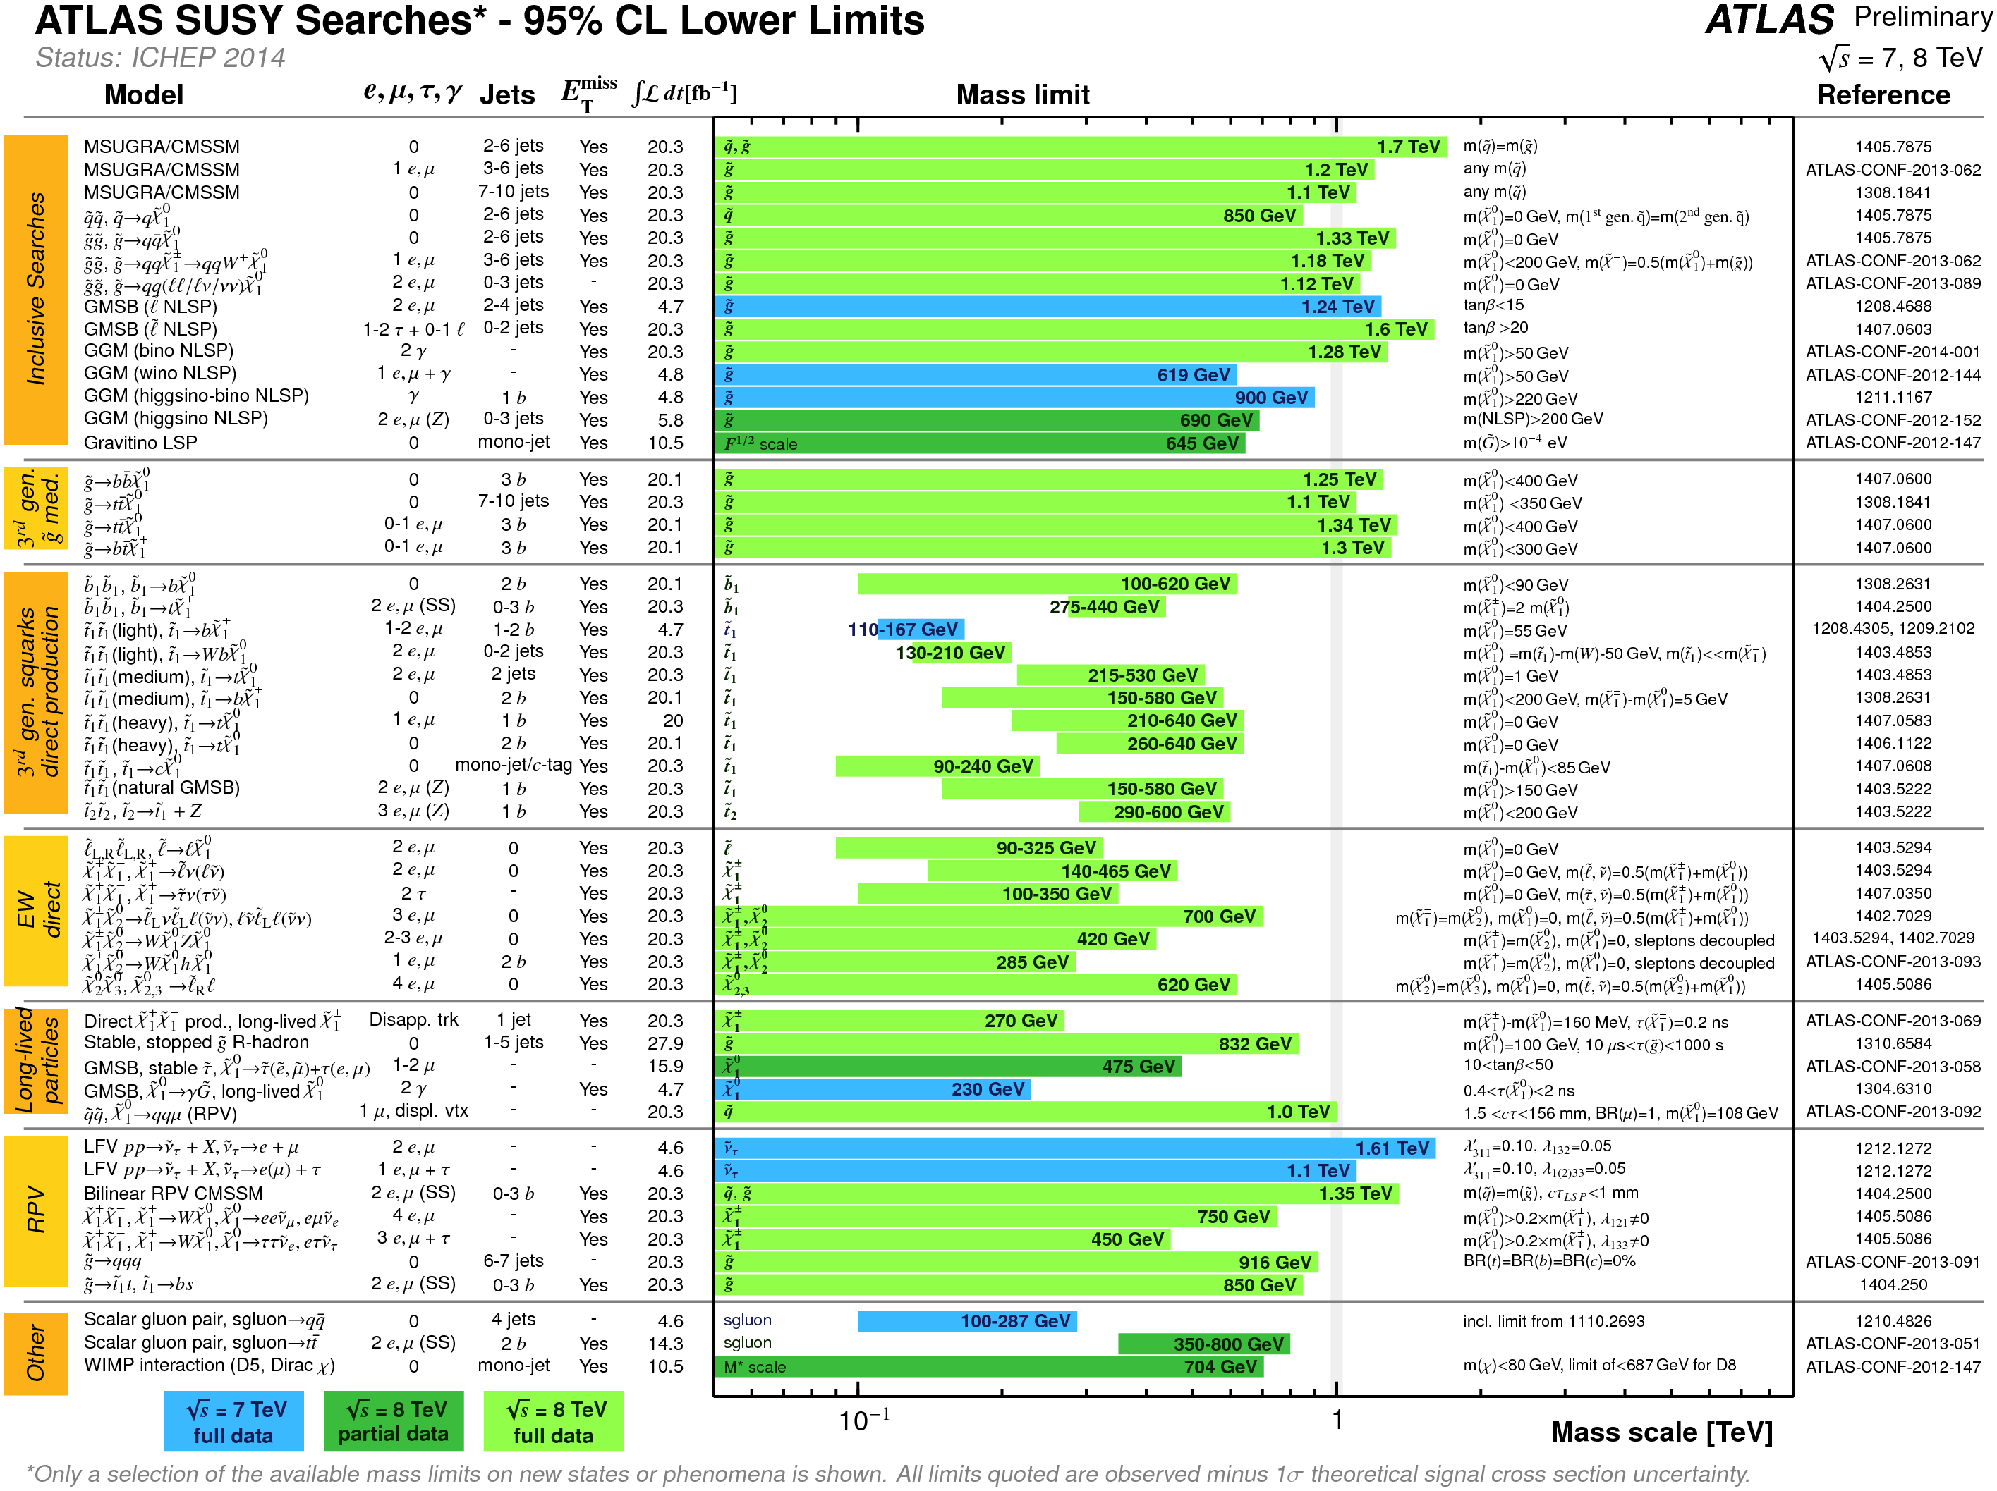
And we have been kept very busy the last few years!

Slide 10
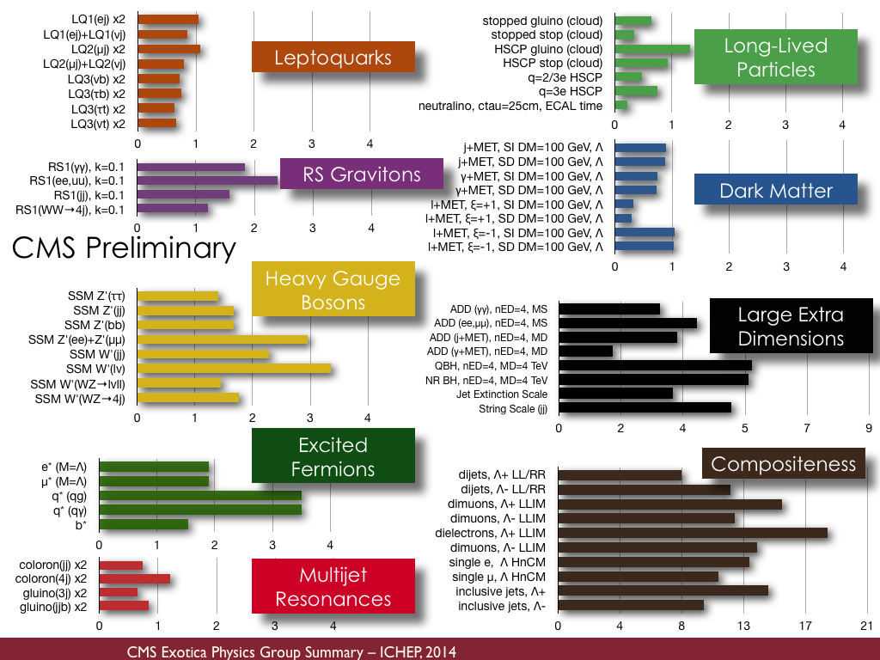
And we have been kept very busy the last few years!

Slide 11
The sampler I have prepared for you today:
1) New Resonances (single production):
Di-fermions:
Di-jets:
Di-bosons:
;
2) New Resonances (pair production):
Supersymmetry:
Vector-like quarks:
3) Non-resonant new phenomena:
Contact interactions
TeV-scale gravity
4) Non-prompt new phenomena:
Displaced SUSY:
Important omissions: dark matter @ LHC (Whiteson) and new physics in Higgs sector (Olsen)
Searches for BSM Physics @ LHC : M. Cooke (LBNL)
Slide 11

Slide 12
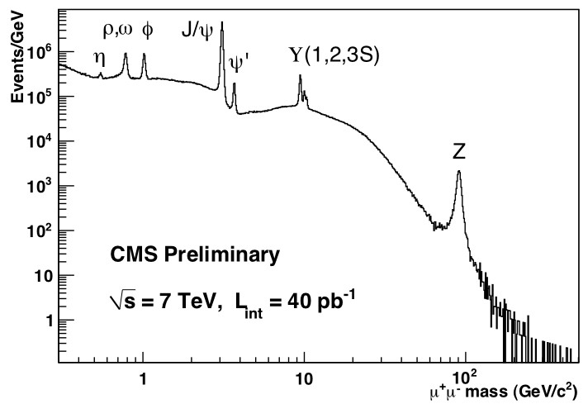
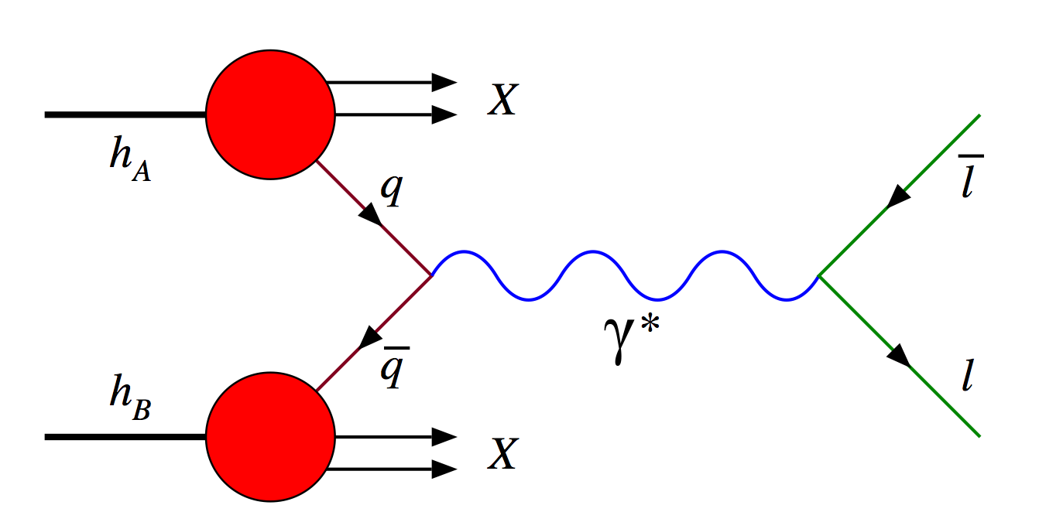
Singly produced resonances: di-fermion mass spectra
The Drell-Yan process is a powerful probe for new bosonic states:
No signal with electron and muon pairs, so limits set: e.g. this ATLAS search excludes SM-like Z’ with masses < 2.9 TeV.
Other searches with tau, bottom, top pairs. Complex final states yield weaker limits (∼2 TeV), but test for preferential coupling to 3rd generation.
[1405.4123]
Searches for BSM Physics @ LHC : M. Cooke (LBNL)
Slide 12

Slide 13
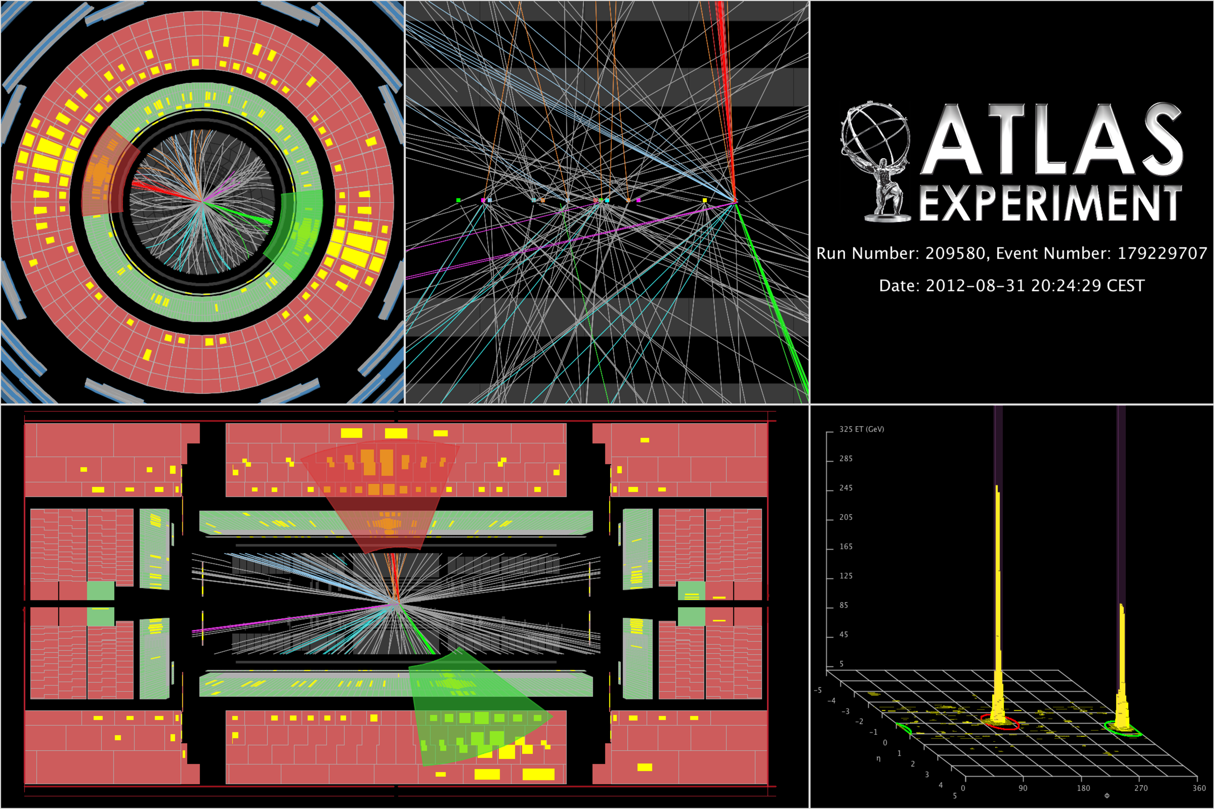
Singly produced resonances: di-jet mass spectra
[1407.1376]
m_{jj} = 4.7 TeV
Di-jet mass spectrum is sensitive to several proposed new resonant states: e.g. excited quarks ( ), color-octet scalars ( ), new gauge bosons ( )
Background modeled w/ analytic function fit over full data range.
No significant local excess. Generic limits set, and on specific models.
Searches for BSM Physics @ LHC : M. Cooke (LBNL)
Slide 13

Slide 14
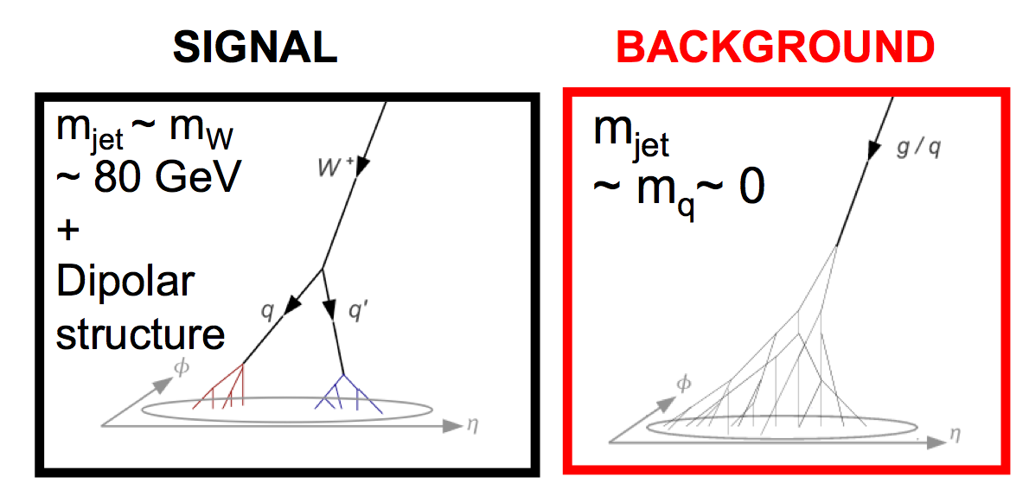
Singly produced resonances: di-jet mass spectra (w/ sub-structure)
Di-jet events analyzed further to assess if one or more of the jets has sub-structure consistent w/ a high p_{T} hadronically decaying W/Z boson.
1 W/Z-tag
Single tag:
[1405.1944]
,
Double tag:
Boosted W/Z Boson Tagging:
2 W/Z-tags
Searches for BSM Physics @ LHC : M. Cooke (LBNL)
Slide 14

Slide 15
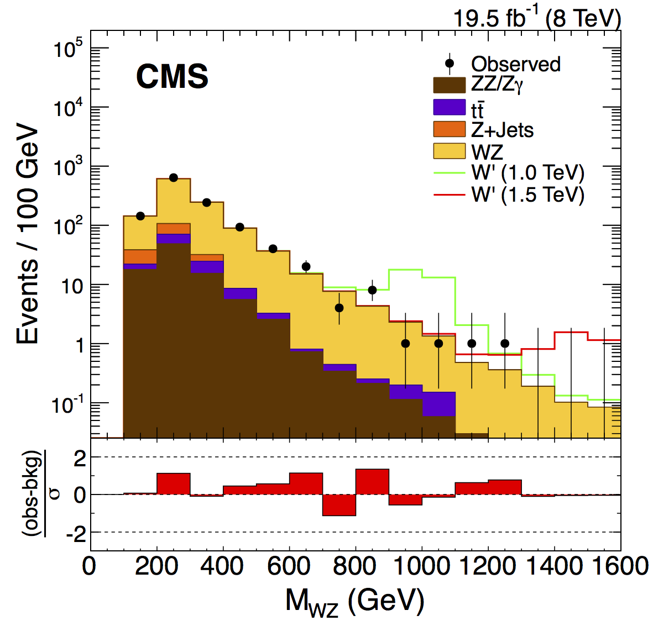
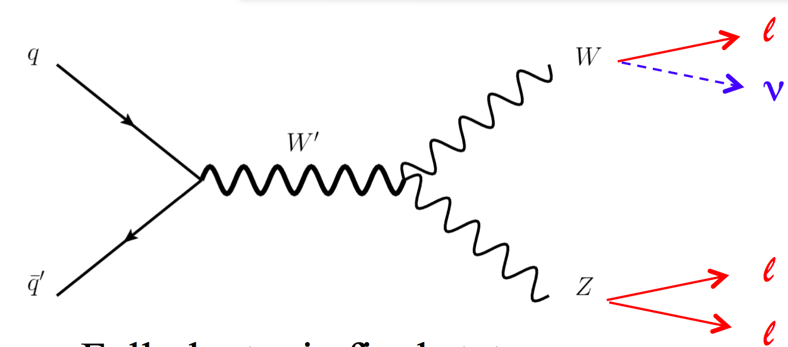
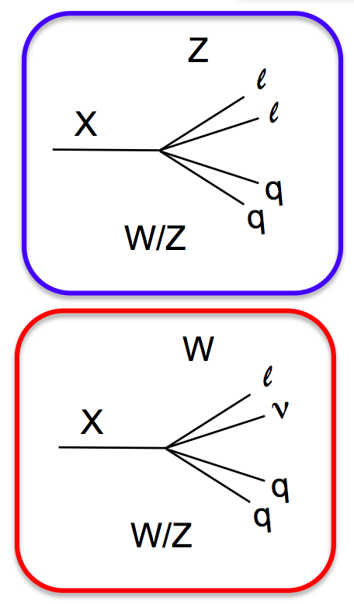
Singly produced resonances: (more) diboson resonances
Completing WW / ZZ / WZ resonance search program w/ leptonic modes.
Here a WZ search in the 3 (visible) leptons + ME_{T} final state.
1407.3476
W
W’
Z
e.g. exclude W’ (EGM) w/ m < 1.5 TeV
See the following for searches w/ 1&2 lepton + jet(s):
1405.3447, ATLAS-CONF-2014-039
Searches for BSM Physics @ LHC : M. Cooke (LBNL)
Slide 15

Slide 16
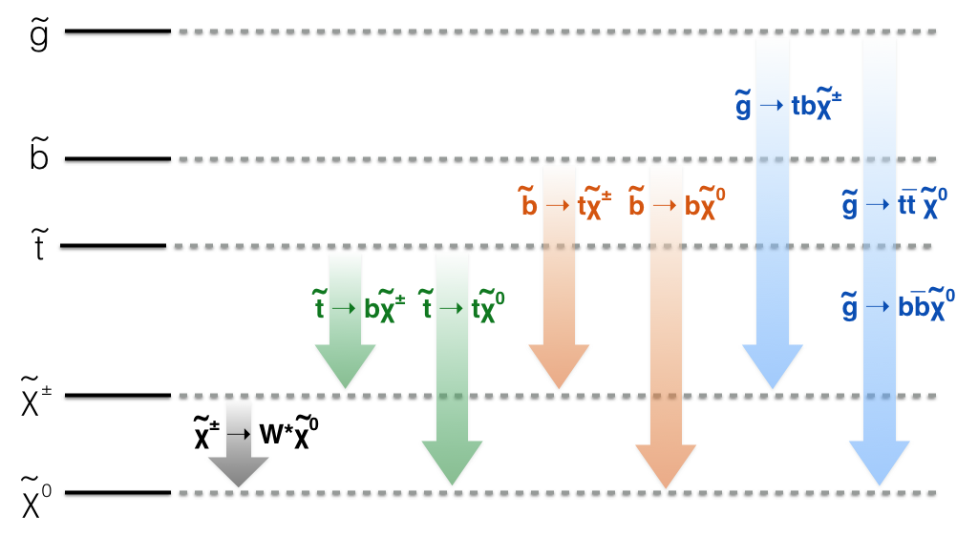
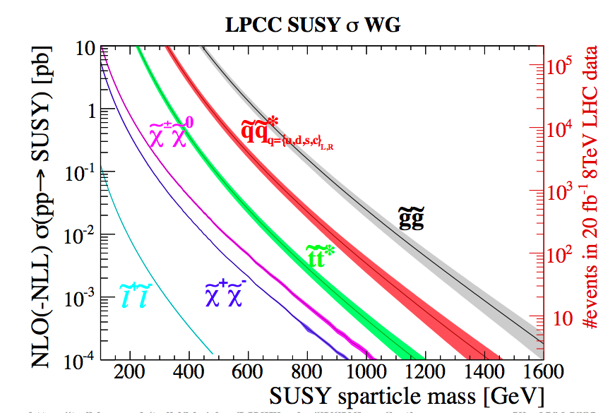
Supersymmetry: simplified models and production
Strategies guided by “natural spectra”
Fix lightest neutralino ( ) as LSP
Focus on gluino, 3rd gen squarks, “EWKinos”
R-parity (pair production, stable LSP)
Will describe search summaries for:
Gluino pair production,
Top-squark pair production,
“EWKino” pair production,
Searches for BSM Physics @ LHC : M. Cooke (LBNL)
Slide 16

Slide 17
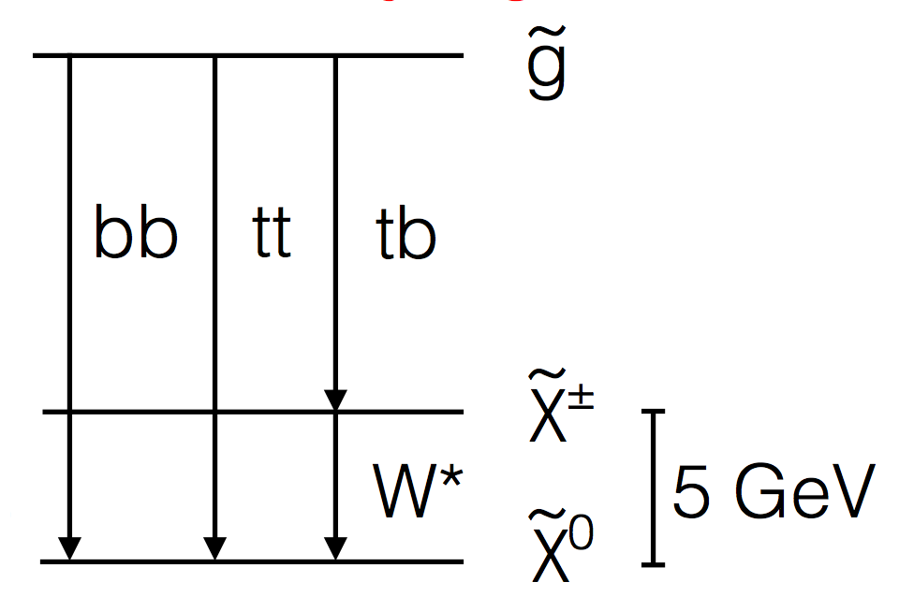
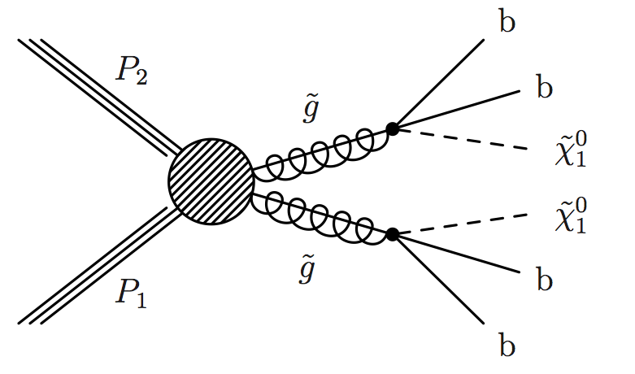
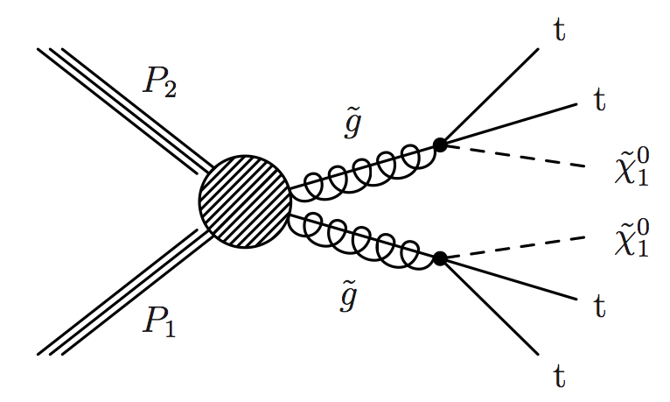
Supersymmetry: constraints on the gluino
Many searches targeting different final states: varying # of leptons, jets, b-jets.
Unfortunately, null results in all channels.
Gluino mass limits (∼ 1-1.5 TeV) depend on assumed decay modes, and spectrum of lighter states.
Example here: gluino decays mediated by heavier 3rd generation squarks.
Results from CMS “razor” analysis.
CMS PAS SUS-14-011
Searches for BSM Physics @ LHC : M. Cooke (LBNL)
Slide 17

Slide 18
Supersymmetry: constraints on the top squark
Top squark a key ingredient if SUSY is to address the naturalness problem.
Thus, an extensive search program.
Many final states covered:
In addition, specialization according to:
Small mass splitting results in low p_{T} visible objects & “gaps” in sensitivity.
Charm tagging used in
region.
Searches for BSM Physics @ LHC : M. Cooke (LBNL)
Slide 18

Slide 19
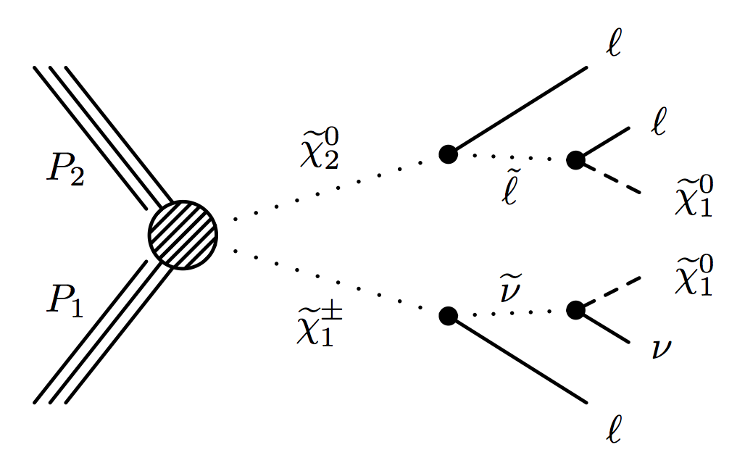
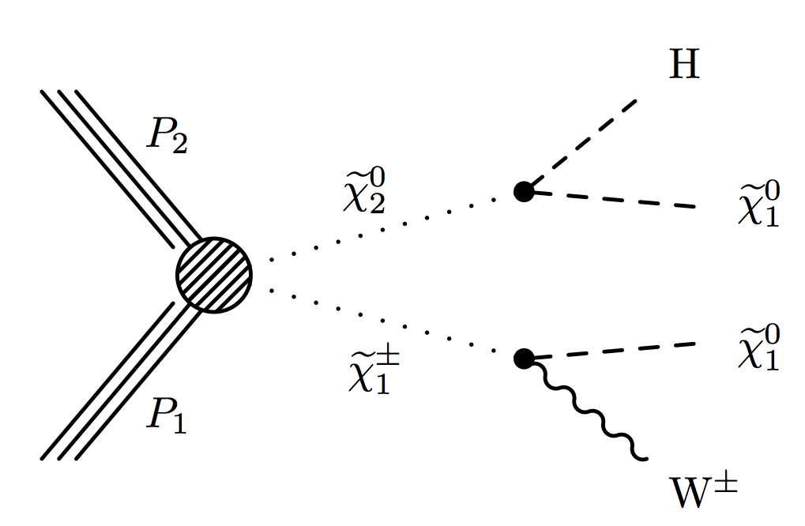
Supersymmetry: constraints on the chargino/neutralinos
Best sensitivity when sleptons exist in the spectrum and are lighter than the chargino.
Also tackling the more difficult cases where the chargino/neutralinos only decay to W/Z/H.
Searches for BSM Physics @ LHC : M. Cooke (LBNL)
Slide 19

Slide 20
Vector-like quarks: pair production (and recently single too)
Color triplet spin ½ fermions whose left and right chirality have same SU(2) x U(1) quantum numbers.
Tree-level decays to W, Z, and H: seek sensitivity to all sets of BRs!
A vector-like T plays similar role as SUSY top squark in regulating Higgs mass divergence. (e.g. in Little and Composite Higgs models)
ATLAS-CONF-2014-036
New result specialized for
and when presented w/ other previous
Searches for BSM Physics @ LHC : M. Cooke (LBNL)
Slide 20

Slide 21
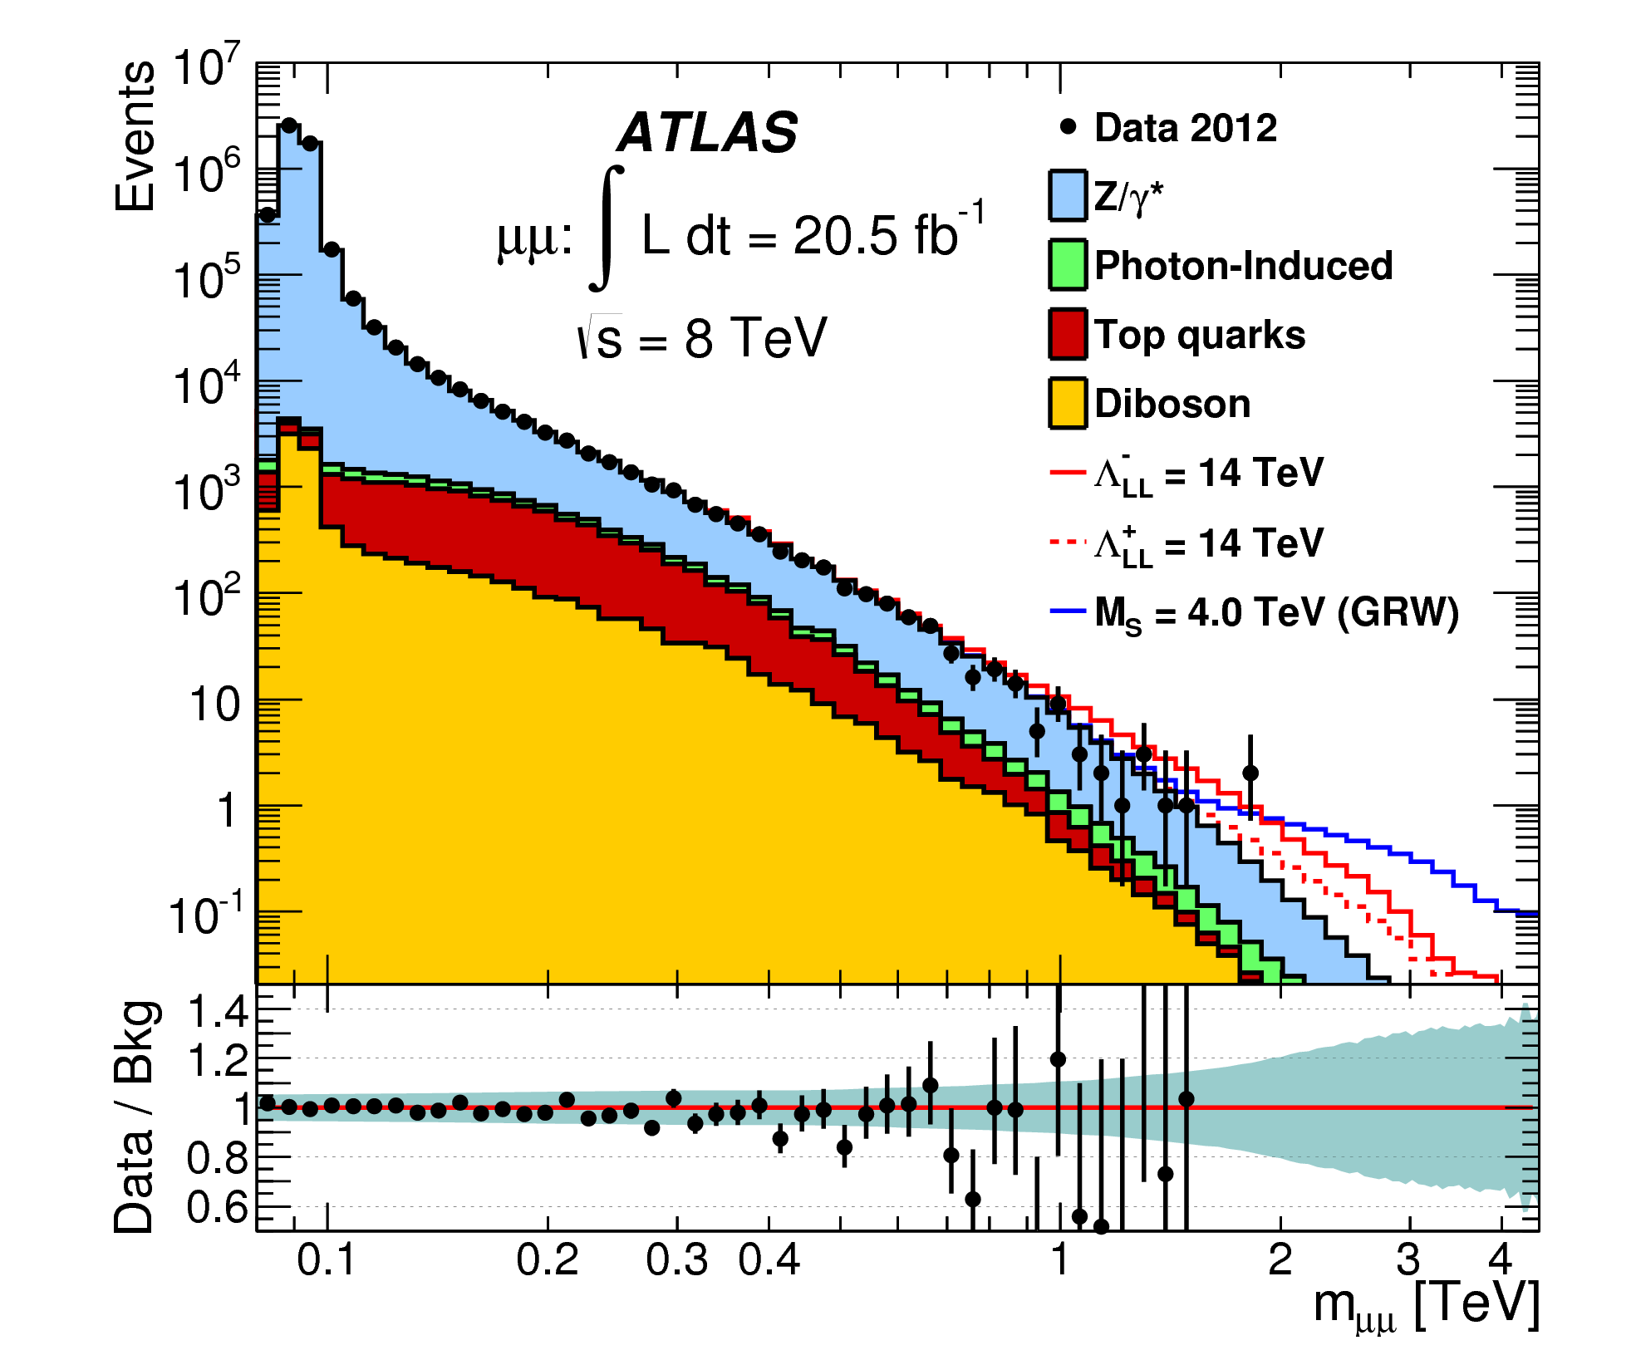
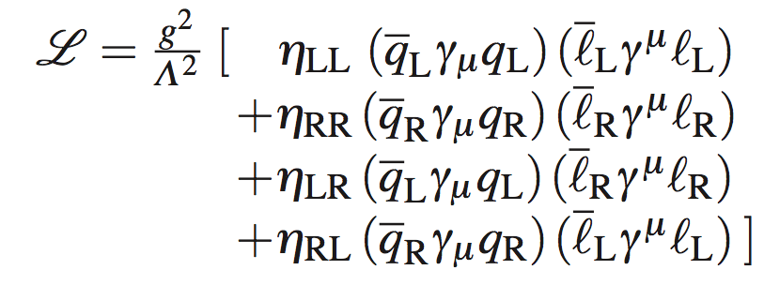
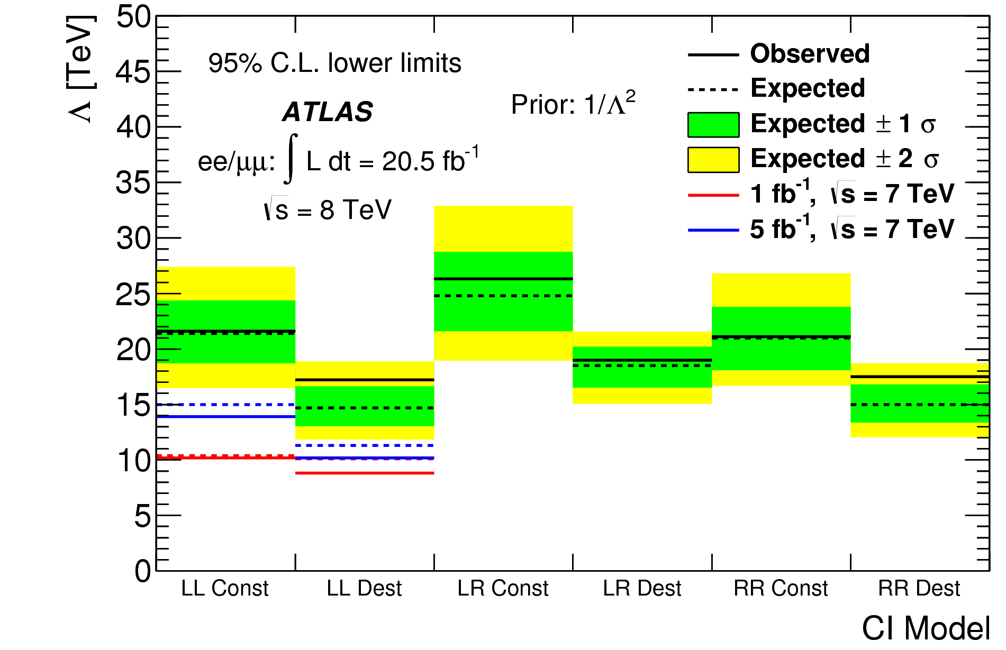
Non-resonant new phenomena: contact interactions
In addition to searching directly for new resonances, should remember the presence of new interaction & states may manifest at lower energies first.
Recall Fermi’s 4-fermion description of the weak interaction. In analogy:
[1407.2410]
Search also constrains large extra dimensions (LEDs), excluding string scale M_{s} < 4-5 TeV.
Searches for BSM Physics @ LHC : M. Cooke (LBNL)
Slide 21

Slide 22
Non-resonant new phenomena: TeV scale gravity
Signatures of TeV scale gravity are predicted to take a number of forms.
Quantum Black Holes: two-particle final states.
[1405.7653]
Semi-classical Black Hole: high-multiplicity energetic final states.
Dense KK graviton spectrum: modified spectra as on previous slide. Also “mono+X” signatures.
This CMS search looks for the extinction of QCD jet production at larger p_{T}.
String models predict suppression of all high p_{T} SM processes beyond some scale.
Searches for BSM Physics @ LHC : M. Cooke (LBNL)
Slide 22

Slide 23
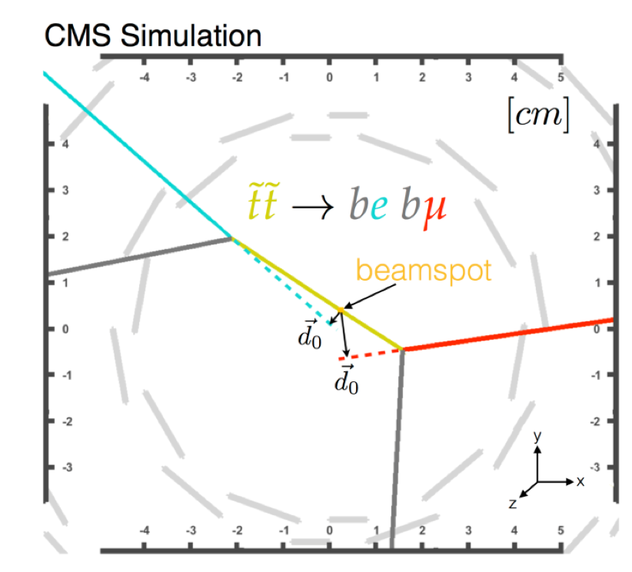
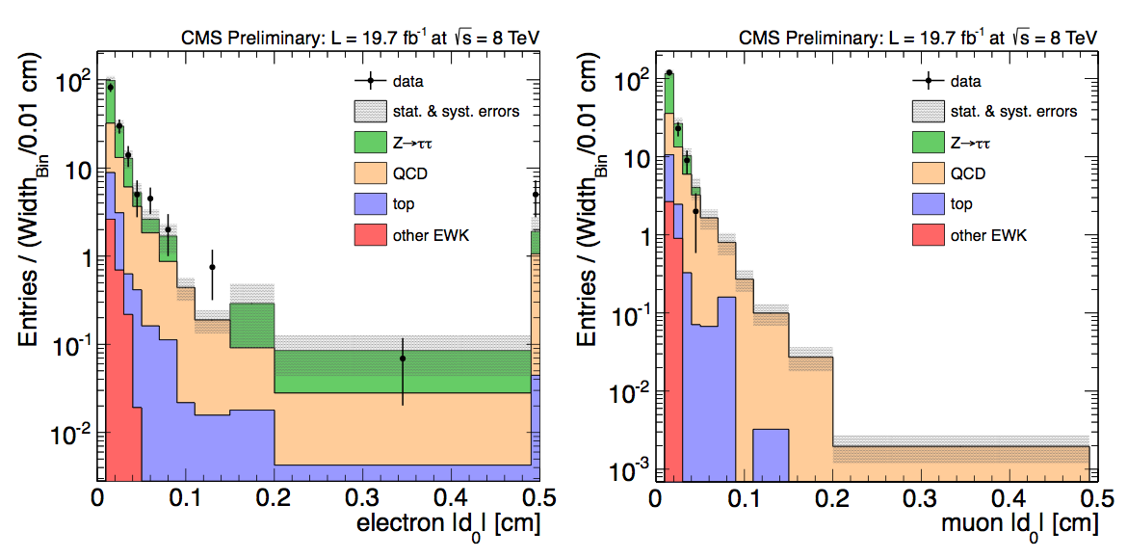
Non-prompt new phenomena: displaced supersymmetry
New states might also not decay promptly; challenge to standard reconstruction techniques.
Ex: search for R-parity violating top squark (LSP) decays.
Require opposite-charge e & μ ; no common vertex.
Look for events where both have large transverse impact parameter (d₀) w.r.t. beam spot.
CMS-B2G-12-024
Searches for BSM Physics @ LHC : M. Cooke (LBNL)
Slide 23

Slide 24
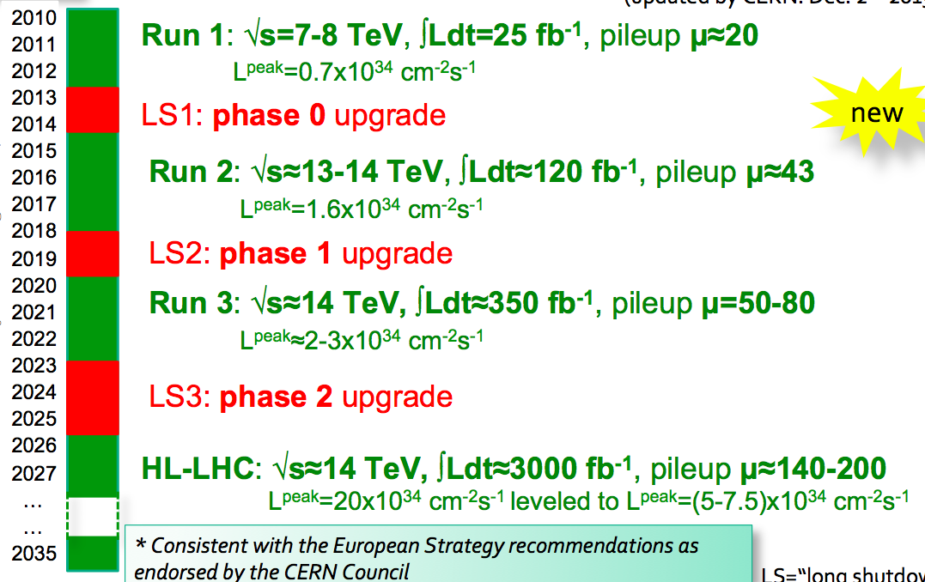
Future LHC runs and upgrade periods
Searches for BSM Physics @ LHC : M. Cooke (LBNL)
Slide 24

Slide 25
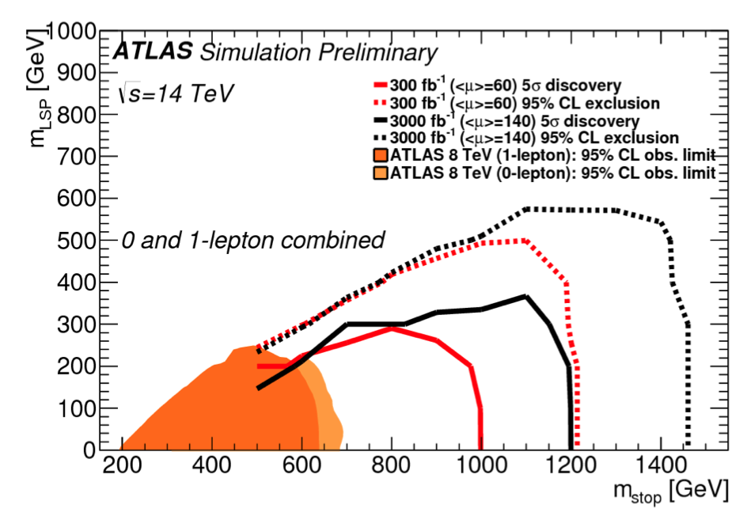
Outlook for new searches at the LHC
We have searched a diverse set of models / signatures in LHC Run 1, but see no striking signals of new physics in our data.
Unlike in the buildup to Run 1, we do not have a “no-lose theorem” (i.e. unitarity) heading into Run 2.
Top squark projections: ATLAS-PHYS-PUB-2013-011
However, we do have problems like dark matter and naturalness that point to new weak-scale physics we have yet to detect.
Run 2 will extend our mass reach by ∼2, and hopefully Run 3 and 4 will be dedicated to studying the new physics in detail!
Searches for BSM Physics @ LHC : M. Cooke (LBNL)
Slide 25

Slide 26
Summary Plots,
And other backup material

Slide 27
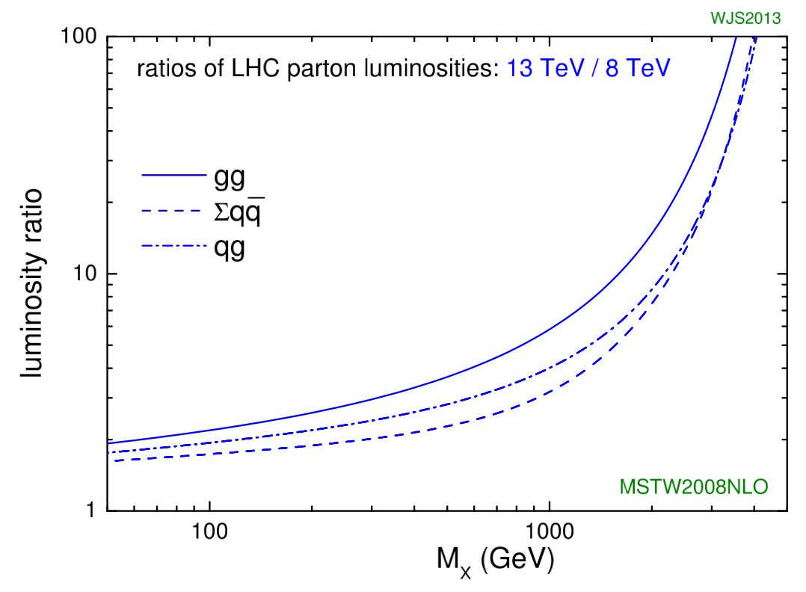
Slide 27

Slide 28
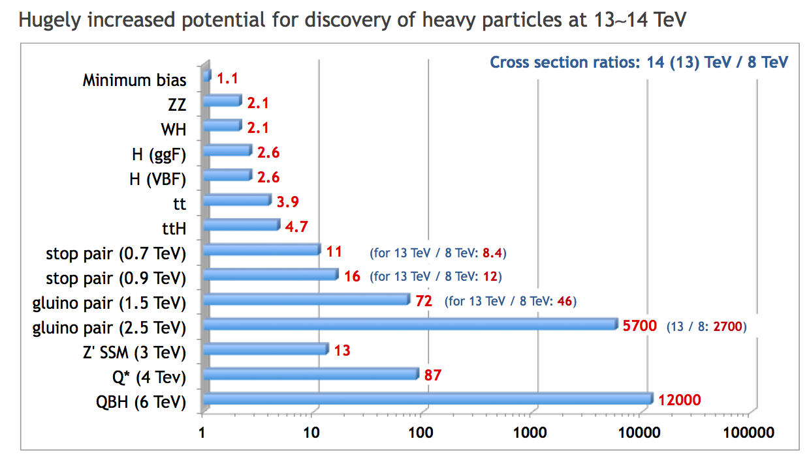
Slide 28

Slide 29
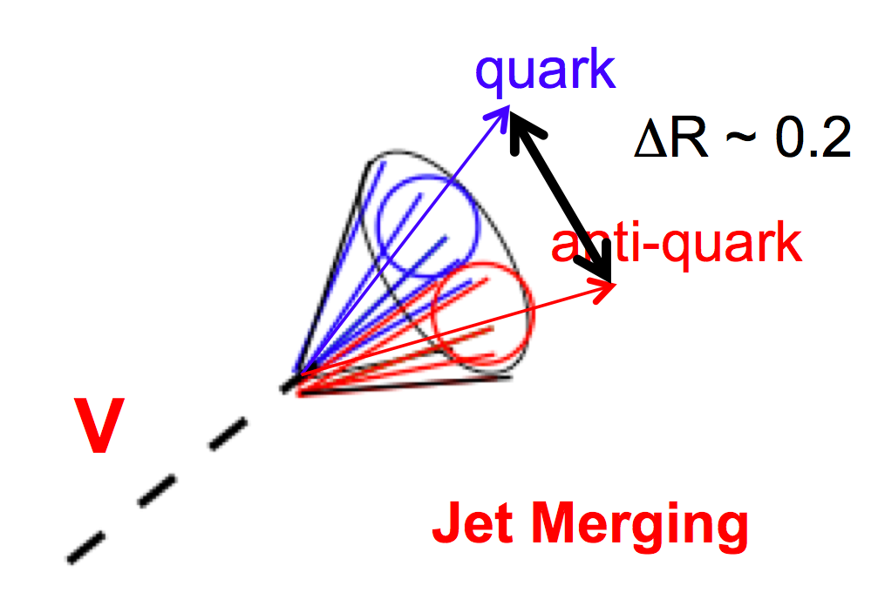
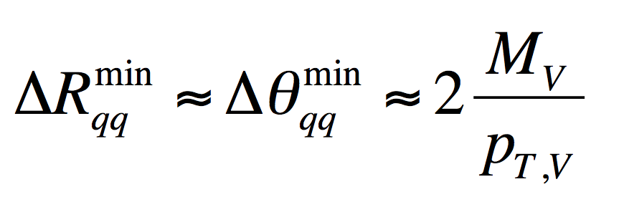
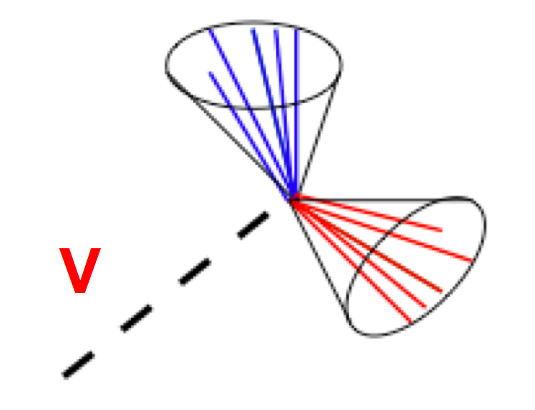
Boosted Boson Tagging
Slide 29

Slide 30
Example searches for non-prompt new phenomena
Search for pair produced long-lived neutral particles decaying in the ATLAS calorimeter: ATLAS-CONF-2014-041
Search for long-lived heavy particles in final states with a muon and a multi-track displaced vertex: ATLAS-CONF-2013-092
Search for long-lived stopped R-hadrons decaying out-of-time: ATLAS 1310.6584
Search for long-lived charged particles: CMS 1305.0491
Search for long-lived particles decaying to final states w/ leptons: CMS EXO-12-037
Search for long-lived neutral particles decaying to di-jets: CMS EXO-12-038
Search for displaced muonic lepton jets from a light Higgs boson: ATLAS 1210.0435
Search for heavy long-lived sleptons: ATLAS-CONF-2013-058
Slide 30

Slide 31
Links to public results
ATLAS Exotics:
https://twiki.cern.ch/twiki/bin/view/AtlasPublic/ExoticsPublicResults
ATLAS SUSY:
https://twiki.cern.ch/twiki/bin/view/AtlasPublic/SupersymmetryPublicResults
CMS Exotica:
https://twiki.cern.ch/twiki/bin/view/CMSPublic/PhysicsResultsEXO
CMS SUSY:
https://twiki.cern.ch/twiki/bin/view/CMSPublic/PhysicsResultsSUS
CMS B2G:
https://twiki.cern.ch/twiki/bin/view/CMSPublic/PhysicsResultsB2G
Slide 31

Slide 32
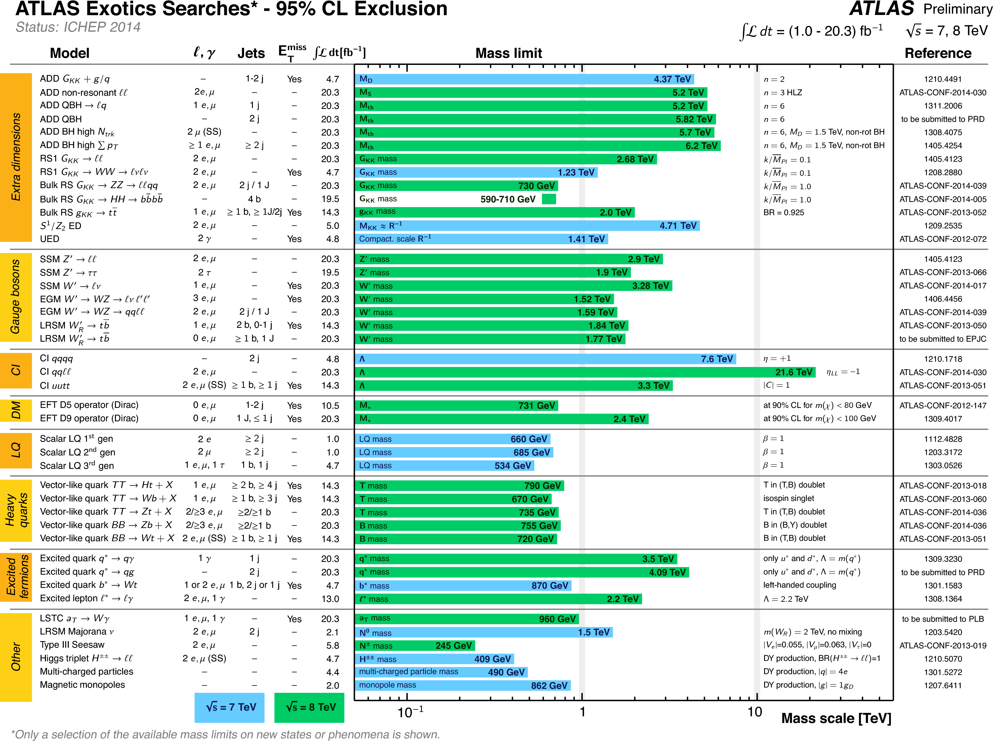

Slide 37
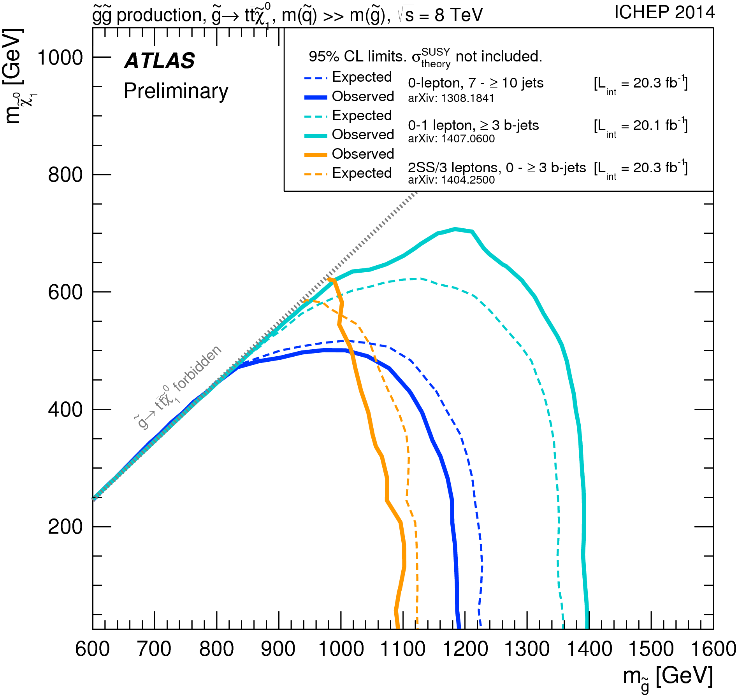
Gluino Summaries
Slide 37

Slide 38
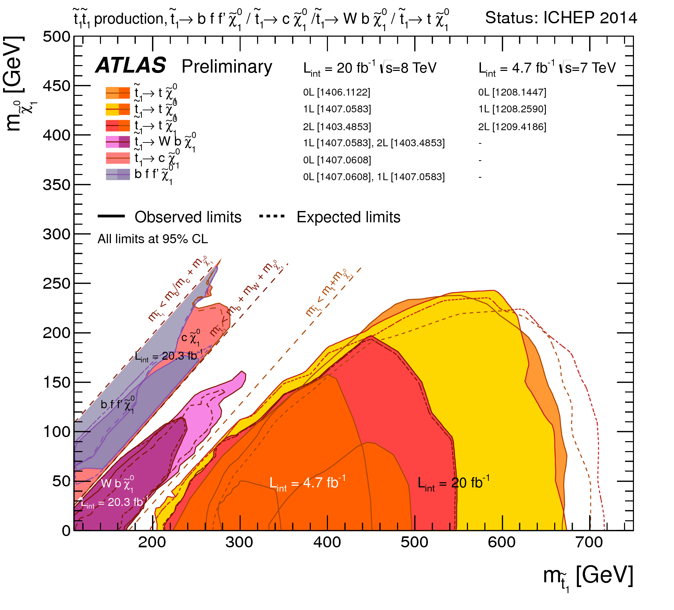
Stop (to neutralino) Summaries
Slide 38

Slide 39
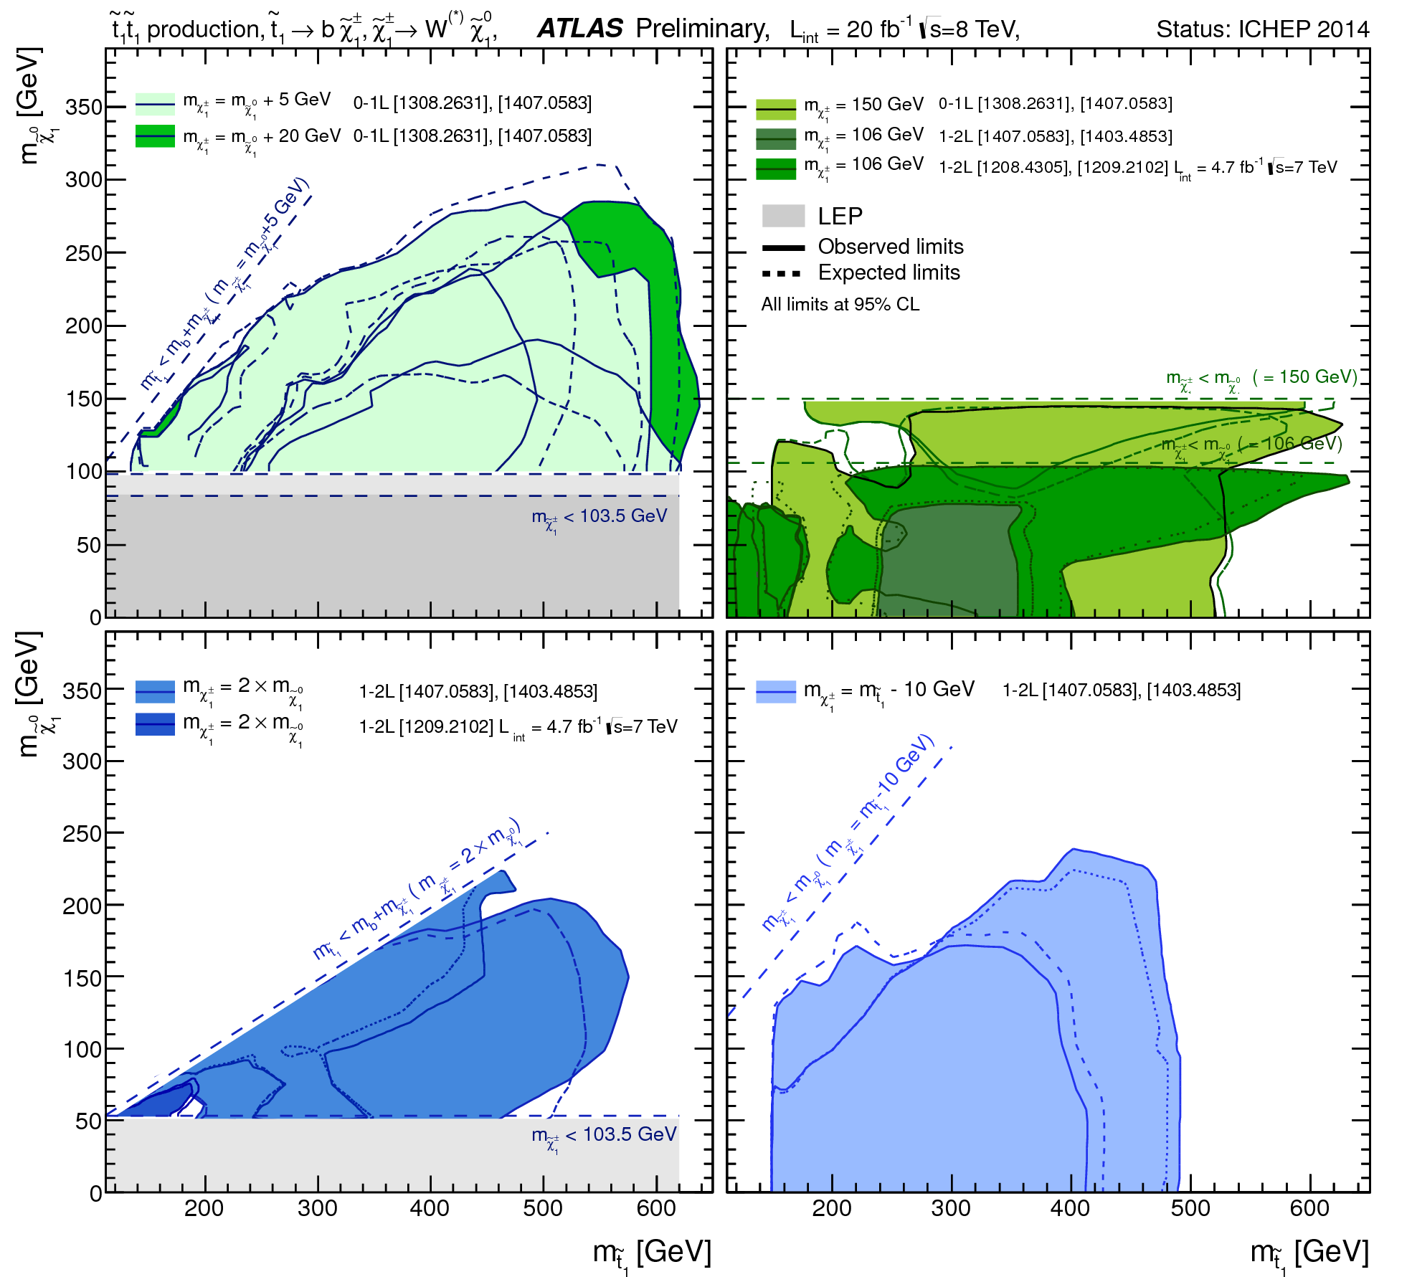
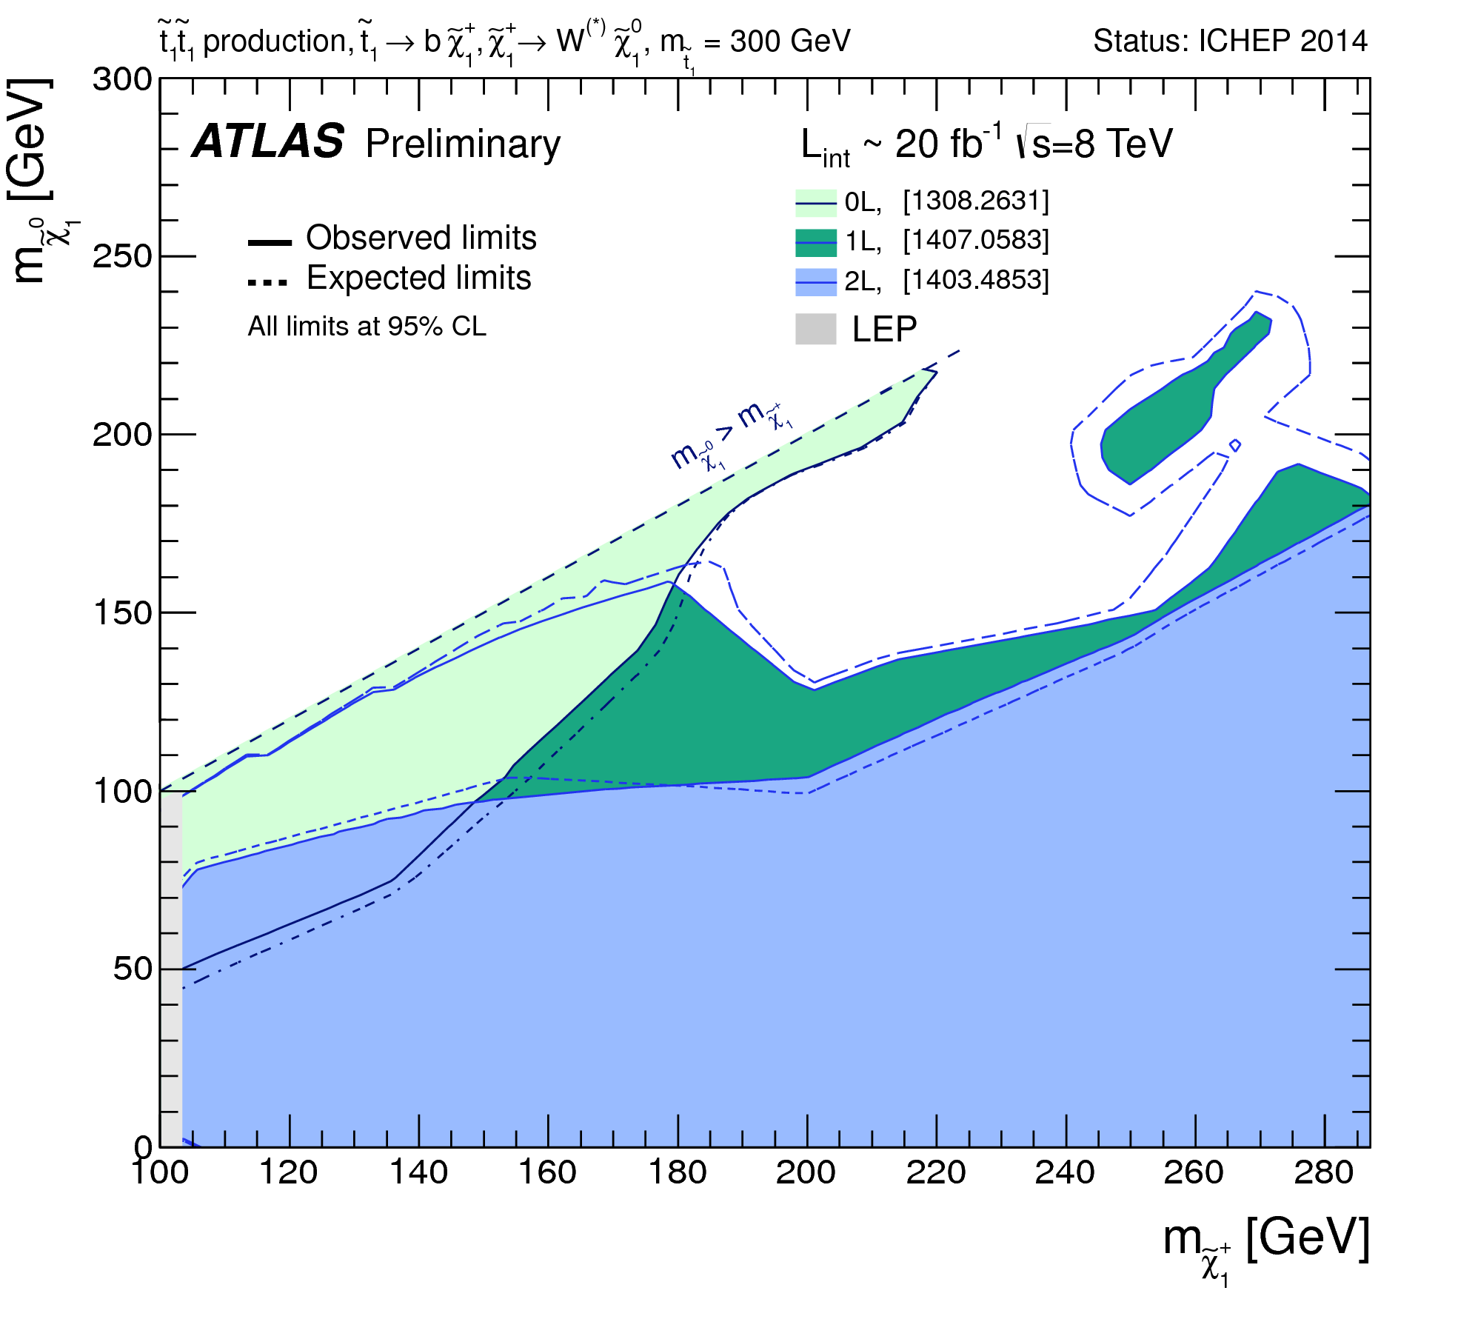
Stop (to chargino) Summaries
Slide 39

Slide 40
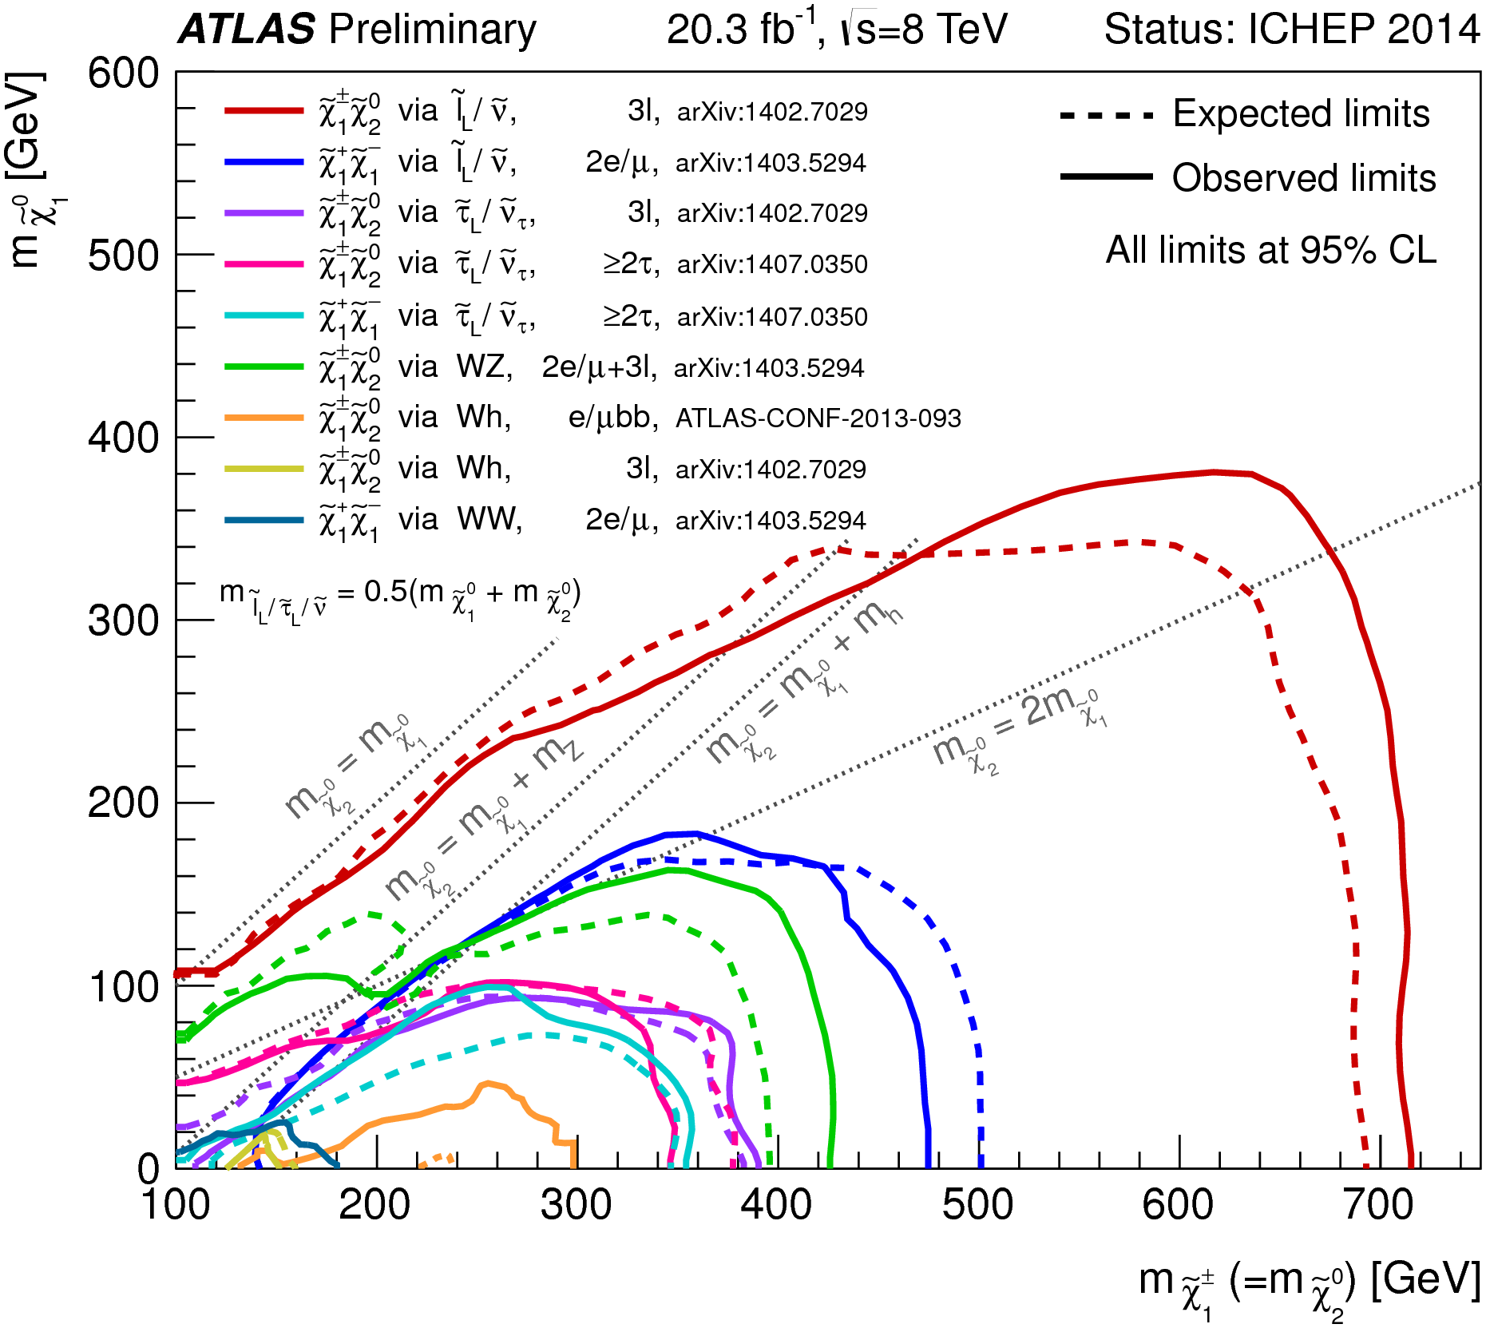
Chargino/neutralino Summaries
Slide 40

Slide 41
Vector-like Bottom Summaries
Slide 41

Slide 42
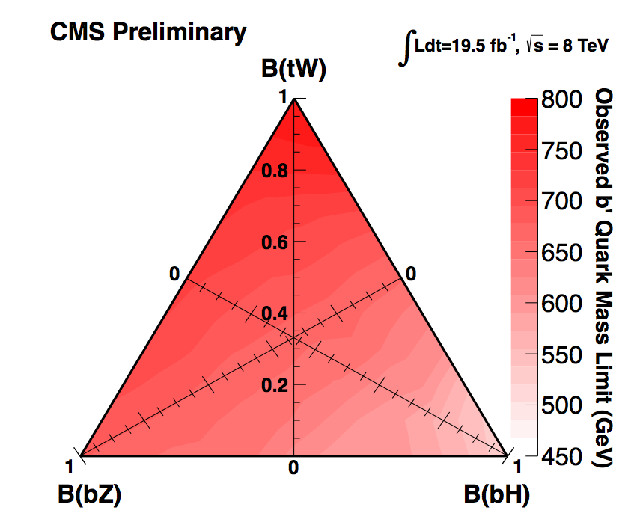
Vector-like Bottom Summaries
Slide 42

Slide 43
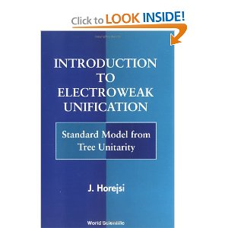
A nice, brief introduction to the electroweak theory, that arrives at the electroweak gauge theory, and the need for a Higgs-like scalar, through unitarity principles.
Slide 43

