Slide 1
Automated Computation of One-Loop Amplitudes
Darren Forde
(SLAC & UCLA)
Work in collaboration with C. Berger, Z. Bern, L. Dixon, F. Febres Cordero,
H. Ita, D. Kosower, D. Maître.
arxiv: 0803.4180 [hep-ph]

Slide 2
Overview – NLO Computations
Maximising discovery potential of the LHC ⇒ require NLO amplitudes,
Automation needed.
Automate computation of one-loop amplitudes using BlackHat
Many process required.
Generalised Unitarity.
On-shell recursion.
Typically of high multiplicity.
Computation of QCD Backgrounds.
Notes:
2

Slide 3
What do we need?
One-loop high multiplicity processes,
Newest Les Houches list, (2007)

Slide 4
What’s Been Done?
Using analytic and numerical techniques
  QCD corrections to vector boson pair production (W⁺W⁻, W±Z & ZZ) via vector boson fusion (VBF). (Jager, Oleari, Zeppenfeld)+(Bozzi)
  QCD and EW corrections to Higgs production via VBF. (Ciccolini, Denner, Dittmaier)
  pp→WW+j+X. (Campbell, Ellis, Zanderighi). (Dittmaier, Kallweit, Uwer)
  pp → Higgs+2 jets. (Campbell, Ellis, Zanderighi), (Ciccolini, Denner, Dittmaier).
  pp → Higgs+3 jets (leading contribution) (Figy, Hankele, Zeppenfeld).
  pp → ZZZ, pp → , (Lazopoulos, Petriello, Melnikov) pp → +(McElmurry)
  pp → ZZZ, WZZ, WWZ, ZZZ (Binoth, Ossola, Papadopoulos, Pittau),
  pp →W/Z (Febres Cordero, Reina, Wackeroth),
  gg → gggg amplitude. (Ellis, Giele, Zanderighi)
  6 photons (Nagy, Soper), (Ossola, Papadopoulos, Pittau), (Binoth, Heinrich, Gehrmann, Mastrolia)

Slide 5
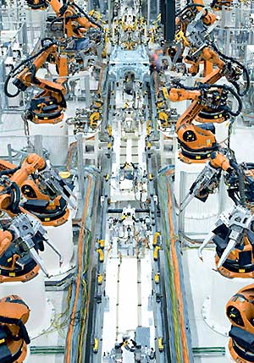
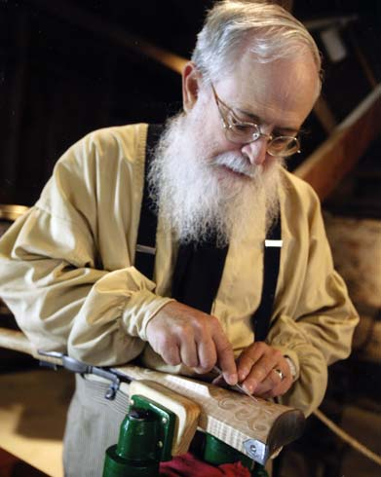
Automation
Large number of processes to calculate (for the LHC),
  Automatic procedure highly desirable.
We want to go from
Implement new methods numerically.
A_{n}(1⁻,2⁻,3⁺,…,n⁺), A_{n}(1⁻,2⁻,3⁻,..
A_{n}(1⁻,2⁻,3⁺,…,n⁺)

Slide 6
Towards Automation
Many different one-loop computational approaches,
  OPP approach – solving system of equations numerically, gives integral coefficients (Algorithm implemented in CutTools) (Ossola, Papadopoulos, Pittau), (Mastrolia, Ossola, Papadopoulos, Pittau)
  D-dimensional unitarity + alternative implementation of OPP approach (Ellis, Giele, Kunszt), (Giele, Kunszt, Melnikov)
  General formula for integral coefficients (Britto, Feng) + (Mastrolia) + (Yang)
  Computation using Feynman diagrams (Ellis, Giele, Zanderighi) (GOLEM (Binoth, Guffanti, Guillett, Heinrich, Karg, Kauer, Pilon, Reiter))
BlackHat (Berger, Bern, Dixon, Febres Cordero, DF, Ita, Kosower, Maître)

Slide 7
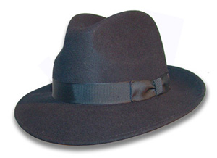
BlackHat
(Berger, Bern, Dixon, Febres Cordero,
DF, Ita, Kosower, Maître)
“Compact” On-shell inputs
Numerical implementation of the unitarity bootstrap approach in c++,
Tree amplitudes
On-shell recursion ⇒ Rational
One-loop Amplitude
Unitarity cuts
⇒ Cut-constructible
Rational building blocks
Much fewer terms to compute
& no large cancelations compared
with Feynman diagrams.

Slide 8
The unitarity bootstrap
Use the most efficient approach for each piece,
Log’s, Polylog’s, etc.
Loop amplitude
Rational terms
Unitarity cuts in 4
dimensions
On-shell recurrence relations
K₃
A₃
R_{n}
R_{<n}
A_{<n}
A₂
K₁
A₁
K₂
Recycle results of amplitudes with fewer legs

Slide 9
A simple idea
Function of a complex variable containing only simple poles. (Britto, Cachazo, Feng, Witten) (Bern, Dixon, Kosower)+(Berger, DF)
z
A_{n}(0)
Factorisation properties of amplitude give on-shell recursion.
Loop level?
Integrate over a
circle at infinity
Branch cuts
A_{n}
A_{<n}
A_{<n}
Unitarity techniques, gives loop cut pieces, C
Gives Rational pieces of loop, R

Slide 10
On-shell recursion relations
At one-loop recursion using on-shell tree amplitudes, T, and rational pieces of one-loop amplitudes, R,
Sum over all factorisations.
“Inf” term from auxiliary recursion.
Not the complete rational result, missing “Spurious” poles.
R_{n}
T
R
R
T
T
T

Slide 11
Spurious Poles
z
Shifting the amplitude by z ⇒ A(z)=C(z)+R(z)
  Poles in C as well as branch cuts e.g.
  Not related to factorisation poles s_{l…m},
  i.e. do not appear in the final result.
Cancel against poles in the rational part.
Use this to compute spurious poles from residues of the cut terms.
Location of all spurious poles, z_{s}, is know
  Poles located at the vanishing of shifted Gram determinants of boxes and triangles.

Slide 12
One-loop integral basis
Numerical computation of the “cut terms”.
A one-loop amplitude decomposes into
Compute the coefficients from unitarity by taking cuts
Apply multiple cuts, generalised unitarity. (Bern, Dixon, Kosower) (Britto, Cachazo, Feng)
Want these coefficients
Rational terms,
from recursion.
1-loop scalar integrals (Ellis, Zanderighi) , (Denner, U. Nierste and R. Scharf),
(van Oldenborgh, Vermaseren) + many others.
Glue together tree
amplitudes

Slide 13
Box Coefficients
Quadruple cuts freeze the integral ⇒ coefficient (Britto, Cachazo, Feng)
Box Gram determinant appears in the denominator.
Spurious poles will go as the power of l^{μ} in the integrand.
In 4 dimensions 4 integrals
⇒
4 delta functions
l
l₁
l₃
l₂

Slide 14
Two-particle and triple cuts
What about bubble and triangle terms?
Triple cut ⇒ Scalar triangle coefficients?
Two-particle cut ⇒ Scalar bubble coefficients?
Disentangle these coefficients.
Additional coefficients
Isolates a single triangle

Slide 15
Bubbles & Triangles
Compute the coefficients using different numbers of cuts
Analytically examining the large value behaviour of the integrand in these components gives the coefficients (DF) (extension to massive loops (Kilgore))
Modify this approach for a numerical implementation.
Depends upon unconstrained components of loop momenta.
Quadruple cuts, gives box coefficients

Slide 16
Triangle coefficients
(del Aguila, Ossola, Papadopoulos, Pittau), (DF)
Apply a triple cut.
Cut integrand, T₃, as a contour integral in terms of the single unconstrained parameter t
Subtract box terms.
Discrete Fourier projection to compute
Cut momentum parameterisation
Previously computed from quadruple cut
t
Pole ⇒ Additional propagator ⇒ Box
Triangle Coeff
Different uses of DFP (Britto, Feng, Mastrolia), (Mastrolia, Ossola, Papadopoulos, Pittau)

Slide 17
Bubble coefficients
Apply a two-particle cut.
Two free parameters y and t in the integrand B₂.
  Contour integral in terms of t (with y[0,1]) now contains poles from triangle & box propagators.
Subtract triple-cut terms (previously computed).
Compute bubble coefficient using
Cut momentum parameterisation
t
Pole ⇒ Additional propagator
⇒ Triangle/Box

Slide 18
Numerical Spurious pole extraction
Numerically extract spurious poles, use known pole locations.
Expand Integral functions at the location of the poles, Δ_{i}(z)=0, e.g.
The coefficient multiplying this is also a series in Δ_{i}(z)=0, e.g.
Numerically extract the 1/Δ_{i} pole from the combination of the two, this is the spurious pole.
Box or triangle
Gram determinant

Slide 19
Numerical Stability
Use double precision for majority of points ⇒ good precision.
For a small number of exceptional points use higher precision (up to ~32 or ~64 digits.)
Detect exceptional points using three tests,
  Bubble coefficients in the cut must satisfy,
  For each spurious pole, z_{s}, the sum of all bubbles must be zero,
  Large cancellation between cut and rational terms.
Box and Triangle terms feed into bubble, so we test all pieces.

Slide 20
MHV results
Precision tests using 100,000 phase space points with cuts.
  E_{T}>0.01√s.
  Pseudo-rapidity η>3.
  Δ_{R}>4,
No tests
Log₁₀ number of points
Apply tests
Precision
Recomputed higher precision

Slide 21
NMHV results
Other 6-pt amplitudes are similar
Log₁₀ number of points
Precision

Slide 22
More MHV results
Again similar results when increasing the number of legs
Log₁₀ number of points
Precision

Slide 23
Timing
On a 2.33GHz Xenon processor we have
The effect of the computation of higher precision at exceptional points can be seen.
Computation of spurious poles is the dominant part.
Helicity | Cut part Only | Full double prec. | Full Multi prec.
--++++ | 2.4ms | 6.8ms | 8.3ms
--+++++ | 4.2ms | 10.5ms | 14ms
--++++++ | 6.1ms | 28ms | 43ms
-+-+++ | 3.1ms | 17.3ms | 24ms
-++-++ | 3.3ms | 60ms | 76ms
---+++ | 4.4ms | 12ms | 16ms
--+-++ | 5.9ms | 42ms | 48ms
-+-+-+ | 6.9ms | 62ms | 80ms

Slide 24
Conclusion
First results
Future work
BlackHat
Include fermions and vector bosons.
Uses the unitarity bootstrap to numerically compute one loop amplitudes.
Multiple gluon amplitudes.
Massive particles.
Combine into full NLO corrections.
Good control of numerical instabilities.
Control of exceptional points.
Reasonable speed.

