Slide 1



Belle and Belle II
Akimasa Ishikawa
(Tohoku University)
akimasa@epx.phys.tohoku.ac.jp

Slide 2
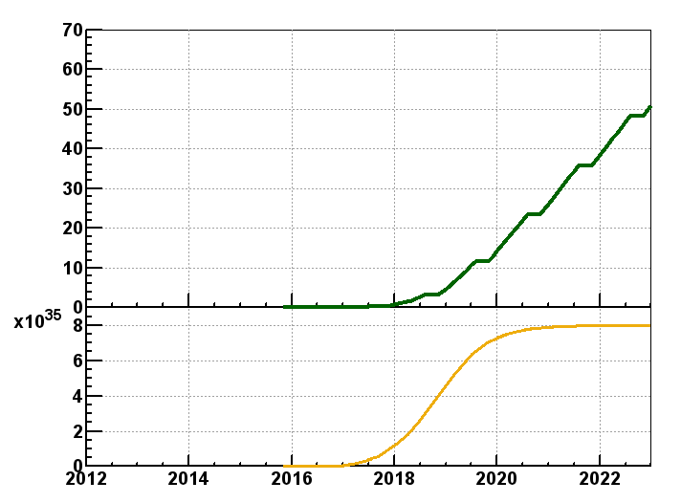
Belle II Schedule
Start from Oct 2016
  But not on Y(4S) but on Y(nS) since PID detector (TOP) is not fully ready
50ab⁻¹ by the end of 2022
50ab⁻¹
Goal of Belle II/SuperKEKB
Integrated luminosity
(ab⁻¹)
9 months/year
20 days/month
Commissioning starts
in early 2015.
Shutdown
for upgrade
Peak luminosity
(cm⁻²s⁻¹)
Calendar Year

Slide 3
Contents
b→sll
Other EWP measurements
What is missing ?
Measurements improve LHCb results and Theory predictions

Slide 4
b→sl⁺l⁻
LHCb will do almost everything in exclusive all charged final states with dimuon
  B→K*⁰(K⁺π⁻)μμ
  B→K⁺μμ
  We can not have comparable sensitivities for these measurements.
What e⁺e⁻ B-factory can do more than or equal to LHCb are
  Ks and π⁰ detection
    Semi-inclusive Measurements : B→Xsll
    Isospin Asymmetry : B→K*⁰(K⁺π⁻)ll VS B→K*⁺(K⁺π⁰, Ksπ⁺)ll
  Sensitivity of electron modes are almost same as muon modes
    Lepton Flavor Universality : B→K ee VS B→K μμ
  Tau with hadronic tagging??
    B→K⁽*⁾ττ

Slide 5
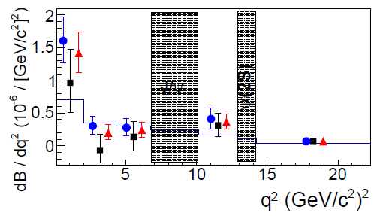
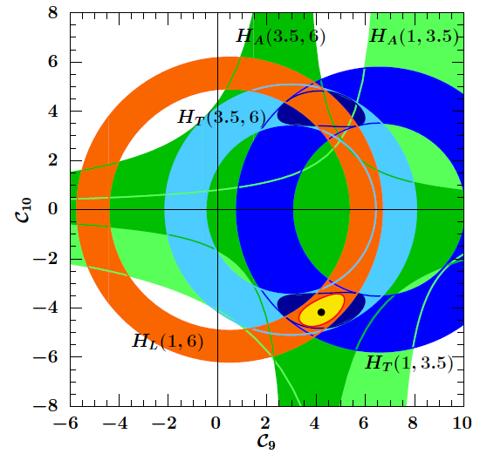
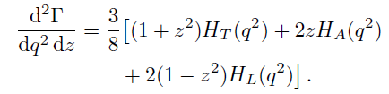
Near Future b→sll Measurements1
Not guaranteed
Order of probability
B→Xsll
  BF and dBF/dq²
    Recently Babar published final result.
  Ratio of BFs of B→Xsee to B→Xsμμ
    Sensitive to A⁰ in NMSSM at large tanβ
  CP and Isospin Asymmetries
  Angular decomposition
    Longitudinal : H_{L}
    transverse : H_{T}, H_{A}
No suppression
G. Hiller
Phys. Rev. D70 (2004) 034018,
K.S.M. Lee et al, Phys. Rev. D 75, 034016

Slide 6
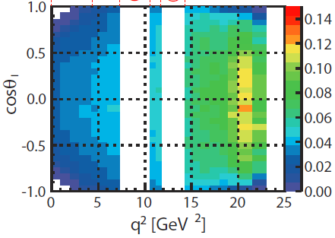
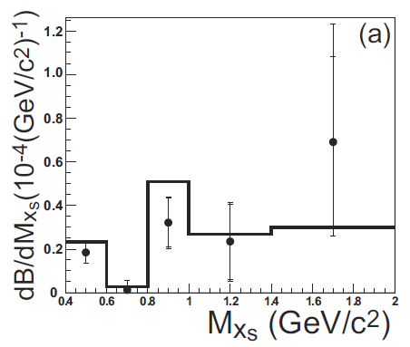
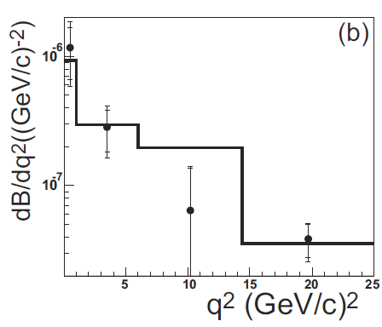
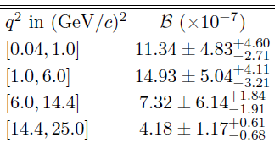
B→Xsl⁺l⁻ with 140fb⁻¹
Efficiency in Electron modes
For A_{FB} analysis
Selections
  18 hadronic modes cover 78% of Xs decays
  p_{lab}^{e} > 0.4GeV
  p_{lab}^{μ} > 0.8GeV
  M_{Xs} < 2.0GeV

Slide 7
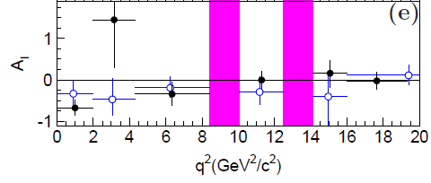

Near Future b→sll Measurements2
Not guaranteed
Order of probability
B→Kll and K*ll
  BF and dBF/dq²
    But this is just cross check of LHCb results with smaller statistics.
  Ratio of BFs of B→Xsee to B→Xsμμ
  CP and Isospin Asymmetries
  ? Full angular analysis
  ? Very low q² region (<1GeV²) in K*ee for a measurement of virtual photon helicity
    C₇’
    Lower q² region, larger events and larger sensitivity.
      Muon modes in low q² is not high sensitivity.
    Cut on q² > (140MeV)² to suppress pi0 Dalitz decay background
      10events with 600fb⁻¹
    Other analyses, TCPV in K*γ and A_{UD} in Kππγ, can search for right handed current
600fb⁻¹
Y. Grossman and D. Pirjol, J. High Energy Phys. 06 (2000) 029

Slide 8


Uncertainties at Belle and Belle II
  Unofficial numbers
  Please not refer in your paper
Stat + syst | 711fb⁻¹ | 5ab⁻¹ | 50ab⁻¹
B(B→Xsl+l-) | 8% + 9% | 3% + 8% | ---
N(B→Xsl+l-) events | 400events | 2800events | 28000events
B(B→Xsl+l-) in 1<q²<6GeV² | 12% + 15% | 5% + 10% | ---
B(B→Xsl+l-) in q²>14.4GeV² | 10% + 15% | 4% + 9% | ---
High q² region is easier to reduce syst errors since efficiency in q² VS cos(theta)is almost flat and high M_{Xs} events are suppressed.
With 50ab⁻¹, we should try other method than semi-inclusive, or try higher M_{Xs} cut
  Fully inclusive?
Babar full data

Slide 9
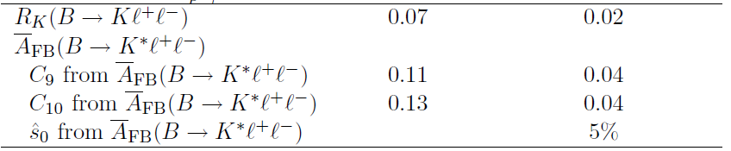
Belle II Sensitivities to b→sll Measurements
13%
C₉ and C₁₀ sensitivities are assumed that no theoretical uncertainties and whole q² region except J/psi and psi’ can be used.
B→K*l+l-
  1800events for 5ab⁻¹
  18000events for 50ab⁻¹
R_{K}=BF(B→Kee)/BF(B→Kmm)
Extrapolation from Belle
Need to update with Belle II software

Slide 10
Other EWP Measurements
b→(s,d)γ
  Branching fraction of inclusive and exclusive decays
  Time dependent CPV in B→K*⁰(Ksπ⁰)γ, ρ⁰γ, ω⁰γ
    Search for right handed current
  CP and isospin Asymmetries
b→sνν
  BF of B→K⁽*⁾νν with hadronic tagging
  25% enchancement in U. Haisch’s model
    Error of BF due to uncertainties in exp and theo should be less than 5%
b→dl⁺l⁻
  Search for B → π⁰ l⁺l⁻, B → ρ⁺ l⁺l⁻
  If found, Isospin and CPV
Bs, B → γγ
Bs, B → ττ

Slide 11
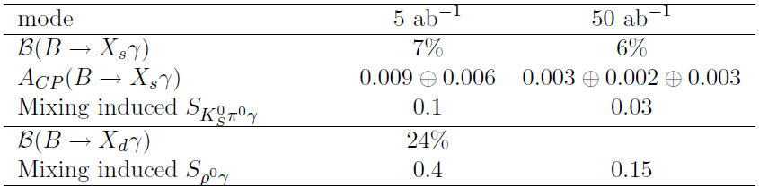
Belle II Sensitivities for EWP Measurements
B→Kνν observation with 5~10ab⁻¹ →20% stat uncertainty (improvements of tracking and tagging method assumed)
  Assuming the BFs
  With 50ab⁻¹, 7%~10% stat uncertainty?
Bs → γγ
  Can be observed with ~600fb⁻¹
Extrapolation from Belle
Need to update with Belle II software
  BF(B_{s} → γγ ) = (0.3−1.0)×10⁻⁶

Slide 12
What is missing?
If you propose something to measure/search but not done at Belle (and Babar), please let me know.
akimasa@epx.phys.tohoku.ac.jp

Slide 13
Measurements Improve LHCb results and Theory Predictions
Normalization modes used at LHCb
  BF(B→J/psi K), BF(B→J/psi K*)
  f₊₋/f₀₀ is the key measurement for these
    f₊₋ = BF( Y(4S) → B⁺B⁻ )
Test of form factors
  Semileptonic decays, dBF/dq² (B → (π,ρ,ω, ππ) l ν )
    |Vub| Inclusive VS exclusive problem?
  Tensor FF at q²=0, BF( B→K*γ ), BF( Bs →φγ )
BFs of B→K(*) + resonances which decay to dilepton measured with other modes
  B→K⁽*⁾ psi(3770), psi(3770)→DD (and other higher charmonium)
  B→K⁽*⁾ phi, phi→KK
  B→K⁽*⁾ ρ, ρ→ππ
  B→K⁽*⁾ ω, ω→πππ⁰
  B→K⁽*⁾ eta, eta→πππ⁰, γγ

Slide 14
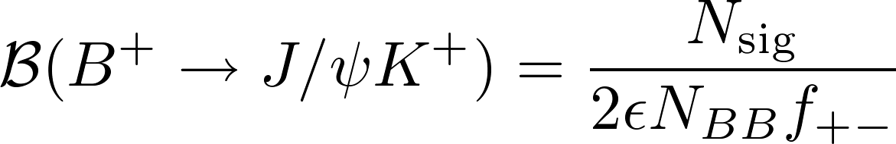
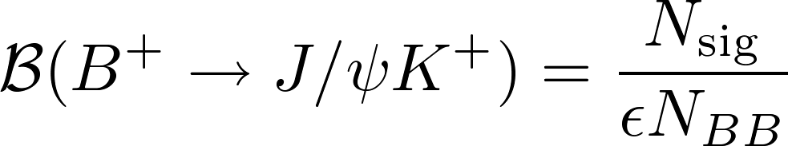
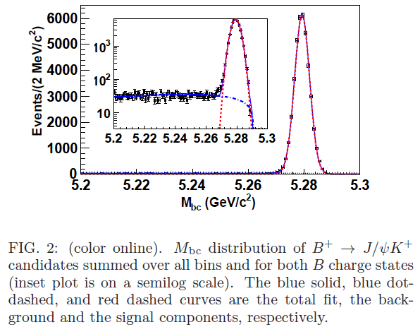
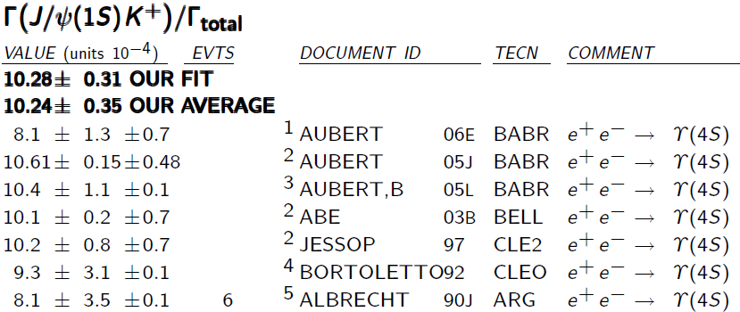
B→J/psi K⁺ at Belle
We measured A_{CP}(B→J/psi K⁺) at Belle with full data.
About 40k events are reconstructed with S/N >> 1, so statistical error of the signal yield (Nsig) should about 0.5%, and the systematic error is less than 1%.
Systematic errors in effciency (ε) is about 1%, and could be improved at Belle II
But the problem is uncertainty of number of B⁺ mesons produced.
  N_{BB} f₊₋
    N_{BB} could be measured with less than 1% using better event shape variables

Slide 15
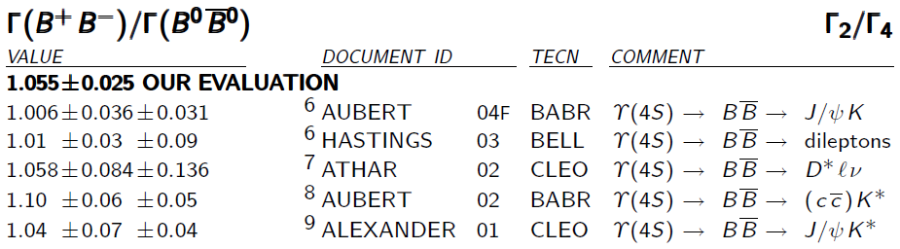
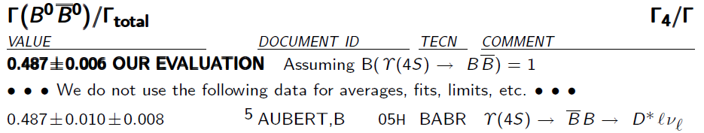
f₊₋/f₀₀
The error is about 2.5%. Need to reduce the error.
Further problem, the measurement used J/psi K⁽*⁾ assuming Isospin symmetry. Other methods should be used.
Babar measured f₀₀ with the ratio of single semileptonic decays (B→D*lν, B→anything) and double semileptonic decays. Belle (II) and Babar can improve the measurements
  If we assume f₀₀+ f₊₋ = 1, uncertainty of f₊₋ could be 1% level.
  f₊₋ can be measured with the same technique.
Uncertainty of BF(B→J/psi K⁺) could be ~2% (but more than 1%).

Slide 16
Measurements Improve LHCb results and Theory Predictions
Normalization modes used at LHCb
  BF(B→J/psi K), BF(B→J/psi K*)
  f₊₋/f₀₀ is the key measurement for these
    f₊₋ = BF( Y(4S) → B⁺B⁻ )
Test of form factors
  Semileptonic decays, dBF/dq² (B → (π, ρ, ω, ππ) l ν )
    |Vub| Inclusive VS exclusive problem?
  Tensor FF at q²=0, BF( B→K*γ ), BF( Bs →φγ )
BFs of B→K(*) + resonances which decay to dilepton measured with other modes
  B→K⁽*⁾ psi(3770), psi(3770)→DD (and other higher charmonium)
  B→K⁽*⁾ phi, phi→KK
  B→K⁽*⁾ ρ, ρ→ππ
  B→K⁽*⁾ ω, ω→πππ⁰
  B→K⁽*⁾ eta, eta→πππ⁰, γγ

Slide 17
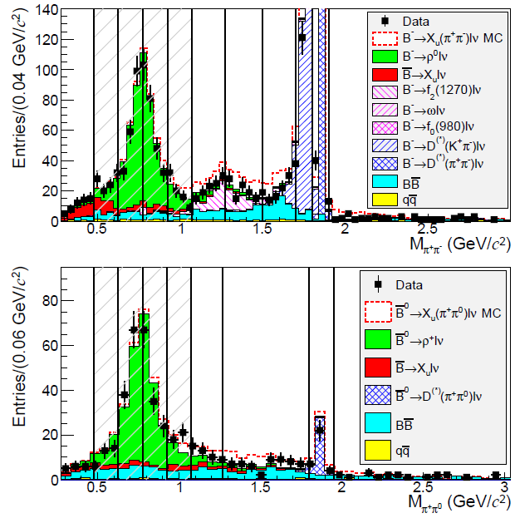

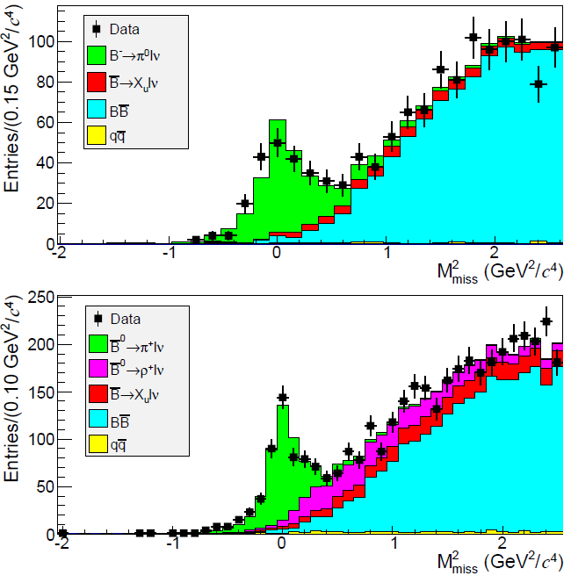
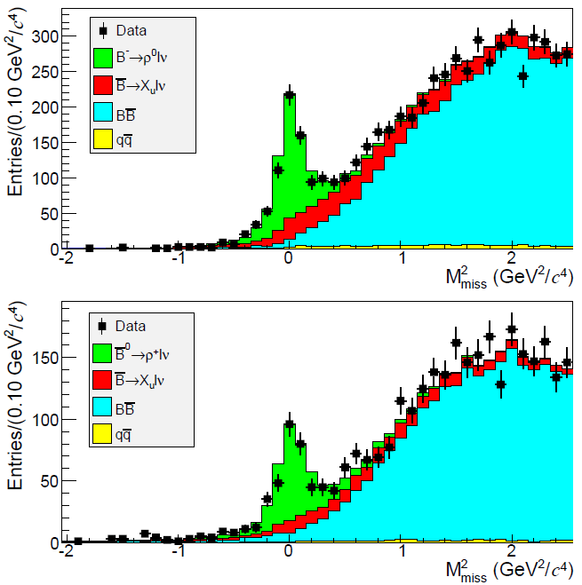
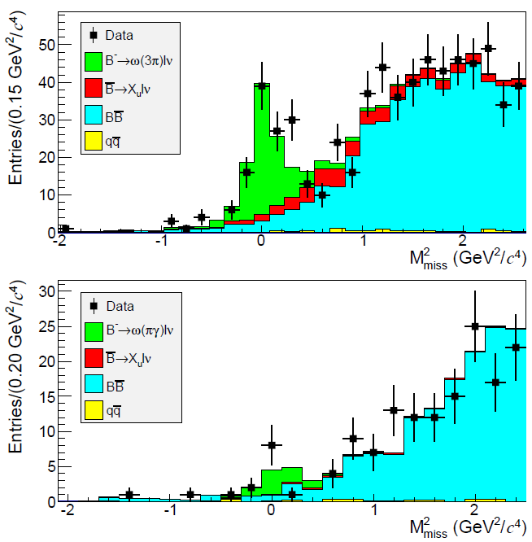
Exclusive B→(π⁺,π⁰,ρ⁺,ρ⁰,ω)lν with hadronic tag
PRD 88, 032005 (2013)
We can test FFs using exclusive b→ulν
6 final states are analyzed simultaneously
missing mass consistent with 0
Also m_{ππ} spectrum measured
Extract FFs assuming |Vub|
  Or shape of FFs can be determined.
π⁰lν
ρ⁰lν
ω(◊3π)lν
π⁺lν
ρ⁺lν
ω(◊π⁰γ)lν

Slide 18
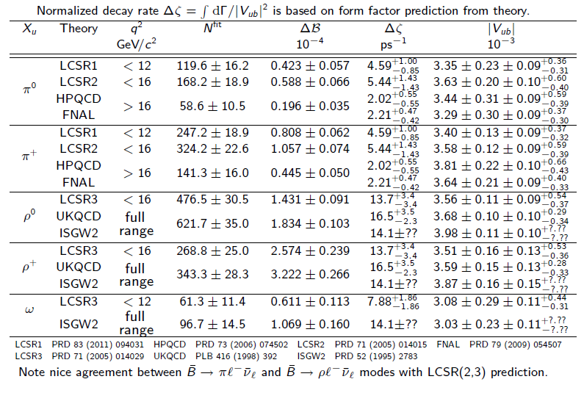
Uncertainty in |V_{ub}| from exclusive B→X_{u}lν
PRD 88, 032005 (2013)
δ|V_{ub}| from exp. is less than 10% with single measurement, and smaller than FFs → can use to test FFs.

Slide 19
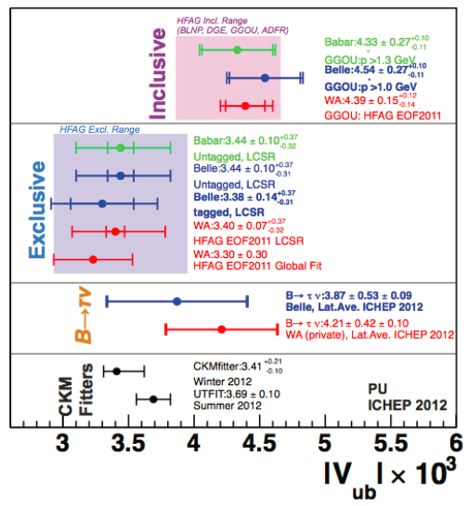
|Vub| : Inclusive VS Exclusive
~3 sigma discripancy.
Same tendency for Babar and Belle
Can we trust FFs or inclusive prediction?
This problem should be solved to understand B→light FFs.
|V_{ub}|

Slide 20
Measurements Improve LHCb results and Theory Predictions
Normalization modes used at LHCb
  BF(B→J/psi K), BF(B→J/psi K*)
  f₊₋/f₀₀ is the key measurement for these
    f₊₋ = BF( Y(4S) → B⁺B⁻ )
Test of form factors
  Semileptonic decays, dBF/dq² (B → (π,ρ,ω, ππ) l ν )
    |Vub| Inclusive VS exclusive problem?
  Tensor FF at q²=0, BF( B→K*γ ), BF( Bs →φγ )
BFs of B→K(*) + resonances which decay to dilepton measured with other modes
  B→K⁽*⁾ psi(3770), psi(3770)→DD (and other higher charmonium)
  B→K⁽*⁾ phi, phi→KK
  B→K⁽*⁾ ρ, ρ→ππ
  B→K⁽*⁾ ω, ω→πππ⁰
  B→K⁽*⁾ eta, eta→πππ⁰, γγ

Slide 21
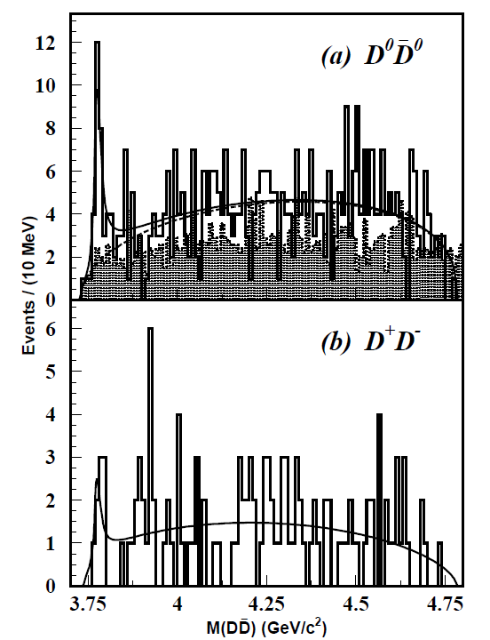
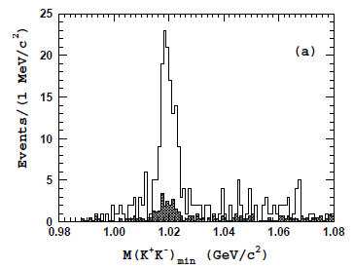
B→psi(3770)K⁺, B→φK
Following psi(3770)→DD, φ→KK Measured
If other experiment (like BESS-III) provides the BF of higher cc→DD nπ, we can measure the BF also.
88fb⁻¹
KK
140fb⁻¹

Slide 22
Summary
LHCb did and will do a very good job for exclusive b→sμμ decays.
We can perform the b→sll measurements not easy at LHCb
  Ks, pi0, electron, tau?
Other EWP modes also important.
We can improve LHCb results and Theory predictions.

