Slide 1
Overview: HTS4Fusion Workshop

Slide 2
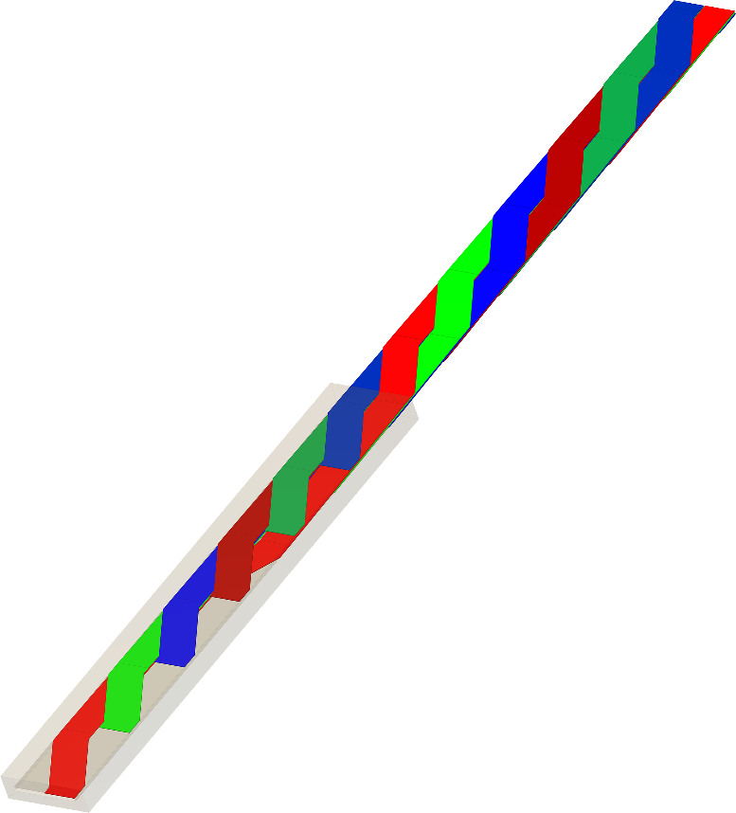
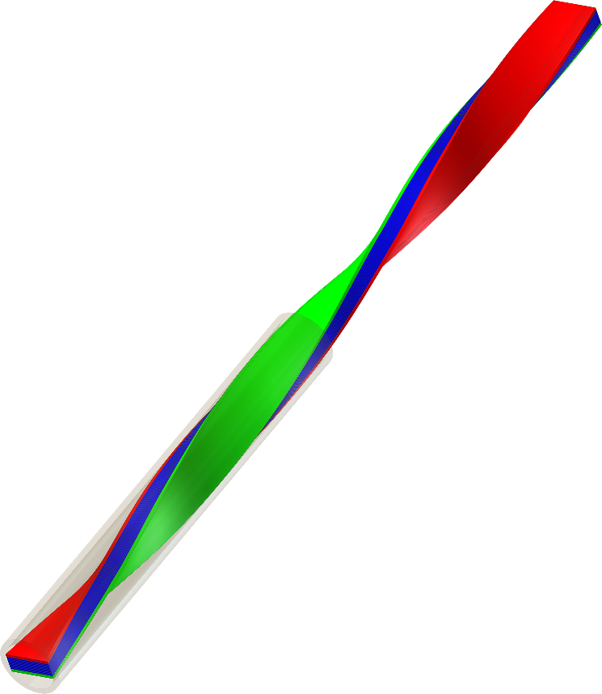
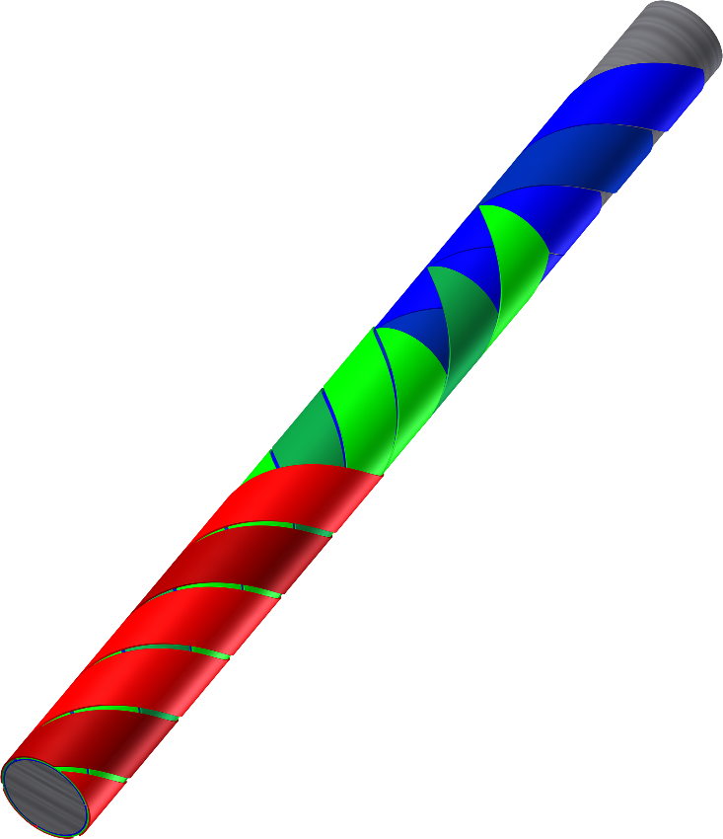
HTS cables
Three main options of tape alignment
Roebel bars → RACC cable
Twisted stacks of tapes → TSTC
Helical → CORC cable
 | RACC | TSTC | CORC
transposition | complete | partial | partial
J_{e} | high | medium | low
tape consumption | high | low | medium

Slide 3
HTS cables: topics
Bending
Mechanical properties
Joints & contacts
Automatic manufacturing
Performance at high fields
Scaling to high currents
AC losses

Slide 4

Roebel Assembled Coated Conductor (RACC) cable

Slide 5
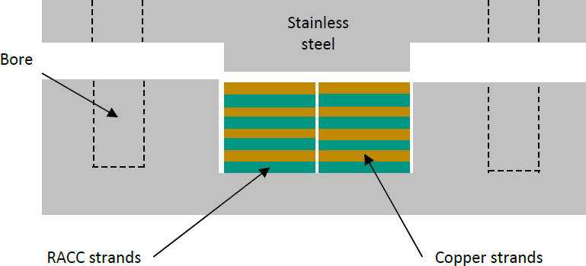
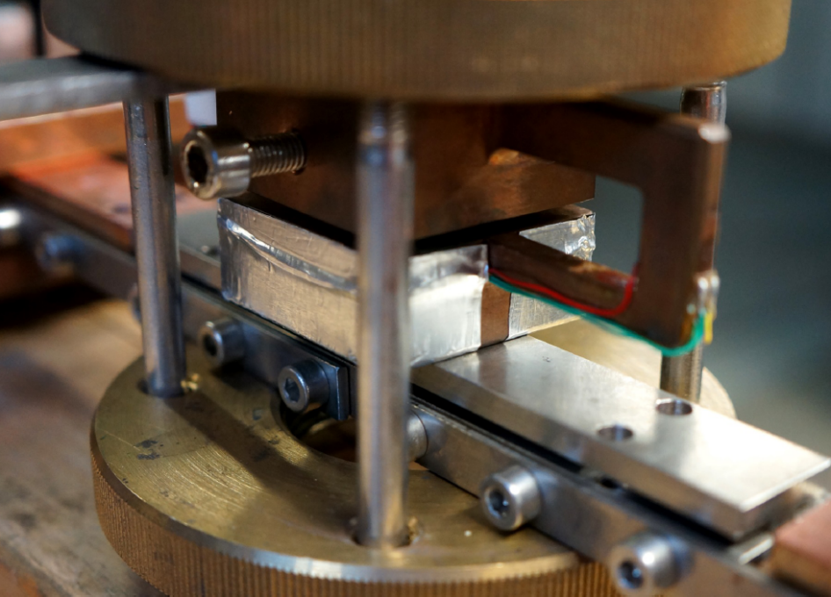
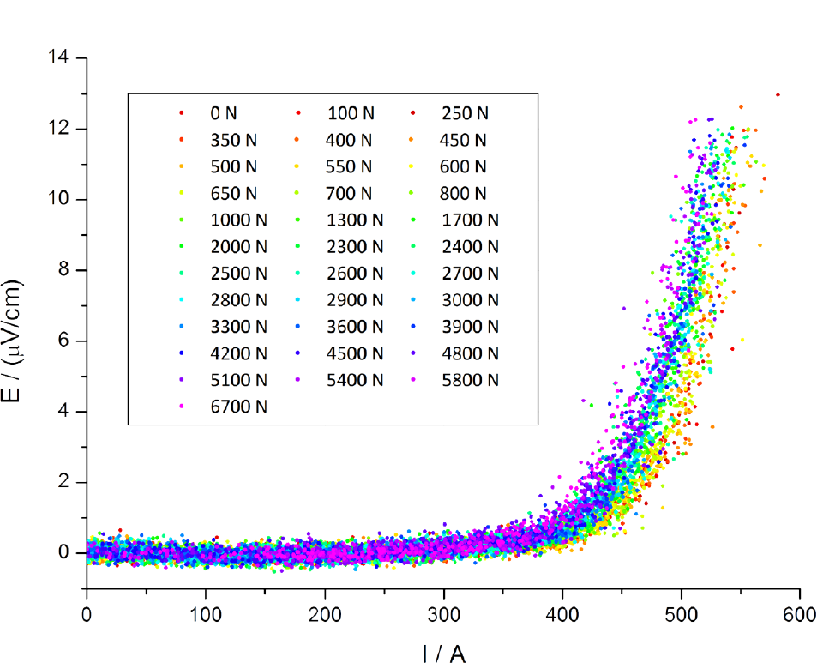
RACC: perpendicular pressure
Applying pressure on RACC cables
6.7 kN → 14 – 43 MPa (contact surface undef.)
10 % reversible I_{c} reduction
Bayer et al. (KIT)

Slide 6
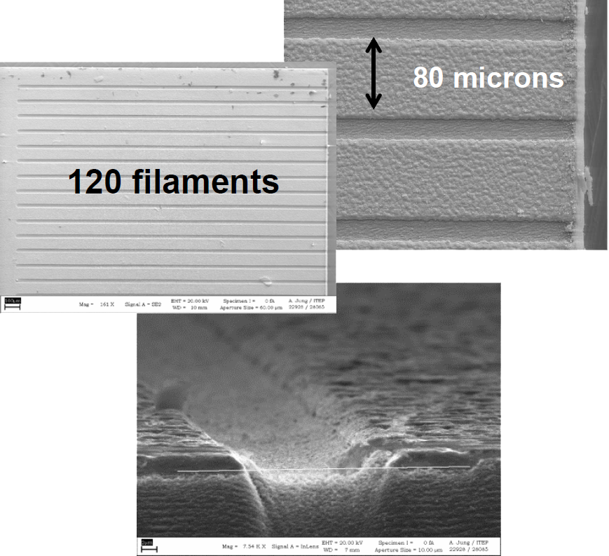
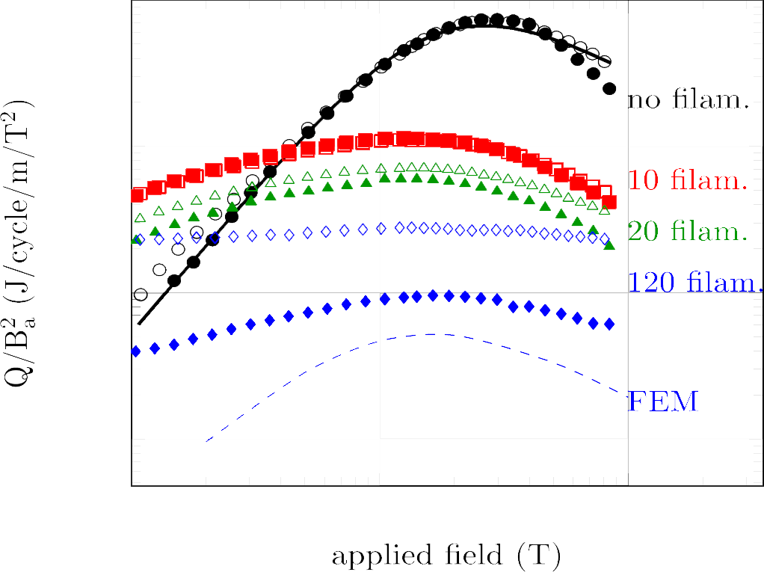
RACC: striations
Improving effect of striations
Cu deposition after laser cut
  couples filaments
  higher AC losses (open symbols)
Heat treatment in O₂
  decouples filaments
  reduces AC losses (closed symbols)
Goldacker et al. (KIT)

Slide 7
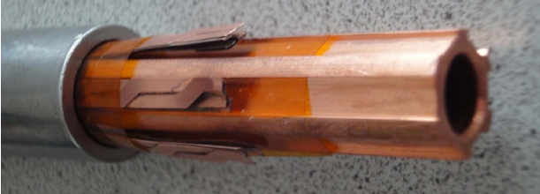
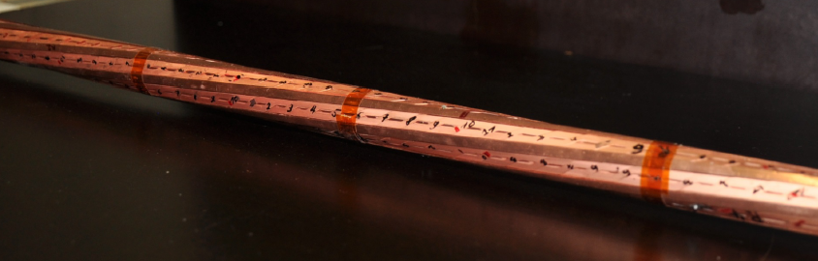
RACC: round Rutherford
Construction & test of fully equipped 1.4 m model cable
6 Roebel strands, 10 tapes each (4 mm wide, from IRL)
77 K self-field:
  I_{c}: 2.5 kA
  J_{c,e}: 1.1 kA/cm⁻²
  inhomogeneous
  distribution
  delamination
Goldacker et al. (KIT)

Slide 8



Twisted Stacked-Tape Cable (TSTC)

Slide 9
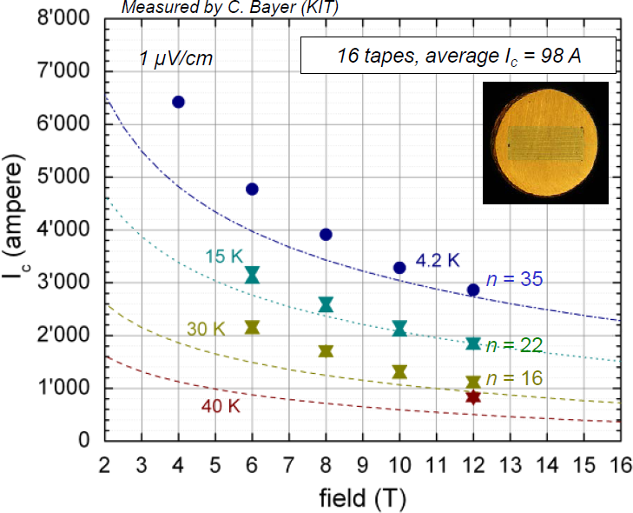
TSTC: I_{c}(B, T)
I_{c} at high perp. field and low temp.
better than expectations:
> average I_{c} of tape * number of tapes * lift factor
Uglietti et al. (CRPP)

Slide 10
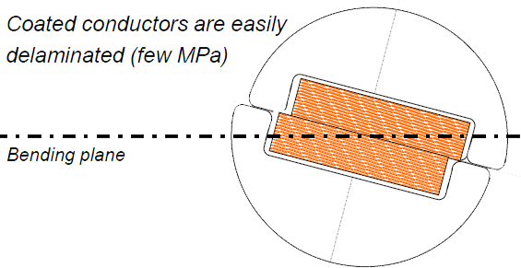
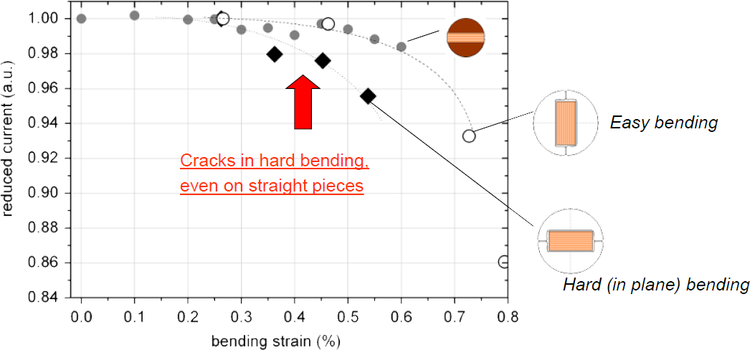
TSTC: bending
Isotropic bending
Easy bending (out of plane): limit: 0.55% strain
Hard bending (in plane): limit: 0.25% strain → 1.6 m Ø
  → delamination
Uglietti et al. (CRPP)

Slide 11
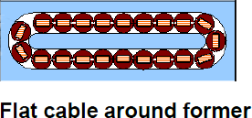
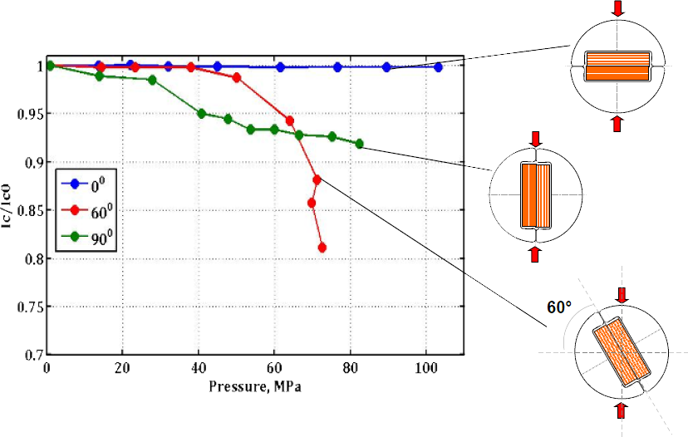
TSTC: transverse pressure
I_{c} vs transverse pressure
Isotropic
Limit in worst case (90 °): 30 MPa
Lower layer of flat cable (15 T, 3 kA per strand): 15 MPa
Uglietti et al. (CRPP)

Slide 12
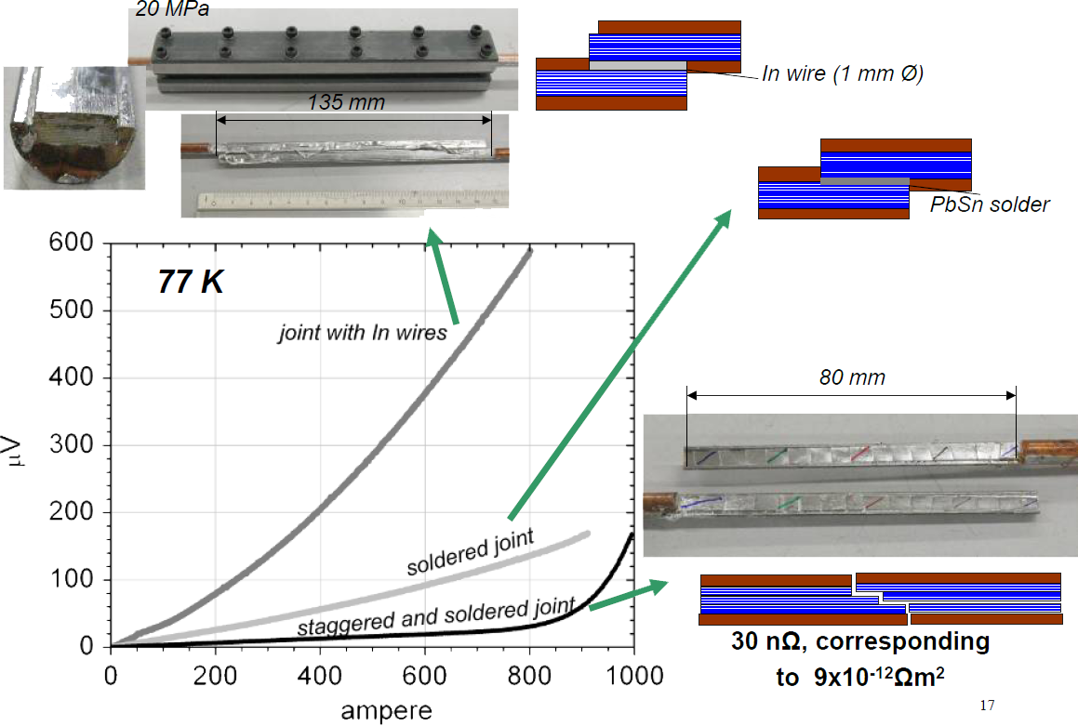
TSTC: joints
Fabrication and test of different types of joints
Uglietti et al. (CRPP)

Slide 13
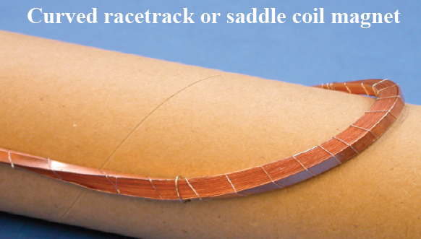
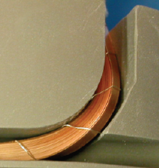
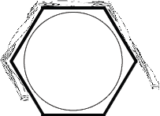
TSTC: twist windings
BEFORE: bending of TSTC
Hard bending side: 140 mm Ø: 3.6 % irr. degradation
NEW: Stacked-Tape Twist-Winding
Cable follows shape of the curve
  → always easy bending side
Takayasu et al. (MIT)

Slide 14
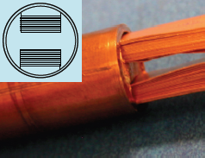
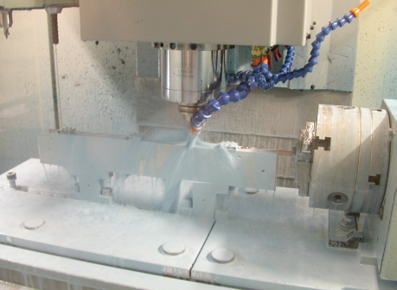
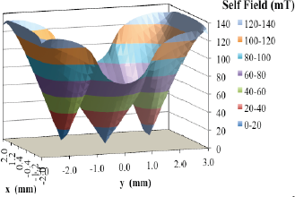
TSTC: H-channel
Scale-up fabrication of 2 channel TSTC (H-channel)
H-channel reduces self-field effect
Automated production: 4-axis
3D milling machine
Takayasu et al. (MIT)

Slide 15
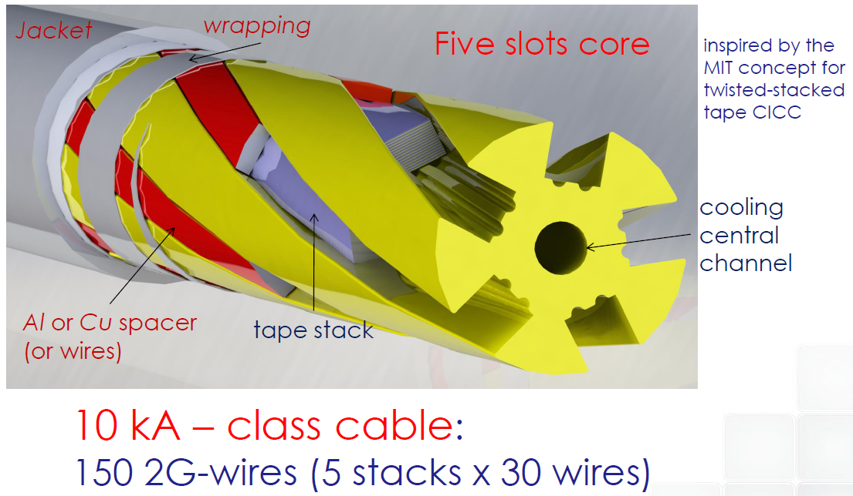
TSTC: slotted 5 core CICC
Design of slotted core CICC
Celentano et al. (ENEA)

Slide 16
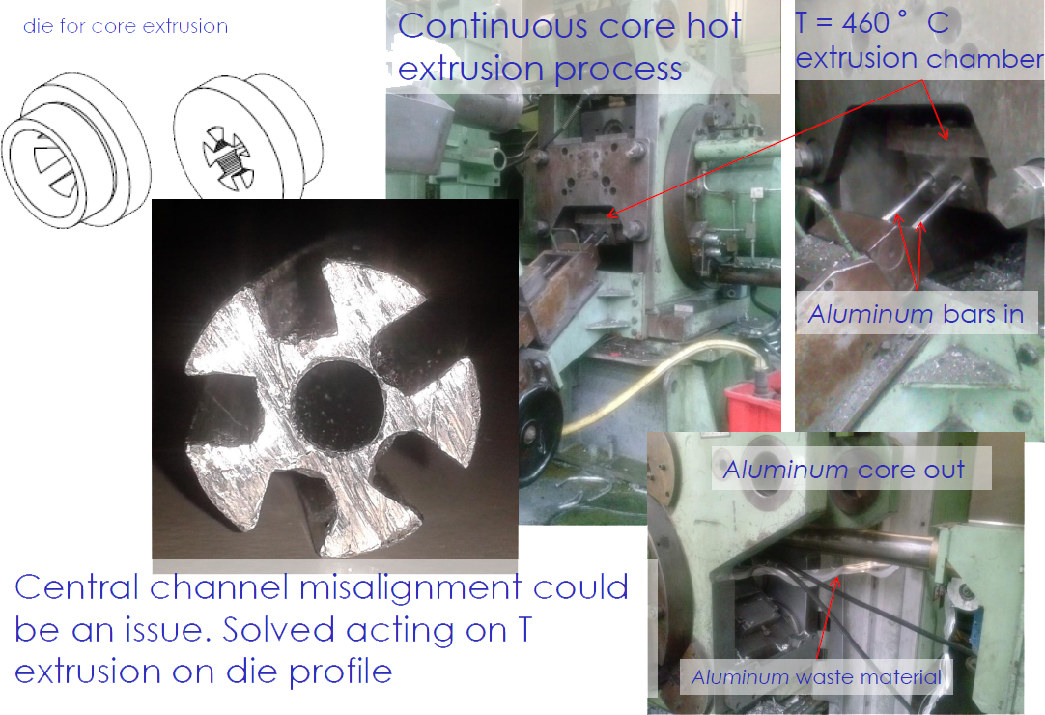
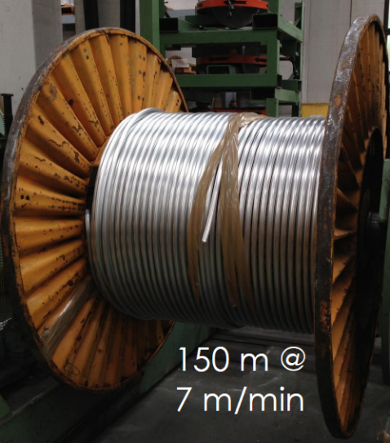
TSTC: slotted 5 core CICC
Automated manufacturing
Celentano et al. (ENEA)

Slide 17


Conductor on Round Core (CORC) cable

Slide 18
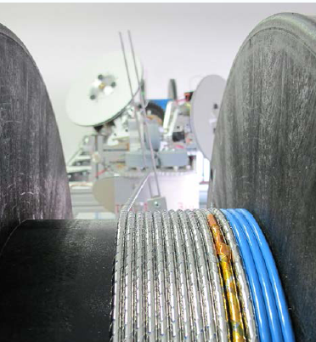
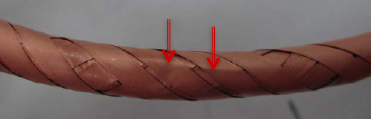
CORC: automated winding
BEFORE: hand winding
irregular tape spacing
  voids in winding pack
  tapes damaged during bending
  (60 mm Ø: 56 % irr. degradation)
NEW: automated winding machine
controlled tape separation,
winding angle & tension
Van der Laan et al. (UC & ACT)

Slide 19
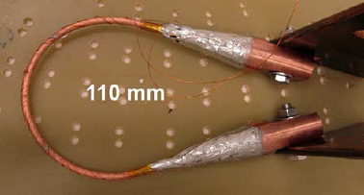
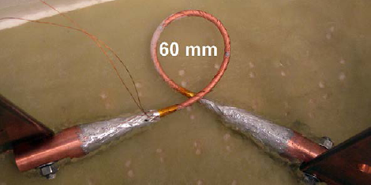
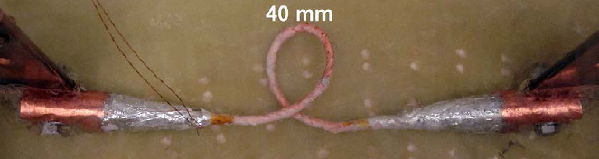
CORC: bending
Improved cable flexibility
bending to low diameters possible:
  40 mm Ø: 2.5 % rev. degradation
Van der Laan et al. (UC & ACT)

Slide 20
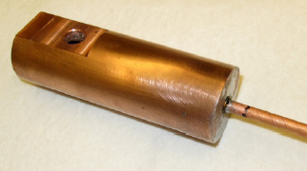
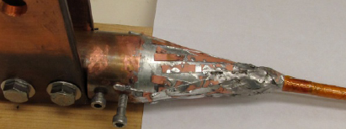
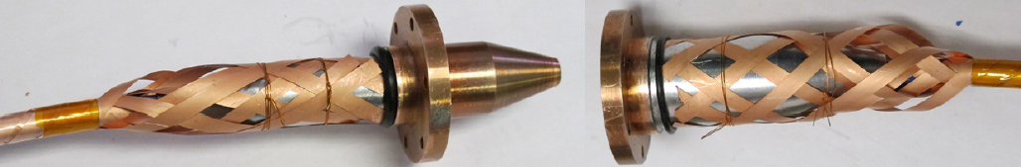
CORC: terminals & joints
BEFORE: conical or solder filled terminals
Solder filled: high resistivity, small
Conical: Low resistivity, very big
NEW: hybrid type joints
Low resistivity, small
Demountable
225 nΩ
36 nΩ
50-60 nΩ each
170 nΩ total
Van der Laan et al. (UC & ACT)

Slide 21
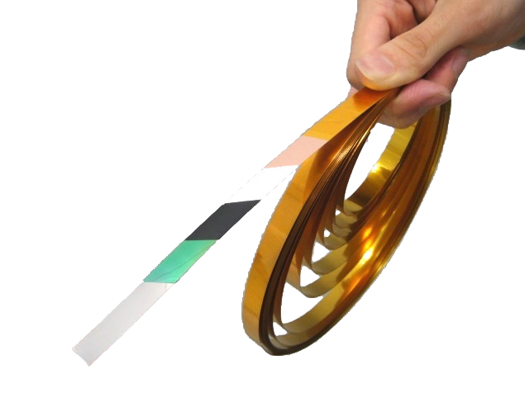

picture: Fujikura
REBCO tape

Slide 22
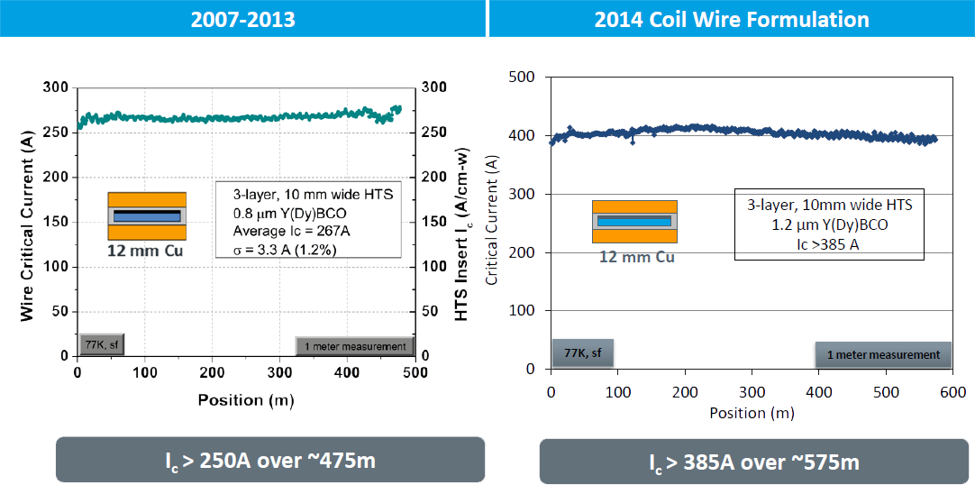
YBCO tapes: 2014 Amperium
50 % increased I_{c} @ same price
NEW 2014 products: 4.4 mm wide: >180 A, 12 mm wide: >350 A
Rouse (AMSC)

Slide 23
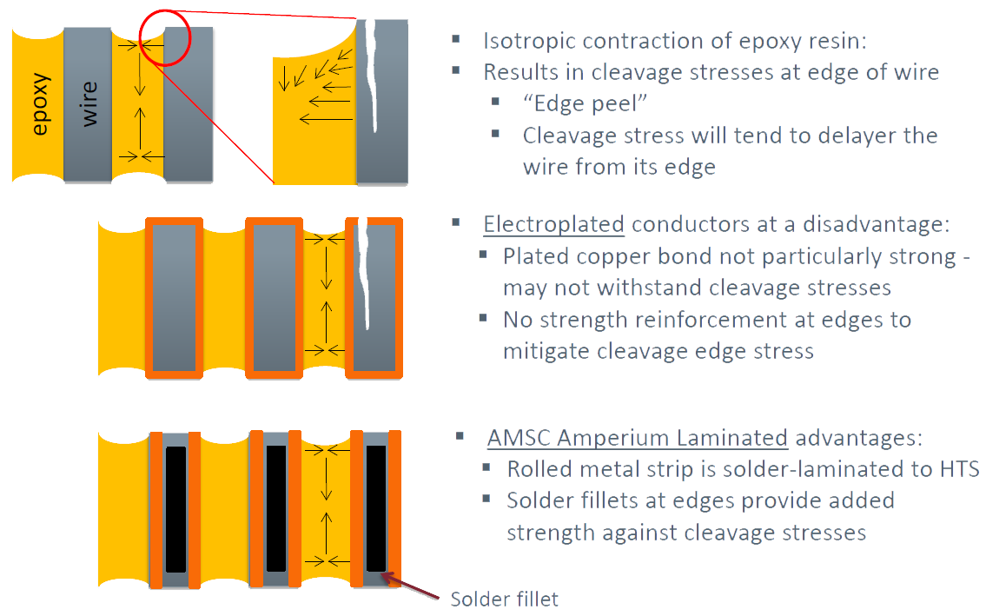
YBCO tapes: peeling resistance
Ideal for epoxy impregnated coils
Rouse (AMSC)

Slide 24


