Slide 1
FCC-FHI 28/1/14
Requirements from Collider
Draft parameters just available in EDMS:
https://edms.cern.ch/comment/1342402/0.3

Slide 2
Main FCC concepts (relevant for FHI)
Two FCC versions considered: Ring and Racetrack
100 TeV target energy: circumference to follow magnet field. 83.1 km for 20 T, 99.7 km for 16 T
Injection energy assumed at 3.3 TeV
25 ns baseline (5 ns option)
Bunch charge 1e11 (0.2e11)
Transverse emittance 2.2 urad (0.44 urad)
400 MHz RF system (200 MHz option)

Slide 3
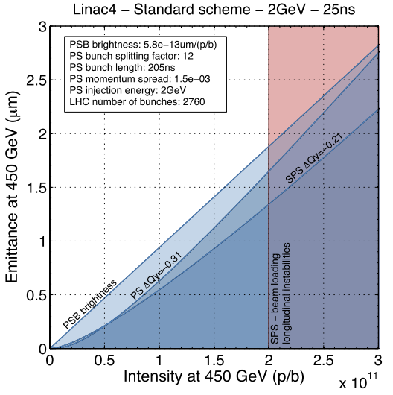
Injector parameters
Should assume minimum filling time (both rings) of ~10 minutes (as for LHC)
  Will increase 2-3 times in reality
Take LIU targets as baseline performance from SPS
25 ns brightness and bunch intensity do not seem challenging
  Check loss in intensity/emittance increase in HEB?
  Minimum emittance ~0.8 um for 5 ns??
FCC 5 ns and 25 ns

Slide 5
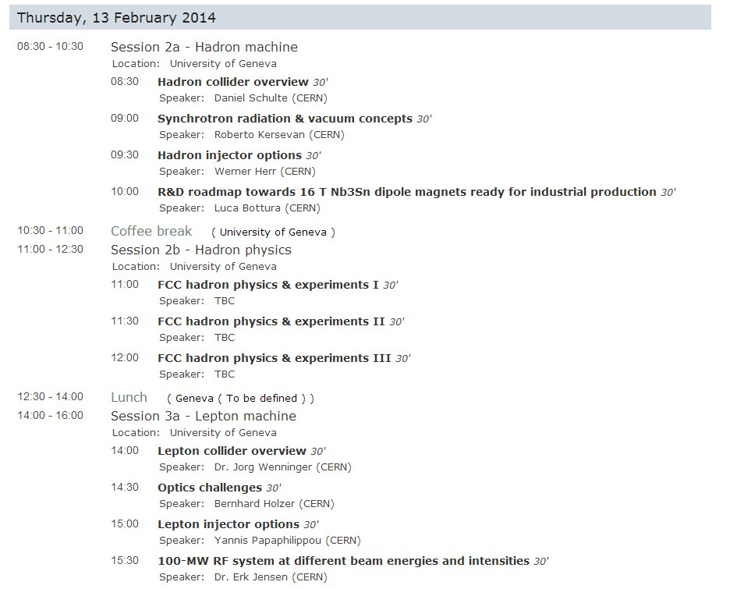
Outline of kickoff meeting talk on Hadron Injectors – for discussion

Slide 6
Hadron Injector Options: Outline
Initial assumptions
  Requirements, constraints, existing pre-injector performance
Review of SSC injector design
Hadron injector options for FCC
  Adding HEB to CERN complex: HEB tunnel options and features
    SPS
    LHC
    FHC
  Features of an “ideal” injector chain for FCC
Initial study directions for Phase 1 feasibility investigation

Slide 8
Study Timeline
2014 |  |  |  | 2015 |  |  |  | 2016 |  |  |  | 2017 |  |  |  | 2018
Q1 | Q2 | Q3 | Q4 | Q1 | Q2 | Q3 | Q4 | Q1 | Q2 | Q3 | Q4 | Q1 | Q2 | Q3 | Q4 | Q1 | Q2 | Q3 | Q4
Explore
Investigations of parameter space
Study
Study few baseline options
Elaborate
Detailed conceptual
design of re-scoped
baseline
DRAFT – NOT YET APPROVED

Slide 9


Study Timeline
2014 |  |  |  | 2015 |  |  |  | 2016 |  |  |  | 2017 |  |  |  | 2018
Q1 | Q2 | Q3 | Q4 | Q1 | Q2 | Q3 | Q4 | Q1 | Q2 | Q3 | Q4 | Q1 | Q2 | Q3 | Q4 | Q1 | Q2 | Q3 | Q4
Study plan, define scope
Explore
Review, adjust scope
Study
Review, select variants
Elaborate
Review, approve material
Report
Release CDR
DRAFT – NOT YET APPROVED

Slide 10
Main FHI study topics for Phase 1
Identify best options for HEB in addition to L4-PSB-PS-SPS:
  SPS tunnel (Nb3Sn)
  LHC tunnel (NbTi “low field”, or LHC reuse)
  Collider tunnel (Superferric or NC)
  Need to identify performance limits, achievable filling time, some idea of cost comparison, evaluate possible showstoppers, address operational issues (like power consumption and availability, think LHC as HEB…)
Parallel: work out concept for “green field” injector complex (SCC, SPL/PS2/SPS+, …

Slide 11
Some ideas for specific study topics/clarifications
Minimum injection energy (field) in FHC
  Key question for Injectors (e.g. 2 TeV opens other options for HEB...)
Maximum ‘flat-bottom’ time for FHC
  Need to know if target of ~10-30 minutes is adequate
Main magnet parameters and technologies for different HEB options
  Apertures, peak field, ramp rate, field quality
Feasibility of LHC reuse for HEB
  Lattice design for simplified synchrotron
  Key question of ramping at ~50 A/s. Tests program??
  Availability (how often were there 4 consecutive LHC ramps??)
  Decommissioning feasibility (e,g, insertions)
Feasibility of HEB in 100 km tunnel
  Beam dynamics at HEB 450 GeV injection energy (space charge, impedance, IBS, …)
  Basic lattice needed and repeat work done on collider by Mounet and Rumolo
Constraints on layout and transfer (FCC location, TLs, HEB extraction, …)
Preliminary cost scaling (mainly for magnet systems) for all options
Machine protection constraints (e.g. during transfer to Collider)

