Slide 1
A First Look at Heavy Ion Operation of VHE-LHC
Michaela Schaumann
Thanks to J.M. Jowett and R. Versteegen
30th January 2014
Special FHC Meeting, CERN

Slide 2
Outline
General assumptions (Pre-accelerator chain, ring and beam parameters)
Estimates for:
  Circulating beam current and stored energy
  IBS
  Radiation Damping
  Radiated power, energy loss per turn, critical photon energy
  Initial luminosity
  Initial beam current lifetime
  Luminosity and beam evolution with time
  Luminosity lifetime
  Beam-beam tune shift
  BFPP power
Cycle optimisation
Summary table ions
(Preliminary simulations for p-p)
Conclusions

Slide 3
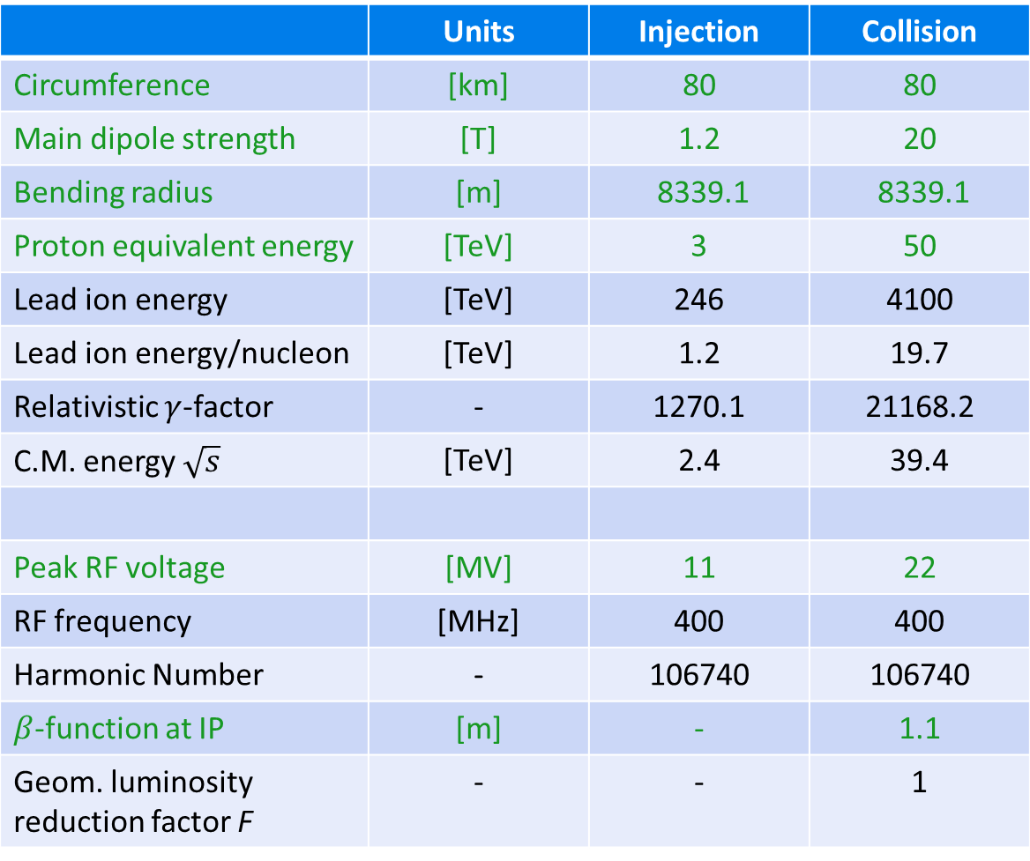
General VHE-LHC Parameters
 | Units | Injection | Collision
Circumference | [km] | 80 | 80
Main dipole strength | [T] | 1.2 | 20
Bending radius | [m] | 8339.1 | 8339.1
Proton equivalent energy | [TeV] | 3 | 50
Lead ion energy | [TeV] | 246 | 4100
Lead ion energy/nucleon | [TeV] | 1.2 | 19.7
Relativistic $γ$-factor | - | 1270.1 | 21168.2
C.M. energy $\sqrt{s}$ | [TeV] | 2.4 | 39.4
Peak RF voltage | [MV] | 11 | 22
RF frequency | [MHz] | 400 | 400
Harmonic Number | - | 106740 | 106740
$β$-function at IP | [m] | - | 1.1
Geom. luminosity reduction factor F | - | - | 1

Slide 4
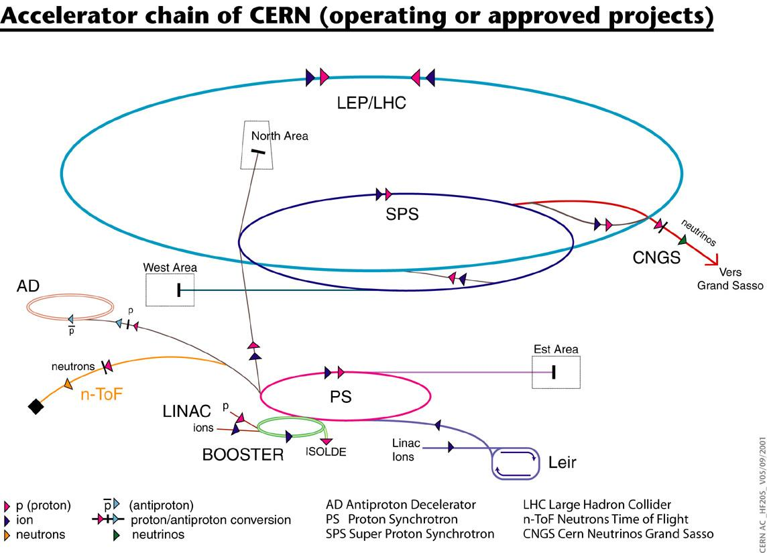
Heavy Ion Pre-Accelerator Chain
LHC, as it is today, is assumed to be the last pre-accelerator before VHE-LHC.
LH
VHE-LHC

Slide 5
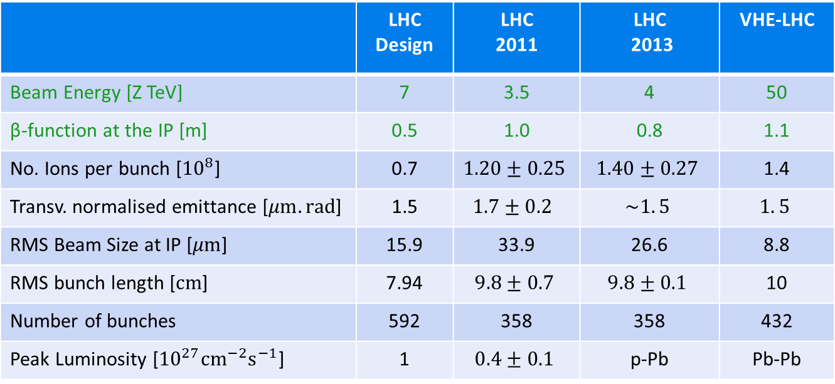
Beam Parameter
In the following the bunch-by-bunch differences are neglected.
→ All bunches are assumed to be average.
 | LHC Design | LHC 2011 | LHC 2013 | VHE-LHC
Beam Energy [Z TeV] | 7 | 3.5 | 4 | 50
β-function at the IP [m] | 0.5 | 1.0 | 0.8 | 1.1
No. Ions per bunch [${10}^{8}$] | 0.7 | $$1.20±0.25$$ | $$1.40±0.27$$ | 1.4
Transv. normalised emittance [$μm.rad$] | 1.5 | $$1.7±0.2$$ | $$\sim 1. 5$$ | $$1. 5$$
RMS Beam Size at IP [$μm$] | 15.9 | 33.9 | 26.6 | 8.8
RMS bunch length [$cm$] | 7.94 | $$9.8±0.7$$ | $$9.8±0.1$$ | 10
Number of bunches | 592 | 358 | 358 | 432
Peak Luminosity [${10}^{27}{cm}^{−2}s^{−1}$] | 1 | $$0.4±0.1$$ | p-Pb | Pb-Pb

Slide 6
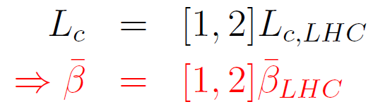
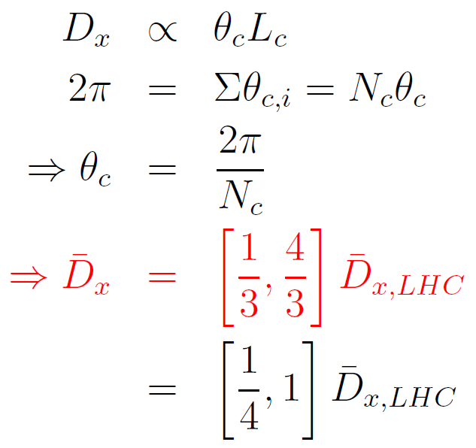
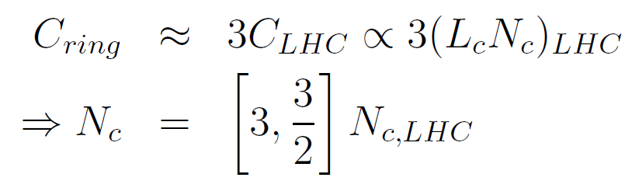


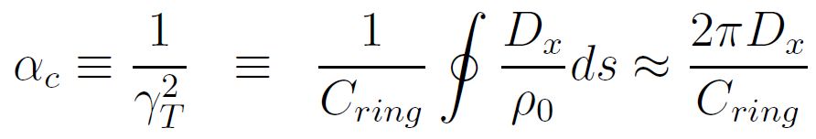
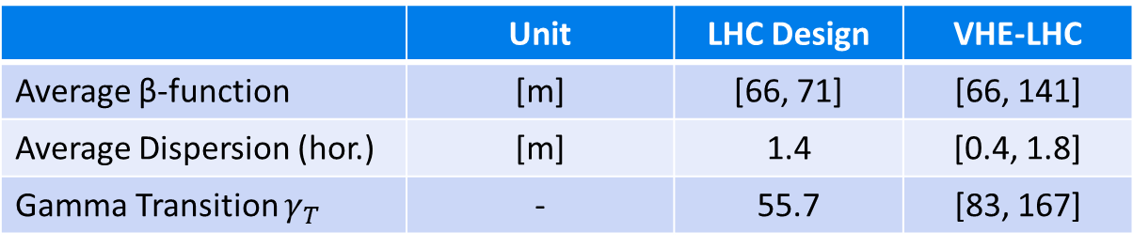
Smooth Lattice Approximation
A lattice design does not yet exist!
Approximations for smooth lattice functions are used where necessary.
Cell Length from aperture constraints
Dispersion
Number of cells
 | Unit | LHC Design | VHE-LHC
Average β-function | [m] | [66, 71] | [66, 141]
Average Dispersion (hor.) | [m] | 1.4 | [0.4, 1.8]
Gamma Transition $γ_{T}$ | - | 55.7 | [83, 167]
K. Wille, The physics of particle accelerators

Slide 7
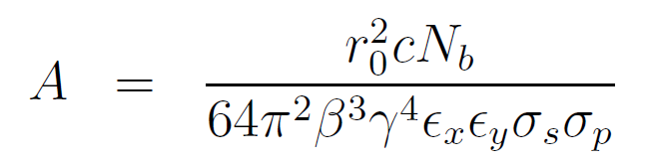
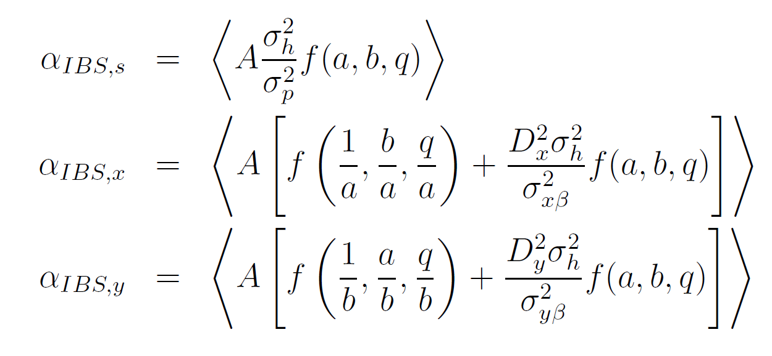
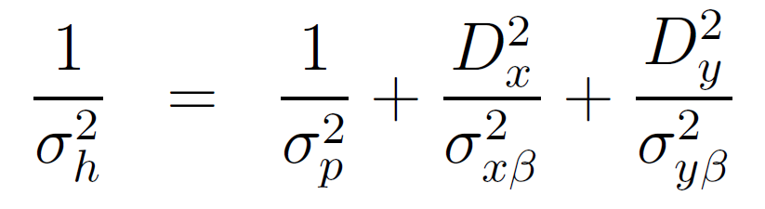
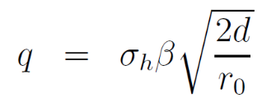
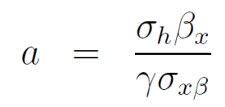
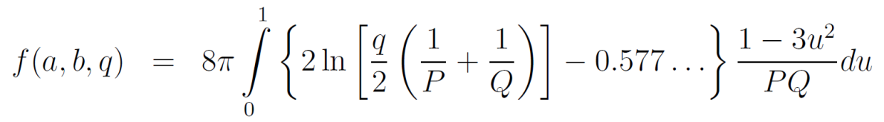
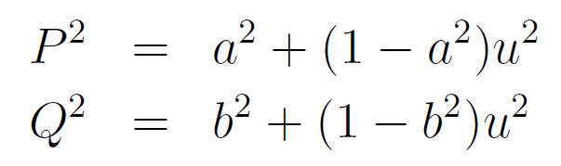
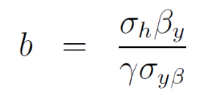
Intra-Beam Scattering
A. Piwinski Formalism for IBS growth rates:
Particle Type
Beam
properties
Energy
The higher the energy the lower the IBS growth rates.
The higher the brightness of the bunch, the higher the IBS growth rates.
Lattice and beam sizes
Handbook of Accelerator Physics and Engineering, 1st Edition, 3rd Print, pp. 141

Slide 8
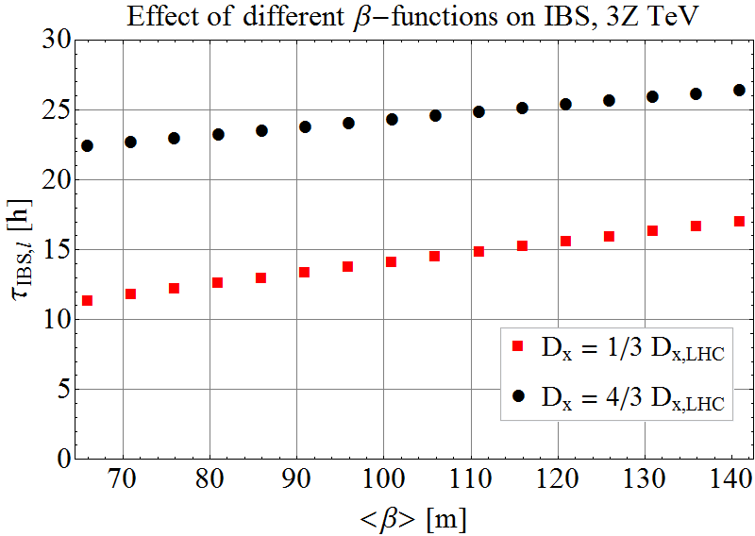
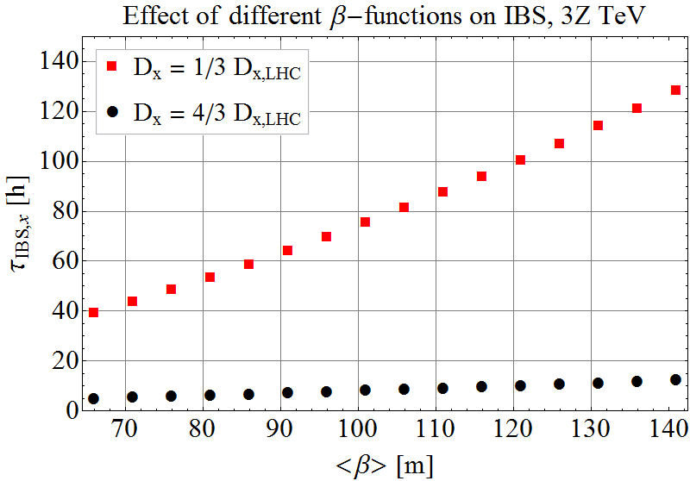
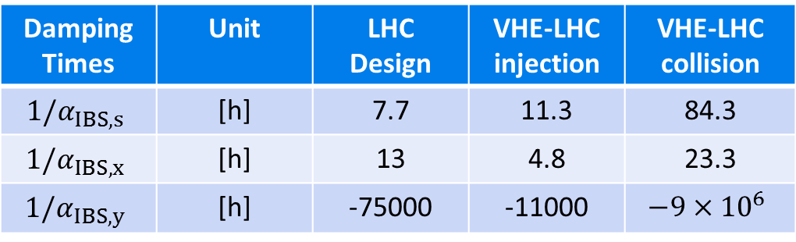
Intra-Beam Scattering
Evolution of IBS growth times with β-function and dispersion
3Z TeV
Horizontal
Longitudinal
Effect of IBS decreases with increasing β-function.
At collision energy, IBS is weak for initial beam parameters.
Damping Times | Unit | LHC Design | VHE-LHC injection | VHE-LHC collision
$$1/α_{IBS,s}$$ | [h] | 7.7 | 11.3 | 84.3
$$1/α_{IBS,x}$$ | [h] | 13 | 4.8 | 23.3
$$1/α_{IBS,y}$$ | [h] | -75000 | -11000 | $$−9×{10}^{6}$$

Slide 9
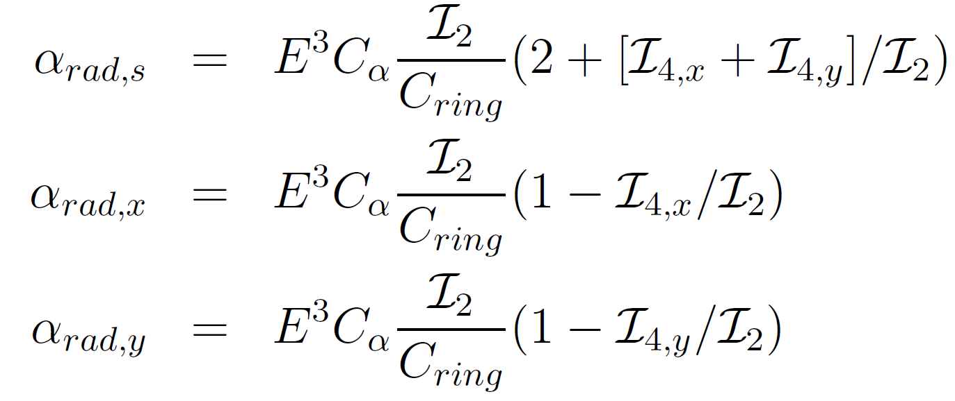
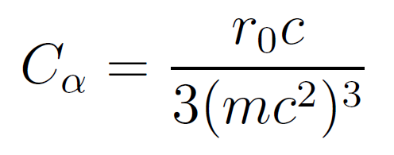
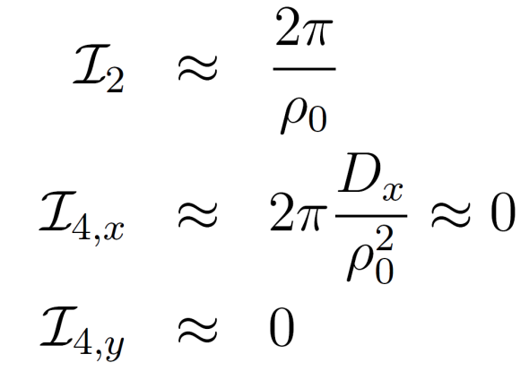
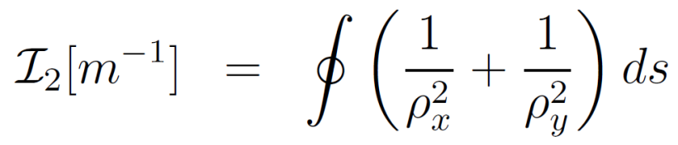
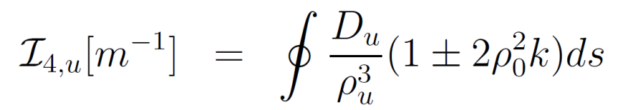

Radiation Damping
Damping Rates
Handbook of Accelerator Physics and Engineering, 1st Edition, 3rd Print,
pp. 210
Energy
Particle Type
Ring
Constant depending on particle’s mass and charge
Radiation Integrals
Isomagnetic ring with separated function magnets & $D_{y}=0$

Slide 10

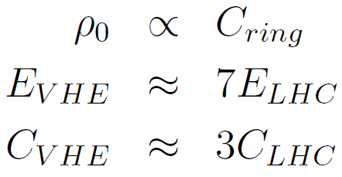
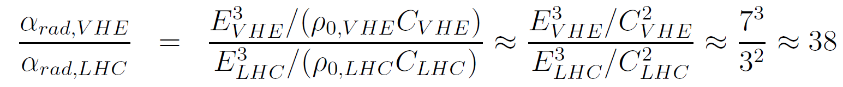
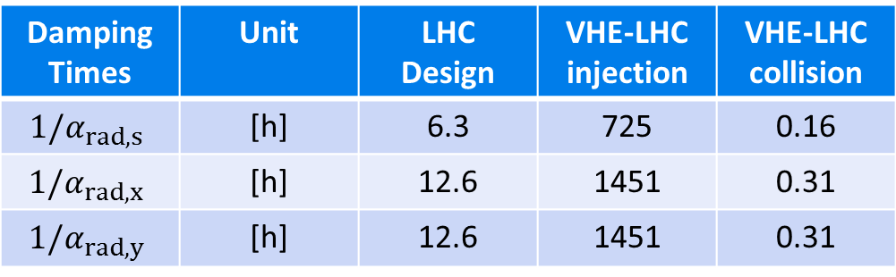
Radiation Damping
Energy
Particle Type
Ring
Compare VHE-LHC to LHC
Damping Times | Unit | LHC Design | VHE-LHC injection | VHE-LHC collision
$$1/α_{rad,s}$$ | [h] | 6.3 | 725 | 0.16
$$1/α_{rad,x}$$ | [h] | 12.6 | 1451 | 0.31
$$1/α_{rad,y}$$ | [h] | 12.6 | 1451 | 0.31

Slide 11
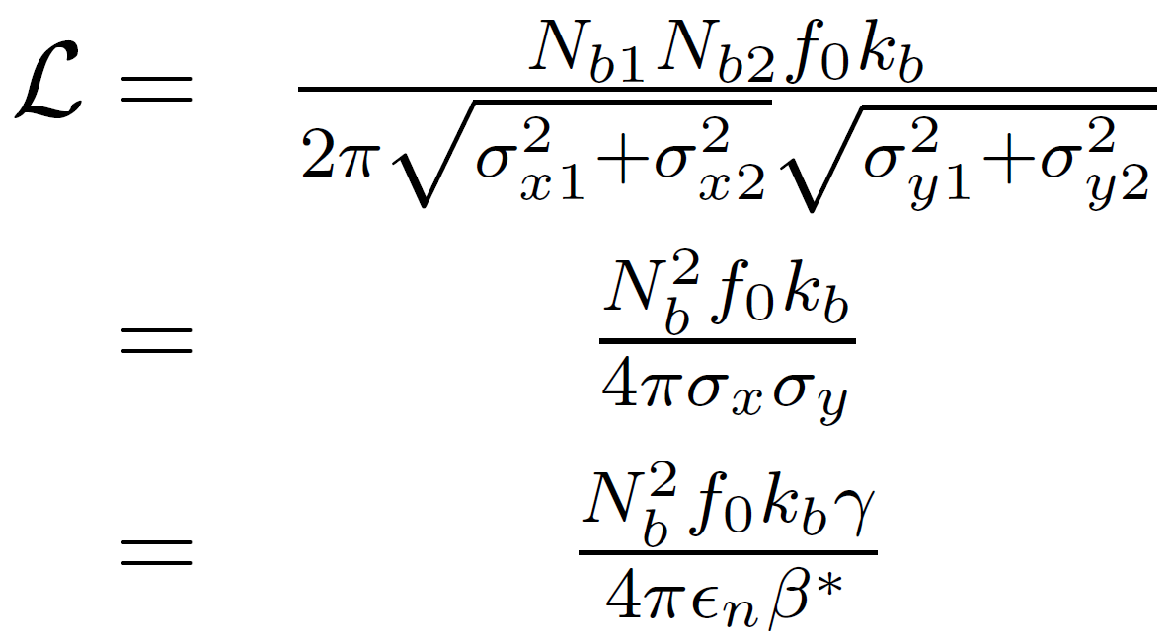
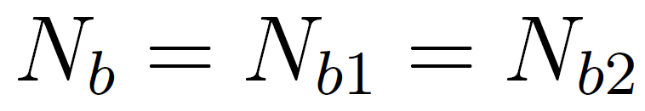
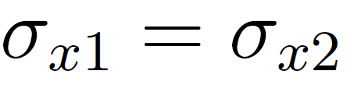
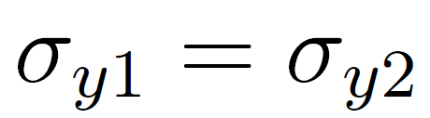
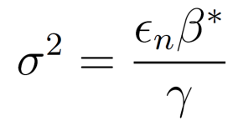

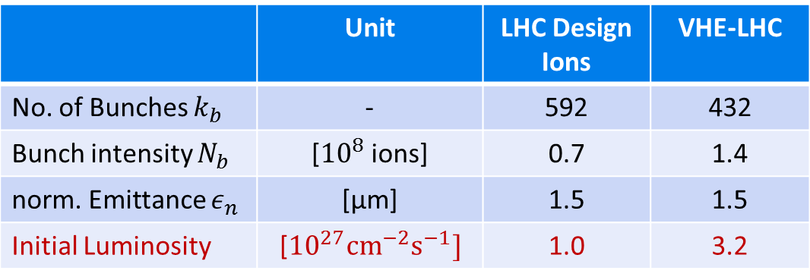
Initial Luminosity
Equal colliding bunches
Initial luminosity calculated form beam parameters coming from the injectors.
$L_{initial}≠L_{peak}$ due to strong radiation damping!
 | Unit | LHC Design Ions | VHE-LHC
No. of Bunches $k_{b}$ | - | 592 | 432
Bunch intensity $N_{b}$ | [${10}^{8}$ions] | 0.7 | 1.4
norm. Emittance $ε_{n}$ | [μm] | 1.5 | 1.5
Initial Luminosity | [${10}^{27}{cm}^{−2}s^{−1}]$ | 1.0 | 3.2

Slide 12
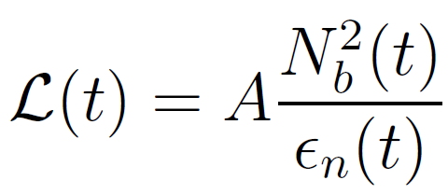
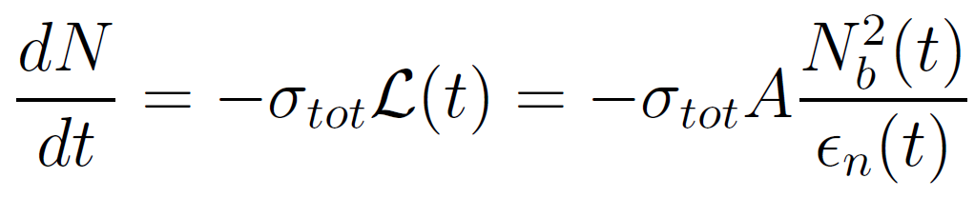

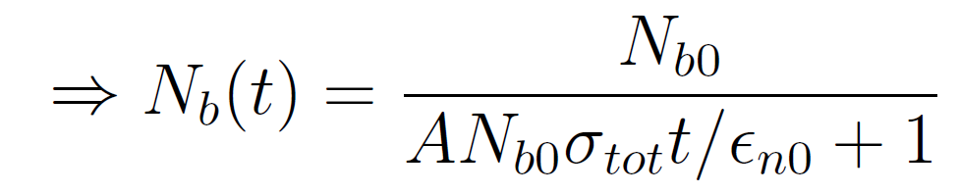
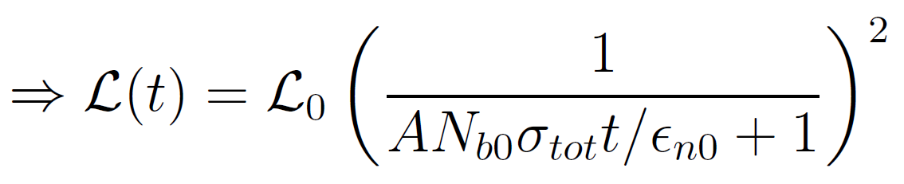
Luminosity Evolution
Luminosity evolution depends on the time dependency of the intensity and emittance:
Intensity evolution:
Case 1) consider only burn off:

Slide 13

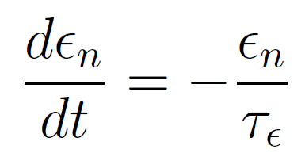
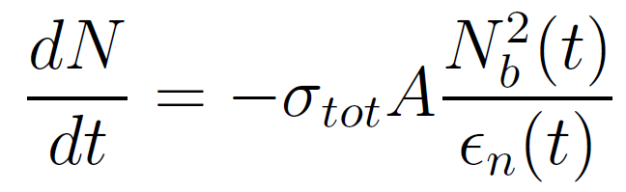
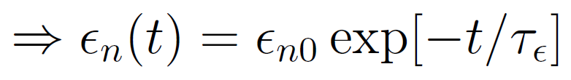
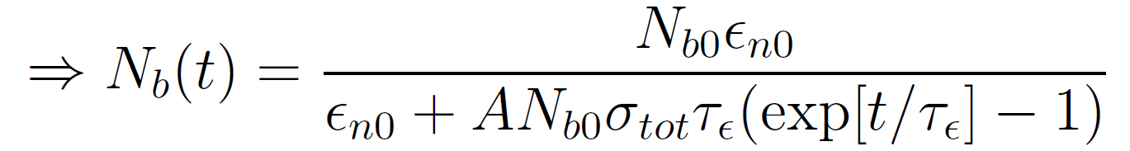
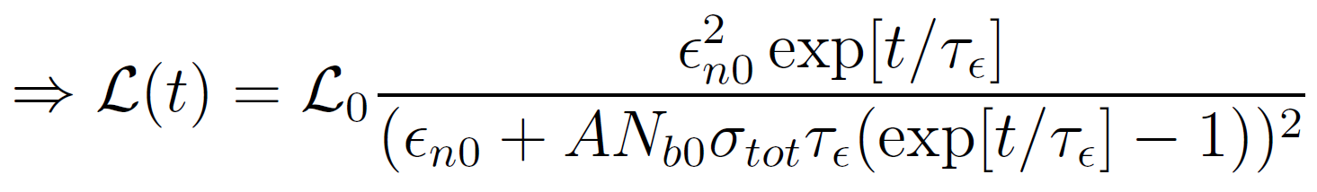
Luminosity Evolution
Case 2) consider burn off and radiation damping:
IBS is weak at top energy and dominated by radiation damping, the emittance growth/damping time is approximated to be constant.
System of two differential equations to be solved:

Slide 14
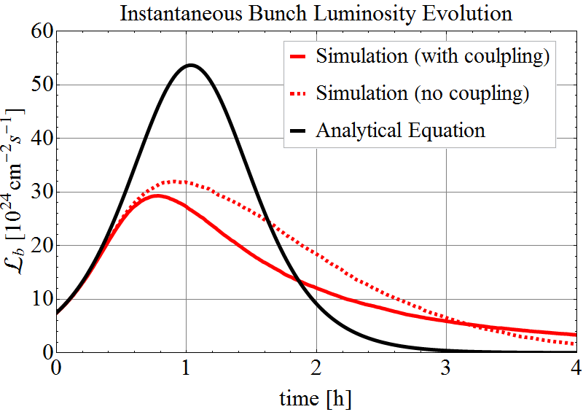
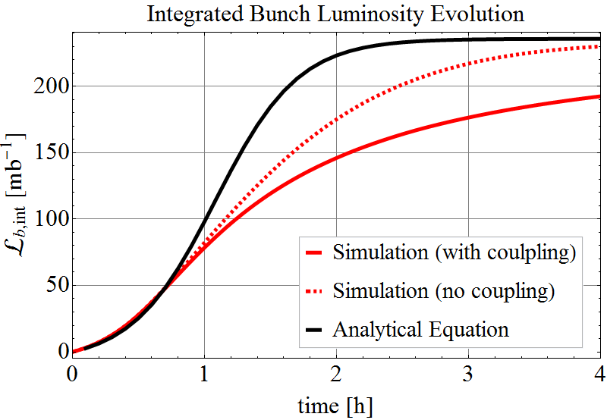

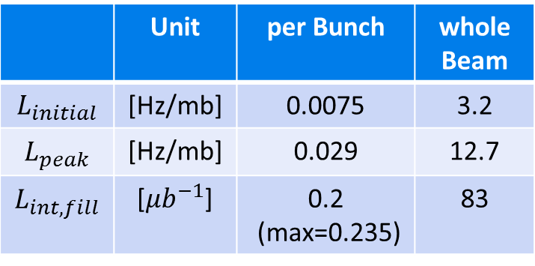
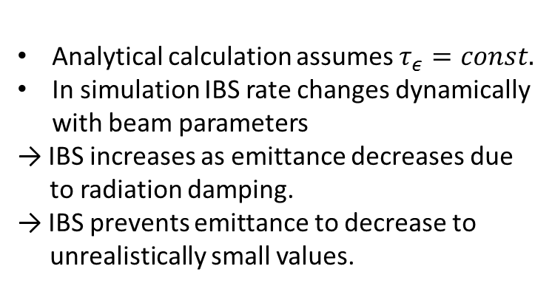
Luminosity Evolution
Analytical calculation assumes $τ_{ε}=const.$
In simulation IBS rate changes dynamically with beam parameters
→ IBS increases as emittance decreases due to radiation damping.
→ IBS prevents emittance to decrease to unrealistically small values.
1 experiment in collisions
 | Unit | per Bunch | whole Beam
$$L_{initial}$$ | [Hz/mb] | 0.0075 | 3.2
$$L_{peak}$$ | [Hz/mb] | 0.029 | 12.7
$$L_{int,fill}$$ | [${μb}^{−1}$] | 0.2 (max=0.235) | 83
Very high $L_{peak}!$
Is detector able to take those rates?
Levelling required?

Slide 15
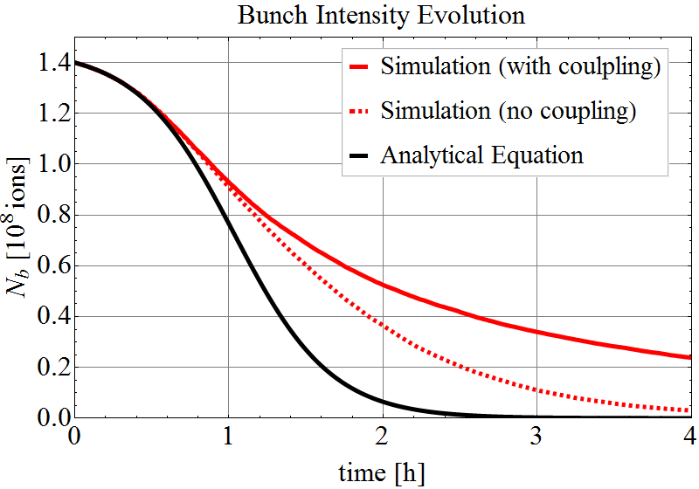
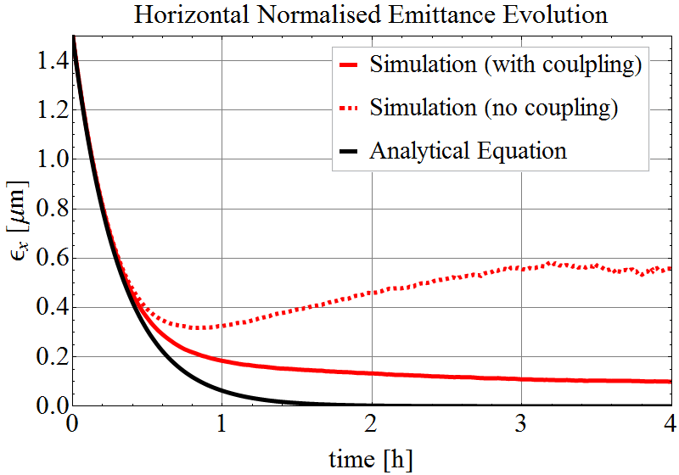
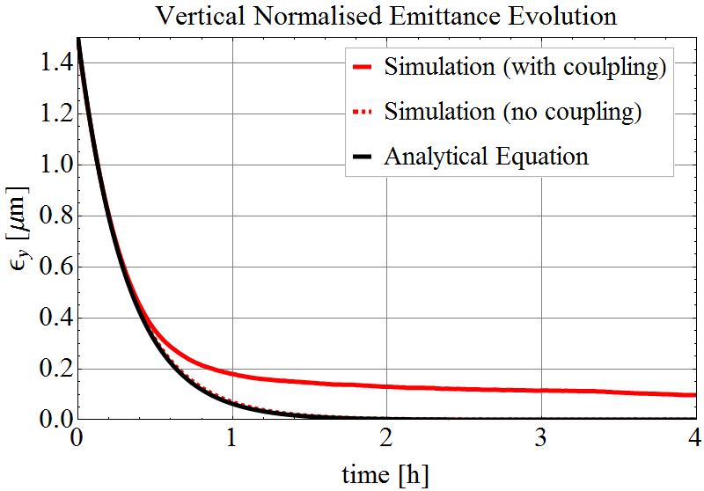

Beam Evolution
Analytical calculation assumes $τ_{ε}=const.$
→ Emittances are damped to $\sim 0$, unrealistic!
In simulation horizontal IBS counteracts radiation damping for small emittances:
→ Without coupling only in horizontal plane,
vertical emittances $\sim$0.
→ With coupling, horizontal IBS growth is transferred to vertical plane.
→ Equilibrium emittance in both planes.

Slide 16




Beam-Beam Tune Shift
Beam-beam tune shift per experiment.
For round beams :
Beam-Beam Parameter per Experiment | Unit | LHC Design Protons | LHC Design Ions | VHE-LHC
Initial | [${10}^{−3}]$ | 3.7 | 0.18 | 0.37
Peak | [${10}^{−3}]$ | 3.7 | 0.18 | 2.0
The tune shift due to beam-beam interactions well below assumed limit.
T. Pieloni, CERN-THESIS-2010-056

Slide 17
Things to be studied…
Bunch length damps 2x fast than transverse plane.
→ Longitudinal instabilities could become a problem.
→ Longitudinal blow-up might be necessary.
For too small transverse emittances (ϵ = 0.1μm → σ* < 2μm)
→ Orbit stability?
→ Finding collisions.
→ Transverse blow up might become necessary – method of
levelling.
…

Slide 18






p-Pb Luminosity Evolution
Analytical calculation only! – Neglecting IBS
Equal geometric beam sizes for p and Pb
1) $N_{b}\left(p\right)≈100 N_{b}(Pb)$ = const.
→ Fast burn-off very fast: $τ_{L}=3.2h$
2) Slow down burn-off by decreasing p-intensity $N_{b}\left(p\right)=N_{b}(Pb)$
→ $N_{b}\left(p\right)≠$const
→ Luminosity lifetime $τ_{L}≈10.6h$
Maximum integrated luminosity is achieved, when all Pb ions are converted into luminosity
 | Unit | per Bunch | whole Beam
$$L_{initial}$$ | [Hz/mb] | 0.007/0.6 | 3.2/267
$$L_{peak}$$ | [Hz/mb] | 8/13 | 3356/5477
$$L_{int,fill}$$ | [${μb}^{−1}$] | 70 | 30240

Slide 19







BFPP Beam Power
LHC Pb beam right of IP2
Main: 208-Pb-82+
BFPP1: 208-Pb-81+
BFPP2: 208-Pb-80+
EMD1: 207-Pb-82+
EMD2: 206-Pb-82+
LHC
The rigidity of each
beam changed by
VHE-LHC
 | VHE-LHC
initial $P_{BFPP}$ | 751 W
peak $P_{BFPP}$ | 2947 W

Slide 20


Cycle Optimisation
3h LHC turn around time
= time between 2 injections to VHE-LHC.
Intensity of 3 typical Pb bunches at injection
10% average intensity loss,
10% average emittance growth,
between two LHC shots at VHE-LHC injection plateau!
Luminosity lifetime $\sim$3h
$≈$ LHC turn around time.
Optimal beam usage – only 15% of particles left after 4h of collisions.
→ Fill both beams of LHC and inject them into VHE-LHC.
→ Refill LHC during physics in VHE-LHC.
→ No waiting time for VHE-LHC due to cycling in LHC.
If 2 experiments are considered, they have to be placed at opposite positions in the ring to be provided with luminosity!
VHE-LHC @
injection
VHE-LHC in collisions

Slide 21

Summary Table (1)
 | Unit | LHC Design | VHE-LHC Injection | VHE-LHC Collision | VHE-LHC Collision
Operation mode | - | Pb-Pb | Pb | Pb-Pb | p-Pb
Particle type | - | Pb | Pb | Pb | p
Beam Energy | [TeV] | 574 | 246 | 4100 | 50
Relativistic γ-factor | - | 2963 | 1270 | 21168 | 53290
Number of bunches | - | 592 | 432 | 432 | 432
No. Ions per bunch | [${10}^{8}$] | 0.7 | 1.4 | 1.4 | 115/1.4
Transv. normalised emittance | [$μm.rad$] | 1.5 | 1.5 | 1.5 | 3.75
RMS bunch length | [$cm$] | 7.94 | 10 | 10 | 10
Synchrotron frequency | [Hz] | 23.0 | 5.5 | 1.9 | 1.9
Longitudinal emittance (4σ) | [eVs/charge] | 2.5 | 4 | 23 | 23
RMS energy spread | [${10}^{−4}]$ | 1.1 | 3.3 | 1.1 | 1.1
Circulating beam current | [mA] | 6.12 | 3.0 | 3.0 | 3.0/0.04
Stored beam energy | [MJ] | 3.81 | 2.4 | 40 | 40/0.5
Longitudinal IBS emit. growth time | [h] | 7.7 | 11.3 | 84.3 | 1$×{10}^{4}$/1$×{10}^{6}$
Horizontal IBS emit. growth time | [h] | 13 | 4.8 | 23.3 | 3$×{10}^{3}$/3$×{10}^{5}$
Longitudinal emit. rad. damping time | [h] | 6.3 | 725 | 0.16 | 0.32
Horizontal emit. rad. damping time | [h] | 12.6 | 1451 | 0.31 | 0.63

Slide 22

Summary Table (2)
 | Unit | LHC Design | VHE-LHC Injection | VHE-LHC Collision | VHE-LHC Collision
Operation mode | - | Pb-Pb | Pb | Pb-Pb | p-Pb
Power loss per ion | [W] | $$2.0×{10}^{−9}$$ | $$1.5×{10}^{−11}$$ | $$8.8×{10}^{−7}$$ | $$5.4×{10}^{−9}$$
Energy loss per ion per turn | [MeV] | 1.12 | 0.01 | 969.1 | 5.8
Synchrotron radiation power per ring | [W] | 83.9 | 0.7 | 53732 | 26587/323
Critical photon energy | [eV] | 2.77 | 0.07 | 336.7 | 5376
β-function at the IP | [m] | 0.5 | - | 1.1 | 1.1
RMS beam size at IP | [$μm$] | 15.9 | - | 8.8 | 8.8
Initial luminosity | [${10}^{27}{cm}^{−2}s^{−1}$] | 1 | - | 3.2 | 267/3.2
Peak luminosity | [${10}^{27}{cm}^{−2}s^{−1}$] | 1 | - | 12.7 | 5477/3356
Integrated luminosity per fill | [${μb}^{−1}$] | <15 | - | 83 | 30240
Beam-beam tune shift | [${10}^{−4}$] | 1.8 | - | 3.7 | 3.7/0.045
Total cross-section | [b] | 515 | - | 597 | 2
Peak BFPP beam power | [W] | 26 | - | 2947 | 0
Initial beam current lifetime (1 exp.) | [h] | <11.2 (2 exp.) | - | 8.7 | 24/2583
Initial luminosity lifetime | [h] | <5.6 (2 exp.) | - | 3.7 | 3.2/10.6

Slide 23





Proton-Proton
Application of same procedures and equations for p-p collisions in the VHE-LHC.
Considering different beam parameters for the 3 spacing options of 5/25/50 ns.
Natural beam evolution, without artificial blow-up!

Slide 24


Proton-Proton
Application of same procedures and equations for p-p collisions in the VHE-LHC.
Considering different beam parameters for the 3 spacing options of 5/25/50 ns.
Natural beam evolution, without artificial blow-up!
Total beam-beam tune shift up to $\sim$10 times higher than the conservative baseline for VHE-LHC without artificial blow-up.

Slide 25

Conclusions
VHE-LHC will enter a different regime of operation.
Very strong radiation damping will lead to small emittances and thus effective intensity burn-off.
The absolute integrated luminosity maximum per fill (convert all particles into luminosity) comes into reach.
The peak luminosity can get very high ($\sim 12×$ nominal LHC) – levelling might have to be considered.
Turn around time of the pre-injector LHC is about as long as the expected time in collisions per fill:
→ fill LHC in parallel to physics operation in VHE-LHC to maximise physics time.
p-Pb: burn-off very fast - decrease the proton intensity compared to LHC operation, to lengthen the fill.

Slide 26
Thank you
for your attention

Slide 27



Bunch-by-Bunch Differences after Injection in the LHC
E = 450 Z GeV
Structure within a train
(1st to last bunch):
  increase: - intensity
  - bunch length
  decrease: emittance.
IBS, space charge, RF noise … at the injection plateau of the SPS:
  while waiting for the 12 injections
  from the PS to construct a LHC
  train.
First injections sit longer at low energy
$→$ strong IBS,
$→$ emittance growth and particle
losses.
Design
1 train
Intensity
Design
Horizontal / Vertical
Emittance

Slide 28



Longitudinal Beam Parameters
at top energy
 | Unit | LHC Design | VHE-LHC
Synchrotron frequency $f_{s}$ | [Hz] | 23.0 | 1.9
Momentum spread $σ_{p}$ | [${10}^{−4}]$ | 1.1 | 1.1
Longitudinal emittance $ε_{s}$ | [eVs/charge] | 2.5 | 23
S.Y.Lee, Accelerator Physics, 3rd edition

Slide 29




Circulating Beam Current and Stored Beam Energy
Circulating beam current:
Stored beam energy:
 | Unit | LHC Design | VHE-LHC injection | VHE-LHC collision
$$I_{beam}$$ | [mA] | 6.12 | 2.98 | 2.98
$$W_{beam}$$ | [MJ] | 3.81 | 2.38 | 39.73

Slide 30



Energy Loss per Turn
Radiated power per ion:
Radiated power per beam:
Energy loss per ion per turn:
Critical photon energy:
Damping Times | Unit | LHC Design | VHE-LHC injection | VHE-LHC collision
$$P_{rad,ion}$$ | [W] | $$2.0×{10}^{−9}$$ | $$1.5×{10}^{−11}$$ | $$8.8×{10}^{−7}$$
$${ΔE}_{rad,ion}$$ | [MeV] | 1.12 | 0.01 | 969.1
$$P_{rad,beam}$$ | [W] | 83.9 | 0.7 | 53732
$$E_{crit}$$ | [eV] | 2.77 | 0.07 | 336.7
Handbook of Accelerator Physics and Engineering, 2nd Edition, pp. 215

Slide 31




Initial Beam Current Lifetime
Lifetime due to burn-off only!
Total cross-section at 50Z TeV:
H. Meier et al, Phys. Rev. A, vol. 63, 032713. 02/2011
 | Unit | LHC Design (2 experiments) | VHE-LHC (1 experiment) | VHE-LHC (2 experiments)
$$τ_{N}$$ | [h] | 11.2 | 8.7 | 4.3

Slide 32

Initial Luminosity Lifetime
Time at which the luminosity has decreased to 1/e of its initial value.
 | Unit | LHC Design (2 exp.) | VHE-LHC (1 exp.) | VHE-LHC (1 exp. simulation) | VHE-LHC (2 exp.)
$τ_{L}$(beam-beam only) | [h] | - | 5.6 | - | 2.8
$τ_{L}$(beam-beam, rad. damping, IBS) | [h] | < 5.6 | 2.4 | 3.7 | 2.0
Case 1
Case 2
Things still to be studied:
Bunch length damps 2x fast than transverse plane.
→ Longitudinal instabilities could become a problem.
→ Longitudinal blow-up might be necessary.
For too small transverse emittances (ϵ = 0.1μm → σ* < 1μm)
→ Orbit stability?
→ Finding collisions.
→ Transverse blow up might become necessary – method of levelling.

Slide 33


Intra-Beam Scattering
Evolution of IBS growth times with β-function and dispersion
50Z TeV
Longitudinal
Horizontal
Effect of IBS decreases with increasing β-function.
At collision energy, IBS growth almost negligible for initial beam parameters.
Damping Times | Unit | LHC Design | VHE-LHC injection | VHE-LHC collision
$$1/α_{IBS,s}$$ | [h] | 7.7 | 11.3 | 84.3
$$1/α_{IBS,x}$$ | [h] | 13 | 4.8 | 23.3
$$1/α_{IBS,y}$$ | [h] | -75000 | -11000 | $$−9×{10}^{6}$$

Slide 34





Beam Evolution Simulations
Evolution of 3 typical Pb-bunches in collisions.
Dashed lines: without coupling
Solid lines: with coupling
Head
Core
Tail

Slide 35




Pb-Pb Luminosity for varying β*

Slide 36

Bunch Luminosity for p-p Operation
for 1 bunch
for the whole beam

Slide 37




Initial IBS for p-p Operation

