Slide 1


Update on radiation damage simulations for endcap upgrades
Alexander Ledovskoy and Laura Bergsten, March 2014

Slide 2
New Data Files
Numerous depth tests showed that the old files contained an error in the depth variable- this has been pointed out and will be corrected.
New data files with tungsten and brass do not have this problem.
Use new code to show radiation damage in terms of dose/factor

Slide 3
Longitudinal particle movement
The tested files contain 100 GeV energy pions and electrons interacting with the scincillating and cerenkov fibers.
These depth overlay plots for electrons (red) and pions (blue) show that this new file begins its depth at 0, and ends at 2000mm. The pions penetrate deeper than electrons.

Slide 4
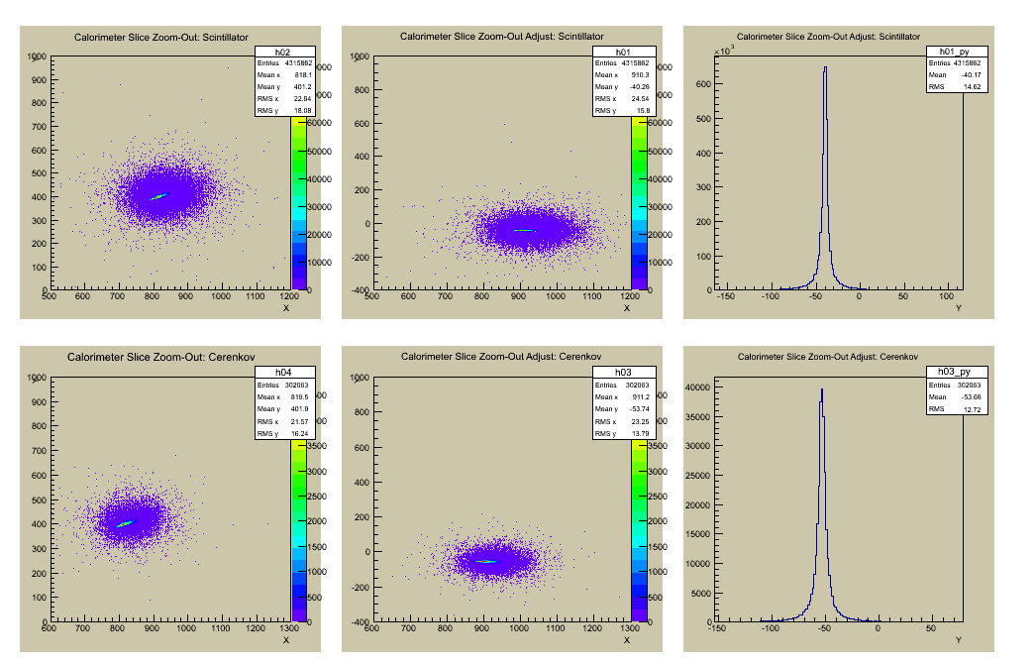
Transverse particle movement
Find angle of xy slice, then turn all points and project on the new y-axis. Find the diameter which 95% of data lie between to find 1D moliere radius. The radii make sense for tungsten and brass material, showing correct calculations.
 | Scincillating | Cerenkov
Tungsten | 18 mm | 14.4 mm
Brass | 30.8 mm | 25.9 mm
Brass moliere radii calculations are shown above

Slide 5
Finding energy changes with radiation dose
11 energy plots formed, each with a different value for dose- ranging from 1 to 1000 MRads, divided over energy with 0 dose.
To see how energy changes as dose increases, we plot the mean and resolution of each plot, then experiment with changing factor.
Example Energy Ratio for dose of 2 MRads

Slide 6
Electrons: mean/res by dose/factor
Factor: 1
Factor: 30
Mean Plots
Resolution Plots

Slide 7
Pions: mean/res by dose/factor
Factor: 1
Factor: 30
Mean Plots
Resolution Plots

Slide 8
Electron/pion overlay: mean
Factor: 1
Factor: 30

Slide 9
Electron scincillating fibers: factor overlay
Mean
Resolution

Slide 10
Time of arrival overlays
Electrons
Pions

Slide 11
Longitudinal movement
This shows how radiation damage affects the longitudinal movement of electrons and pions.

Slide 12
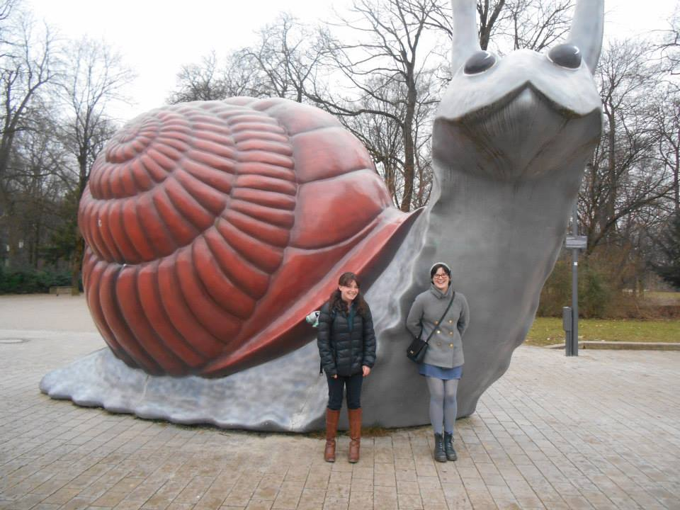



Thanks to Dr. Alexander Ledovoskoy for all his guidance and help, to University of Michigan for this opportunity, and to the Texas Tech group for letting me join their group!

