Slide 1
AMB HW low level simulation vs HW output
G. Volpi, INFN Pisa

Slide 2
FTK emulation reminder
FTK emulation developed to:
  Study the system performance
  Tune existing algorithms
  Add or remove new features
Started as standalone program and evolved as Athena integrated package
  The core code is common among the two versions
  Most features and formats are in common
Input preparation
Road finding
Track fitting
ID RDO data are prepared for the FTK emulation
Tower segmentation can be applied
Clustering can also be added (not done at the moment)
Hits are routed in the layers used by the RF stage
Comparison with the pattern bank is performed
Found road can be written on disk or passed to the track fitter
Possible combinations are fitted
Good tracks are passed to 2nd stage
The list of tracks in each tower is built
Track merging
Track from all towers are collected
Duplicated tracks are removed

Slide 3
Emulation of the AM features
Goal: read raw silicon hits and control the clustering, distribute in towers, find the roads, make them available for the track fitter
The offline FTK emulation (TrigFTKSim) has a complete implementation of the Associative Memory working principle
  The emulation was used to develop use of “don’t care” features, new for FTK, and the “tree search processor” (TSP), not implemented for FTK
    Can be used to emulate old models of AM chip (SVT-like chip, <AM04), the current models with DC-bits or not existing model 2 levels of patterns (TSP)
The AM emulation is controlled by a core code that combines the AM+AUX system, stopping before the fitter
The emulation code is mostly controlled by a single C++ class (FTK_AMBank) or derived (FTKTSPBank, DC and TSP features)
  The code is still usable as standalone program or Athena algorithm
    Each version as a specific interface program to be called

Slide 4
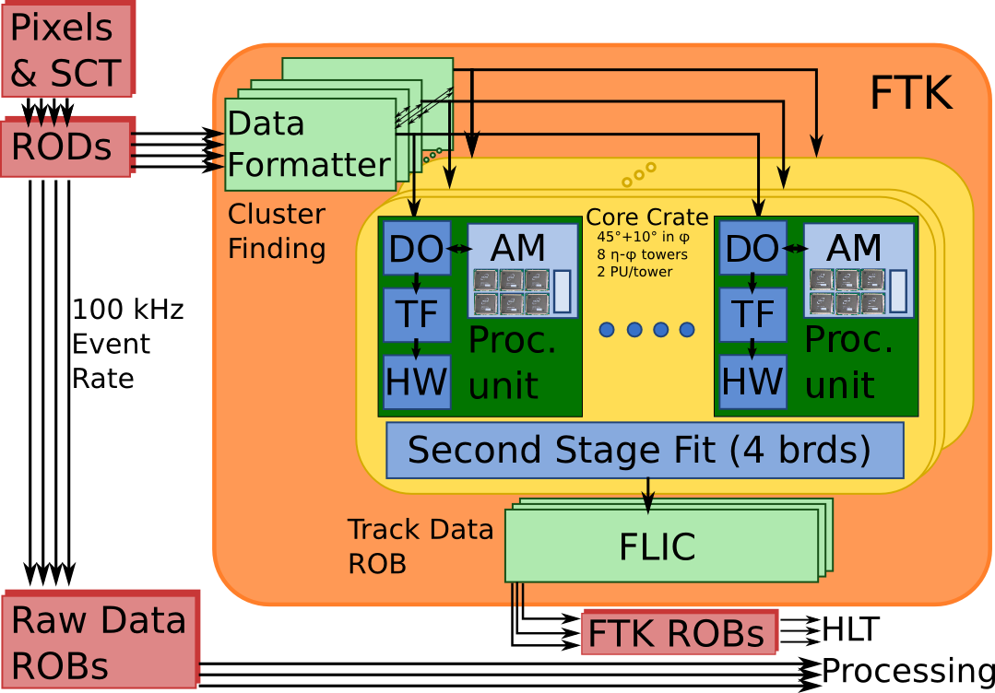
AM emulation relation with the HW
AM Emulation controlled features
The AM emulation control the whole initial stage of the HW:
Read the hits and control the clustering
Distribute the clusters to the proper towers
Convert the clusters in SS and make the match
Store the input to be read by the TF
This code embeds the features of different boards/cards.
A more HW-like code organization can be achieved or the difference between boards and hi-level code has to be consedered.

Slide 5
Pattern bank fromat and AM emulation logic
The pattern bank preparation is divided among several programs
  A pattern bank at the best precision is made (a.k.a. TSP bank), no DC bits are set: allow to have a first evaluation of efficiency and board load
  The TSP patterns are clustered in courser resolution patterns (AM patterns)
    Preliminary step to prepare the AM→TSPs relation
  DC bank: reading only a fraction of the TSPs the related AM patterns are enabled
    For each AM pattern only a few TSP pattern are loaded
    Comparing the TSP distributions the DC—bits can be enabled
Final bank prepared dynamically during the emulation, allowing studies for the optimal working points
  A pattern bank, with the DC configuration, can be saved as “cached” bank
DC-bits used to filter the roads in 2 steps process
Pattern representation is not like in the HW
  Conversion has to be made
Patterns are distributed in file according memory usage constraints and don’t map the HW
  A better organization can be achieved

Slide 6
Emulation output and HW comparison
Despite the difference the FTK emulation can still be a useful HW debugging tool
The AM emulation output is equivalent to the TF input
  A list of roads and a table of SS with hits
    Using the many features the output can be very detailed and predict HW response at different levels
  The hits can be attached to the roads respecting the DC bits content
  Hits not associated to any good roads can be also saved
Loading the patterns in a known order can allow to match the roads using the pattern ID
  Pattern bank preparation tool for the HW is required, with simple rules a match is possible
Processing the outputs the output can be directly compared with the HW
Internal and external data types can be changed to simplify the HW debugging
  Some care is required because the emulation is also used for large production

Slide 7
Conclusions
The AM emulation code is quite stable and mature
  It allows to test all the logic features of the system and check the impact on the system load or the trigger performance
  It was tested against in the Vertical Slice and verified reliable as HW emulation
Data are internally represented not satisfying the HW constaints
  The patterns are stored as big 32 bits integers
  The DC-bits are used to reject roads
Internal workflow doesn’t completely map the HW
More HW data type can be introduced
Post processing can allow to match emulation to HW objects
Emulation also used for large production:
  Any change in the core part of the simulation has to be carefully tested and validated
  Performance has to remain unchanged or improve or HW feature have to remain optional

